Slide 1

Alcohol & Gambling:
At The Point of Sale
Ashley Baggett, Tobacco Prevention & Education Program
Brianne Mares, Prevention Specialist

Slide 2
This Session
Background
Audit Logistics
Counting Rules
Notes:
How many of you have been affected by tobacco, Alcohol, or gambling?

Slide 3
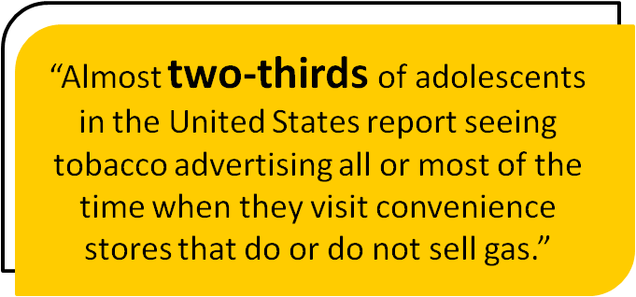
Background
The Tobacco Industry Targets Youth
Notes:
The tobacco industry aggressively targets youth through advertising and products like dissolvable orbs—what we call “tobacco candy.”
How much do you think the Tobacco industry spend in advertising alone in OR? The tobacco industry spends about $140 million a year advertising in Oregon

Slide 4
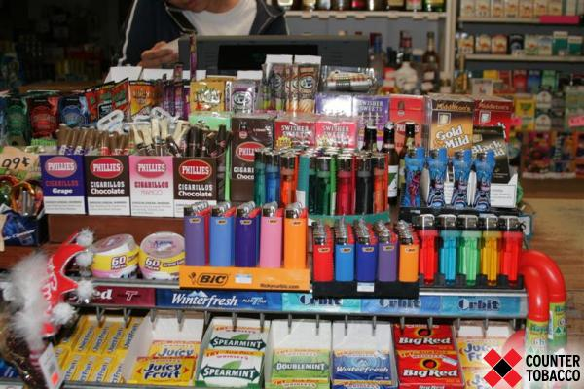
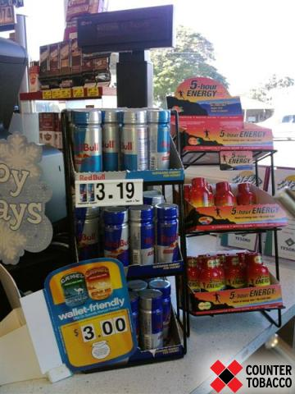
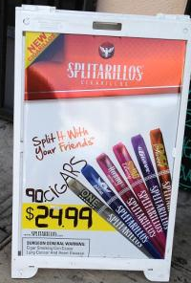
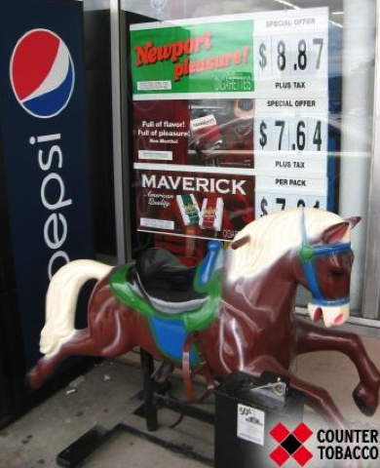
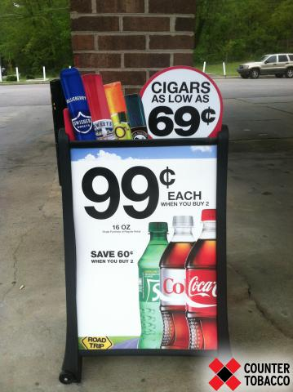
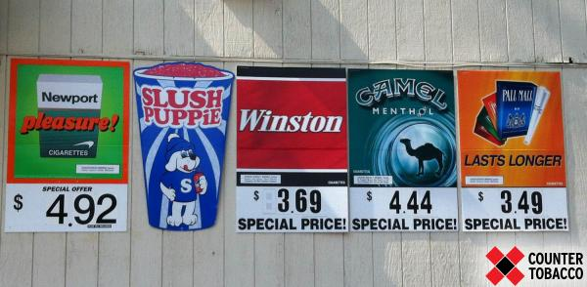
Notes:
Nationally: 1.3 million (12 and older) smoked cigarettes for the first time in 2011. Approximately 3700 new users a day (Data: SAMHSA)
What do you think the percent of 8th graders smoking for Columbia County? 5% (OR 6%)
What do you think the percent of 11th graders smoking for Columbia County? 17% (OR 12%)
1.8% of 6th grade used cigarettes in the last 30 days
1.8% of 6th grade used a form of tobacco in the last 30 days
9.8% of 8th grade used cigarettes in the last 30 days
8.2% of 8th grade used a form of tobacco in the last 30 days
19.5% of 11th grade used cigarettes in the last 30 days
13.2% of 11th grade used a form of tobacco in the last 30 days

Slide 5
Background
…So do Alcohol & Gambling Companies

Slide 6
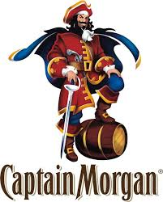
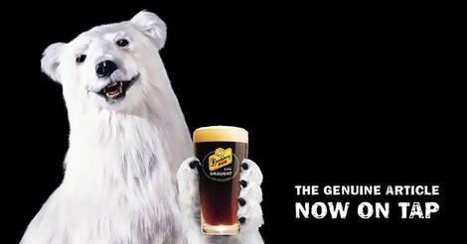

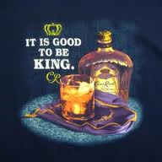
Notes:
Nationally: 2.9 million (12-18 year olds) used alcohol for the first time. That equates to 7,900 new users a day.
5.3% of 6th grade used alcohol in the last 30 days
23.3% of 8th grade used alcohol in the last 30 days
34.0% of 11th grade used alcohol in the last 30 days

Slide 7
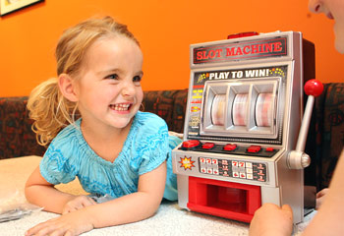
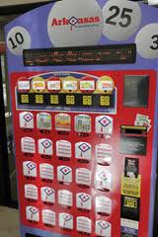
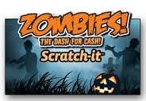
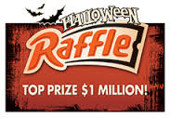
Notes:
38.2% of Columbia Co 6th graders have done some form of gambling.
40.2% of Columbia Co 8th graders have done some form of gambling
39.0% of Columbia Co 11th graders have done some form of gambling

Slide 8
Our Goal:
Product placement for tobacco, alcohol, and gambling
Price promotion for tobacco and alcohol
Advertisement placement for tobacco, alcohol, and gambling

Slide 9
Audit Logistics
How to do a store audit

Slide 10
General Instructions
We suggest 2 students per audit
Plan for 15 minutes per store audit
Regular store hours, during the daylight
If the store is busy, wait a few minutes
Complete all audits in one day

Slide 11
While in the Store
Be aware of store employees, stockers, and other shoppers when completing measures
  Avoid standing in front of any area (e.g., counter) for long period of time
  Avoid areas where workers are stocking the shelves
Try to be inconspicuous when looking at ads
Do not pick up or handle any tobacco or alcohol products
Do not ask clerk if items are available

Slide 12
Introducing the Study
For all stores conduct exterior study without asking permission
For large stores: don’t need to ask permission. If asked explain the study and direct them to us.
For small stores: better to ask permission. Provide study letter if needed.
If asked to leave – leave quietly
If store is busy wait a few minutes; return at a later time

Slide 13
Introducing the Study
Hello, my name is ____________, I am working on a project in our community where we count the kinds of products that are sold in our stores.
Would you mind if we looked around? It will only take a few minutes. We will not get in the way of your customers.

Slide 14
Counting Rules
How to do a store audit

Slide 15
Overview of Audit Form
Store type
Exterior
  Tobacco price promotions
  Alcohol price promotions
  Lottery advertisement
Interior
  Cigarette price promotions
  Little cigars & cigarillos
  E-cigarettes
  Cigarette price
  Alcohol price
  Lottery advertisement
Notes:
Hand the students a copy of the survey.

Slide 16
The Store Type
Convenience store = No gas
Gas convenience store = C-store + Gas
Grocery store: traditional grocery store
Warehouse club/Supercenter = Walmart w/grocery store
Tobacco store
Other
Notes:
Here is a list of the type of stores we will be visiting today.

Slide 17
Tobacco, Alcohol, & lottery exterior audit
Price promotions

Slide 18
Where are Exterior Marketing Materials
Parking Lot/Property
  Only count those provided by select retailers not other retailers who share the parking lot or property
  Look all around perimeter of property and high and low
  Marketing materials are everywhere
Building Exterior
  Includes signs on the building exterior and on interior windows facing out
  Include marketing materials on all sides of building visible to consumers

Slide 19
Exterior Audit: Store Property vs. Store Exterior
Sign on store property
Sign on store exterior
Notes:
Tobacco – Checking “Yes” or “No” if there is price promotion on property and building

Slide 20
Exterior Promotions
Promotion with sale or special price
  Words to look for include: “special value” “special offer” “discount” “cents-off” reduced price” “save $___” “sale price” “special promotion” “promotion offer”
Notes:
Do Not include words such as “everyday low price” “low” “value brands” “saving brands” “ basic” “Premium brand” or “quality”

Slide 21
Exterior Promotions
Promotions include both industry promotions and store/club promotions:
Notes:
Example of industry promotions: Kroger club members get a $1.00 off
If you see this circle yes under Special Price

Slide 22
Exterior Promotions
Multi-pack promotion
  A multi-pack promotion is an offer for a discount on multiple packs. Idea is customers need to buy more than one.
  E.g: “Buy two get one free” “two for the price of one” “free pack with caron”
Notes:
The idea is that customers needs to buy more than one pack to get the discount.

Slide 23
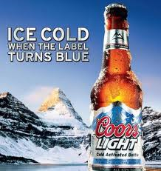
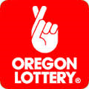

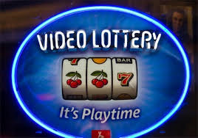
Advertising of Alcohol and Lottery
Notes:
If its just the front doors of the retailer – <25% (1/4 of the building)
If it extends beyond the front doors – 25% - 50%
If most of the outside of the building is covered – 50 – 75%
If the building and property is covered - >75%
Grocery retailers are examples of <25%

Slide 24

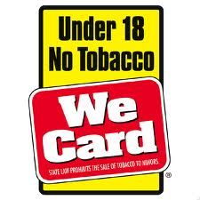

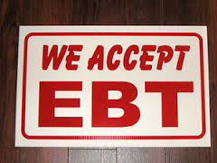
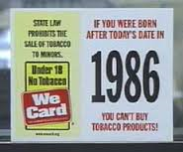

Other signage

Slide 25
Tobacco interior audit
Cigarette price promotion
Little cigar & cigarillos
E-cigarettes
Cigarette prices

Slide 26
Interior Promotions
Remember the earlier rules….
Notes:
Special Price: Words to look for include: “special value” “special offer” “discount” “cents-off” reduced price” “save $___” “sale price” “special promotion” “promotion offer”
Multi-Pack offer: The idea is that customers needs to buy more than one pack to get the discount.
The promotions are typically seen on sign or on the packs themselves.

Slide 27
Cigarette Price Promotion
Check if YES:
Dual-product offer = Cigarette + Snus or other tobacco product
 | Special Price | Multi-pack Offer | Dual-Product Offer
Camel Cigarettes
Notes:
If you see a dual-product promotion add it to the notes at the bottom of the survey.

Slide 28
Flavored little cigars/cigarillos sold?
Check if YES:
Notes:
DO NOT include Menthol flavors
Only looking to see if flavors are present (Cherry, berry, grape, peach) or Chocolate

Slide 29
E-cigarettes sold?
Check if YES:
Notes:
DO NOT include Menthol flavors
Only looking to see if flavors are present (Cherry, berry, grape, peach) or Chocolate

Slide 30
Cigarette Price
Record the price of a 20-pack of Camel cigarettes. (Do not include sales tax)
If no price can be identified, DO NOT ASK the retailer – simply enter “0”
Notes:
Also looking for prices on Marlboro, Newport Greens, other cigarettes

Slide 31
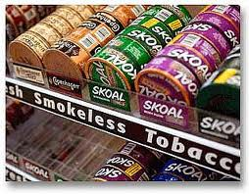
Chew/Snus & other Smokeless Product Prices
Chew
Snus

Slide 32
Tobacco interior practice

Slide 34
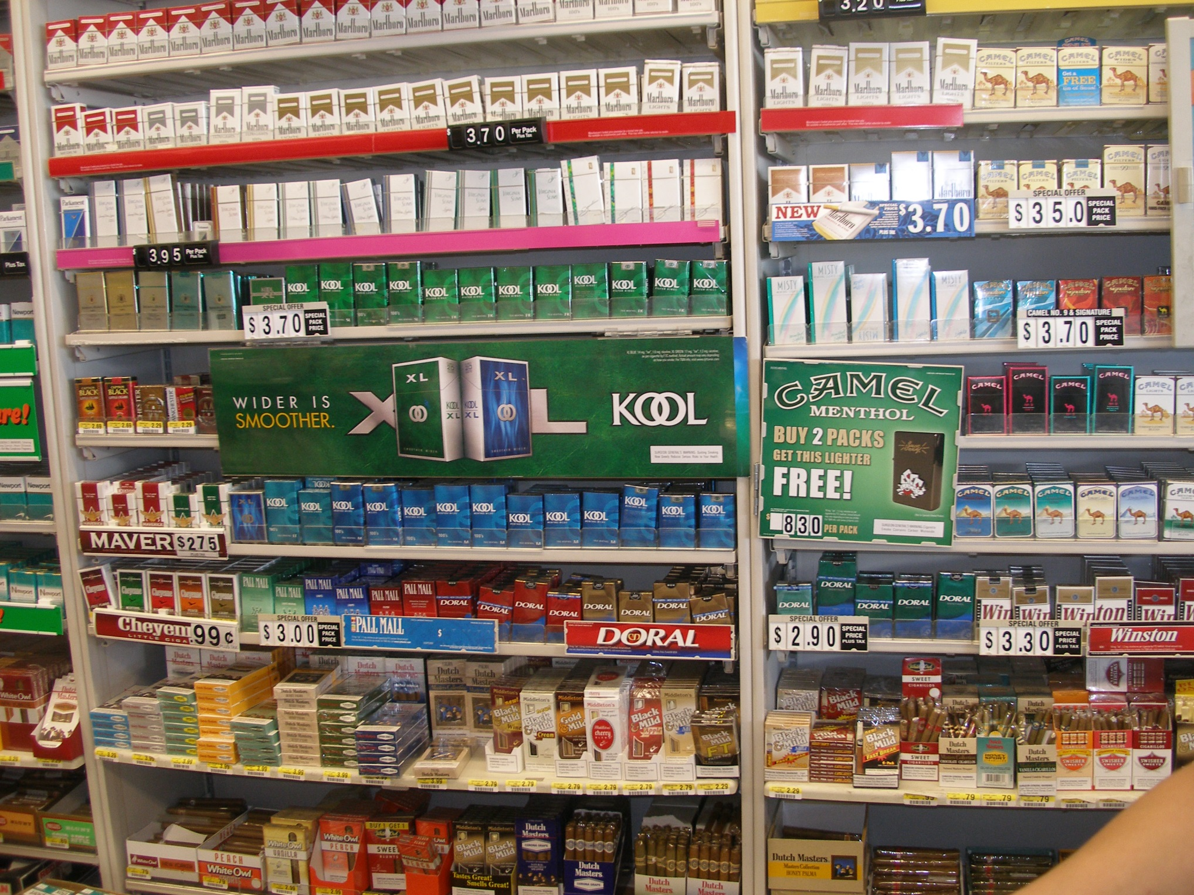
Notes:
Practice – what do you see

Slide 35
Tobacco Placement
Notes:
Youth Placement:
Check “Yes” if you see branded Tobacco Signs being displayed at or below a child’s eye level, which is about 3 feet off the ground
Check “Yes” if you see branded Tobacco Products being displayed at or below a child’s eye level, which is about 3 feet off the ground

Slide 36
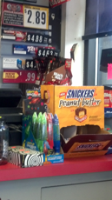
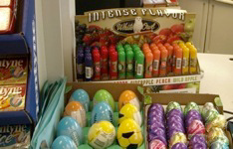
Tobacco Placement
Notes:
Check “Yes” if any tobacco products are displayed within 12 inches of candy: candy bars, gums, mints
Granola bars do Not count as candy
This could be on the counter, below the counter or behind the counter, or any place else in the store where tobacco is displayed

Slide 37
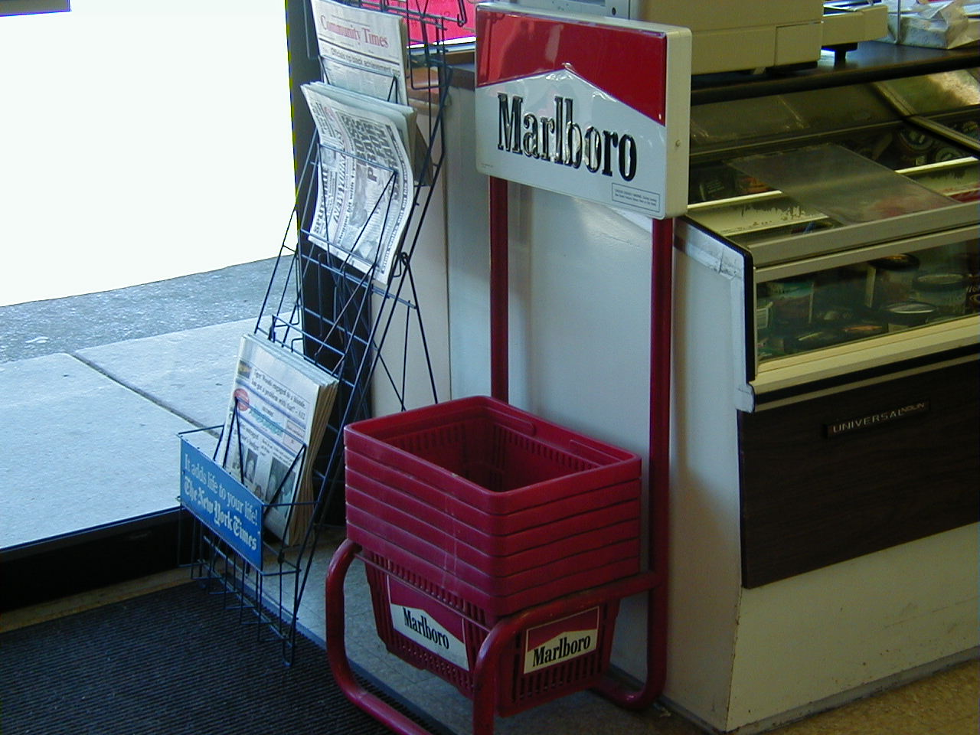
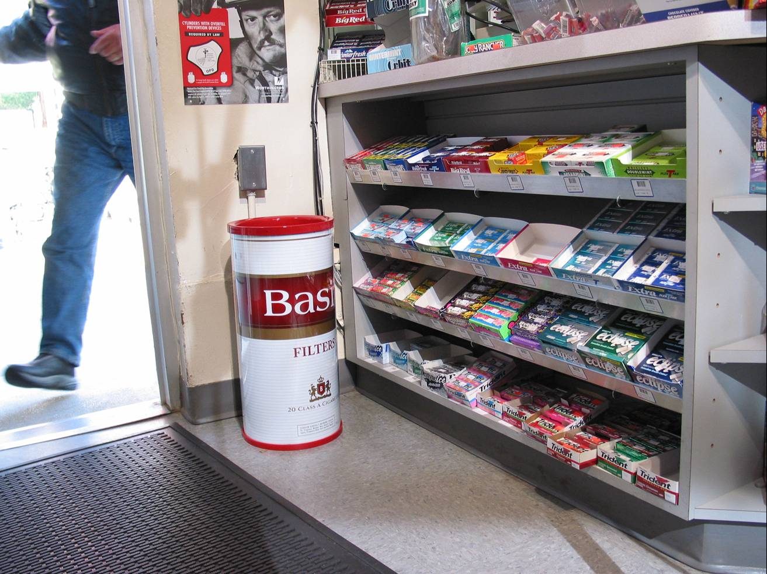
Advertising through tobacco branded functional objects
Marlboro shopping baskets
Basic trash can

Slide 38
Questions?

Slide 39
Debrief
Was there anything surprising?
What do you want to do with the information?

