Slide 2
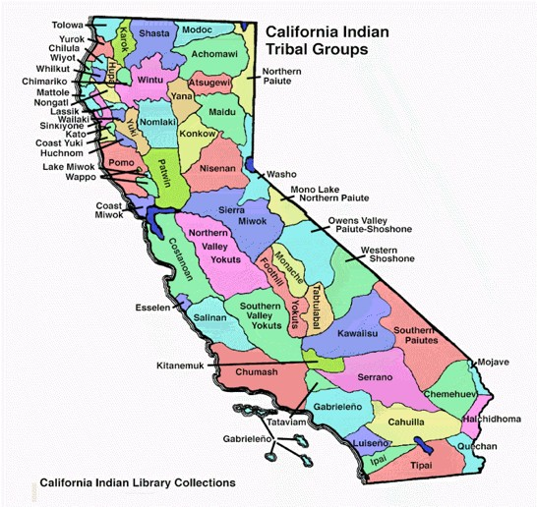

Slide 3
California Department of Education:
Tobacco Use Prevention Education
(TUPE) Program
Purpose/Objectives
“The purpose of the TUPE program is to reduce youth tobacco use by helping young people make healthful tobacco-related decisions through tobacco-specific educational instruction and activities that build knowledge as well as social skills and youth development assets.”
www.cde.ca.gov/ls/he/at/tupeoverview.asp

Slide 5
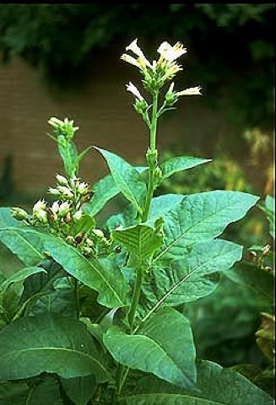

Slide 7
The Media Machine
Youth recall tobacco ads at twice the rate of adults
Youth are more likely to cite ads over peer pressure as reason to start smoking/chewing
Promotions (coupons/discounts) lead to 1/3 of youth experimentation

Slide 11
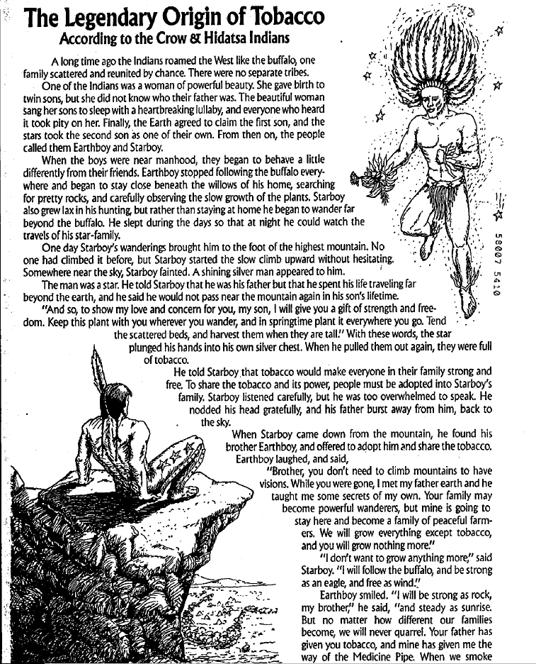
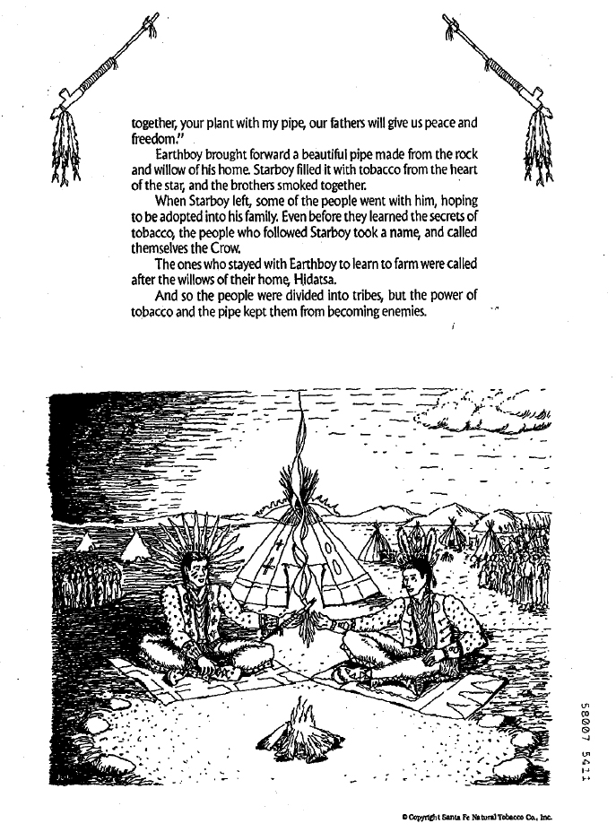

Slide 12
Humboldt Youth Purchase
Survey Results:
The rate of illegal sales in Humboldt County is 2.5 times higher than the state average.
The state rate of illegal tobacco sales is 10.7%
Humboldt County has an overall illegal sales rate of 26.8%
*Youth in Humboldt County can buy tobacco from 1 in 4 retail stores
May 1, 2008

Slide 13
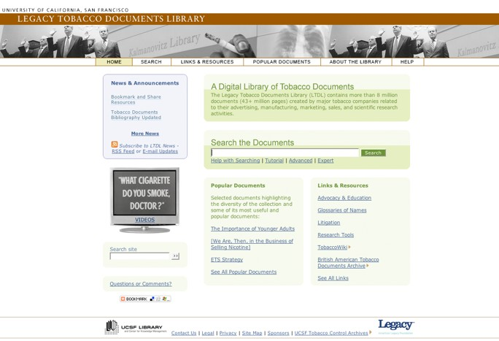

Slide 14
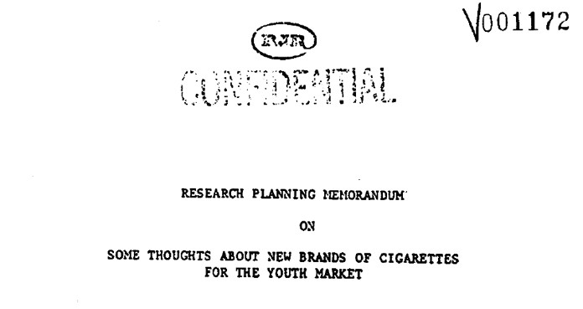

Slide 15
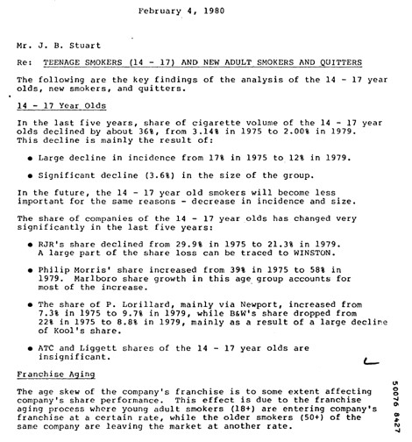

Slide 16
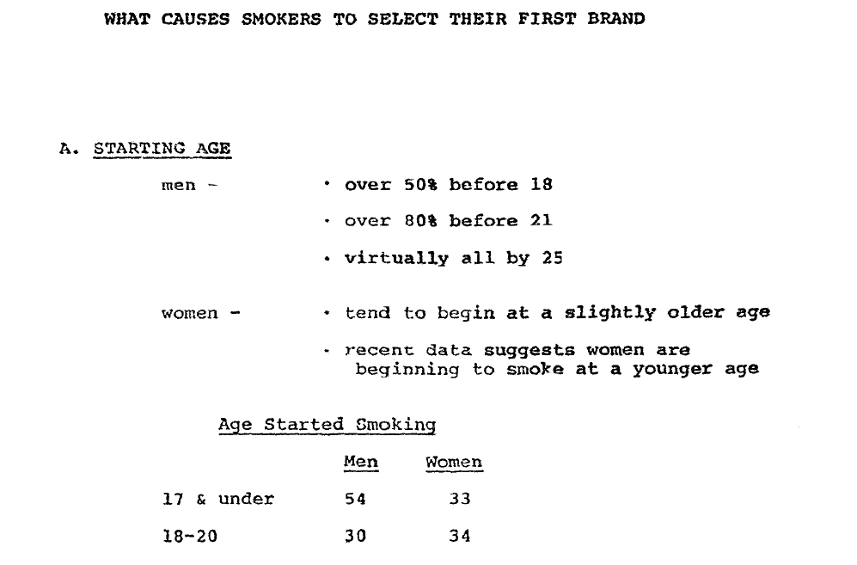

Slide 17
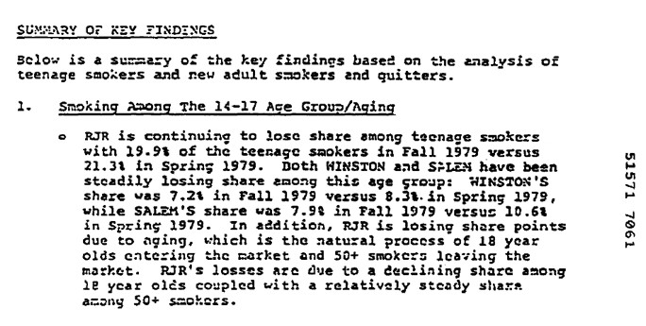

Slide 18
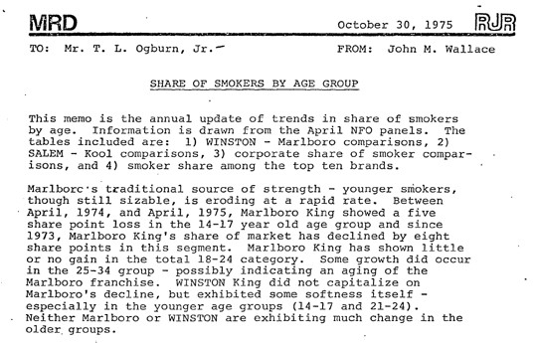
“Marlboro King showed a five share point
share loss in the 14-17 year old age group”
John Wallace, 1975

Slide 19
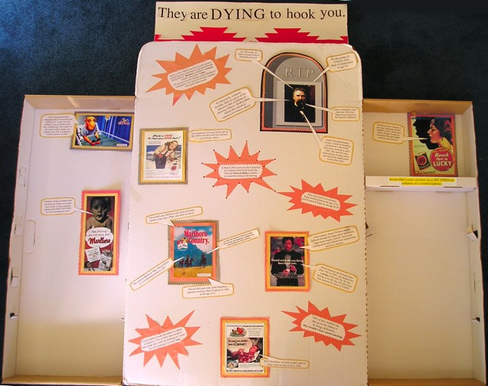

Slide 20
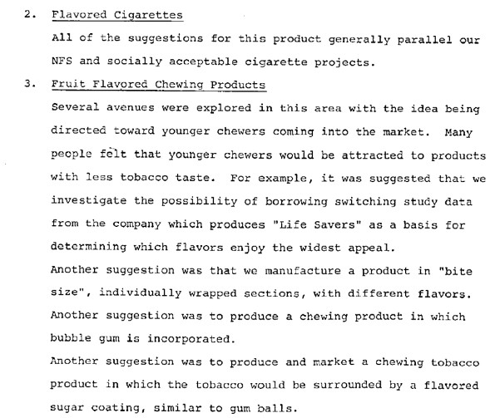
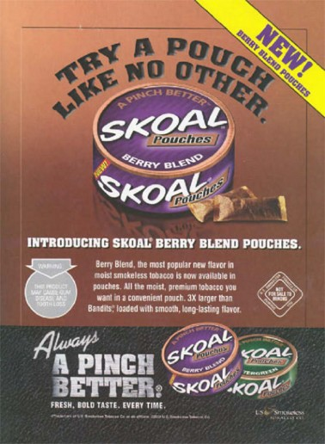
Lorillard June 8, 1979

Slide 21
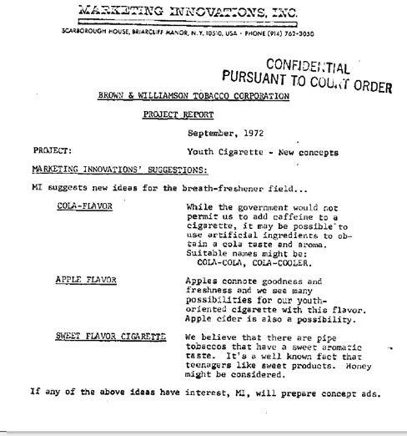
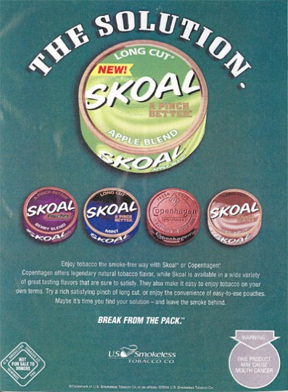
APPLE FLAVOR: “Apples
connote goodness and
freshness”
SWEET FLAVOR CIGARETTE:
“It’s a well known fact that
teenagers like sweet products.”

Slide 22
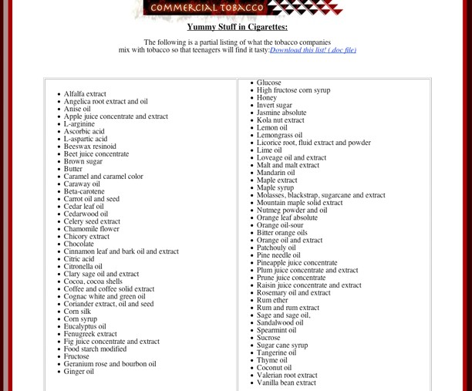

Slide 23
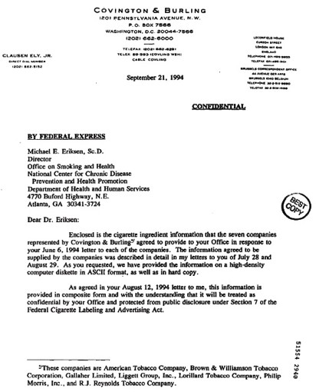
“Enclosed is the cigarette ingredient information…”

Slide 24
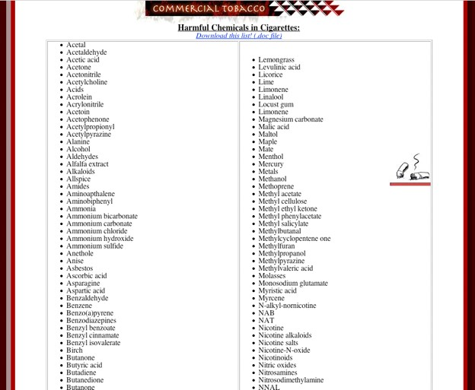

Slide 25
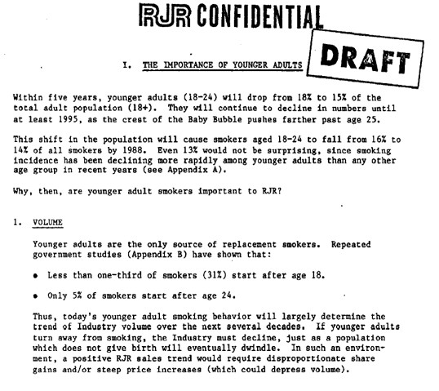

Slide 26
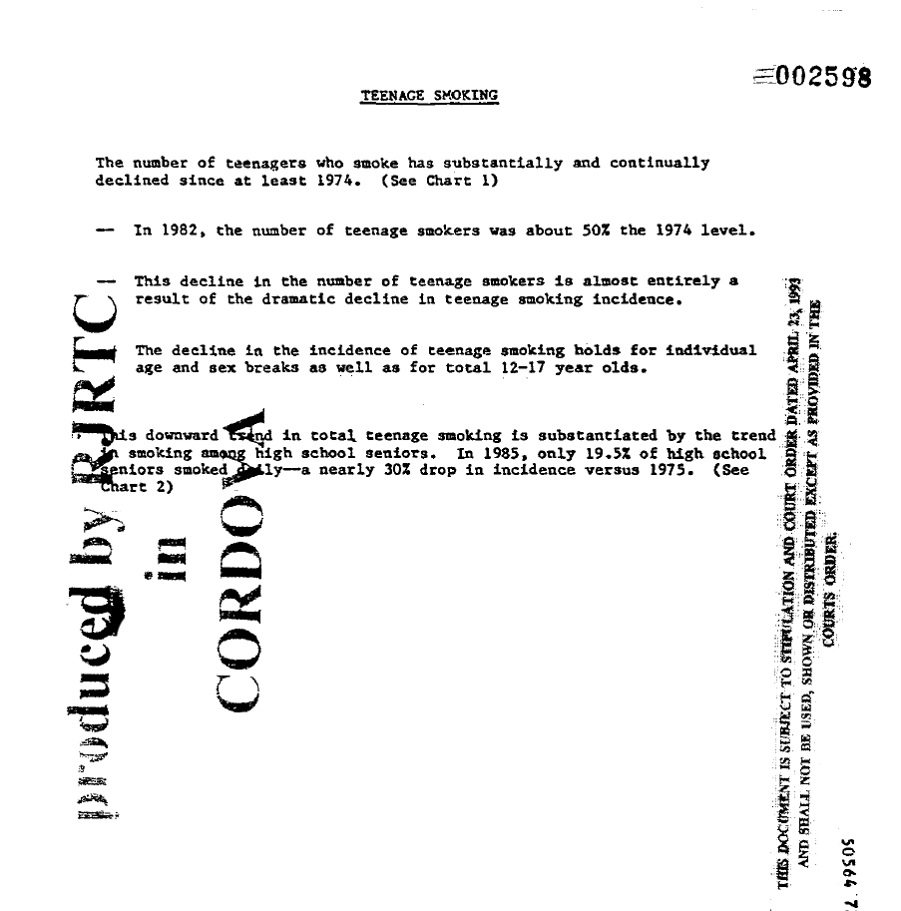

Slide 27
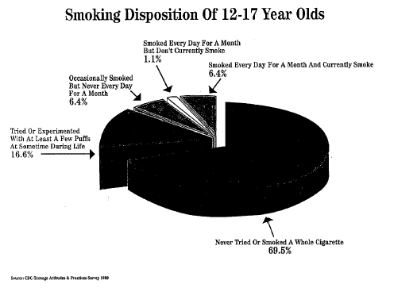

Slide 28
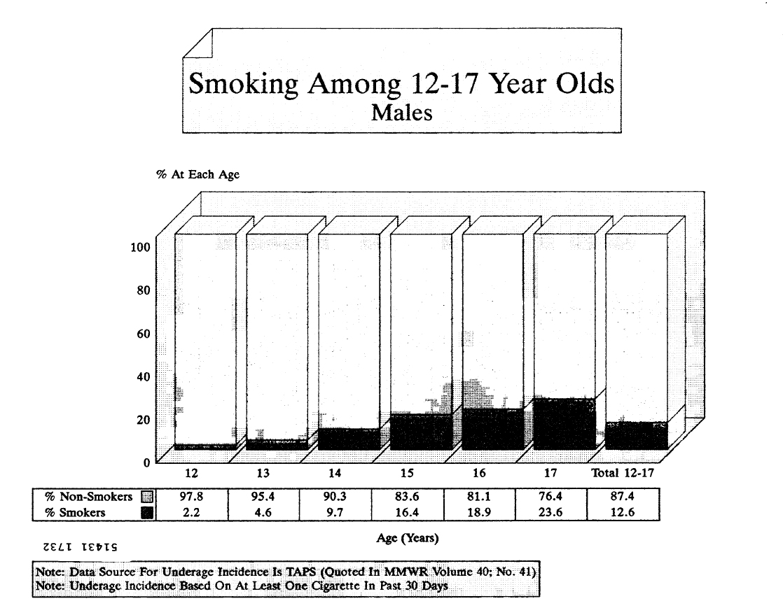

Slide 29
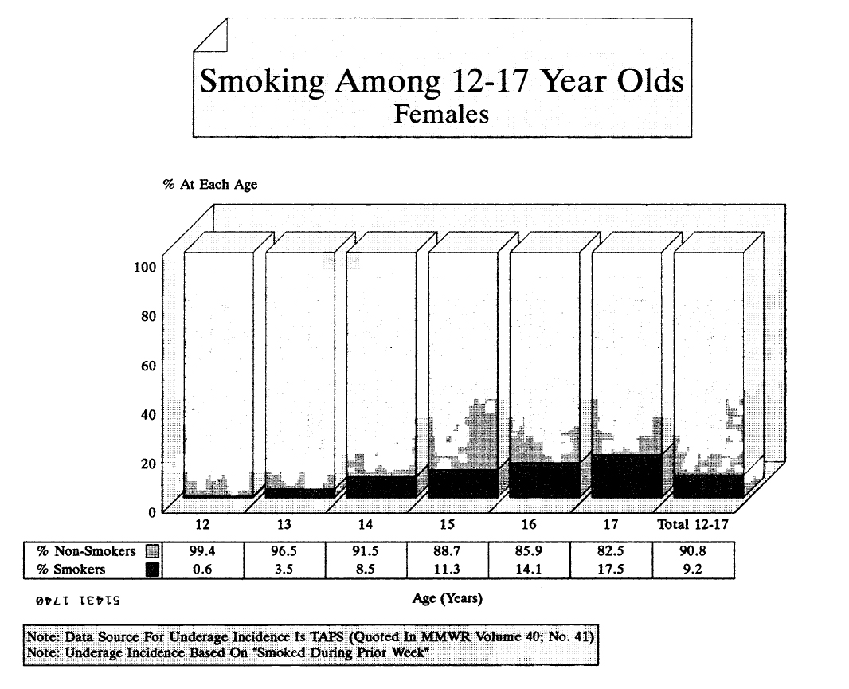

Slide 30
