Slide 5
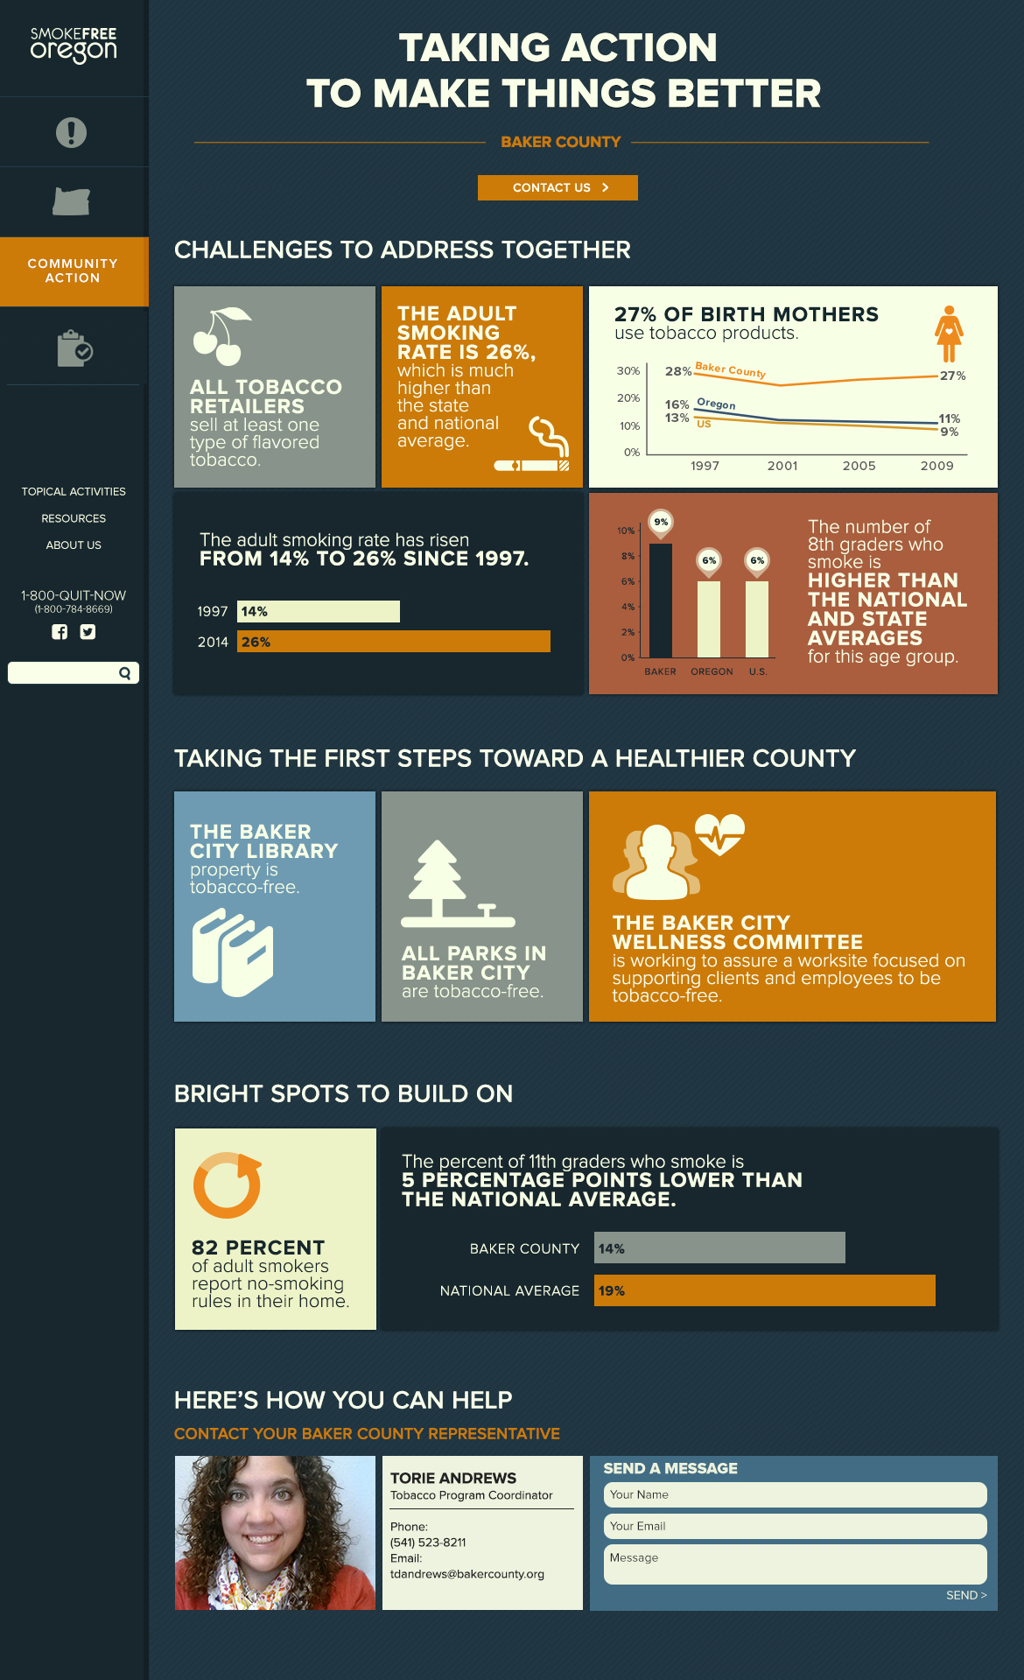

Slide 10
Communications Exercise

Slide 11
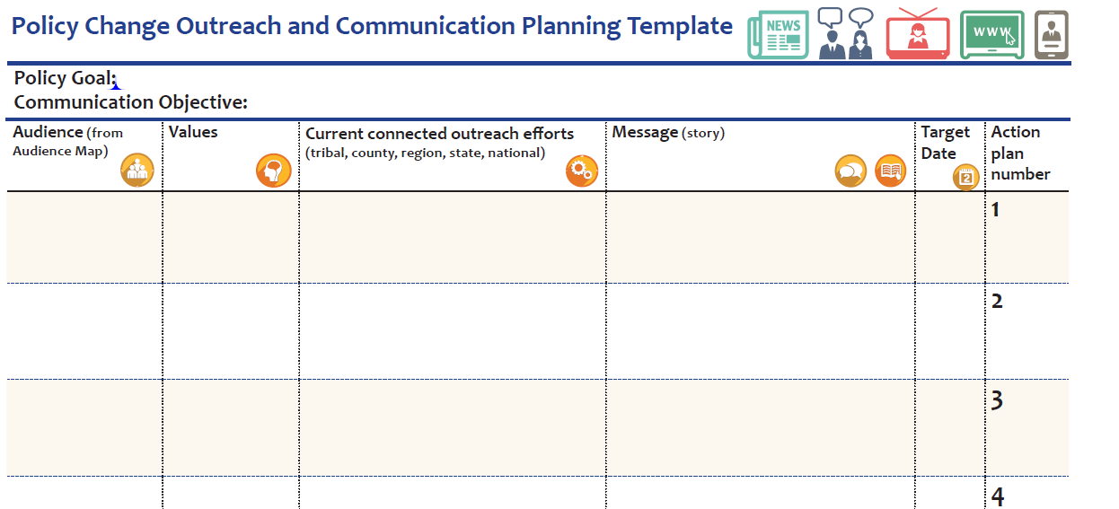
Policy Goal: Facilitate passage and implementation of meaningful tobacco prevention policies for the retail setting.
Communications Objective: Inform County Commissioners through the hearing process (before, during, after) on the burden of tobacco and the tobacco prevention aspects of tobacco retail licensing.

