Slide 1

Tobacco Retail Policy
Overcoming Roadblocks
May 20, 2015

Slide 2
Objectives
Gain knowledge on how to effectively implement retail policy in the real world
Enhance understanding of tobacco retail licensing, non-tax approaches to increasing the price of tobacco, and locational proximity restrictions
Strategize on overcoming roadblocks

Slide 3
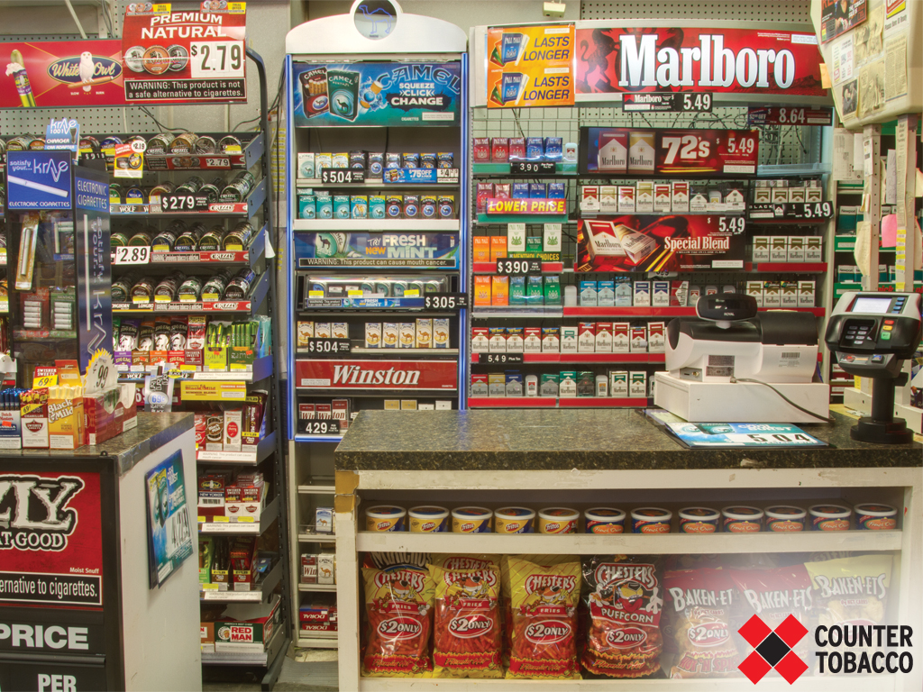
Outline
Overview of TRL policy concepts
Lane County process and barriers
Group activity

Slide 4
Preemption
What?
  A “higher” level of government eliminates or limits the authority of a “lower” level of government to regulate a certain issue
So What?
  Tactic used by Tobacco Industry
  Strongest policies emerge at the local level
  Constrain local communities from innovating and taking action to meet the needs of their community
  Results in health and social norm disparities
  Healthy People 2020 Goal
  Respected health organizations against preemption

Slide 5
Floor vs. Ceiling
Floor Preemption
  Establishes a minimum standard
Ceiling Preemption
  Prohibits local governments from requiring anything more or different
Examples
Notes:
Floor: Minimum set of requirements, and expressly allows lower levels of government to pass or enforce laws that impose more rigorous requirements
Ceiling: prohibits lower levels of government from requiring anything more than or different from what the higher-level law requires.

Slide 6
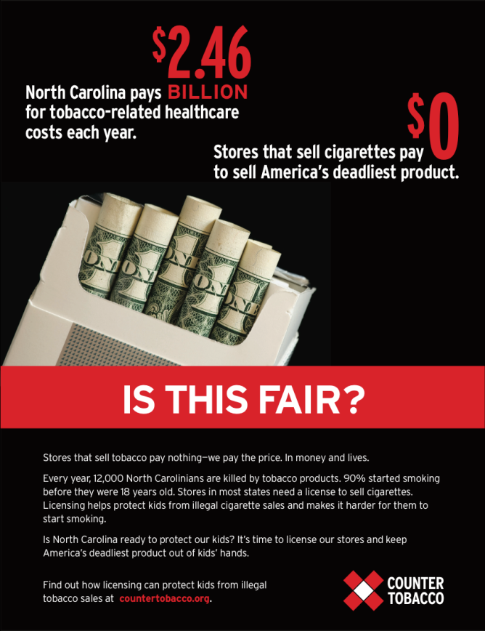
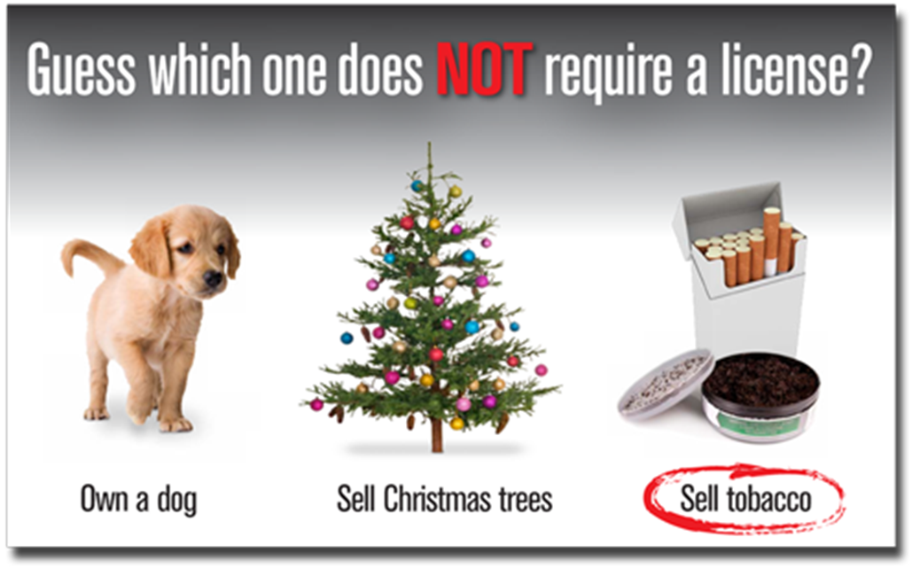
Tobacco Retail Licensing (TRL)
Require a license to sell tobacco products
Notes:
Tobacco retail licensing requires that the jurisdiction issue businesses, new and existing, a license before they are allowed to sell tobacco products.

Slide 7
Comprehensive License
Implement Prevention Policies
  Reduce density, type, and location of retailers
  Reduce youth initiation and prevalence
  Reduce adult rates and help people quit
  Reduce health care costs
Enforce
  Youth access laws
  Local, state, and federal laws
Fund and sustain monitoring
  Track retailers
Notes:
A comprehensive tobacco retail licensure can be used to better enforce youth access laws, as well as implement prevention policies that will have a meaningful impact on youth use of tobacco.

Slide 8
Core components of TRL
Meaningful fees and penalties
  Application and annual
  Graduated fines and penalties
Ability to suspend or revoke a license
  Inclusive of all local, state, and federal laws
Include electronic cigarette retailers
Notes:
Having adequate fees and graduated fines associated with the license is critical to being able to enforce local, state and federal laws in the retail setting.
Licensing fees and fines that fully cover all program costs, including administration, inspection, and enforcement ensure a sustainable and effective licensing system.
Adequate consequences for violations of any tobacco control law, such as license suspensions and revocations, are important tools to maintain compliance with the law. Removing a retailer’s ability to generate revenue from tobacco products has a much larger impact than a fine for violations.

Slide 9
Additional Policies
Limit retailer proximity to schools
Prohibit the redemption of coupons or multi-pack offers
Prohibit the sale of flavored tobacco
Raise the age of purchase from 18 to 21 years
Prohibit free samples
Require little cigars to be sold in packs of 20
Prohibit tobacco sales in pharmacies
Cap number of licenses
Require minimum distance between retailers
Require retailers to post Quit Line information
Require retail clerks to meet the MLSA

Slide 10
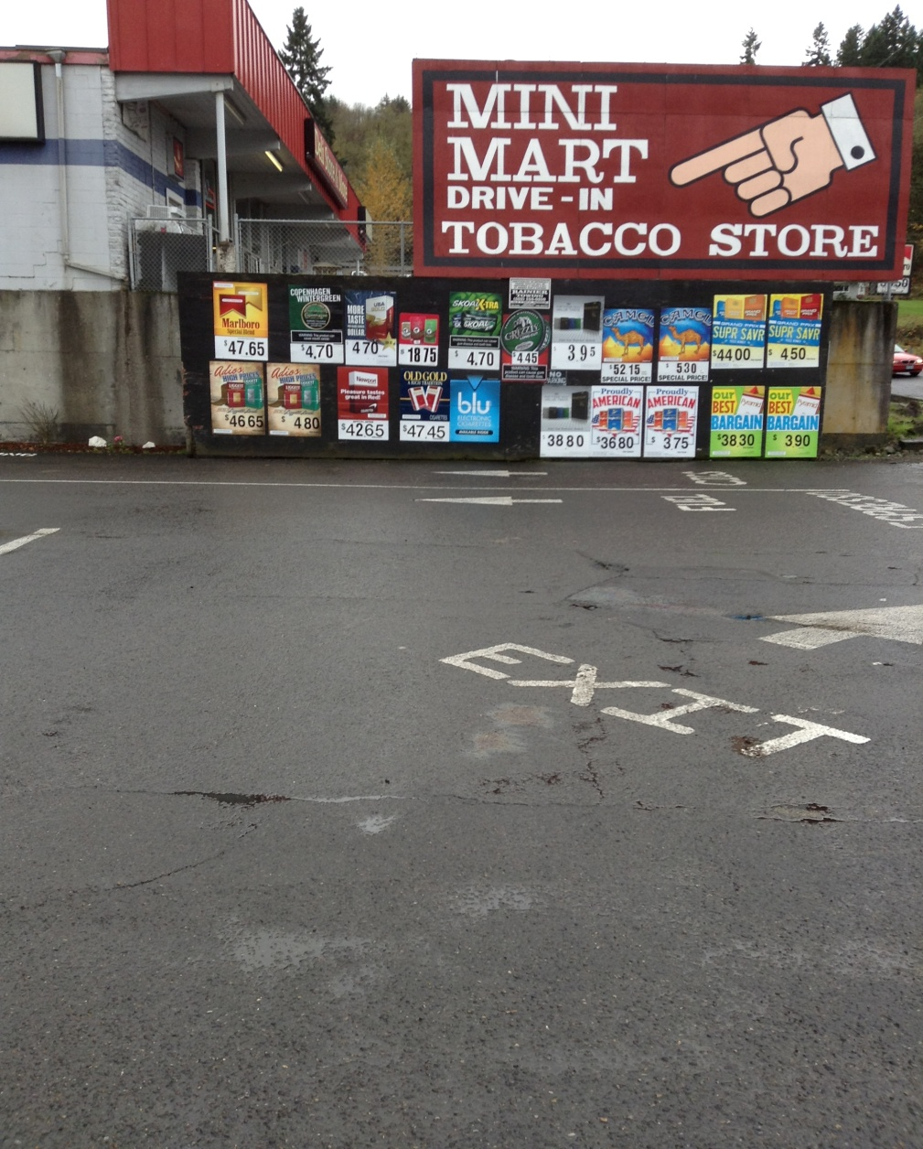

Limit proximity to schools
Higher density = higher smoking rates
Reduces availability
Reduces Exposure
1000 ft.
Notes:
Youth who live or go to schools in neighborhoods with the highest density of tobacco outlets (or with the highest density of retail tobacco advertising) have higher smoking rates compared to youth who live or go to schools in neighborhoods with fewer or no tobacco outlets.
Prohibiting tobacco retailers near places youth visit reduces tobacco retailer density and limits the availability of and exposure to tobacco products.

Slide 11
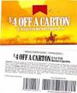
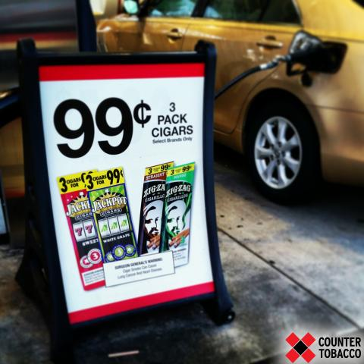
Prohibit coupons and multipack offers
Price promotions encourage initiation and discourage cessation
When the price increases by 10% youth use decrease by 7%
Notes:
Exposure to tobacco products and price promotions at the point of sale encourages initiation and discourages cessation.
When tobacco products cost more, fewer people use tobacco, fewer initiate tobacco use, and more people quit tobacco use. This is especially true among price sensitive youth.
When the price of tobacco increases by 10 percent, youth use decreases by 7 percent.

Slide 12

Lane County
TRL Processes and Roadblocks
Christy Inskip
Lane County Public Health
Notes:
In December 2014, Lane County passed a TRL policy for unincorporated areas of the county and included tobacco prevention policy concepts. Christy is going to share her examples.

Slide 13
TRL – Policy Process
CHIP - BOH work session
Map retailers, assess local TRL & compliance
Retail assessments
Tobacco hero videos
Advisory Committees requests BOH work session on e-cigarettes

Slide 14
TRL – Policy Process
BOH TRL/e-cig work session
Draft ordinance
Educate community partners/champions
1st & 2nd reading of ordinance
H&HS works with cities to pass policy

Slide 15
TRL - Drafting Ordinance
Jurisdiction
Model policy template & checklist
Policy plug-ins
Definitions
Fines & penalties
Legal & technical assistance
Fees

Slide 16
Lane County TRL Ordinance
Requires TRL
Bans price discounts
Prohibits tobacco retailers within 1,000 feet of schools etc.
Bans free samples
Bans self-service displays and mobile vending
Requires posting of health warnings and Tobacco Quit Line
Includes retailer incentive program

Slide 17
Price discounts
Ordinance prohibits:
  Coupon redemption
  Price discounts & multipack offers
  Promotional products with purchase
  Selling for less than listed price
Notes:
We used broad, strong language from NYC Admin Code, which was upheld by the U.S. District Court for the Southern District of NY.
Ordinance language:
(k) Honoring or accepting a price reduction instrument in any transaction related to the sale of Tobacco Products or Tobacco Paraphernalia to a
consumer.
(l) Selling or offering for sale Tobacco Products or Tobacco Paraphernalia to a consumer through any multi-package discount or otherwise provide to
a consumer any Tobacco Products or Tobacco Paraphernalia for less than the listed price in exchange for the purchase of any other Tobacco Products or Tobacco Paraphernalia by the consumer.
(m) Selling, offering for sale, or otherwise providing any product other than Tobacco Products or Tobacco Paraphernalia to a consumer for less than the
listed price in exchange for the purchase of Tobacco Products or Tobacco Paraphernalia by the consumer.
(n) Selling, offering for sale, or otherwise providing Tobacco Products or Tobacco Paraphernalia to a consumer for less than the listed price.
With this language, the only way a retailer could discount the price is to reduce the listed price. However, we could prevent this by adding a provision for minimum pricing.
Examples of what the language here would prevent include:
(k) A consumer receives a coupon in the mail from the Lorillard Tobacco Company offering $1 off of the listed price for a pack of Newport cigarettes. The consumer may redeem the coupon at any store that sells Newport cigarettes.
(l) A retailer provides a promotion whereby upon purchasing 2 packs of Marlboro cigarettes, a consumer receives $2 off of the listed price for purchasing a third pack of Marlboro cigarettes.
(m) In exchange for purchasing a pack of Camel cigarettes, a retailer provides a consumer with a free, or discounted, lighter bearing the Camel logo.
(n) A retailer provides a one-day sale where all American Spirit cigarettes are sold at $1 off of the listed price.

Slide 18
Proximity to schools
Ordinance prohibits tobacco retailers within 1,000 feet of any school, child care center, and other establishments that serve children
  Private or public school, library, playground, youth center, recreation facility, arcade, park, licensed child-care facility or preschool
Measured by a straight line from nearest point of one property to the other
Current tobacco retailers grandfathered

Slide 19
TRL - Implementation
Administration
Retailer education/training
Enforcement
  Minor decoy inspections
  Compliance inspections

Slide 20
Challenges & Solutions
Challenges
Solutions
Leaders move policy too quickly
Tobacco industry organizing
BCC & leaders lack understanding about effective tobacco prevention
Educate leaders early
Engage retailers early; identify BCC influencers
Educate leaders before pursuing policy; highlight past good deeds & connect to values; engage community partners; create MOU with cities; give options, analyze impact to policy intent
Notes:
Develop strong public and decision maker support and clear understanding for TRL policy before attempting to pass ordinance.

Slide 21
Challenges & Solutions
Challenges
Solutions
No access to county legal counsel
Questions about implementation of price discount ban & proximity to schools
Who conducts compliance inspections
How to impose fines
Work with TCLC & other legal aid in OR
Work with HPCDP & TCLC to interpret
Contract with local police, retired state police, or others
Work with HPCDP, H&HS leaders, EH

Slide 22
Positive Outcomes
Built relationships with community partners & identified new ones
Built new champions
Raised understanding & awareness of issues -> increased policy readiness
Got BCC & city councils to discuss & support tobacco prevention

Slide 23

Group activity
Split into 3 groups based on
  (1) TRL infrastructure and core components
  (2) Coupon redemption and multi-pack offers
  (3) Limiting proximity to schools
Answer the following questions and report back
1.) What are the real or anticipated roadblocks?
  For adopting the policy
  For implementing the policy
2.) What are the next steps to overcoming the roadblock?
Notes:
Split into 3 groups based on which area each grantee is interested in or pursuing.
Answer the following questions:
1.) What are their real or anticipated roadblocks?
A. for adopting the policy
B. for implementing the policy
2.) What are their next steps to overcoming the roadblock?
A. Who are the advocates that you can call on, who is the most influential community champion?
B. Legal TA
C. Leadership buy-in
D. Education and awareness
At least one person from each group will share back.

