Slide 1
Community Programs New Coordinator Orientation: Surveillance and Evaluation
Oct. 1

Slide 2
Stacey Schubert, Surveillance and Evaluation Manager Shaun Parkman, Evaluation Specialist

Slide 3
Surveillance Defined
SURVEILLANCE¹ is the ongoing, systematic collection, analysis, and interpretation of health data, essential to the planning, implementation and evaluation of public health practice, closely integrated with the dissemination of these data to those who need to know and linked to prevention and control.
¹Centers for Disease Control and Prevention. Lexicons, Definitions and Conceptual Framework for Public Health Surveillance. MMWR 2012;61(Suppl; July 27, 2012):[10-14].

Slide 4
Main Surveillance Data Sources
Full Count Datasets:
• Oregon State Cancer Registry
• Birth and death records
• Medicaid Management Information System
• All Payers All Claims Database

Slide 5
Main Surveillance Data Sources
Surveys:
Oregon adults [Behavioral Risk Factor Surveillance System, aka BRFSS]
Oregon youth [Oregon Healthy Teens Survey, aka OHT]
New mothers [Pregnancy Risk Assessment Monitoring System, aka PRAMS]
Employers [Oregon Employer Survey]
Medicaid clients [Medicaid BRFSS]
State/school employees [BRFSS Survey of State/School Employees, aka BSSE]

Slide 6
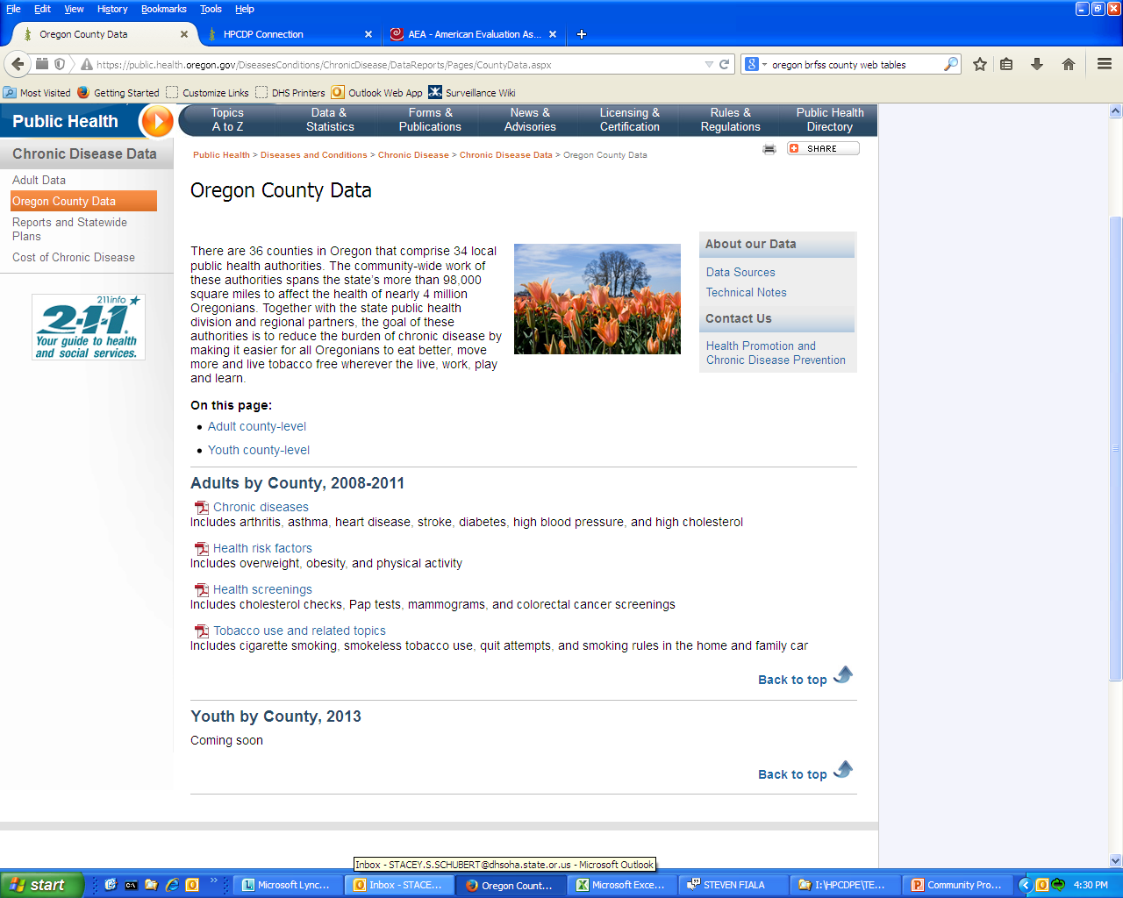
County-level Data
https://public.health.oregon.gov/DiseasesConditions/ChronicDisease/DataReports/Pages/CountyData.aspx
Tables contain data on:
Chronic disease
Health risk factors
Health screenings
Tobacco use and related topics
https://public.health.oregon.gov/DiseasesConditions/ChronicDisease/Cancer/oscar/Pages/AR2010.aspx
Table 3 contains data on all cancers combined and top cancer sites

Slide 7
CCO-AREA Data
https://public.health.oregon.gov/ProviderPartnerResources/PublicHealthAccreditation/Pages/HealthStatusIndicators.aspx
Tables contain data on:
Causes of death
Quality of life
Illness and injury
Health behaviors

Slide 8
Tribal Data
The Oregon Health Authority does not collect data at the tribal level. However, data are collected from adults who are American Indian and live in Oregon. These data are summarized here:
https://public.health.oregon.gov/DiseasesConditions/ChronicDisease/DataReports/Pages/AdultData.aspx#re
Tables contain data on:
Population characteristics
Chronic disease
Health risk and protective factors
Health screenings
Tobacco use and related topics

Slide 9
SDARF
Special Data Analysis Request Form, aka SDARF, is used to request data not already displayed.
Process:
Find form on HPCDP Connection: https://partners.health.oregon.gov/Partners/HPCDPConnection/Pages/TechnicalAssistance.aspx
Fill out form
Send to your assigned liaison
Receive a response within a reasonable timeframe
Often several rounds of communication will occur before final products is sent

Slide 10
LETARF
Local Evaluation Technical Assistance Request Form, aka LETARF, is used to request assistance with local evaluation activities.
Process:
Find form on HPCDP Connection: https://partners.health.oregon.gov/Partners/HPCDPConnection/Pages/TechnicalAssistance.aspx
Fill out form
Send to your assigned liaison
Receive a response within a reasonable timeframe
Several rounds of communication often occur before final product(s) are completed

Slide 11
Evaluation Defined
“To evaluate something means determining it merit, worth, value, or significance. Program or project evaluations typically involve making the following kinds of judgments:
How effective is the program? To what extent has the program been implemented as expected? What goals, outcomes and results were achieved by the program? What are the strengths and weaknesses of the program, and how can it be improved? What worked and what didn’t work? …”
-MQ Patton. 2012. Essentials of Utilization-Focused Evaluation. (pg. 2)

Slide 12
Overview of Current Local Evaluation Projects
See HPCDP Connection main page for more details
Community Readiness Assessment (CRA)(for TPEP)
Tobacco Free Properties Policy Evaluation in Counties (ToPPEC) (for TPEP)
Finishline Evaluation (for TPEP right now)
SPArC Evaluation (for TPEP)

Slide 13
Community Readiness Assessment (CRA)
Part of a long arc of evaluating TPEP
Assessment in each local LPHA to identify the community’s readiness to address tobacco use
Interviews with 5 key stakeholders in the county
Consult with your liaison

Slide 14
Tobacco Free Properties Policy Evaluation in Counties (ToPPEC)
An evaluation of policy efforts toward tobacco-free county government properties
Main work will begin in November

Slide 15
Finishline Evaluation
A series of case studies documenting tobacco control successes in Oregon communities.
4 projects only – Baker, Washington, Warm Springs, State Parks and Beaches (Tillamook and Clatsop)

Slide 16
SPArC Evaluation
Strategies for Policy and enviRonmental Change (SPArC)
Each grantee is working on unique evaluation plans

