Slide 1
Tobacco industry's historical pattern of public deception
Erik C Vidstrand, MPH
Program Specialist
Multnomah County Health Department
Wed., Dec. 10, 2014 9:30 AM
Thu., Dec. 11, 2014 1:30 PM

Slide 2
Desired outcomes
Participants will learn:
• About multiple examples of the tobacco industry’s deceptive practices.
• How to recognize discreet messages behind the tobacco industry’s efforts.
• What can be done in communities despite these practices.

Slide 3
Uncovering strange bedfellows
Outcomes
To shame health-related allies of cigarette manufacturers, in the belief that this helps to isolate and ostracize a rogue industry.
Conclusions
organized medicine sports teams and leagues
Universities
Hospitals
Chain drug stores (including Walmart, Costco)
Arts organizations and museums
Airlines
Pharmaceutical industry
These conclusions offer sobering lessons for policy makers attempting to identify barriers to reducing demand for tobacco products.

Slide 4
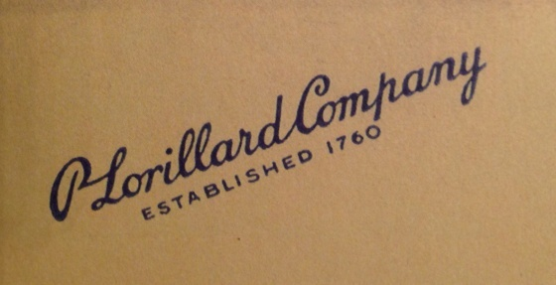


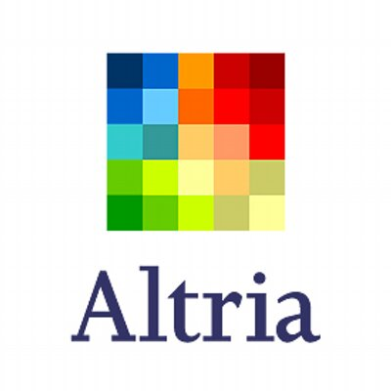



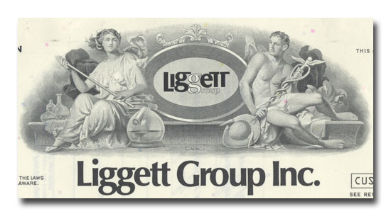



Tobacco companies over the years
Notes:
The ’tobacco industry’ does not consist only of manufacturers of tobacco products: it also includes
those engaged in all aspects of the growing, manufacture, distribution and sales of tobacco, who
are likely to be averse to effective tobacco control.

Slide 5

Notes:
Top ten brands

Slide 6
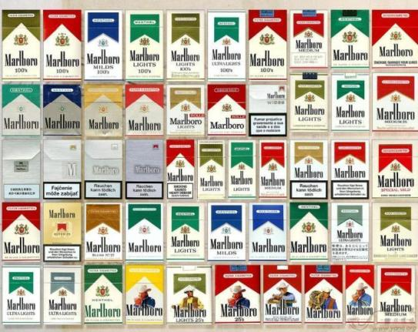
Notes:
Over 40 different Marlboros

Slide 7
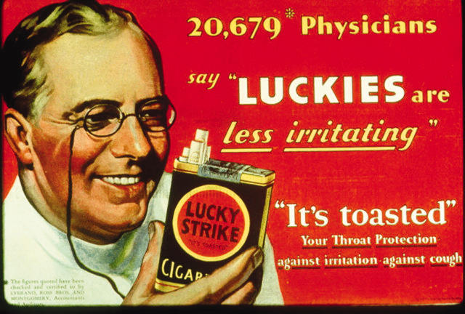
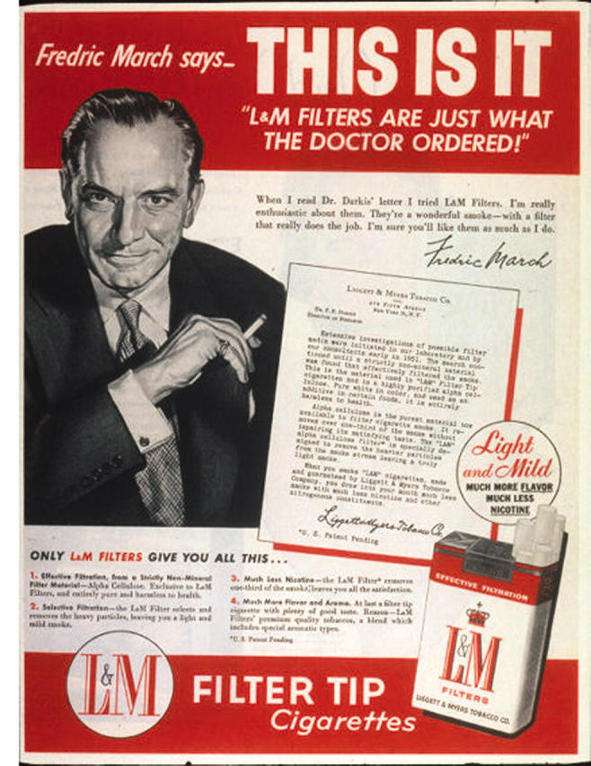
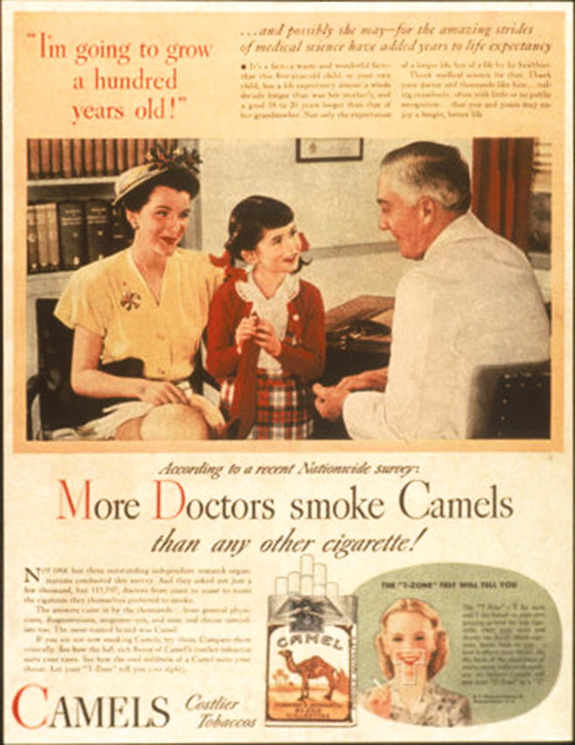
Deception
Notes:
Diethylene-glycol, made them moister and less irritating than other brands

Slide 8
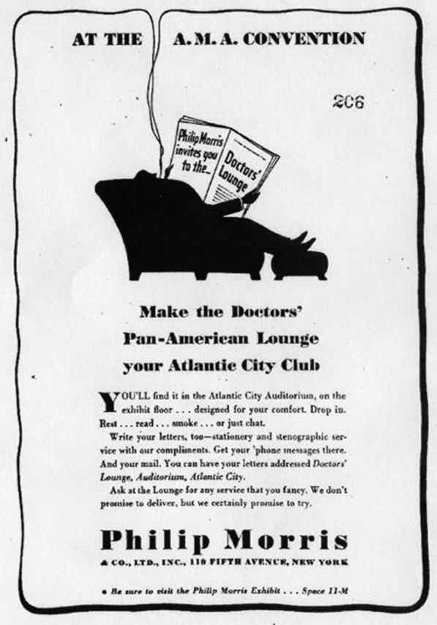
Silence and complacency

Slide 9
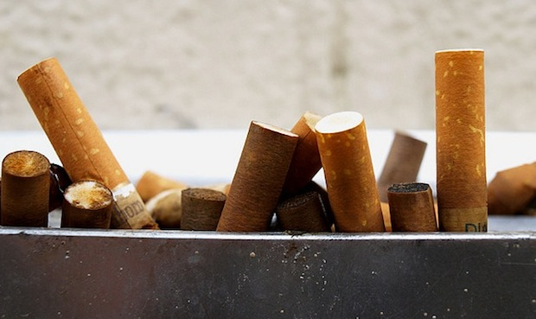
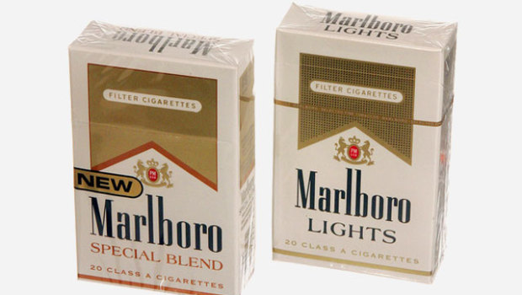
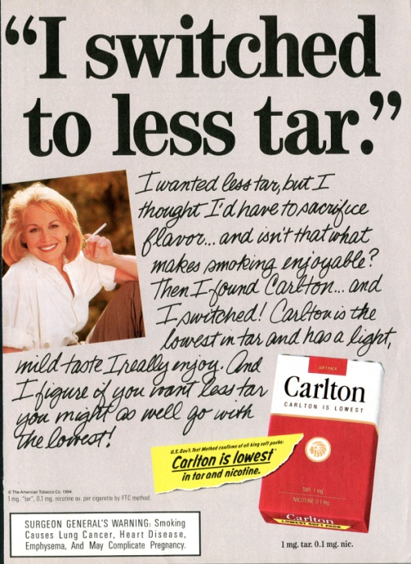
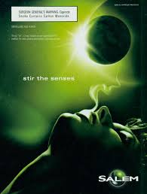
Fraud
As dangers became more profound, cigarette manufacturers invented:
Filters
Low-tar
Light
Menthol
Notes:
When smoking was implicated as the major avoidable cause of emphysema and heart disease, cigarette manufacturers invented filters and "low-tar" and "light" cigarettes. Yet filtered, low-tar, light, ultra-light, or menthol (an anesthetic) cigarettes are not safer in any way. Filtered brands, the choice of more than 95% of those who smoke cigarettes, not only fail to reduce harm but actually increase the risk of heart disease and emphysema by virtue of the smoker having to compensate for the presence of a filter by inhaling more deeply.

Slide 10

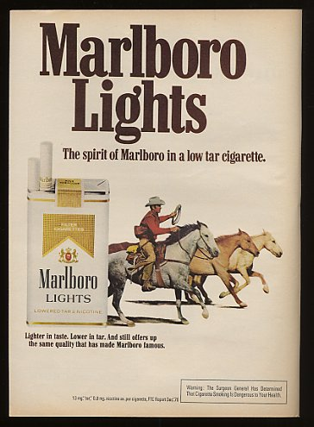
Jesse Williams’ lawsuit
Notes:
Mayola Williams, the widow of Jesse D. Williams, who died of smoking-related lung cancer in 1997, sued Philip Morris USA, a cigarette manufacturer,^{[1]} for fraud based on Philip Morris advertisements and sponsored studies that made cigarettes seem less dangerous than they actually were. Philip Morris then paid Williams $61 million, as under Oregon law the state collects 60% of all punitive awards and places those funds into a compensation fund for crime victims that made cigarettes seem less dangerous than they actually were.
At that time, the verdict was the largest against a tobacco company.
The Oregon Supreme Court again disagreed with Philip Morris in December 2011 and ruled that they had to pay the remaining punitive damages, which after interest then totaled $99 million
Lights low tar Lights now gold, menthol now green, mild, now silver
Our very own Chuck Tauman, TOFCO, was the lead defense team ont his very long and drawn out case.

Slide 11
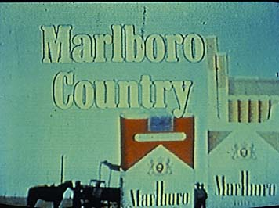
Notes:
Used to be on TV. Ads went off the air in 1971.

Slide 12
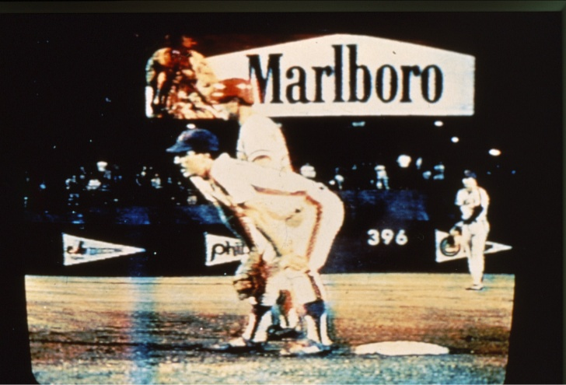
Notes:
Marlboro shea stadium billboard. It wasn’t until 1999 that all billboards finally came down. 1999.

Slide 13
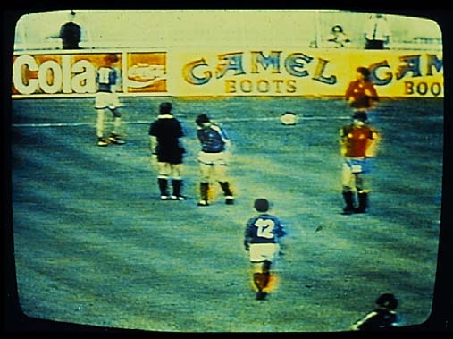
Notes:
Camel became Camel Boots

Slide 14
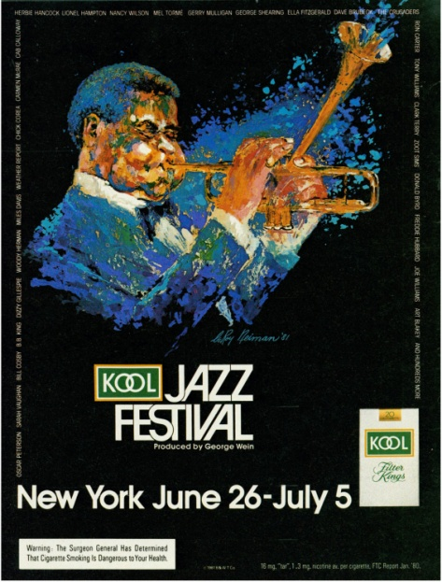
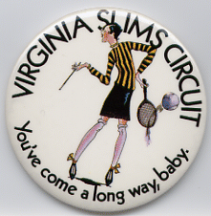

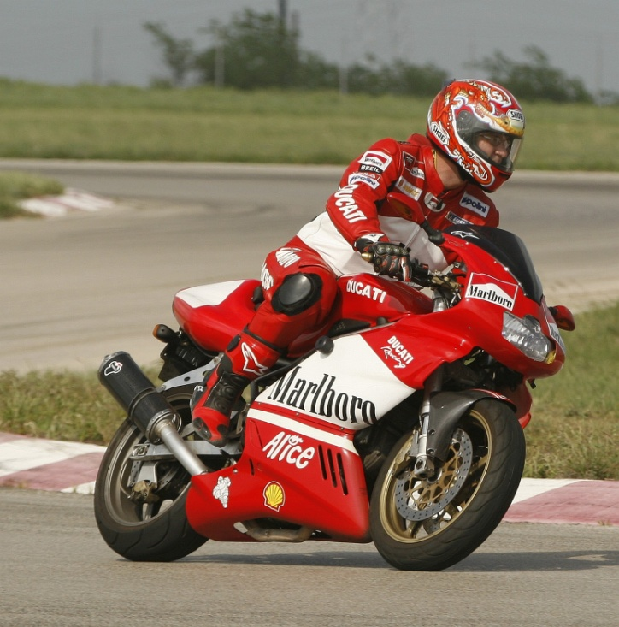


Notes:
The main goal of the Federal Cigarette Advertising and Labeling
Act of 1970 was to remove cigarette ads from the broadcast media. Yet no
sooner had cigarette commercials left the airwaves than televised sporting
events such as NASCAR Winston Cup and The Virginia Slims Women’s
Tennis Circuit began airing for hours on end, providing even greater
Cigarette images.

Slide 15
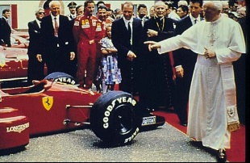
Pope John Paul II
Blesses Mario Andretti, head driver of the Marlboro Racing Team

Slide 16
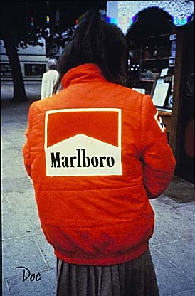

Slide 17
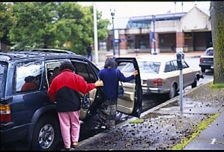

Slide 18
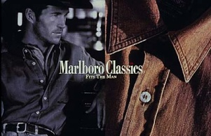
Notes:
Marlboro clothing.

Slide 19
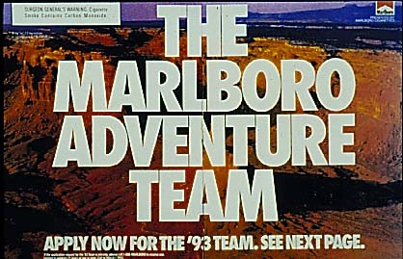
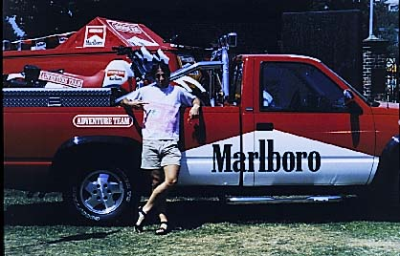
Former Philip Morris campaign which began in Europe
Notes:
It came to America in 1993.

Slide 20
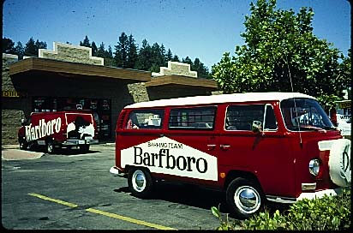
Notes:
“First encounter”, July 1993, Santa Cruz, Calif.

Slide 21
Outmaneuvering health advocates
The TI found a way to utilize the industry’s money to fund antismoking education.
The Master Settlement Agreement of 1998 has resulted in a tiny fraction of settlement funding being directed toward smoking prevention and cessation programs.
Only four states are currently allocating to tobacco prevention the minimum amount recommended by the Centers for Disease Control and Prevention.
All told, only 2.6% of tobacco revenues are being spent on tobacco prevention and cessation.

Slide 22
MSA funds
$4M finally came to Oregon this past year.
Utilized for small grants projects.

Slide 23
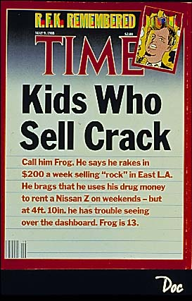

Slide 24
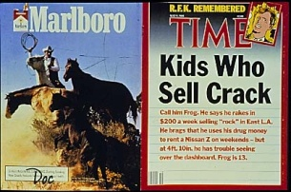

Slide 25
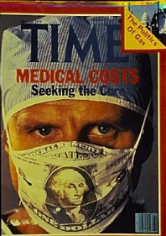
Juxtaposition

Slide 26
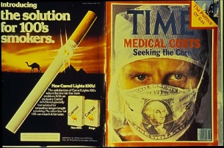

Slide 27
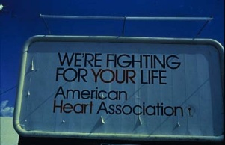

Slide 28
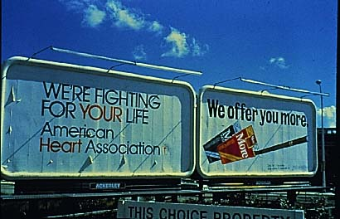

Slide 29
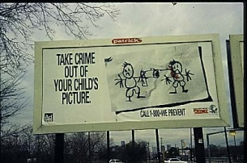

Slide 30
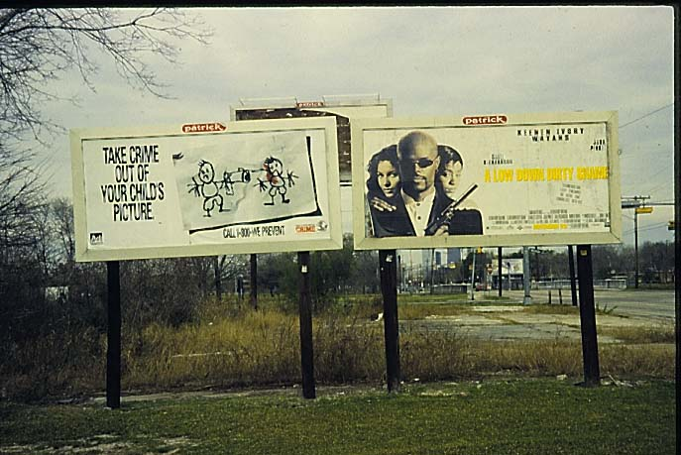

Slide 31

Cultural philanthropy
Social Responsibility
http://www.pmi.com/eng/about_us/charitable_giving/disaster_relief/pages/disaster_relief.aspx

Slide 32
Cigarette maker Philip Morris spent $2 million on domestic violence programs nationally and $108 million on the advertising campaign to tell us about it.
Tobacco can't be advertised on TV, but tobacco makers' token support of good causes can.
AlterNet / By Lori Dorfman

Slide 33
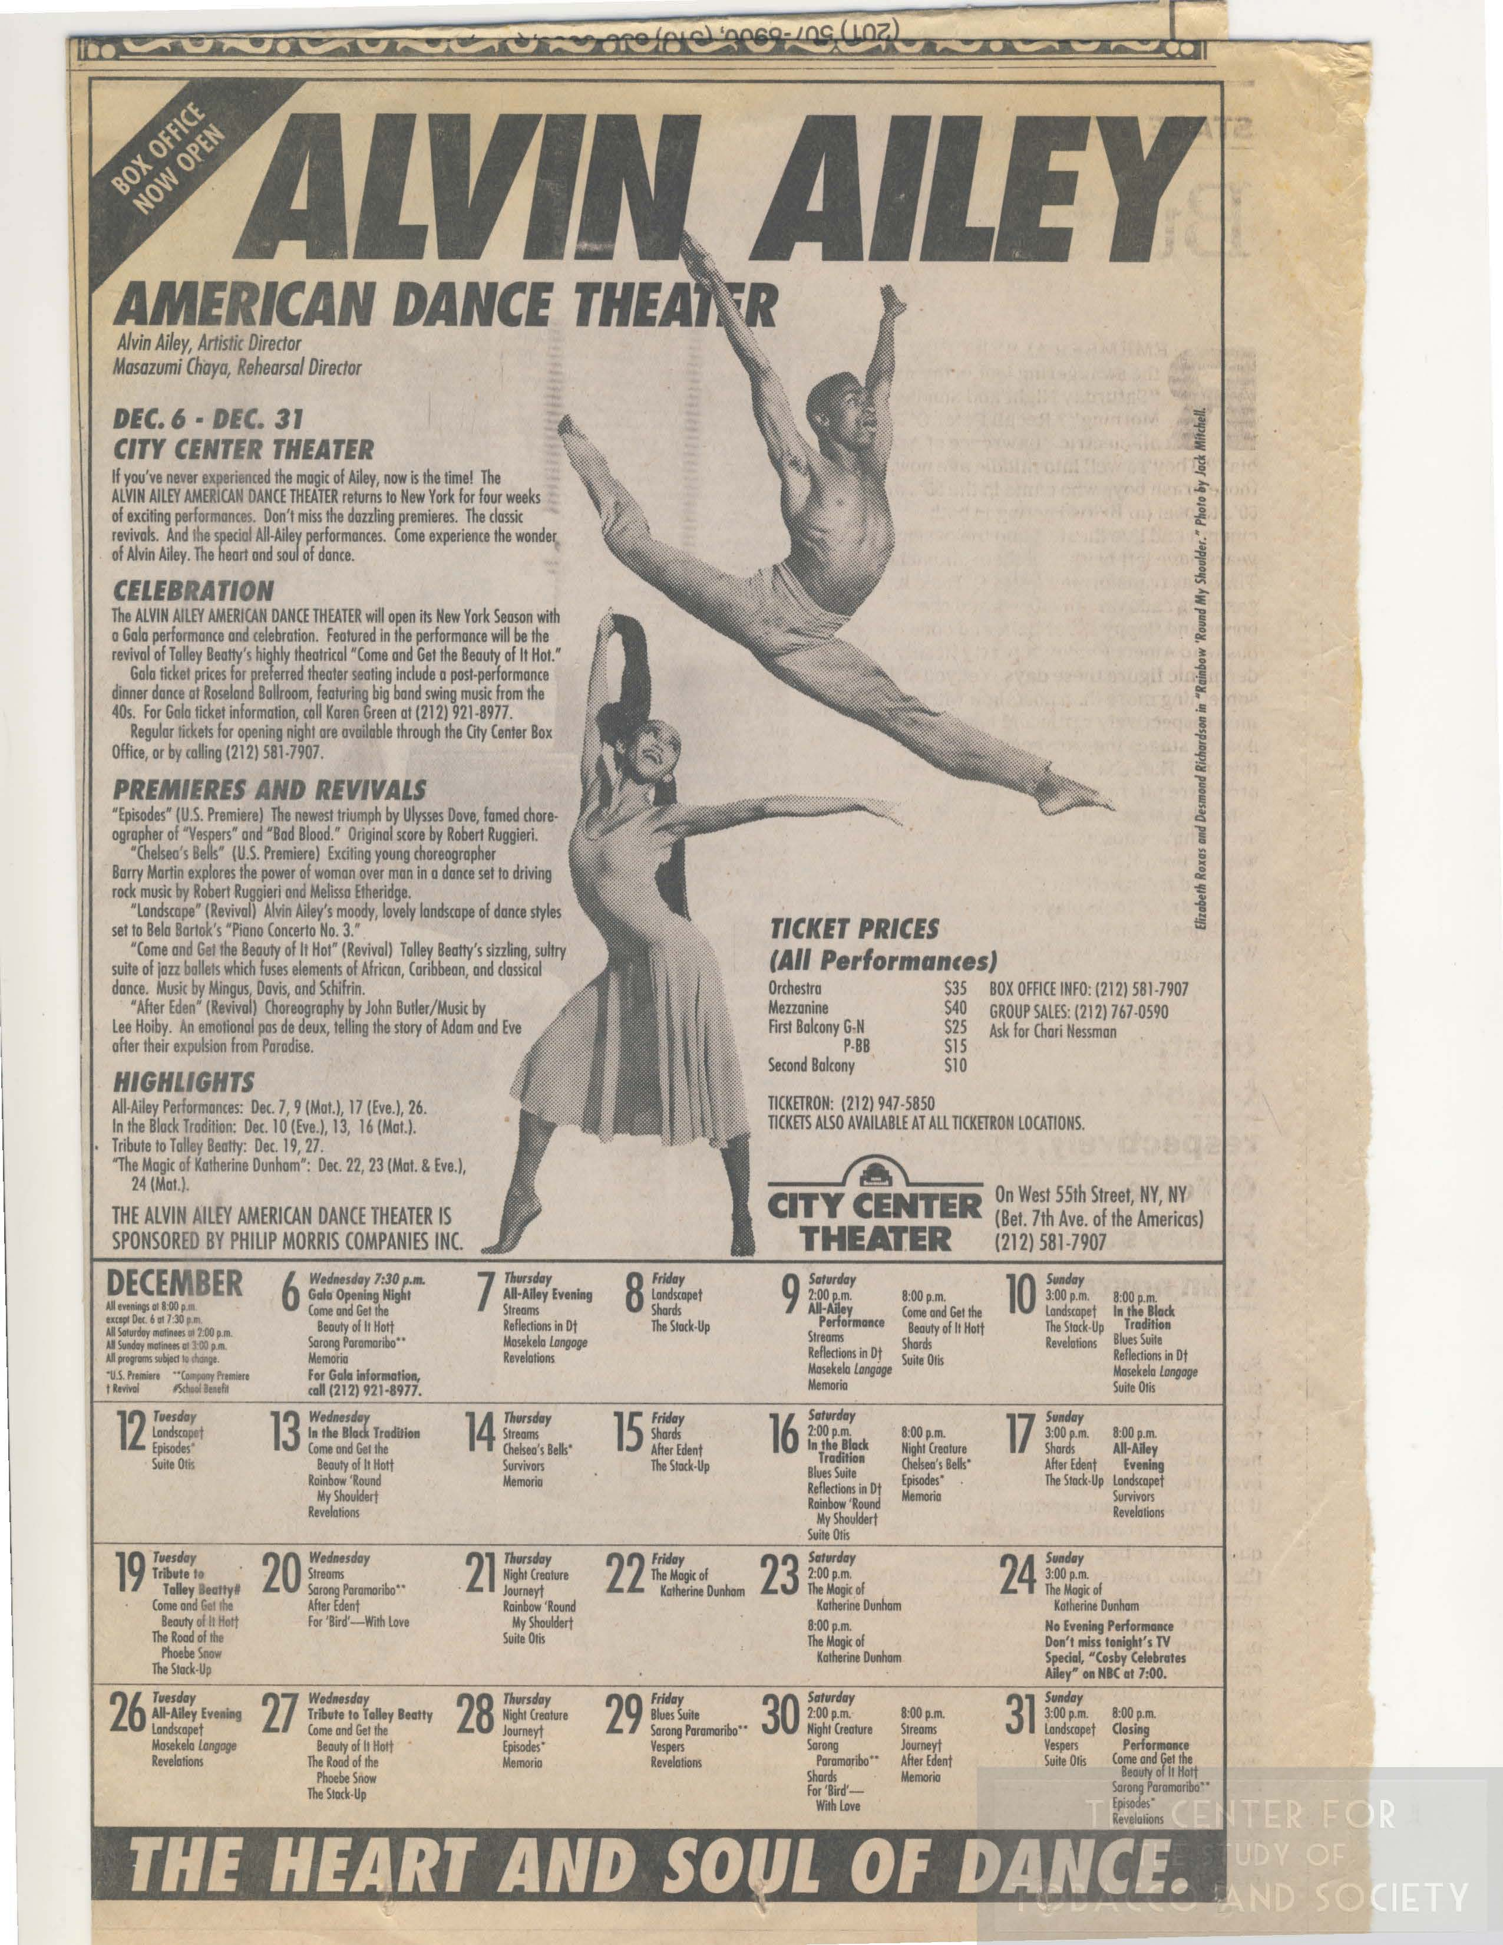
Big patron of the arts
Notes:
Philip Morris executives say they attach no conditions to their grant money. They don't even require that museums allow smoking at the opening-night parties, although as Weissman, the retired Philip Morris chairman says, "it is a matter of courtesy if a lot of cigarette people are coming.“Michael Kaiser, executive director of the Alvin Ailey, points to the dearth of government funding for institutions such as his own. "You have to look increasingly to the corporate sector. . . . And they are the major corporate sponsor keeping us alive and thriving."

Slide 34

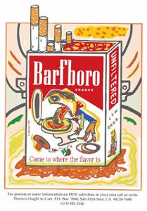
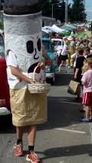
Art Action
Letters to the institution
Education of the community
Counter-advertising
Sidewalk theatre
Work with artists
Work with children artists
Poster contests*
Notes:
PM funded an art exhibit in Portland about ten years ago.

Slide 35
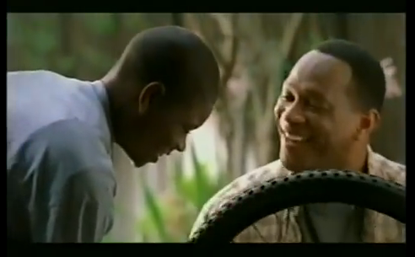
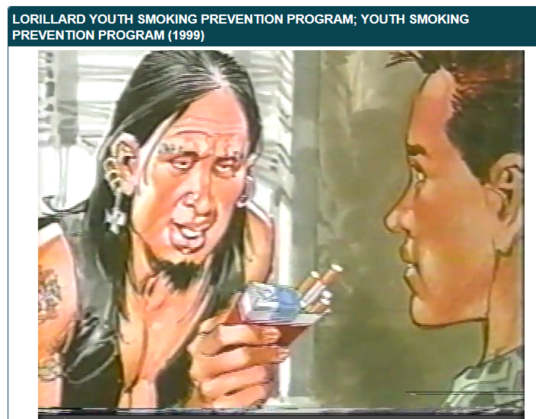
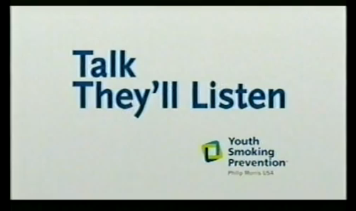
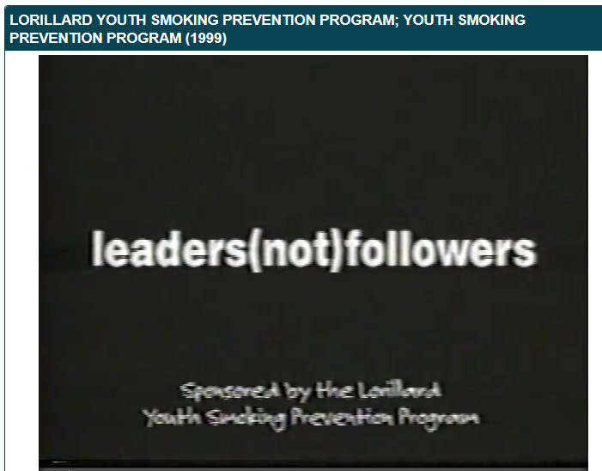
Smoking prevention ads
Source: UCSF Tobacco Industry Videos: https://archive.org/details/tobacco_bbt64d00
Notes:
Commercials: https://www.youtube.com/watch?v=z9OIVeiCx0Q and https://archive.org/details/tobacco_bbt64d00

Slide 36

RJReynolds Program

Slide 37
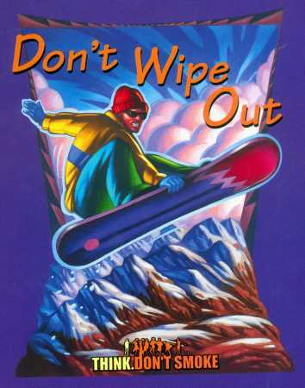
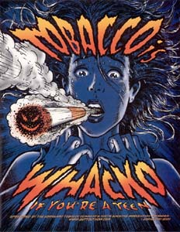
Book covers and comic books
Notes:
confiscated in PPS schools

Slide 38
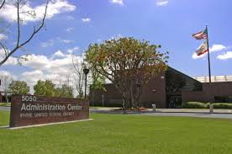
Action
Contacted schools, districts, PTAs
Confiscated them
Repurposed them
Wrote letters to the editor

Slide 39






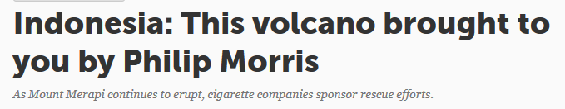
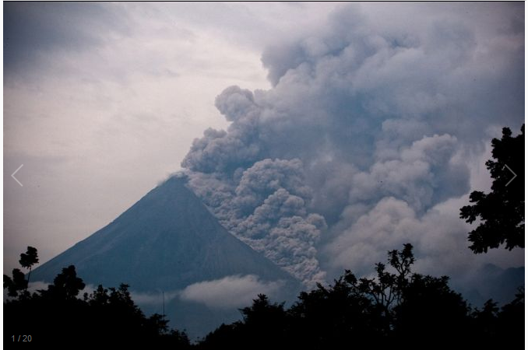
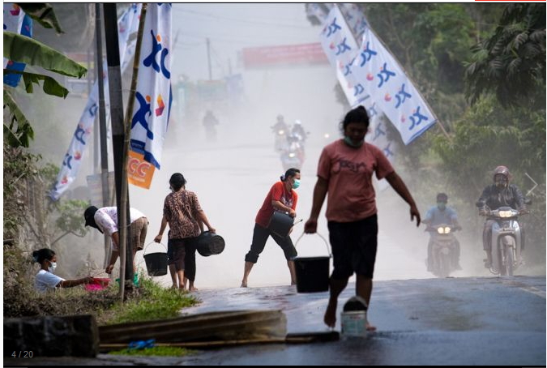
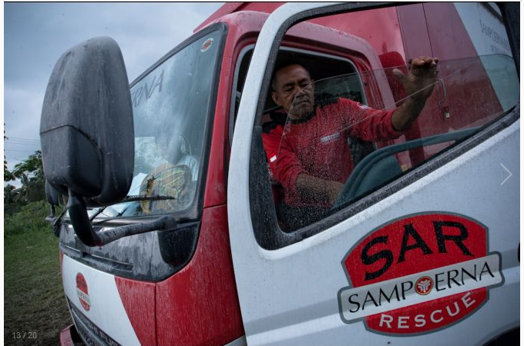
Charitable works by tobacco companies
Sources: St. Lawrence University, http://it.stlawu.edu/~global/pagessemiotics/testphilipmo.html & GlobalPost, November 4, 2010, Will Carless
Notes:
Tobacco companies assume that nonprofits desperately need money and will ignore that the "gift" comes from the deadliest drug cartel in the world. They are hoping your people will only notice the good deeds they do and forget how they are harming the very population you want to help

Slide 40
Cause and effect
Tobacco Industry benefits
Results
Tax deductions
Good publicity
Extremely high profits
Well intentional and generous
Are in business to make money for their stockholders
3000 new customers each day
Hire doctors, lawyers, athletes, politicians, actors, musicians to present their good side
Costs billions of dollars in loss productivity
Costs billions on health care
Kills up to 485,000 people each year in the US
Allies take money including at one time the AMA, ALA, ACS, NAACP, United Negro College Fund, Women’s groups
Cast doubt by paying scientists and doctors to lie for them and hiring attorneys to hide the facts from their own research
Notes:
Tobacco companies hide their profits. They create holding companies, purchase media, and buy food companies like Kraft and Gevalia in an attempt to shelter their profits from lawsuits

Slide 41
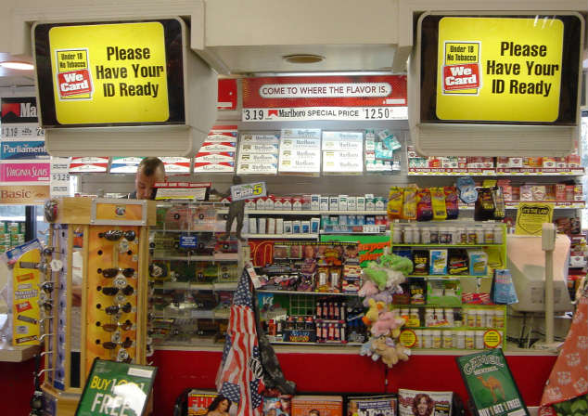
Retailers
Notes:
Despite continued concerns regarding the program's effectiveness, Coalition for Responsible Tobacco Retailing (CRTR) concluded that We Card training provided “evidence that further restrictions and taxes aren't necessary.”⁴²
Shift cost of program to retailers in new century, whereas before all materials were free.
CRTR also developed materials in new languages (Spanish, Korean), drew up agreements with new companies to support the program, and sent We Card materials to congressional hearings in an effort to prevent the passage of new tobacco restrictions,. (2001)
However, the coalition's activities for more than a decade focused primarily on handing out materials, without any effort to determine whether they changed behavior; collecting endorsements; publicizing We Card; and praising the program's sponsors
enforcement consisted of writing letters to retailers—and, in the worst case, imposing a short-term suspension of promotional programs

Slide 42


Improve the tobacco industry's image
Reduce regulation and the enforcement of existing laws
From a PM report in 2000,
  The “We Card” commercials are widely seen and an extremely positive influence on attitudes toward the tobacco industry generally and PM specifically… .
  Exposure to this ad greatly helps in the sale of the responsible-marketing-only-to-adults message and reducing positive response to the [American Legacy Foundation “truth”^{174,175}] ads vilifying the company.¹⁷⁶
Notes:
FDA regulators attempting to improve Synar compliance noted that retailers had no serious interest in using We Card to actually reduce tobacco sales to minors. Retailers think they've met their responsibility as soon as they post the signs
We Card training efforts helped gain the recognition of hundreds of elected officials on the local, state and federal levels through hundreds of positive news stories.

Slide 43
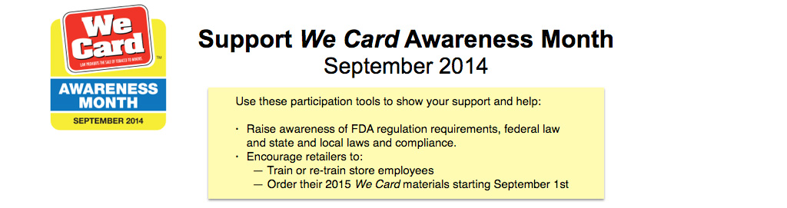



We Card Awareness Month
Notes:
to improve the tobacco industry's image and to reduce regulation and the enforcement of existing laws. Policymakers should be cautious about accepting industry self-regulation at face value, both because it redounds to the industry's benefit and because it is ineffective.

Slide 44

“Oregon does have a requirement of signage (ORS 163.580), but it does not specify a specific sign be hung. In effect, all a retailer must have visible is a sign that clearly states that the sale of tobacco to minors is prohibited.”
Jeff Ruscoe
Addictions and Mental Health
Notes:
Yet a 1996 news article from North Carolina noted that more than a quarter of retail workers failed to card minors, even after being given We Card materials. In addition, retailers who checked IDs often sold tobacco to underage teens even after seeing evidence that they were minors.^{45–47}

Slide 45

Name the brand.

Slide 46

Organic, recyclable, no additives

Slide 47

Colors

Slide 48
What’s next?

Slide 49

Notes:
Lebanon, JOANNA KHALIL
American University of Beirut, Lebanon

Slide 50


Slide 51




Tools
Notes:
Multnomah County Chair Deborah Kafoury visited Madison High School this week to meet with students who are part of an anti-smoking program designed to convince youth to stay away from tobacco and nicotine.
The Madison students participate in Providence Health Services’ “Rebels for a Cause” program. They gathered Wednesday, Nov. 19, to show Chair Kafoury the efforts they are making in educating students about the dangers of tobacco and e-cigarettes.

Slide 52



Nights
Weekends
Holidays

Slide 53
Resources
Robbins John. Reclaiming our health: exploding the medical myth and embracing the source of true healing. 1996.
University of Alabama Center for the Study of Tobacco and Society Archive
Blum AM. The cigarette underworld. New York State Journal of Medicine, 1985.
Levin Myron. Buying innocence by association: tobacco’s strange bedfellows, 1988
NCBI/NIH http://www.ncbi.nlm.nih.gov/pmc/articles/PMC2882417/
Siegel M, Blum A. FDA regulation of tobacco: reprieve for the Marlboro
man? Lancet 2006; 368: 266-68. Testimony at Congressional hearing on proposed FDA bill.
Blum A, Brown A, Cummings KM, Purpera J, Solberg E. Uncovering strange bedfellows: 35 years of exposing allies of the tobacco industry. Research Day, Univ. of Alabama, 2012.
Ruscoe J. Oregon Addictions and Mental Health Division.
Claus, S. The North Pole.

Slide 54


Dedicated to Linda Hornbuckle
1954-2014

Slide 55

Thank you and (cough, cough)
Merry Christ (cough) mas!
erik.c.vidstrand@multco.us
503.988.9420

