Slide 1
Reducing Sugary Drink Consumption In Healthcare Facilities
Starting the Conversation
The legal information and assistance provided in this webinar does not constitute legal advice or legal representation.

Slide 2
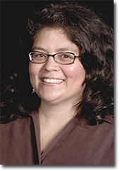
Introductions
Julie Ralston Aoki
Staff Attorney,
Public Health Law Center

Slide 3
Objectives
Learn about:
A new resource: Minnesota Healthy Beverages in Healthcare Toolkit
Healthy beverages in healthcare work nationally and here in Minnesota
Tips for starting the conversation with an organization

Slide 4
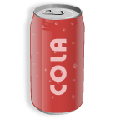
What’s a “sugary” drink?*
Beverages sweetened with added sugar including:
Soft drinks
“Fruit” drinks, punches and ades
Sports drinks
Energy drinks
Flavored milks
Teas and coffee drinks with caloric sweetener
*Drinks labeled as 100% fruit juice are not considered sugary drinks, although portion control is important for 100% juice.

Slide 5
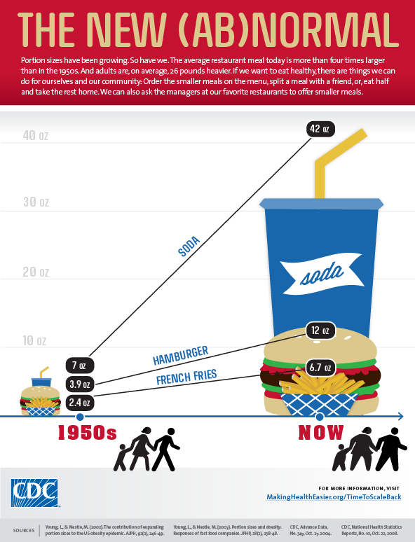
Why sugary drinks?
Consumption of sugar sweetened beverages has been associated with at least 20% of the increase in weight in the U.S. since 1977
Notes:
Beverages are a large source of added sugar in our diets. For adults, 33% of calories from added sugars come from beverages
For children and adolescents, 40% of calories from added sugars come from beverages
According to Minnesota Student Survey data from 2010, about one-third of Minnesota 6th and 9th-graders and one-quarter of 12th-graders reported that they drank one or more sports drink a day. Additionally, nearly 50% of 6th-, 9th-, and 12th-graders surveyed reported that they drank one or more pop or soda drinks in a day.
Source:
Minn. Dep’ts of Educ., Health, Human Servs., and Pub. Safety, Minnesota Student Survey 1992-2010 Trends 38 (2010), available at http://www.health.state.mn.us/divs/chs/mss/trendreports/msstrendteport2010.pdf.

Slide 6
Health risks of sugary drinks
weight gain/obesity
diabetes
hypertension
negative impact on cardiovascular health
poorer oral health
Notes:
Sugary drink consumption is associated with obesity—single food with the strongest association
Obesity is now prevalent world wide in epidemic proportions, including in MN
--
Several other health conditions have been associated with the consumption of SSBs. These include diabetes,29,30 elevated triglycerides,31,32 cardiovascular disease,33 non-alcoholic fatty liver disease,34 elevated uric acid levels,35 gout,36 and dental caries.37
Furthermore, SSB consumption has been linked to nutritionally inadequate diets, possibly due to displacement of nutrient-rich foods, such as milk, with SSBs.
In fact a study recently showed men who consume one serving of sugary beverage per day were 20% more likely to develop heart disease.--Sugary drink per day increased men’s heart disease risk by 20% (Circulation; March 2012)
Why do sugary drinks promote long term weight gain? Possible mechanisms include:
High sugar content
Failure to compensate for liquid calories
Insulin response to high sugar content may increase hunger
Inability of fructose to satisfy hunger
Desire for sweet taste overrides normal satiety signals
Increased risk of some cancers

Slide 7
Sugary drinks, obesity and cancer
Approximately one-third
of the most common cancers
are associated with unhealthy eating
and lack of physical activity.
National Cancer Institute 2012
Notes:
Approximately one-third of cancers could be prevented by physical activity and healthy diet. Based on current trends in the rate of obesity,
Obesity could lead to about 500,000 additional cases of cancer in the United States by the year 2030. In comparison, if U.S. adults decreased their body mass index (BMI) by one percent , this would prevent the increase in cancer cases and actually decrease cancer cases by 100,000 annually.

Slide 8
Sugary drinks, cancer, and obesity
Cancers associated with excess weight:
Esophagus
Colon and rectum
Kidney
Breast (post-menopausal)
Pancreas
Endometrial
http://www.livelighter.com.au/the-facts/about-fat.aspx
Notes:
Excess weight is associated with increased risk of these common cancer types and possibly others

Slide 9
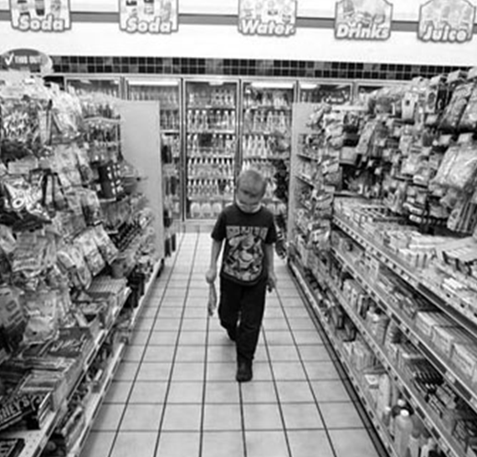
Why PSE change?
Major health problems will not be solved solely by individual actions
Health problems are influenced by societal policies and environments that promote unhealthy behaviors or fail to foster healthier choices
Chronic disease prevention requires an “upstream” approach that improves the environments where we live, work, learn, play, and receive health care

Slide 10
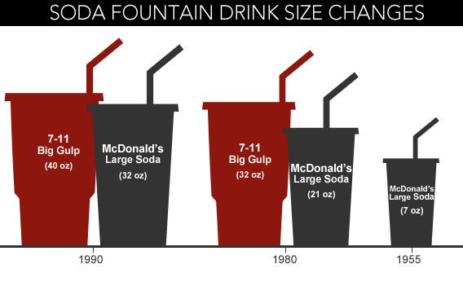
Unhealthy has become the default . . .
http://www.slate.com/articles/news_and_politics/explainer/2012/09/new_york_city_soda_ban_when_did_soft_drinks_get_so_big_in_the_first_place_.html

Slide 11
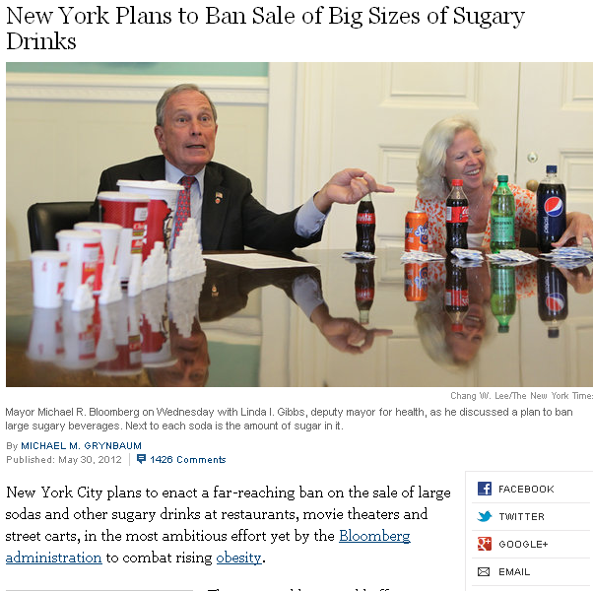
One way to change a default . . .

Slide 12
Sugary drink reduction efforts
Health-care settings
Organiz-ational efforts
Notes:
How does this hospital work fit within the larger strategic goal of reducing SSBs—and why healthcare?

Slide 13
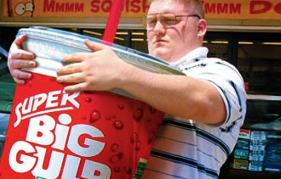
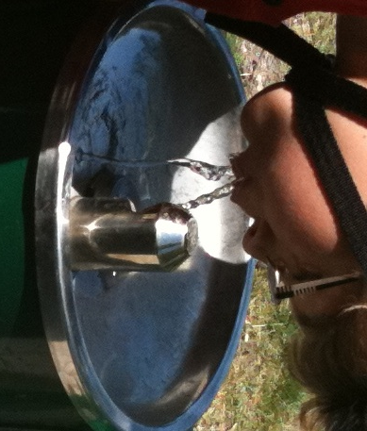
Key strategies—both/and
Reducing consumption of unhealthy options
Promoting consumption of healthy options
http://www.entrepreneur.com/blog/224077
© Public Health Law Center

Slide 14
Make the healthy choice the easy choice . . .
cost
convenience
“cool” factor
Notes:
Julie

Slide 15
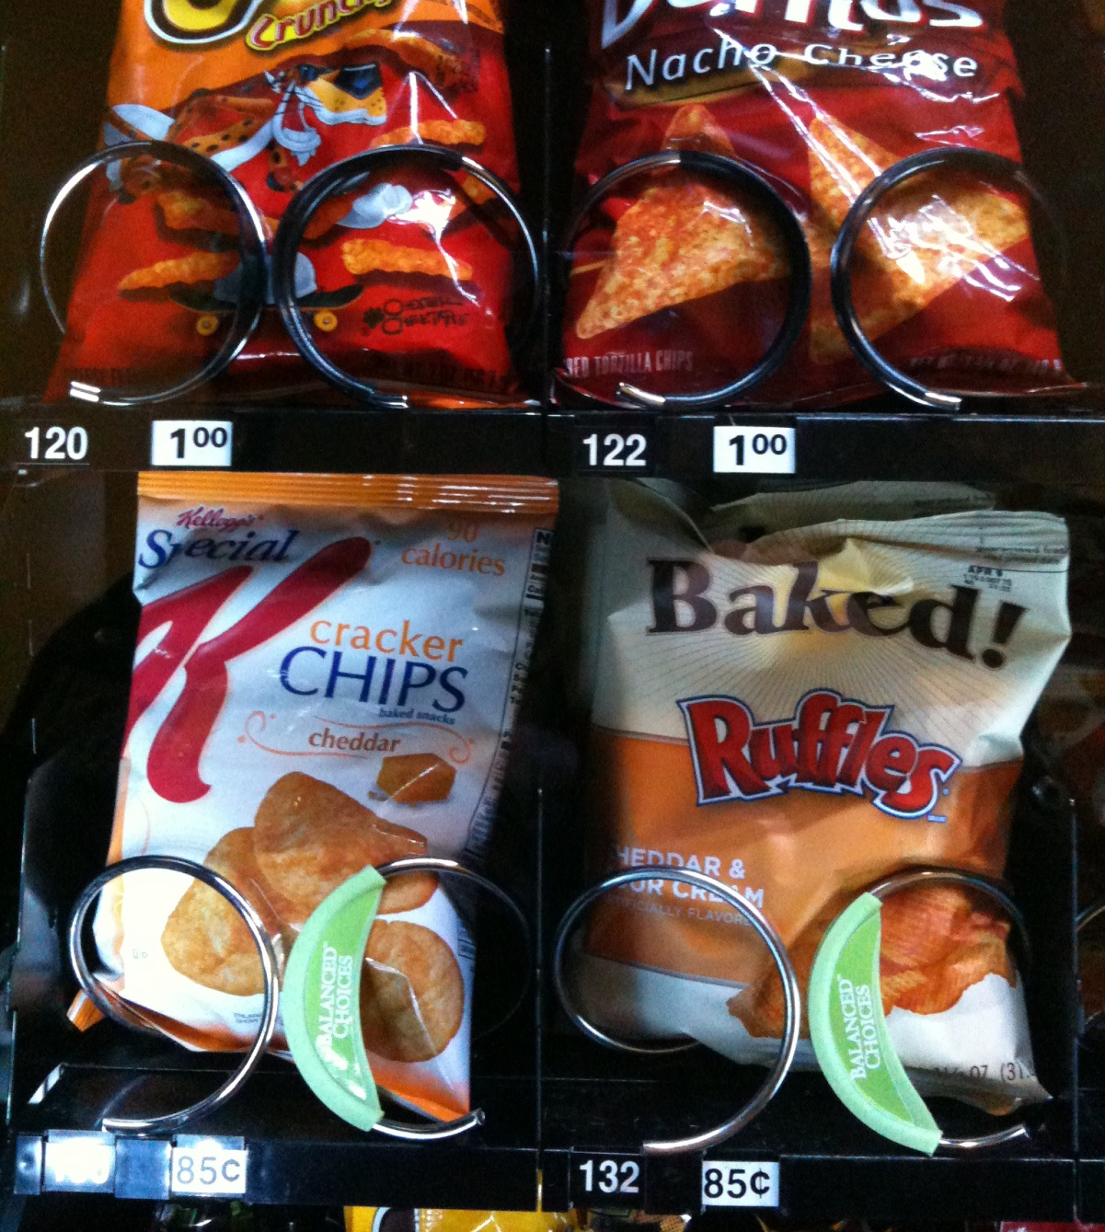
Cost
© Public Health Law Center
© Public Health Law Center
Notes:
Julie
Healthy vending policies may also include guidelines to increase the visibility of healthy items through product placement (placing healthy items at eye level) or labeling of caloric content or otherwise identifying healthy options.
They may also use pricing strategies to encourage purchase of healthy options by making healthy items less expensive or the same price as unhealthy items.

Slide 16
Product placement, prices
before
after
Notes:
Julie
Example from a previous webinar on healthy food procurement policies; Massachusetts General Hospital – changed the “choice architecture” in its cafeteria to promote healthier choices—put them at eye level, within easy reach; put the less healthy options in less visible, slightly less convenient places
Put bottled water everywhere within easy reach
Could do similar placement strategies with items in vending machines
Same with pricing

Slide 17
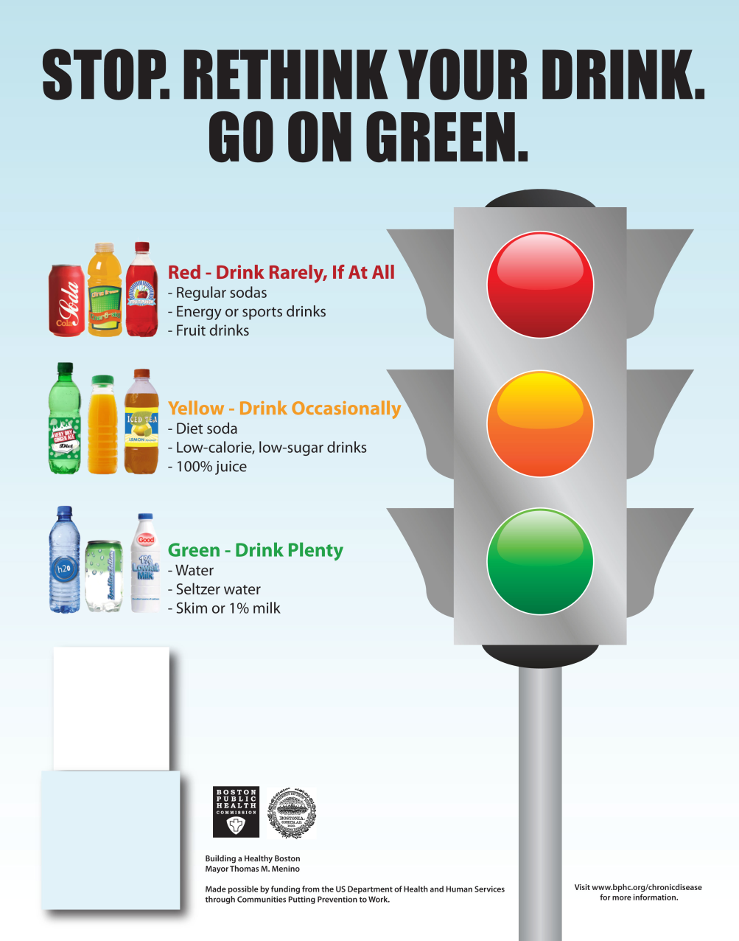
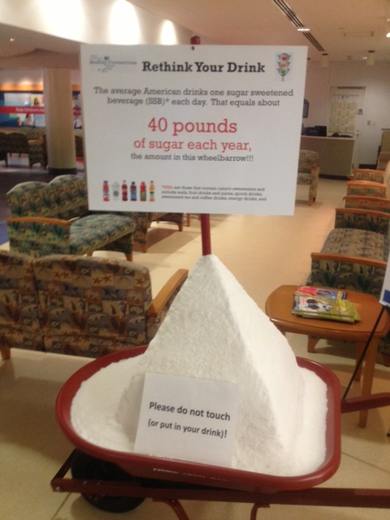
Education
Notes:
Julie

Slide 18
Labeling (also education)
Notes:
Julie

Slide 19
Building a Statewide Network
Connect with key partners
Create resources
Collaborate
Notes:
We here at the Pub Health Law Ctr are especially excited because while we have partnered on a national level with the American Heart Association and HealthCare without Harm on these types of efforts, we were really glad to have the opportunity to do this work within our own state.
So this slide captures our global approach in doing this work, but I also wanted to give you some specific examples of the things that we’re doing, and then an elaborate on some of the key partners and activities in the next few minutes.
Early on -- Convened an invitation-only healthy beverages in healthcare discussion with key potential partners to discuss perspectives, strategies
Invitees included clinicians, medical professional associations, healthplan reps, hospital association, and public health
We developed educational webinars to explain what we’re doing and why, to promote better understanding of the need to create environments that support healthy behaviors—also opportunity to highlight and promote partner activities
Presentations—at public health conferences, oral health summit, Cancer Disparities summit, upcoming presentation at MHA trustees meeting
Providing free, customized technical assistance on reducing sugary drinks in healthcare and worksite settings

Slide 20
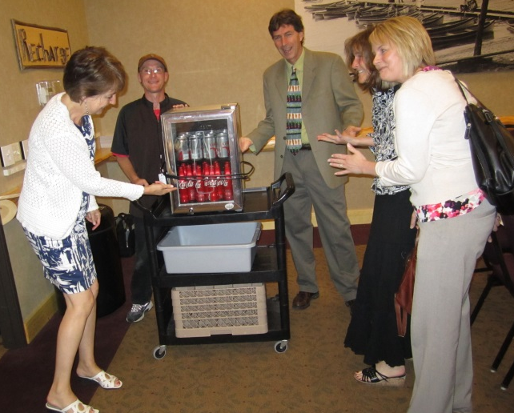
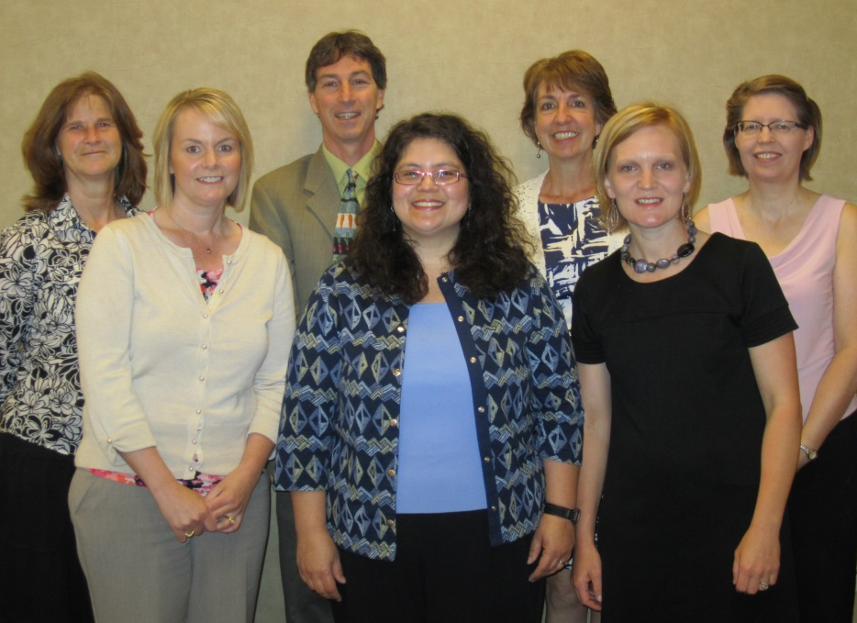
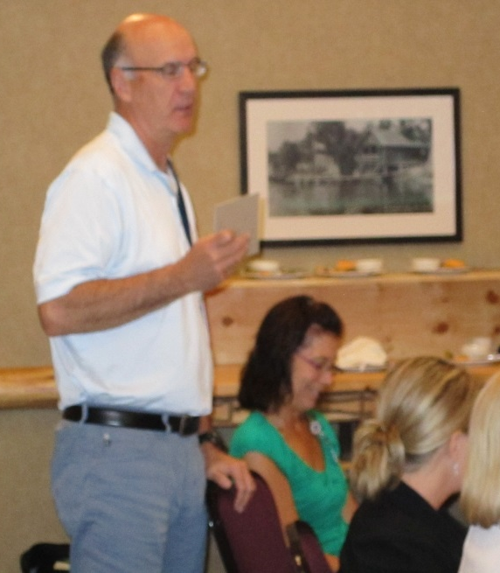
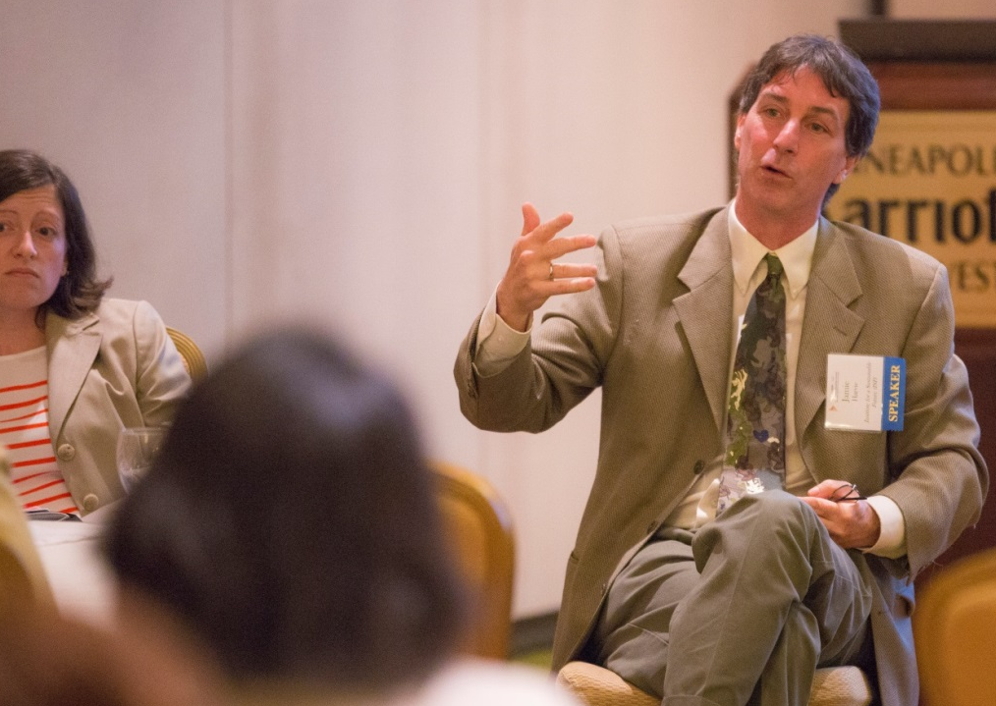
Working with partners
Notes:
Julie
This slide represents how we’ve been able to put all these pieces together—from events and presentations that we’ve collaborated on during this past summer.
Earlier this summer, we worked with a local public health department and SHIP grantee in west-central MN called PartnerSHIP4Health to hold a leadership meeting, building off the relationships that this group has built with its community partners—including over 20 large employers and health care providers in their region
Jamie Harvie of the Hospital Challenge came to talk about why hospitals are doing this work, and brought a representative from one of the hospitals that has taken the sugary drink pledge, who could provide a real-life perspective and share how they did it
The Center provided information about the link between cancer and obesity to reinforce the Challenge’s message about the important role of healthcare in modeling community health, explained the toolkit, and offered technical assistance.
We did a survey after the meeting—
About 55% of the survey respondents indicated that before the meeting, they were either undecided about or were not very interested in exploring a policy that would reduce or eliminate sugary drink consumption within their facility.
After the event, however, only 8% of the respondents remained undecided, and 91% agreed or strongly agreed that they were interested in exploring this type of policy.
We were very pleased with these indicators.
June—since then, we check in periodically, continue to offer support and encouragement, and are talking about doing another event early next year where people can report on progress.

Slide 21
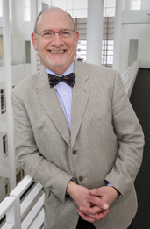
Messaging
“By phasing out the sale of soda and other sugar-sweetened beverages, the health care facilities in Northeastern Minnesota are saying they prioritize good health—before, as well as after, people are sick. They are offering inspired leadership for other hospital and health care systems, their patients, staff, and the entire community.”
Edward P. Ehlinger, MD, MSPH, Commissioner, Minnesota Department of Health (editorial published in the Duluth Herald Tribune)
Notes:
Michelle
By focusing on the role of hospitals in promoting healthy beverage environments, we created an opportunity for public health leaders to deliver positive messages on reducing sugar sweetened beverages.

Slide 22
Healthy Beverages in Healthcare Toolkit
Guide
Fact sheets
Case studies

Slide 31
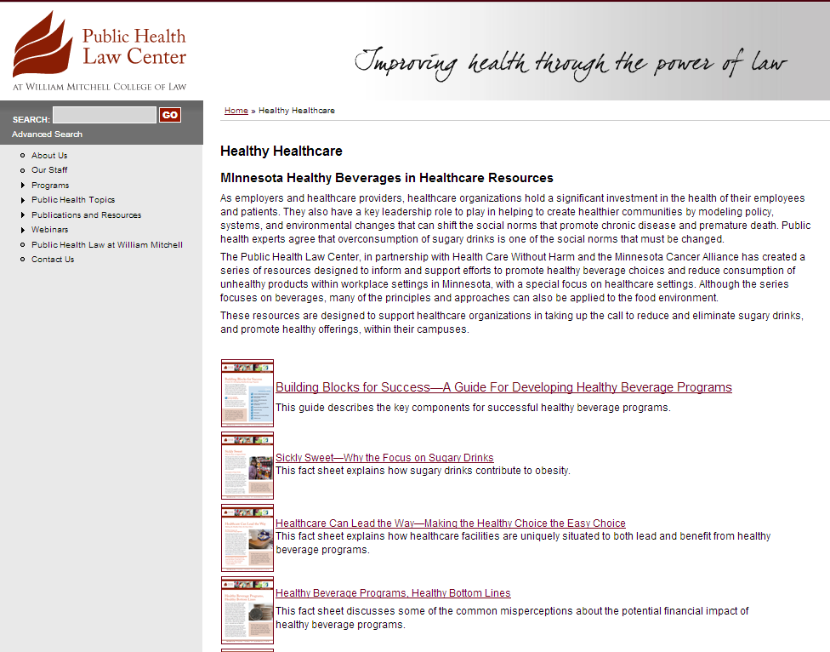
http://www.publichealthlawcenter.org/resources/healthy-healthcare

Slide 32
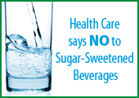
Healthy Beverages in Healthcare
Health Care Without Harm’s Healthy Beverages Initiative
http://www.healthyfoodinhealthcare.org/healthybeverage.php
Healthy Hospital Food Initiative
Susan Roberts
sroberts@ahealthieramerica.org
202.842.9001 ext. 202
Tiffany Sanchez. Manager
tsanchez@ahealthieramerica.org
202.842.9001 ext. 210

Slide 33
Notes:
TA pilot program

