Slide 1
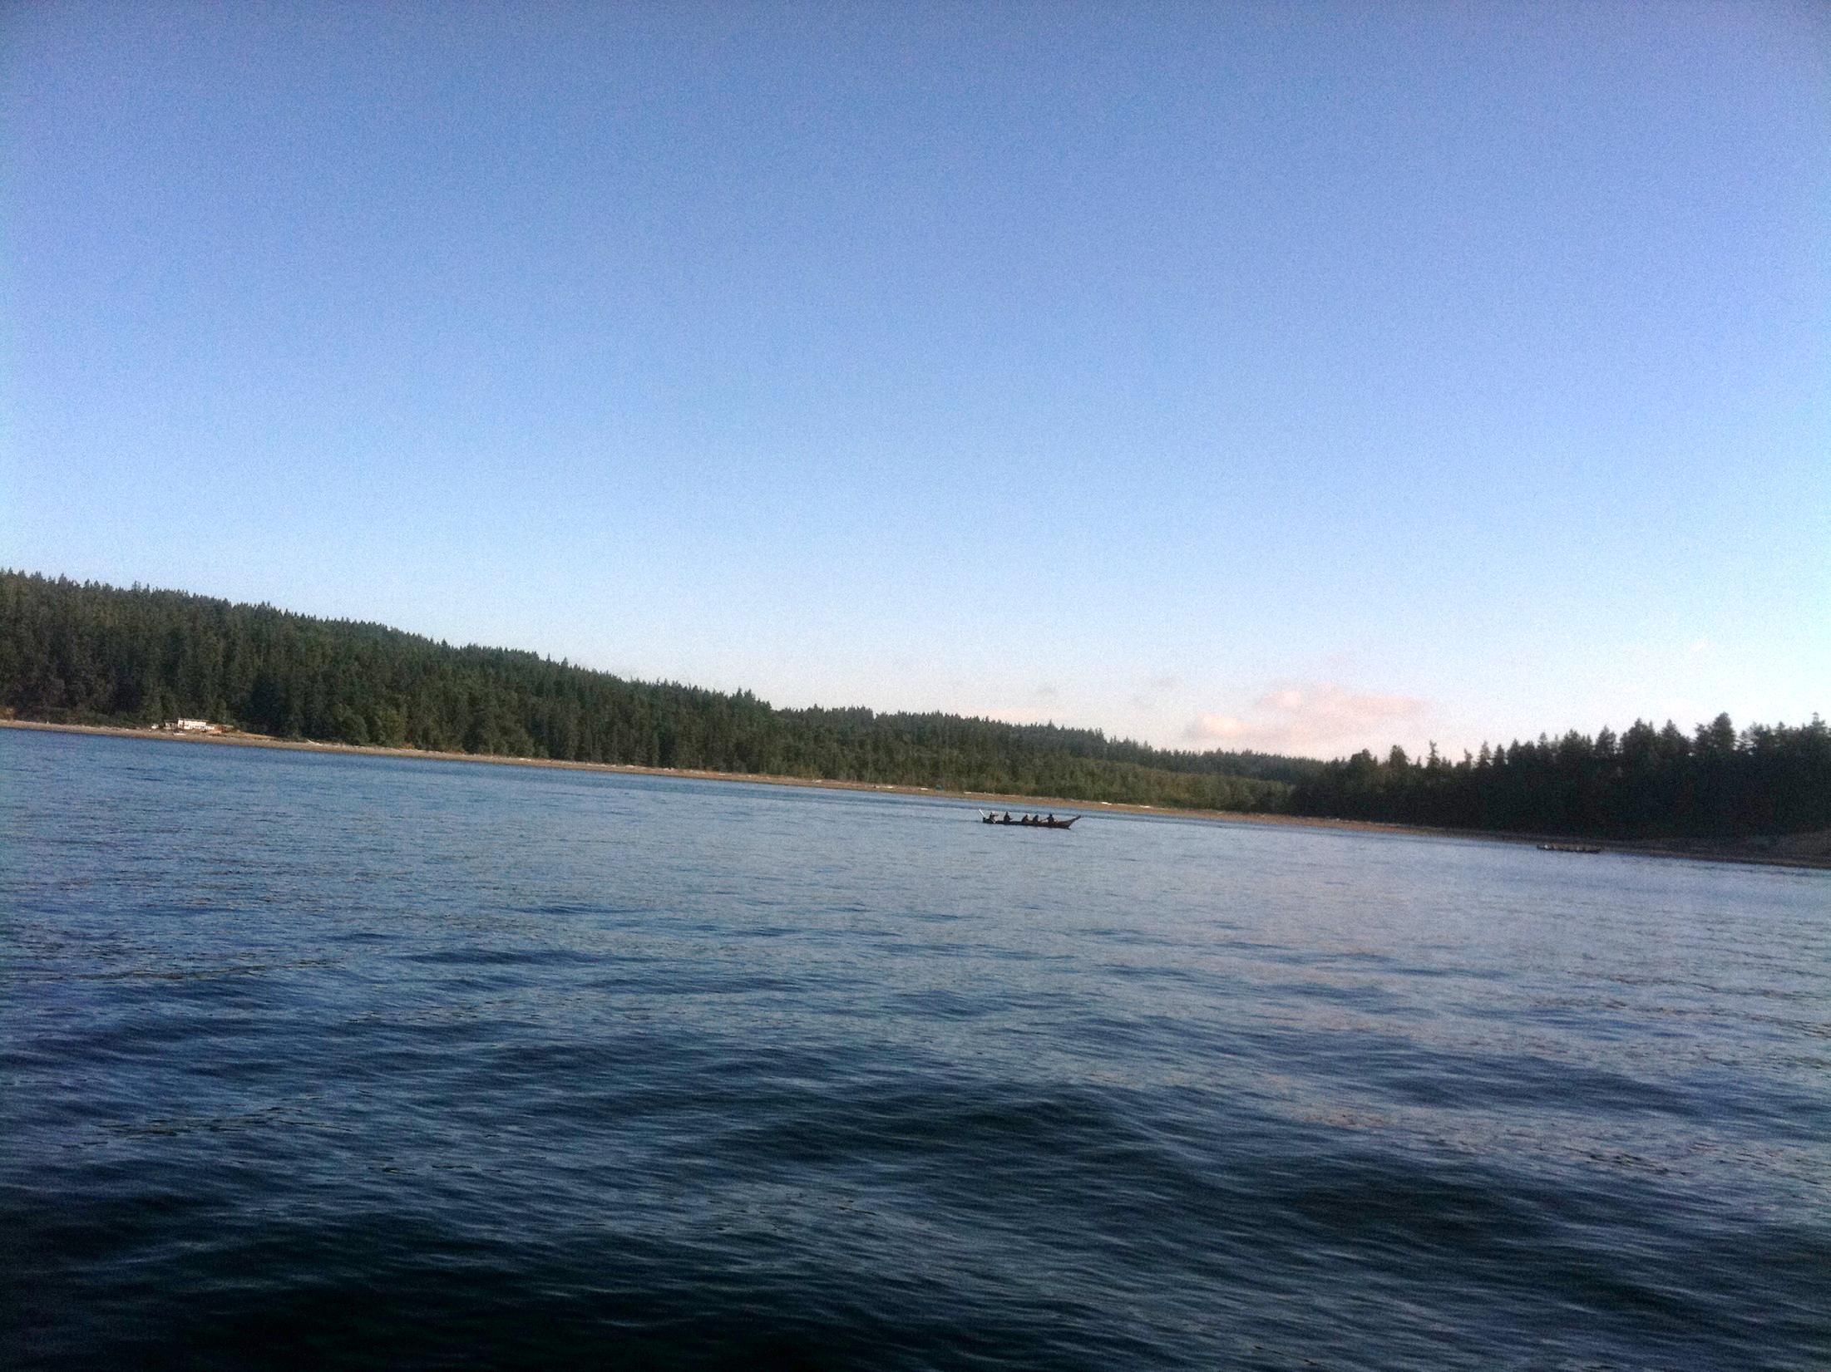
Canoe Journey The Sacred Journey
Doug Barrett, Mark Petrie, and Jimmy Barton
October 22, 2011
Created by Josh Davies

Slide 2
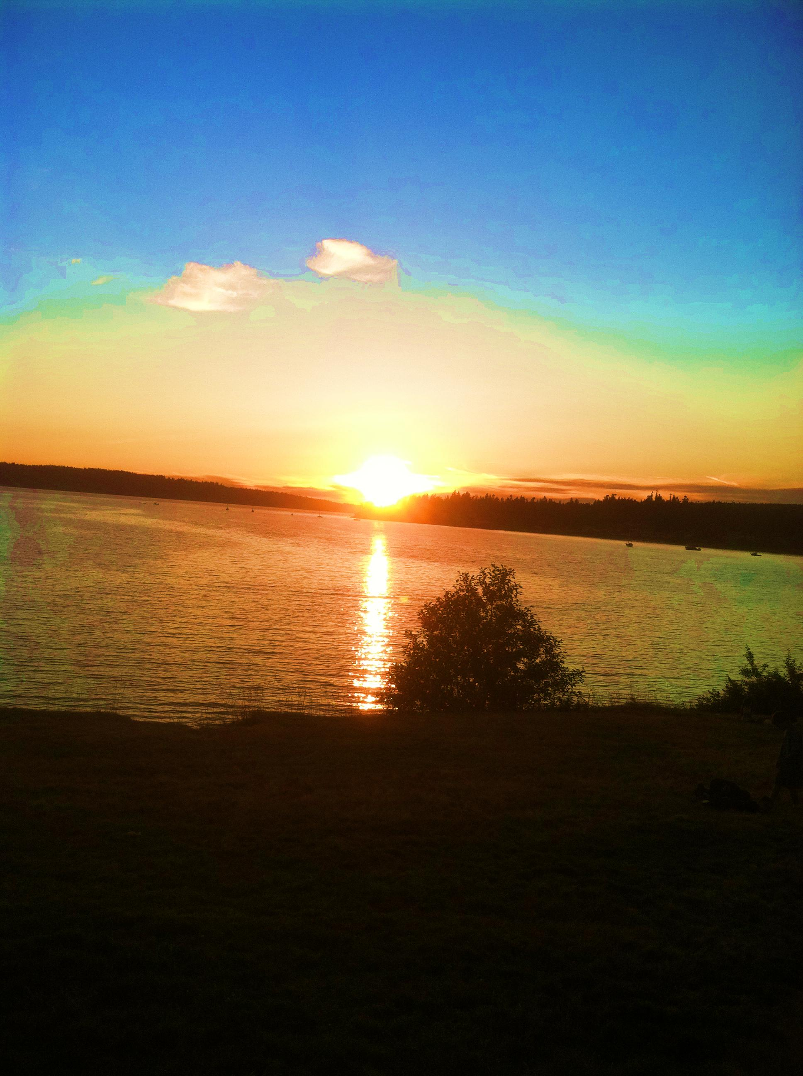
Beginning of Canoe Journey
Cedar canoes are the traditional mode of transportation for coastal people of the Pacific Northwest.
9 canoes in ‘Paddle to Seattle’ (1989).
Then, in 1993, the Heiltsuk Nation in Bella Bella, BC challenged all canoe nations to travel by canoe to their village participate in the Qutawas Festival. 28 canoes answered that challenge.
89 Canoes landed at Neah Bay Makah (2010).
79 canoes participated in ‘Paddle to Swinomish’ (2011).
Next Year, Summer of 2012, is ‘Paddle to Squaxin Island.
5:49

Slide 3
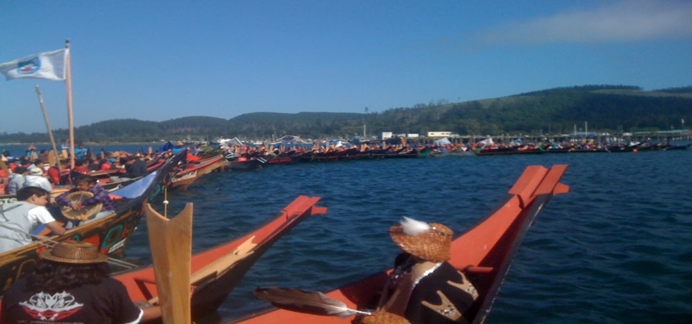
Landing at Makah – 2010 Pictures are worth more than words

Slide 4
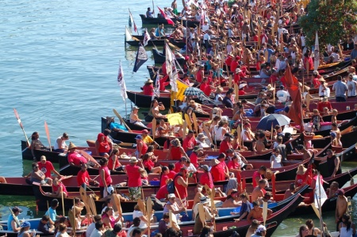
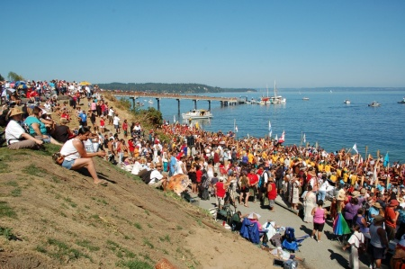
The Canoe Journey Has Become:
Today more than a 100 canoes from as many as 90 US Tribes, Canadian First Nations and New Zealand and an estimated 12,000 people participate in the annual Tribal Canoe Journeys. We pull together; we sing and dance; and we share our culture – everything in honor of our past, present and future generations.
RESPECT for EVERYTHING is part of the Journey
Pictures taken from Paddle to Makah (2010)

Slide 5
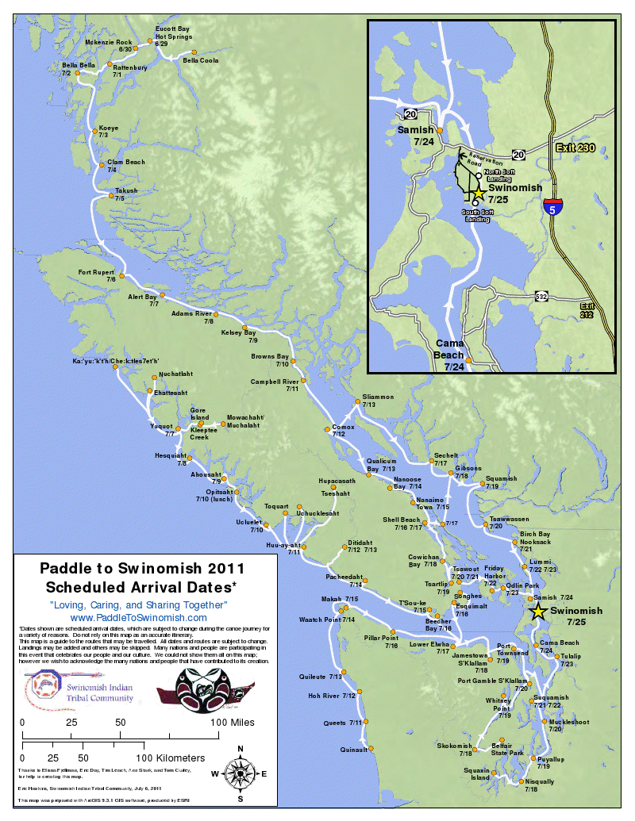
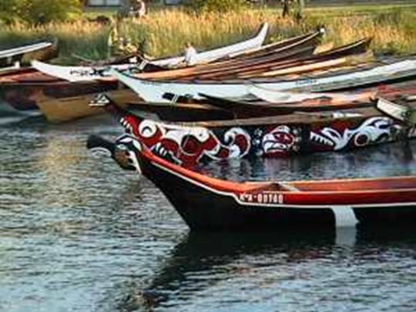
Paddle to Swinomish
Alaska and Canada Tribes begin a month in advance
CTCLUSI members put canoe in at Squaxin Island near Olympia, Washington
Landed above Seattle at Swinomish located across from La Conner, Washington
Swinomish Video via Grande Ronde 14:20
Picture : Canoe Journey to Makah 2010

Slide 6
10 Canoe Rules taken from Tribal Journeys World Press
1. EVERY STROKE WE TAKE IS ONE LESS WE HAVE TO MAKE Keep going! Even against the most relentless wind or retrograde tide, somehow a canoe moves forward. This mystery can only be explained by the fact that each pull forward is a real movement and not a delusion.
2. THERE IS TO BE NO ABUSE OF SELF OR OTHERS Respect and trust cannot exist in anger. It has to be thrown overboard, so the sea can cleanse it. It has to be washed off the hands and cast into the air, so the stars can take care of it. We always look back at the shallows we pulled through, amazed at how powerful we thought those dangers were.
3. BE FLEXIBLE The adaptable animal survives. If you get tired, ship your paddle and rest. If you get hungry, put in on the beach and eat a few oysters. If you can’t figure one way to make it, do something new. When the wind confronts you, sometimes you’re supposed to go the other way.
4. THE GIFT OF EACH ENRICHES ALL Every story is important. The bow, the stern, the skipper, the power puller in the middle – everyone is part of the movement. The elder sits in her cedar at the front, singing her paddle song, praying for us all. The weary paddler resting is still ballast. And there is always that time when the crew needs some joke, some remark, some silence to keep going, and the least likely person provides.
5. WE ALL PULL AND SUPPORT EACH OTHER Nothing occurs in isolation. When we aren’t in the family of a canoe, we are not ready for whatever comes. The family can argue, mock, ignore each other at its worst, but that family will never let itself sink. A canoe that lets itself sink is certainly wiser never to leave the beach. When we know that we are not alone in our actions, we also know we are lifted up by everyone else.
6. A HUNGRY PERSON HAS NO CHARITY Always nourish yourself. The bitter person, thinking that sacrifice means self-destruction, shares mostly anger. A paddler who doesn’t eat at the feasts doesn’t have enough strength to paddle in the morning. Take that sandwich they throw at you at 2.00 A.M.! The gift of who you are only enters the world when you are strong enough to own it.
7. EXPERIENCES ARE NOT ENHANCED THROUGH CRITICISM Who we are, how we are, what we do, why we continue, flourish with tolerance. The canoe fellows who are grim go one way. The men and women who find the lightest flow may sometimes go slow, but when they arrive they can still sing. And they have gone all over the sea, into the air with the seagulls, under the curve of the wave with the dolphin and down to the whispering shells, under the continental shelf. Withdrawing the blame acknowledges how wonderful a part if it all every one of us really is.
8. THE JOURNEY IS WHAT WE ENJOY Although the start is exciting and the conclusion gratefully achieved, it is the long, steady process we remember. Being part of the journey requires great preparation; being done with a journey requires great awareness; being on the journey, we are much more than ourselves. We are part of the movement of life. We have a destination, and for once our will is pure, our goal is to go on.
9. A GOOD TEACHER ALLOWS THE STUDENT TO LEARN We can berate each other, try to force each other to understand, or we can allow each paddler to gain awareness through the ongoing journey. Nothing sustains us like that sense of potential that we can deal with things. Each paddler learns to deal with the person in front, the person behind, the water, the air, the energy; the blessing of the eagle.
10. WHEN GIVEN ANY CHOICE AT ALL, BE A WORKER BEE – MAKE HONEY!
P.S. Never, NEVER call CANOE a “boat”. Them’s splashin’ in words, friend.

Slide 7
Protocol for Journey
Every canoe must ask permission to come ashore for the evening
Happens every night at the host Tribe along the Journey
Usually stay 1-2 nights at each nightly host Tribe
After dinner, different Tribes come to share their songs and dances with everyone
Protocol changes within each location
Every canoe must ask permission to leave their waters
Ground Crew picks up camp while canoes leave the land
Ground Crew moves to next location and sets up camp for arrival of canoes
Depending on when Tribe leaves establishes how many stops the Ground Crew must do this for
One night Protocol Long House along the Journey

Slide 8
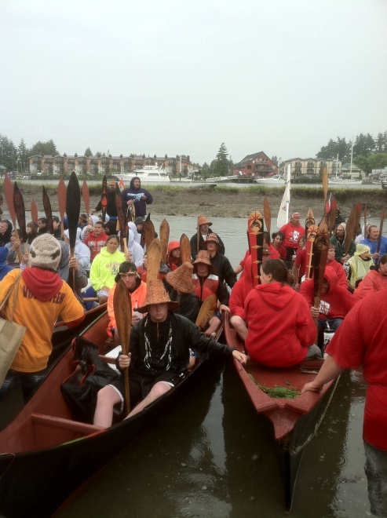
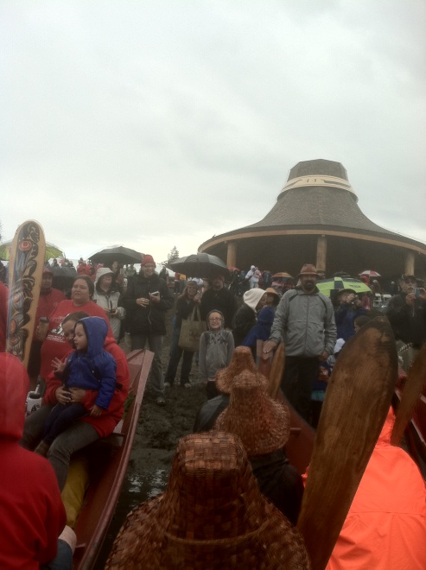
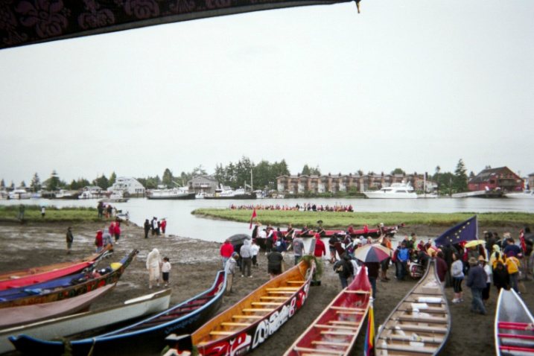
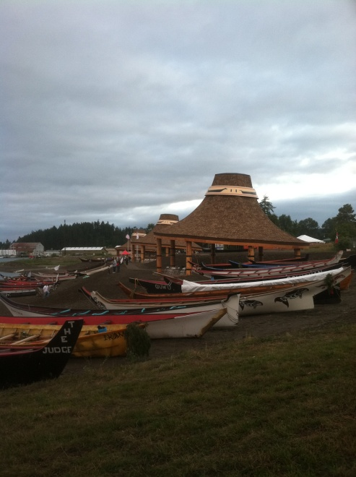
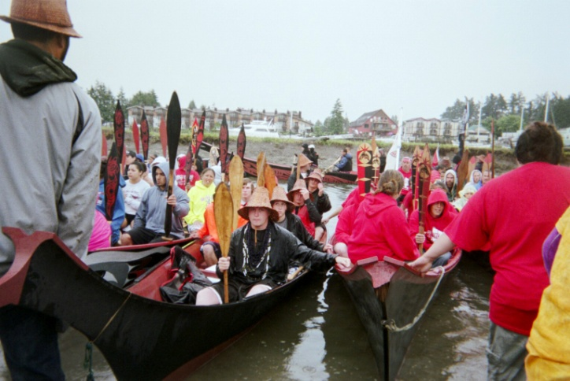
Landing at Swinomish
2:14

Slide 9
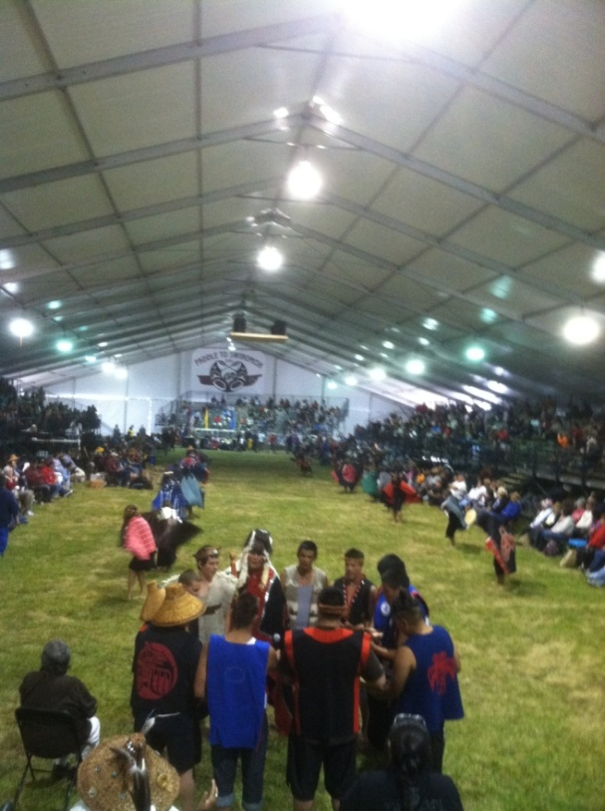
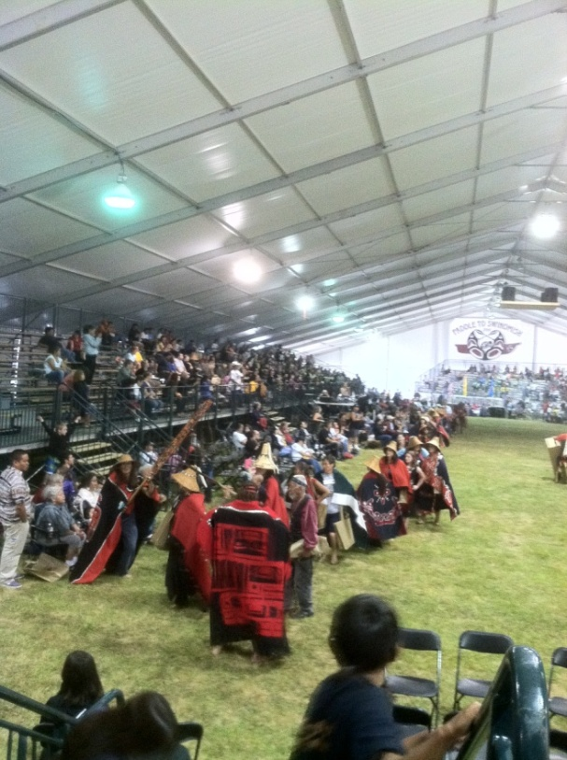
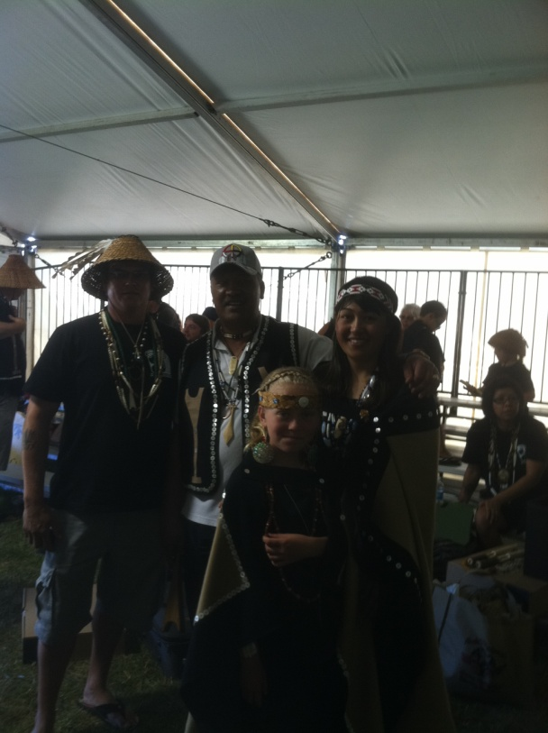
Protocol Tent at Swinomish

Slide 10
Main Objectives Of Canoe Journey
Largest Drug and Alcohol Free Event in the Northwest (Ring Ceremony – Pledge)
Builds continuing relationships with youth from many other Tribes (Respect for yourself, environment, and all others)

Slide 11
Protocol of Final Landing Day
2011 – Swinomish host Tribe
All canoes must ask permission to land and come ashore
Three tents: Protocol, Meals, and Meal Preparation
Lasts for nearly a week and involves all Tribal Canoe Families involved in the Journey
Each Tribe puts on regalia and comes on stage to share their songs and dances
Break times only consist of meal and sleep time
Canoe Families have various songs where audience can participate

Slide 12
1st Journey Tips
FIRST-TIMER? Don’t worry, you will learn as you go.
Remember …
It is a JOURNEY …
A Cultural, Spiritual, and Personal journey. We learn, change, and grow in the process.
We stretch beyond the boundaries and limitations that we, and others have set for us, as we rise above the “circumstances” to meet the needs and expectations of the journey.
……………………………………………………………………………………………..
Things everyone can do to promote a positive journey experience:
* Be kind and considerate.
* Keep a good attitude.
* Smiling is good. It improves everyone’s looks, and outlook.
* Be thankful. Show appreciation to Host, Crewmates, and Others.
* Show respect. Courtesy and respect are always appropriate.
* Help make sure that Elders, little children, and Special-Needs folks are cared for.
1. Do they need food or beverage?
2. Are they warm enough? Or too warm?
3. Do they need shelter from rain or sun, or a drink of water to cool off?
4. Do they need to find a restroom? Or need help getting there – quick?
5. Are other people crowding in front of them so they can’t see the event?
6. Are they being pushed aside and unable to get where they need to?
7. At meal time, has someone served them?
* Be a “team player”. Being thoughtful and working together makes a better experience for everyone, including yourself.
* If you see that someone needs help… take the initiative to help them. Or if you can’t, find someone who can.
* Take care of yourself too. If you are always too tired, or too hungry, or too busy, you cannot contribute to the good of the journey (for yourself or others).
Copyright – Sue Charles 2003, 2008

Slide 13
Ground Crew
Driving (equipment, pullers to canoe, and travel to next locations)
Tear Down and Set up camp at each stop location
Make sure pullers and canoe are ready each morning and evening
Everyone helps with pull out (landing) and put in (departure) of each location

Slide 14
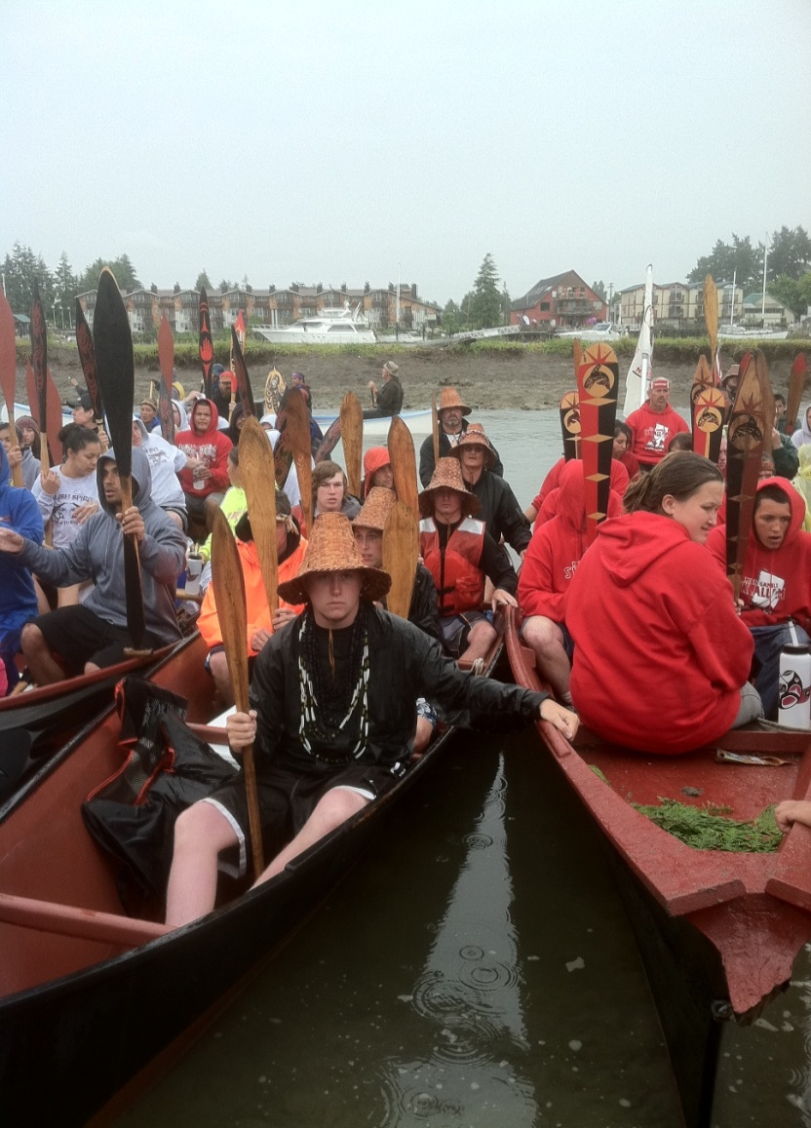
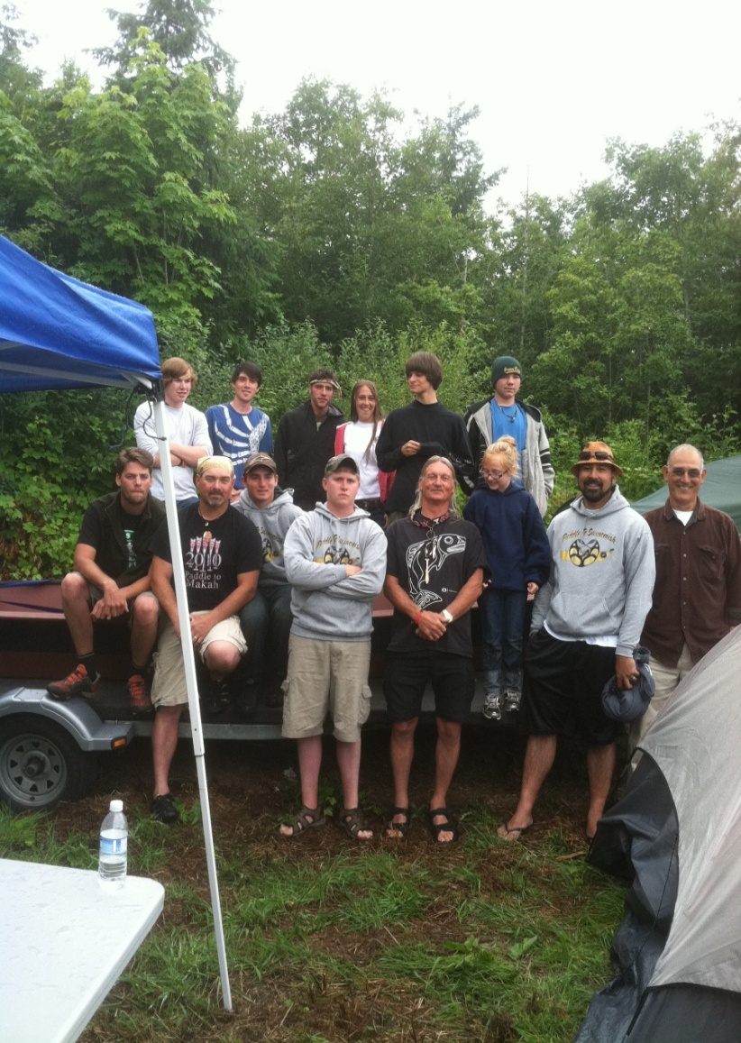
Canoe Pullers
Canoes landing at Swinomish.
Coquille canoe – “Ponto” – on left.
Back Row Left to Right: Jimmy Barton, Mark Petrie, JT, Stefanie Barrett, Jamie Holling, Nathan Short Jr.
Front Row Left to Right: Jason Meacum, Dustin Beauvais, William Hargis, Lyman Meade, Doug Barrett, Makyra Meade, Shirod Younker, Tom Younker
Not pictured: Rocky and Terry Doyle (Support Boat)

Slide 15
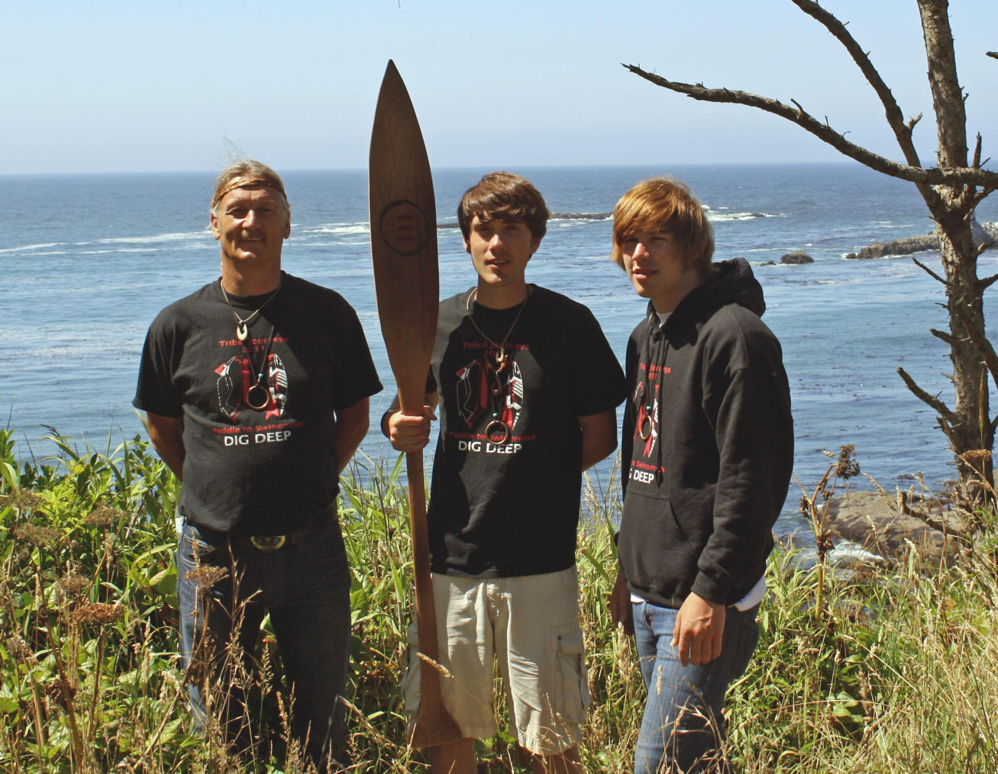
2011 Canoe Journey Participants Doug Barrett, Mark Petrie, and Jimmy Barton The Confederated Tribes of Coos, Lower Umpqua, and Siuslaw Indians

