Slide 1
Using Environmental Strategies to Achieve Population Level Change for Alcohol and Drug Prevention
Rodney A. Wambeam, PhD
HPCDP Grantees and Contractors Annual Meeting
Portland, Oregon
November 7-9, 2017

Slide 2
Purpose of this Training
Participants will:
Learn how population-level approaches differ from individual-level strategies
Understand community-level change and policy-based environmental strategies
Plan for implementation of environmental strategies in their communities
Network with others in Oregon

Slide 3

Activity 1: History of Prevention
1. What did drug use look like when your were in high school?
2. What did prevention look like when you were in high school?

Slide 4
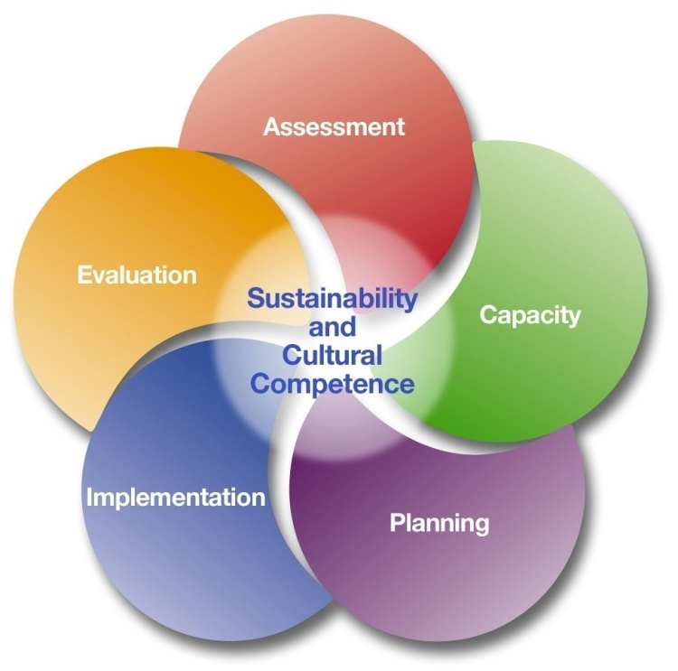
Public Health and the SPF Model

Slide 5
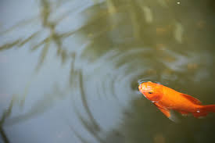
Public Health Approach to Prevention
Agent?
Host?
Environment?
Strategies?

Slide 6
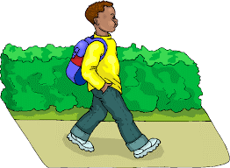
Example
Agent = Flu
Host = 10 year old George
Environment = School
Strategies?

Slide 7
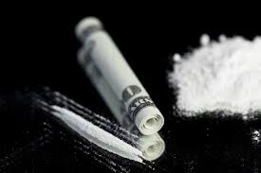
Example
Agent = Cocaine
Host = 21 year old Nicole
Environment = Local Bar
Strategies?

Slide 8
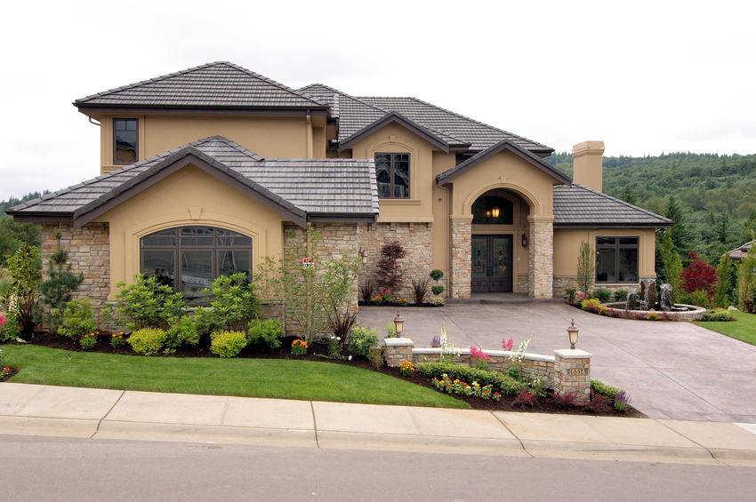
Mind Experiment

Slide 9
If You Ever Only Read Two Articles…
Hawkins, J. D., Catalano, R. F., & Miller, J. Y. (1992). Risk and protective factors for alcohol and other drug problems in adolescence and early adulthood: Implications for substance abuse prevention. Psychological Bulletin, 112, 64-105.
1

Slide 10
If You Ever Only Read Two Articles…
2
Retail Availability
Evidence-Based Policies, Practices, and Programs Addressing Each Broad-Based Risk and Protective Factor
Birckmayer, J.D., Holder, H.D., Yacoubian, GS,
& Friend, K.B., (2004). A general causal
model to guide alcohol, tobacco, and
illicit drug prevention: Assessing the
research evidence. Journal of Drug
Education, 34, 121-153.
Social Availability
Community Norms
Substance-Related Consequences
Substance-Related Consumption
Promotion
Law Enforcement
Price
Individual Factors

Slide 11

Individual & Environmental Strategies
Strategies Targeting Individualized Environments
Strategies Targeting the Shared “Community” Environment
Family
School
Norms
Regulations
INDIVIDUAL YOUTH
ALL YOUTH
Faith Community
Health Care Providers
Availability
National Community Anti-Drug Coalition Institute

Slide 12

Individual-focused Strategies
Prevention efforts aimed at providing information, building skills or supporting individuals or targeted groups of individuals.
  - Afterschool Programs - Parenting Classes
  - School curricula - Tutoring programs
  - Life skills training - Assessment/Referral /Counseling
  - Employment programs - Media Literacy
  - Health Fairs - Awareness Days / Weeks
  - School Assemblies - Youth Councils
  - Media Campaigns - Mentoring Programs

Slide 13
Environmental Strategies
Prevention efforts aimed at changing or influencing community conditions, standards, institutions, structures, systems and policies that shape behaviors.
  - Hours/Days of Sale - Outlet Density Reduction
  - Clean air laws - Open Container Ordinance
  - Happy hour Ordinance/Laws - Festivals – Beer Gardens
  - Advertising Ordinance/Laws - Third Party Transaction – shoulder tap
  - Social host ordinances - Responsible Beverage Server Training
  - Compliance Checks - Fake ID Enforcement
  - Party Patrol - Controlled Party Dispersal

Slide 14
Environmental Strategies
Environmental Prevention Strategies can:
Reach entire populations
Impact the overall environment
Create lasting change in community norms and systems
Produce “quick wins”
Instill commitment toward long-term impact

Slide 15
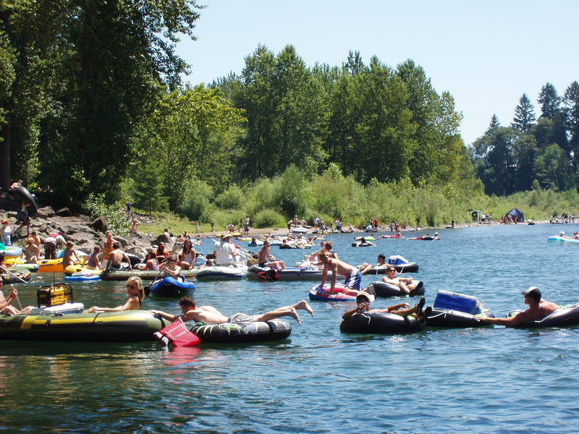
The Clackamas River in Oregon
“For 30 years there was a problem and increasing concern regarding alcohol use and related consequences. The community has now embraced this change, families have returned to the park in record numbers. Last year, the parks were closed 6 times due to over-capacity, and there were no drownings for the first time in 10 years the summer of 2014.”

Slide 16
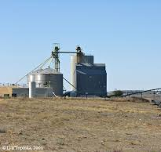
Activity 2: Elevator Speech
1. What are environmental strategies?
2. How does a coalition / prevention organization use environmental strategies do to achieve community-level change?

Slide 17

Selecting Strategies
Criteria for Selecting Strategies
  Fit with local coalition plan
  Capacity to implement
  Readiness to implement
  Evidence of effectiveness
  Part of a comprehensive plan

Slide 18
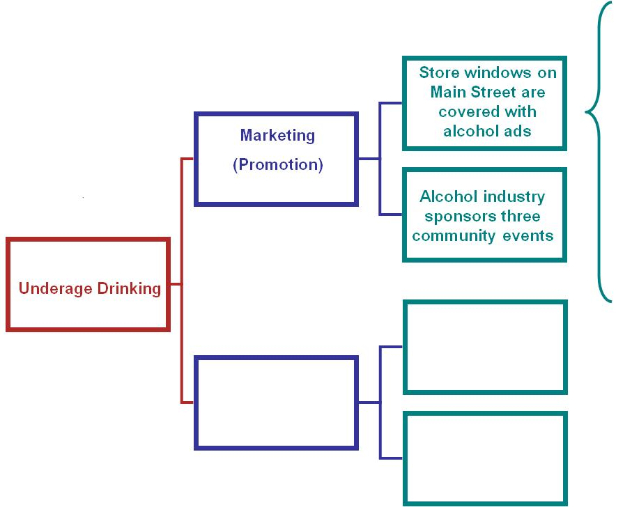
Fit with Local Conditions
Send flyers / meet retailers
Training on sign restrictions
Law Enforcement MOU
Recognize retailers
Alternative Ads
Sign Removal
City Ordinance

Slide 19
Comprehensive Approaches
ONDCP (DFC) / CADCA Strategies
  Provide information
  Build skills
  Provide support
  Change access / barriers
  Change consequences
  Alter the physical design of the environment
  Change policies, rules, practices, procedures

Slide 20
Comprehensive Approaches
Local Condition: Retail stores are selling tobacco products sold to youth despite age restrictions.
Provide Information—Post signs: “We don’t sell to minors…”
Build Skills—Train merchants to check ID’s
Provide Support—Technical assistance to merchants
Access/Barriers—Translate merchant education materials
Incentives/Disincentives—Increase fines/Recognize sellers
Physical Design—Place tobacco products behind the counter
Policies or Regulations— Enforcement policy to increase compliance checks/Laws to increase fines & require RBST

Slide 21

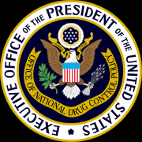




Evidence-based Strategies
Sources of Evidence-Based Strategies

Slide 22
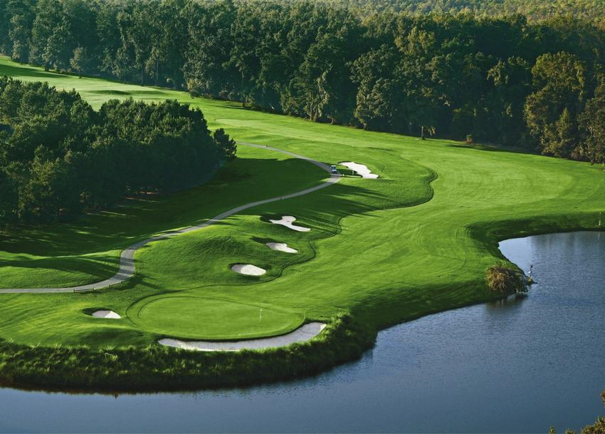

Implementing the Short and Long Game

Slide 23

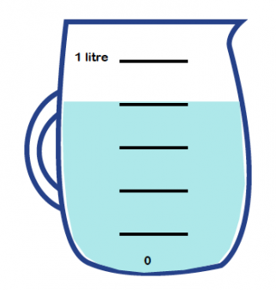
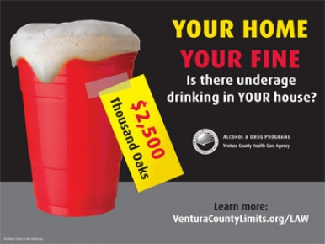
Capacity to Implement
Individual
Strategies
Environmental
Strategies

Slide 24

Readiness to Implement
Individual
Strategies
Environmental
Strategies

Slide 25
Fidelity Assessment Guidelines
Fidelity Rubric for Alcohol Compliance Checks
Preparation
Core Activity | Missing 0 | Weak Fidelity 1 | Moderate Fidelity 2 | Strong Fidelity 3 | Rating Score
Assessment of previous local compliance check efforts and results were used to inform implementation approach. | No assessment made of previous local efforts and results | Some assessment of previous efforts and results, but this was not a key factor in implementation approach | Assessment of previous efforts and results had some influence on implementation approach | The rationale for implementation approach is clearly linked to assessment of previous efforts and results
Law enforcement, judicial and/or regulatory system officials (courts, liquor control officials), and community leaders or groups were involved in planning. | Only the implementing agency (i.e., law enforcement or liquor control) was involved in planning | Implementing agency provided other officials and community leaders with information about plans | Implementing agency included other officials and community leaders in planning meetings | Other officials and community leaders were key contributors, working closely with the implementing agency
Public awareness activities conducted to inform licensees that compliance checks are planned and build stakeholder support (e.g., media announcements, letters or visits to licensees) | No awareness activities conducted | Implemented either media activities or licensee letters/visits | Implemented a media activity and licensee letters/visits | Implemented multiple types of media activities and licensee letters/visits

Slide 26

Activity 3: Is Your Organization Ready?
Choose an Environmental Strategy
What capacity does a provider need to implement it successfully?
What capacity does a coalition need to implement it successfully?

Slide 27

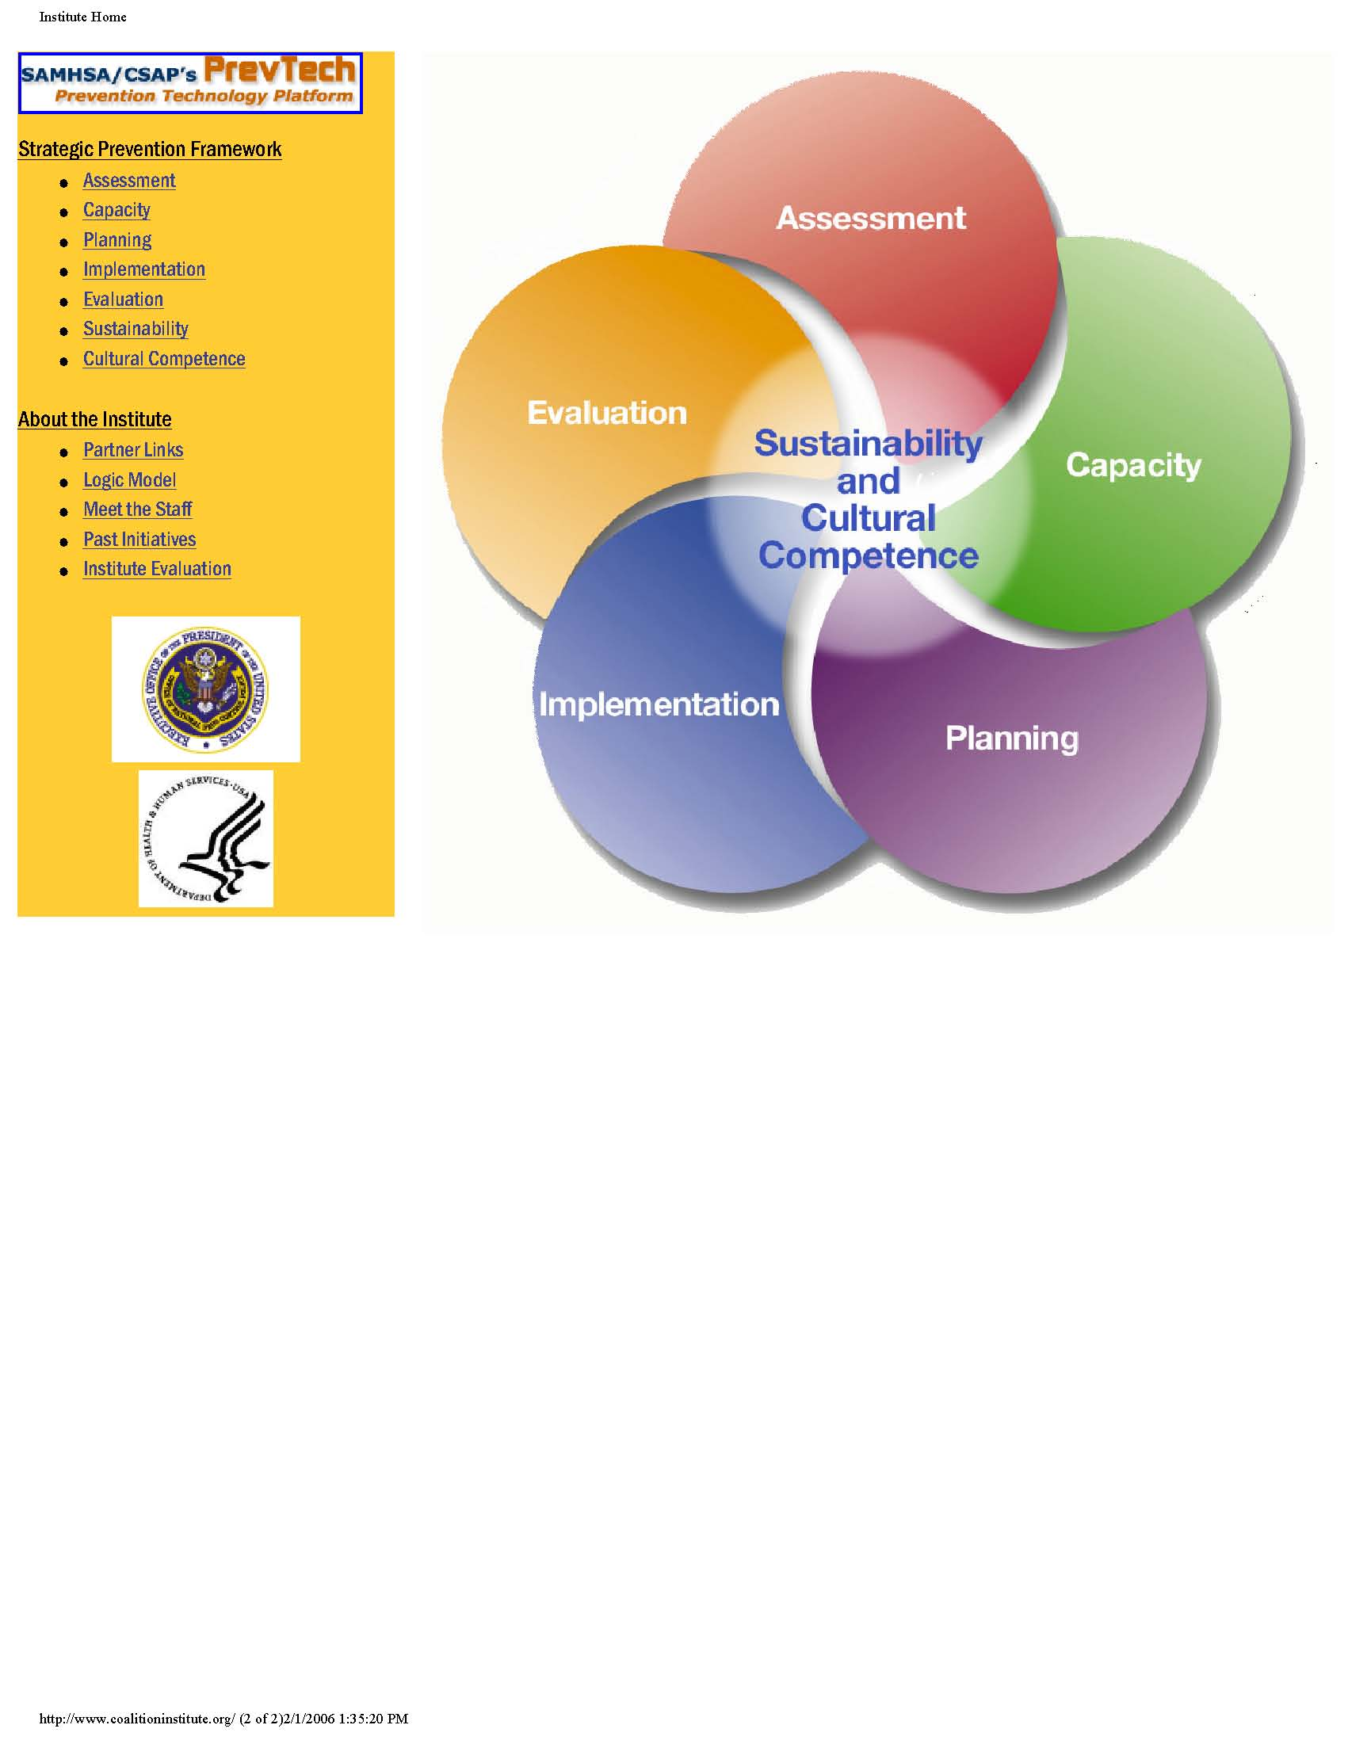
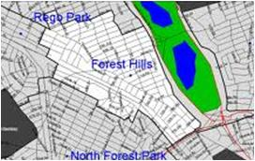
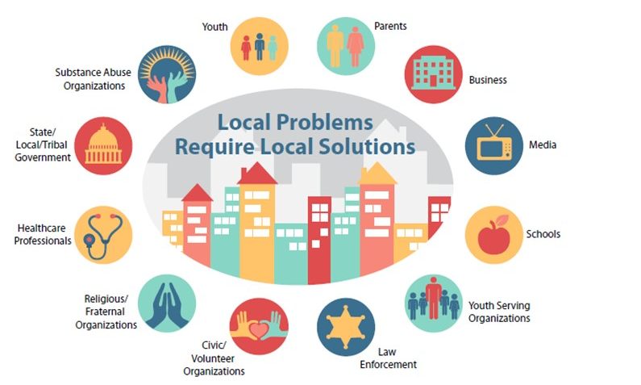
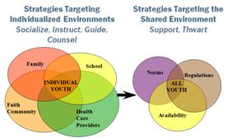
Role of Coalitions and Service Providers in Achieving Community-level Change
Achieve Positive Outcomes
Impact a Defined
Community
Uses an effective planning framework
Engage All Sectors of the Community
Promote Comprehensive Strategies
27

Slide 28
Prevention Providers
Prevention Providers can:
  “Institutionalize” the program – include in organizational policy (little p)
  Participate in policy / advocacy efforts to impact Laws (Big P)
  Ensure the programs are part of comprehensive strategies
  Partner with a coalition

Slide 29
Coalitions
Prevention Coalitions can:
  Engage in a community assessment of the community environment & community resources
  Coordinate in policy / advocacy efforts to impact Laws (Big P)
  Ensure the programs are part of comprehensive strategies
  Partner with prevention providers

Slide 30
Final Discussion
What are your next steps as providers to achieve population level change?
What are your coalition’s next steps to achieve population level change?

Slide 31
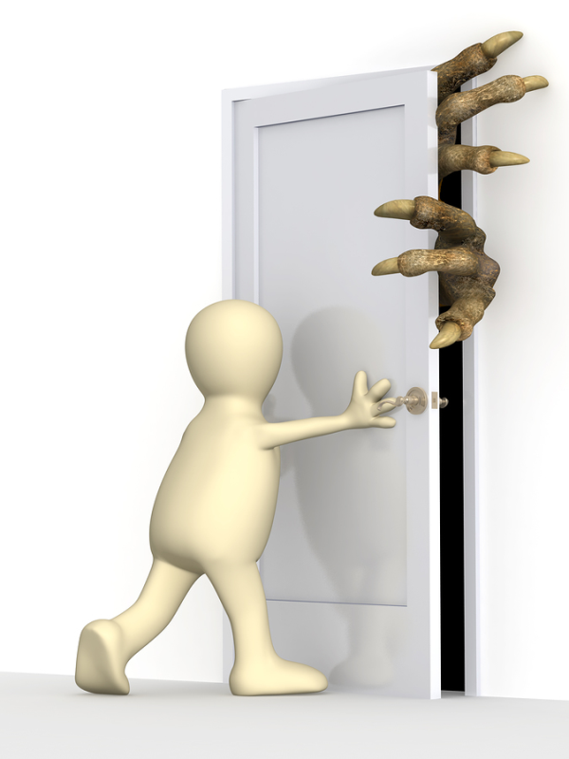
Final Thoughts and Questions

Slide 32
Thank You!
Rodney A. Wambeam, PhD
Senior Research Scientist
307-760-8928
rodney@uwyo.edu

