Slide 1
Family Friendly Retailer Campaign
Emily Buff Bear
Lane County Public Health – Prevention Section
November 8th, 2017

Slide 2
Building Social Will
Healthy Directions Coalition launched the Family Friendly Retail Campaign in order to build social will to address underage drinking in the community of Florence, Oregon

Slide 3
Defining Family Friendly
Healthy Directions Coalition defines “family friendly” as:
Retailers that provide food and a fun atmosphere without focusing on adult activities and alcohol.

Slide 4
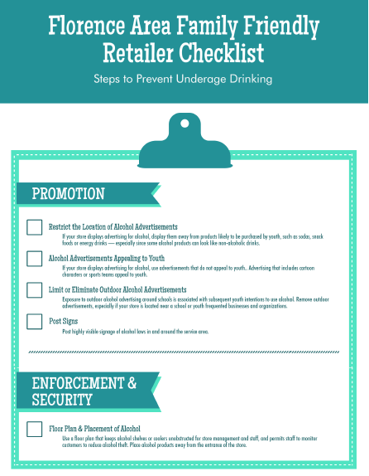
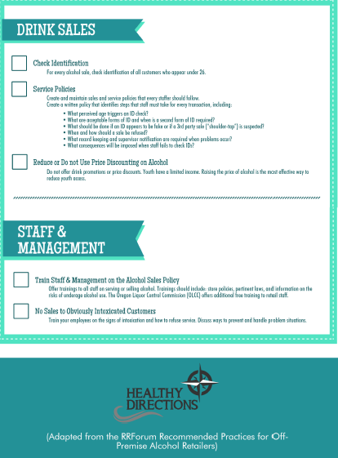
Developing Criteria

Slide 5
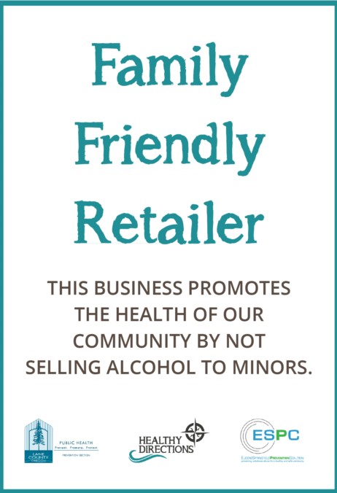
Recognition

Slide 7
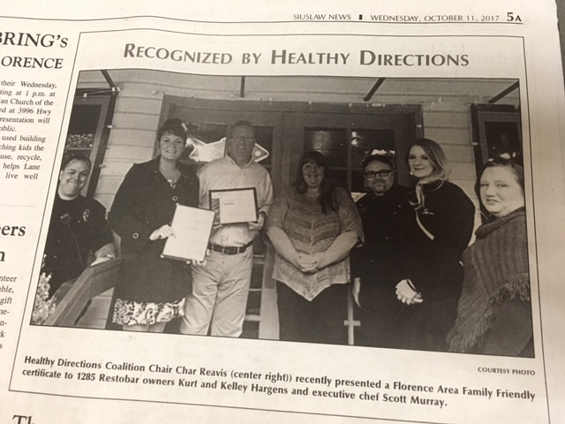

Slide 8
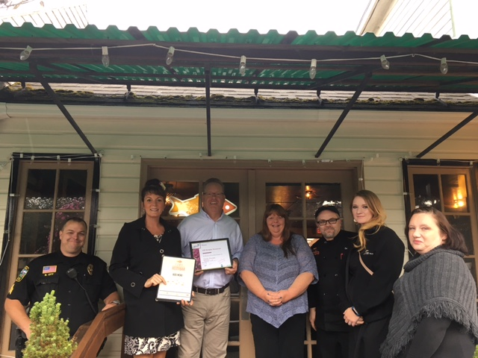
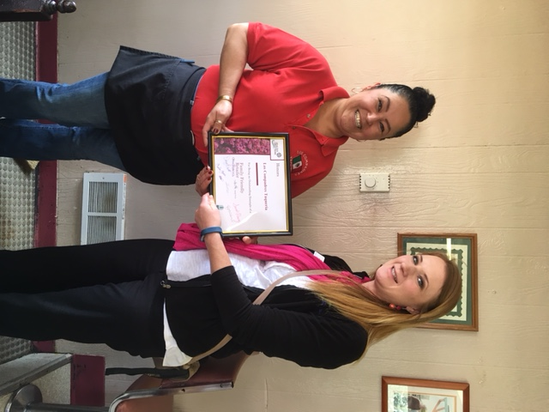
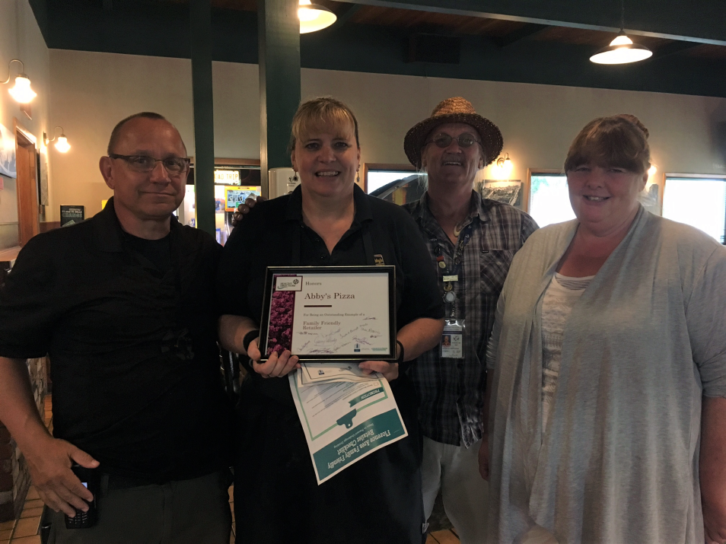

Slide 9
Outcomes
Coalition recognition and exposure
Positive relationships with retailers
Retail Education
Segway to Responsible Beverage Training

