Slide 1
Indoor Clean Air Act 101
Ilana Kurtzig
Jennifer Chandler
November 7, 2017

Slide 2
Outline
Indoor Clean Air Act (ICAA) Overview
ICAA Data
WEMS Overview
Mock Complaint Activity

Slide 3
History of the ICAA…
1998-2001 – Twelve Oregon communities passed smokefree workplace laws.
2001 – Passage of first private employer smokefree workplace law, excludes bars and taverns, bar areas of restaurants, bingo halls, bowling centers.
Notes:
Corvallis, Benton County, Central Point, Baker City, Multnomah County, Eugene, Philomath, Grants Pass, St. Helens, Tillamook County, Lake Oswego, Tualatin

Slide 4
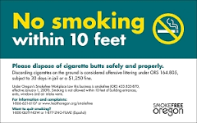
History of the ICAA…
2007 – Oregon passed a comprehensive smokefree workplace law called the Indoor Clear Air Act.
Eliminated most exemptions
Prohibited smoking within 10 feet of:
entrances,
exits,
windows that open, and
ventilation intakes for workplaces and public places.
PREEMPTION LANGUAGE REMOVED
Notes:
In 2007, the Oregon Legislature expanded the Oregon Smokefree Workplace Law (also known as the ICAA), by eliminating prior exemptions for bars and taverns, bar areas of restaurants, bingo halls and bowling centers. It also prohibited smoking within 10 feet of entrances, exits, windows that open, and ventilation intakes for workplaces and public places.
Exemptions remained for qualifying smoke shops, cigar bars and up to 25% of hotel or motel rooms.
The 2007 law also removed preemption for smokefree ordinances related to public and private workplaces. Thus, some cities and counties in Oregon also have enacted local smokefree workplace laws with standards and requirements that are stricter than in state law (e.g. Benton County does not exempt smoke shops).

Slide 5
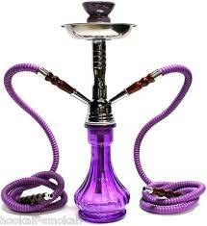
History of the ICAA…
2011 – HB 2726 passed, adding restrictions to smoke shops and created a new category of smoke shop.
Notes:
In 2011, the Oregon Legislature amended the ICAA to add restrictions for existing exempt smoke shops, and created a new category of smoke shop in law (smoke shop A). This went into effect June 30, 2011.

Slide 6
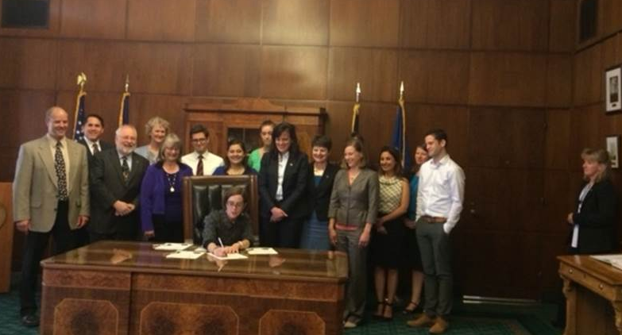
2015 Legislative Session House Bill 2546 and the ICAA
Notes:
During the 2015 legislative session, House Bill 2546 was passed and was signed by Governor Brown into law.
This law is the inclusion of electronic cigarettes in Oregon’s Indoor Clean Air Act, which means they cannot be used inside public places and places of employment or within 10 feet of entrances, exits, windows, and ventilation systems of businesses.
This was a huge effort by many people. Every person in this picture, and many more, contributed to the passage of this successful policy. Oregon’s law is one of the strongest.

Slide 7
Defined “Inhalant delivery systems”
IDS are devices that can be used to deliver nicotine, cannabinoids and other substances, in the form of a vapor or aerosol.
These include e-cigarettes, vape pens, e-hookah and other devices.
These are not considered tobacco products under the new law.
Notes:
Defined “inhalant delivery systems”
IDS are devices that can be used to deliver nicotine, cannabinoids and other substances, in the form of a vapor or aerosol.
These include e-cigarettes, vape pens, e-hookah and other devices. These are not considered tobacco products under the law.

Slide 8
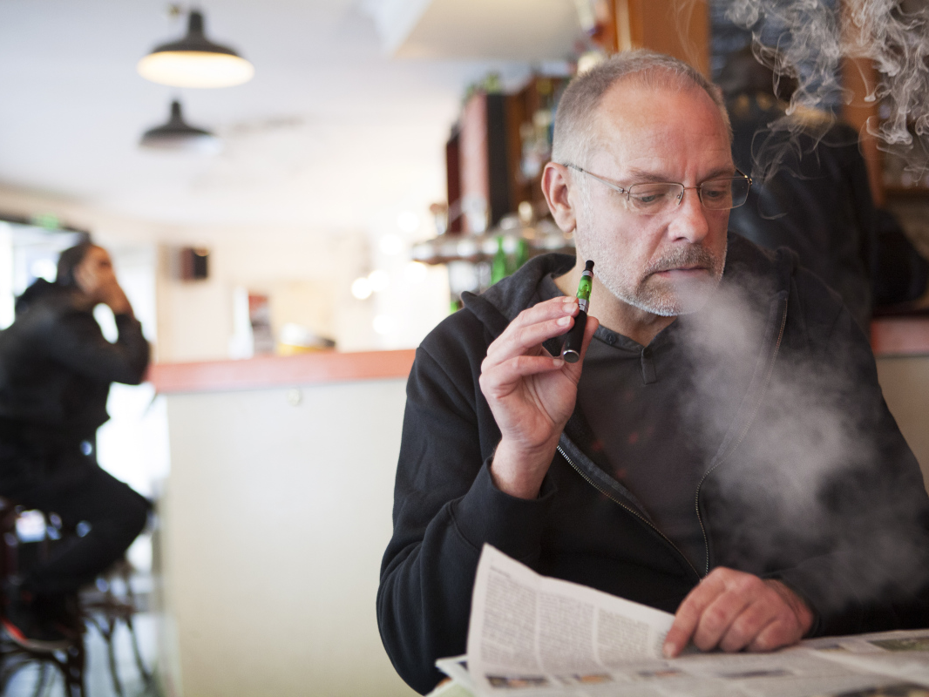
Prohibits use in indoor public places
Notes:
Prohibits the use of e-cigarettes and other inhalant delivery systems in workplaces, restaurants, bars and other indoor public places.

Slide 9
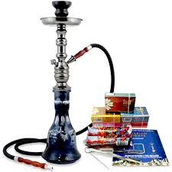
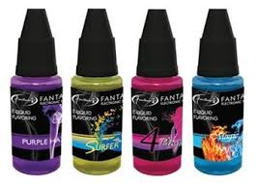
Prohibits use of Inhalants
Delivered into a person’s respiratory system:
Nicotine
Cannabinoid
Other Substances
Herbal hookah
Notes:
For reference:
“Inhalant” means nicotine, a cannabinoid or any other substance that:
(a) Is in a form that allows the nicotine, cannabinoid or substance to be delivered into a
person’s respiratory system;
(b) Is inhaled for the purpose of delivering the nicotine, cannabinoid or other substance
into a person’s respiratory system; and
(c)(A) Is not approved by the United States
Food and Drug Administration for a
therapeutic purpose; or
(B) If approved by the United States Food and Drug Administration for a therapeutic
purpose, is not marketed and sold solely for that purpose.

Slide 10
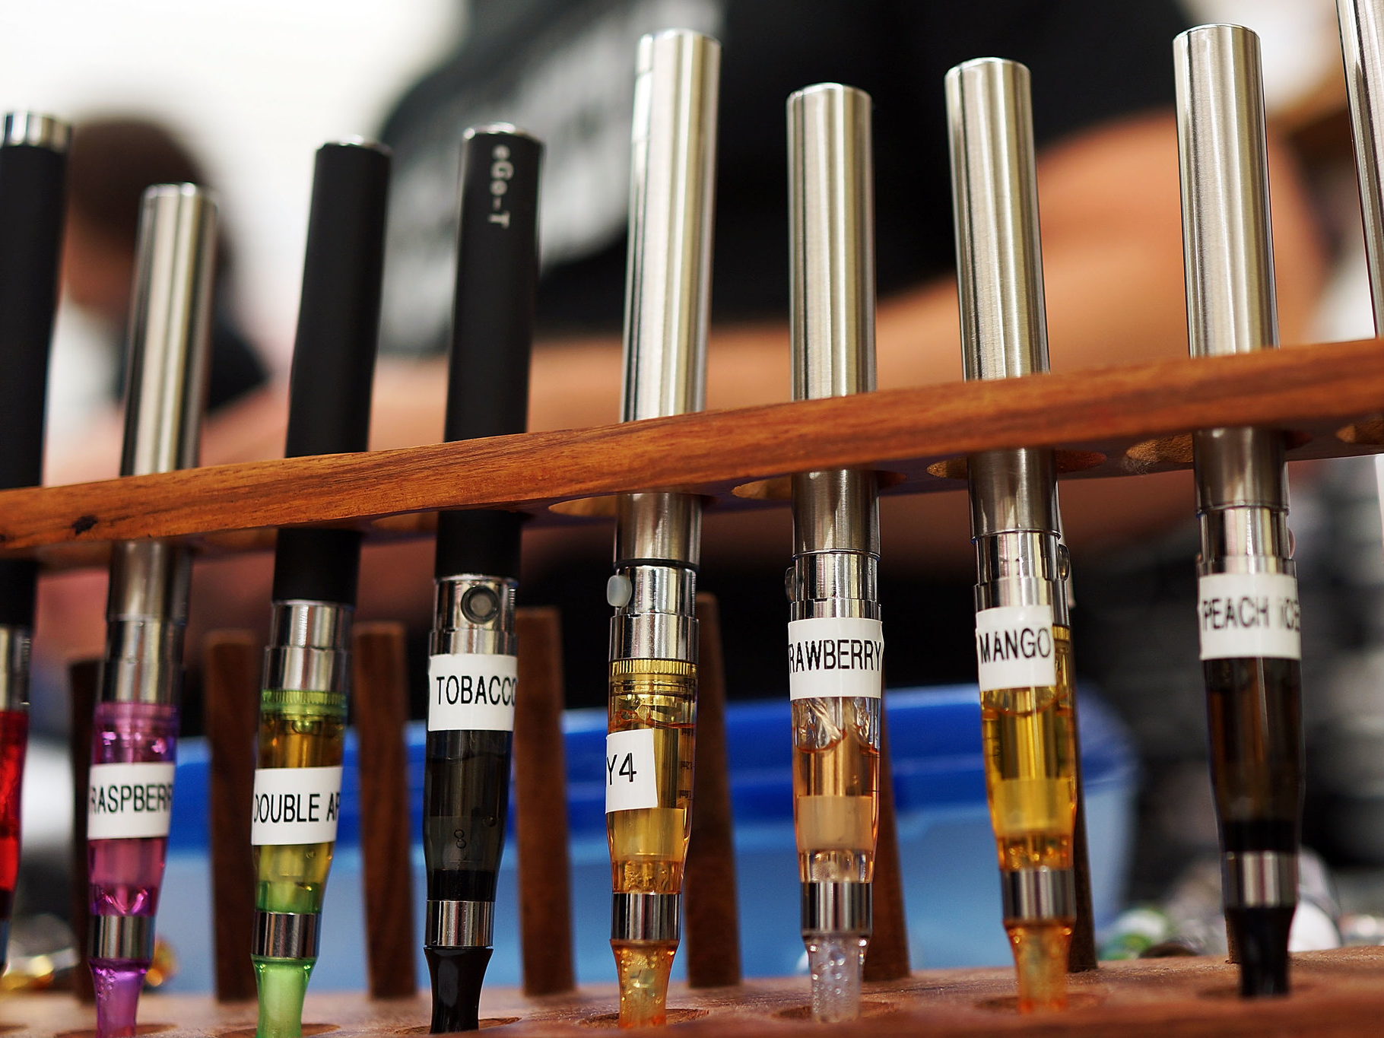
No exemptions for electronic cigarette retail outlets
Notes:
There are no exemptions for electronic cigarette retail outlets, smoke shops, bars or other venues. This means sampling of e-liquids is not allowed.

Slide 11
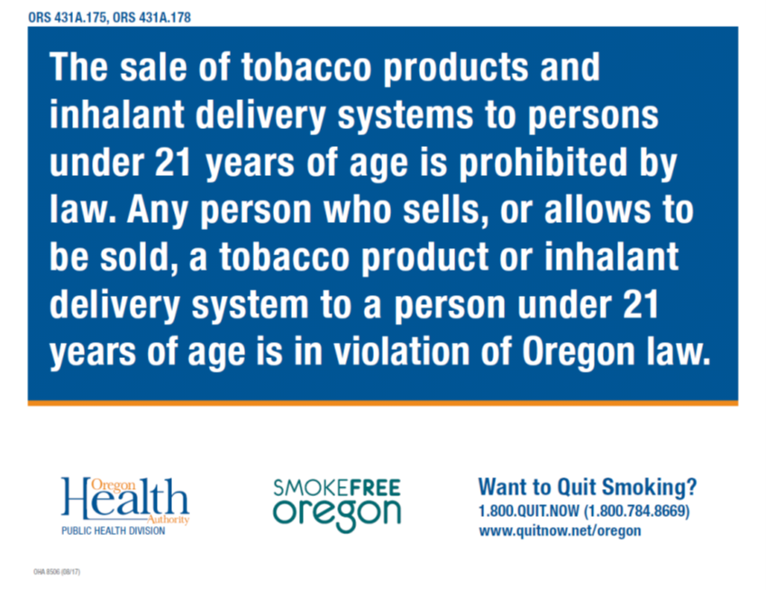
In 2017, SB 754 passed
Signed into law on August 9, 2017.
Raised the minimum legal sales age of tobacco products and inhalant delivery systems from 18 to 21 years old.
Amended the definition of tobacco products to include devices that can deliver tobacco to the person using the device.
Created a tiered violation schedule for sales to those under the age of 21.

Slide 12
How are violations received?
The ICAA is a complaint-driven law.
Employees and the public may report violations of the law by filing a complaint with OHA either online or by phone.
Notes:
Don’t go out looking for violations

Slide 13
Who enforces the ICAA?
Oregon Health Authority has a delegation agreement with each local public health authority in Oregon to educate on the law and compliance and initial inspections.
When a violation reaches the citation stage, it is elevated to the state for enforcement.
Notes:
Delegation Agreement

Slide 14
Roles for Enforcement
LPHA
First point-of-contact
Provide technical assistance and education about the law
OHA
Enforcement
Issue Citation

Slide 15
Data related to ICAA support
Public opinion
Support for the ICAA
Exposure to secondhand smoke and vape
Perceived harm from smoke and vape
Need for protection from smoke and vape
Support for tobacco-free locations
Restaurant and on-premises alcohol establishments - numbers of businesses

Slide 16
Nearly 9 out of 10 Oregon adults support the ICAA¹
Includes cigarette smoke, marijuana smoke and e-cigarette vapor
Support for expanding ICAA²
64% Increase distance from doors and windows more than 10 feet
Support includes both strongly and somewhat supportive responses
Sources, (1) Online Panel Survey Sp2017, (2) Telephone Opinion Poll 2016
Notes:
86% Strongly or somewhat support the ICAA

Slide 17
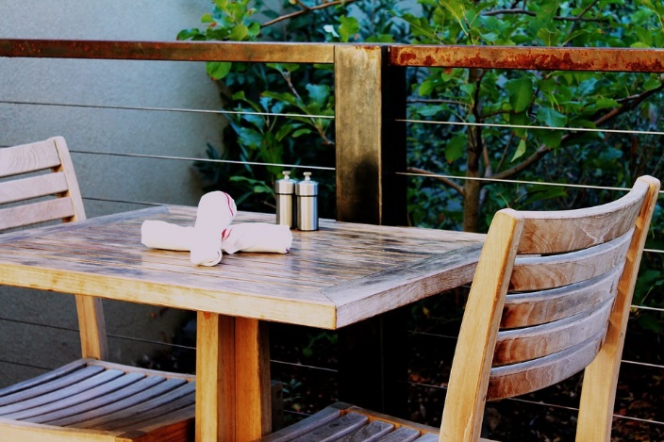
41% Exposed to secondhand smoke outdoors at a restaurant or bar*
*Past 30 days, among those that have been to such a place
Source, Online Panel Survey, 2016

Slide 18
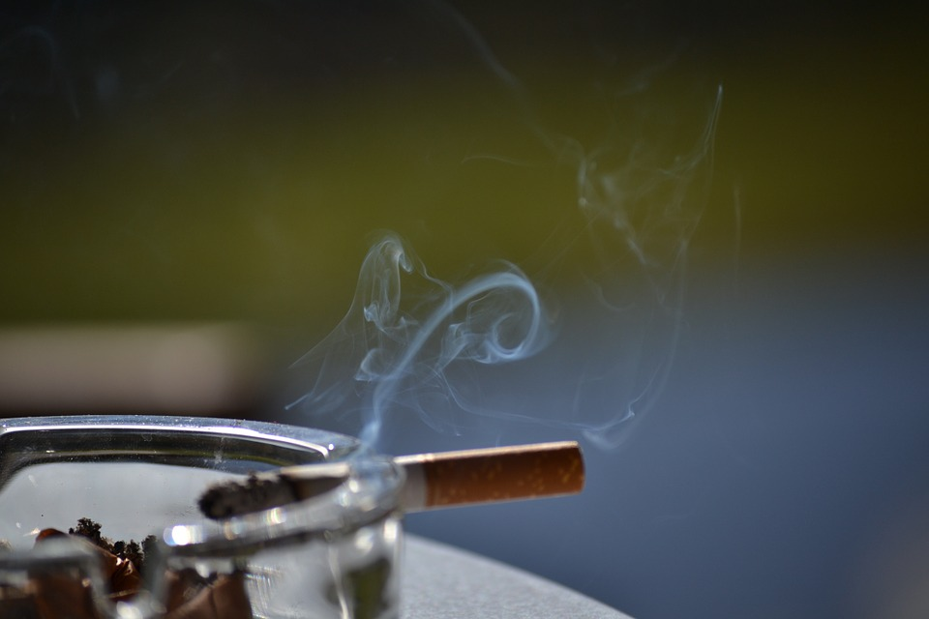
Believe secondhand exposure is harmful, outdoors
83% Smoke
59% Vape
58% Marijuana smoke or vape
Source: Online Panel Survey, Fall or spring 2016

Slide 19
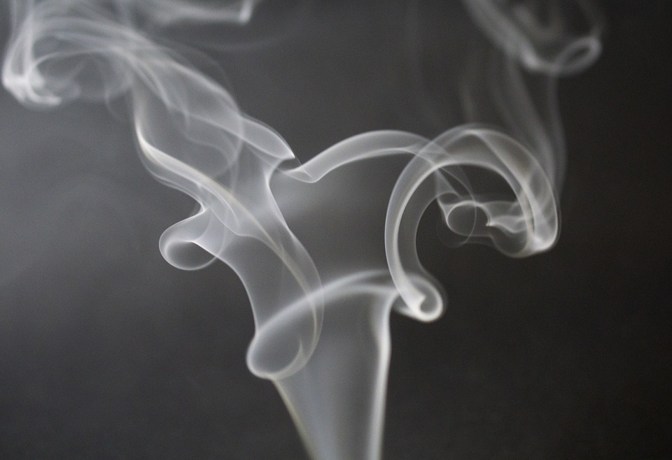
Believe people should be protected from breathing secondhand:
91% Smoke
81% Vapor
79% Marijuana smoke or vapor
Source: Online Panel Survey, Spring 2017
Notes:
These questions were not specified indoor/outdoor. On other panel surveys in 2016 we asked specifically about outdoor exposure. SHS = 75%, vapor= 72%, mj = 74%.

Slide 20
Support for making locations tobacco free
69% Outdoor seating areas at restaurants
64% Hotels and motels (entirely smoke, vape- free)
60% Casinos
Sources: Telephone Opinion Poll, 2016; Online Panel Survey, spring 2017
Notes:
Support for TB-free bars is less (50%) when separated from restaurants.

Slide 21
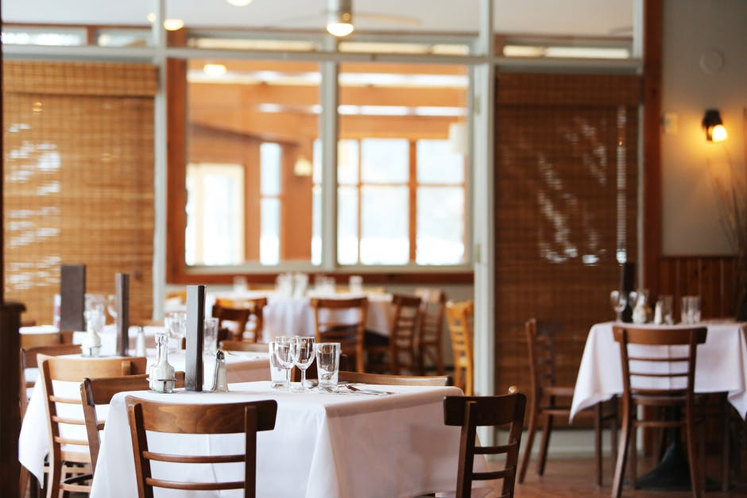
Numbers of food and drinking establishments in Oregon

Slide 22
Restaurants and other food establishments
Source: Environmental Public Health, Licensed Facility Statistics, annual reports
Notes:
Source: OHA Environmental Public Health, Licensed Facility Statistics reports (http://www.oregon.gov/oha/PH/HEALTHYENVIRONMENTS/FOODSAFETY/Pages/stats.aspx)

Slide 23
On-premises liquor sales*
*Bars, restaurants with bars, brew pubs
Source: Oregon Liquor Control Commission, unpublished data
Notes:
Source: Oregon Liquor Control Commission, unpublished data
Full definition of F-coms (commercial full on-premises sales). “May sell and serve distilled liquor, malt beverages, wine, and cider for consumption on the licensed premises. May sell malt beverages, wine, and cider to individuals in a securely covered container (“growler”) for consumption off the licensed premises (the container may not hold more than 2 gallons). Eligible to apply to get pre-approved to cater some events off of the licensed premises (events that are small, usually closed to the general public, and where food service is the primary activity)”

Slide 24
Brew pubs
Source: Oregon Liquor Control Commission, unpublished data

Slide 25
ICAA complaints received
Source: Workplace Exposure Monitoring System (WEMS)
Notes:
Total complaints – actionable and non-actionable. ~20% of complaints are generally deemed non-actionable.
Most common violations are ten-foot rule (~60%) and indoor smoking (20%)
Source: Workplace exposure monitoring system (WEMS)

Slide 26
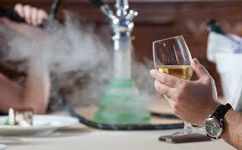
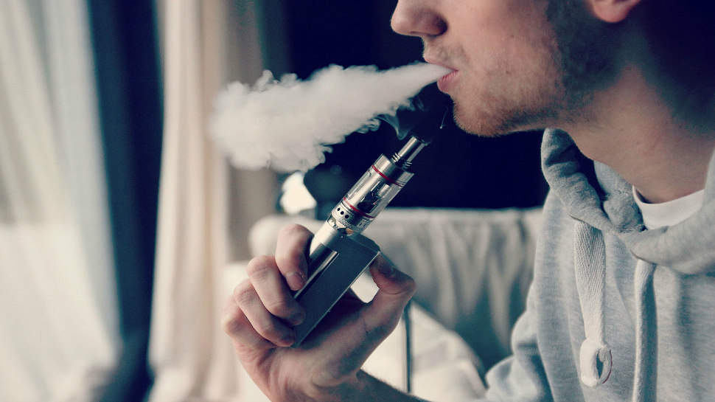
Threats to the ICAA
Expansion of Current Smoke Shop Exemptions
https://www.timeout.com/newyork/bars/best-hookah-bars-in-nyc
Vaping Indoors
https://thevape.guide/
Notes:
During 2015 Leg session when 2546 passed, discussion around creating an exemption for smoke shops to allow alcohol indoors.
Also, during 2015, discussion to allow vaping indoors

Slide 27
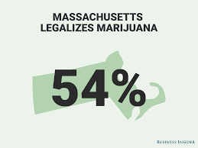
Threats to the ICAA
Social Consumption of Marijuana
Social Justice
Where to smoke?
Economics/Tourism
What about small businesses?
Portland’s tourism industry
Other states/cities
https://cannabiswire.com/apartment
Notes:
Social justice:
Where can someone use marijuana when it is prohibited by landlords, HOA, public housing authority
Will this lower the chance that people will consume elsewhere if there is a place to consume legally?
Businesses:
People come to Oregon for marijuana tourism, but where can they smoke?
Hotels can give 25% of their rooms to smoking
Precedent:
Denver’s initiative 300 has created a space for social use within the city. It has not yet been implemented so it is not clear how it will work, and the city has been threatened with a lawsuit already as proponents feel there are too many restrictions…but this model could be used to make arguments for precedent.
State capacity to work on legislative issues vs. industry advocates; money, resources. Local communities are part of a larger movement. Industry is taking first steps and will move forward.
How do you see yourselves in the statewide context? How do you engage in your community and how do you connect to the state? Importance of local policies for protecting the ICAA. These things typically start locally.

Slide 28
Workplace Exposure Monitoring System
Notes:
- All coordinators should be signed up to receive complaint notifications through WEMS. If you don’t think you are signed-up, please let your liaison know ASAP
Once you log-in, you should see this page

Slide 29
Notes:
Try all variations of the business name with as little information as possible:
- Bill’s and Bills without “tavern and grill”, for example

Slide 30
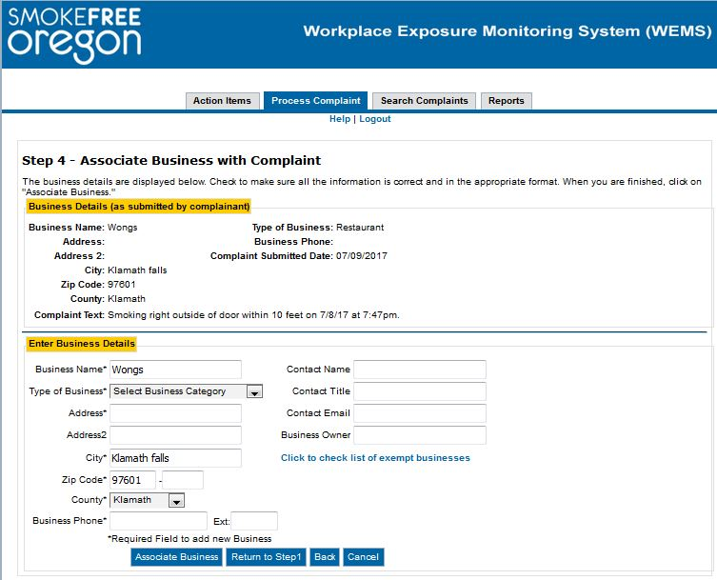
Notes:
Go on Google, drive by, etc.
Fill-in as much information as possible, as accurately as you can
Must do this step, even if the complaint is not valid, even if its for something like a dirty hotel or restaurant
- Mark invalid

Slide 31
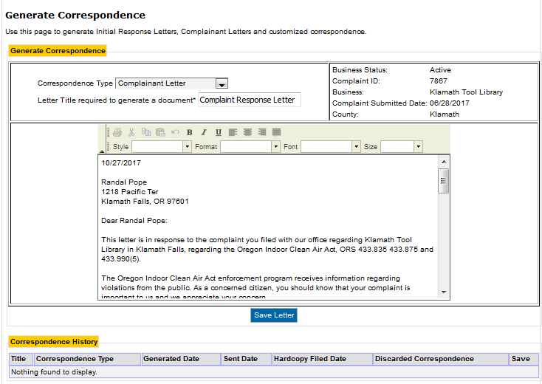
Notes:
Complainant response letters due go to the person who submitted the claim
Initial Response letters due go to the business
When you click on the complaint ID from this screen, it takes you directly to the form letter

Slide 32
Notes:
Good time to mention that you need to be in EI or Firefox
Edit, copy, and paste on to letter head
Complete dates in correspondence history
You are done with this complaint

Slide 33
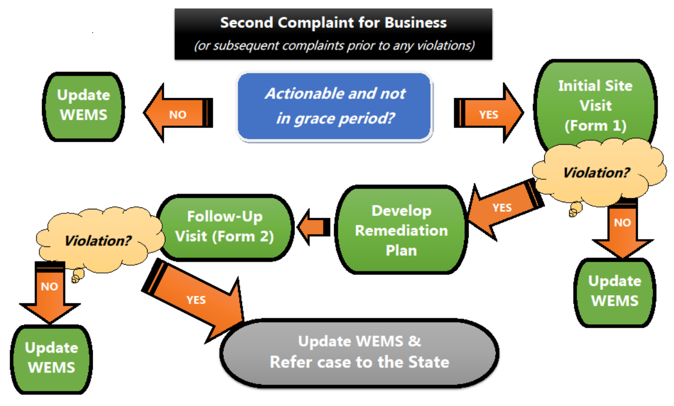

Slide 34
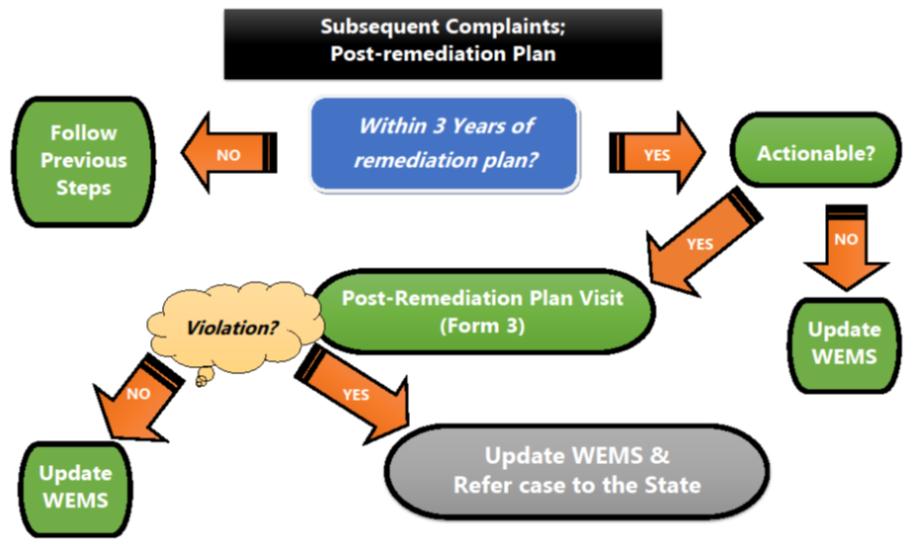
Notes:
If complaint is received more than three years after entering into a remediation plan, and no violations were observed in that three-year period, follow the process in Figure 2.

Slide 35
Scenario #1
William Miller submitted the following complaint:
Russell’s Bar & Grill
5678 Penny Lane
Stillwater, OR
This establishment has a smoking area directly in front of the entrance, within 10 ft. In order to enter or exit you have to walk through a haze of smoke. The smoke travels into the dining area. Our server told us that they had complained to management but nothing had changed.
Is this a valid complaint?
What is your first step?
Russell’s Bar & Grill cannot be found in WEMS
What do you do next?
Notes:
Yes
Associate the business
Create business
Send IRL and complainant letter (if applicable)
If had to do a site visit, tape measure could be helpful.
In small groups discuss the following:

Slide 36
Scenario #2
Inigo Montoya submitted the following complaint:
Pirate Roberts Vape Shop
Buttercup Drive
Humperdinck, OR
They hold massive get together "vape competitions" in their shop at night, literally flooding the building and surrounding buildings with vapors. When we come in the next morning, the smell is almost choking.
Is this a valid complaint?
What is your first step?
This business is associated with a valid complaint dated 6 months ago.
What do you do next?
Notes:
Yes
Associate the business
Conduct a site visit
In small groups discuss the following:

Slide 37
Scenario #2, continued
During the site visit, no one was observed vaping or smoking inside. The back entrance did not have a no smoking or vaping sign. The store employee verbally commented on their lounge area being a place that people vape. He explained that he had been told by the Police department that he needed to smoke inside because the neighboring store is a kids clothing store. The owner was extremely unhappy with the complaint and stated that the complaint is not valid because they are not a "public place"; they only allow members access the facility.
What tools or resources would help address the business owners concerns?
What are the next steps before leaving the store?
What are the next steps moving forward?
Notes:
Knowledge of who is subject to the ICAA: public places, places with an employee (this includes hired entertainment or other), certified smoke shops (where they are, how they are certified) vs. uncertified business. There are only 23 exempt smoke shops in the state and 10 exempt cigar bars. None allows the smoking of marijuana and none allows vaping inside; they are for consuming tobacco products only.
Signs are required by law at every entrance and exit.
Before leaving the store: enter into a remediation plan for the signs. No other violations were observed.
Some counties provide signs to businesses and hand out information about the ICAA, Quit Line and other relevant resources.
Update WEMS, follow up site visits after 15 days.
Also: take photos, keep notes.

Slide 38
Scenario #3
Christopher Robin submitted the following complaint:
Kanga Kitchen Supply
4321 Honey Way
Hundred Acre Wood, OR
The building at this address contains multiple businesses. None of them have the proper no smoking signage posted. Employees of most of the businesses at this address ignore the no smoking laws and are frequently seen smoking in areas not allowed under the law.
Is this a valid complaint?
What is your first step?
This business is associated with a valid complaint dated 1 year ago.
What do you do next?
Notes:
Yes.
Associate business
Site visit
In small groups discuss the following:

Slide 39
Scenario #3, continued
At the site visit, the owner of Kanga Kitchen Supply reports that none of their employees smoke and they ask employees of other business not to smoke near their entrance during store business hours. However, Kanga Kitchen Supply is open until 3 and some of the other business stay open until later in the evening. The owner of Kanga Kitchen Supply believes these violations are occurring outside of their business hours.
Who is the responsible party?
What technical assistance might you provide to the store owner? The property owner?
Notes:
Businesses are responsible for ensuring they do not violate the ICAA. Store owner is responsible. Recommend store owner talk to the building owner about the issue and options: e.g. drawing 10 ft. lines, extending 10 ft. area, going totally smoke-free; what is in the lease for the building tenants.

Slide 40
Resources
ICAA Enforcement Toolkit: http://www.oregon.gov/oha/PH/DISEASESCONDITIONS/CHRONICDISEASE/HPCDPCONNECTION/TOBACCO/Pages/ICAAToolkit.aspx

