Slide 1
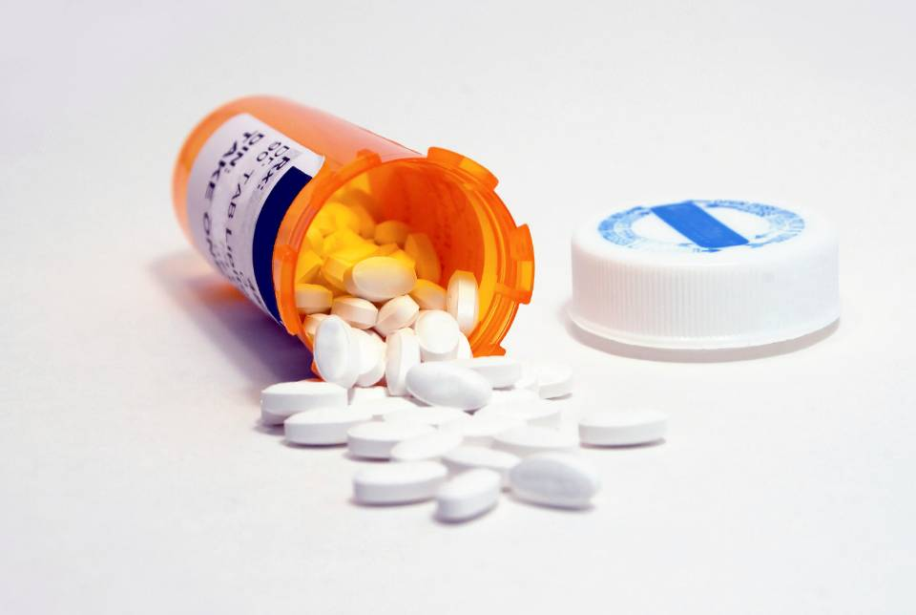
Opioid Overdose in Oregon:
A Public Health Perspective
Mary Borges
PDO Coordinator
Oregon Public Health Division
2017 Grantee & Contractors Annual Meeting
November 8, 2017

Slide 2
Objectives
Objectives
To understand:
The Oregon Opioid Initiative regional approach and collaboration across the state.
How to access data resources and create materials using the Oregon Data Dashboard.
Examples of PDO and AD PEP coordination in Lane County.

Slide 3
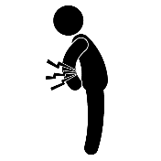

Oregon and prescription opioids
Prescription Opioids in Oregon:
Scope of the Problem
Pain Treatment with Prescription Opioids
~20% of Oregonians have chronic pain (760,000)
In 2016, almost 1 in 4 Oregonians received a prescription for opioid medications (>900,000)
Non-Medical Use of Prescription Opioids
Tied for 2nd in the nation in 2012-2013; 1st in 2010-2011.¹
212,000 Oregonians (5% of population); 9% of 18-25 year olds

Slide 4


Prescription Opioids in Oregon:
Scope of the Problem
Hospitalizations
  330 hospitalizations for overdose;
  4300 for opioid use disorder
  $8 million in hospitalization charges in 2014
Death Rate
  180 deaths (4.5 per 100,000 residents) for pharmaceutical opioid overdose in 2015
Source: National Survey on Drug Use Health (NSDUH)¹

Slide 5
The Oregon Opioid Initiative
Aim: Reduce deaths, non-fatal overdoses, and harms to Oregonians from prescription opioids, while expanding use of non-opioid pain care
1
2
3
Reduce risks to patients by making pain treatment safer and more effective, emphasizing non-opioid and non-pharmacological treatment
Reduce harms for people taking opioids and support recovery FROM substance use disorders by making naloxone rescue and medication-assisted treatment (MAT) more accessible and affordable
Protect the community by REDUCING THE NUMBER OF PILLS IN CIRCULATION through implementation of safe prescribing, storage, and disposal practices
4
OPTIMIZE OUTCOMES BY MAKING STATE AND LOCAL DATA AVAILABLE for informing, monitoring, and evaluating, policies and targeted interventions

Slide 6
OHA opioid grant projects
CDC PDO Prevention for States
2015 - 2019
Fund high-burden regions to coordinate prevention infrastructure
Develop toolkit and training for implementation of opioid prescribing guidelines
SAMHSA State Targeted Response
2017 - 2019
Expands and enhances CDC PDO grant
Department of Corrections: peer recovery support, individual and family support, housing for community transitions
Tribal needs assessment & Opioid Summit
Regional opioid/pain summits
Enhance OPC pain training module
Pain Management Improvement Team providing TA and trainings to health systems and clinics
Tele-Pain for rural providers
OHSU Project ECHO for rural providers
Increase MAT and OTPs in rural/frontier counties
Public awareness campaign

Slide 7
Funded high-burden regions
Based on prescribing data, opioid overdose outcome rates, and population
8 Regions, 23 Counties, 10 PDO Coordinators
4. North Coast
1. Multnomah, Washington, Clackamas
8. Eastern Oregon
7. Marion, Yamhill, Polk
5. Lincoln, Linn, Benton
6. Central Oregon
2. Lane, Douglas
3. Coos, Curry
Jackson, Josephine

Slide 8
Regional PDO Coordination
Build or strengthen a community network that contributes to reducing problematic prescribing, improving coordination of care, increasing use of non-opioid treatment for chronic non-cancer pain and evolve an more interconnected community level network of services.
Convene or strengthen an Interdisciplinary Action Team (IAT) to help adopt and promote prevention and community interventions.
Convene or strengthen a Pain Guidance Group (PGG) to adopt and promote PDMP, and opioid prescribing guidelines.
Promote prescriber enrollment and adoption of the PDMP.
Promote health system and public policies through data driver decision making.

Slide 9
High Burden Regions
Central Oregon – Deschutes, Crook, Jefferson
Eastern Oregon – Baker, Union, Malheur, Umatilla,
Lane, Douglas
Lincoln, Linn, Benton
Mid-Willamette Valley - Marion, Yamhill, Polk
North Coast – Clatsop, Tillamook, Columbia
South Coast – Coos, Curry
Tri Counties - Multnomah, Washington, Clackamas
The lead organizations and fiscal agents for this work is through the Local Public Health Authorities in each of the bolded counties. In the South Coast region the lead and fiscal agent is WOAH, Western Oregon Advanced Health, LLC.

Slide 10
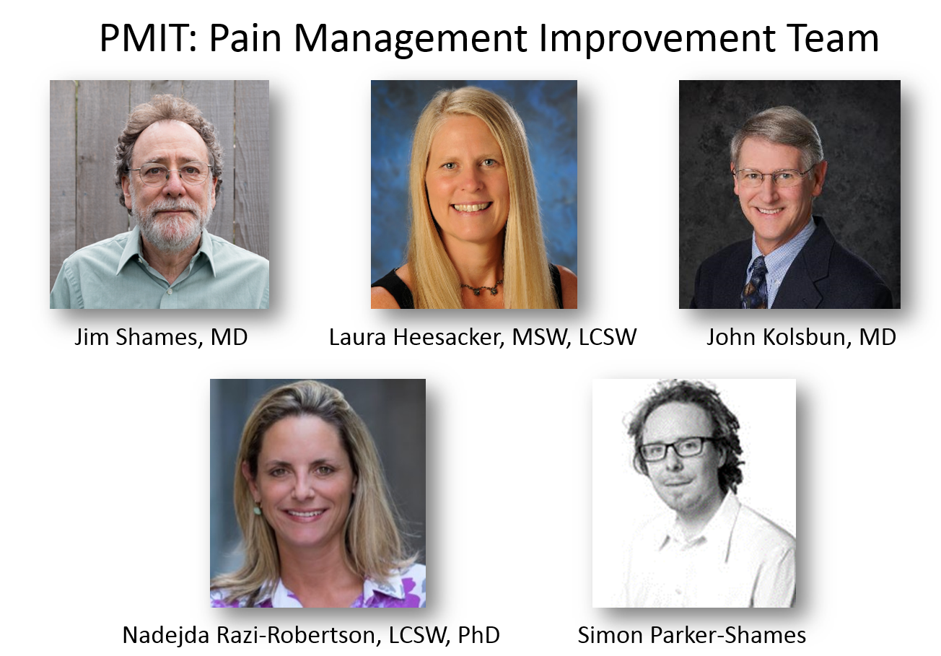
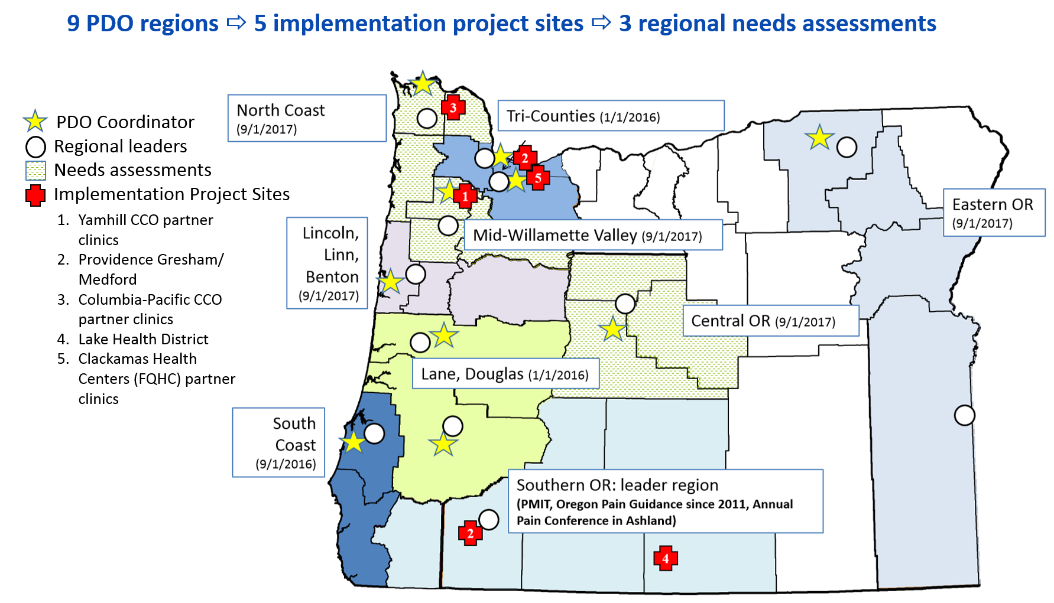
PDO implementation: who and what is PMIT?
Oregon’s Pain Management Improvement Team (PMIT) is a multi-disciplinary team from Oregon Pain Guidance in Jackson County, Oregon’s leader in mobilizing a community response for prevention of prescription drug overdose (PDO).
PMIT is providing technical assistance to 5 health care organizations to address the opioid epidemic with a team-based approach to pain and/or opioid management.
Using an evidence-based framework (The Six Building Blocks of Opioid Prescribing), PMIT helps organizations assess their current state of pain treatment and opioid prescribing and to develop a metrics-based work plan.
PMIT provides training and monitoring on best clinical practices, quality improvement metrics, electronic health record (EHR) integration, work flow optimization, forming regional communities of practice, and other strategies.
5 health care organizations are participating in the PDO implementation project through 8/31/2018, with technical assistance by Pain Management Improvement Team (PMIT)
3 regions will receive a needs assessment and funding to help local leaders boost communities of practice
For questions: lisa.m.shields@state.or.us

Slide 11
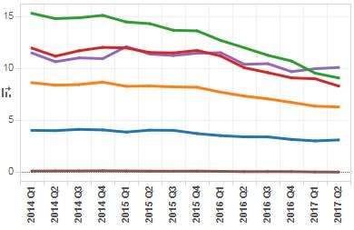
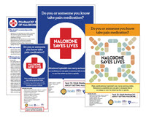
Other
PDMP – Prescription Drug Monitoring Program
Data Dashboard
Lines for Life / OrCRM (Oregon Coalition for Responsible Use of Medications) Opioid Summits
Portland State University Evaluation Partners
Health Education Campaign
Oregon Pain Commission
Naloxone Toolkit for Pharmacists
Notes:
Provide data on controlled substance prescriptions to improve patient safety and health.
Available to providers, pharmacists, and their delegates

Slide 12
Questions ?
Mary Borges
Mary.l.borges@state.or.us

