Slide 1
Root Causes of Alcohol and Tobacco Use Disparities
Kati Moseley
Health Promotion Strategist
Health Promotion and Chronic Disease Prevention
Nurit Fischler
MCH Policy Lead and Title V Coordinator
Maternal Child Health Section

Slide 2
What we’ll cover
Socio-ecological Framework
A brief on the social determinants of health
Trauma, toxic stress and resilience
Data – What’s happening to Oregonians?
Frieden’s Pyramid
Conclusion

Slide 3
Socio-Ecological Model
PUBLIC POLICY
national, state, local laws
COMMUNITY
relationships among organizations
ORGANIZATIONAL
organizations, social institutions
INTERPERSONAL
family, friends, social networks
INDIVIDUAL
knowledge,
attitudes, skills
Notes:
The most effective approach leading to healthy behaviors is a combination of efforts at all levels – individual, interpersonal, organizational, community, and public policy.
Individual behavior is influenced at all of these levels, and the levels are influenced by those above and below.
For example, bars would likely not have chosen to go smokefree in the absence of a statewide clean indoor air law. Clean indoor air helps tobacco users quit, and protects people from starting to use tobacco….and, of course, it protects everyone from secondhand smoke.

Slide 4
Framework for Action on Root Causes
STRUCTURAL
DETERMINANTS OF HEALTH INEQUITIES
INTERMEDIARY
DETERMINANTS OF HEALTH
IMPACT ON HEALTH EQUITY
SOCIOECONOMIC
AND POLITICAL
CONTEXT
Socioeconomic
Position
Governance
Social Class
Gender
Sexual Orientation
Disability status
Ethnicity, Race
Individual and Community Material Circumstances
Behaviors and Biological Factors
Psychological Factors
Macroeconomic
Policies
Public Policies
education
Dominant Culture and Societal Values
occupation
income
Health System
Social Cohesion/Social Capital
Notes:
The influence of government policy and organizational/institutional policy have clear effects on health, and are know as the social determinants of health. This model, slightly modified from the WHO, describes how action at all levels of the SEM influences health, and also shows the inter-relatedness of action at all the levels of the SEM.
INTRODUCE VIDEO – Larry Wallack.
Health starts where we live, learn, work and play. It is also impacted by the experiences of our parents, grandparents and ancestors. Supporting the health of all people requires us to uproot the causes of health inequity. As a group, these root causes are called the social determinants of health (SDOH).
Social determinants of health (SDOH) include healthcare and also the things we rarely think of in relation to health: from food supply to housing, and transportation to education. We know that the distribution of these resources across populations is inequitable. People from vulnerable and disadvantage communities experience poor health outcomes, poor quality of life and shorter lifespans as a result of these inequities.
These determinants can impact individual and community health, directly or indirectly.

Slide 5


Slide 6
What is Trauma?
An event, series of events, or set of circumstances that is experienced by an individual as physically or emotionally harmful or life threatening and that has lasting adverse effects on the individual's functioning and mental, physical, social, emotional, or spiritual well-being. - SAHMSA
  Can be single event. More often multiple events, over time (complex, prolonged trauma).
  Interpersonal violence or violation, especially at the hands of an authority or trust figure, is especially damaging.
  Event, Experience, Effect (SAMHSA)
  Including experiences systemic oppression & targeted violence (eg. ableism, ageism, racism, sexism, classism)
Notes:
Introduction of what is trauma and how ongoing and repeated traumatic experiences can lead to toxic stress and its multiple lifelong effects on health

Slide 7
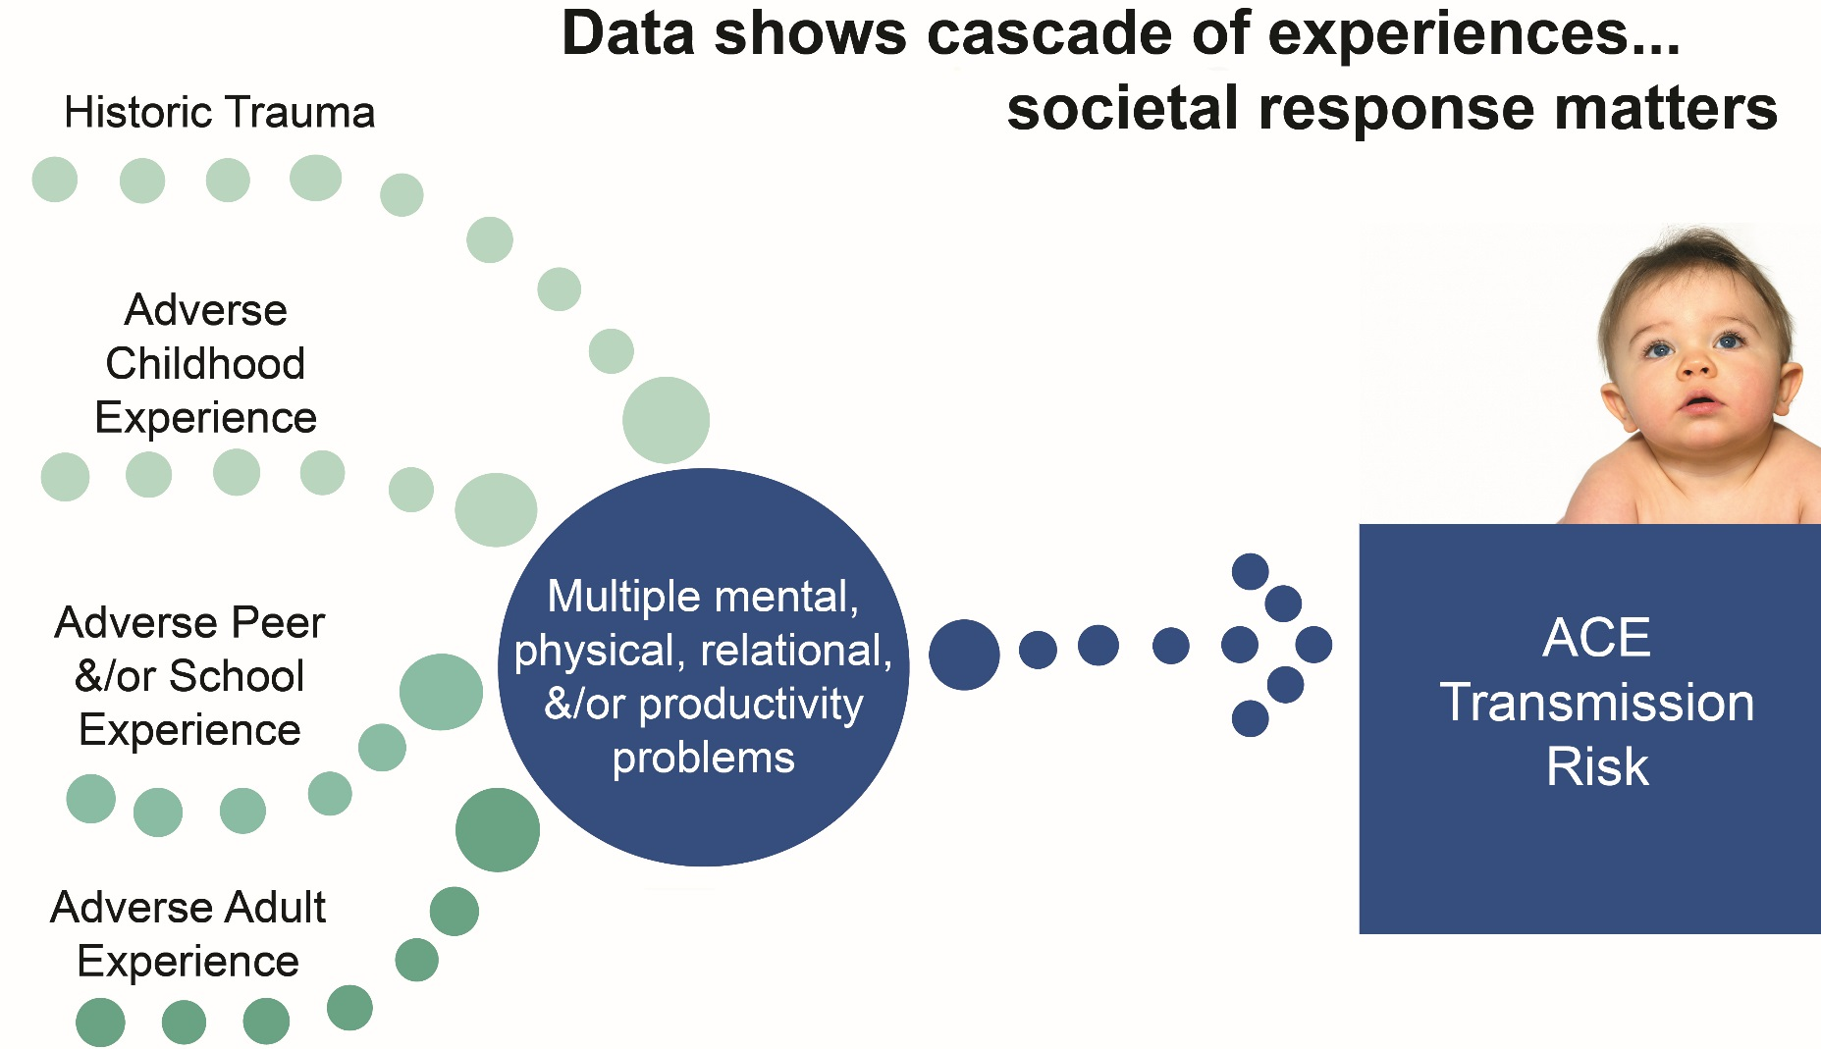
Adverse childhood experiences and other forms of trauma (historic and personal) are common.
Notes:
Adversity and trauma can arise from different sources across the lifespan: historical trauma, racism, childhhood adversity, etc.
The toxic stress resulting from these experiences results in multiple mental, physical, relational, and productivity problems
ACEs can be transmitted across generations, which makes our work with parents to prevent ACEs in the next generation so critical
Disparities in what populations are at risk for multiple ACES – race, income,

Slide 8
Why Now? Why is it Important?
Enormous advances in neurobiology in the last two decades, understanding how toxic stress impacts the architecture of the developing brain.
Adverse Childhood Experiences Study (Kaiser & CDC)
  Link with mental, behavioral, and physical outcomes
  Compelling evidence for a public health perspective
Trauma affects brain function - cognitive and social/behavioral, decision-making, etc.
Trauma affects how people approach societal institutions and services.
Societal institutions and service systems have often been activating or re-traumatizing.

Slide 9
The Science
Neurobiology
Epigenetics
Adverse childhood experiences
Resilience

Slide 10
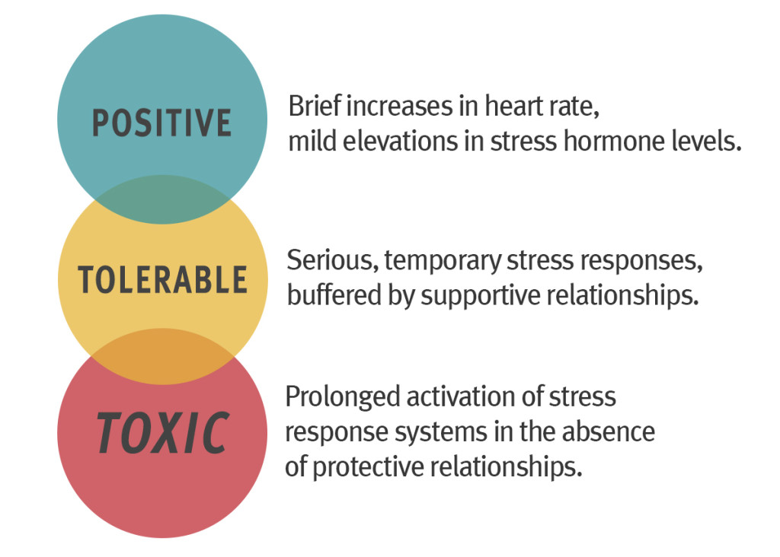
Research on the biology of stress illustrates how threat raises heart rate, blood pressure, and stress hormone levels, which can:
  impair brain architecture,
  immune status,
  metabolic systems, and
  cardiovascular function.
    Harvard University Center on the Developing Child
Notes:
Science Tells Us that Early Life Experiences Are Built Into Our Bodies Research on the biology of stress illustrates how threat:
- raises heart rate, blood pressure, and stress hormone levels, which can
- impair brain architecture, immune status, metabolic systems, and cardiovascular function.

Slide 11
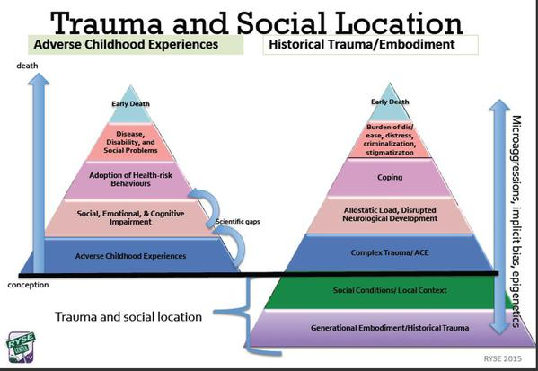
Adverse childhood experiences
Links adversities in childhood to adult health
http://www.acesconnection.com/blog/adding-layers-to-the-aces-pyramid-what-do-you-think
Notes:
Connect the ‘why’ adversity is connected to health outcomes

Slide 12

Key components of resilience for individuals
  Capability: Self-regulation, self-efficacy and perceived control, intellectual and employable skills; social/emotional competence in children
  Attachment and belonging: Strong adult/child relationship; social connections/positive relationships with friends, supportive adults
  Connection to Community: Culture, spirituality
Notes:
Public health approaches aim to prevent the circumstances that create trauma, promote resiliency, and avoid re-traumatization through TI systems and services
Resiliency can be defined as the ability of an individual or community to withstand, rebound and/or adapt to toxic stress, trauma or adversity
Resilliency buffers the effects of trauma – building both
Relationship is central to resiliency.

Slide 13

Key components of resilience for communities
  Equitable opportunity: living wages, quality education, local wealth
  People: connected to community and each other; strong, healthy relationships and community norms
  Place: safe, supportive environment – safe parks and open spaces, cultural expression, access to healthy foods, quality housing, transportation, etc.

Slide 14
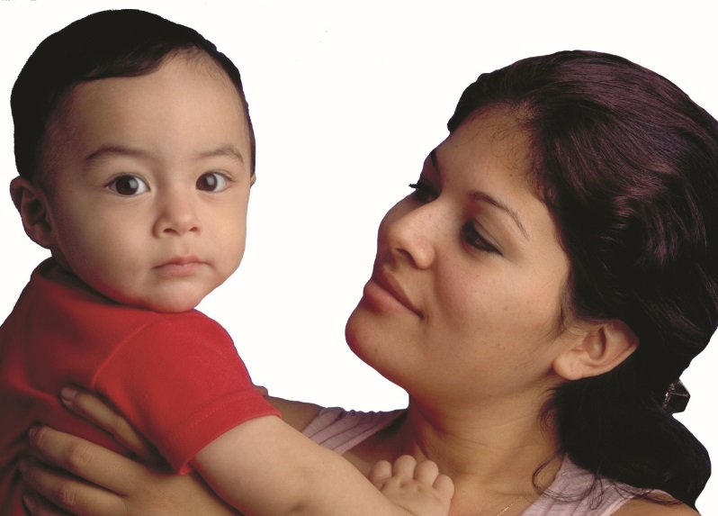
Public health approach to trauma
Work upstream to prevent adversity and trauma (e.g. family friendly policies)
Develop trauma informed systems and services to assure equitable access and avoid re-traumatization
Promote resilience in communities, individuals, and families (community capacity and family protective factors)

Slide 15
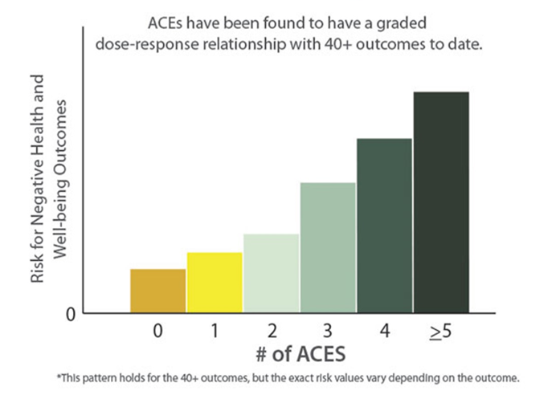
Adverse Childhood Experiences (ACEs)
Childhood experiences of physical, emotional, or sexual abuse and household dysfunction are associated with a myriad of diseases and high risk behaviors in adulthood.
Source: https://www.cdc.gov/violenceprevention/acestudy/ace_brfss.html
Notes:
Emotional abuse, household substance abuse, and parental separation or divorce are the most commonly experienced ACEs among Oregon adults

Slide 16
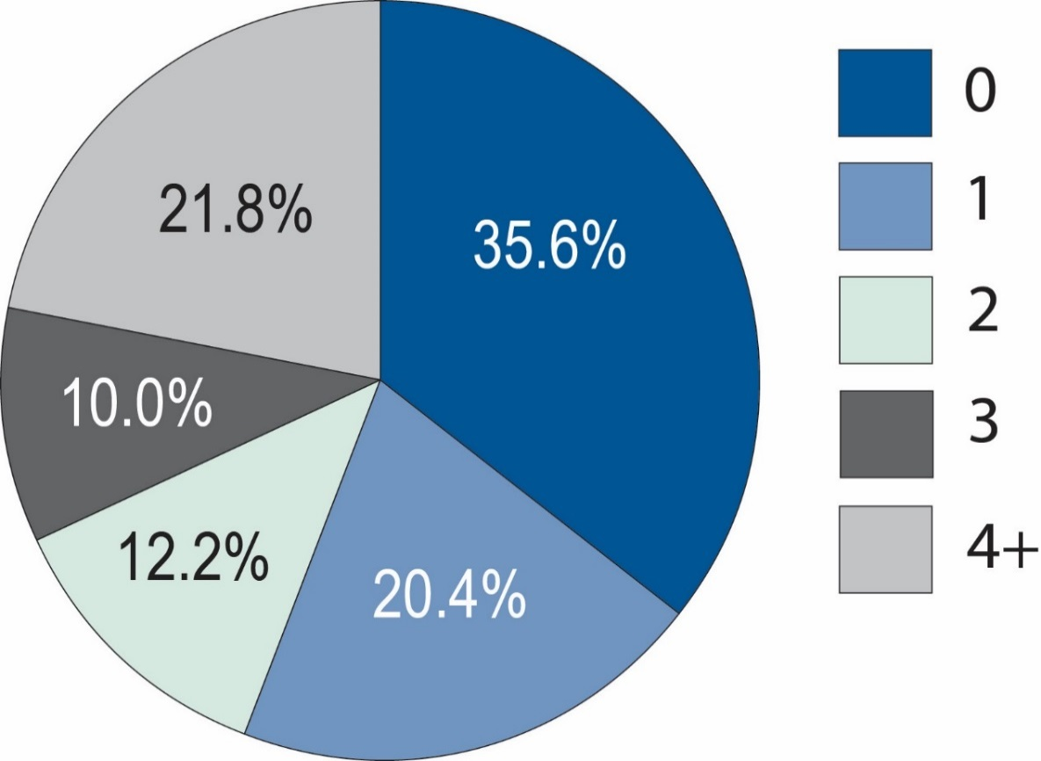
Number of ACEs among adults, Oregon, 2015
44% of Oregonians experienced 2 or more ACEs during childhood; 22% experience 4 or more.
Data source: Behavioral Risk Factor Surveillance System
Notes:
BRFSS surveys adult Oregonians about their experience of ACEs when they were children
-

Slide 17
Prevalence of ACEs types among adults in Oregon, 2015
Data source: 2015 Behavioral Risk Factor Surveillance System
Notes:
Oregon BRFSS, 2013-15
Native-Hawaiian/Pacific Islander and Multiple Race excluded due to sample size

Slide 18
Adults in Oregon with high ACEs score (4+)
Data source: 2013 – 2015 Behavioral Risk Factor Surveillance System
Notes:
Oregon BRFSS, 2013-15
Native-Hawaiian/Pacific Islander and Multiple Race excluded due to sample size

Slide 19
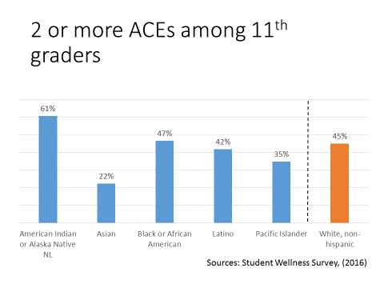
Notes:
Each of these are counted a 1 ACE
Were your parents ever separated or divorced after you were born?
Have you ever lived with a household member who is/was depressed or mentally ill?
Have you ever lived with someone who is/was a problem drinker?
Have you ever lived with someone who uses/used street drugs?
At least one of these= 1 ACE (If they say yes to both, it is still only 1 ACE)
Have you ever felt that you did not have enough to eat?
Have you ever felt that you had to wear dirty clothes?

Slide 20
Flourishing and ACEs (US Children Age 6-17)

Slide 21
Adverse Childhood Experiences and
Adult High Risk Behaviors
Adults in Oregon with 4 or more ACEs are:
Data source: 2013 – 2015 Behavioral Risk Factor Surveillance System
Notes:
Heavy drinkers (adult men having more than two drinks per day and adult women having more than one drink per day).
Binge drinkers (males having five or more drinks on one occasion, females having four or more drinks on one occasion).

Slide 23
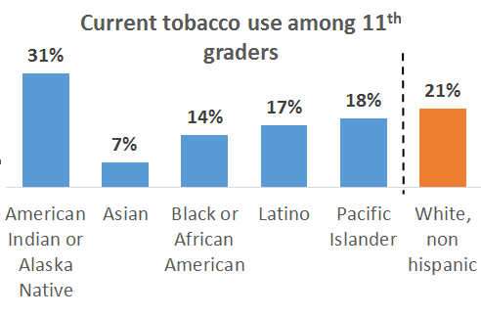
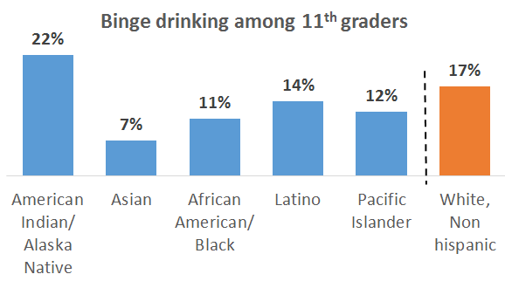
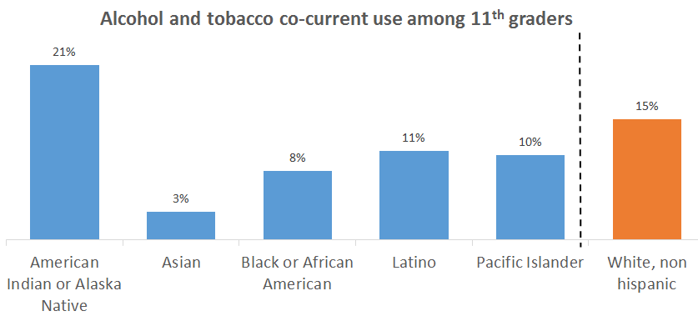
Risk Factors and Race/Ethnicity
Sources: Student Wellness Survey, (2016)
Notes:
When you look at Race ethnicity by these alcohol and tobacco risk factors, we see an over arching theme that disproportionally affects the American Indian and Alaska Natives.
11th graders who identify as AIAN are 28% more likely to be co-current alcohol and tobacco users
Comment about compounding affects of Risk factors and ACES as well as of Risk factors and Race ethnicity data

Slide 24
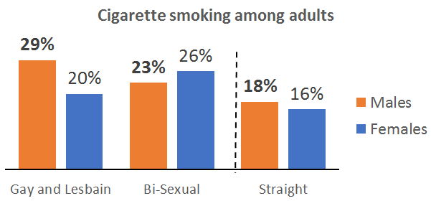
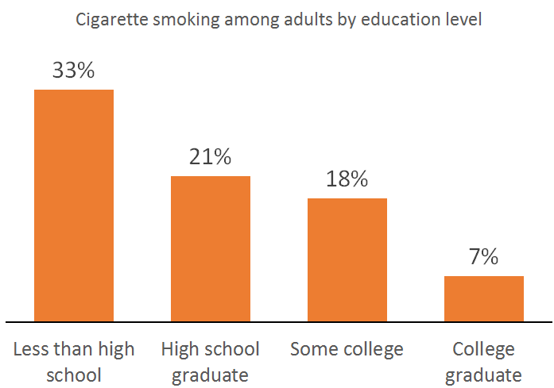
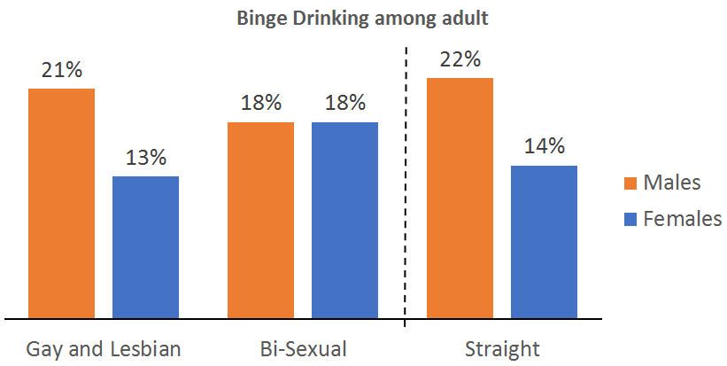
Risk Factors and other socio-demographics
Notes:
We see these difference with other socio-demographics as well.
These is a inverse relationship with education and cigarette smoking

Slide 25
Cigarette smoking among adults
Source: 2010-2011 Oregon BRFSS Race Oversample
Notes:
Even when looking at adult data by race ethnicity, we see that American Indian or Alaska Native individuals disproportionately smoke cigarettes compares to whites.
We also note that black or African American individuals have a much higher prevalence.
Comment about African Americans initiating smoking later in life.

Slide 26



Factors that Affect Health
Examples
Smallest
Impact
Condoms, eat healthy, be physically active
Counseling
& Education
Clinical Interventions
Rx for high blood pressure, high cholesterol
Long-lasting Protective Interventions
Immunizations, brief intervention, cessation treatment, colorectal cancer screening
Changing the Context
to make individuals’ default decisions healthy
Fluoridation, 0g trans fat, iodization, smoke-free laws, tobacco tax
Largest
Impact
Socioeconomic Factors
Poverty, education, housing, racism
Source: Dr. Tomas R. Frieden, Director, U.S. Centers for Disease Control & Prevention

Slide 27
Framework for Action on Root Causes
Emerging PH Practice Current PH Practice
STRUCTURAL
DETERMINANTS OF HEALTH INEQUITIES
INTERMEDIARY
DETERMINANTS OF HEALTH
IMPACT ON HEALTH EQUITY
SOCIOECONOMIC
AND POLITICAL
CONTEXT
Socioeconomic
Position
Governance
Social Class
Gender
Sexual Orientation
Disability status
Ethnicity, Race
Individual and Community Material Circumstances
Behaviors and Biological Factors
Psychological Factors
Macroeconomic
Policies
Public Policies
education
Dominant Culture and Societal Values
occupation
income
Health System
Social Cohesion/Social Capital
Notes:
As we now look again a the model for action on social determinates, or root causes, we can see that there is an area of public health practice that is still emerging. As we become more modernized in this, we’ll see better health outcomes.

Slide 28
Want to connect?
Kati Moseley
Health Promotion Strategist
Health Promotion and Chronic Disease Prevention Section
971-673-1002
Katarina.Moseley@dhsoha.state.or.us
Nurit Fischler
MCH Policy Lead and Title V Coordinator
Maternal Child Health Section
971-673-0344
Nurit.R.Fischler@dhsoha.state.or.us

