Slide 1
Surveillance data to support alcohol, tobacco and drug prevention
Vicky Buelow, MA
Alcohol and Drug Prevention Lead Research Analyst
Grantees & Contractors Annual Meeting
November 8, 2017
Notes:
Good afternoon everyone. Let’s get started.

Slide 2
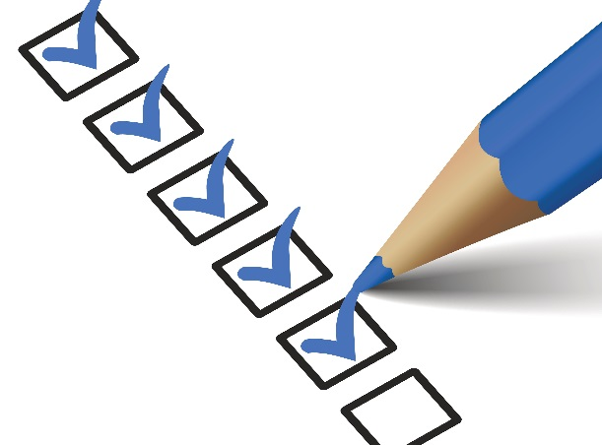
Session objectives
1
Understand the value of statewide surveillance systems and how they can be used to support your work
2
Understand the limitations and opportunities for improving statewide surveillance systems
3
Learn when and how to request assistance with data-related needs
Notes:
Our objectives today are to……….

Slide 3
In the context of…..
1
Who we are
2
What we do
3
How you can help us help you
Notes:
We’ll get to those learning objectives within the context of:

Slide 4
Notes:
First let’s break some ice.
Who is in the room?
Tell us your name, where you are from, what is you role, and one thing you like OR dislike about using data in your work.

Slide 5
Surveillance Basics
Notes:
Let’s go over some surveillance basics

Slide 6
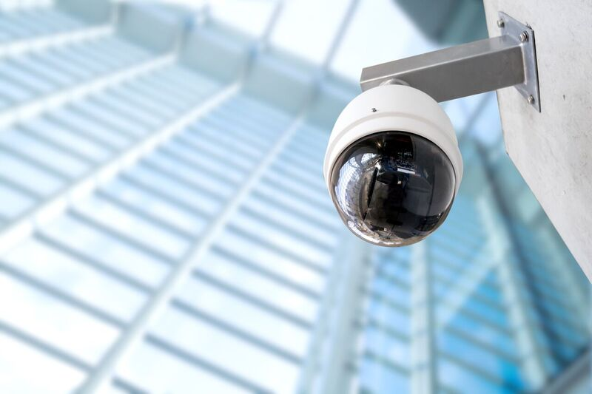
Notes:
What do you think of when you hear the word “surveillance”?
M-W defines surveillance as “the duty or function of watching or guarding for the sake of proper direction or control.”
Sounds kind of creepy, maybe?
Another definition of surveillance is “an act or period of watching for signs of activity, danger, or opportunity.”

Slide 7
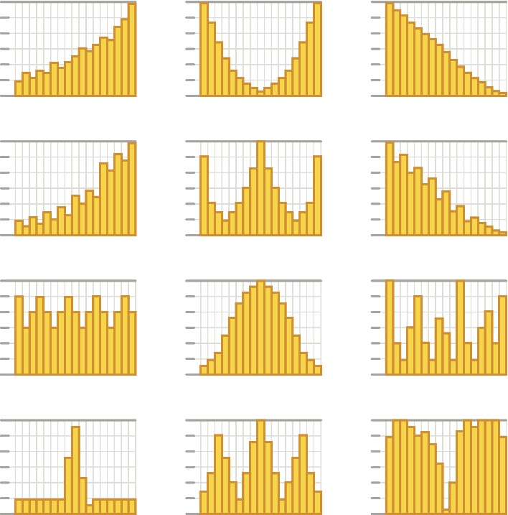
Notes:
The kind of surveillance we are going to talk about today probably looks a little more like this – essentially a bunch of nerds collecting, analyzing, and reporting data.
I thought it was interesting when I looked up synonyms for surveillance and found: lookout, vigil, care, watch, charge, and guidance.
So in a board sense, surveillance involves a bunch of nerds watching over the data.

Slide 8
Public health surveillance
“The ongoing, systematic collection, analysis, interpretation, and dissemination of data about health-related events in order to reduce morbidity and mortality and to improve the public’s health.”
- SAMSHA’s Center for the Application of Prevention Technologies
Notes:
Specifically, we will be talking about public health surveillance. SAMSHA defines public health surveillance as:
Key words here being:
Ongoing
Systematic
Improve health

Slide 9
Public health surveillance
“The ongoing, systematic collection, analysis, interpretation, and dissemination of data about health-related event for use in public health action to reduce morbidity and mortality and to improve health.”
- Centers for Disease Control and Prevention (CDC)
Notes:
The CDC further includes verbiage around action in their definition.
Yes we use surveillance to improve health, but this definition is explicit about using it in action

Slide 10
How is it used?
Notes:
So how is surveillance data used?
Magnitude and scale being especially important – this is going to tell you where to put your efforts. We all struggle with limited resources and many identified problems – so knowing the magnitude and scale of the issues is key.

Slide 11
How is it used?
Identify problems
Gauge magnitude and scale
Inform decisions
Notes:
So how is surveillance data used?
Magnitude and scale being especially important – this is going to tell you where to put your efforts. We all struggle with limited resources and many identified problems – so knowing the magnitude and scale of the issues is key.

Slide 12
How is it used?
Identify problems
Planning and prioritizing
Gauge magnitude and scale
Evaluate programs and interventions
Inform decisions
Monitor changes
Notes:
So how is surveillance data used?
Magnitude and scale being especially important – this is going to tell you where to put your efforts. We all struggle with limited resources and many identified problems – so knowing the magnitude and scale of the issues is key.

Slide 13
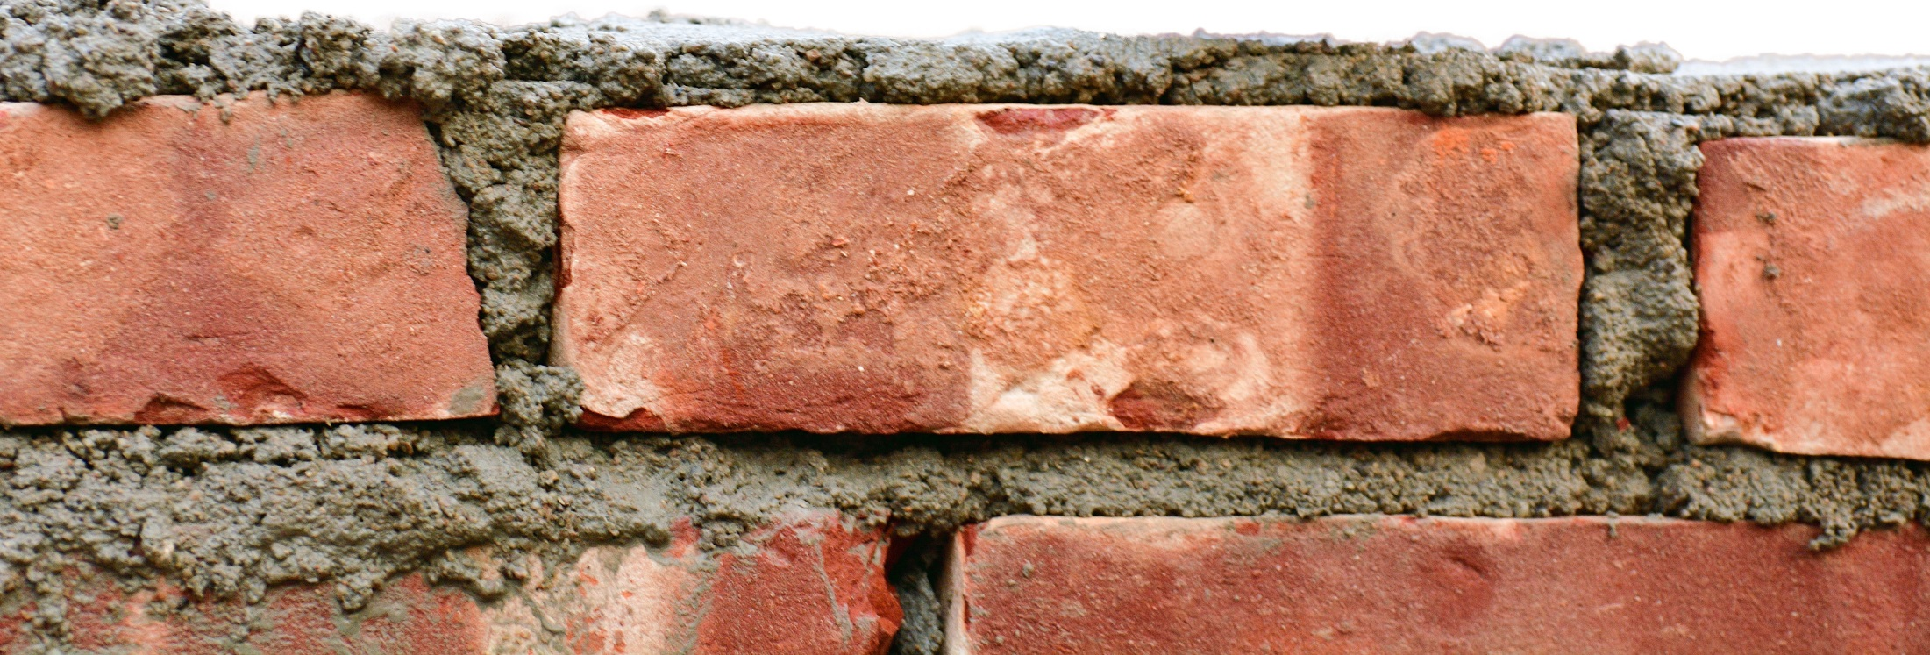
Data is the foundation of our work!
How is it used?
Identify problems
Planning and prioritizing
Gauge magnitude and scale
Evaluate programs and interventions
Inform decisions
Monitor changes
Notes:
So how is surveillance data used?

Slide 14
Where does surveillance data come from?
Notes:
But where does surveillance data comes from?

Slide 15
Surveillance systems
Notes:
Surveillance data comes from surveillance systems.
Surveillance systems are the methods and means in which we collect the data for public health surveillance.
Who can name some surveillance systems?
In order to carry out public health surveillance, we need good surveillance systems.
These are systems that are built to answer specific questions about population health.
We’ll go over what a surveillance system looks like later.

Slide 16
What makes a good system?
Notes:
Some general attributes of a useful surveillance system:
Two components: data itself and the system that generates it.
In terms of the system,
It has to be easy to use in structure and operation. The simpler the system, the more timely it is likely to be and take fewer resources to operate.
It has to be able to adapt to changing needs – can the system respond to changing information needs or conditions with little additional time, personnel, or resources?
It has to have buy in from users and stakeholders – everyone has to be willing to participate and use the system.
And has to be reliable and stable (Stability) – can it collect, manage, and provide data properly without failure?

Slide 17
What makes a good system?
System
Easy to use
Able to adapt to changing needs
Have buy-in from stakeholders
Reliable / stable
Notes:
Some general attributes of a useful surveillance system:
Two components: data itself and the system that generates it.
In terms of the system,
It has to be easy to use in structure and operation. The simpler the system, the more timely it is likely to be and take fewer resources to operate.
It has to be able to adapt to changing needs – can the system respond to changing information needs or conditions with little additional time, personnel, or resources?
It has to have buy in from users and stakeholders – everyone has to be willing to participate and use the system.
And has to be reliable and stable (Stability) – can it collect, manage, and provide data properly without failure?

Slide 18
What makes a good system?
System
Easy to use
Able to adapt to changing needs
Have buy-in from stakeholders
Reliable / stable
Data (output)
Able to detect the health event
Complete and valid
Representative of the population
Timely
Notes:
Some general attributes of a useful surveillance system:
Two components: data itself and the system that generates it.
In terms of the system,
It has to be easy to use in structure and operation. The simpler the system, the more timely it is likely to be and take fewer resources to operate.
It has to be able to adapt to changing needs – can the system respond to changing information needs or conditions with little additional time, personnel, or resources?
It has to have buy in from users and stakeholders – everyone has to be willing to participate and use the system.
And has to be reliable and stable (Stability) – can it collect, manage, and provide data properly without failure?

Slide 19
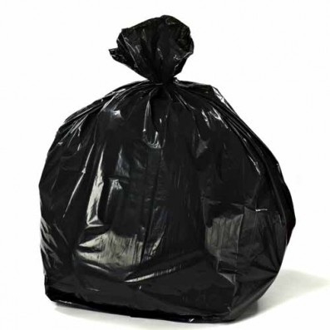
Data
Data
Notes:
Have you heard of the phrase “Garbage in, garbage out”?
We don’t want data that ends up useless and in the trash bin! This is what we want to avoid, and I’ll go into how we can avoid this later.

Slide 20
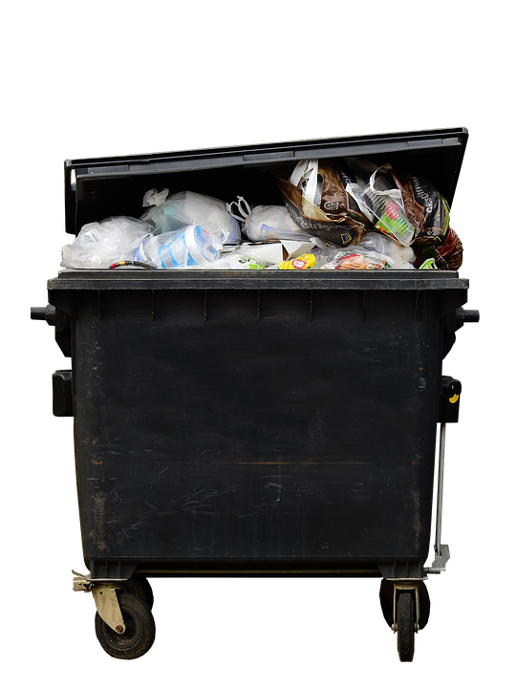
Data
Data
Data
Notes:
We don’t want data that ends up useless and in the trash bin! This is what we want to avoid, and I’ll go into how we can avoid this later.

Slide 21
:(
Data
Data
Data
Notes:
That would be sad ☹

Slide 22
Two approaches
Notes:
There are two approaches to chronic disease surveillance: passive and active.
Passive systems rely on data that come from various institutions.
Some examples include disease registries which Meena will talk about today;
Vital records which Craig will talk about;
And health services data such as medical claims data, clinical data, and electronic health record data which are a sort of new frontier in public health surveillance.
Some surveillance systems can have both active and passive elements, but the majority of chronic disease surveillance systems are passive.

Slide 23
Two approaches
1. Passive
Relies on data reported by various institutions
Ex: disease registries, vital records, health services data
Notes:
There are two approaches to chronic disease surveillance: passive and active.
Passive systems rely on data that come from various institutions.
Some examples include disease registries which Meena will talk about today;
Vital records which Craig will talk about;
And health services data such as medical claims data, clinical data, and electronic health record data which are a sort of new frontier in public health surveillance.
Some surveillance systems can have both active and passive elements, but the majority of chronic disease surveillance systems are passive.

Slide 24
Two approaches
1. Passive
Relies on data reported by various institutions
Ex: disease registries, vital records, health services data
2. Active
Regularly contacting sources directly to obtain information.
Ex: health surveys, cohort studies etc.
Notes:
There are two approaches to chronic disease surveillance: passive and active.
Passive systems rely on data that come from various institutions.
Some examples include disease registries which Meena will talk about today;
Vital records which Craig will talk about;
And health services data such as medical claims data, clinical data, and electronic health record data which are a sort of new frontier in public health surveillance.
Some surveillance systems can have both active and passive elements, but the majority of chronic disease surveillance systems are passive.

Slide 25
Strengths and limitations
Notes:
Passive systems are usually less expensive compared to active systems.
Passive systems are useful for monitoring trends as active systems are more cross-sectional with the intent of measuring a certain point in time, but with active systems you can obtain more detailed information.
Passive systems can be less timely because data are received from several different places; which also poses challenges for data quality.
Actives systems can be more timely, but can also be difficult to sustain over time to due high cost.

Slide 26
Strengths and limitations
Passive
Less expensive
Useful for monitoring trends
Less timely
Difficult to control data quality
Notes:
Passive systems are usually less expensive compared to active systems.
Passive systems are useful for monitoring trends as active systems are more cross-sectional with the intent of measuring a certain point in time, but with active systems you can obtain more detailed information.
Passive systems can be less timely because data are received from several different places; which also poses challenges for data quality.
Actives systems can be more timely, but can also be difficult to sustain over time to due high cost.

Slide 27
Strengths and limitations
Passive
Less expensive
Useful for monitoring trends
Less timely
Difficult to control data quality
Active
More expensive
Can obtain more detailed information
More timely
Difficult to sustain over time
Notes:
So really, it all comes down to time and money.

Slide 28
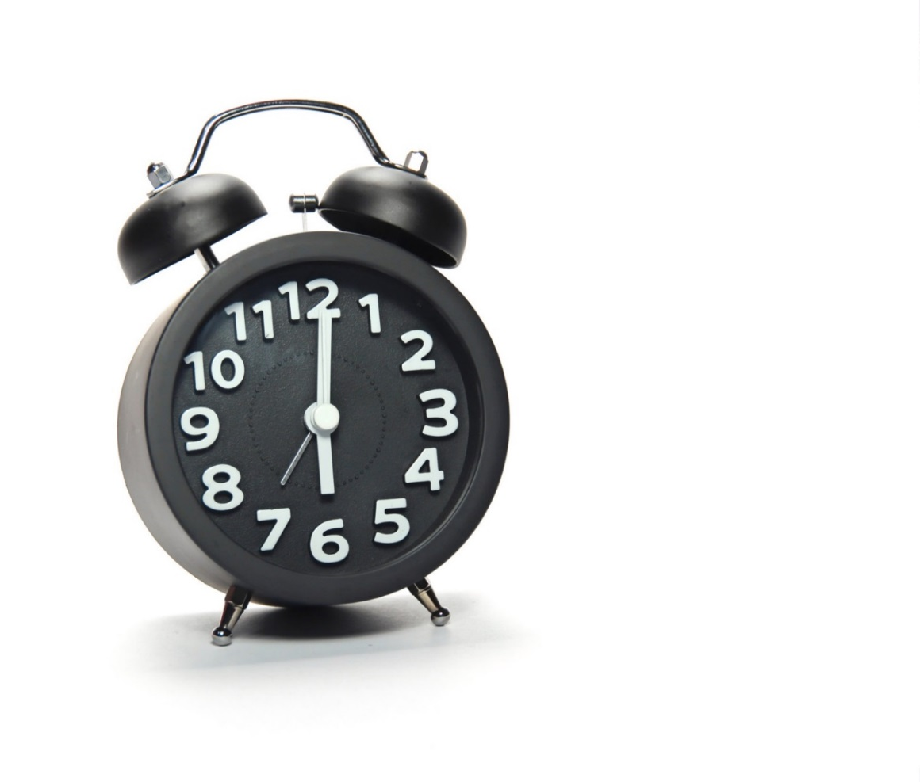
Strengths and limitations
Notes:
So really, it all comes down to time and money.

Slide 29
Take aways
1
Data is the foundation of the work we do
Data come from surveillance systems
There are strengths and limitations to all systems
2
3

Slide 30
Surveillance & Evaluation in HPCDP

Slide 31
The Surveillance and Evaluation Team (SET)
Who are we?
Notes:
We work as a team

Slide 32
The Surveillance and Evaluation Team (SET)
Who are we?
We are a team of 13 epidemiologists and research analysts tasked with using surveillance data to:
Identify strategic priorities and best practices for population level prevention
Measure progress towards health outcome goals and targets
Provide internal and external data-related technical assistance
Notes:
We work as a team

Slide 33
The Surveillance and Evaluation Team (SET)
1
Manager
Todd Beran
Notes:
We work as a team

Slide 34
The Surveillance and Evaluation Team (SET)
1
Manager
Todd Beran
5
Lead Analysts
Epidemiologist
Methods and Statistics
Evaluation
Tobacco & Evaluation
Alcohol and Drug
Notes:
We work as a team

Slide 35
The Surveillance and Evaluation Team (SET)
1
Manager
Todd Beran
5
Lead Analysts
Epidemiologist
Methods and Statistics
Evaluation
Tobacco & Evaluation
Alcohol and Drug
7
Analysts
Risk factor & chronic disease programs
Oregon State Cancer Registry
Notes:
We work as a team

Slide 36
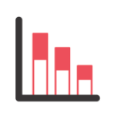
HPCDP work streams reflect a comprehensive program approach
Surveillance & evaluation
Notes:
How we fit within HPCDP

Slide 37
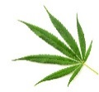
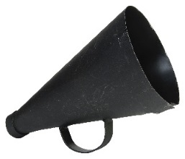
HPCDP work streams reflect a comprehensive program approach
Surveillance & evaluation
State & community programs
Health systems & self-management
Communications
Fiscal and operations
Notes:
How we fit within HPCDP

Slide 38
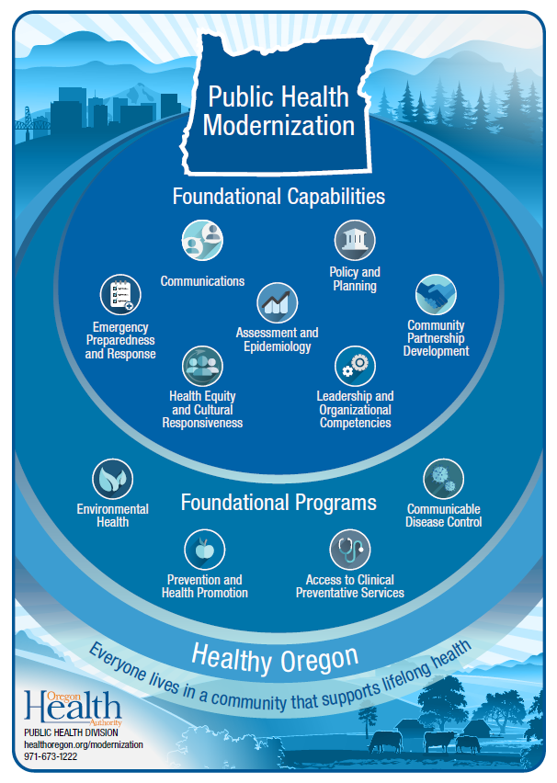
Notes:
How we fit in the larger public health system

Slide 39
Notes:
We work in foundational programs (Prevention and Health Promotion; Access to clinical services)

Slide 40
Assessment and Epidemiology
is a core component of a modern public health system
Notes:
And a core foundational capability of any public health program is assessment and epidemiology

Slide 41
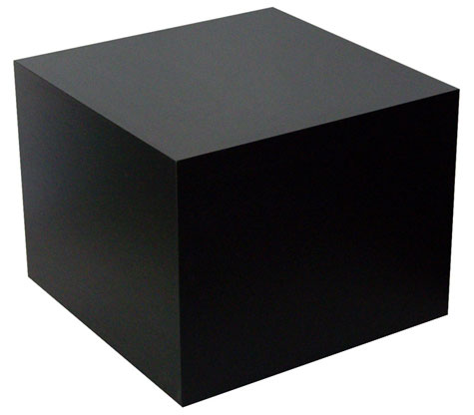
What do we do?
Notes:
What do we do (or, what's in the black box?)

Slide 42
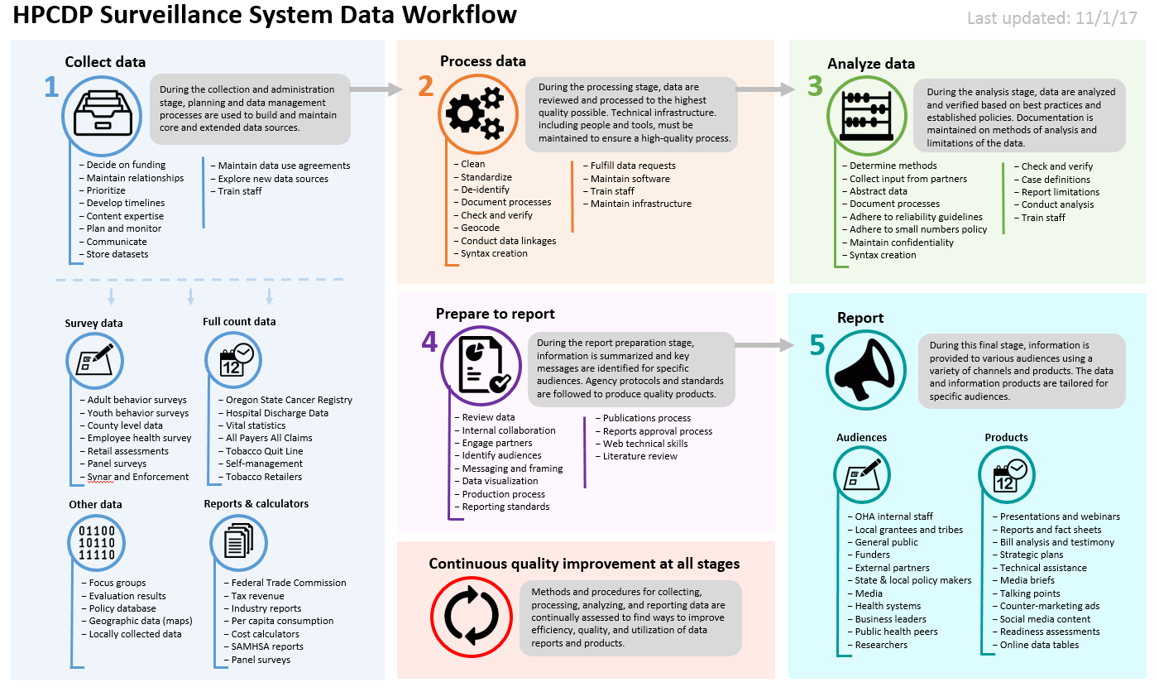
Notes:
Our “map” of how we work with data – this is a living document that we continue to refine

Slide 44
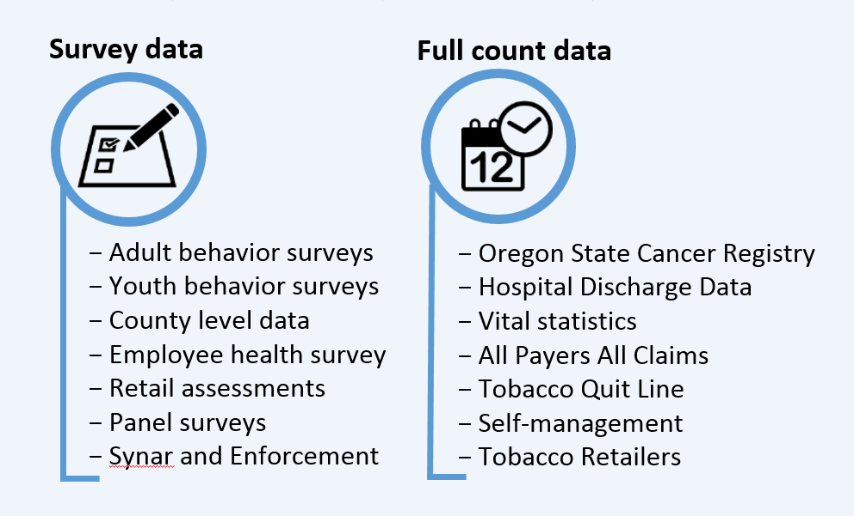
Notes:
Plug retail assessment session

Slide 45
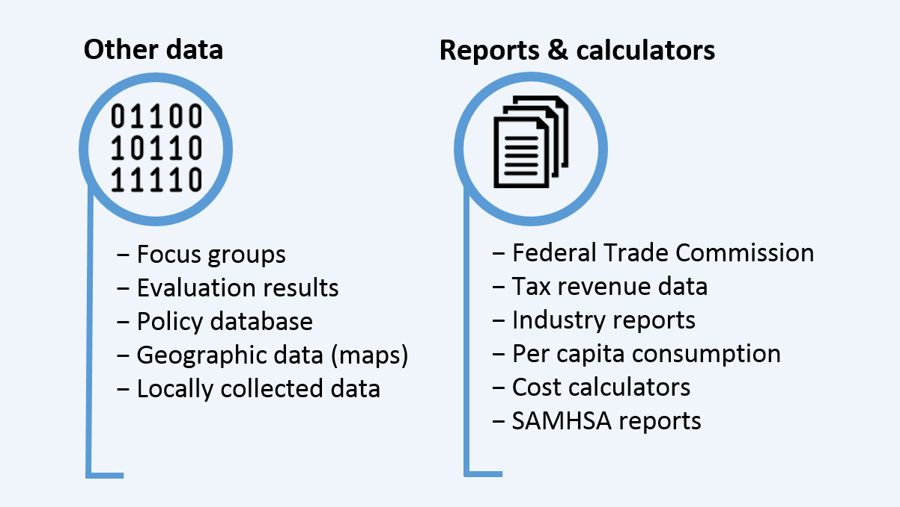

Slide 46
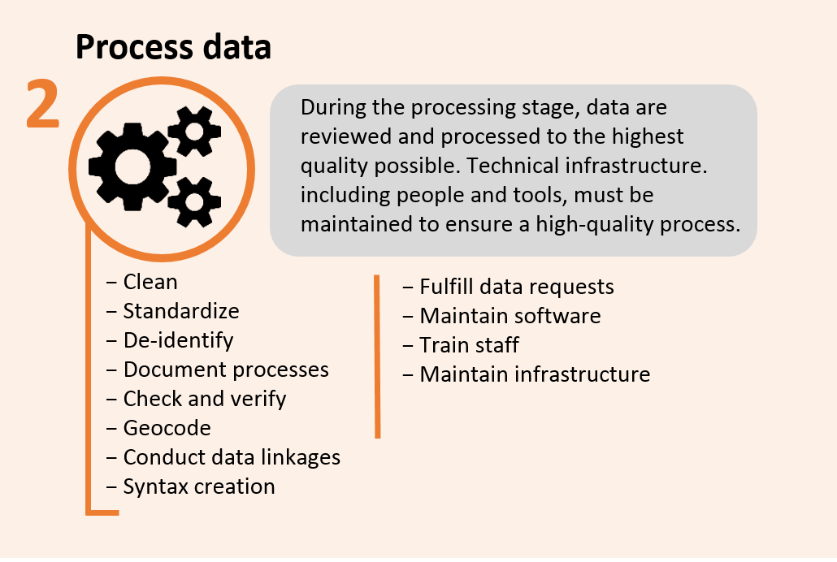
Notes:
Fulfilling data requests is a big part of what we do – will talk more about that later.

Slide 48
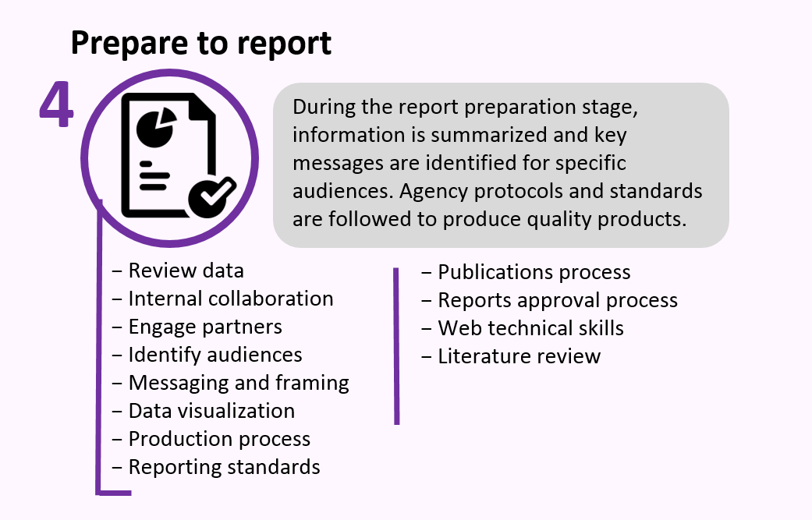

Slide 49
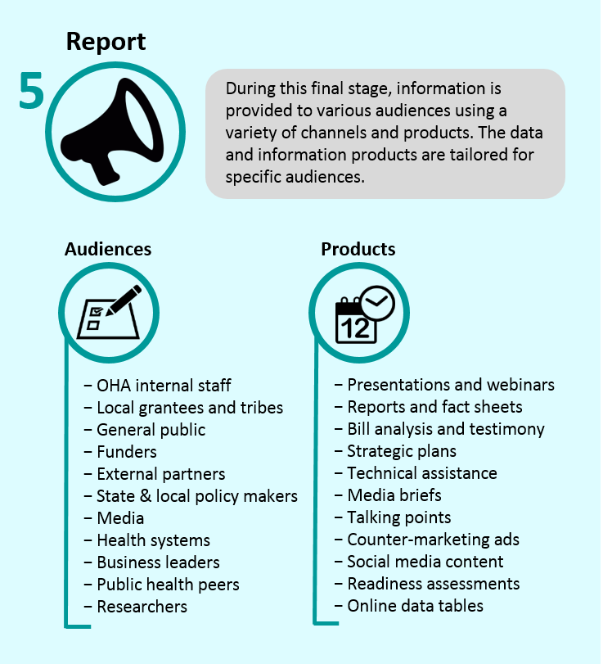

Slide 50
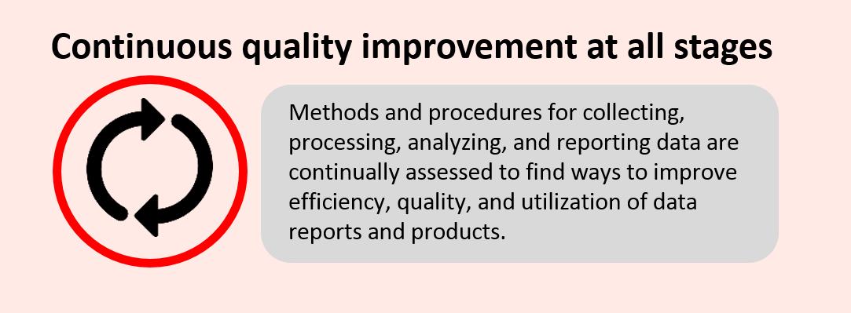

Slide 51
Take aways
1
There is an entire team within HPCDP dedicated to surveillance and evaluation
We keep track of A LOT of data and information
We are always looking for ways to improve
2
3

Slide 52
What’s in our toolbox?
Notes:
Technical assistance - What’s in it for me?

Slide 53
We can help with:

Slide 54
We can help with:
Getting current data

Slide 55
We can help with:
Getting current data
Custom data analysis

Slide 56
We can help with:
Getting current data
Custom data analysis
Support for local data collection and evaluation

Slide 57
We can help with:
Getting current data
Custom data analysis
Support for local data collection and evaluation
Our goal is to help you get the best data and information available for your needs

Slide 58
Q: How do I request help from the Surveillance and Evaluation Team?

Slide 59
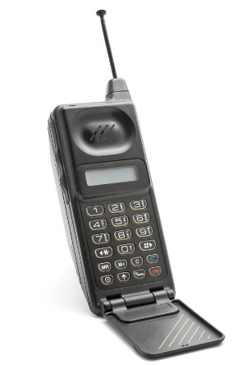
A: Contact your program liaison.
You’ll be assigned a SET member who will follow up and work with you on your request.

Slide 60
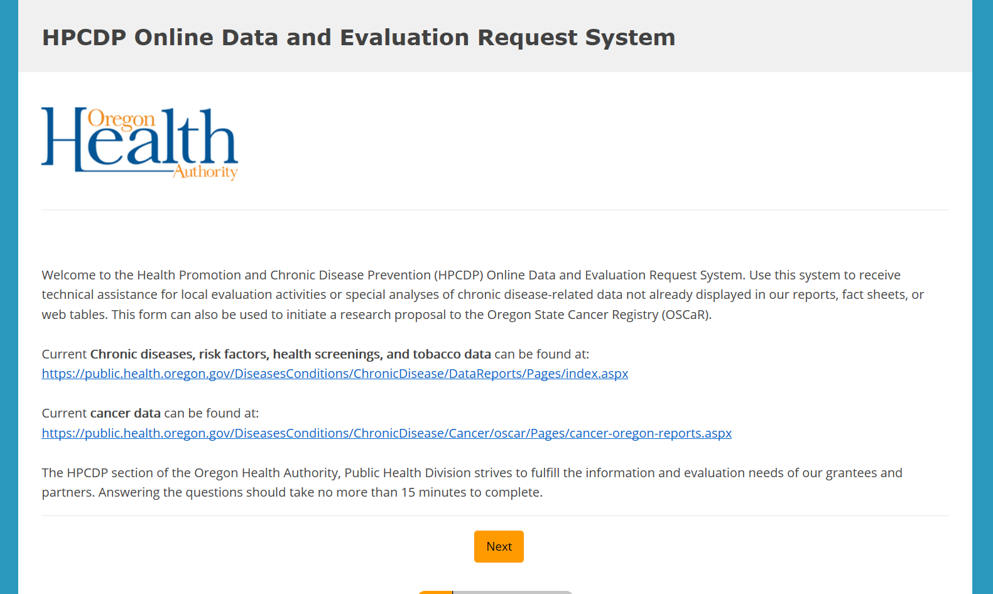
Notes:
Your liaison may point you to our Online Data and Evaluation Request System. This is where you make an ODER. Tee hee!
We use this so we can track requests.

Slide 61
Save time – plan ahead
What is the intent? What are you using the data for?
Notes:
Before contacting your liaison, ask yourself:

Slide 62
Save time – plan ahead
What is the intent? What are you using the data for?
Who is the audience? Who will you be providing results to?
Notes:
Before contacting your liaison, ask yourself:

Slide 63
Save time – plan ahead
What is the intent? What are you using the data for?
Who is the audience? Who will you be providing results to?
What specific data do you need? Ex: “I need the prevalence of binge drinking among 18-24 year old males.”
Notes:
Before contacting your liaison, ask yourself:

Slide 64
Save time – plan ahead
What is the intent? What are you using the data for?
Who is the audience? Who will you be providing results to?
What specific data do you need? Ex: “I need the prevalence of binge drinking among 18-24 year old males.”
When do you need the request completed by?
Notes:
Before contacting your liaison, ask yourself:

Slide 65
for caveats
Notes:
We won’t have everything
Ex: Race/ethnicity; small geographic areas
But, our job is to try and find something useable for you. If the data you really want doesn’t exist, we can help you work through an alternative, or help you find a way to use other data that will serve the same purpose of your work.

Slide 66
Where can I find HPCDP data?
Notes:
Where can I find data?

Slide 67
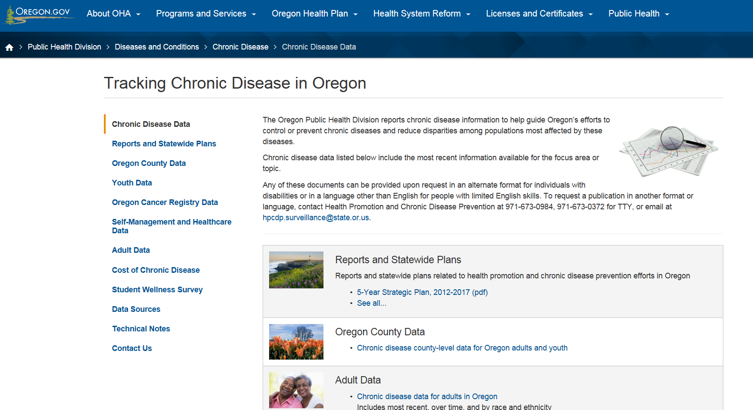
Search for “Oregon chronic disease data” to find the HPCDP online data hub
Notes:
That being said, I want to share some of our online data resources with you.
If you search for “Oregon chronic disease data”, our online data hub will be one of the first hits.

Slide 68
Search for “Oregon chronic disease data” to find the HPCDP online data hub
Notes:
This is where we post high level data tables and information including……
We developed these tables based on feedback we’ve received over the years.
We do not post everything we have – if you don’t see what you need, ask!
We are currently planning on adding more alcohol and drug data to these pages, and we love to have input from you all on what would be most useful.

Slide 69
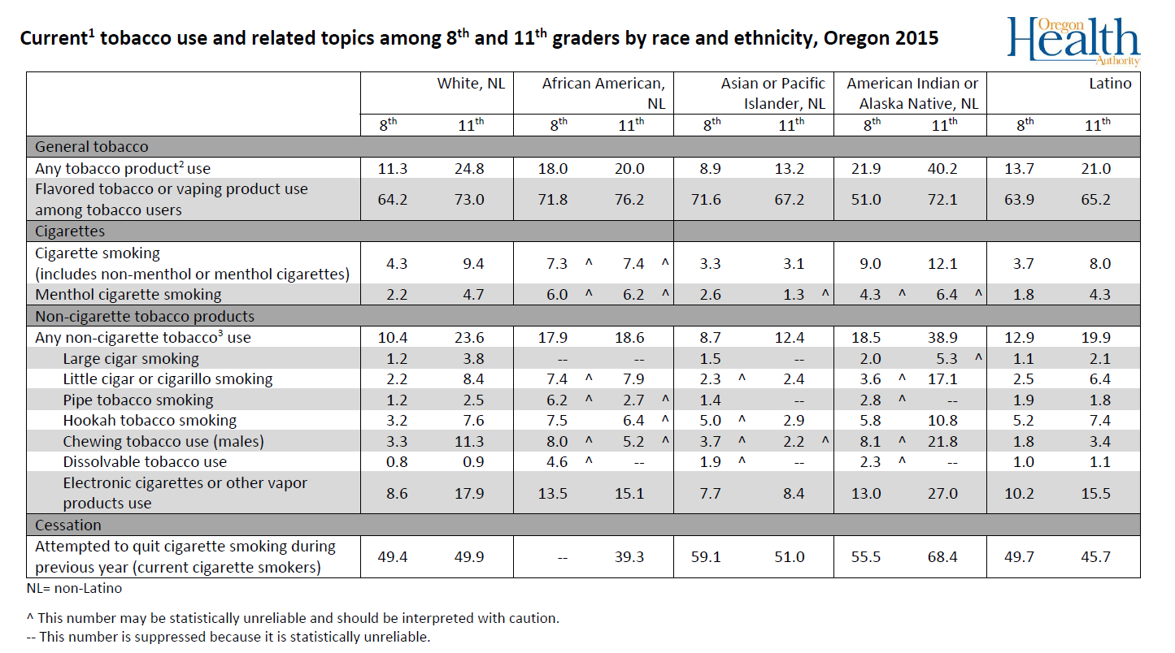
Notes:
An example data table
Other sources; IVPP Opioid Data Dashboard

Slide 70
Data is only part of the picture
Notes:
But data is only part of the picture
There are many other moving pieces and elements. You’re likely to paint different pictures depending on your audience, and some may not include any data at all.

Slide 71
Tell us your data needs – we want to hear from you
Notes:
That being said, again, we want to help.
The best way you can help us help you is to ask. Voice your needs. The more you ask, the more we are able to understand what you need. And when we understand what you need, we can plan and adjust our surveillance systems accordingly. In that way you can help us grow and continue to build our capacity to meet your needs.

Slide 72
Notes:
And because we are all about the continuous quality improvement

Slide 73
Notes:
Your feedback can help us improve our processes at all stages.

Slide 74
Take aways
1
Need help with data? Contact your liaison first.
Be as specific as possible about what you need
Knowing your needs helps us improve
2
3

Slide 75
Activity+
Q&A

Slide 76
d

Slide 77
Thank you!

Slide 78
HPCDP Surveillance and Evaluation Team Leads
Todd Beran, MS
Data & Surveillance Manager
todd.beran@state.or.us
Shaun Parkman, MA
Evaluation Lead
shaun.w.parkman@state.or.us
Rodney Garland-Forshee, MS
Epidemiologist & Team Lead
rodney.garland@state.or.us
Sarah Hargand, MPH
Tobacco and Evaluation Lead
sarah.hargand@state.or.us
Duyen Ngo, MPH, PhD
Surveillance Technical Lead
duyen.l.ngo@state.or.us
Vicky Buelow, MA
Alcohol & Drug Prevention Lead
victoria.h.buelow@state.or.us

