Slide 1
Standardized Tobacco Assessment for Retail Settings (STARS)
Training for data collectors
Acknowledgement: This presentation is based on materials developed by the Stanford Prevention Research Center for the California Tobacco Control Program (CTCP). Thanks are due to CTCP and the Tobacco Control Evaluation Center for sharing photos and training materials for STARS.

Slide 2
Objectives for data collectors
Recognize key product categories and brands
Learn key concepts:
  Tobacco flavors
  Store types
  Advertisements
  Product placement
  Price promotions
  How to record price of product

Slide 3
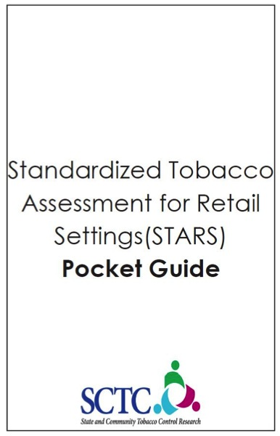
Pocket Guide
Follow along with your pocket guide during presentation
Take notes in the “training notes” section of pocket guide

Slide 4
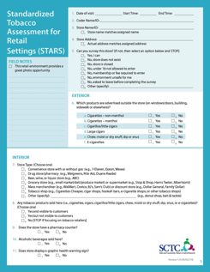
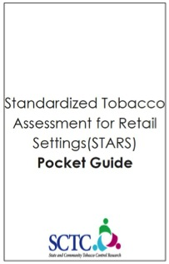

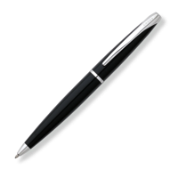
Supplies
Copies of survey
Pocket guide
Pen
Hard writing surface (e.g. notebook, clipboard)
Optional: list of stores to visit, map of area

Slide 5
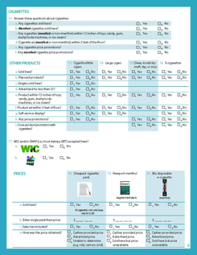
STARS
20 questions, ≈10 minutes
Tasks include assessing the following:
  Types of tobacco products
  Outside advertisements
  Store type
  Store qualities (e.g., pharmacy, alcohol sold)
  Product placement
  Interior tobacco ad placement
  Price promotions
  Prices for three tobacco products

Slide 6

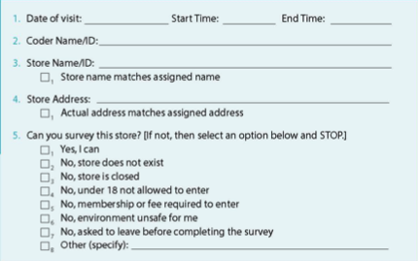
Let’s begin…

Slide 7
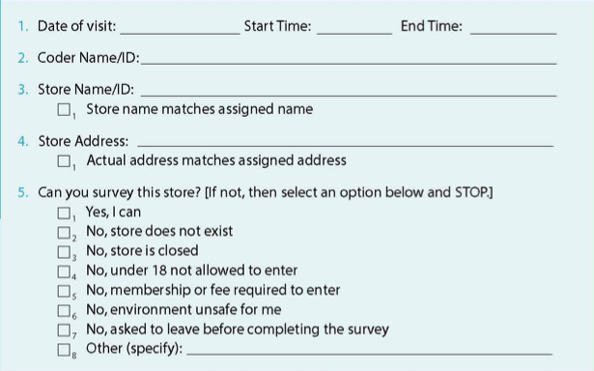
1 & 2. Date and Coder Name/ID
Record date and start/end times of survey
Record data collector (coder) name or ID

Slide 8
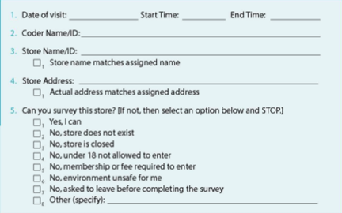
3 & 4. Store Name and Address
If stores are not assigned then record the name and address of the store
If you are visiting assigned stores and the store name and address match the assigned name and address then simply check the boxes
  If the name or address does not match then record the actual name or address

Slide 9
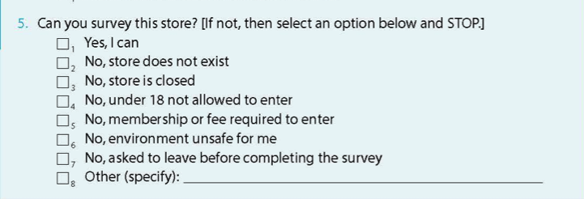
5. Can you survey this store?
Yes answer is most common
If No, select the option that explains why not
  If asked to leave store before completing survey mark, “No, asked to leave before completing survey”
  If store is temporarily closed, note reopening date in “field notes” section of survey form
If you answer No, then stop survey and continue to next store

Slide 10
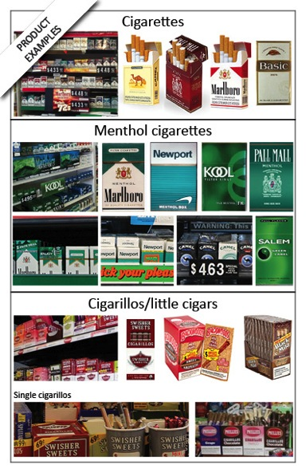
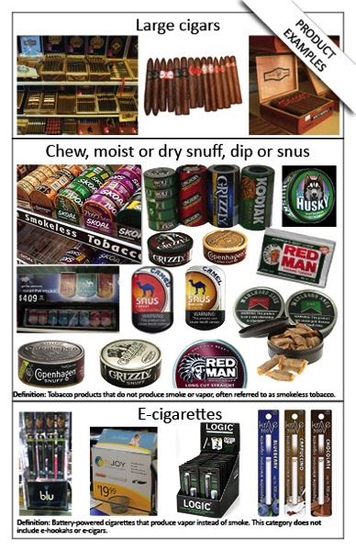
Product overview

Slide 11
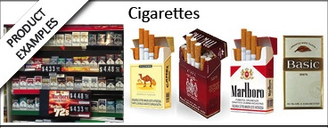

Cigarettes
Refer exclusively to tobacco cigarettes
  Does not include electronic cigarettes
Cigarettes may be menthol cigarettes or non-menthol
Follow along in your pocket guide

Slide 12
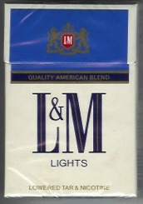
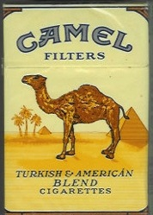
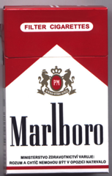
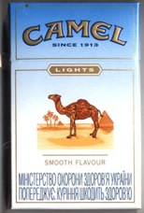
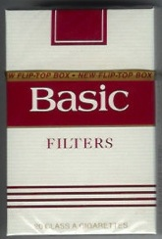
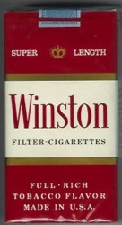
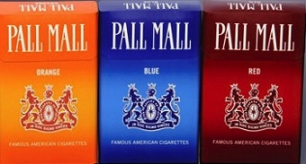
Popular brands of cigarettes
Popular brands include Marlboro, Newport, Pall Mall, Camel, and Winston

Slide 13
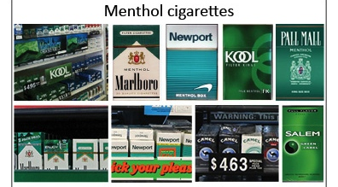
Menthol cigarettes
Menthol is the only flavored cigarette permitted by federal law
Typically green packs but may come in other colors
Follow along in your pocket guide

Slide 14
Popular brands of menthol cigarettes
Popular brands include Newport, Salem, Kool, and Marlboro menthol

Slide 15
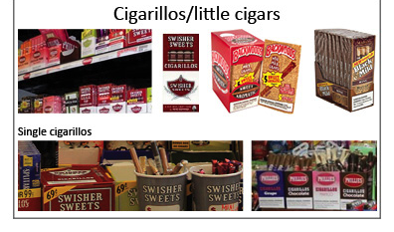
Cigarillos/little cigars
Tobacco wrapped in a tobacco leaf (or a brown paper containing tobacco)
Short (3-4 inches) or the size of a cigarette
  Smaller than a large cigar
May be sold individually, a few in a pack, or in a pack of 20 or more that looks like a cigarette pack
  Blunt and blunt wrappers are considered cigarillos/little cigars
Follow along in your pocket guide

Slide 16
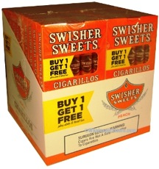
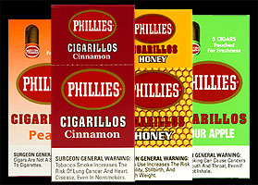
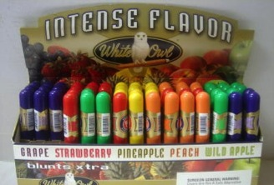
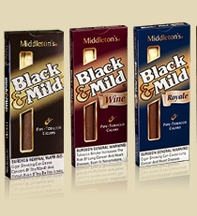
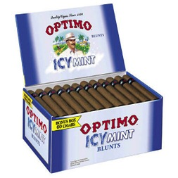
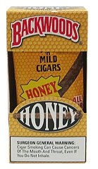
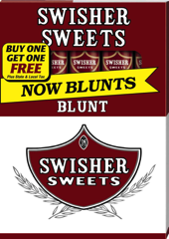
Popular brands of cigarillos/little cigars
Popular brands include Swisher Sweets, Black & Mild, Phillies, and White Owl

Slide 17
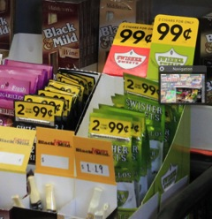
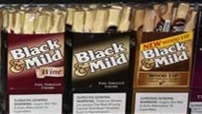


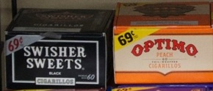
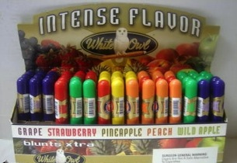

Single cigarillos/little cigars
Smaller unit sizes indicate lower purchase prices
Examine the brands of cigarillos/little cigars to try and find single cigarillos/little cigars
Does not count as single cigarillo/little cigars because it is sold in packs of two

Slide 18
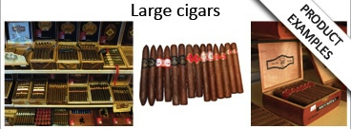
Large cigars
Typically contains at least one-half ounce of aged, fermented tobacco wrapped in tobacco leaf (or a brown paper containing tobacco)
Often sold as singles but can be found in boxes
Larger than cigarillos/little cigars
Follow along in your pocket guide

Slide 19
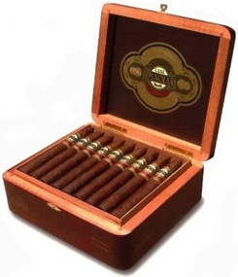
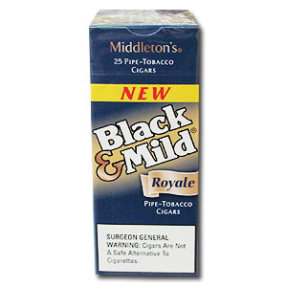
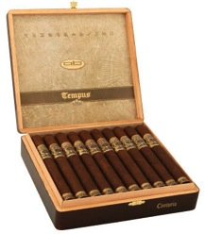
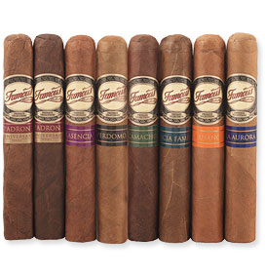
Images of large cigars
NOTE: Some cigarillos/little cigars have the word “cigar” on the package (e.g. “25 pipe-tobacco cigars”). These are not considered large cigars since they are sold in a pack and are smaller than a large cigar.

Slide 20
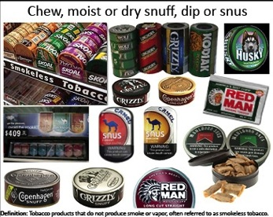
Chew, moist or dry snuff, dip or snus
These are different forms of smokeless tobacco all treated as one product category
You don’t need to recognize the difference between chew, snuff, dip or snus
The products are packaged in cans or pouches and are usually shelved near cigarettes.
Follow along in your pocket guide

Slide 21

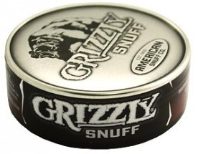
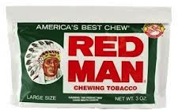
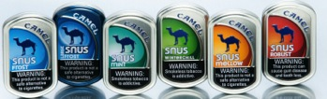
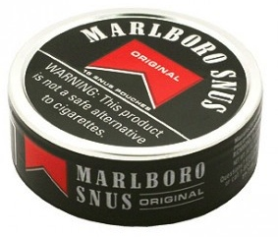
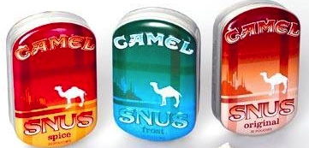
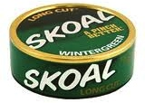
Popular brands of smokeless tobacco
Popular brands include Marlboro, Camel, Skoal and General

Slide 22
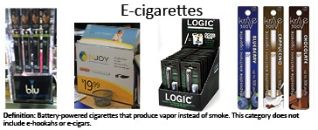
Electronic cigarettes (E-cigarettes)
Battery-powered devices that produce vapor instead of smoke
  Can be disposable or refillable
Using e-cigarettes is called vaping
Category does not include e-hookah or e-cigars
May be shelved with tobacco products, in a self-service container or with nicotine-replacement products like Nicorette
  Some e-cigarette displays advertise “100% water vapor”
Follow along in your pocket guide

Slide 23
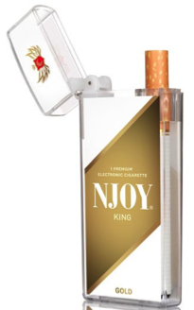


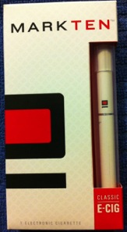
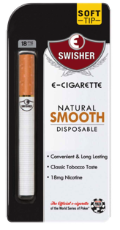
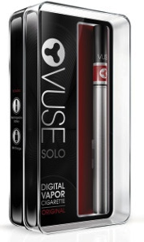
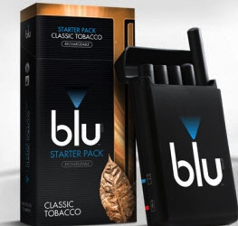



Popular brands of e-cigarettes
Popular brands include Blu, NJOY, Swisher and Starbuzz

Slide 24

Tobacco product flavors
Tobacco products come in a variety of flavors
Tobacco products that can be flavored include cigarillos/little cigars, large cigars, chew, snuff, dip or snus, and e-cigarettes
  The only flavored cigarettes are menthol cigarettes
You do not need to tell the difference between flavor types (e.g. fruit, liquor) – you only need to find one flavor of any type
Flavor examples
Fruit or sweet | Liquor | Mint
Apple (green, wild) Cherry Chocolate Cinnamon Cream Grape (white, red) Honey Java Peach Spice Strawberry Sweet Vanilla | Bourbon Cognac Margarita Peach schnapps Pina Colada Spiced Rum Whiskey Wine Wine grape | Fresh Frost Menthol Peppermint Spearmint Wintergreen Winterchill
Follow along in your pocket guide
Note: these are only examples of flavors and not an exhaustive list

Slide 25








Not flavors
The following are not considered flavors:
  Black
  Bold
  Diamond
  Jazz
  Mild
  Perfecto
  Purple or purple haze
  Red
  Regular
  Royale

Slide 26








Examples of flavored cigarillos/little cigars
Note: Cigarillos/little cigars that are labeled “sweet” are considered flavored

Slide 27




Examples of flavored chew, snuff, dip and snus

Slide 28


Examples of flavored e-cigarettes
Examples of flavored e-cigarettes
Tobacco is not considered flavors

Slide 29



6. Which products are advertised outside the store (on windows/doors, buildings, sidewalk or elsewhere)?
Select Yes for each tobacco product advertised outside the store
If there are no exterior advertisements for a tobacco product, select No
Follow along in your pocket guide

Slide 30





Advertisements are
Intended to sell products
Branded (name or logo)
Displayed as a sign, poster, banner or neon light
  With or without price
Printed, not hand-written
  Can have hand-written price information

Slide 31





Advertisements are not
Store name
Hand-written promotions
Unbranded references (e.g., cigars, hookah, cigarettes)
Product displays inside that are visible through the window

Slide 32








Signs that advertise more than one product
Some brands sell multiple tobacco products, therefore you might see signs that advertise more than one type of tobacco product.
Marlboro
Swisher Sweets
This sign advertises:
-Cigarettes – non-menthol
Cigarettes – menthol
Snus

Slide 33




Where to look for advertisements
Storefront windows, doors, building & sidewalk
Push/pull, enter/exit signs and functional items (e.g. shopping basket, trash can) with product advertisement
Include advertisements on a door that is propped open and on top of gas pumps

Slide 34




Let’s practice…

Slide 35




Quiz #1: Which storefront windows/doors advertise tobacco products? (Choose all)
A
B
C
D

Slide 36

Quiz #1: Which storefront windows/doors advertise tobacco products? Answer: B, C, D
Not an advertisement because it is unbranded.

Slide 37


Quiz #2: Which products are advertised outside the store?

Slide 38

Quiz #2: Which products are advertised outside the store? Answer: Cigarettes – non menthol and cigarettes - menthol
Cigarettes – menthol
Cigarettes – non menthol

Slide 39

Quiz #3: Which products are advertised outside the store?

Slide 40

Quiz #3: Which products are advertised outside the store?
Answer: Cigarettes – non menthol, cigarettes – menthol and e-cigarettes
Cigarettes – non menthol
E-cigarettes
Cigarettes – menthol

Slide 41


Time to go inside the store!
Completing this survey may require talking with a cashier or other store employee
Refer to the training materials from your local health department or community agency about introducing yourself in each store
Courtesy is important
  Wait for paying customers to finish before asking questions of a cashier
  Don’t block the doors or aisles and avoid disrupting store employees or customers

Slide 42


7. Store type
Choose one from seven store types defined in the following slides.
Follow along in your pocket guide

Slide 43



Convenience store with or without gas
Sell limited line of goods (e.g., milk, bread, soda, snacks)
Can have gas pumps
Do NOT sell uncooked meats intended to be cooked before eating
Popular convenience stores include
  7-Eleven
  Arco AM/PM
  Chevron Food Mart

Slide 44



Drug store/pharmacy
Known primarily for selling prescription drugs and over the counter medicines
Popular drug store/pharmacies include
  Duane Reade
  Walgreens
  Rite Aid

Slide 45


Beer, wine or liquor store
Sell mostly beer, wine and/or liquor
May sell a limited supply of snack foods
Popular beer, wine or liquor stores include
  ABC
  BevMo!

Slide 46



Grocery store or supermarket
Includes small market, deli and produce market
Some have gas pumps
Sell raw meat that is meant to be cooked at home
  The sale of raw meat (meant to be cooked at home) distinguishes a grocery store from a convenience store
Popular grocery stores or supermarkets include
  Stop & Shop
  Piggly Wiggly
  Safeway
  Lucky

Slide 47


Mass merchandiser or discount store
Sell variety of goods including clothes, electronics and food
Sell products at lower prices than traditional retail outlets
Some have gas pumps
Popular mass merchandisers and discount stores include
  Walmart
  Costco
  Sam’s Club
  Dollar General
  Family Dollar

Slide 48



Tobacco shop
Smoke shop or other retailer that primarily sells tobacco products
Includes hookah bars, e-cigarette shops and cigar shops
Popular tobacco shops include
  Cigarettes cheaper
  Cigar shops

Slide 49


Other shops
Select “other” if none of the six store types fit
Specify the store type (write a brief description)
Other shops may include
  Gas station kiosk
  Donut shop
  Bait & Tackle
  Cell phone or electronic store
  Auto repair shop

Slide 50

8. Any tobacco products sold here?
Select Yes if any tobacco product(s) is sold and is visible
If you cannot see tobacco products, ask the cashier whether the store sells them
Select Yes but not visible to customers if tobacco products are kept in a case so that they can not be seen by customers
Select No if there are no tobacco products sold at the location
  - Do not continue with survey if focusing on tobacco retailers
Follow along in your pocket guide

Slide 51



Where to look for tobacco products
Indicate that tobacco is still sold at the store even if the product is “out of stock”
Often near cash register
Walk around store, particularly if you are in a supermarket or mass merchandiser.
Sometimes advertisements are visible but products are not. Products might not be visible if they are in a covered display case.

Slide 52

9. Does the store have a pharmacy counter?
Select Yes if the store has a pharmacy counter
Select No if the store does not have a pharmacy counter
NOTE: Stores do not have to be a drug store/pharmacy to have a pharmacy counter (e.g. WalMart)
Follow along in your pocket guide

Slide 53

10. Alcoholic beverages sold here?
Select Yes if alcoholic beverages are sold at the store
Select No if the store does not sell alcoholic beverages
Follow along in your pocket guide

Slide 54


Alcoholic beverages
Includes any beverage designed for consumption that contains at least 0.5% alcohol by volume
Do not include products that contain alcohol but are not meant for consumption as a beverage (e.g., cooking wine, vanilla)

Slide 55




Examples of alcoholic beverages
Distilled spirits (e.g., whiskey, rum, vodka and other distilled products)
Beer
Alcopops (labeled “malt beverages” usually with a sweet, fruity flavor)
Wine (including fortified wine, and champagne)
Notes:
Example of types of alcohol. You do not need to record the types of alcohol sold you only need to record if any alcohol is sold.

Slide 56

11. Does store display a graphic health warning sign?
Select Yes if a graphic health warning sign is visible in the store
Select No if the store does not have a graphic health warning sign
Follow along in your pocket guide

Slide 57


Graphic health warning
Realistic photo or illustration that depicts negative health consequences of tobacco use
Does not include graphic health warnings that appear on tobacco products or signs requesting ID if under 18

Slide 58

On the flip side (pg. 2)

Slide 59

12a-12f: Answer these questions about cigarettes
The next set of slides will guide you through 12a-12f
  Key concepts include product placement, advertisement placement and price promotions

Slide 60

12a & 12b. Any cigarettes or menthol cigarettes sold here?
Select Yes if cigarettes (any kind) or menthol cigarettes are sold at the store
  If cigarettes or menthol cigarettes are usually sold but are currently “out of stock,” select Yes
If there are no cigarettes or menthol cigarettes sold at the store, select No
Please ask the cashier in stores where tobacco products are not visible to customers

Slide 61


12c. Any cigarettes (menthol or non-menthol) within 12 inches of toys, candy, gum, slushy/soda machines or ice cream?
Mints also count but energy drinks and bottled soda are excluded
Look carefully at the cigarette display
12 inches is roughly equal to two hand lengths
Do not count cigarette advertisements near toys, candy, etc.
Select Yes if any cigarette (menthol or non-menthol) is within 12 inches of question items
If there are no cigarettes (menthol or non-menthol) within 12 inches of question items, select No
Within 12 inches
Follow along in your pocket guide

Slide 62


12d. Product ad (menthol or non-menthol) within 3 feet of floor?
Look on door, near counter and around store entrance
Do not include advertisements outside of the store (e.g., sidewalk signs) or behind the counter
Select Yes if any cigarette (menthol or non-menthol) advertisement is within 3 feet of floor
If there are no cigarette (menthol or non-menthol) advertisements within 3 feet of floor, select No
Within 3 feet of floor
Follow along in your pocket guide

Slide 63
12e & 12f. Any cigarette or menthol cigarette price promotions?
Select Yes if there is a visible cigarette or menthol cigarette price promotion inside or outside the store
If there are no cigarette or menthol cigarette price promotions inside or outside the store, select No

Slide 64



Price promotions are
Signs or package labels that indicate sale (cents or dollar-off), discount, time-limited or trial offer
  Can be hand-written
Do not need to know difference between special price and multi-pack discount price promotions
Look outside the store on windows, doors, side of building or sidewalk for price promotions if none are visible in the store for a tobacco product
Special price: Indicated by terms such as “special value”, “discount”, “cents off”, “on sale”, “reduced price”, or “limited time offer”
  Multi-pack discount: An offer to purchase more than one item that results in a lower price (e.g., buy-one-get-one free, get 5 free when you buy 3, pay $__ when you buy more than one)
Follow along in your pocket guide

Slide 65










Price promotions are not
Cigarette carton deals
Signs that have statements like, “low price”, “everyday low price”, “value brand”, “great price”, and “best value”
Just any sign with a price is not a promotion because it is only displaying the everyday price of the item and doesn’t have words associated with a special price (e.g., “reduced price”)

Slide 66






Examples of cigarette price promotions
NOTE: Ignore cigarette cartons. Menthol cigarette price promotions are considered cigarette price promotions

Slide 67




Examples of menthol cigarette price promotions
NOTE: Ignore menthol cigarette cartons. Only consider menthol cigarette price promotions.

Slide 68





Examples of cigarillo/little cigar price promotions

Slide 69






Examples of chew, moist/dry snuff, dip or snus price promotions

Slide 70



Examples of e-cigarette price promotions

Slide 71


Let’s practice…

Slide 72




Quiz #4: Which of these are price promotions? (choose all)
A
B
C
D
Notes:
72

Slide 73
Quiz #4: Which of these are price promotions? Answer: A, B & D
A
B
C
D
Not a price promotion because it is only stating the price of the product.
Notes:
73

Slide 74




Quiz #5: Which of these are price promotions? (choose all)
A
B
C
D
Notes:
74

Slide 75

Quiz #5: Which of these are price promotions? Answer: D
A
B
C
D
Notes:
75

Slide 76

13a – 16i: Other products
13
14
15
16
Focus on one product at a time
  Work down the columns (e.g., 13a-13h) to answer the questions
As you become more familiar with this form you may develop your own method for answering the questions
The next set of slides addresses the following concepts:
  Advertised for less than $1
  Self-service display
  Cross-product promotion with cigarettes

Slide 77



13d. Advertised for less than $1?
Include cigarillos/little cigars in packs and singles
Select Yes if there is any cigarillo/little cigar advertised for less than $1

Slide 78


13g, 14g, & 16g. Self-service display?
Displayed so customers can take tobacco product instead of asking clerk for assistance
The opening must face the customer
Do not include
  Products that face the customer but that are behind the counter
  Products that are on the counter but are protected by a display case
  Cigarettes (menthol or non-menthol), chew, snuff, dip or snus that are self-service

Slide 79




Examples of self-service displays
Follow along in your pocket guide

Slide 80


15i & 16i. Cross-product promotion with cigarettes?
An offer to purchase any brand of cigarettes (menthol or non-menthol) that results in a free or discounted price of any brand of smokeless tobacco (e.g., chew, snuff, dip or snus) or e-cigarettes
Follow along in your pocket guide

Slide 81


17. WIC and SNAP accepted here?
Ask cashier if WIC or SNAP (i.e., food stamps, EBT) is accepted if there is no visible sign
Select Yes if WIC or SNAP is accepted
Select No if the store does not accept WIC or SNAP
Follow along in your pocket guide

Slide 82



WIC
WIC stands for Women Infants and Children
  Special supplemental nutrition program that provides food to women, infants and children who may be nutritionally at risk
WIC symbol differs state-by-state
Look for WIC symbol on
  Windows/doors
  Near cash register
  Food price labels

Slide 83




SNAP (food stamps/EBT)
Referred to as food stamps
SNAP stands for Supplemental Nutrition Assistance Program
  Provides financial assistance for purchasing foods to low-income people in US
Funds for SNAP can be placed on a payment card called an Electronic Benefit Transfer (EBT)
Look for SNAP, food stamp or EBT symbol on
  Windows/doors
  Near cash register
  Food price labels

Slide 84
18a – 20d: Prices
Focus on one product at a time
  Work down the columns (e.g., 18a-18d) to answer the questions
The next set of slides addresses the following concepts:
  Obtaining price
  Sales tax
18
19
20

Slide 85

18a, 18b & 18d. What is the cheapest price to purchase a single pack of cigarettes?
Ask the cashier, “What’s the cheapest single pack of cigarettes? How much is it?”
  You do not need to record the brand name
  This price must be for a single pack purchase not a 2-pack price or carton price
  Record discounted price if on sale
  Can be menthol or non-menthol
If you are unable to get an answer from the cashier then look for the lowest advertised price of cigarettes
Record price in blanks (18b) and select whether you received the price from the cashier or if it was an advertised price that you observed (18d)
Select unable to determine only if you have no information from the cashier, advertised price, or the location only sells cigarette cartons

Slide 86




Examples of cheap cigarette brands
Popular brands include Pall Mall, Fortuna, Maverick, Basic

Slide 87




18c, 19c & 20c. Sales tax included in price?
Ask cashier, “Does the price include sales tax?”
If you recorded an advertised price then look carefully at the sign or label
Select Yes if tax is included in the price
Select No if tax is not included in the price
Prices without tax are indicated by signs or labels that state “plus tax”
Prices with tax are indicated by signs or labels that state “tax included”
Follow along in your pocket guide

Slide 88



19. What is the price to purchase one regular hard pack of Newport menthol?
Look for the price of one Newport menthol regular hard pack (green pack)
  Do not substitute the price for any other variety of Newport, such as different cigarette length or flavor (e.g., Newport 100’s or red pack)
  Do not compute this price from a multi-pack discount or from a carton price
  Record discounted price if on sale
If price is not advertised, please ask cashier and ask if the price includes sales tax
Select sold here but price unavailable if the cashier is unwilling or unable to help or if there is no advertised price for the product

Slide 89


Newport menthol price example

Slide 90




20. What is the price to purchase one Blu disposable e-cigarette (menthol)?
Look for the price of one Blu disposable e-cigarette (menthol)
  Do not substitute the price for any other Blu product (e.g., Blu starter kits, Blu cartridges )
  Record discounted price if on sale
If price is not advertised, please ask cashier and ask if the price includes sales tax
Select sold here but price unavailable if the cashier is unwilling or unable to help or if there is no advertised price for the product

Slide 91


Blu disposable e-cigarette price example

Slide 92



Field notes & photo opportunity
Take any necessary notes in this section while completing the store observation
Check box if a photo at the store:
  Could be useful to illustrate results, to interest the public, or to educate policy makers
  Illustrates a local priority issue (e.g., tobacco products near candy)
  Good examples for training

Slide 93

Congratulations, you have completed the training!
Take this time to review any concepts you’d like (e.g., price promotion)
Feel free to review these slides at any time during your data collection
If you have any questions, please contact:
Notes:
Contact information is purposely left blank - please include your local contact information on this slide.

