Slide 1

State and Federal Cannabis Research Programs
Presented by: Candice Beathard, PhD
December 15, 2015

Slide 2
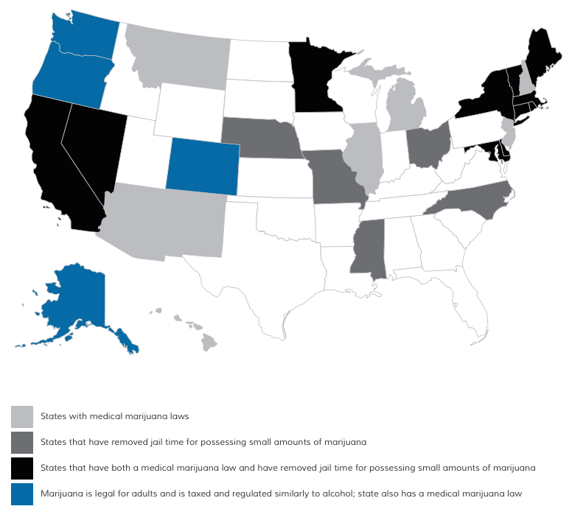
Background
23 States and D.C. have enacted medical cannabis programs¹

Slide 3
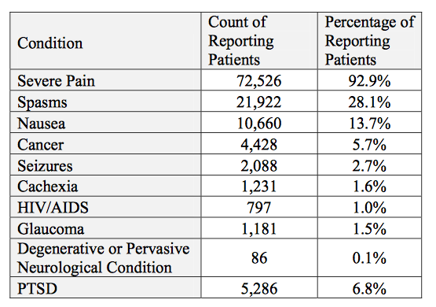
Background
State programs specify list of qualifying conditions
  Ranging from 8-16 conditions
  OMMP recognizes 10 medical conditions²⁻³
    Can have more than 1 qualifying condition

Slide 4
Expanded Access Research Programs
16 states⁴
Defined as “research” programs, but intended as a means of providing cannabis as last resort
Medication resistant epilepsy
Utilizing FDA approved pharmaceutical grade Cannabidiol (CBD) product or hemp extract

Slide 5
Expanded Access Research Programs
Georgia⁵
  Georgia Cannabidiol Study
  N=50 children
  $4.8 million, free pharmaceutical grade cannabis derivative
Alabama⁶
  UAB Cannabidiol Program
  N=100, 50 children and 50 adults
  $1 million, free pharmaceutical grade cannabis derivative
North Carolina⁷
  Pilot Studies
  Hemp extract

Slide 6
State-Level Medical Cannabis Research Programs
Three states evaluating the medical benefits of cannabis
  California, Colorado, Minnesota
Varied structure, funding, and study type/focus
  Structure: university, state
  Funding: state funded, patient fees, manufacture fees
  Study type: clinical, observational

Slide 7
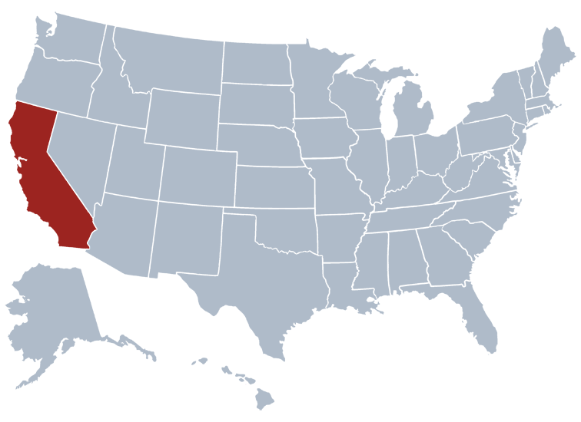
California
1999: University of California Center for Medicinal Cannabis Research (CMCR)⁸
Clinical and pre-clinical trials
$8.7 million, authorized to accept private donations
13 completed studies⁹
  Neuropathic pain (5); vaporization; MS; Sleep; Driving; CD4 Immunity in AIDS

Slide 8
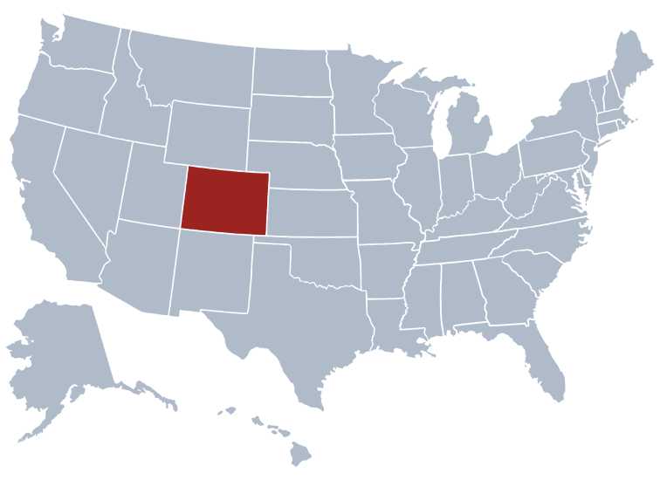
Colorado
2014: Medical Marijuana Research Grant Program¹⁰
Clinical and observational trials
$9 million in tax revenue, authorized to accept private donations
9 proposed/beginning studies
  PTSD (2); pediatric epilepsy (2); pediatric brain tumors; Parkinson’s; Inflammatory bowel disease; sleep; cannabis vs. oxycodone

Slide 9
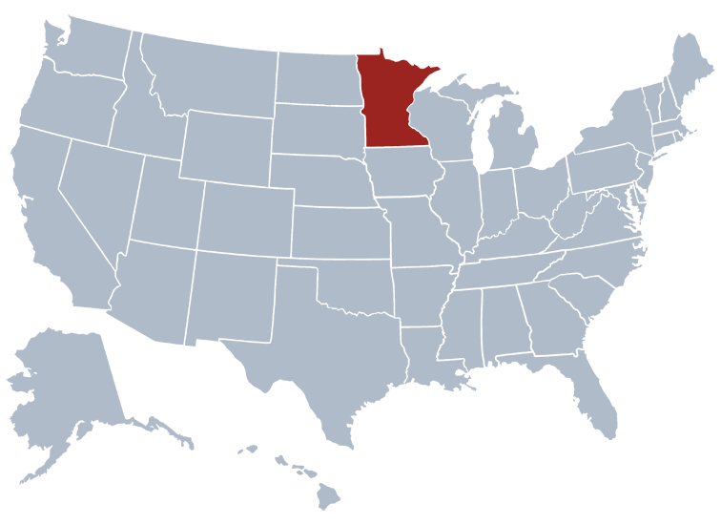
Minnesota
2015: Medical Cannabis Program¹¹
Observational
1 ongoing study with all registered patients, N=662
Patients surveyed every time they purchase cannabis

Slide 10
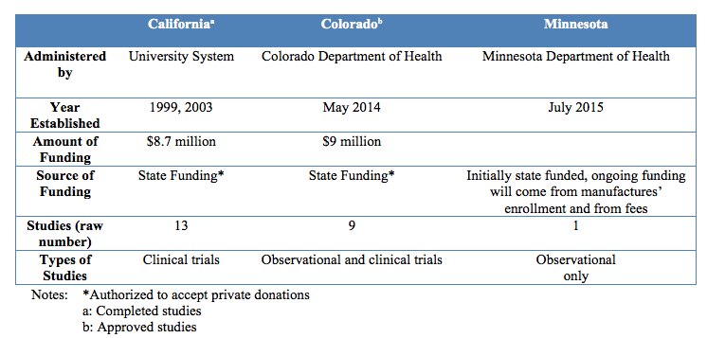
Comparison of State-Level Research

Slide 11

Federally Funded Studies
NIH funded 30 studies¹²
6 categories of medical conditions:
  Seizures, substance use disorders, psychiatric disorders, autoimmune diseases, inflammation, and pain
  Human and animal trials

Slide 12
Discussion Questions
What types of research would the state want to encourage (i.e. observation, clinical, bench)?
What structures would be best for a state sponsored program (i.e. funding only, state run, independent research institute)?
What partnerships would be beneficial for a state sponsored program (i.e. pharmaceutical company, other state programs, etc.)?

Slide 13
References
Marijuana Policy Project. 2015. State Policy. Retrieved from https://www.mpp.org/states/
Oregon Health Authority. Oregon medical marijuana program statistics. Oregon.gov. Retrieved from http://public.health.oregon.gov/DiseasesConditions/ChronicDisease/MedicalMarijuanaProgram/Pages/data. aspx. Accessed October 6, 2015.
Oregon Health Authority. Oregon medical marijuana program statistics: Statistical snapshot, October 2015. Oregon.gov. Retrieved from https://public.health.oregon.gov/DiseasesConditions/ChronicDisease/MedicalMarijuanaProgram/Documents/OMMP%20Statistic%20Snapshot%20-%2010-2015.pdf
National Conference of State Legislatures. State medical Marijuana Laws. Retrieves from http://www.ncsl.org/research/health/state-medical-marijuana-laws.aspx#Table%202 Accessed December 3, 2015
Georgia Regents University, 2014. Georgia Cannabidiol Study Frequently Asked Questions. Retrieved from 24 http://www.gru.edu/gov/gcsr.pdf.
University of Alabama. UAB cannabidiol program. Retrived from https://www.uab.edu/medicine/neurology/research/uab-cannabidiol-program.
North Carolina General Statutes, Chapter 90; Section 113.100.
Center for Medicinal Cannabis Research. Welcome to the Center for Medicinal Cannabis Research. Retrieved from http://www.cmcr.ucsd.edu
Center for Medicinal Cannabis Research. Report to the legislature and governor of the state of California presenting findings pursuant to SB847 which created the CMCR and provided state funding. Retrieved from http://cmcr.ucsd.edu/images/pdfs/cmcr_report_feb17.pdf. Accessed October 15, 2015.
Colorado Department of Public Health & Environment. (2015). Approved medical marijuana research grants. Retrieved from https://www.colorado.gov/pacific/cdphe/approved-medical-marijuana-research-grants. Accessed October 7, 2015.
Minnesota Department of Health. (2015). Medical Cannabis Qualifying Conditions. Resources. Retrieved from http://www.health.state.mn.us/topics/cannabis/patients/conditions.html
National Institute on Drug Abuse. (2015). NIDA Research on the Therapeutic Benefits of Cannabis and Cannabinoids. Retrieved from http://www.drugabuse.gov/drugs-abuse/marijuana/nida-research-therapeutic-benefits-cannabis-cannabinoids. Accessed December 4, 2015.

Slide 14
Thank you

