Slide 1
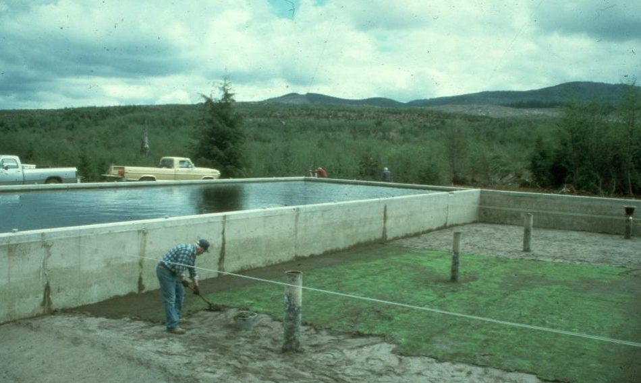
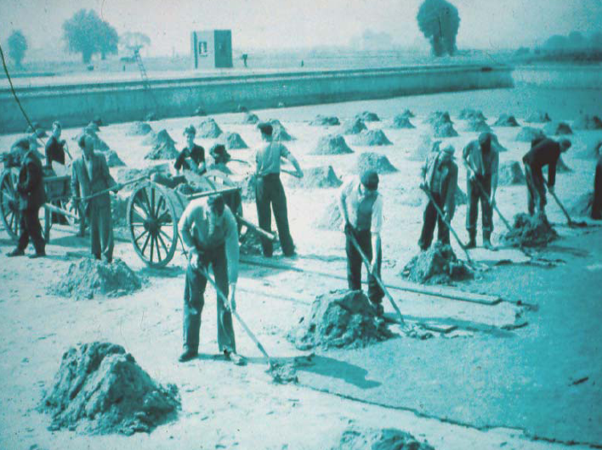
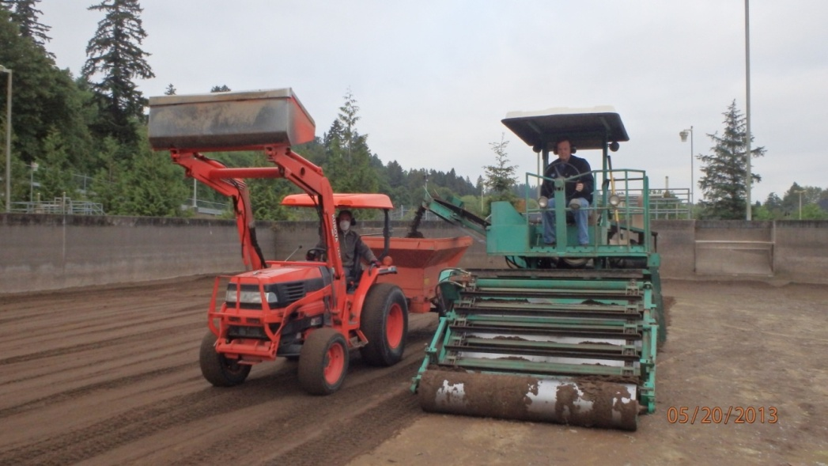
Operations
Wickiup Water District, Oregon
2013. North Clackamas County Water Commission, OR. SSF Cleaning (photo taken by Chris Johnsen, NCCWC)

Slide 2
Critical Variables That can impact Performance
Critical Variables
Raw water characteristics (temperature, particle characteristics, color, algae, nutrients, organic compounds, oxygen content). Sand size (d₁₀) and uniformity (U) Flow control and air binding Head loss allowed Sand bed depth Filtration rate and variability Maturity of the sand bed and biological organisms Filter cleaning (frequency, length of time the filter is out of operation, ripening period)
Notes:
As previously mentioned, there are a number of variables that can have a big impact on performance. This segment will touch on the operation and maintenance of slow sand filters.

Slide 3
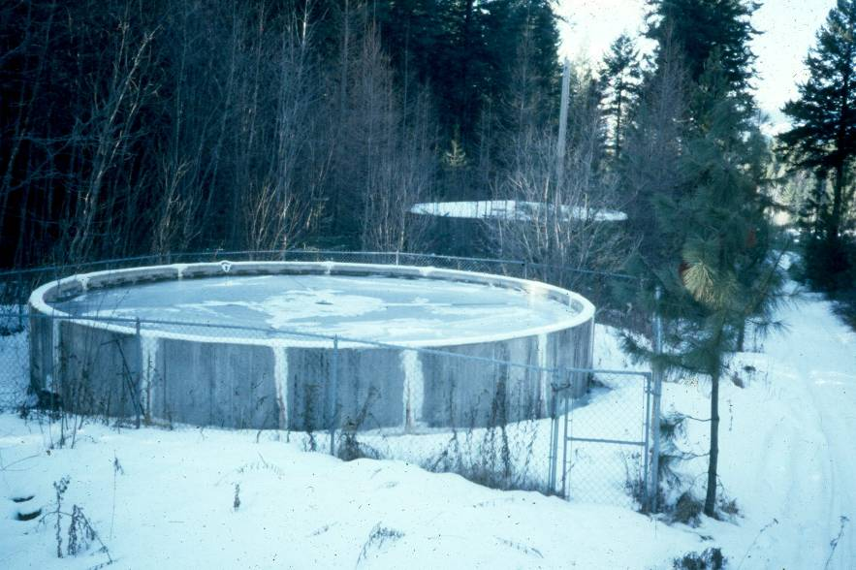
Filtration
Rate
Filtration rate should be continuous
  Good for dissolved oxygen
  Good for nutrient supply
  Good for biological mechanisms
  Influent flow should not scour sand surface
  0.1 gpm/ft² maximum filtration rate
  0.03 gpm/ft² minimum filtration rate
  Cold temperatures may need lower filtration rates (e.g., 0.05 gpm/ft² when water temp < 5°C)
  Controls should be in place to prevent the tail water (effluent side) from dropping below the sand bed during operation (e.g., an effluent weir) – this helps prevent vacuum conditions and air entrainment.
Notes:
The filtration rate should be continuous with rate changes needed to accommodate system demands made gradually over a period of several days or weeks. Operating this way keeps a constant supply of nutrients and dissolved oxygen needed for healthy biological activity. Filtration rates should not exceed 0.1 gpm/ft² and should not drop below 0.03 gpm/ft².

Slide 4
Flow Control –Inlet vs Outlet
Flow control can be practiced at the inlet or outlet. Inlet flow control can be either operated as constant rate or declining rate modes.
Inlet flow Control – Constant Rate
Uses a throttling valve plus a flowmeter or V-notch weir prior to each filter. The operator uses the flow control valve to set the desired filtration rate. As the resistance of the filter bed increases, the water level rises. When it reaches the overflow pipe the bed should be cleaned.
  Requires less operator involvement
  Ensures a more constant rate of filtration
  Allows operator to see headloss development as headwater rises
  Low headwater at the beginning of filter runs may make filters more vulnerable to freezing in the winter if filters are not covered or insulated
Inlet Flow Control – Declining Rate
Uses a hydraulic control valve with a flowmeter and valve at the raw water line prior to each filter that regulates flow while maintaining a constant water surface elevation above the filter. Effluent flow decreases as the filter plugs.
  Headwater level is not indicative of headloss development (piezometers or pressure gages are needed)
  Decline in effluent rate or approach to terminal headloss indicates cleaning

Slide 5

Constant Rate Inlet Control
Starts off with a lower headwater level
Influent valve is set to the desired rate (e.g., 0.1 gpm/ft²)
Outlet valve is fully open
The filter will need to be cleaned when the headwater approaches the overflow
Overflow
Filter inlet
Filter
Drain
To waste or return to inlet
Filter effluent
What goes into the filter will go out of the filter (filter effluent or to waste/inlet)
Headloss builds up towards the end of the filter run as it plugs up causing headwater to rise
Cleaning unplugs filter allowing headwater to drop
Excess water produced is re-circulated (pumped) to influent or sent to waste (gravity)
Notes:
In inlet controlled filters, the rate of filtration is set by the filter inlet valve. Once the desired rate is set, no further adjustment of the valve is needed. At first the headwater level will be relatively low, but will gradually rise as the filter plugs. Once the level has reached the scum outlet or overflow, the filter has to be cleaned. Inlet control reduces the amount of work and keeps a constant rate of delivery of water into the filter.

Slide 6
Flow Control –Inlet vs Outlet
Outlet Flow Control (declining rate)
Uses a control valve and flowmeter on the outlet pipe from each filter. As the filter plugs, the filtration rate will decrease, even if the headwater level is increased. The level of water on top of the filter can be controlled by using float switches to turn on and off raw water pumps or control inlet control valves. Excess water can also be diverted out an overflow and directed back to the source.
  Most common
  Fairly simple control method although operator involvement is higher if no automation is used
  Higher rates may be implemented faster for emergency situations, since you don’t have to wait for headwater to rise as with constant rate influent control.
  Ability to maintain higher headwater level provides better protection from freezing.
  Higher headwater level provides raw water storage should influent flows be interrupted due to power failure or intake shutdown due to damage or to avoid high turbidity events.
  Headwater level is not indicative of headloss development (piezometers or pressure gages are needed)

Slide 7
Declining Rate Outlet Control
Starts off with a higher headwater level
Influent valve is adjusted to keep filter from overflowing
Outlet valve is partially closed at first and then is gradually opened as the yield drops due to filter plugging
The filter will need to be cleaned when the yield cannot keep up with demands
Overflow
Filter inlet
Filter
Drain
Overflow
Filter effluent
What goes into the filter will go out of the filter (Excess can be overflowed if needed)
Headloss builds up towards the end of the filter run as it plugs up causing headwater to rise
Cleaning unplugs filter allowing headwater to drop and yield to recover
Influent water is balanced with effluent or excess can be overflowed from headwater
Notes:
In outlet control, the effluent is restricted at the beginning of the filter fun to keep flows down to 0.1 gpm/sf or less, while the headwater level is maintained by adjusting the filter inlet. Daily or every couple of days the valve has to be opened a little further to compensate for the increase in headloss, causing a slight variation in the rate of filtration. Inlet and outlet flows have to adjusted regularly to balance flows into and out of the filter throughout the filter run.

Slide 8
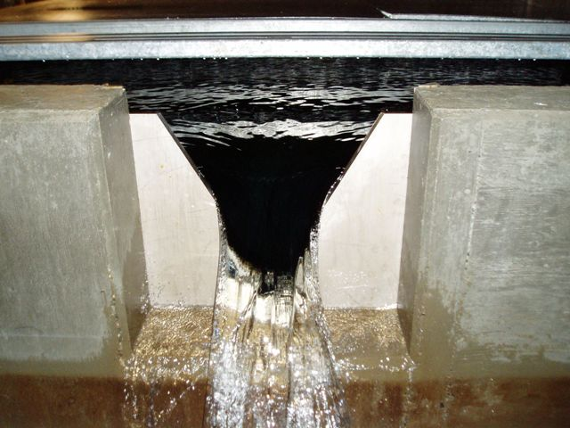
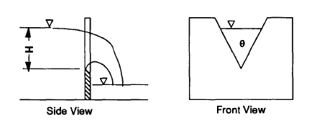
Flow Measurements
Flow can be measured using weirs (square, v-notch), orifice plates, or flow meters.
Flow calculation for V-notch weir with a 60 degree angle:
Q = 1.44 H^{5/2}
Where:
Q = ft³/second
H = height of water level above weir crest (ft)
Notes:
Outlet flow measurements can be made whether using weirs, orifice plates, or flow meters.

Slide 9
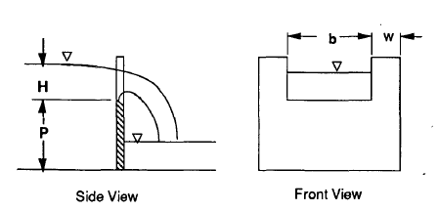
Flow Measurements
Flow calculation for rectangular weir:
Q = C_{w} * (2*g)^{0.5} * b * H^{3/2}
Where:
Q = ft³/second
H = height of water level above weir crest (ft)
g = 32.2 ft/s² (gravity)
b = length of weir crest (ft)
C_{w} = weir coefficient where C_{w} = 0.40 + (0.05 * (H/P)) where P = distance in feet from floor of channel to weir crest
Notes:
This is the formula for flow measurements made from a rectangular weir.

Slide 10
Flow Measurements
Rectangular weir flow determinations:
Flow calculations for rectangular weir – Yellow cells indicate acceptable range of filtration rates from 0.03 – 0.1 gpm/ft² (with unit conversions for H & P in inches and Q in gpm, MGD, or gpm/ft²)
Q = C_{w} * (2*g)^{0.5} * b * H^{3/2} C_{w} = 0.40 + (0.05 * (H/P)
Weir Parameters |  |  | Q (gpm) |  |  | Q (MGD) |  |  | Q (gpm/ft²) w/ 1,000 ft² Filter Area
H (inches) | P (in) | C_{w} (ft³/s) | b = 1 ft | b = 2 ft | b = 3 ft | b = 1 ft | b = 2 ft | b = 3 ft | b = 1 ft | b = 2 ft | b = 3 ft
0.25 | 72 | 0.4002 | 4.3 | 8.7 | 13.0 | 0.006 | 0.012 | 0.019 | 0.004 | 0.009 | 0.013
0.5 | 72 | 0.4003 | 12.3 | 24.5 | 36.8 | 0.018 | 0.035 | 0.053 | 0.012 | 0.025 | 0.037
0.75 | 72 | 0.4005 | 22.5 | 45.1 | 67.6 | 0.032 | 0.065 | 0.097 | 0.023 | 0.045 | 0.068
1 | 72 | 0.4007 | 34.7 | 69.4 | 104.1 | 0.050 | 0.100 | 0.150 | 0.035 | 0.069 | 0.104
1.25 | 72 | 0.4009 | 48.5 | 97.1 | 145.6 | 0.070 | 0.140 | 0.210 | 0.049 | 0.097 | 0.146
1.5 | 72 | 0.4010 | 63.8 | 127.7 | 191.5 | 0.092 | 0.184 | 0.276 | 0.064 | 0.128 | 0.192
1.75 | 72 | 0.4012 | 80.5 | 160.9 | 241.4 | 0.116 | 0.232 | 0.348 | 0.080 | 0.161 | 0.241
2 | 72 | 0.4014 | 98.4 | 196.7 | 295.1 | 0.142 | 0.283 | 0.425 | 0.098 | 0.197 | 0.295
Notes:
This table shows flow measurements made using the formula for a rectangular weir. Some of the unit conversions have been incorporated into the results (e.g., H & P in inches rather than feet and Q in gpm or MGD rather than ft³/second).

Slide 11
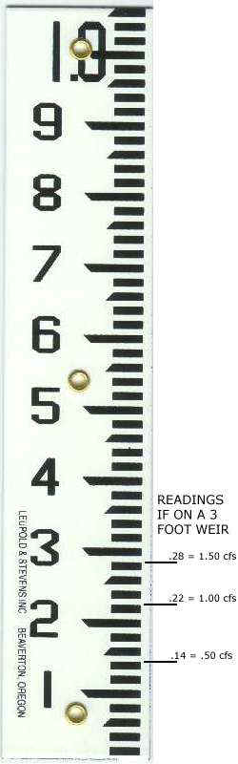
Cleaning (scraping/harrowing)
Factors that impact filter cleaning:
Cleaning method (scraping or harrowing)
Cleaning mechanisms (hand shovel or larger equipment)
Presence of 2 or more filter beds (the more filters, the smaller the area to be cleaned at any one time)
Room to stage equipment, stockpile sand, etc.
Other provisions to minimize down time during cleaning
Monitoring capability (individual and combined filter effluent turbidity, taps to sample for individual filter effluent coliform bacteria, turbidity, and other parameters, and filter-to-waste effluent taps for monitoring coliform and turbidity during the ripening period)
Ability to measure sand bed depth (keyway, staff gage (shown), etc.)
Notes:
Many factors impact effective cleaning. Cleaning can be accomplished by scraping or harrowing and can be done either by hand or using machines, depending upon the size of the beds. Either way, cleaning efforts should strive to minimize the time a filter is off-line, which is facilitated by the presence of a sufficient number of filters, which not only provides for redundancy, but also reduces the size of the filter area to be cleaned at any one time. Access to the filter beds is dictated by the cleaning method. Storage should also be provided for equipment and stockpiled sand. Ideally, the design should include on-line instrumentation to monitor individual and combined filter effluent turbidity as well as providing taps for sampling of filter-to-waste water for determining when a newly cleaned filter is ready to be put back into service. Provisions should also exist to determine how much sand is remaining in the filter bed, which is typically reduced with each cleaning.

Slide 12
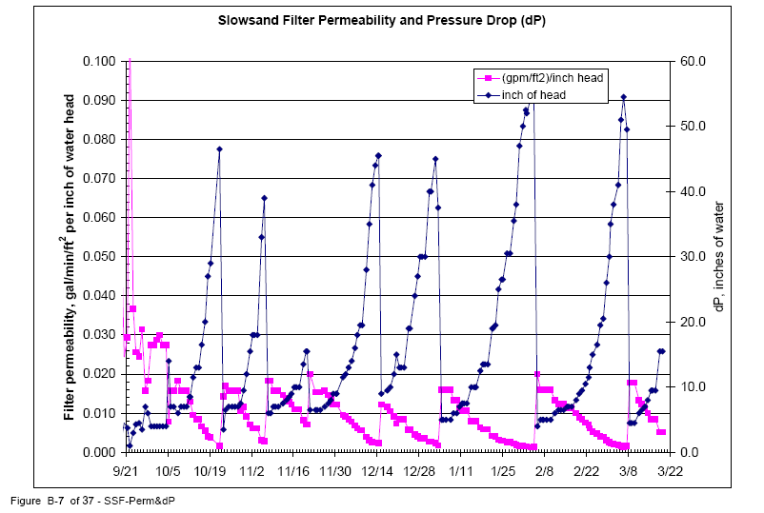
When to clean
Cleaning is needed when either terminal head loss is reached (i.e., headwater reaches the overflow level) or when filter effluent is unable to keep up with system demands.
This graph
shows head loss
increase, while
permeability
decreases
towards the end
of each filter run.
Notes:
Cleaning is needed when either terminal head loss is reached or when filter effluent is unable to keep up with system demands. This graph shows head loss increase, while permeability decreases towards the end of each filter run. This graph is from the Bureau of Reclamation’s August 2000 report entitled Alternatives for Using Central Arizona Project Water in the Northwest Tucson Area.

Slide 13
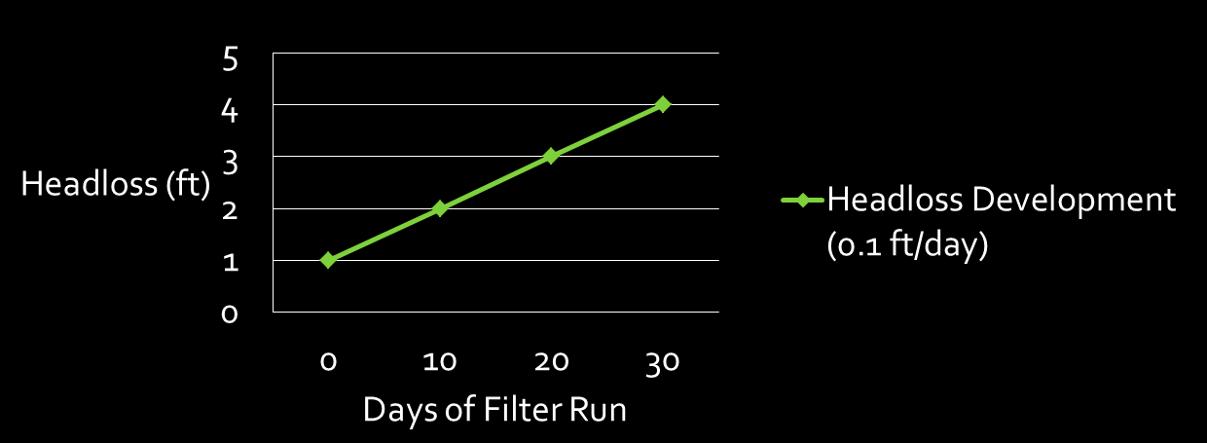
Predicting When to clean
Daily measurement of headwater (influent or supernatant water) and tailwater (effluent or permeate water) levels can be used to develop plots of headloss versus time (like the one shown below), which can then be used to predict when the filter will need to be cleaned.
Note: The clean bed headloss through 4-ft of media is only about 10 inches, depending on effective size and filtration rate, which only amounts to a decrease in filter run of 2-3 days as compared with a 3-ft deep bed (HL ~ 8 inches)
Headloss = headwater elevation – tailwater elevation
For the graph shown, if the terminal headloss = 5-ft
then cleaning is predicted to be needed in 50 days = 5-ft / (0.1ft/day)
Notes:
Daily measurement of headwater and tailwater levels can be used to develop plots of headloss versus time, which can then be used to predict when the filter will need to be cleaned.

Slide 14

Predicting When to clean
Headloss development is exponential towards the end of a filter run
Headloss = headwater elevation – tailwater elevation
Notes:
Headloss development is exponential, increasing rapidly towards the end of a filter run.

Slide 15
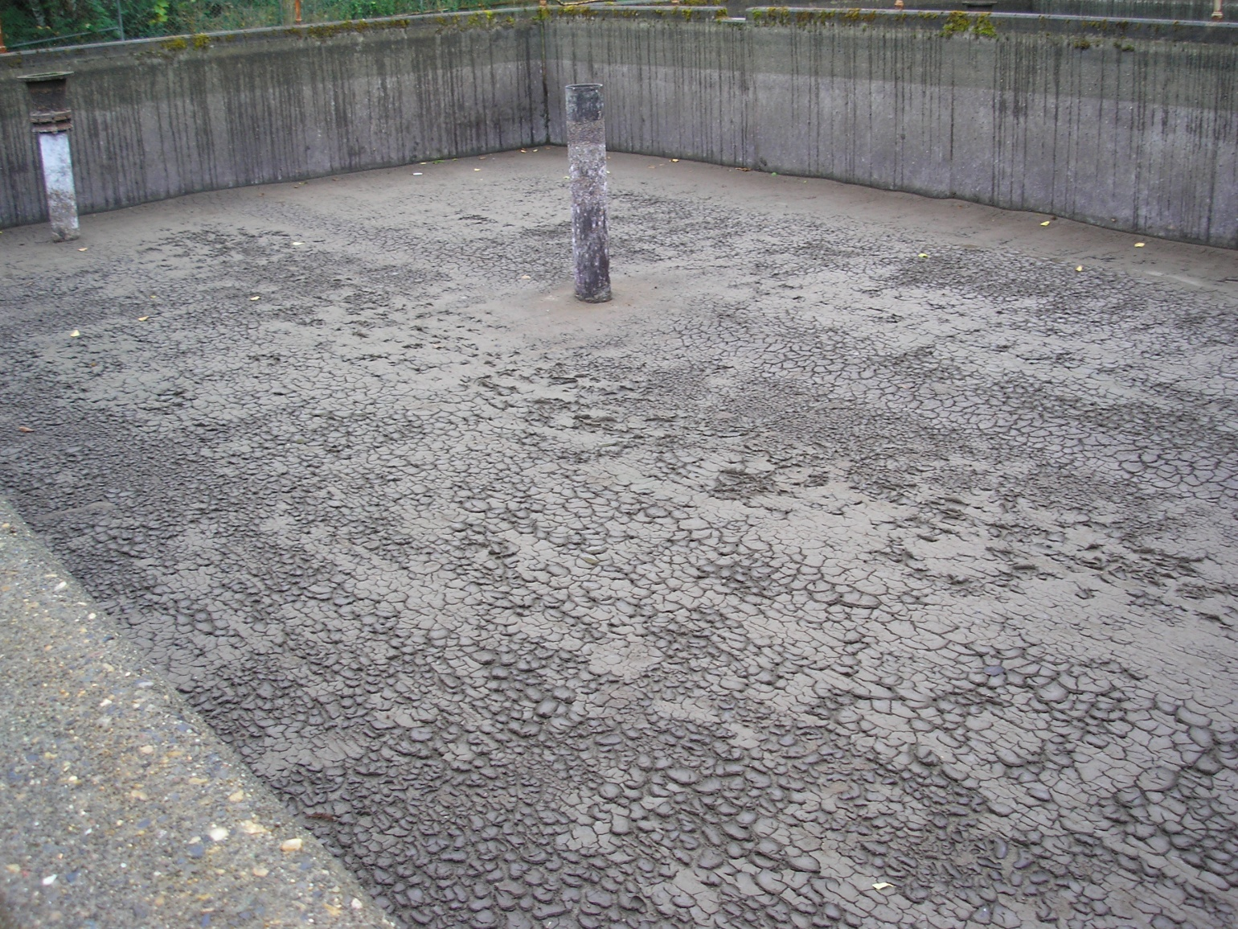
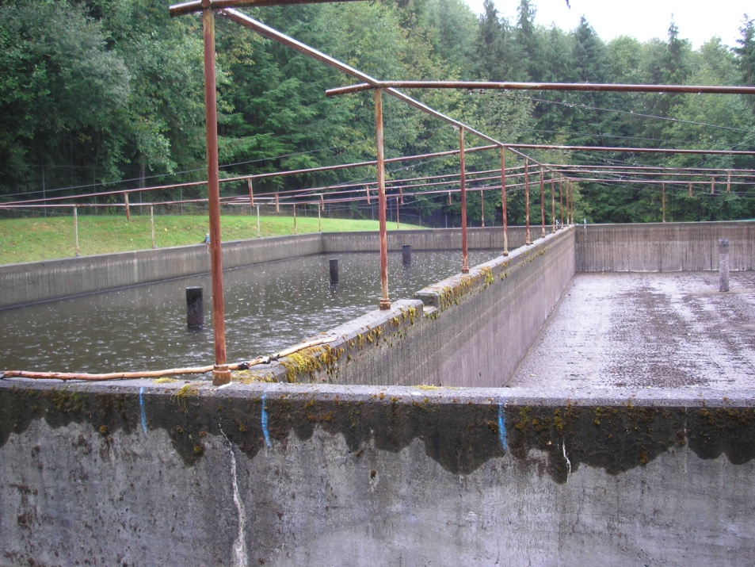
Cleaning Method
Cleaning can be
accomplished
by either:
Scraping or
Harrowing
2009. Wickiup Water District in Clatsop County, OR
Notes:
When the filter becomes clogged and effluent flows can no longer meet system demands, the filters must be cleaned. One method is to scrape the schmutzdecke and clogged portion of the sand off. The other method is wet harrowing. This photo shows a filter for the Wickiup Water District located in Clatsop County, Oregon drained and ready to be scraped.

Slide 16
Scraping Process
Scraping Process (also called dry skimming)
Water is lowered to approximately 2-12” below the sand level (to be able to safely walk and maneuver machinery around);
Schmutzdecke and plugged sand (1-2 cm) is scraped with either flat shovels or specially designed machinery;
The debris is then conveyed out of the filter bed using a wheel borrow or dump truck;
The beds are leveled;
Slowly re-filled from the bottom with filtered unchlorinated water to about 12” above the sand (this prevents sand scour that may occur from top filling)
Slowly filled from the top the remaining amount; and
Filtered to waste until fully ripened.
Notes:
When the filters are cleaned by scraping (or dry skimming) Water is lowered to approximately 2 feet below the sand level and scraped with either flat shovels or specially designed machinery. The debris is then conveyed to a wheel borrow or dump truck. The beds are leveled, re-filled, and filtered to waste until fully ripened.

Slide 17
Scraping
Phase 1
Shut off raw water inlet
and let filter drain down
(overnight for larger filters)
Or use supernatant drain
for smaller filters
Filter to be Scraped
Overflow
Raw Water
Inlet Supernatant Water
Supernatant Schmutzdecke Weir
Drain Inlet Box
Sand Bed To
Support Gravel & Under Drain Clearwell
Filtered Water for Backfilling FTW
Drain Drain
Notes:
The first phase in scraping a filter is to shut off raw water inlet and let filter drain down (overnight for larger filters) or use the supernatant drain for smaller filters.

Slide 18
Scraping
Phase 2
Shut off the effluent valve to the clear well;
Open the supernatant drain to drain off any remaining water; and
Drop the weir to lower the water level 2-24” below the sand.
Filter to be Scraped
Overflow
Raw Water
Inlet Supernatant Water
Supernatant Schmutzdecke Weir
Drain Inlet Box
Sand Bed To
Support Gravel & Under Drain Clear well
Filtered Water for Backfilling FTW
Drain Drain
Notes:
The next step is to shut off the effluent valve to the clear well, open the supernatant drain to drain off any remaining water and drop the weir to lower the water level 2-24” below the sand.

Slide 19
Scraping
Phase 3
Scrape the schmutzdecke and roughly ¼ - ½ inch (0.635 – 1.27 cm) of sand from the filter.
Close the supernatant drain, raise the weir and then begin re-filling from the bottom with filtered water at a rate below that which would fluidize the sand (around 0.3-0.6 ft/hr (0.1 – 0.18 m/hr or 0.0374 – 0.0748 gpm/ft²)) This purges air from the sand bed.
Continue filling until the supernatant water is 12 inches above the sand bed – this prevents scouring when raw water is introduced from the top.
Filter to be Scraped
Overflow
Raw Water
Inlet Supernatant Water
Supernatant Schmutzdecke Weir
Drain Inlet Box
Sand Bed To
Support Gravel & Under Drain Clearwell
Filtered Water for Backfilling FTW
Drain Drain
Notes:
Then the following steps are carried out:
Scrape the Schmutzdecke and roughly ¼ - ½ inch (0.635 – 1.27 cm) of sand from the filter.
Close the supernatant drain, raise the weir and then begin re-filling from the bottom with filtered water at a rate below that which would fluidize the sand (around 0.3-0.6 ft/hr (0.1 – 0.18 m/hr or 0.0374 – 0.0748 gpm/ft²)) This purges air from the sand bed.
Continue filling until the supernatant water is 12 inches above the sand bed – this prevents scouring when raw water is introduced from the top.

Slide 20
Scraping
Phase 4
Stop filling from the bottom and introduce raw water from the top to fill to a supernatant depth of 4-5 feet.
Begin filtering to waste at around 0.1 gpm/ft2 for 24-48 hrs for ripening until turbidity is < 1 NTU and coliform counts are < 10 CFU/100 ml.
Filter to be Scraped
Overflow
Raw Water
Inlet Supernatant Water
Supernatant Schmutzdecke Weir
Drain Inlet Box
Sand Bed To
Support Gravel & Under Drain Clearwell
Filtered Water for Backfilling FTW
Drain Drain
Notes:
Once filling from the bottom is stopped, raw water is introduced from the top to fill to a supernatant depth of 4-5 feet. The filtered is then filtered to waste at around 0.1 gpm/ft² for 24-48 hrs for ripening until turbidity is < 1 NTU and coliform counts are < 10 CFU/100 ml.

Slide 21
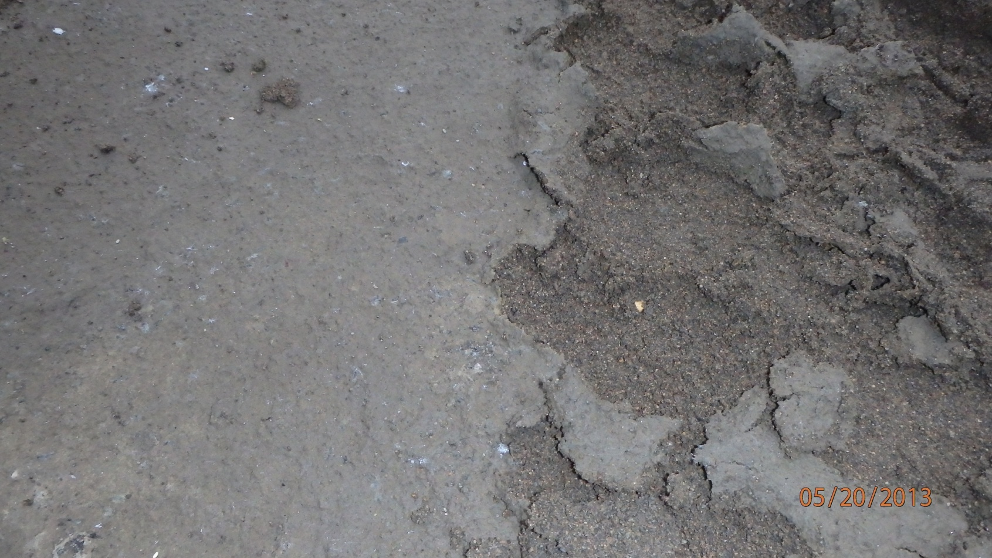
Scraping
Scraping
Schmutzdecke on the left and sand on the right
2013. North Clackamas County Water Commission, OR. SSF Cleaning (photo taken by Chris Johnsen, NCCWC)
Notes:
This photo shows the difference when the schmutzdecke has been scraped off of a filter cell at the North Clackamas County Water Commission plant (photo credit Chris Johnsen).

Slide 22
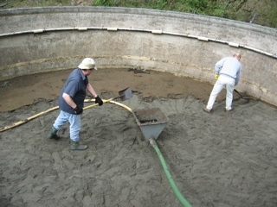

Scraping Method
Scraping Method
hand shovel
larger equipment
Photo courtesy of Stephen Baker, WA DOH
2013. North Clackamas County Water Commission, OR. SSF Cleaning (photo taken by Chris Johnsen, NCCWC)
Notes:
Scraping, can be accomplished either by hand or using machines, depending upon the size of the beds. Either way, cleaning efforts should strive to minimize the time a filter is off-line. Design should account for this and allow for ways to identify when too much sand has been removed through progressive cleanings. Storage should also be provided for equipment and stockpiled sand. Design should consider access to the filter beds, as dictated by the cleaning method of choice. Ideally, the design should include on-line instrumentation to monitor individual and combined filter effluent turbidity as well as providing for sampling of filter-to-waste water for determining when a newly cleaned filter is ready to be put back into service.

Slide 23
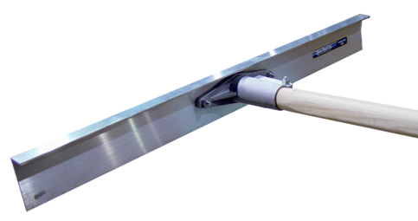
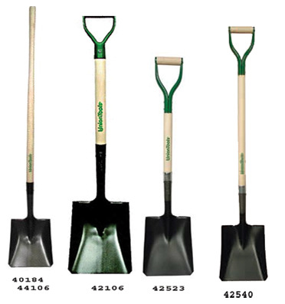
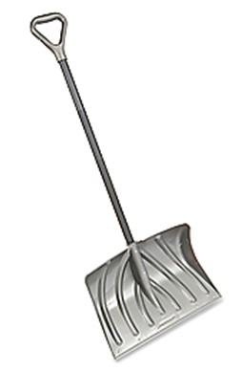
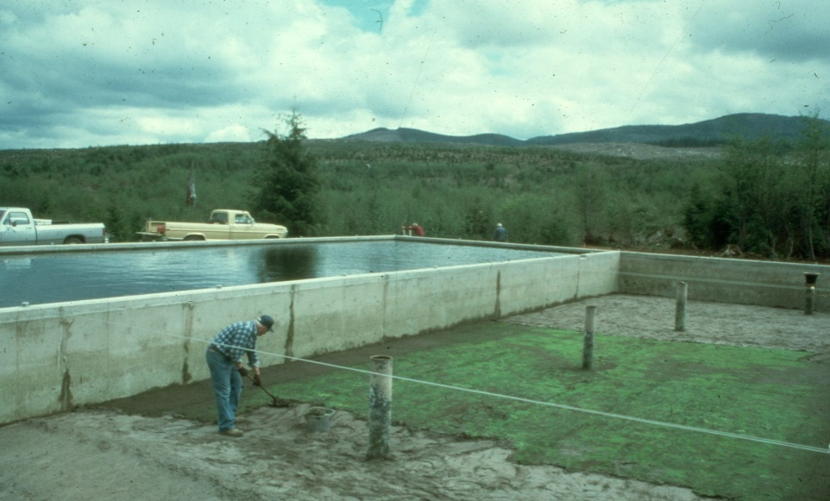
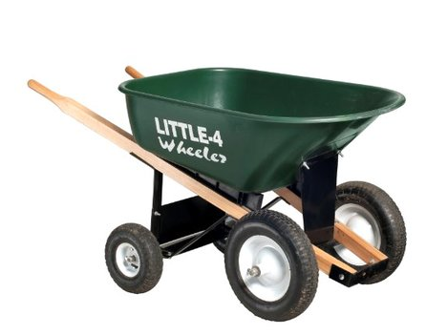
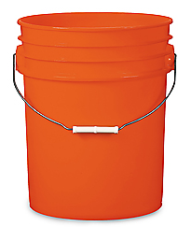
Scraping by Hand
Hand Scraping Tools
Asphalt lute (top)
Snow shovel (lower right)
Flat blade, square point transfer shovels (lower left)
Wheelbarrow or 5-gal buckets (for removal from filter bed)
Notes:
Flat, square bladed shovels, snow shovels or asphalt rakes have all been used to scrape filters. This photograph shows a fairly large filter being scraped by hand using a flat bladed shovel. Photo provided by Stephen Tanner, ret. Idaho DEQ.

Slide 24
Scraping by Hand
Hand scraping at Empire, Colorado, filter:
Scrape schmutzdecke and top 0.5 cm of sand bed into windrows using asphalt lute
Shovel scraped material from windrows into 5-gallon buckets [or could use wheelbarrow] for removal
Cleaning Rate = 205 ft² / person / hr
Note:
Avoid treading directly on schmutzdecke
Use plywood and planks to keep from treading on or running wheelbarrows on sand bed
Notes:
Hand scraping was performed at the Empire, Colorado filter plant, in which the schmutzdecke and the top 0.5 cm of sand was scraped into windrows using asphalt lutes. The scraped material was then shoveled into 5-gallong buckets for removal. The cleaning rate for this operation was estimated to be 205 ft² of filter area per person per hour. Avoid treading directly on the schmutzdecke by using plywood and plants to tread and/or operate wheelbarrows on.

Slide 25
Scraping by Hand
Hand scraping filter:

Slide 26
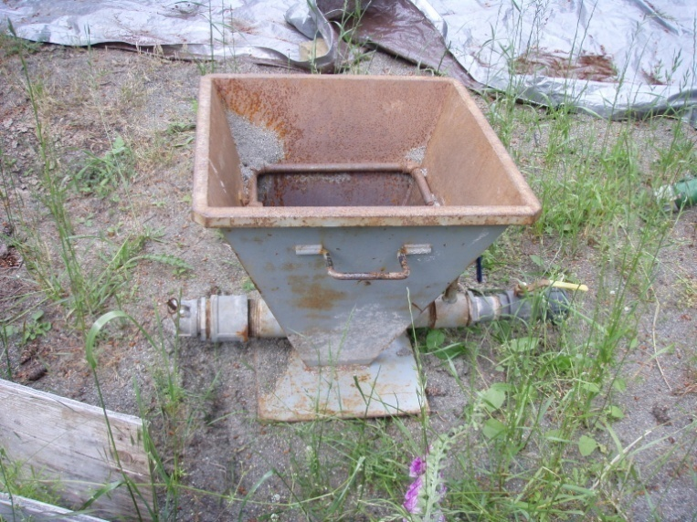

Scraping by Hand
Scraping
hand shovel
Water Eductor
Photos courtesy of Stephen Baker, WA DOH
Notes:
Manual cleaning operations eliminate the risk of spilled oils or hydraulic fluid from tractors or other motorized or hydraulic equipment, not to mention the capital and O&M costs of such equipment. This photo shows sand being scraped off of a slow sand filter using shovels and loaded into a water powered eductor (shown below) where it is then “sucked” into the sand washer (shown at right). These photos were taken by Stephen Baker at the Washington Department of Health.

Slide 27
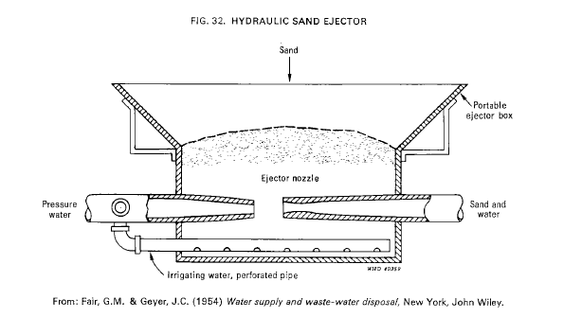
Scraping by
Hand
Water Eductor
Notes:
The “eductor” is described as a “hydraulic sand ejector” in the World Health Organization’s “Slow Sand Filtration” Manual from 1974.

Slide 28
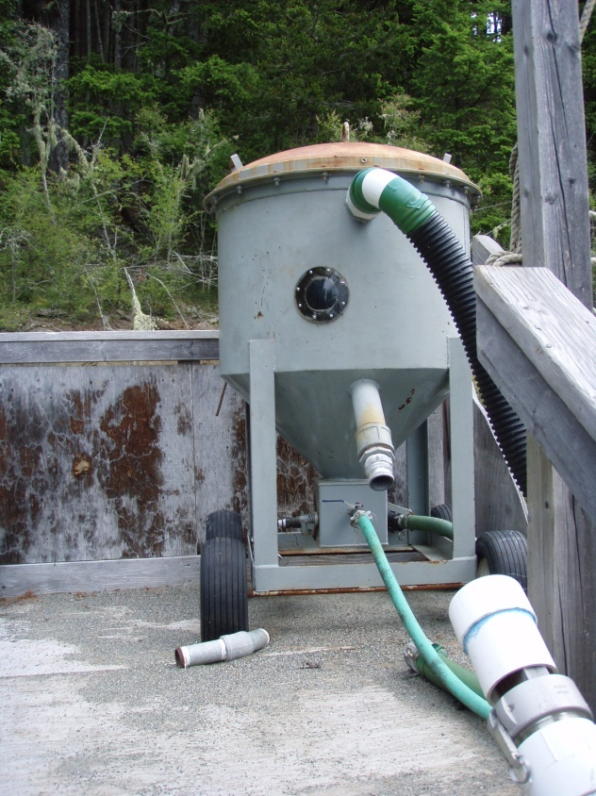
Washing Sand
Washing Sand
hand shovel => eductor =>
Washer =>
Sand filter or stockpile
Photos courtesy of Stephen Baker, WA DOH
Notes:
From the eductor, sand and water are transported to the sand media washer. This photo was also taken by Stephen Baker at the Washington Department of Health.

Slide 29
Sand Washing Process
This diagram illustrates the sand washing and grading process
Used sand
Conveyor Cyclone Conveyor
Rotary
Screens
Sand
Hopper Static Cone Density Stockpile
Separator
Reject
Overflow to waste
Notes:
This diagram illustrates the basic sand washing, screening, and stockpiling of used sand.

Slide 30
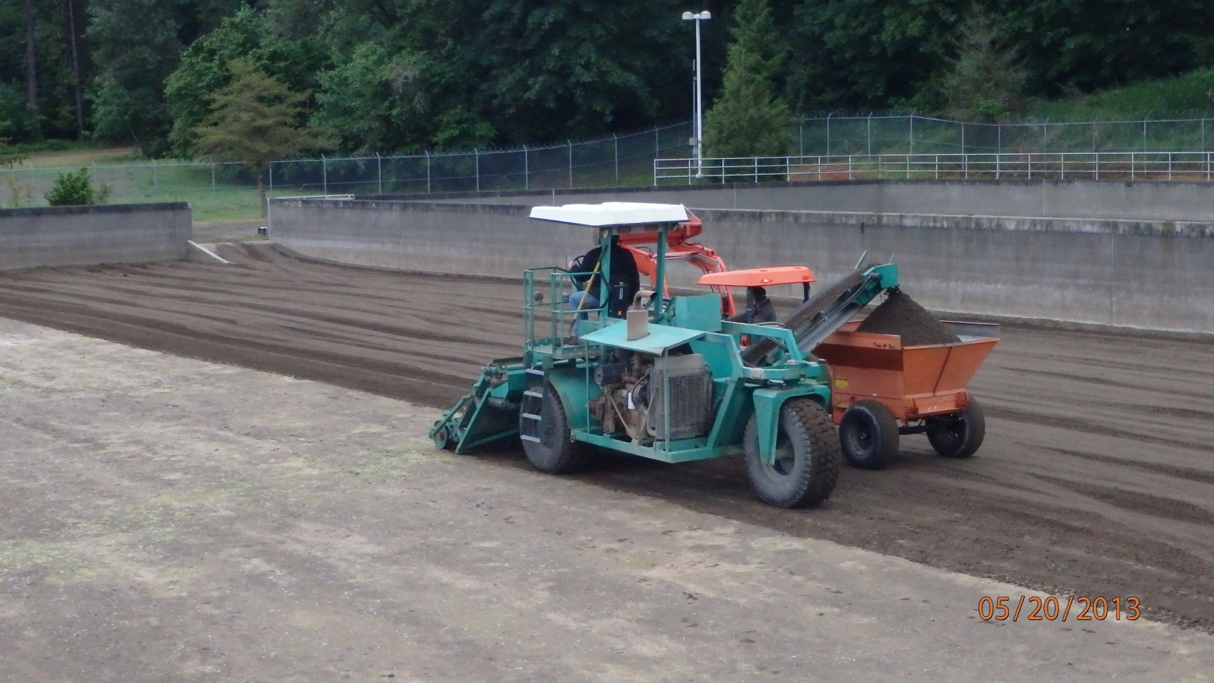
Scraping Machines
Scraping
larger equipment
2013. North Clackamas County Water Commission, OR. SSF Cleaning (photo taken by Chris Johnsen, NCCWC)
Notes:
This photo shows cleaning a slow sand filter cell at the North Clackamas County Water Commission using a DeJong Products, Inc. “sand cleaner”, now marketed as a “Filter Bed Refurbisher” (photo credit Chris Johnsen, DeJong Products is located in Sheridan, OR. http://www.dejongproducts.com/).

Slide 31
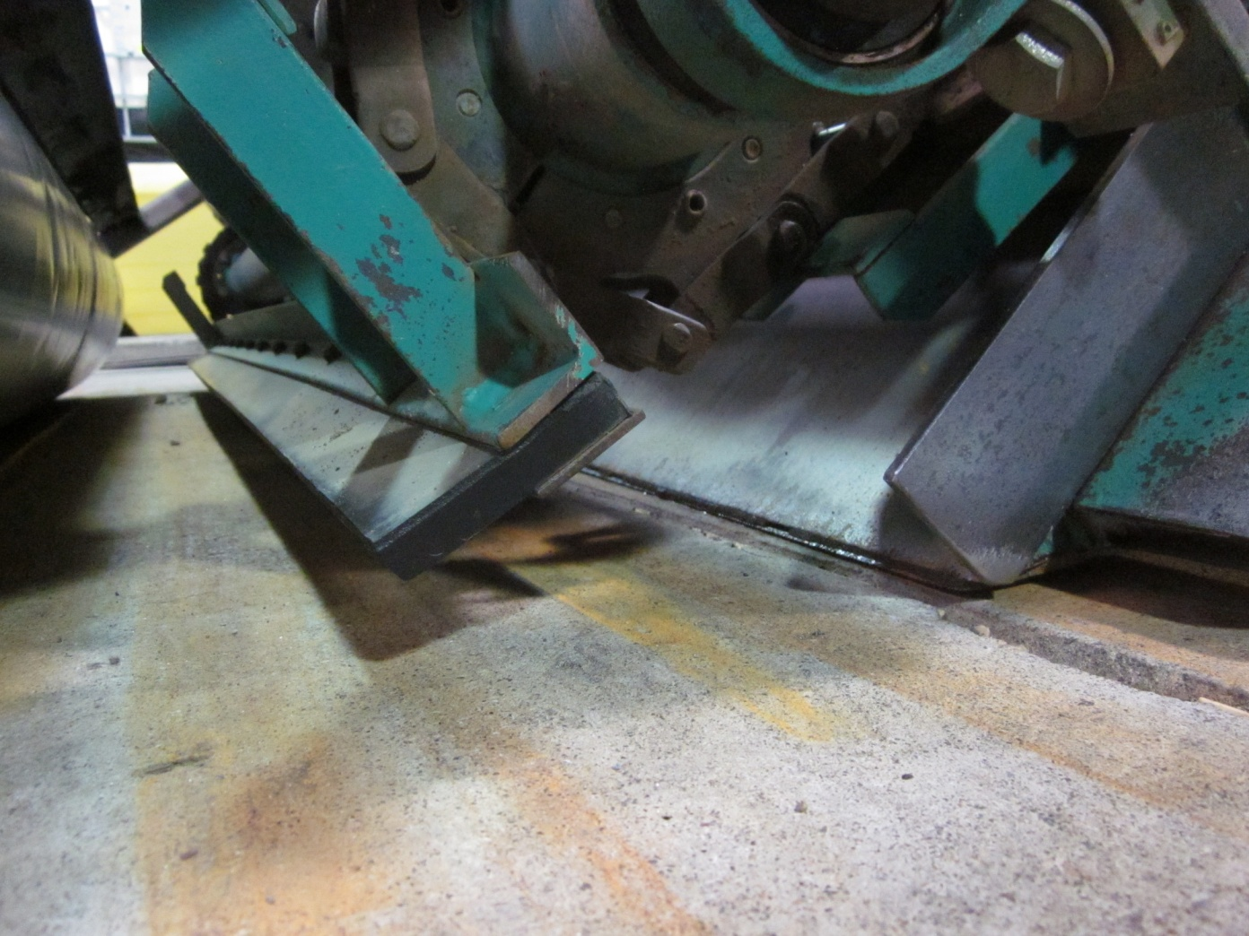
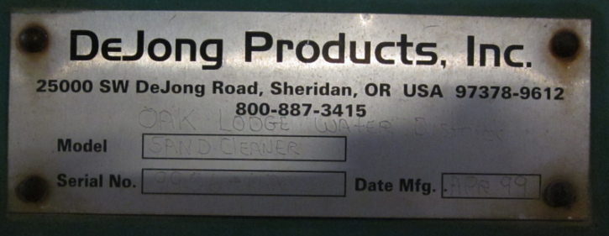
Scraping Machines
Scraping
scraping blade
The blade height can be set for precise filter media skimming thickness tolerances
2013. North Clackamas County Water Commission, OR. SSF Cleaning (photo taken by Alan Schacht, NCCWC)
Notes:
Scraping machines can allow for the blade height to be set for precise filter media skimming thickness tolerances. This photo shows the scraping blade for the DeJong sand cleaner or “filter bed refurbisher” at the North Clackamas County Water Commission (photo credit Alan Schacht, NCCWC).

Slide 32
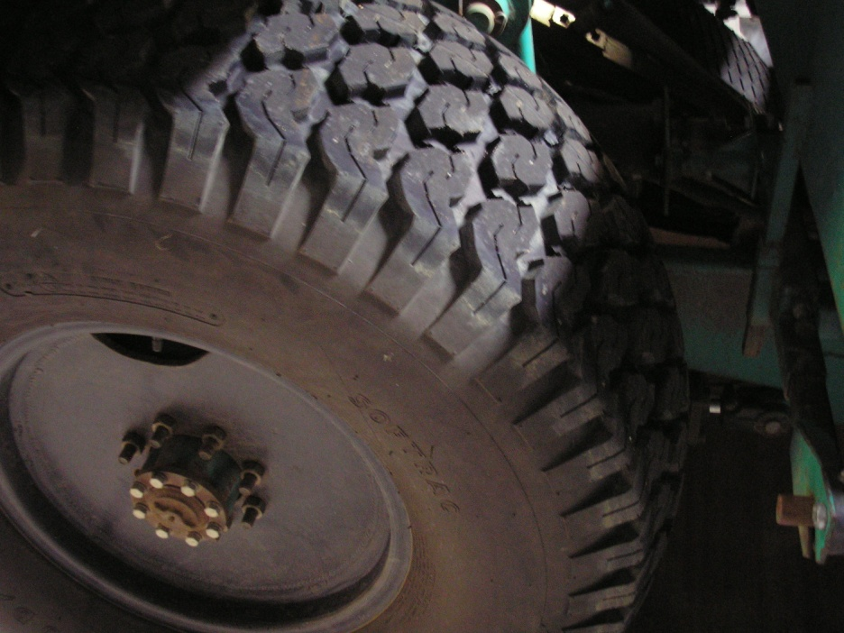
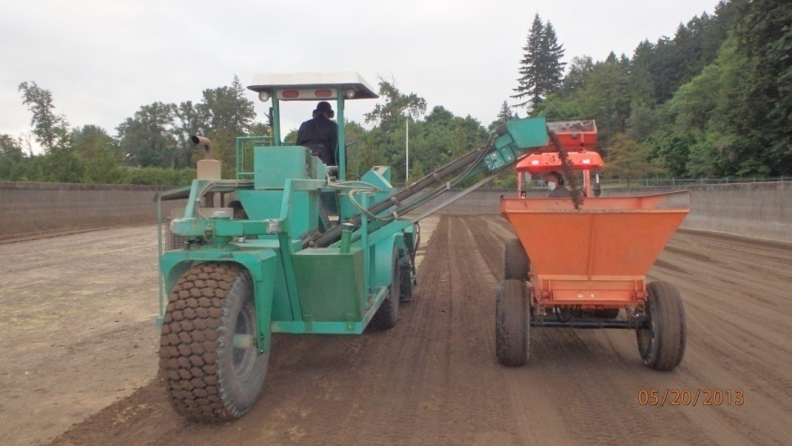
Scraping Machines
Scraping
larger equipment
2013. North Clackamas County Water Commission, OR. SSF Cleaning (photo taken by Chris Johnsen, NCCWC)
Notes:
Note the tires used on cleaning machines are designed to distribute the weight minimizing compaction and ruts.

Slide 33
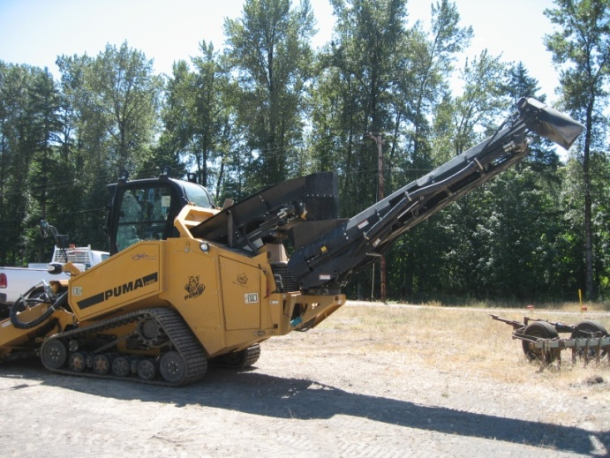
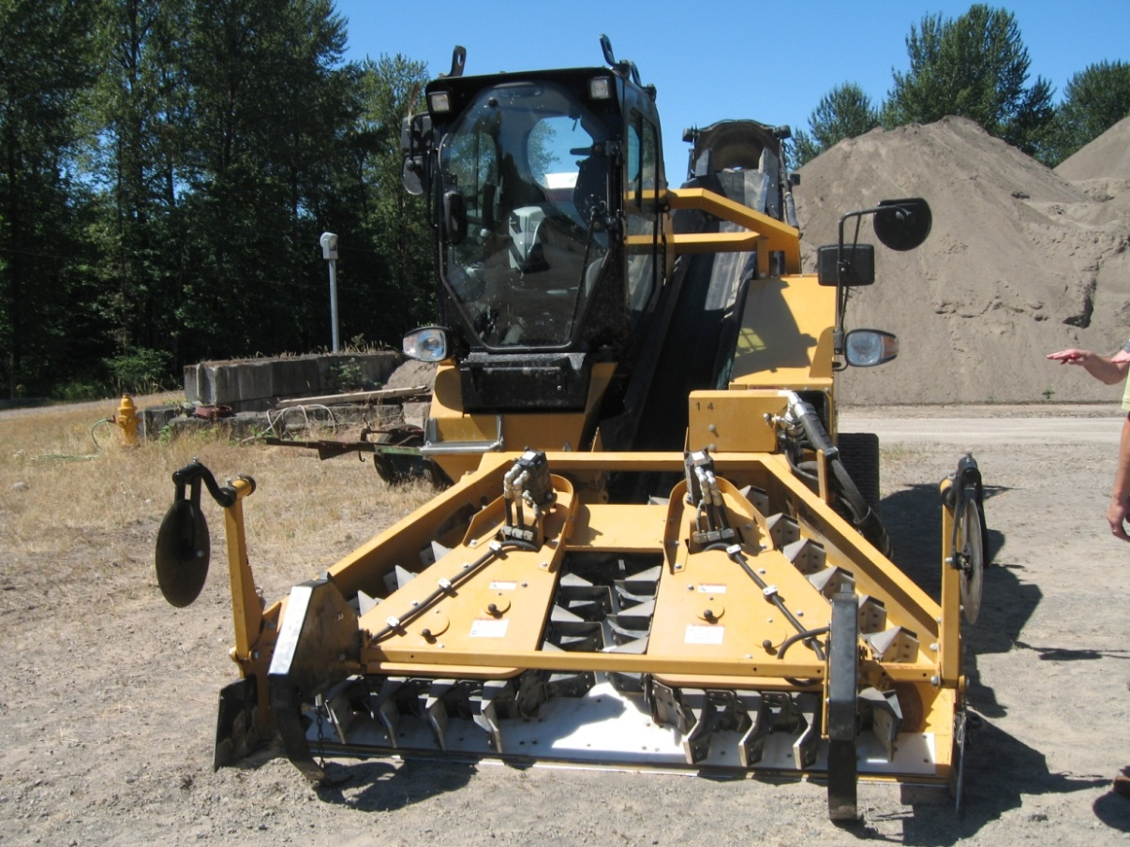
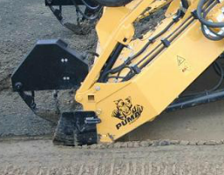
Scraping Machines
USG Puma 2400 “Sand Skimmer”
skimming thickness tolerances
between 0-100 mm (0 – 4 inches) at a rate of up to 16,000 ft²/hr (4,240 ft³/hr)
2011, City of Salem , OR SSF Cleaning Machine
USG Puma 2400 “Sand Skimmer”
Notes:
Larger equipment may be used to clean filter beds, like this USG Puma 2400 “Sand Skimmer” designed in the United Kingdom and used by the City of Salem (USG Umwelservice GmbH & Co KG, http://www.puma2400.de/en/component/content/frontpage). An adjustable blade allows for precise skimming at a fairly fast rate (16,000 ft²/hr to remove 4” sand depth. Typically only ~1/4 – ½ an inch of sand is removed at any one cleaning)

Slide 34


Scraping
USG Puma 2400
USG Puma 3000
www.youtube.com/embed/g259QNQRbDY
www.youtube.com/embed/AtX65tbf1q8

Slide 35
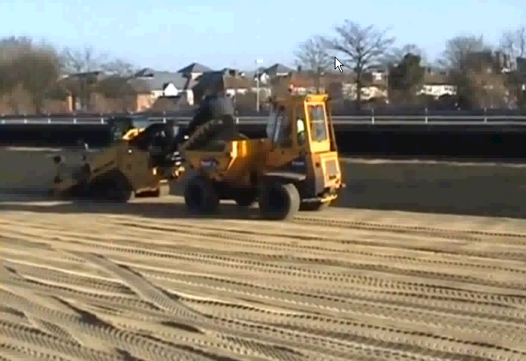
Scraping
USG Puma 2400
USG Puma 3000
www.youtube.com/embed/g259QNQRbDY
www.youtube.com/embed/AtX65tbf1q8

Slide 36
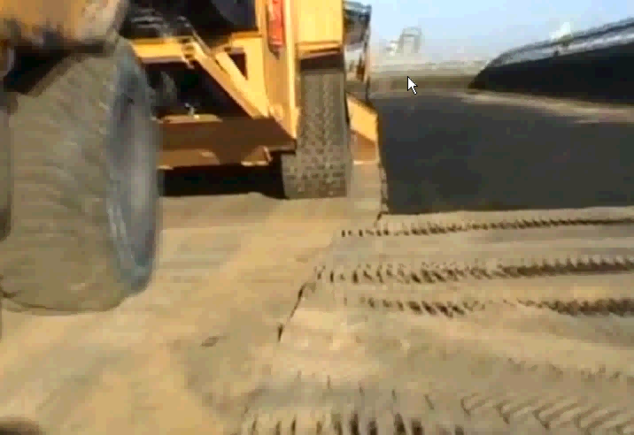
Scraping
USG Puma 2400
USG Puma 3000
www.youtube.com/embed/g259QNQRbDY
www.youtube.com/embed/AtX65tbf1q8

Slide 37
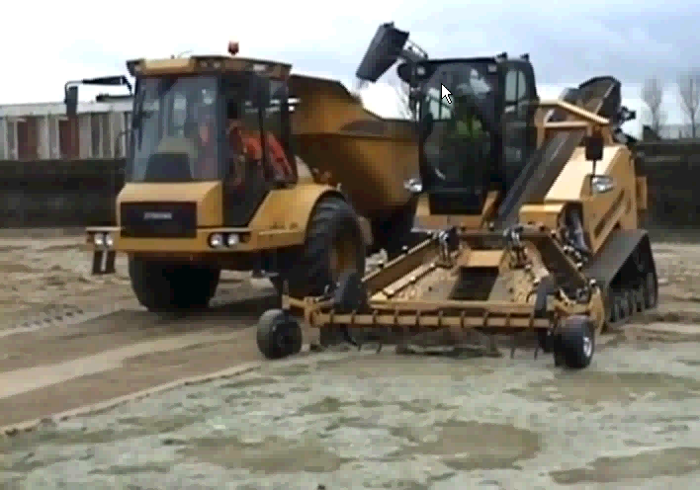
Scraping
USG Puma 2400
USG Puma 3000
www.youtube.com/embed/g259QNQRbDY
www.youtube.com/embed/AtX65tbf1q8

Slide 38
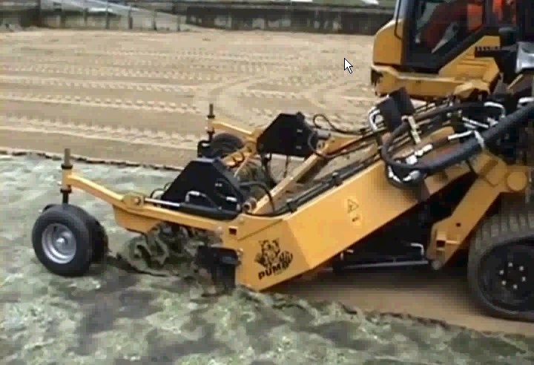
Scraping
USG Puma 2400
USG Puma 3000
www.youtube.com/embed/g259QNQRbDY
www.youtube.com/embed/AtX65tbf1q8

Slide 39
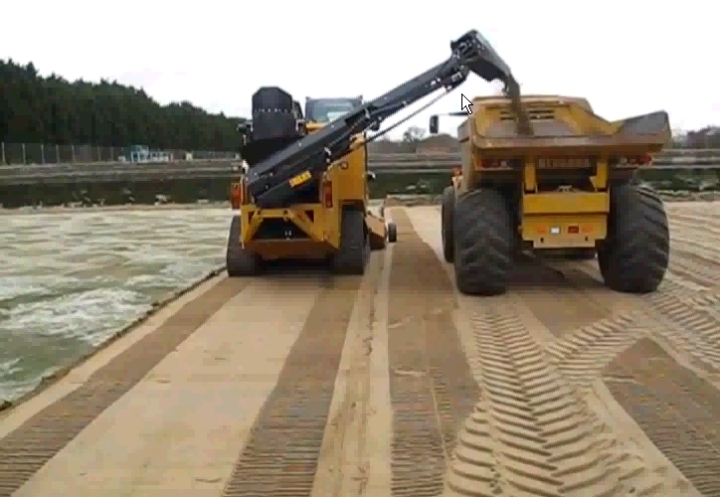
Scraping
USG Puma 2400
USG Puma 3000
www.youtube.com/embed/g259QNQRbDY
www.youtube.com/embed/AtX65tbf1q8

Slide 40
Harrowing Process
Harrowing Process (also called wet harrowing)
Water is lowered to approximately 6” above the sand level;
Water is introduced to provide a cross flow at a rate of about 20 gpm/ft² of cross-sectional area (e.g., 1,000 gpm for 6” water depth in a 100-ft long filter);
Filtered, unchlorinated water is introduced from the bottom to provide a “backflow”, which keeps debris from sinking into the filter bed;
Stiff tined rake or harrow equipment is run over the top of the sand;
The debris (not sand) is then conveyed out of the filter bed from a harrow drain located just above the sand bed;
The beds are leveled;
Slowly re-filled from the bottom to about 12” above the sand (this prevents sand scour that may occur from top filling)
Slowly filled from the top the remaining amount; and
Filtered to waste until fully ripened, which is typically shorter than scraping.
Notes:
Wet harrowing is a common method of cleaning small filters. This is often accomplished with just a stiff-tined garden rake. With the water level lowered to about 6” above the sand, the top 2-3 inches of sand is agitated. The material suspended by the raking action is then decanted from the top of the filter through a harrowing valve and waste piping. A slow backflush using filtered (but unchlorinated water) helps keep the suspended material from being driven down into the filter.

Slide 41
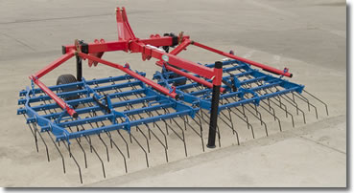
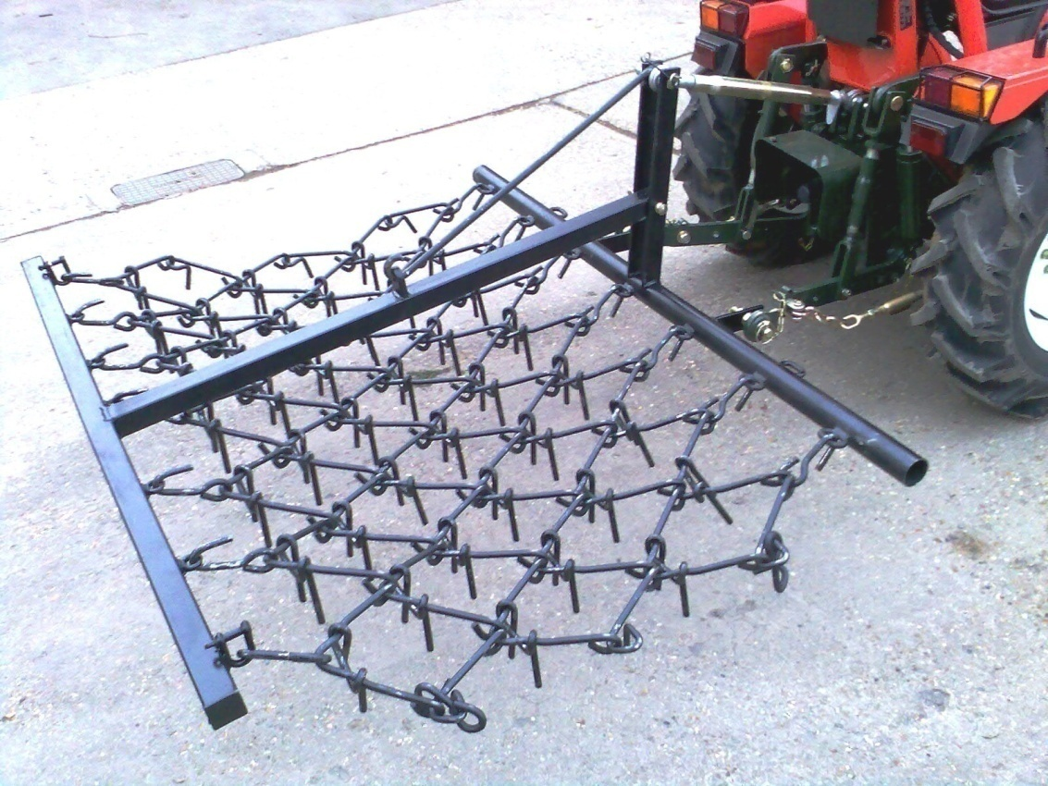
Harrowing Equipment
Harrowing Equipment
Wet harrowing can be done with a chain harrow, comb-toothed harrow, or a stiff tined rake.
Notes:
Wet harrowing can be done with a chain harrow or a comb-toothed harrow.

Slide 42
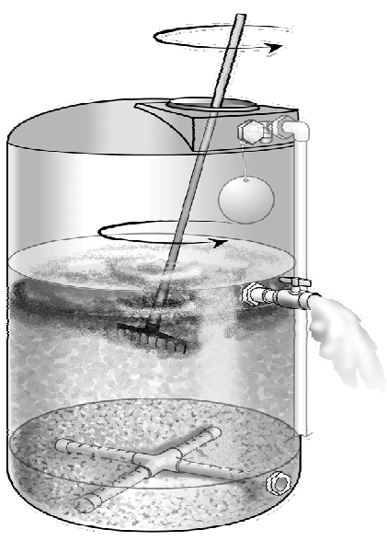
Harrowing small filters
Wet harrowing is a common
method of cleaning small
filters.
Basic process:
Lower water level to ~6” above
  the top of the sand.
Use a rake or rake-like
  Mechanism
agitate top 2”-3” of sand
  while slowly backflushing with
  filtered, but unchlorinated water
Notes:
Wet harrowing is a common method of cleaning small filters.

Slide 43
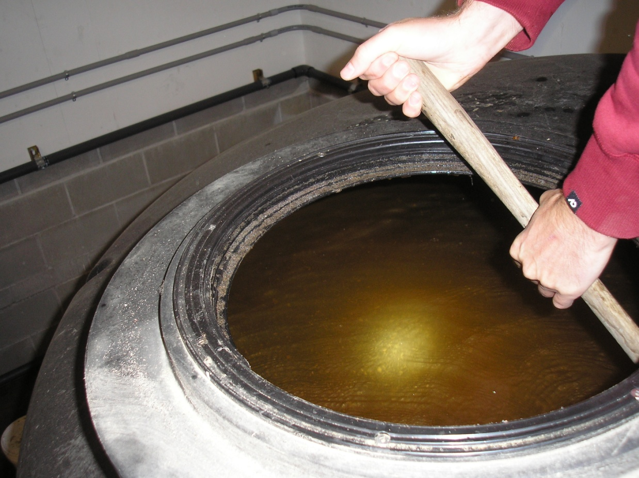
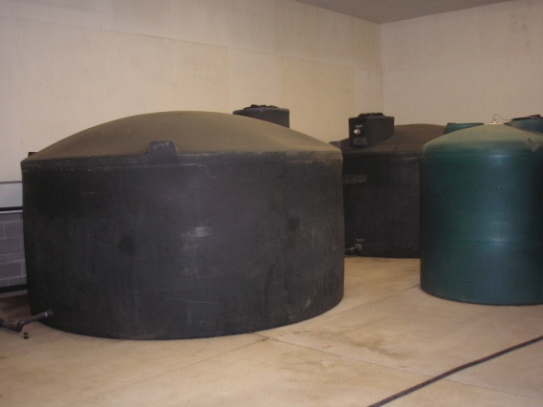
Harrowing small filters
Harrowing small
3-gpm filters using a
stiff-tined
garden rake.
2012. Jewell School District #8 in Clatsop County Oregon.
Notes:
This shows harrowing in process of a small, 3-gpm filter. [This photo is Jewell School District #8 in Clatsop, Oregon.]

Slide 44
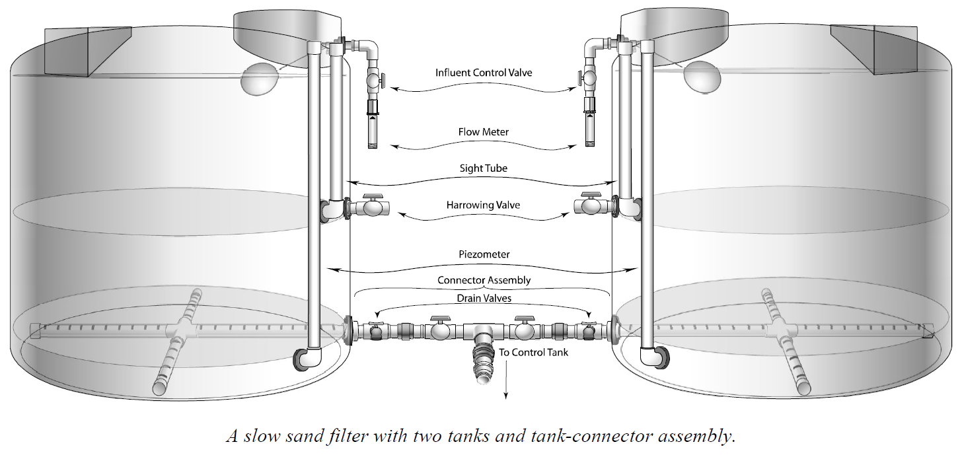
Harrowing Piping
Blue Future Filters rely on a wet harrowing process
Notes:
This diagram shows the harrowing valve and underdrain piping in a modular filter design marketed as Blue Future filters.

Slide 45
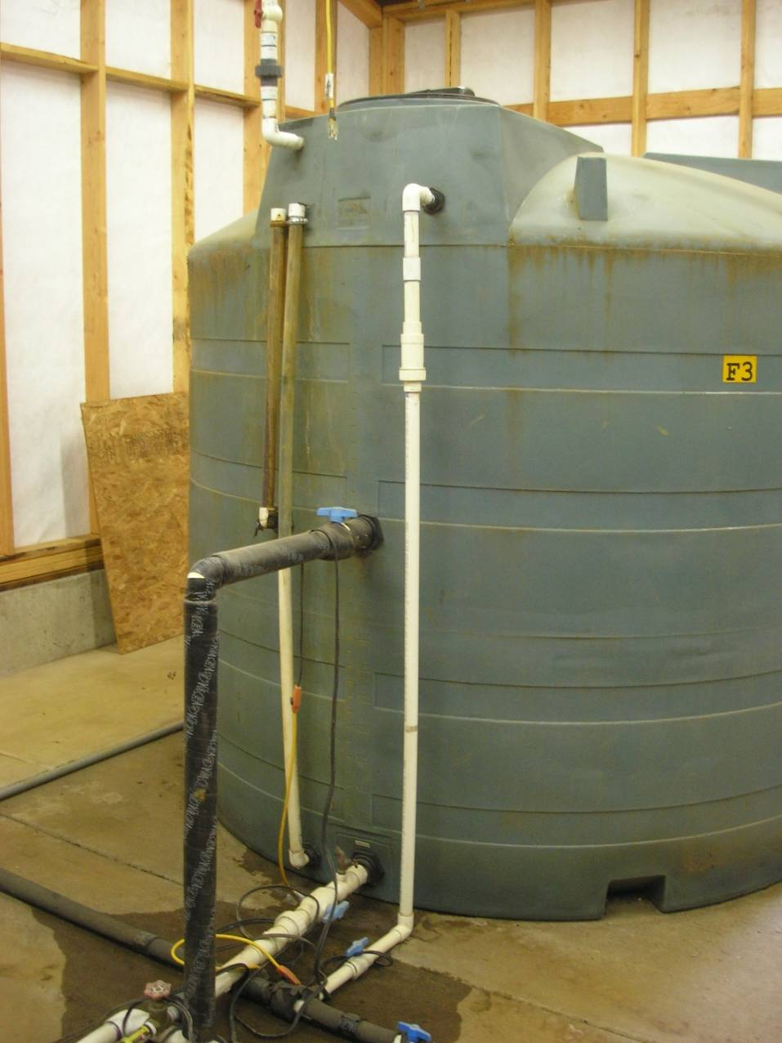
Harrowing Valve
Harrowing
Harrowing Valve
and Waste Line
2012. Camp Yamhill in Yamhill County Oregon.
Notes:
This shows the location of a harrowing valve and waste line, situated just above the sand bed, which allows the backflushed debris to be wasted. This photo is from Camp Yamhill in Yamhill County, Oregon.

Slide 46

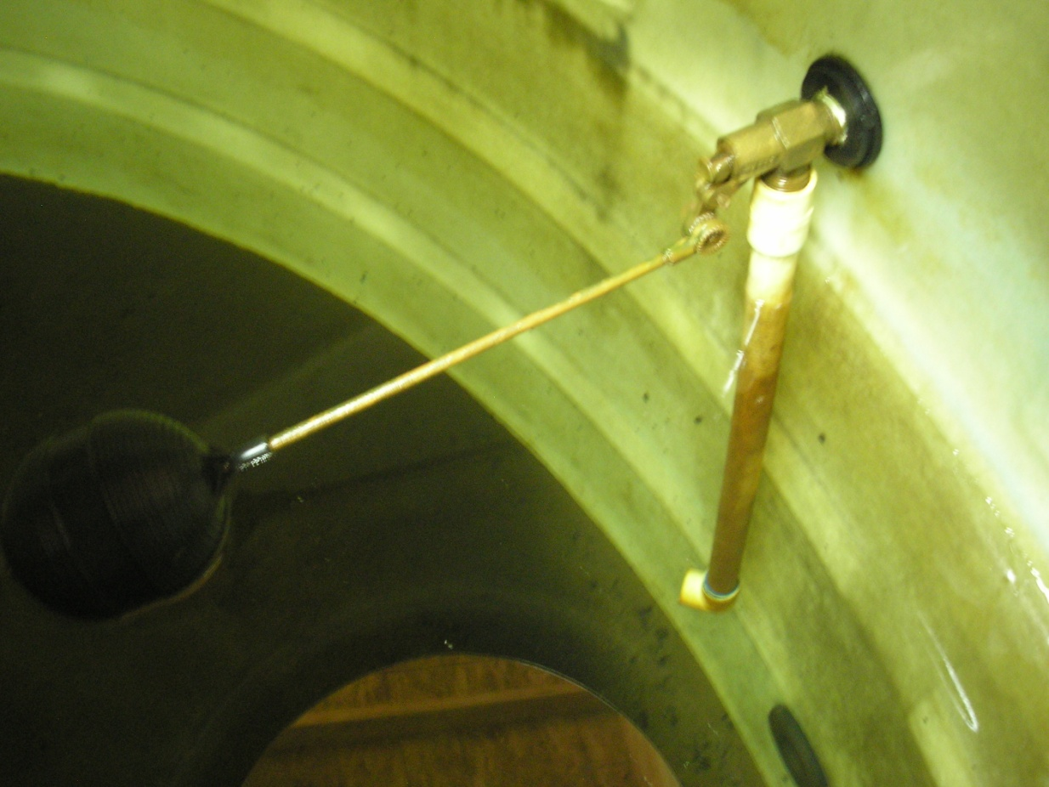
Harrowing valve Waste line
Inlet float control valve
Harrowing
Valve &
Waste Line
2012. Camp Yamhill in Yamhill County Oregon.
Notes:
This shows the location of the inlet float control valve as well as the harrowing waste line on the inside of the filter. [This photo is also from Camp Yamhill in Yamhill County, Oregon.]

Slide 47
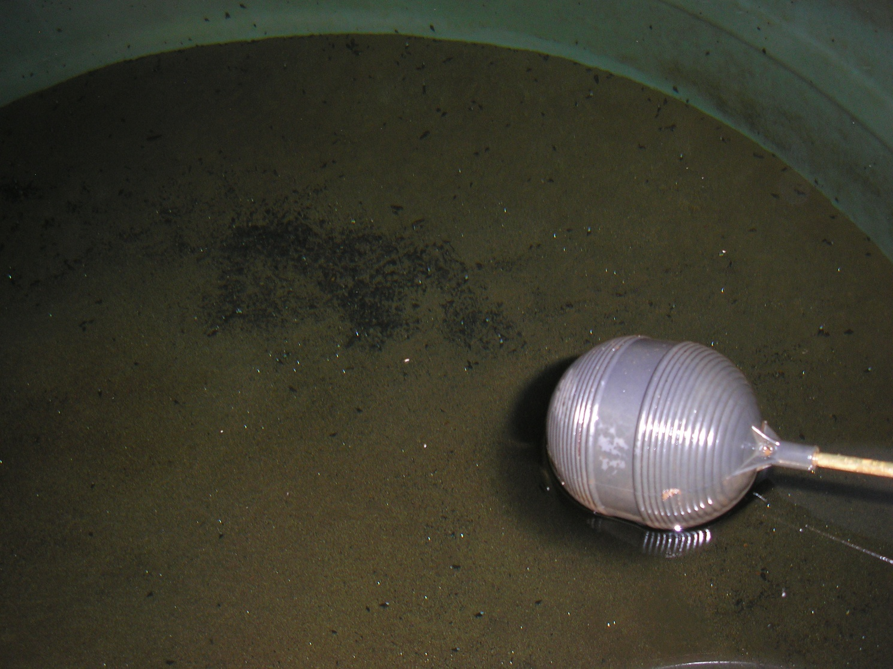
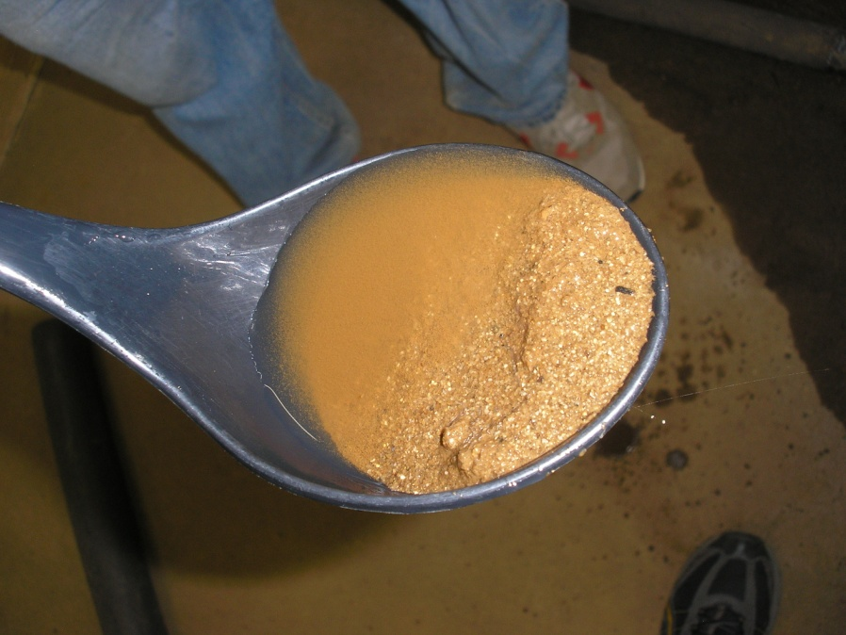
Harrowing
Harrowing
As seen before,
the
schmutzdecke
is different in
covered filters
2012. Camp Yamhill in Yamhill County Oregon.
Notes:
As seen before, the schmutzdecke is more of a brownish layer in a covered filter rather than a filamentous mat as oftentimes observed in uncovered filters exposed to sunlight. [This photo is also from Camp Yamhill in Yamhill County, Oregon.]

Slide 48
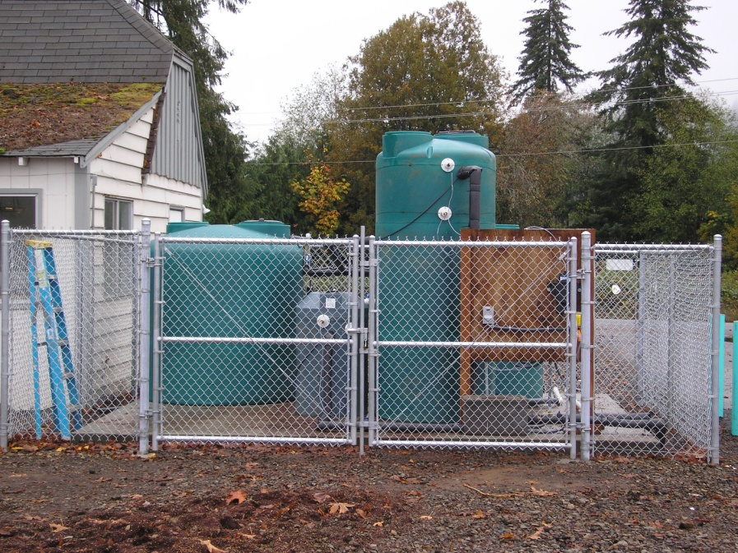
Ensure Adequate Access
Access to Filters
Make sure ample room exists to enable cleaning. Protection from the elements not only facilitates cleaning operations, but also prevents freezing and longer ripening times.
2009. Jewell School District #8, OR. “Blue Future” covered filter (left) and raw water control tank (right)
Notes:
This photo shows a covered “Blue Future” filter installed at the Jewell School District #8 in 2009. The green tank on the left is the filter, the taller green tank on the right is the raw water control tank, and the small grey tank in the middle is the effluent control tank. These filters are also designed to be harrowed rather than scraped and were later fully enclosed inside a building.

Slide 49
Scraped vs Harrowing
Parameter | Scraped | Harrowed (wet harrowed)
Biomass Development | Biomass and schmutzdecke take longer to develop due to the removal of biomass | Biomass and schmutzdecke restore at a faster rate, however, the sudden release of nutrients can cause dissolved oxygen to dip as microbial grazing intensifies. Keeping influent water flowing and filtering to waste at a higher initial rate can help to replenish depleted oxygen levels.
Removal Efficiency | Equivalent once filter is properly ripened | Equivalent once a filter is properly ripened – usually takes less time to accomplish this.
Filter life | Impacted by removal of top ~2 cm of plugged sand layer | Little media loss leads to longer filter life. Media is more susceptible to deep bed clogging if not done properly.
Notes:
There are pros and cons to the use of either scraping or harrowing methods and although harrowing seems to have many benefits such as faster ripening times and less depletion of sand, if not done properly, harrowing can lead to deep bed clogging and depleted oxygen levels. Harrowing also requires a lot more water for flushing, which may make it unfeasible for some larger applications where availability of filtered water and storage of wastewater are limited.

Slide 50
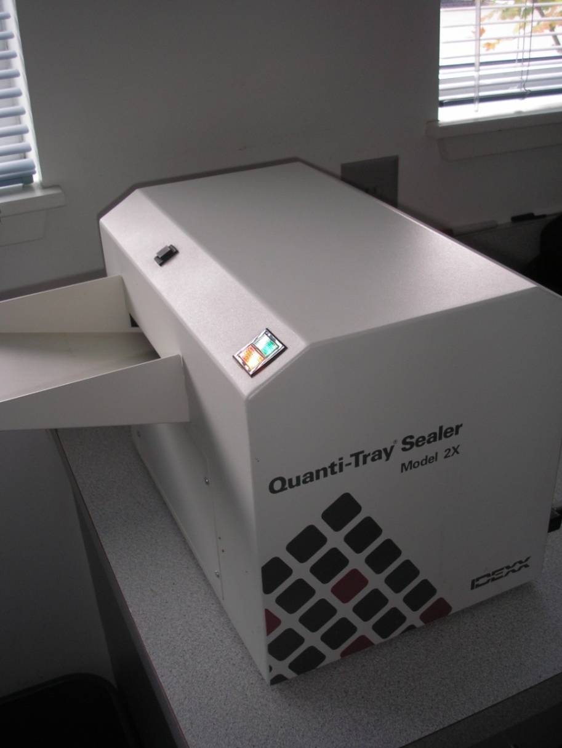
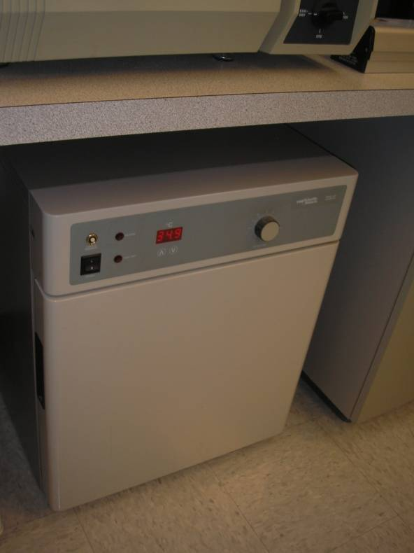
Filter ripening
Turbidity
Coliform Counts (CFU/100 ml)
Incubator IDEXX Quanti-Tray Sealer
Notes:
Turbidity and coliform counts in terms of colony forming units per 100/ml are used to determine when the filter has sufficiently ripened (or recovered) from a cleaning. This can all be done in-house. This example shows an IDEXX Quanti-Tray sealer (right) and incubator (left).

Slide 51
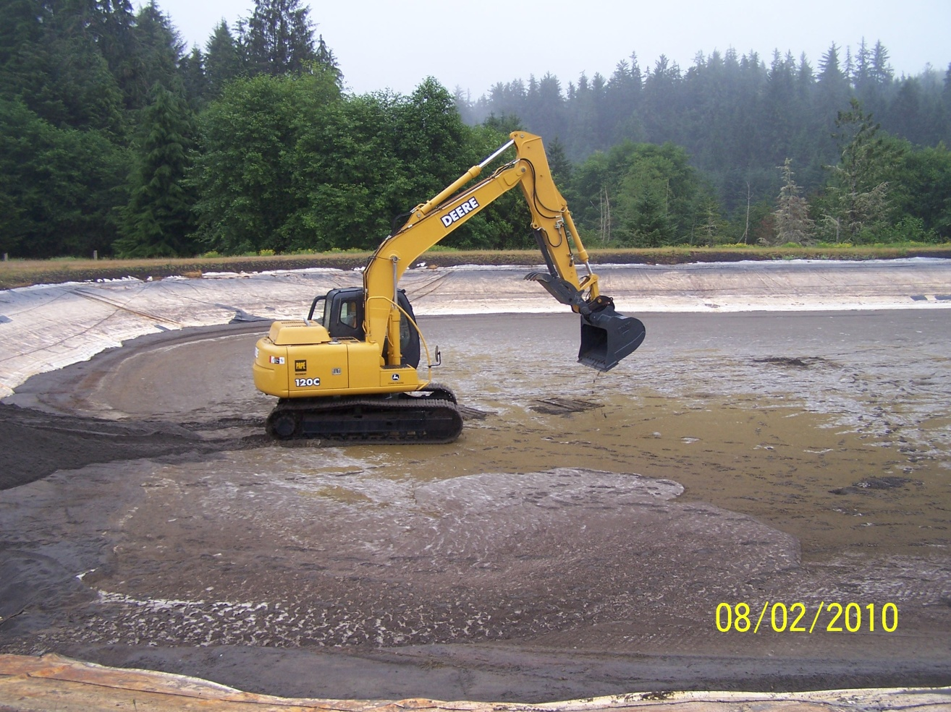
Filter re-sanding
Two methods
Trenching or “throw-over” method
Full replacement
City of Astoria Re-sanding effort =>
Notes:
There are two methods commonly used to re-sand filters. One method is called the trenching or “throw-over” method, where some of the old sand is re-used and the other is just a full replacement of the sand, where all the sand is excavated and replaced.

Slide 52
Filter re-sanding
Trenching or “throw-over” method:
Sand bed is cleaned (scraped or harrowed)
Most of the sand is removed and set aside for later reuse from a strip along one wall, forming a trench (underlying gravel is left undisturbed by leaving 4-6 inches (10-15 cm) of sand).
Fresh sand (either new or washed) is placed in the trench to a thickness, with the residual sand, equals the depth of the sand in the filter prior to re-sanding.
Residual sand from the next strip is “thrown over” on top of the freshly placed sand in the first strip.
This process is repeated until the last row. New sand is placed in the last row and the sand excavated from the first row is then placed on top of the new sand in the last row.
Notes:
The trenching method or “throw-over” method is described here.

Slide 53
Filter re-sanding
Trenching or “throw-over” method New Sand
Design Spec
Filter to be re-sanded
Head
Water
Sand Bed
Under Drain
Note: Burying old sand under new sand can cause taste and odor issues as the biological material dies off and decays.
Notes:
This is an illustration of how the trenching method is carried out.

Slide 54
Ripening of Re-sanded Cell
Ripening of newly sanded filters can take 3 or more weeks as evidenced by total coliform counts. Oftentimes it takes more than a month to wash out fines and ripen the filter.
Notes:
Once re-sanded, the filter should be filtered-to-waste until it is fully ripened. This can take several weeks to months to accomplish. This graph show a newly sanded filter cell #2 for the City of Astoria, OR. Data to the left of the vertical green line shows filter performance before the filter was taken off-line for re-sanding. Data to the right of the green line shows coliform removal and sand bed ripening during filter-to-waste after re-sanding.

Slide 55
Ripening of Re-sanded Cell
Historical Performance
January 2010 – November 2010
Notes:
This graph shows historical turbidity performance data for Astoria’s re-sanded Cell #1. 1 NTU is shown as the regulatory “goal” or limit. Data to the left of the vertical green line shows filter performance before the filter was taken off-line for re-sanding. Data to the right of the green line shows turbidity removal and sand bed ripening during filter-to-waste after re-sanding.

Slide 56
Ripening Re-Sanded cell
Performance after re-sanding
August 2010 – October 2010
Notes:
This graph shows turbidity performance data during the filter-to-waste and ripening for Astoria’s re-sanded cell #1. This is just a close-up view of the data shown on the previous slide to better see the performance improvement during ripening. Again, data to the right of the green line shows turbidity removal and sand bed ripening during filter-to-waste after re-sanding.

Slide 57
Need for Optimization Goals & Practices
Misunderstood removal mechanisms
Used in small communities (limited resources/expertise)
Turbidity is not a good indicator of filter performance
Good operating practices are the key to optimal performance
Goals were developed through literature review and comments received from experts in the field.
Notes:
Based on the reasons cited here, staff from several states in the northwest (ID, OR, AK, WA, and UT) recognized a need to have clear water quality goals and operational guidelines if slow sand filters were to be maintained in operated in an optimal manner. Working with EPA and Process Applications, Inc., a literature review was undertaken to acquire available information. Goals were then developed and provided to experts in the field of slow sand filtration to get input. The goals provided in this training are intended as guidelines as site-specific situations may dictate otherwise.

Slide 58
Key Publications - 1974
"Slow Sand Filtration", World Health Organization, 1974 ISBN 92-4-154037-0
http://www.who.int/water_sanitation_health/publications/ssf9241540370.pdf

Slide 59

Key Publications - 1987
Raman, A., Paramasivam, R., Heijnen, H.A. and Visscher, J.T., 1987. Slow sand filtration for community water supply : planning, design, construction, operation and maintenance. (Technical paper series / IRC; no. 24). The Hague, The Netherlands: IRC International Water and Sanitation Centre.
http://www.irc.nl/docsearch/title/108720

Slide 60

Key Publications - 1991
“Manual of Design for Slow Sand Filtration“ . David Hendricks. American Water Works Association, 1991. ISBN 978-0898675511

Slide 61

Key Publications - 2009
“Technical Guidelines for the Construction and Management of Slow Sand Filters”. UNICEF, 2009.
http://www.bsf-south-sudan.org/sites/default/files/SS+Tech+Guide--Slow+Sand+Filters.pdf

Slide 62

Key Publications - 2012
“Water Treatment Plant Design, 5th Edition”. Stephen J. Randtke, Ph.D., P.E.; Michael B. Horsley, P.E. Co-published by the American Water Works Association; Environmental and Water Resources Institute of American Society of Civil Engineers; McGraw-Hill Professional. 2012. ISBN: 9780071745727

Slide 63


Input from Experts
Gary S. Logsdon, P.E.
<= Dr. Robin Collins

Slide 64





Input State expert staff
Stephen Tanner, Idaho DEQ
Stephen Baker
Washington
DOH

Slide 65
Operational Guidelines
Operational Guidelines for Normal Operation
Operate slow sand filters continuously without filter effluent flow rate changes. If filter effluent flow changes are needed, ensure that the flow changes are made gradually to minimize detachment of particles from the sand with no more than a 50% variation in flow in a 24-hr period. Use filter effluent flow controls to accommodate changes in system demands (e.g., set the filtration rate high enough to meet anticipated peak day demands and divert excess water to waste or filter headwater influent during low demand periods). Intermittent operation of slow sand filters should not be used as a means of rate control.
Influent water should be introduced into the headwater at least 1-ft of clearance above the sand bed and filter walls.
Ensure filter effluent rates (Hydraulic Loading Rates, or HLR) of between 0.03 - 0.10 gpm/ft² (0.07 – 0.24 m/hr). Filtration rates may need to be lowered should raw water quality deteriorate with lower temperatures. A flow rate of 0.05 gpm/ft² may be used with water temperatures less than 5°C.
In order to prevent air binding within the filter, the tail water elevation must always be maintained at or above the level of the sand bed. Filtration rates and effluent weir levels should be routinely checked and adjusted only if needed.
Notes:
Operational guidelines stress the importance of flow control to ensure continuous operation of between 0.03 – 0.10 gpm/ft2, with minimal flow changes (e.g., weekly, as opposed to multiple times a day).

Slide 66
Operational Guidelines
Notes:
This graph shows the filtration rate goals at the far right as compared to filtration rates recommended by various sources.

Slide 67
Water Quality Goals
Optimization Goals for Normal Operating Conditions
IFE & CFE Turbidity < 1.0 NTU in 95% of the highest daily readings, measured at least once daily.
IFE & CFE Turbidity < 5.0 NTU, measured at least once daily.
IFE Total Coliform < 10 MPN/100 ml, measured at least weekly.
Water entering the distribution system is absent of total coliform bacteria (measure weekly when IFE or CFE turbidity > 1 NTU)
IFE = Individual Filter Effluent
CFE = Combined Filter Effluent
NTU = Nephelometric Turbidity Units
TC = Total Coliform, Most Probable Number (MPN) or Colony Forming Units (CFU) per Standard Methods.
Notes:
Turbidity is not necessarily a good indicator of performance, since fine colloids may pass causing turbidity spikes that do not necessarily indicate deficiencies in pathogen removal, the turbidity “goal” was set no less stringent than the regulatory requirement. Coliform removal, however, is a good indicator of performance, since it better reflects the biological mechanisms at work in slow sand filters. A total coliform goal of less than or equal to 10 colony forming units (or MPN) per 100 ml of water at the effluent of each filter was established. Water entering the distribution system, after disinfection, should also be absent of total coliforms.

Slide 68
Water Quality Goals
Notes:
This graph from data obtained from the City of Salem illustrates that turbidity can be maintained at very low levels, well within the regulatory limit of 1 NTU.

Slide 69

Water Quality Goals
Notes:
This graph is data obtained from a full-scale research slow sand plant in Logan, Utah. The data shows how coliform removal is effective, even with colder temperatures.

Slide 70
Filter Scraping
Guidelines
Operational Guidelines for Cleaning - Scraping
Scraping should be done when: Headwater depth reaches the headwater overflow level; The achievable filter production rate decreases to 0.03 gpm/ft² (0.073 m/hr); or Daily demands are anticipated to not be met.
When removing a filter from service for cleaning, schedule the event to avoid overloading the remaining filters.
Minimize the time a de-watered filter is off-line.
Do not de-water the filter more than necessary in order to safely clean the filter (e.g. 2-12 inches below the sand surface).
Notes:
Filter scraping guidelines stress minimizing down-time and the amount of the sand bed that is allowed to be de-watered.

Slide 71
Filter Scraping
Guidelines Continued
Operational Guidelines for Cleaning - Scraping
Remove the schmutzdecke and no more than 1/4" - 1/2" (0.635-1.27 cm) of sand with each cleaning. Depending upon the effective size (d₁₀) and applied water quality, more sand may need to be scraped (1/2” – 1”) in order to remove the plugged portion of the filter, allowing clean bed headloss to recover. Operators should monitor headloss before and after each scraping in order to determine how much sand is needed to be removed to maximize filter recovery while avoiding excessive sand removal. Monitoring headloss development by plotting daily headloss readings for each filter should be used to schedule filter cleanings during times of low demands and higher applied water temperatures (above 5⁰C). Scheduling cleanings during low systems demands will help ensure that demands are able to be met without overloading adjacent filters. Scheduling cleanings during times of warmer water temperature will help minimize the adverse effects of cold temperatures on the filter biota. The minimum permissible sand bed depth should be no less than 20-24 inches.

Slide 72
Filter Scraping
Guidelines Continued
Operational Guidelines for Cleaning - Scraping
Remove the schmutzdecke and no more than ¼ - ½ inch (0.635 – 1.27 cm) of sand with each cleaning. Keep the sand bed to within a minimum of 20 – 24 inches in depth.
Avoid walking or driving directly on the schmutzdecke during cleaning.
After the filter has been cleaned, slowly refill the filter from the bottom at a rate of 0.3-0.6 ft of bed depth per hour (0.1 – 0.18 m/hr or 0.0374 – 0.0748 gpm/ft²) in order to purge entrained air. Refill with non-chlorinated filtered water from one of the other filters until the headwater is 1-ft above the sand to minimize scouring of the sand bed when filling from the top begins. Then fill from the top at a rate that minimizes disturbing the sand bed. Note: To convert ft/hr to gpm/ft², multiply (ft/hr )by (1 hr/60 min) and then multiply by (7.48 g/ft³). Example: 0.3 ft/hr x (1 hr/60 min) x (7.48 gpm/ft³) = 0.0347 gpm/ft².

Slide 73
Filter Scraping
Guidelines Continued
Operational Guidelines for Cleaning - Scraping
Begin filtering to waste at the same rate as was used prior to cleaning, or at the anticipated rate needed when the filter is brought back on-line. Do not exceed the design flow rate and keep the rate < 0.1 gpm/ft².
Filter to waste one hour for each hour that the filter is off-line, but for no less than 24 hours. Filter to waste until the optimization goals following filter cleaning have been met.

Slide 74
Filter Scraping Guidelines

Slide 75
Filter Harrowing Guidelines
Operational Guidelines for Cleaning - Harrowing
Lower water level to the level of the harrowing waste valve (e.g., about 6” (15 cm) above the sand bed). This is done to keep the head pressure low in order to minimize migration of debris down into the filter during the raking process.
Open the harrowing waste valve and begin introducing filtered unchlorinated water from the bottom of the filter at a rate of 0.16 ft/hr (0.02 gpm/ft²) and low enough to prevent the sand from being fluidized. This serves to suspend debris, and keeps it from settling back into the filter bed during raking.
Introduce water into the top of the filter at a rate low enough to prevent sand migration, but high enough to flush the debris to waste during raking. For rectangular filters, a typical flow rate of about 20 gpm times the depth of water above the sand during harrowing times the length of the filter that is perpendicular to the incoming flow will work. For example, 1,000 gpm will work with 6 inches of water depth in a 100-ft wide filter provided the flow path is directed across the width of the filter. For other filters, influent flow should be adjusted to maintain a steady water level above the sand during raking. In either case, it is important to maintain a constant water level above the sand throughout the harrowing process by balancing flows into and out of the filter.
Using a stiff tined rake or harrowing equipment, gently agitate the top 2 – 3” (5 – 8 cm) of sand until the headwater begins to clarify, as indicated by the ability to see the sand bed when the raking is stopped.

Slide 76
Filter Harrowing Guidelines
Operational Guidelines for Cleaning - Harrowing
After it has been cleaned, slowly refill the filter from the bottom at a rate of 0.3-0.6 ft of rise per hour (0.1 – 0.18 m/hr or 0.0374 – 0.0748 gpm/ft²) in order to purge entrained air. Refill with non-chlorinated filtered water from one of the other filters until the headwater is 1-ft above the sand to minimize scouring of the sand bed when filling from the top begins. Then fill from the top at a rate that minimizes disturbing the sand bed. Note: To convert ft/hr to gpm/ft², multiply (ft/hr )by (1 hr/60 min) and then multiply by (7.48 g/ft³). Example: 0.3 ft/hr x (1 hr/60 min) x (7.48 gpm/ft³) = 0.0347 gpm/ft².
Begin filtering to waste at the same rate as was used prior to cleaning, or at the anticipated rate needed when the filter is brought back on-line. Do not exceed the design flow rate and keep the rate < 0.1 gpm/ft².
Filter to waste one hour for each hour that the filter is off-line, but for no less than 24 hours. Filter to waste until the optimization goals following filter cleaning have been met.

Slide 77
Filter Ripening Guidelines
Optimization Goals Following Filter Cleaning (scraping or harrowing)
Filter to waste for each hour that the filter is off-line, but no less than 24 hours, until sampling demonstrates that the goals below have been met
Filter not to be brought on-line until: IFE TC < 5/100 ml (MPN or CFU) (sample no earlier than 24 hours after the start of filtering to waste) IFE NTU < 1.0 NTU
IFE = Individual Filter Effluent
CFE = Combined Filter Effluent
NTU = Nephelometric Turbidity Units
TC = Total Coliform, Most Probable Number (MPN) or Colony Forming Units (CFU)
Notes:
This table summarizes the coliform and turbidity levels used to indicate when the filter has had sufficient time to ripen.

Slide 78

Filter Ripening Guidelines
“Scraping invariably reduces a filter’s ability to remove E. coli.”
(Unger & Collins, 2008)
(Unger & Collins, 2008)
“Total coliform was the most suitable surrogate…borne out by data in which there was the closest correspondence between removals of total coliform and Giardia cysts [and serves as] an index that the filter is biologically mature". (Hendricks, 1984)
Notes:
Data has shown that scraping does have an impact on coliform removal, which has also been correlated to the removal of Giardia cysts.

Slide 79
Recommended Media Specs for re-sanding
Silica Filter Sand Specification | Recommended Range
Effective Diameter (d10) | 0.2 – 0.35 mm
Uniformity Coefficient (U) | 1.5 – 3.0
% fines passing #200 sieve | < 0.3% by Wt.
Acid Solubility | < 5%
Apparent Specific Gravity | > 2.55
Minimum Depth | 20-24 inches
Delivery/Installation | Sand should be washed prior to installation
NSF-61 | Certified or equivalent
Notes:
This table summarizes some of the main specifications for sand and bed depth when re-sanding becomes necessary.

Slide 80
Operation & Maintenance
Manual
An O&M Manual should include procedures for…
Determining filtration rate
Changing filtration rate
Determining when to clean filters
Draining and refilling filters
Cleaning (scraping/harrowing)
Assuring adequate filter ripening
Dealing with seasonal changes
  (e.g., cold winters, high NTU, algae blooms, etc.)
Determining sand bed depth and when to re-sand
Re-sanding (including media specifications and handling)
Maintaining/operating disinfection system
Notes:
An operation and maintenance manual is critical to producing consistent water quality and maintaining facilities year after year. This documentation becomes especially important during changes of operational staff or staff functions. At a minimum, the manual should include procedures listed here.

Slide 81
O&M Manuals
Other procedures include:
Instrument calibration methods and frequency
Data handling/reporting
    (Monitoring for regulatory requirements and process control)
Chemical dosage determinations
CT determinations
Responding to abnormal conditions (emergency response plan)

Slide 82
Maintenance Tasks
Frequency | Labor (person hours) | Slow Sand Filter Maintenance Task
Daily | 1 - 3 | Check raw water intake Check/adjust filtration rate Check water level in filter Check water level in clear well Sample & check water quality (raw/finished NTU, raw temp) Check pumps Enter observations in logbook
Weekly | 1 - 3 | Check & grease any pumps & moving parts Check/re-stock fuel Sample & check water quality (coliform) Enter observations in logbook
1 – 2 months | 5 / 1,000 ft2 50 / 1,000 ft2 /12 inches of sand for re-sanding (Letterman & Cullen, 1985) | Scrape filter beds Wash scrapings & store retained sand Check & record sand bed depth Enter observations in logbook
Notes:
The O&M manual should also include a table of maintenance tasks including daily & weekly activities, as well as general cleaning frequency, which take place about every 1-2 months. This table shows the amount of labor that can be expected to be spent on these various tasks.

Slide 83


Monitoring
The recommended minimum location points
for recording and monitoring include:
Source water for:
  Turbidity
  Flow
  Temperature
  pH
  Grab sampling of coliform, TOC, or other water quality parameters
Supernatant for:
  Level (for filter headloss)
  Grab sampling of coliform, TOC, or other water quality parameters

Slide 84


Monitoring
Individual filter effluent for:
  Flow rate and quantity
  Turbidity
  Grab sampling of coliform, TOC, or other water quality parameters
  Pressure (for filter headloss)
Combined filter effluent for:
  Flow rate and quantity
  Turbidity
  Grab sampling of coliform, TOC, or other water quality parameters
Finished water (post disinfection and storage used for disinfection contact time) for:
  Flow rate and quantity
  pH
  Temperature
  Chlorine residual
  Grab sampling of coliform, TOC, or other water quality parameters
Finished water storage for:
  Effluent flows
  Level

Slide 85


Coliform Counts
  Membrane Filtration (CFU/100 ml) – SM 9221A,B – exact count
  Multiple-Tube Fermentation (MPN/100 ml) – SM 9222A,B,C – statistical estimate
  ONPG-MUG Test or “Autoanalysis Colilert” (MPN/100 ml) – SM 9223 – estimate
Most Probable Number (MPN/100 ml)
(both examples below use statistical MPN tables)
Multiple-tube fermentation (MTF)
(e.g., 10-tube Standard Methods MTF)
  Test tubes (20 x 150 mm)
  Culture media (e.g., R2A agar)
  Scale to measure media
  Autoclave to sterilize media
  Incubator
  Formation of gas first indicates
  presumptive positive results,
  which are then confirmed
IDEXX Quanti-Tray and Quanti-Tray/2000
  Quanti-Tray Sealer & Incubator (35°C)
  IDEXX Quanti-Tray Range: 1-200 CFU/100 ml (95% confidence)
  IDEXX Quanti-Tray/2000 Range: 1 – 2,419 CFU/100 ml (95% confidence)
  Ortho-nitrophenyl-β-galactopyranoside (ONPG) reagent
  4-methylumbelliferyl-β-D-glucuronide (MUG) - only E.coli produce an enzyme that reacts with MUG

Slide 86

Coliform Counts
  Membrane Filtration (CFU/100 ml) – SM 9221A,B – exact count
  Multiple-Tube Fermentation (MPN/100 ml) – SM 9222A,B,C – statistical estimate
  ONPG-MUG Test or “Autoanalysis Colilert” (MPN/100 ml) – SM 9223 - estimate
Membrane Filtration (Colony Forming Units/100 ml)
A sample of water is filtered through a membrane (0.22-0.45 µm pore size)
Filter is removed and placed on growth medium (nutrients feed colony growth)
Number of colonies are counted (each colony arises out of 1 coliform)
Photographs of plates with countable colonies (left), too few colonies to count (middle) and too numerous colonies to count (right). Colonies are the white circular forms and theoretically arise from a single cell called a colony forming unit.
(A Photographic Atlas for the Microbiology Laboratory. Michael J. Leboffe and Burton E. Pierce. 2nd Edition. Pp 83-85, Morton Publishing Co, Englewood, CO).
Notes:
In the membrane filtration technique, water samples are drawn through a membrane filter with a particular pore size. Most filters used in this process have pore sizes of 0.22 or 0.45 microns (μm). The pores allow matter smaller than 0.22 or 0.45 um to pass through the filter, whereas matter/cells that is larger gets caught on top of the filter. Therefore, microorganisms that are usually 1.0 um and larger are caught on top of the filter. The filter is then removed and placed on top of a growth medium. The nutrients freely diffuse through the membrane and the microbial cells are able to grow on top of the membrane. The photographs show plates with countable colonies (left), too few colonies to count (middle) and too numerous colonies to count (right). Colonies are the white circular forms and theoretically arise from a single cell called a colony forming unit.

Slide 87

Multiple-Tube Fermentation (SM 9222 A,B,C)
  Membrane Filtration (CFU/100 ml) – SM 9221A,B – exact count
  Multiple-Tube Fermentation (MPN/100 ml) – SM 9222A,B,C – statistical estimate
  ONPG-MUG Test or “Autoanalysis Colilert” (MPN/100 ml) – SM 9223 – estimate
Notes:
The most probable number test, also called the multiple tube fermentation assay, is an alternative to plate counts or membrane techniques, especially for samples with higher turbidity. The MPN procedure is a tube-dilution method using a nutrient-rich medium, which is less sensitive to toxicity and supports the growth of environmental-stressed organisms. The MPN method detects and estimates the bacteria in water samples (and can be applied to foods and soils) by the multiple fermentation tube technique. The number of bacteria per 100 ml of sample is estimated by the use of probability tables. The method has two test stages: The Presumptive Test, and the Confirmed Test. The presumptive tests are designed to grow the target bacteria. The media used in the confirmed tests are designed to validate the growth of target bacteria in the presumptive test. Confirmed test conditions are usually more stringent than presumptive conditions. Thus, the presumptive test provides a preliminary estimate of bacterial density based on enrichment in minimally restrictive tube media. The results of this test are never used without further analysis; the MPN must be carried through the Confirmed Test for valid results. The MPN per 100 ml is calculated from the MPN table based upon the Confirmed Test results.

Slide 88









  ONPG-MUG Test. Example: IDEXX Colilert Quanti-Tray® (SM 9223 B)
Collect 100-ml sample
2) Added Colilert Reagent
3) Turn on Quanti-Tray Sealer
5) Insert tray into sealer
4) Add Sample to Quanti-Tray tray
6) Incubate at 35°C for 24 hrs
(or 18-hrs with Colilert-18)
7) Count total coliform positive wells
8) Count fluorescent e-coli positive wells (use black light)
9) Use MPN table to determine MPN/100-mls
http://www.idexx.com/view/xhtml/en_us/water/products/quanti-tray.jsf
Notes:
In the ONPG-MUG test, a 100 mL water sample is added to a flask containing the MMO-MUG powder, mixed, and incubated at 35 ± 0.5º C for 24 hours (or 18-hrs using Colilert-18). The formation of a yellow color denotes the presence of total coliforms. E-coli is indicated by those yellow cells in the Quanti-tray that fluoresce in the presence of a black light. Coliform react with Ortho-nitrophenyl-β-galactopyranoside (ONPG) resulting in the yellow color and and only E.coli produce an enzyme that reacts with 4-methylumbelliferyl-β-D-glucuronide (MUG) causing the fluorescence under a black light (long-wave UV light), therefore the ONPG-MUG test can be used to detect both total coliform and E. coli.

Slide 89

Monitoring Head Loss
Head loss Measurement
On smaller facilities, routine visual observation of the supernatant depth and recording of the flow rate may be sufficient to monitor filter head loss development.
On larger facilities, screened probes at the top and bottom of the filter sand can allow easy measurement of head loss with simple piezometers mounted outside the filter, or through the use of a differential pressure transducer connected to the facility’s SCADA system.
Tracking this data will allow the operator to predict and plan filter cleanings.

Slide 90
Questions about operations?
Wickiup Water District, Oregon
Notes:
Photo is of cleaning in progress at the Wickiup Water District, Oregon.

