Slide 1
Conventional and Direct Filtration
Focus on Public Health

Slide 2
Class Outline
9 AM Introduction/Overview
  10:15 AM – 15 minute break
10:30 AM Coagulation/Flocculation
  12 noon – Lunch (on your own)
1 PM Clarification/Sedimentation
2 PM Filtration
  2:15 PM – 15 minute break
2:30 PM Filtration (continued)
3:30 PM General Operations
  4:30 PM - End

Slide 3
As we go through this training…
How you would answer the following questions?
How do you define optimized performance?
What does a well managed plant look like?

Slide 4

How do you set priorities?
What is a basis for setting priorities in optimizing your treatment plant?
Finished water quality?
Production?
Budgets?
Time?
$$$
CT
LCR
NTU
DBP
Notes:
The basis for setting priorities in optimization is to always try and utilize operational data to justify changes and enhancements. A good tool to demonstrate the relative role of activities is the optimization triangle (See the next slide). The basic concept is that unless you have spent the time to develop the data and demonstrate the need operationally you should not be working on changing administrative, design, or maintenance areas of the plant. Efforts in each of these areas should be based on a need to support a capable plant the allows achievement of optimized performance goals.

Slide 5
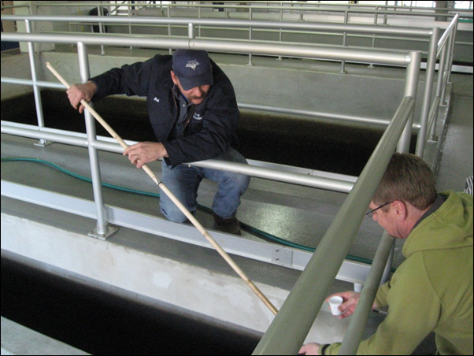
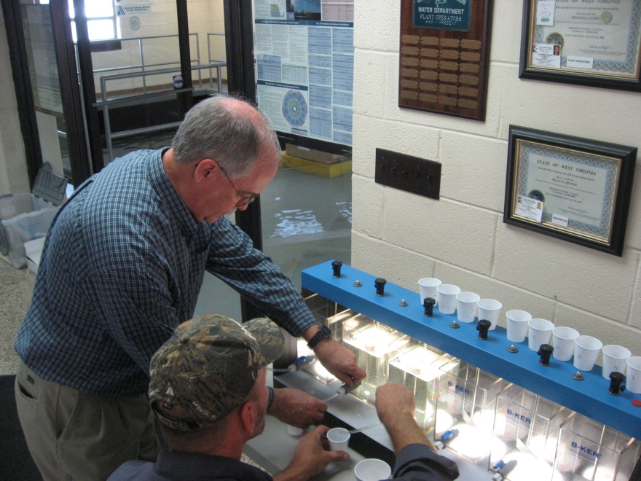
What Problem-Solving Tools Do You Have?
Training
Operational Guidelines
Water quality goals
Management support to conduct optimization studies often needed to meet those goals
Notes:
Operational Guidelines:
A written guideline, developed by staff, can be used to improve communication so that consistent optimization based activities can be implemented. The tool also serves as a training aid for new or inexperienced personnel plus it provides a mechanism for continual enhancement of plant procedures.
Special Studies:
This tool allows operational, design, administrative and maintenance activities to be performance focused and data based. It is the application of the scientific method to your utility and lets a common treatment plant become a research facility. The results can be used to define why things are done the way they are or to serve as an avenue for change based on carefully conducted studies and documented results.

Slide 6
How do you interpret the data you have?
Is it valid data?
Is it enough (or too much) data?
What are you trying to determine?
Is there anything to compare it to (optimization goals, level of service, etc.)?
Coagulant Addition
Turbidity Goal
Variable Quality Source Water
Turbidity Goal
Disinfection Goal
Disinfection Goal
Disinfectant Addition
Coagulation Flocculation Barrier
Sedimentation Barrier
Filtration Barrier
High Quality Finished Water

Slide 7
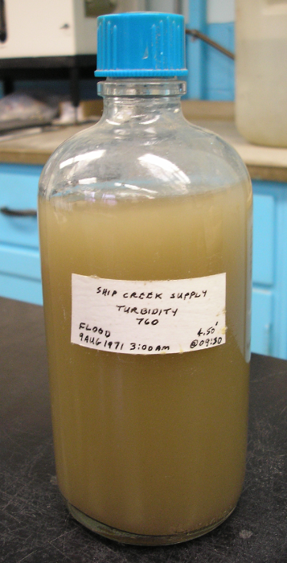
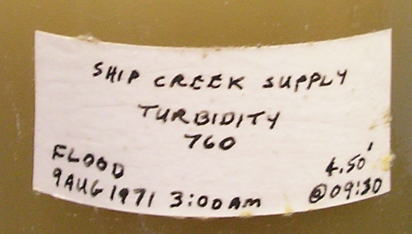
Are you prepared for unusual events?
What happens if your streaming current meter stops working?
Can you operate in fully manual mode?
Can you treat water during a flood?
Sample of 760 NTU water taken from the Ship Creek supply Aug 9, 1971 – Fort Richardson, AK

Slide 8

Hopefully we can help you answer some of those questions today

Slide 9

Hopefully we can help you answer some of those questions today
But you have to be engaged!
Notes:
Multiple Barrier Concept:
Each unit process in a water treatment facility should be optimized such that it has a minimal impact on the downstream processes. The major barriers in a conventional plant are flocculation and sedimentation, filtration, and disinfection. Each of these barriers should have optimized performance goals in place to minimize the potential for passage of pathogenic organisms through the plant.
Optimized Performance:
Optimized performance is when each barrier consistently (>95% of the time) meets its performance goals despite variations in raw water quality and seasons.

Slide 10
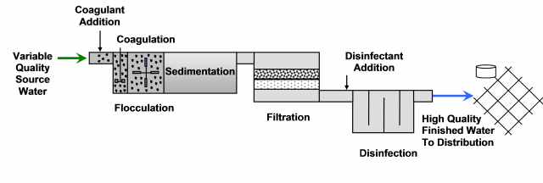
Overview
  Conventional Filtration Treatment
    “means a series of processes including coagulation (requiring the use of a primary coagulant and rapid mix), flocculation, sedimentation, and filtration resulting in substantial particle removal.”

Slide 11
Overview
  In conventional filtration treatment..
    A coagulation chemical is added and rapidly mixed to neutralize particle charges
    Flocculation is a stage of gentle mixing so that a larger settleable floc forms
    Sedimentation is the stage were floc particles settle out prior to filtration

Slide 12
Overview
  Direct Filtration Treatment
  “means a series of processes including coagulation (requiring the use of a primary coagulant and rapid mix) and filtration but excluding sedimentation resulting in substantial particulate removal.”

Slide 13
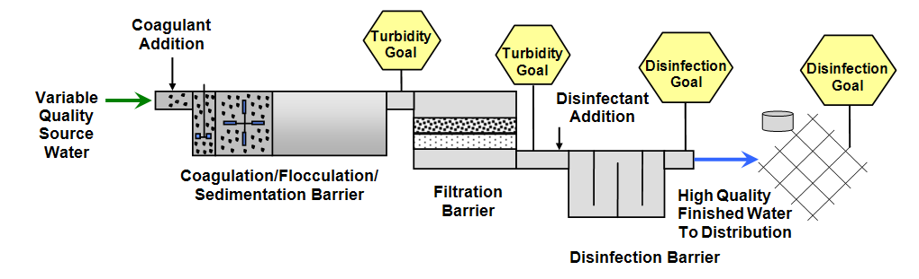
Overview
Regardless of the filtration type, the multiple barrier approach to public health protection applies – i.e., optimize barriers to Giardia and Crypto.
Notes:
Multiple Barrier Concept:
Each unit process in a water treatment facility should be optimized such that it has a minimal impact on the downstream processes. The major barriers in a conventional plant are flocculation and sedimentation, filtration, and disinfection. Each of these barriers should have optimized performance goals in place to minimize the potential for passage of pathogenic organisms through the plant.
Optimized Performance:
Optimized performance is when each barrier consistently (>95% of the time) meets its performance goals despite variations in raw water quality and seasons.

Slide 14
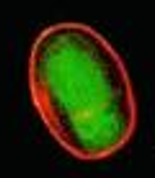
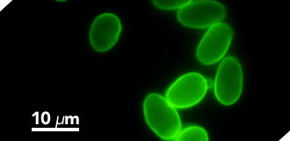
Overview - Giardia
Giardia lamblia is a protozoan which occurs in cyst form in the environment.
This is an image of Giardia lamblia showing the red outline of the cyst wall, which makes the cyst somewhat resistant to disinfection.
Photo Credits: H.D.A. Lindquist, U.S. EPA
Notes:
The image on the left is a composite of the Giardia lamblia red outline of the cyst wall selectively imaged through the use of fluorescent-labelled (TRITC) antibody that is cyst wall specific and the cyst imaged in green (both images) through the use of carboxy fluorescein diacetate.
Photo Credit: H.D.A. Lindquist, U.S. EPA
This image is in the public domain and is thus free of any copyright restrictions. For public domain images, permission is not required for their use but we do ask that you credit the EPA and the contributors (found in the Photo Credit line) whenever an image is used in any publicly distributed media. Image was used from on-line post at: http://www.epa.gov/microbes/giardia.html

Slide 15
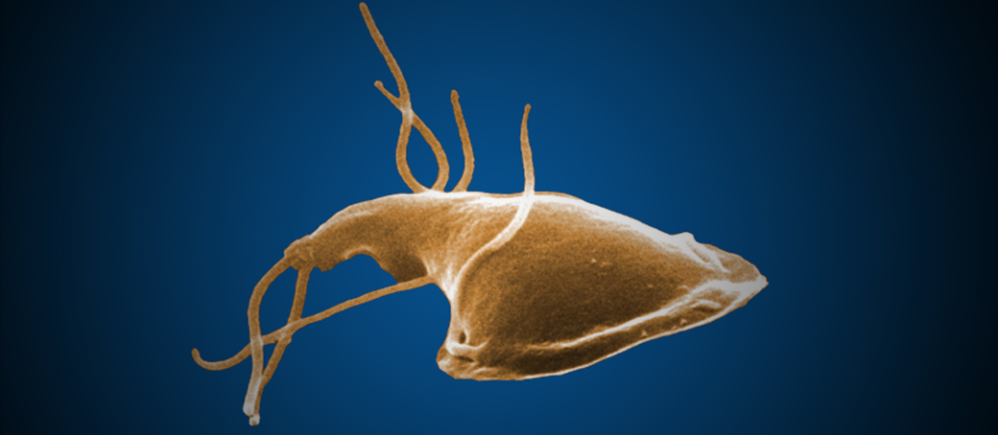
Overview - Giardia
Giardia are protozoan parasites which occur in a trophozoite and an oval-shaped cyst form.
The trophozoite causes diarrheal disease of the small intestines called Giardiasis.
Image from CDC’s site: http://www.cdc.gov/parasites/crypto/index.html
Cysts excreted in the feces of an infected host move passively through the environment. If cysts are subsequently ingested, infection may be transmitted to another vertebrate host.
Cysts can survive for 2 to 3 months in water temperatures of less than 10°C, and almost a month at 21°C. Cysts are killed in 10 minutes at 54°C and almost immediately at boiling.

Slide 16
Overview - Giardia
How infective is Giardia and what is the incubation time of Giardiasis?
Giardia cysts are highly infective.
  As few as ten human-source Giardia cysts produced infection in a clinical study of male volunteers. (EPA, Giardia: Drinking Water Fact Sheet, September 2000)
  Each year 4,600 persons with giardiasis are estimated to be hospitalized in the United States. Hospitalized cases are primarily children under five years of age, and dehydration is the most frequent co-diagnosis (EPA, 2000).
The incubation period (time interval between ingestion and the first appearance of symptoms) can range from 3 to 25 days.

Slide 17
Overview - Giardia
What are the symptoms of Giardiasis?
Giardia infection may be acquired without producing any symptoms, and this is often the case for children.
In symptomatic patients, acute diarrhea is the predominate feature.
In some instances, diarrhea may be transient and mild, passing without notice, while in others diarrhea can be chronic.
  Stools may be pale, greasy, and malodorous.

Slide 18
Overview - Giardia
What are the symptoms of Giardiasis?
Other symptoms may include:
  Abdominal cramps, bloating, and flatulence;
  Weight loss;
  Vomiting;
  Death is rare.
A potentially serious consequence is nutritional insufficiency which may result in impaired growth and development of infants and children.
In otherwise healthy people, symptoms of giardiasis may last 2-6 weeks, however, occasionally they may last for months or years. Medications can help decrease this time.

Slide 19
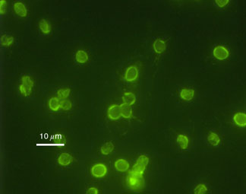
Overview - Cryptosporidium
Cryptosporidium is another protozoan which occurs in cyst form.
This is an image of Cryptosporidum parvum oocysts (C. parvum), stained to show the intense green outline of the oocyst wall, which makes the oocyst very resistant to disinfection – optimal coagulation/filtration is critical to their removal.
Photo Credit: H.D.A. Lindquist, U.S. EPA
Notes:
This image is an Immunofluorescence image of Cryptosporidium parvum oocysts, purified from murine fecal material. (Same field of view) Oocysts were stained with commercially available immunofluorescent antibodies. Oocysts should have an intense apple green fluorescence on the periphery of their oocyst wall, and measure 4 to 6 microns in diameter. Scale bar is 10 microns – Photo Credit: H.D.A. Lindquist, U.S. EPA
This image is in the public domain and is thus free of any copyright restrictions. For public domain images, permission is not required for their use but we do ask that you credit the EPA and the contributors (found in the Photo Credit line) whenever an image is used in any publicly distributed media. Image was used from on-line post at: http://www.epa.gov/microbes/giardia.html

Slide 20
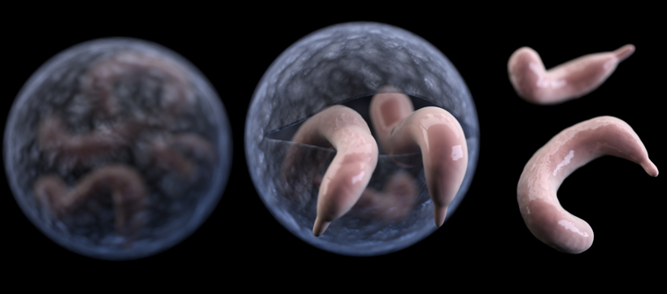
Overview - Cryptosporidium
The infective stage of Cryptosporidium is called an oocyst. The oocyst consists of a very tough “shell” surrounding four individual parasites.
After the oocyst is swallowed, the shell breaks open and the parasites are released.
Image from CDC’s site: http://www.cdc.gov/parasites/crypto/index.html

Slide 21
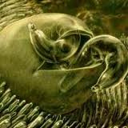
Overview - Cryptosporidium
The parasites enter the cells that line the lower small intestine and begin to develop. After the parasite cells reproduce, two kinds of oocysts are produced:
    Thin-walled oocysts that start another cycle of infection
    Thick-walled oocysts that enter the environment in the feces and can then infect other animals
The disease is called cryptosporidiosis

Slide 22
Overview - Cryptosporidium
What are the symptoms and the incubation time of Cryptospordiosis?
Symptoms may appear anytime from two to ten days after infection, with the average being from four to six days.
The nature of acute disease (having a rapid onset and following a short but severe course) associated with C. parvum is
  Intestinal,
  Tracheal (trachea (‘windpipe’) associated) or
  Pulmonary (lung-associated) cryptosporidiosis.
The most common symptom of cryptosporidiosis is watery diarrhea. Other symptoms may include stomach cramps, nausea, vomiting, dehydration, low-grade fever (99-102°F), fatigue, weakness and weight loss.
Pulmonary and tracheal cryptosporidiosis in humans is associated with coughing and low-grade fever.
Some people will be asymptomatic (will not develop any symptoms).

Slide 23
Overview - Cryptosporidium
How long do symptoms last?
The C. parvum infection is self-limiting, and people with healthy immune systems are usually ill with cryptosporidiosis for one to two weeks before the infection begins to resolve.
Some infected individuals may not even get sick
In immune-compromised patients (elderly, very young, people with certain illnesses or organ donor recipients taking anti-rejection medications) symptoms are more severe and may last for several weeks with hospitalization being required.
It is also possible for the infection to become chronic, and in some cases fatal.
Those who are infected may shed oocysts in their feces for months, even after they no longer appear to be ill.

Slide 24
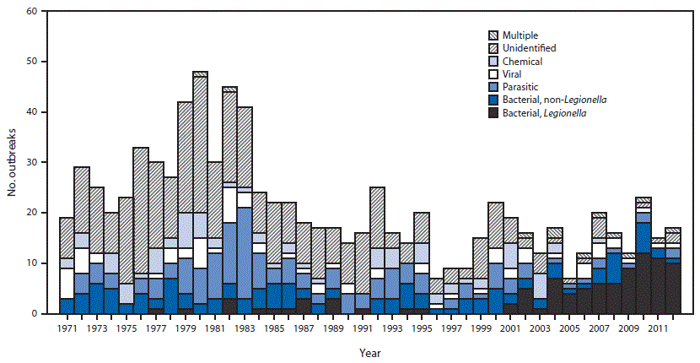
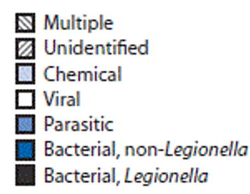
Overview - Outbreaks
How many drinking water associated disease outbreaks have there been from 1971-2012? ….
885 according to CDC’s Surveillance for Waterborne Outbreaks Associated with Drinking Water – United States 2011-2012
* Legionellosis outbreaks were first reported to CDC Waterborne Disease and Outbreak Surveillance System in 2001; Legionellosis outbreaks before 2001 were added retrospectively during the 2007–2008 reporting period.
Notes:
Source: Surveillance for Waterborne Disease Outbreaks Associated with Drinking Water — United States, 2011–2012
Weekly August 14, 2015 / 64(31);842-848
http://www.cdc.gov/mmwr/preview/mmwrhtml/mm6431a2.htm#Fig

Slide 25
Overview – Outbreaks
So how can you help protect your community from pathogens and avoid outbreaks?

Slide 26
Overview – Outbreaks
So how can you help protect your community from pathogens and avoid outbreaks?
Optimize treatment for pathogen removal by optimizing particle removal (i.e. turbidity)

Slide 27
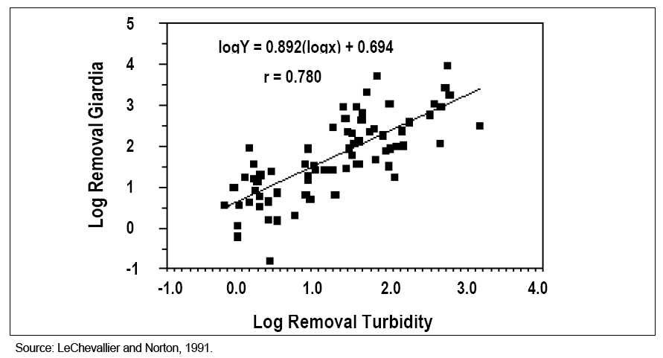
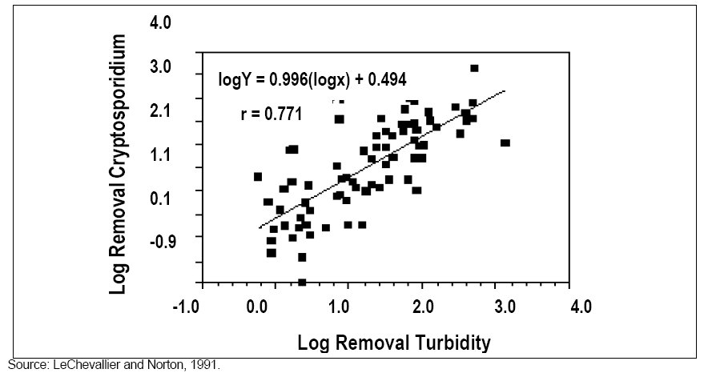
Overview – Optimization Goals
Why turbidity?
Turbidity removal is strongly correlated to removal of Giardia and Cryptosporidium.
Emelko (2000) - Pilot scale work to assess Cryptosporidium removal through filtration (University of Waterloo)
  Stable operation: 5 to 6 log
  (turbidity ~ 0.04 NTU)
  End-of-run: 2 to 3 log
  (turbidity increase to 0.10 NTU)
  Breakthrough: 1.5 to 2 log
  (turbidity increase to 0.3 NTU)
Notes:
Removal of turbidity is strongly correlated with removal of cryptosporidium and giardia. This research shows that with stable operation at a filter effluent of about 0.04 NTU, you can get as much as 5 to 6-log removal of cryptosporidium. When turbidity increases towards the end of the filter run to around 0.1 NTU, they measured 2 to 3-log removal. The filter was continued to allow to operate until turbidity reached 0.3 NTU, at which point they measured only 1.5 to 2-log removal.

Slide 28
Overview – Optimization Goals
Settled water turbidity optimization goals:
Settled turbidity ≤ 1 NTU, 95% of the time if average annual raw water turbidity is < 10 NTU
Settled turbidity < 2 NTU, 95% of the time if average annual raw water turbidity is > 10 NTU
Settled Water Turbidity Goal
For conventional systems goals are based on maximum daily raw & settled water turbidity taken from grab samples or on-line instrumentation.

Slide 29
Overview – Optimization Goals
Filter effluent turbidity optimization goals:
IFE & CFE Turbidity ≤ 0.10 NTU 95% time
Maximum IFE & CFE Turbidity: < 0.30 NTU
Filtered Water Turbidity Goal
Goals are based on continuous 1-minute readings of individual filter effluent (IFE) and combined filter effluent (CFE) readings.

Slide 30
Overview – Optimization Goals
Post backwash turbidity optimization goals
Minimize spike during filter-to-waste period (< 0.30 NTU)
Return to < 0.10 NTU within 15 minutes
Return to service at ≤ 0.10

Slide 31
Overview – Goals Summary
Filter effluent turbidity optimization goals
Turbidity: ≤ 0.10 NTU 95% time
Maximum turbidity: < 0.30 NTU
Post backwash turbidity optimization goals
Minimize spike during filter-to-waste period (< 0.30 NTU)
Return to < 0.10 NTU within 15 minutes
Return to service at < 0.10 NTU

Slide 32
Overview – Goals Summary
Why not just meet the regulatory turbidity standards?
Regulatory standards are there to help protect against major pathogen breakthrough (e.g. up to 90% removal of Cryptosporidium at 0.3 NTU), but they do not reflect optimized pathogen removal (e.g. > 95% removal at 0.1 NTU).
Filter performance that exceeds regulatory standards for turbidity requires notification to the State, corrective action, and public notification (either a boil notice, notice within 30 days, or in the Consumer Confidence Report, depending upon the level of turbidity).
Barely meeting the regulatory standards is generally not good practice.

Slide 33
Overview – Regulatory Requirements
Regulatory requirements also employ the multiple barrier approach
Measure settled water turbidity
Turbidity must be < 0.3 NTU
Chlorine > 0.2 mg/l
CT must be met
Maintain detectable residual

Slide 34
Overview – Regulatory Requirements
  Well operated systems that achieve substantial particle removal (turbidity reduction) should be able to meet the Giardia and Cryptosporidium removal credits shown below.
Regulated Pathogen | Total Treatment Required | Filtration Type | Credit for Filtration | Treatment Needed Through Disinfection
Viruses | 99.99% (4-log) removal/inactivation | Conventional and direct | 0 | 4-log
Giardia | 99.9% (3-log) removal/inactivation | Direct & some conventional w/inadequate sedimentation | 99% (2-log) | 1-log (0.5-log must be after disinfection)
 |  | Conventional | 99.5% (2.5-log) | 0.5-log (all after disinfection)
Cryptosporidium | 99% (2-log) removal | Conventional and direct | 2-log | None in most cases depending upon levels of cryptosporidium in source water.

Slide 35
Overview – Turbidity Requirements
OAR 333-061-0030(3)(b)(A) – Maximum turbidity limits
  Maximum contaminant levels for turbidity in drinking water measured at a point representing filtered water prior to any storage:
    Turbidity must be < 0.3 NTU in at least 95% of the measurements taken each month.
    Turbidity must not exceed 1 NTU at any time.

Slide 36
Overview – Turbidity Requirements
OAR 333-061-0040(1)(d) – Turbidity > 5 NTU
  All surface water systems that provide filtration must report within 24 hours after learning that the filtered water turbidity exceeds 5 NTU.
Make sure your instruments can record data up to 5.49 NTU (e.g. 0-10 NTU)

Slide 37
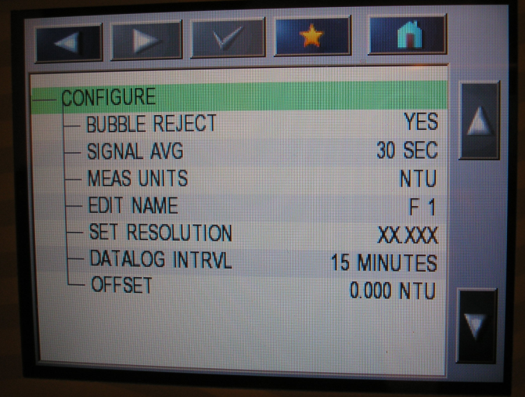
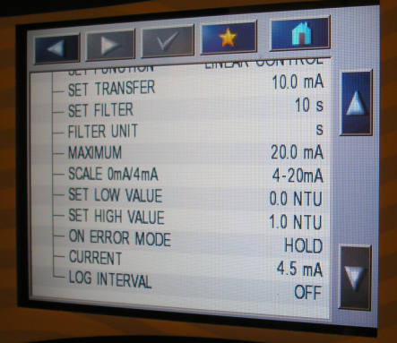
Error Mode is set to “Hold”
This means that the controller will send the last turbidimeter reading to SCADA should an error in the meter occur
Make sure your instruments can record data up to 5.49 NTU (e.g. 0-10 NTU)
Low and high values of the on-line turbidimeters are set to 0 – 1.0 NTU
This means that the signal output is “read” by SCADA as
4 mA = 0 NTU
20 mA = 1 NTU

Slide 38
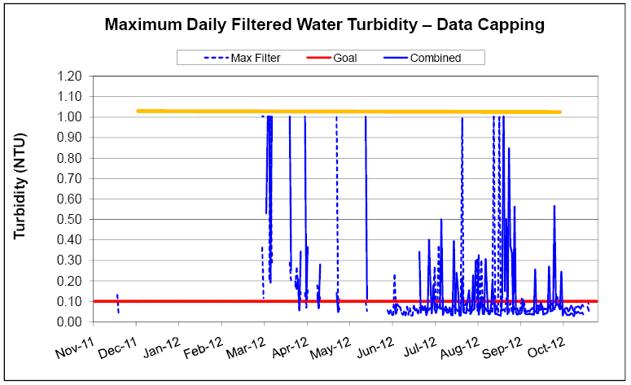
Scaling limited to 1 NTU may show up as “Data Capping”

Slide 39
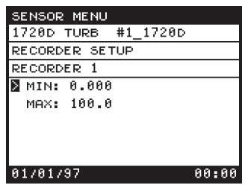
Caution!
The 4-20 mA scale must be set in both the turbidimeter controller and the PLC
Example, the scale is changed in the controller to send a 20 mA signal when the turbidity is 10 NTU, but the change was not made in the PLC.
A spike to 10 NTU occurs at which point the PLC receives a 20 mA signal. This spike will be stored in the SCADA system as a 1 NTU spike

Slide 40
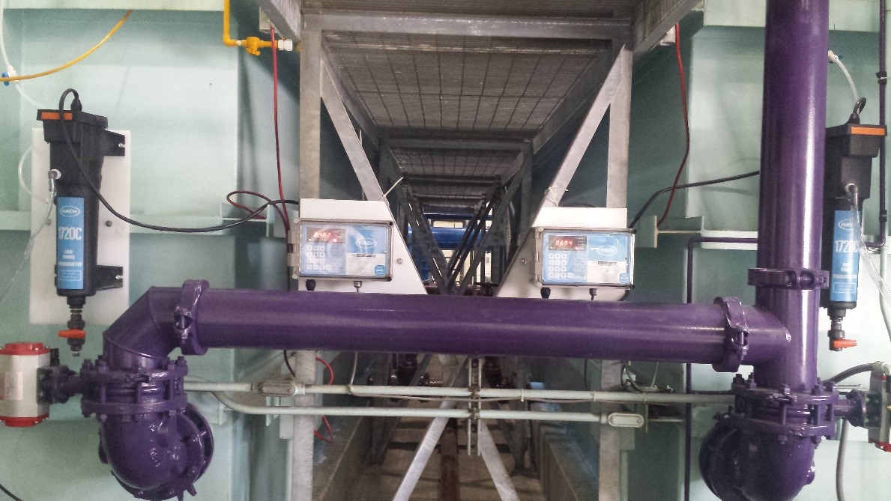
Overview – Turbidity Requirements
OAR 333-061-0036(5)(b) – Settled Water Turbidity Monitoring
  Conventional filtration systems must measure settled water turbidity every day.
Individual Settled Water Turbidimeters
Seaside Roberts Pacer II contact adsorption clarifier plant 2015

Slide 41
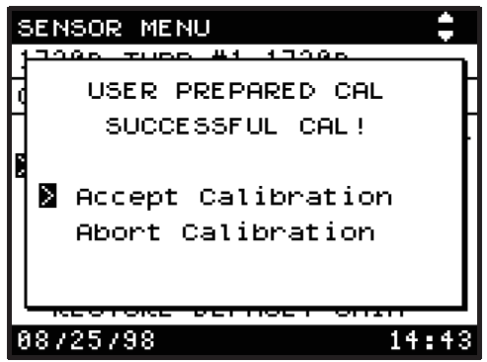
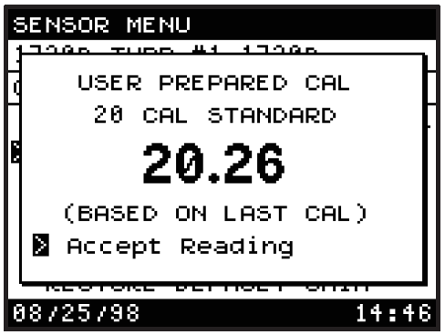
Overview – Turbidity Requirements
OAR 333-061-0036(5)(b) – Combined Filter Effluent (CFE) Monitoring
  Conventional & Direct Filtration Treatment Systems must:
    Measure combined filter effluent (CFE) water turbidity (prior to storage) every four hours (or more frequently).
    Turbidimeters must be calibrated at least quarterly & per manufacturer.

Slide 42
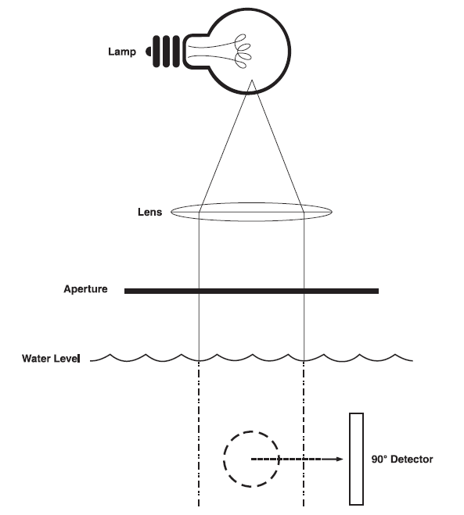
Overview – Turbidity Requirements
Accurate turbidity measurement depends on:
Strength of bulb
Clean photo detector lens

Slide 43
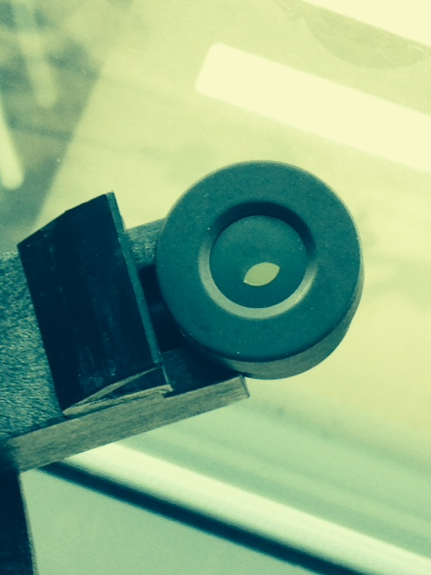
Overview – Turbidity Requirements
Accurate turbidity measurement depends on:
Strength of bulb
Clean photo detector lens
Photocells can leak fluid in 1720D and E, which may cause erratic readings
“The filling solution establishes a common refractive index so as the light passes through to the photocell it is as though there is no window. If only air were in the space of course the light would refract. One can typically see a bubble when the photocell is laid face up but not always. But if the area is void (the solution has leaked out) it is normally pretty obvious. The 1720D is now obsolete so I don’t know whether or not we can still supply replacement photocells. If it seems to work okay, I wouldn’t worry about it.”
Terry Engelhardt
Application Sales Engineer - HACH
tengelhardt@hachhst.com

Slide 44
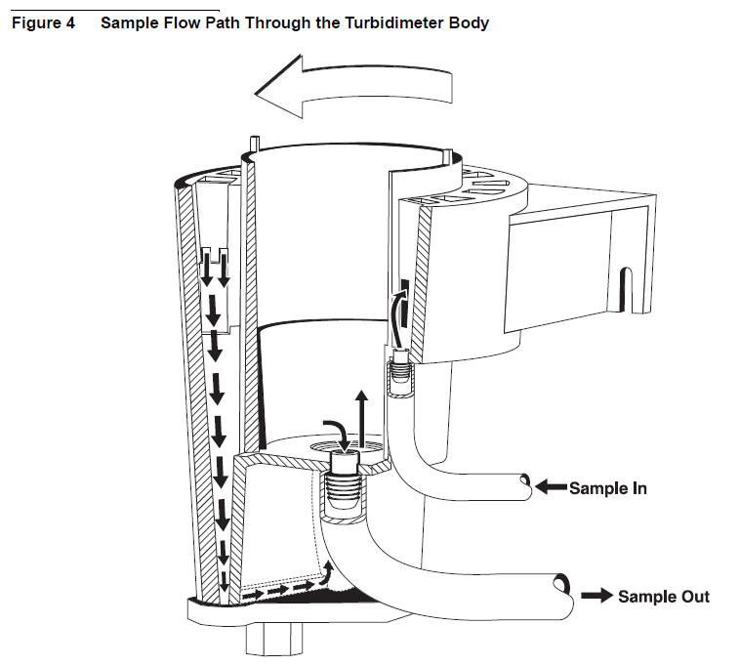
Overview – Turbidity Requirements
Accurate turbidity measurement depends on:
Strength of bulb
Clean photo detector lens
Sufficient flows
  (e.g. 250-750 ml/min for HACH 1720D/E)
Good calibration
Good sample point

Slide 45
Overview – Turbidity Requirements
Accurate turbidity measurement depends on:
Strength of bulb
Clean photo detector lens
Sufficient flows
Good calibration
Good sample point

Slide 46
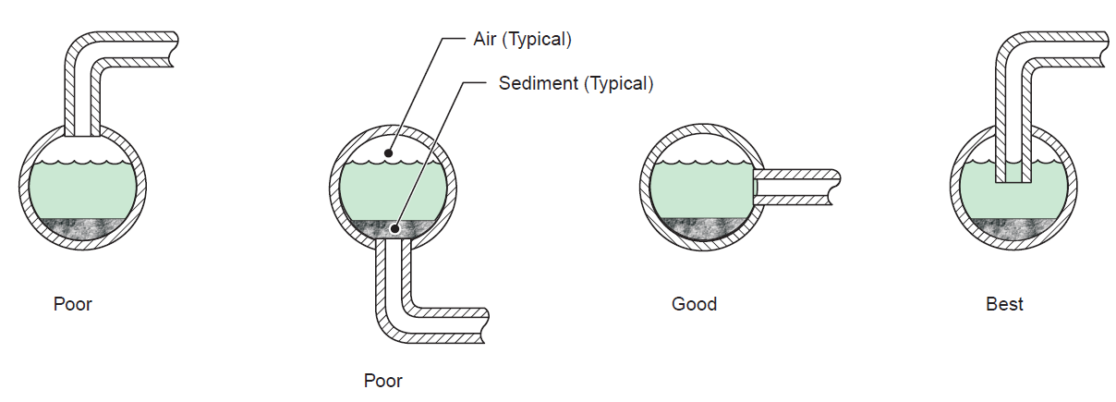
Overview – Turbidity Requirements
Accurate turbidity measurement depends on:
Good (or “Best”) sample point
Air
Sediment
Best
Sample Line
Pipe
Good
Poor Sample Taps
Notes:
Sampling from the top of the pipe can introduce air into the sample line. Sampling from the bottom of a pipe can allow sediments to be drawn into the turbidimeter. Ideally you want to sample from the center of the pipe to ensure that the sample tap is under fully flooded conditions, yet not susceptible to sediment.

Slide 47
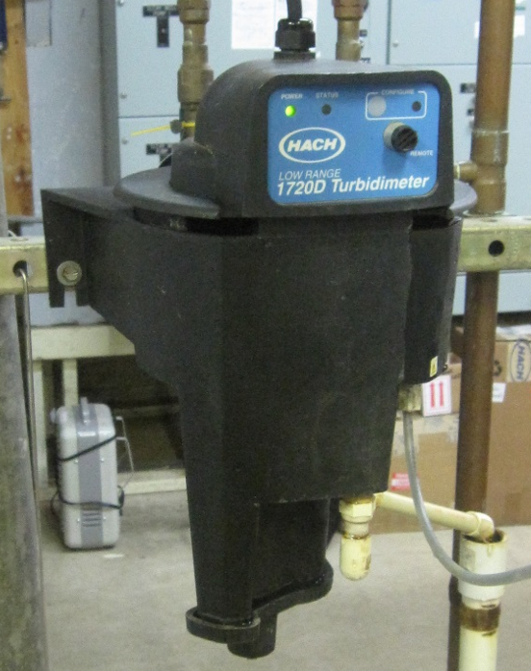
Overview – Turbidity Requirements
Accurate turbidity measurement depends on:
Strength of bulb
Clean photo detector lens
Sufficient flows
Good calibration
Good (or “Best”) sample point
Attentive Operator

Slide 48
Overview – Turbidity Requirements
Anything wrong with this picture?

Slide 49
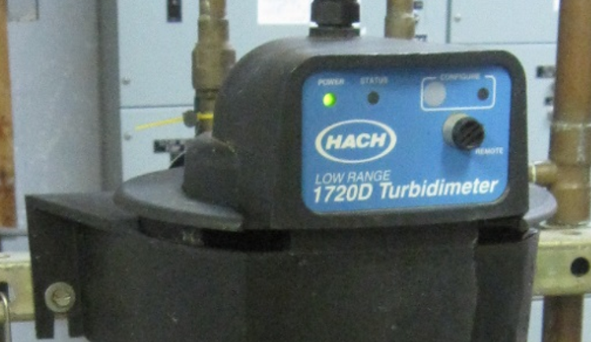
Overview – Turbidity Requirements
Anything wrong with this picture? How about now?
Notes:
The turbidimeter head is not fully seated.

Slide 50
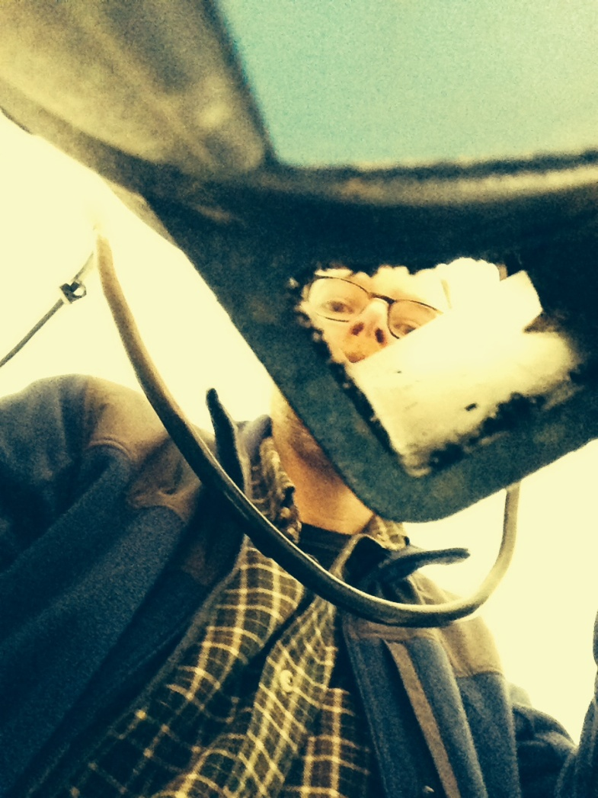
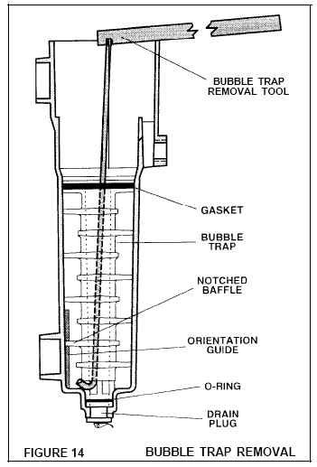
Introduction/Overview
How about this one?
Notes:
The missing air filter can allow moths and other insects to enter the chamber.

Slide 51
Turbidity Data Integrity
Data provided by instruments provides the basis for assessing water quality – important to get it right!
Common problems
  Sampling location
  Measurement techniques
  Calibration frequency and approach
Possible solutions
  May require investigations (special studies)
  Modifications to sample lines
  Establish guidelines on sample line cleaning
  Establish calibration procedure

Slide 52
Overview – Turbidity Requirements
OAR 333-061-0036(5)(d) – Individual Filter Effluent (IFE) Monitoring
  Conventional & Direct Filtration Treatment Systems must also:
    Conduct continuous turbidity monitoring for each individual filter. IFE results must be recorded every 15 minutes. Turbidimeters must be calibrated at least quarterly & per manufacturer.
    If there is a failure in continuous monitoring equipment, grab samples must be taken every 4 hours until the equipment is repaired and back on-line. Systems serving 10,000 people or more have 5 days to repair equipment while systems serving less than 10,000 people have 14 days.
    Systems having only 1 or 2 filters may conduct continuous monitoring of CFE turbidity in lieu of IFE monitoring, although the recording and calibration requirements of -0036(5)(d) still apply

Slide 53
Overview – Turbidity Requirements
OAR 333-061-0036(5)(b) – Turbidity Profile
  Conventional & direct filtration systems must develop turbidity profiles for individual filters every calendar quarter.
  Profiles consist of a graph showing turbidity over a complete filter run, including filter start-up, duration of the run, backwash, and filter-to-waste.

Slide 54
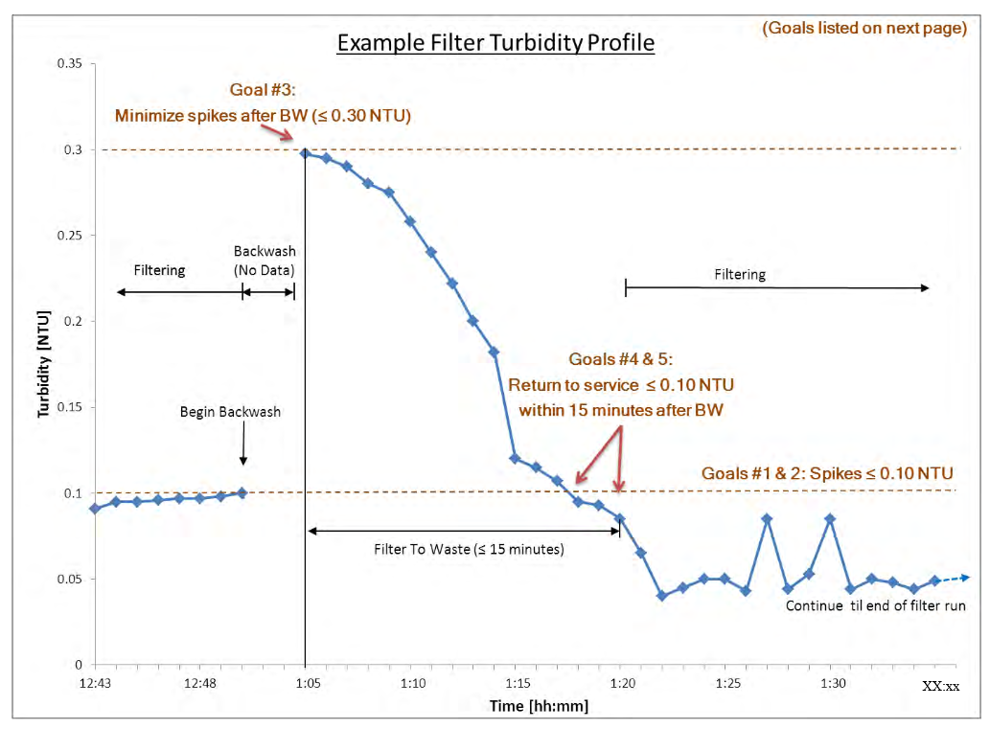
Notes:
Why do Oregon regulations require quarterly filter turbidity profiles?
Filtration is the key unit process removing pathogens to make water safe. Filtration is a complex dynamic process affected by: coagulation/flocculation,
loading rate, surface wash, media health, rate-of-flow controls (e.g., valving), etc. Filter profiles are a tool to assure these related processes perform correctly. The graph helps the operator to discover times and reasons when turbidity increases pass through the filter and provide the ability to detect (good & bad) trends when monitoring the process over time.
Elements of a good turbidity profile include:
Clear times and turbidities on axes
Description of backwash trigger
Backwash start/finish times
Filter-to-waste begin/end
When filter is put back into service
Filtered water turbidities & duration
Explanation of any turbidity spikes
Description of loading rate changes, if any

Slide 55
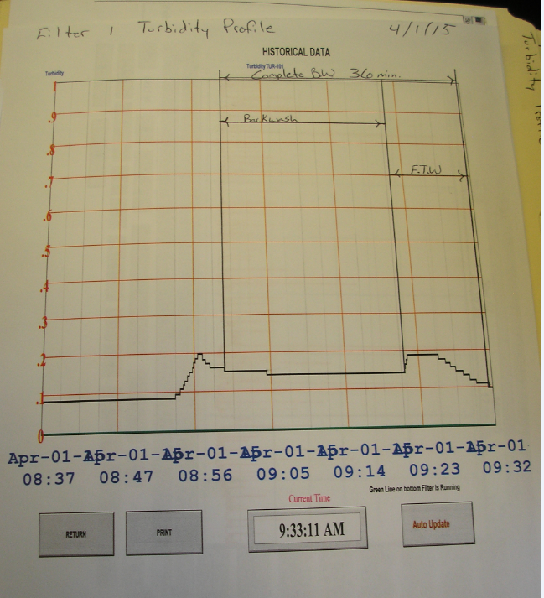
This is a good example of a filter profile of the backwash and filter-to-waste process in that:
The scale is readable,
The start and end of backwash and filter-to-waste are clearly labeled;
It shows that a backwash was initiated at 0.2 NTU.
After the backwash, it was filtered to waste until turbidity dropped to 0.1 NTU.
Notes:
This is an example from Rainier, Oregon

Slide 56
Overview – Turbidity Requirements
OAR 333-061-0040(1)(e)(B)(ii) and -0040(1)(e)(C)(i) – Turbidity Triggers
  Certain circumstances or “triggers” require water systems to take corrective actions, based on population served.
  If a system only has one or two filters and only measures CFE turbidity, these triggers also apply to the CFE readings.
  There are 4 turbidity triggers.
  Corrective actions may include developing or performing a:
      Filter Turbidity Profile
      Filter Self-Assessment
      Comprehensive Performance Evaluation

Slide 57
Overview – Turbidity Requirements
IFE Turbidity Triggers | Required Actions: Serving 10,000 or more people | Required Actions: Serving fewer than 10,000 people
IFE turbidity > 1.0 NTU in 2 consecutive measurements taken 15 minutes apart | Report: Filter number, name, or identifier Turbidity values over 1.0 NTU Dates of occurrence Cause of occurrences A filter turbidity profile may be needed
IFE turbidity > 1.0 NTU in 2 consecutive measurements taken 15 minutes apart for 3 consecutive months | Report filter number, turbidity level, and date of occurrence. Conduct a filter self-assessment within 14 days of the third high turbidity level. | Conduct a filter self-assessment within 14 days of the third high turbidity level. A Comprehensive Performance Evaluation (CPE) may be conducted in lieu of a filter self-assessment.
IFE turbidity > 2.0 NTU in 2 consecutive readings taken 15 minutes apart for 2 consecutive months. | Report filter number, turbidity level, and date of occurrence. Arrange to have a CPE conducted within 30 days of the 2nd month of the high turbidity. Submit the CPE report within 90 days of the 2nd month of high turbidity. | Report filter number, turbidity level, and date of occurrence. Arrange to have a CPE conducted within 60 days of the 2nd month of the high turbidity. If you wish to have the State conduct the CPE, the request must be made by the 10th of the third month. Submit the CPE report within 120 days of the 2nd month of high turbidity.
IFE turbidity > 0.5 NTU in 2 consecutive readings taken 15 minutes apart within the first 4 hours of continuous operation after the filter has been backwashed or during startup after the filter has been off-line. | Report filter number, turbidity level, and date of occurrence. Produce a filter turbidity profile within 7 days of the incident. Report the reason for the abnormal performance if known. | No required action for these systems.
Adapted from Pipeline article – OHA, Summer 2008
Notes:
This table shows the corresponding actions for water systems serving populations of 10,000 or greater (A), and those systems serving fewer than 10,000 people (B) for the four triggers. Corrective actions are explained following the table.

Slide 58
Overview – Turbidity Requirements
Explanation of Turbidity Trigger Actions
  Filter Turbidity Profile – previously described, this includes a graph showing turbidity over a complete filter run, including filter start-up, duration of the run, backwash, and filter-to-waste.
  See “Preparing a Filter Turbidity Profile” under “Forms & Tools” on-line at www.healthoregon.org/swt

Slide 59
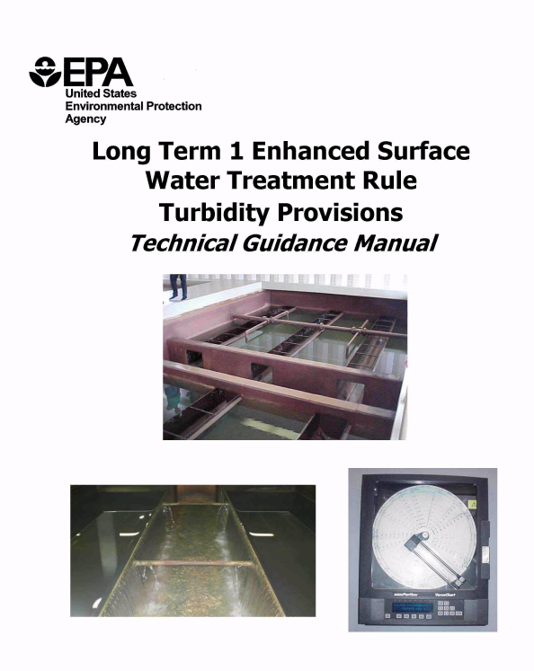
Overview – Turbidity Requirements
Explanation of Turbidity Trigger Actions
  Filter Self-Assessment
  Consists of a written report assessing filter performance, including
    A filter turbidity profile;
    Identification and prioritization of factors limiting filter performance; and
    Assessment of the applicability of corrections.
See link under “Filtration” at www.healthoregon.org/swt
http://www.epa.gov/safewater/mdbp/pdf/turbidity/chap_05.pdf
Notes:
Chapter 5 of EPA’s Technical Guidance Manual for the Long Term 1 Enhanced Surface Water Treatment Rule - Turbidity Provisions covers Filter Self-Assessments and is available on-line.

Slide 60
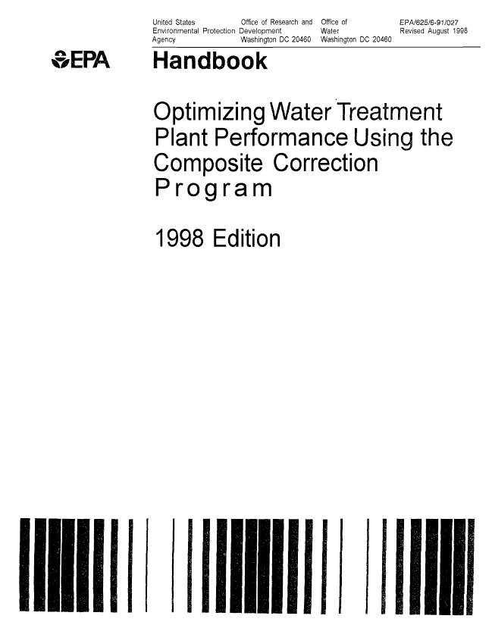
Overview – Turbidity Requirements
Explanation of Turbidity Trigger Actions
  Comprehensive Performance Evaluation
  Consists of a written report is a thorough evaluation of an existing treatment plant, including a review of the design as well as operational, and managerial practices that may limit the plant’s performance.
  The results of the evaluation establish the plant capacity and identify a set of prioritized factors that limit performance.
See link for EPA’s 1998 Handbook for Optimizing Water Treatment Plant Performance Using the Composite Correction Program under “Filtration” at www.healthoregon.org/swt
http://public.health.oregon.gov/HealthyEnvironments/DrinkingWater/Operations/Treatment/Documents/1998CCPManual.pdf
Notes:
EPA’s 1998 Handbook for Optimizing Water Treatment Plant Performance Using the Composite Correction Program covers Comprehensive Performance Evaluations and is available on-line.

Slide 61
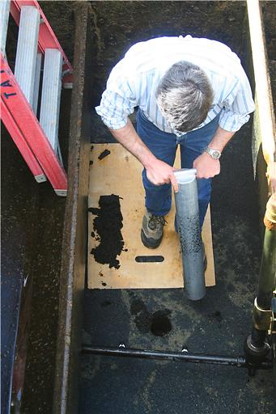
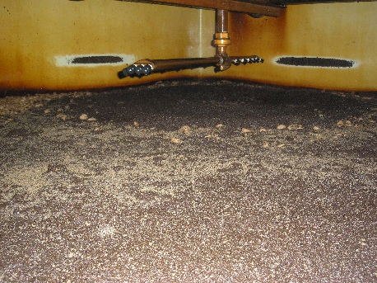
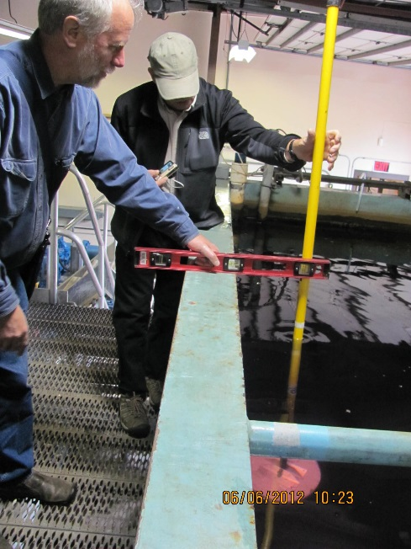
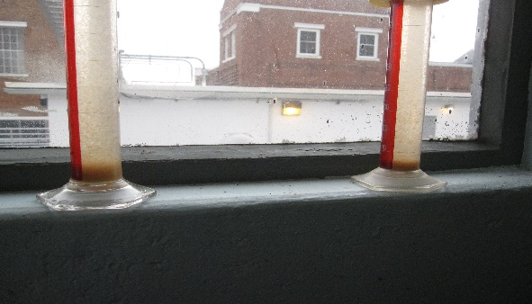
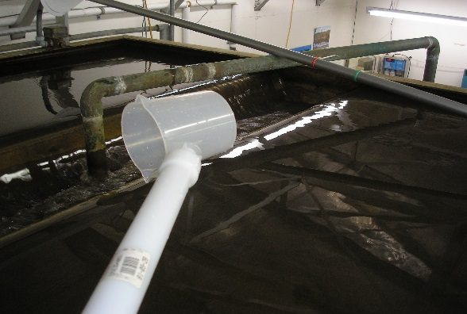
Overview – Turbidity Requirements
Evaluating Media Depth
Warm Springs CPE
2008
Sludge Solids Analysis
Albany CPE 2012
Filter Coring
Corvallis CPE 2007
Measuring Filter Bed Expansion
Ilwaco CPE 2012
Measuring Backwash Trough Turbidity Midland CPE 2015
These are some of the activities performed at CPEs in Oregon
Notes:
These are examples of some of the activities that have taken place at CPEs.

Slide 62
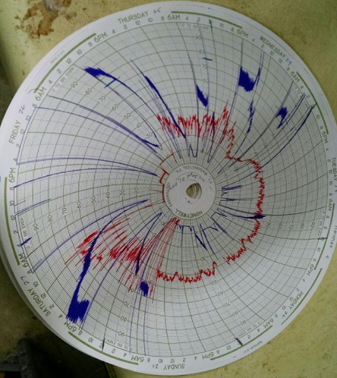
Overview – Turbidity Requirements
This is an example of a circle chart for a system in Oregon in which IFE triggers were exceeded enough to require a CPE (Turbidity on a scale of 0-2 NTU is shown in Blue; red is chlorine residual).
Filtered water turbidity exceeded 1.0 NTU in 2 consecutive 15-minute readings for 3 consecutive months (actually exceeded for 4 months).
Filtered water turbidity exceeded 2.0 NTU in 2 consecutive 15-minute readings for two consecutive months.
2.0 NTU

Slide 63
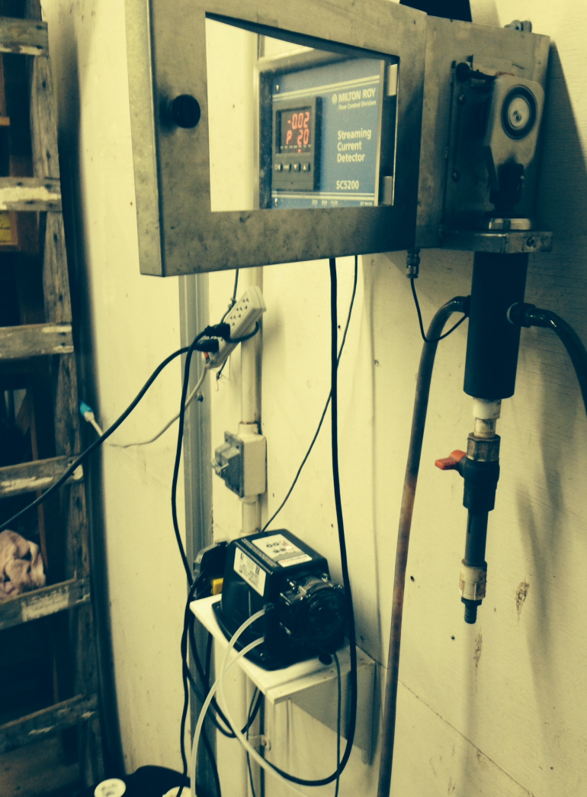
Overview – Turbidity Requirements
The turbidity exceedances occurred due in part to power interruptions resulting in improper SCM-controlled coagulant feed pump, heavy rains, and un-manned operation which resulted in significant delays in responding to high turbidity alarms.
2 NTU
Notes:
The turbidity exceedances occurred due in part to power interruptions resulting in improper SCM-controlled coagulant feed pump, heavy rains, and un-manned operation which resulted in significant delays in responding to high turbidity alarms.

Slide 64
Overview – Turbidity Requirements
The resulting CPE identified many issues in addition to inadequate coagulation control including:
Inoperable surface wash arm.
Improperly installed and calibrated plant effluent flow meter.
Non-compliant pH meter.
Poor filter bed expansion during backwash (<15%).
Excessive backwash times.
Inadequate disinfection at the plant (required “do not drink” signs to be posted at the plant)
Insufficient budgeting practices and availability of operations staff without automated safeguards.
Positive findings included supportive management and willingness of operator to seek help and make improvements as needed.

Slide 65
CFE Turbidity Monitoring (summary)
Combined filter effluent (CFE) turbidity
  Applies to all SW systems
  Location: post all filtration prior to chemical addition and any storage
  Frequency: At least every 4 hours for conventional/direct filtration
  Limits:
    95% of 4-hr readings < 0.3 NTU (9 or less out of 180 readings in a month)
    All readings less than 1 NTU

Slide 66
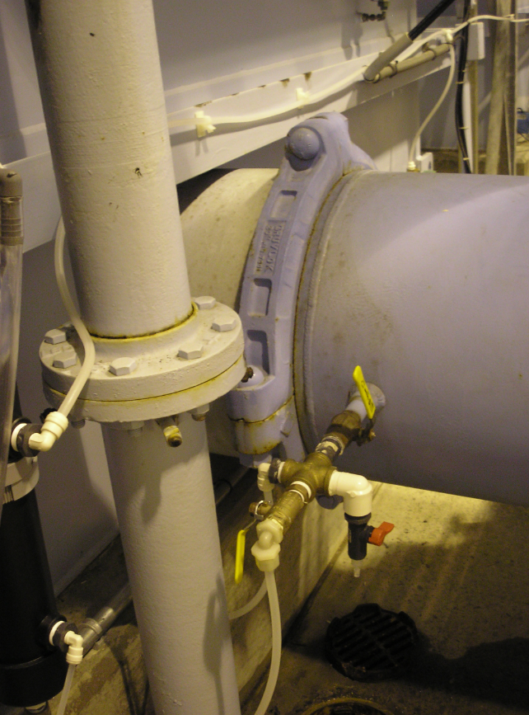
IFE Turbidity Monitoring (Summary)
Individual filter effluent (IFE) turbidity
  Applies to all conventional & direct systems (membrane systems also)
  Location: after each individual filter
  Frequency: continuous (every 15 minutes)
  Know what the IFE triggers are!
IFE Sample Tap
City of Seaside, 2011

Slide 67
IFE Triggers (Summary)
  Report the following events immediately and conduct a filter profile within 7 days (if no obvious reason exists) if the IFE turbidity is:
    > 1.0 NTU in 2 consecutive 15-min readings
    > 0.5 NTU in 2 consecutive 15-min readings within 4 hours of being backwashed or taken off-line
  Report the following events and conduct a filter self assessment within 14 days if the IFE turbidity is:
    > 1.0 NTU in 2 consecutive 15-min readings at any time in each of 2 consecutive months.
  A CPE must be done within 30 days if the IFE turbidity is:
    > 2.0 NTU in 2 consecutive 15-min readings at any time in each of 2 consecutive months.

Slide 68
Overview – Disinfection Requirements
OAR 333-061-0032(5) – Disinfection Requirements
  Disinfection must be sufficient to ensure that the total treatment process, including filtration credit, achieves:
    3-log (99.9%) inactivation and/or removal of Giardia lamblia cysts (2.0 to 2.5-log is achieved through filtration)
    4-log (99.99%) inactivation and/or removal of viruses

Slide 69
Overview – Disinfection Requirements
OAR 333-061-0032(5) – Disinfection Requirements
  Disinfection must be sufficient to ensure that the total treatment process, including filtration credit, achieves:
    3-log (99.9%) inactivation and/or removal of Giardia lamblia cysts (2.0 to 2.5-log is achieved through filtration)
    4-log (99.99%) inactivation and/or removal of viruses
  The residual disinfectant concentration of water entering the distribution system (entry point or “EP”) cannot be less than 0.2 mg/l for more than 4 hours.
        Continuous (on-line) monitoring if > 3,300 population
        4x/day if serving 2,501 – 3,300 people
        3x/day if serving 1,001 – 2,500 people
        2x/day if serving 501 – 1,000
        1x/day if serving < 500 people

Slide 70
Overview – Disinfection Requirements
OAR 333-061-0032(5) – Disinfection Requirements
  Disinfection must be sufficient to ensure that the total treatment process, including filtration credit, achieves:
    3-log (99.9%) inactivation and/or removal of Giardia lamblia cysts (2.0 to 2.5-log is achieved through filtration)
    4-log (99.99%) inactivation and/or removal of viruses
  The residual disinfectant concentration of water entering the distribution system (entry point or “EP”) cannot be less than 0.2 mg/l for more than 4 hours.
        Continuous (on-line) monitoring if > 3,300 population
        4x/day if serving 2,501 – 3,300 people
        3x/day if serving 1,001 – 2,500 people
        2x/day if serving 501 – 1,000
        1x/day if serving < 500 people
  The residual concentration in the distribution system, cannot be undetectable in more than 5% of samples each month, for any two consecutive months that the system serves water to the public.

Slide 71
Entry Point Residual
Where would you measure the chlorine residual entering the distribution system?

Slide 72
Entry Point
Residual
After the clearwell and prior to the distribution system.
“Clearwell” in this case refers to a storage tank or reservoir used to hold chlorinated water for a sufficient amount of time for effective disinfection.

Slide 73
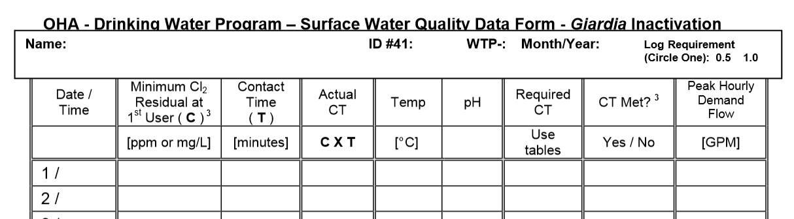
Entry Point
Residual
What EP residual would you report?
Report the lowest daily residual on the “Surface Water Quality Data Form”

Slide 74
Distribution Residual
Where would you sample in the distribution system?

Slide 75
Distribution Residual
Where would you sample in the distribution system?
“At one or more representative points at a frequency that is sufficient to detect variations in chlorine demand and changes in water flow but in no case less often than twice per week” OAR 333-061-0036(9)(a)(A)
“At the same points in the distribution system and at the same times as total coliforms are sampled” -0036(9)(a)(B)

Slide 76
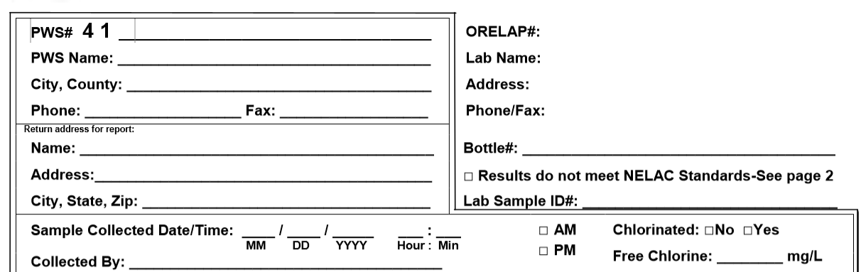
Distribution Residual
What distribution residual would you report?
Keep semiweekly residuals on-site for two years
Use the coliform sample lab form to report residual at the time of coliform sampling.

Slide 77
Overview – Disinfection Requirements
Do not exceed these limits…
OAR 333-061-0031(1) – Maximum Residual Disinfectant Levels (MRDLs)
Disinfectant Residual | MRDL in mg/l
Chlorine | 4.0 (as Cl₂)
Chloramines | 4.0 (as Cl₂)
Chlorine Dioxide | 0.8 (as ClO₂)

Slide 78
Overview – Disinfection Requirements
OAR 333-061-0036(5)(b) – Monitoring CT
  Conventional & Direct Filtration Treatment Systems must calculate CT each day the plant is in operation.
  CT is a way to measure if disinfection is adequate

Slide 79
How do we calculate CT?
Do not confuse “CT” and “Contact Time”
  CT = Chlorine Concentration x Contact Time
The chlorine concentration is from daily measurements taken at or before the entry point to the distribution system or “1st user”.
More on CT later….

Slide 80
Overview – NTU and Disinfection Reporting Requirements
OAR 333-061-0040(1)(d) – Reporting requirements
  All surface water systems that provide filtration must report within 24 hours after learning:
    That the filtered water turbidity exceeds 5 NTU.
    Of a waterborne disease outbreak potentially attributable to the water system
    That the disinfectant residual of the water entering the distribution system fell below 0.2 mg/l and whether or not the residual was restored to at least 0.2 mg/l within 4 hours.

Slide 81
Overview – NTU and Disinfection Reporting Requirements
OAR 333-061-0040(1)(d) – Reporting requirements, continued
  Conventional & Direct Filtration Treatment Systems must also report within 10 days after the end of each month:
    The total number of filtered water turbidity taken each month (min of every 4 hours);
    The number and percentage of results exceeding 0.3 NTU; and
    The date and value of any turbidity that exceeded 1 NTU.

Slide 82
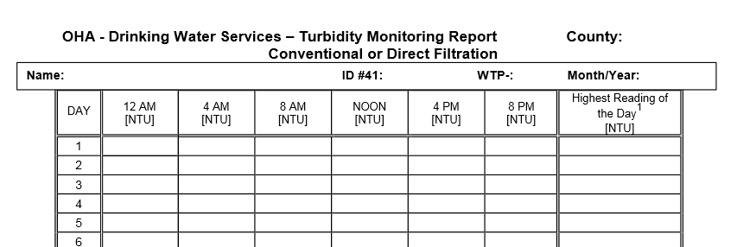
Overview – NTU and Disinfection Reporting Requirements
  Use the State’s Turbidity Monitoring Report form to help fulfill
  reporting requirements - maintain records for at least three years.
  Form is available on-line under “Forms & Tools” link at www.healthoregon.org/swt

Slide 83
Overview – NTU and Disinfection Reporting Requirements
  Form is available on-line under “Forms & Tools” link at www.healthoregon.org/swt
  There are 4 forms:
  Conventional/Direct
  Slow Sand / Membrane / DE / Unfiltered
  Cartridge
  UV (if used for Giardia credit)
  Must use the correct form because each has questions that must be answered that are specific to filtration type.

Slide 84
Overview – NTU and Disinfection Reporting Requirements
  CFE Turbidity
  Chose time closest to when daily turbidity is measured and enter results
  Enter highest turbidity of all measurements for the day (e.g., online instrument or highest of multiple daily grab samples)
0.34 0.50
0.24 0.66
0.44 0.46
Notify the State if NTU > 1 NTU.
Notify the State within 24-hrs if turbidity > 5 NTU (includes after hours)
Public Health After Hours Duty Officer:
Cell (971) 246-1789
Oregon Emergency Response System:
1-800-452-0311

Slide 85
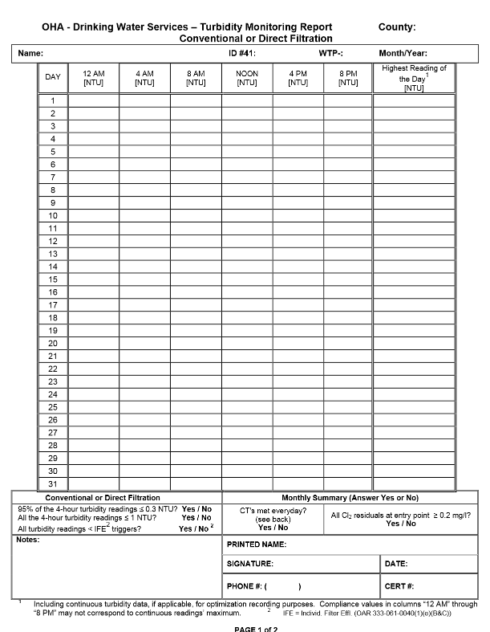
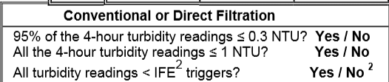
Overview – NTU and Disinfection Reporting Requirements
  CFE & IFE Turbidity
  Based on the results entered for the month, circle “yes” or “no” to the three questions at the bottom of the form.

Slide 86
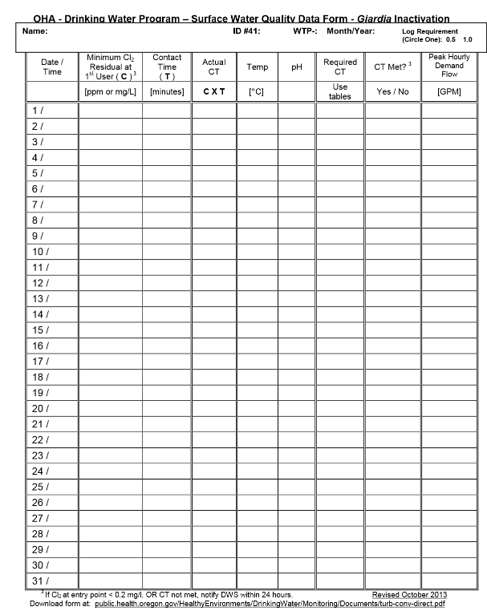
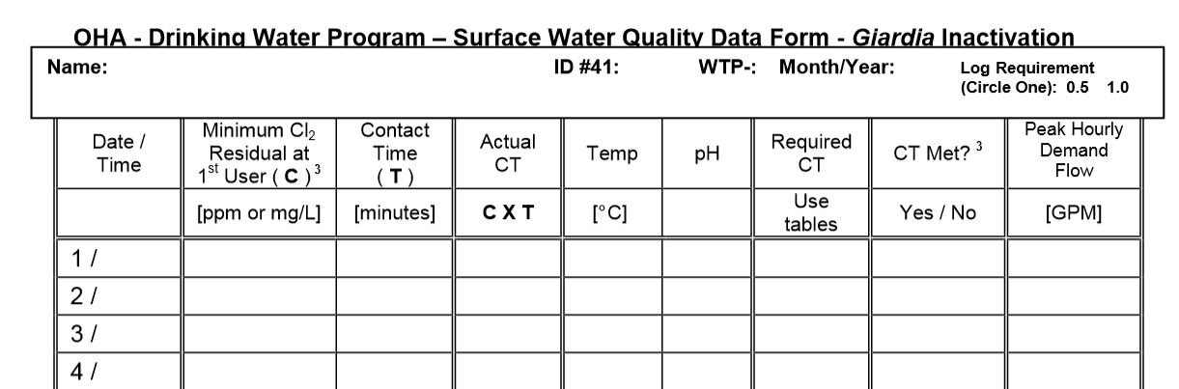
Overview – NTU and Disinfection Reporting Requirements
  Peak hourly demand flow (gpm)
  Enter peak hourly demand (PHD) flow and the time that the PHD flow occurred.
  This flow should not exceed 10% above the peak flows replicated at the time of the tracer study.
9 AM 1,000

Slide 87

Overview – NTU and Disinfection Reporting Requirements
  What is peak hourly demand flow?
  The greatest volume of water passing throught he system during any one hour in a consecutive 24 hr period
  Not the same as Peak Instantaneous Flow
  Report demand flow (flow leaving the clearwell, not plant flow (in most cases)

Slide 88
Overview – NTU and Disinfection Reporting Requirements
  How do you determine peak hourly demand flow?
  For systems with a totalizing flow meter only:
  Spot check throughout the day to determine the time of peak demand (e.g. 9 am or 9 pm for residential or mid-day for industrial uses)
  Then record how much water is used during that hour in gallons and divide by 60 minutes to get the peak hour demand in gpm.
  For systems that can measure and record flow rate:
  On a daily basis, use the best available operational data to identify the hour within the 24 hr period that had the highest demand flow.
  For the hour of highest demand flow:
    Calculate the average flow rate within the one hour period (i.e., add the flow rates and divide by the number of data points).
    Use as many data points as possible, preferably no less than four data points taken at 15 minute intervals.

Slide 89
Overview – NTU and Disinfection Reporting Requirements
  The red line represents the span of 1 hour with the highest demand
  (7:30 am – 8:30 am). The average of the 4 data points is 4,125 gpm.

Slide 90
Overview – NTU and Disinfection Reporting Requirements
  Think of it like a running hourly average of demand flow measurements…
Time | Demand Flow (gpm) | Running Hourly Average (gpm)
7:00 AM | 2,000
7:15 AM | 2,400
7:30 AM | 3,000
7:45 AM | 5,000 | 3,100
8:00 AM | 4,000 | 3,600
8:15 AM | 3,500 | 3,875
8:30 AM | 4,000 | 4,125
8:45 AM | 3,500 | 3,750
9:00 AM | 2,700 | 3,425

Slide 91
Overview – NTU and Disinfection Reporting Requirements
  Minimum chlorine residual and contact time
  The minimum chlorine residual is measured at the end of the disinfection segment at the entry point prior to or at the first user
  Contact time is the time that the disinfectant is in contact with the water within the disinfection segment.
9 AM ??? ??? 1,000

Slide 92
Overview – NTU and Disinfection Reporting Requirements
  How is contact time determined?
Tracer studies are used to determine contact time (T) which is used in calculating CT achieved, where
CT = chlorine Concentration x contact Time.
Contact time is the time that chlorine is in contact with the water from the point of injection to the point where it is measured (sometimes referred to as the “CT segment”)
    May be at or before the 1st user
    May be more than one CT segment
Tracer studies are often conducted to simulate a worst-case scenario where peak hour demand flows are high and reservoir levels are low. This gives a conservative (i.e. lower) contact time than would normally be expected.

Slide 93
Overview – NTU and Disinfection Reporting Requirements
  Remember, the disinfection segment is between the point of chlorine injection and the entry point.

Slide 94
Overview – NTU and Disinfection Reporting Requirements
  Remember, the disinfection segment is between the point of chlorine injection and the entry point.
So if we were conducting a tracer study, this is the segment showing the potential flow path we would be looking at and determining the contact time T for.

Slide 95

Overview – NTU and Disinfection Reporting Requirements
  What impacts contact time?
The more efficient the mixing is in a reservoir or tank, the more contact time is available for disinfection.
Estimates of contact time based on tank or reservoir design are not allowed for calculating CT’s for surface water!

Slide 96



Overview – NTU and Disinfection Reporting Requirements
  What impacts contact time?
Mixing efficiency improves with high flow path length to width ratios, found in pipelines and simulated in tanks with the use of baffles (hence the term baffling efficiency or factor).

Slide 97
Tracer studies
Conducting a tracer study:
  If water is pumped from the clearwell at different rates depending on time of year, do tracer study at each of those flow rates
  Conduct study at typical winter/summer peak hour demand flows
  Otherwise use “worst-case scenario” parameters:
    Highest flow rate out of clearwell (conduct during peak hour or conditions that simulate e.g. open a hydrant)
    Keep flow rate constant
    Keep clearwell water level close to normal minimum operating level

Slide 98
Tracer studies (continued)
Conducting a tracer study:
  Community water systems with populations <10,000 and non-profit non-community systems can use the circuit rider to perform a tracer study
  Must submit a proposal to the state for approval prior to conducting the tracer study (even if using the circuit rider).
  Must redo tracer study if peak hour demand flow increases more than 10% of the maximum flow used during the tracer study

Slide 99
Example
Conducting a tracer study

Slide 100
Example: Tracer studies
Directions: Look at the diagram and answer the questions.
Figure 1: Water Treatment Plant
Smith Creek
NTU, flow
filter #1
filter #2
NTU
NTU
Two houses
Chlorine injection
Flow control valve: 270 gpm max
16.1’ max volume
Reservoir
75,000 gal.
Clearwell 220,000 gal
10.5’ min volume
Flow
To distribution
Questions:
If this was your treatment plant, highlight the part of the plant where you might conduct a tracer study.
In a “worst-case scenario” tracer study, what would the flow rate be? 270 gpm
In a “worst-case scenario” tracer study, what would the clearwell level be? 10.5-ft

Slide 101
Where do I report contact time?
Use the time T from the tracer study on the monthly reporting form in the “Contact time (min)” column
  Use the smallest T (highest flow) if the tracer study was done at multiple flow rates
This may not be your exact time, but it represents your worst case (as long as the peak flow is less and clearwell volume is more than they were at the time of the tracer study)

Slide 102
Can I use a baffling factor?
Once you know the time T from the tracer study, you can back-calculate to determine the baffling factor of the clearwell
    Baffling factor (%) = Time (min) x Flow During Tracer Study (gpm)
Clearwell Volume During Tracer Study (gal)
T can be adjusted based on flow (at <110%) with the following equation:
    T = Current clearwell Volume (gal) x Baffling Factor (%)
    Peak Hourly Demand Flow (gpm)
If tracer study includes pipeline segments or multiple tanks, contact the state for guidance on using baffling factors

Slide 103
Overview – NTU and Disinfection Reporting Requirements
  Now we can enter the min chlorine residual, contact time, and CT_{actual}
  The minimum chlorine residual is measured at the end of the disinfection segment at the entry point prior to or at the first user
  Contact time is the time that the disinfectant is in contact with the water within the disinfection segment.
  CT_{actual} = Chlorine residual x contact Time
Notify the State within 24-hrs if chlorine residual < 0.2 mg/l
Public Health After Hours Duty Officer:
Cell (971) 246-1789
Oregon Emergency Response System:
1-800-452-0311
9 AM 0.6 100 60 1,000

Slide 104
How do I know if CT_{actual} is adequate?
We use the EPA tables to determine the CTs needed to inactivate Giardia (CT_{required})
  In order to use the EPA tables, we need to know the log Giardia inactivation required to meet a total removal/inactivation of 3.0-log (generally either 0.5-log or 1-log). 0.5-log Giardia inactivation will also achieve 4.0-log virus inactivation.
  We also need to know the following parameters, measured each day at or before the first user or entry point:
    pH,
    temperature, and
    free chlorine residual
Then we compare CT_{required} with Ct_{actual}
Must keep CT_{actual} > CT_{required}

Slide 105
Overview – NTU and Disinfection Reporting Requirements
  Now enter the pH, temperature, and circle the appropriate log removal required
  Log removal required is for Giardia and is always going to be at least 0.5-log.
  Although the requirement can vary from plant to plant, generally for conventional plants, 0.5-log is needed and for direct plants, 1.0-log is needed (check with your regulator if uncertain)
9 AM 0.6 100 60 12 6.8 1,000

Slide 106
Calculating CT_{required}
You should know how to use the EPA tables to determine the CTs needed to inactivate Giardia (CT_{required}) – more on that later!
You can also use “regression” equations determined by EPA
Regression equations are built into the Microsoft Excel reporting forms on-line under the “Forms and Tools” section of our surface water treatment page on-line at www.healthoregon.org/swt

Slide 107
Calculating CT_{required} Using Regression Equations
Regression equations can be programmed into plant SCADA or spreadsheets
Regression Equation (for Temp < 12.5°C)
  CT = (0.353*L)(12.006 + e(2.46-0.073*T+0.125*C+0.389*pH))
Regression Equation (for Temp > 12.5°C)
  CT = (0.361*L)(-2.261 + e(2.69-0.065*T+0.111*C+0.361*pH))
Variables:
  CT = Product of Free Chlorine Residual and Time required
  L = number of log inactivation for Giardia (L = 1 for slow sand)
  T = temperature, in Celsius
  C = chlorine residual in mg/L
  pH = pH of water
  e = 2.7183, base for natural log
(Smith, Clark, Pierce and Regli, 1995, from EPA's 1999 Guidance Manual for Disinfection Profiling and Benchmarking)

Slide 108
Calculating CT_{required} Using EPA CT Tables - Temperature
You should all be able to use the CT tables to calculate CT_{required}
  There are six EPA CT tables based on temperature
  Find the correct table based on your water temperature in degrees Celsius.
      °C = 5/9 x (°F – 32)
  If water temp is between values, then round down
  Disinfection is less effective at colder temperatures.

Slide 109

Calculating Ct_{required} Using EPA CT Tables - Temperature
If the water temperature = 12°C
Use 10°C table for T = 10 – 14.9°C
(round down for temp)

Slide 110
Calculating CT_{required} Using EPA CT Tables - pH
  There are 7 sections for pH on each table
  Find the section that corresponds to your water’s pH level
  If your pH is between the choices, then round up to the higher pH
  Disinfection is less effective at higher pH
  Rounding up is more conservative (leads to a higher CT_{required})
pH = 7.0

Slide 111
Calculating CT_{required} Using EPA CT Tables, Continued
Assume the pH = 6.8°C
Use pH = 7.0 column
For pH = 6.6 – 7.0
(round up for pH)

Slide 112

Calculating CT_{required} Using EPA CT Tables – Log
Assume the required log inactivation of Giardia for a conventional treatment plant is 0.5-log
Image from CDC’s site: http://www.cdc.gov/parasites/crypto/index.html
Use the 0.5-log column

Slide 113

Calculating CT_{required} Using EPA CT Tables – Chlorine
Match up your chlorine residual with the log inactivation column as shown below. Where they intersect is the CT_{required}.
If residual falls between values in the table, round up to yield a higher CT_{required}

Slide 114
Calculating CT_{required} Using EPA CT Tables – Chlorine
Match up your chlorine residual with the log inactivation column as shown below. Where they intersect is the CT_{required}.
If you get confused on which way to round, think about how you want to set the bar (CT_{required}) as high as possible to be the most conservative and most protective of public health.

Slide 115
Overview – NTU and Disinfection Reporting Requirements
  Now enter Required CT and indicate if CT was met
  (i.e. put “Yes” if CT_{actual} > Ct_{required})
9 AM 0.6 100 60 12 6.8 18 Yes 1,000
Notify the State within 24-hrs if CT was not met.
Public Health After Hours Duty Officer:
Cell (971) 246-1789
Pager (503) 938-6790
Oregon Emergency Response System:
1-800-452-0311

Slide 116

Overview – NTU and Disinfection Reporting Requirements
  Everyone needs to fill out the CT section of the Monthly Summary

Slide 117



Overview – NTU and Disinfection Reporting Requirements
  Be sure your reports are complete before sending them in by the 10th of each month
Clatsop
XWZ Water System 99999 A 09/2015
0.08 0.09 0.07 0.08 0.09 0.06 0.12 NTU
Evan Hofeld
09/26/15
971 322-8027 12345
XWZ Water System 99999 A 09/15
9 AM 0.6 100 60 12 6.8 18 Yes 1,000

Slide 118
Overview – NTU and Disinfection Reporting Requirements
Common Mistakes
Not calculating CT’s daily
  Don’t wait until the end of the month to do the calculations because if you discover you didn’t meet CT’s, it’s too late!
If adjusting contact time according to flow rate, use the demand flow, not the plant flow.
Failure to answer questions at bottom of form correctly (or at all)
Always answering “Yes” to the questions at the bottom of the form without actually looking at the numbers

Slide 119
Overview – NTU and Disinfection Reporting Requirements
Common Mistakes, Continued
Rounding errors when using EPA tables to determine CT_{required}
  Must round down for temperature
  Must round up for pH
  Must round up for free chlorine residual
Bad CT formulas in excel spreadsheets:
  Make sure you understand your formula
  Wilkes Equation not allowed, must use Regression Equation

Slide 120

Overview - TOC
OAR 333-061-0036(5) – Total Organic Carbon (TOC)
  Conventional Filtration Treatment Systems must:
    Monitor source water TOC and alkalinity prior to treatment (this can be from a combined header after blending of more than one source water)
    Monitor combined filter effluent (CFE) water TOC.
Coagulant
Chlorine

Slide 121
Overview - TOC
OAR 333-061-0036(5) – Total Organic Carbon (TOC)
  Conventional Filtration Treatment Systems must:
    Monitor source water TOC and alkalinity prior to treatment (this can be from a combined header after blending of more than one source water)
    Monitor combined filter effluent (CFE) water TOC.
    Source TOC and alkalinity and CFE TOC must be taken at the same time as a “paired” sample set used to determine TOC removal efficiency.
    Sampling must be done each month
    Reductions to quarterly sampling can occur if average CFE TOC < 2.0 mg/l for 2 consecutive years or < 1 mg/l for one year
    If annual average treated water TOC > 2.0 mg/l, the reduction is lost and monthly monitoring must resume at the end of the quarter.

Slide 122
Overview - TOC
OAR 333-061-0032(10)(d) – TOC removal requirements
  Community (e.g., year-round residents) and Non-transient Non-community (e.g. schools, businesses, etc.) using conventional filtration must operate with enhanced coagulation or enhanced softening to achieve certain total organic carbon (TOC) percent removal levels specified in -0032(10)(e) unless at least one of the following alternative compliance criteria are met:
    Source water TOC < 2.0 mg/l (calculated quarterly as a running annual average (RAA)).
    Treated water RAA TOC < 2.0 mg/l
    Source water RAA TOC < 2.0 mg/l & RAA alkalinity > 60 mg/l & TTHM & HAA5 < ½ the MCL (TTHM MCL = 0.080 mg/l, HAA5 MCL = 0.060 mg/l)
    TTHM & HAA5 < ½ the MCL and chlorine is the only disinfectant used
    Source water RAA SUVA < 2.0 L/mg-m
    Finished water RAA SUVA < 2.0 L/mg-m
  Note: Softening systems have additional criteria – SEE OAR 333-061-0032(10(d)(B)

Slide 123
Overview – Recycle Streams
OAR 333-061-0032(11) – Recycled water requirements
  Both conventional and direct plants that recycle spent filter backwash water, thickener, supernatant, or liquids from dewatering processes must notify the State and will generally be expected to return these flows to the head of the treatment plant prior to coagulant injection

Slide 124
Overview – Significant Deficiencies
In addition to other rule violations, significant deficiencies identified during a water system survey would include the following commonly found issues:
      Monitoring not completed as required;
      Incorrect location for compliance turbidity monitoring;
      Turbidimeters not calibrated quarterly;
      Regardless of size, no auto-dial, call-out alarm or auto-plant shutoff for high turbidity when no operator is on-site;
      Settled water turbidity not measured daily for conventional plants;
      For systems serving more than 3,300 people, no auto-dial, call-out alarm or auto-plant shutoff for low chlorine residual;
      No means to adequately determine flow rate on clearwell;
      No means to determine disinfection contact time under peak flow and minimum storage conditions;
      Failure to calculate CT correctly; and
      Inadequate written Operations and Maintenance procedures

Slide 125

Overview – Homework!
Homework:
Trace data from the sample tap to regulatory reporting forms.
What did you find?
Notes:
These are examples of some of the activities that have taken place at CPEs.

Slide 126
Overview – Homework!
Write an SOP for CT determination
  Check how T is calculated at your plant
  Do all treatment plant operators understand it?
  Review spreadsheet equation for CTs (if applicable)
  Arrange for a tracer study if necessary
  Calculate CT and fill out monthly report daily
Know what to do and who to call when things go wrong (contact State regulator & refer to Emergency Response Plan)
Notes:
These are examples of some of the activities that have taken place at CPEs.

Slide 127

Overview – Homework!
Make data reliability a plant goal
Establish protocols for collection and recording of data. Only collect data used for process control or compliance reporting
Establish a data verification process that can be routinely used to confirm data integrity
Turn data into information (e.g., draw the graph).
Notes:
These are examples of some of the activities that have taken place at CPEs.

Slide 128
Class Outline
9 AM Introduction/Overview
  10:15 AM – 15 minute break
10:30 AM Coagulation/Flocculation
  12 noon – Lunch (on your own)
1 PM Clarification/Sedimentation
2 PM Filtration
  2:15 PM – 15 minute break
2:30 PM Filtration (continued)
3:30 PM General Operations
  4:30 PM - End

