Slide 1
Class Outline
9 AM Introduction/Overview
  10:15 AM – 15 minute break
10:30 AM Coagulation/Flocculation
  12 noon – Lunch (on your own)
1 PM Clarification/Sedimentation
2 PM Filtration
  2:15 PM – 15 minute break
2:30 PM Filtration (continued)
3:30 PM General Operations
  4:30 PM - End

Slide 2
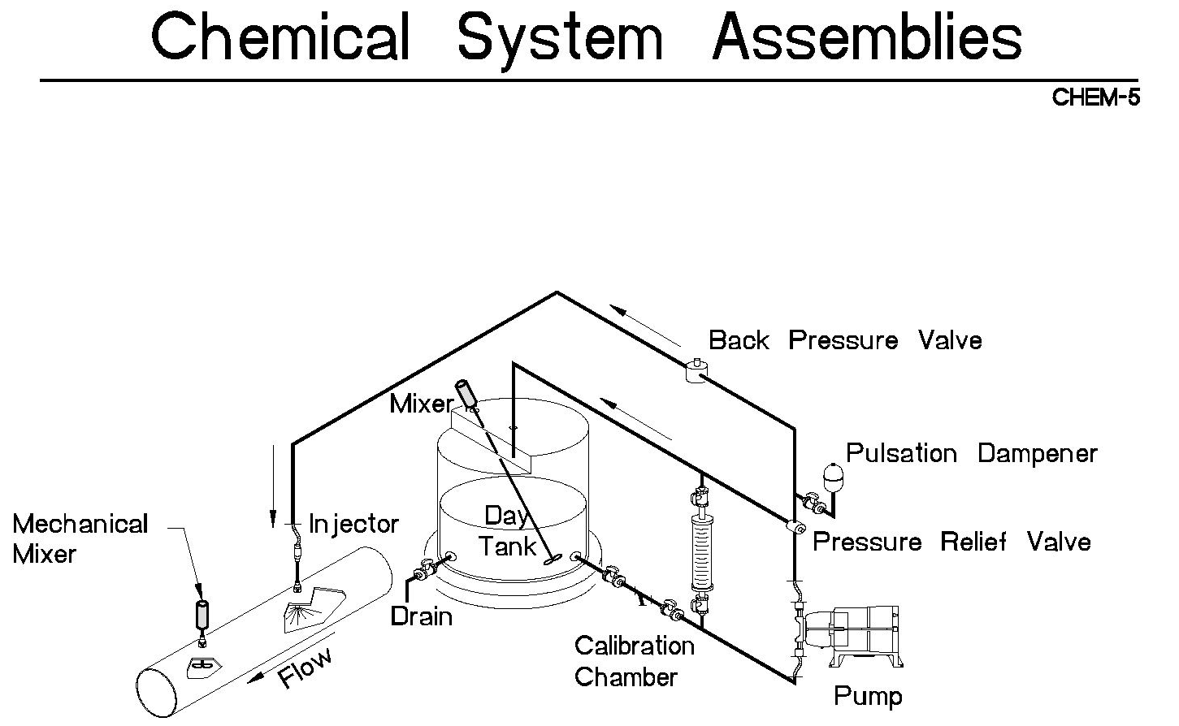
Coagulation
Typical coagulant feed system

Slide 3
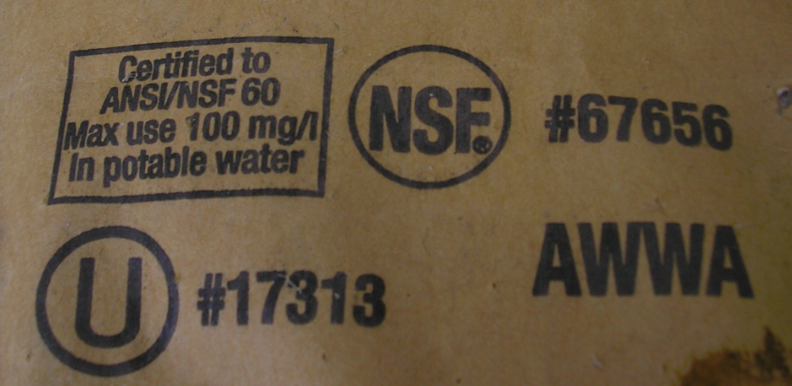
Chemicals must meet ANSI/NSF 60
Make sure product meets ANSI/NSF Standard 60 and you are not exceeding maximum use.
Solvay Dense Soda Ash (Sodium Carbonate, Anhydrous)

Slide 4
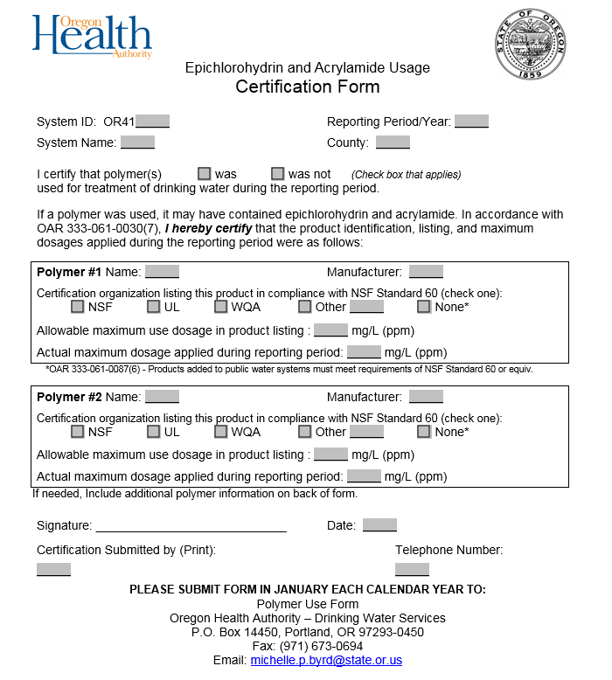
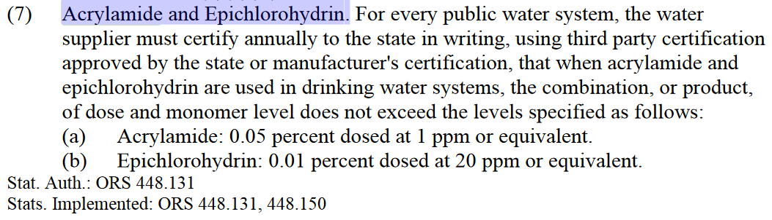

Epichlorohydrin & Acrylamide (ANSI/NSF 60)
Do not exceed maximum use identified by ANSI/NSF 60.
NSF, UL, and WQA all specify a maximum use that ensures compliance.
A form will be mailed out each year to help you meet the reporting requirements of OAR 333-061-0030(7)
Notes:
NSF = National Sanitation Foundation, UL = Underwriters Laboratories, and WQA = Water Quality Alliance.

Slide 5
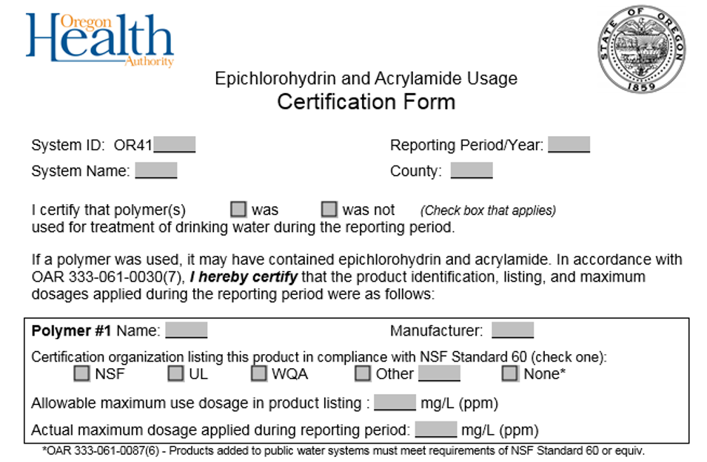
Epichlorohydrin & Acrylamide (ANSI/NSF 60)
A form will be mailed out each year to help you meet the reporting requirements of OAR 333-061-0030(7)

Slide 6
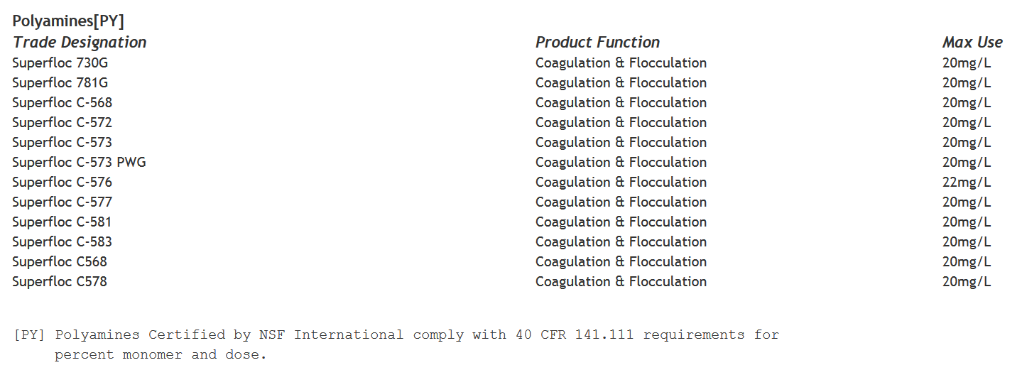
Epichlorohydrin & Acrylamide (ANSI/NSF 60)
Do not exceed maximum use identified by ANSI/NSF 60.
http://info.nsf.org/Certified/PwsChemicals/
Beware of product name changes and loss of NSF-60 certification.
40 CFR 141.111 is the federal rule citation for acrylamide and epichlorohydrin addressed under -0030(7) in OAR.

Slide 7
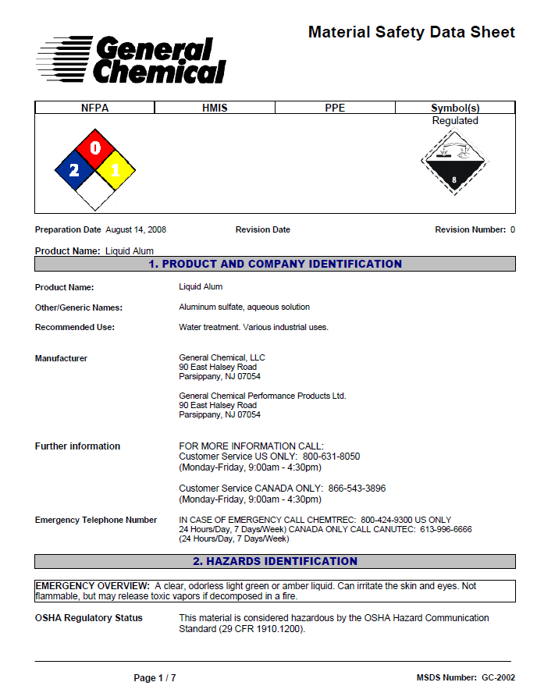
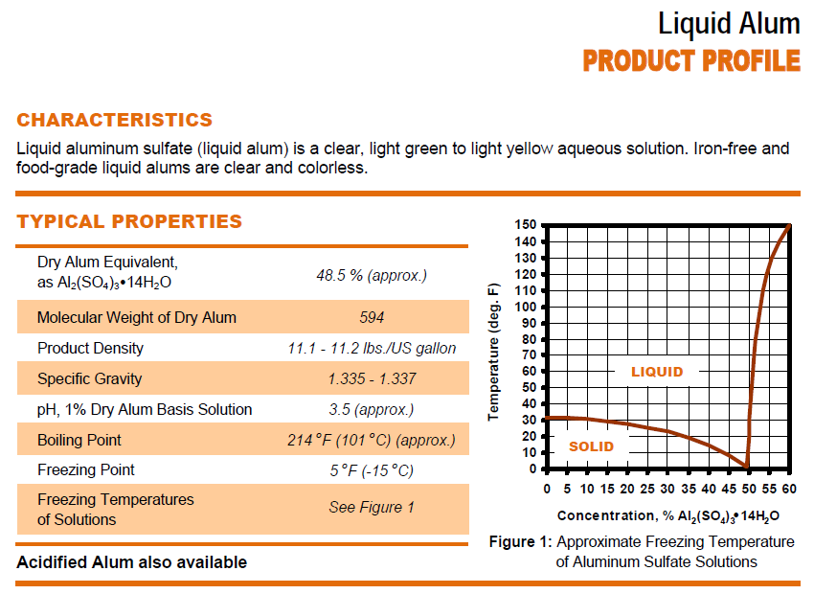
Maintain current MSDS & Product Specs
Maintain current MSDS and product specification sheets

Slide 8
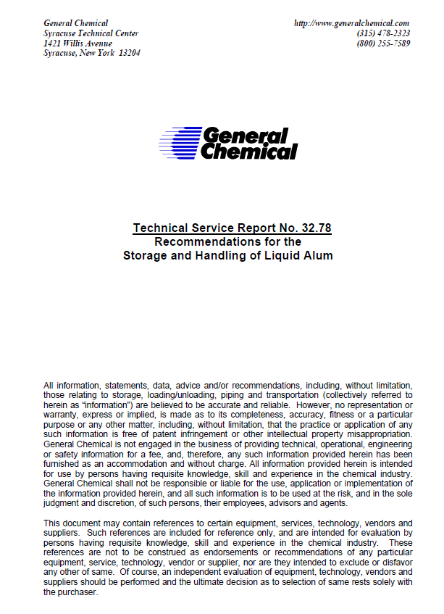
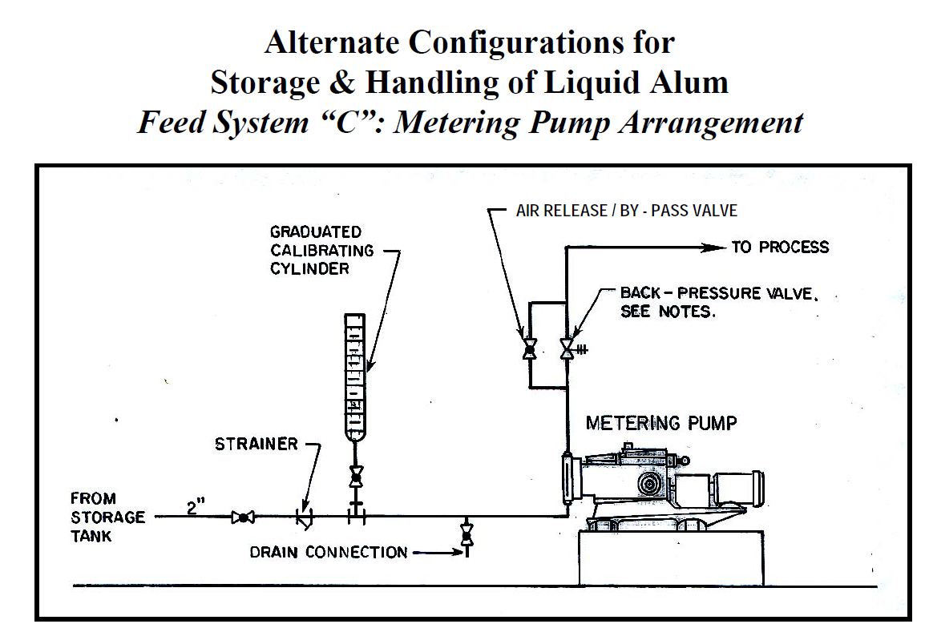
Store and Handle Per Manufacturer

Slide 9
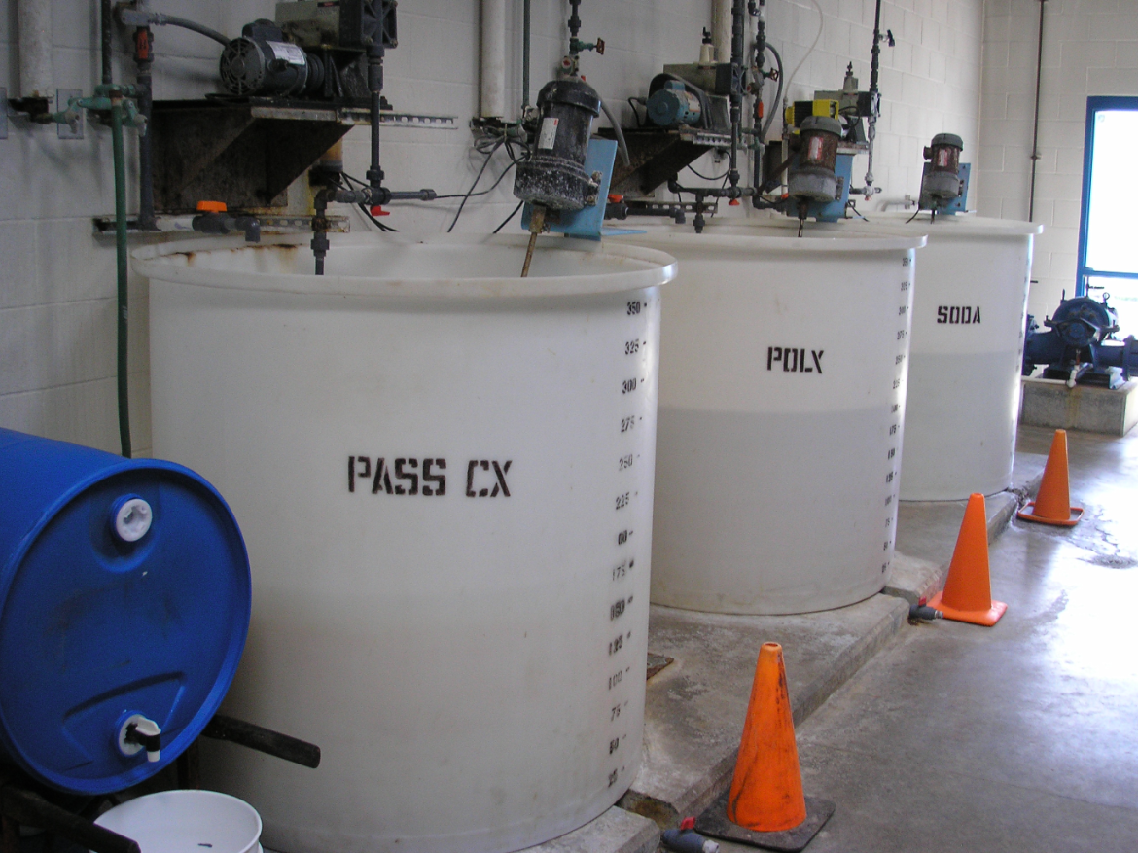
Clearly Label Tanks
City of Vernonia, 2010

Slide 10
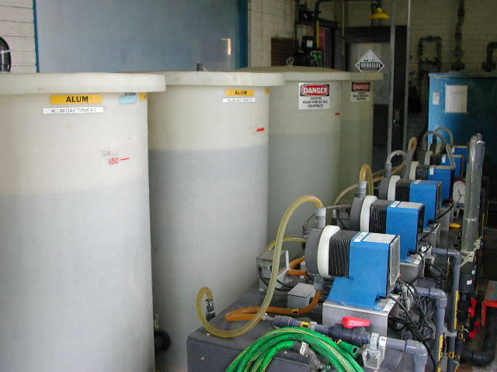
Coagulation
Objectives depend on raw water quality
Most particles found in source waters are negatively charged (e.g., clay, organics, algae cells)
  Particles repel each other
Coagulant(s) added to destabilize particles (neutralize negative charge)
  Neutralized particles collide and build floc

Slide 11
Coagulation Depends on Mixing
Injection quills can help evenly disburse chemical and improve mixing
chemical stays near top
chemical spreads out
more evenly

Slide 12
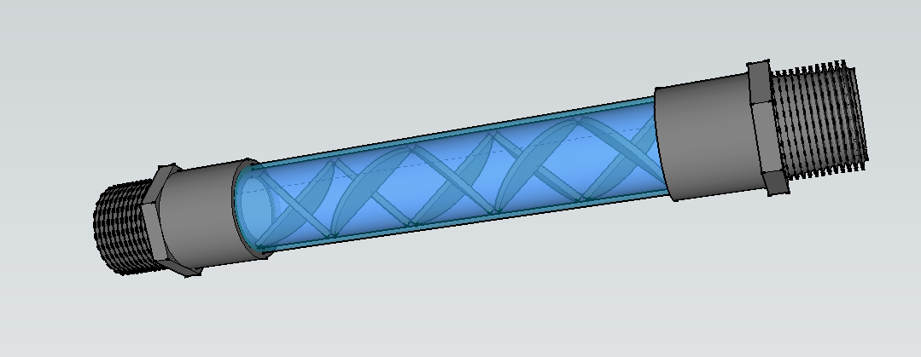
Coagulation Depends on Mixing
Static mixers have veins or “elements” that promote mixing.
The more water is pushed through a static mixer, the higher the head loss and better mixing you have.

Slide 13
Factors Affecting Coagulation
Dosage: determined by jar test for optimum qualities of floc: (size, settling rate).
Mixing: Mechanical or static. Need to rapidly mix chemicals.
Alkalinity: 50 mg/l or less can shift pH downward.
Temperature: Colder water slows coagulation.
Color: Pre-oxidation may be required.
Turbidity: Changing conditions require more frequent jar tests.

Slide 14
Coagulants
Aluminum sulfate (alum): very common, only effective in narrow pH range (typically pH = 6.0 – 7.4). Consumes about 0.5 mg/l alkalinity for every 1 mg/l of alum dosed.
Ferric chloride: More expensive, but works in wider pH range (pH = 4.0 – 11.0). Consumers about 1 mg/l alkalinity for every 1 mg/l ferric chloride dosed.
Poly aluminum chloride (PACL): not affected by pH, doesn’t change pH, works well with low alkalinity, leaves less sludge because dosage is low.
Aluminum Chlorohydrate (ACH): similar to PACL.

Slide 15
Flocculation
Objectives depend upon subsequent processes (sedimentation, type of filtration, etc.)
Generally the objective is to:
  Develop settleable or filterable floc particle.
  Optimize flocculation detention time and energy
Typical Hydraulic Detention Times |  | Hydraulic
 |  | Detention Time
Single-Stage | Temp <= 5ºC | 30 minutes
 | Temp > 5ºC | 25 minutes
Multiple Stages | Temp <= 5ºC | 20 minutes
 | Temp > 5ºC | 15 minutes

Slide 16
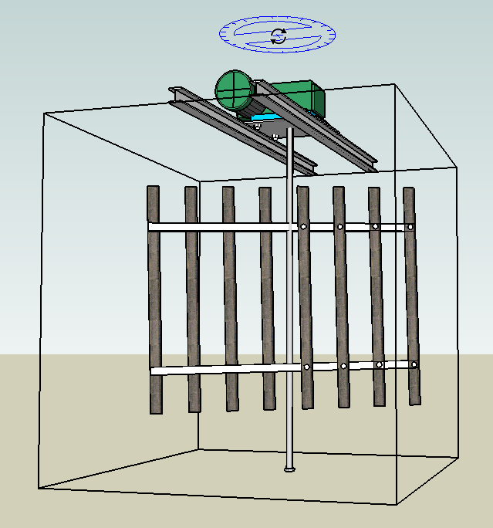
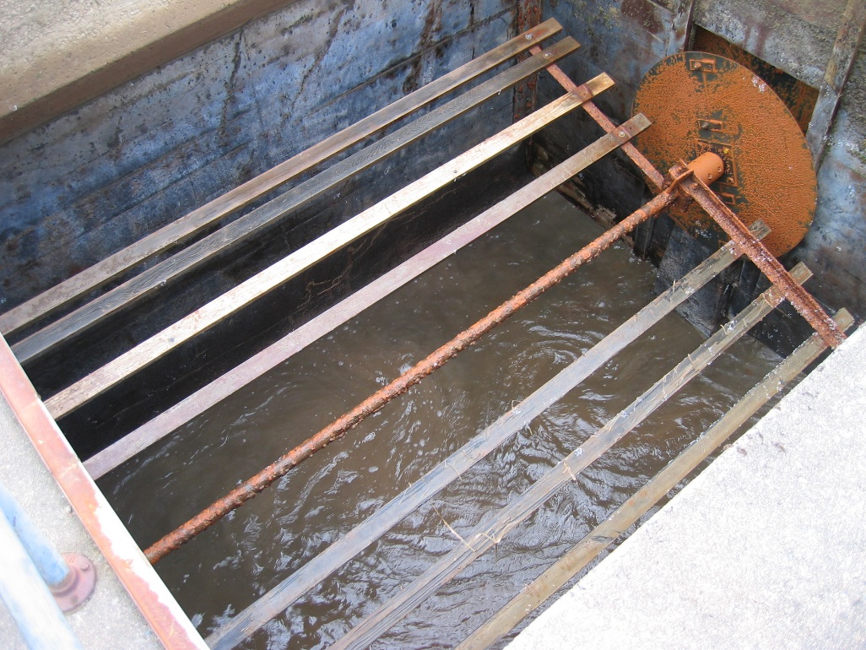
Flocculation
Flocculation mixing can be accomplished using paddle-wheel flocculators, mounted horizontally or vertically.
Flocculation paddles - photo from 2007 CPE at Sweethome, OR

Slide 17
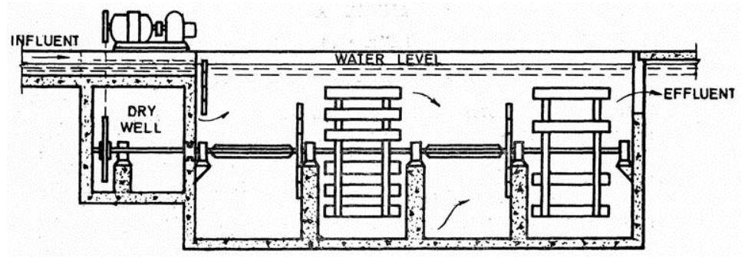
Flocculation
Flocculation usually involves multiple stages of progressively lower mixing intensity.
This can be accomplished by having fewer paddle boards in the next stage as shown below.

Slide 18
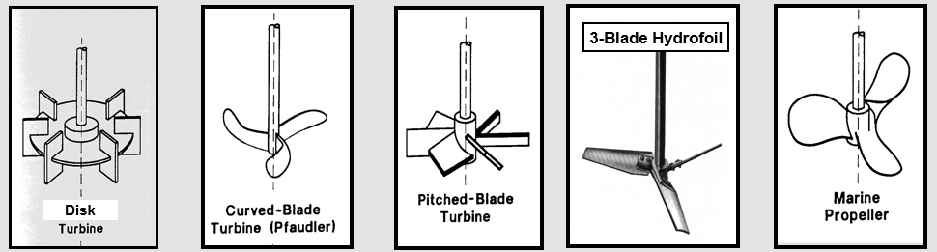
Flocculation
Mixing can also be accomplished using a variety of turbines and hydrofoils.

Slide 19
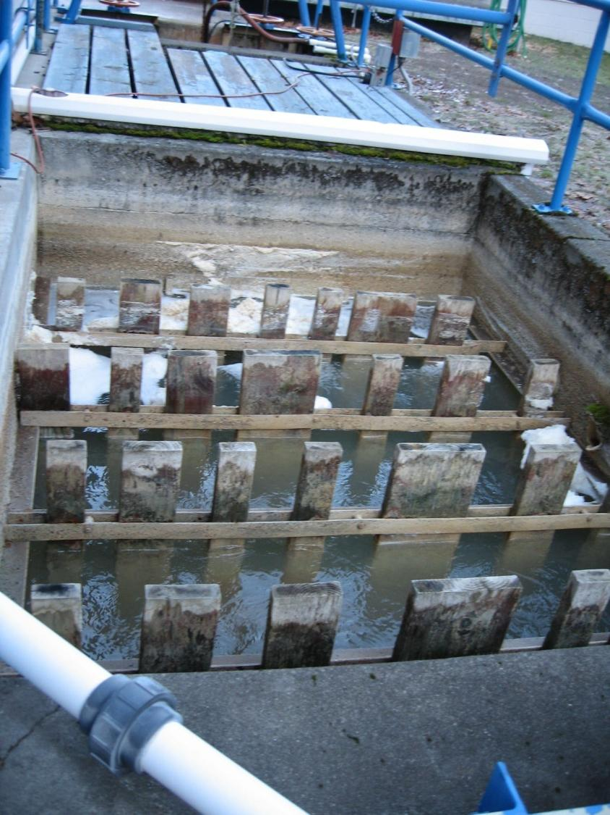
Flocculation
Mixing can also be accomplished hydraulically, using baffle walls

Slide 20
Common Coagulants and Flocculants
Several types of coagulants available
(often source of confusion):
  Metal salts (alum and ferric)
  Blended Products: Polyaluminum Chloride (PACl), Aluminum Chlorohydrate (ACH)
  Polymers:
    Cationic
    Anionic
    Non-ionic

Slide 21
Alum and Ferric Considerations
Know the product strength:
  Alum: 48 %wt ~5.4 lb per gal
  Ferric chloride: 30 %wt ~3.4 lb per gal
Don’t forget alkalinity:
  Every 1 mg/L alum consumes ~0.5 mg/L alkalinity
  Every 1 mg/L ferric chloride consumes
  ~0.75 mg/L alkalinity
  Maintain 5 to 10 mg/L alkalinity or add alkalinity (e.g., lime, soda ash)

Slide 22
Blended Product Considerations (e.g., PACl)
Contains either aluminum or iron.
Product strength typically same as product weight.
  Equivalent dosages determined by % metal concentration (Al₂O₃, Fe) if known.
Basicity is term used to describe product’s relative charge.
  Higher basicity products have higher positive charge.
These products typically consume less alkalinity
(i.e., less impact on pH).
  Higher basicity products consume less alkalinity
  (i.e., 50% basicity product would consume half the alkalinity of equivalent alum dose).
Notes:
An interesting special study would be on the effectiveness of ACH (high basicity) in treating water with high algal counts.

Slide 23
Polymer Considerations
Consist of long chain organic molecules.
  Described by their molecular weight and charge density.
Minimal effect on alkalinity.
Product strength typically same as product weight (e.g. assume 100% strength).
Provide multiple functions:
  Coagulant (cationic)
  Flocculant (anionic)
  Filter aid (cationic, anionic, or non-ionic ⇒ all at very low dosages: < 0.1 mg/L)
Notes:
Flocculants may be an effective product for source waters with high algae counts. Flocculants can be added to increase the size and weight of the relatively light algal floc formed in the coagulation process.

Slide 24
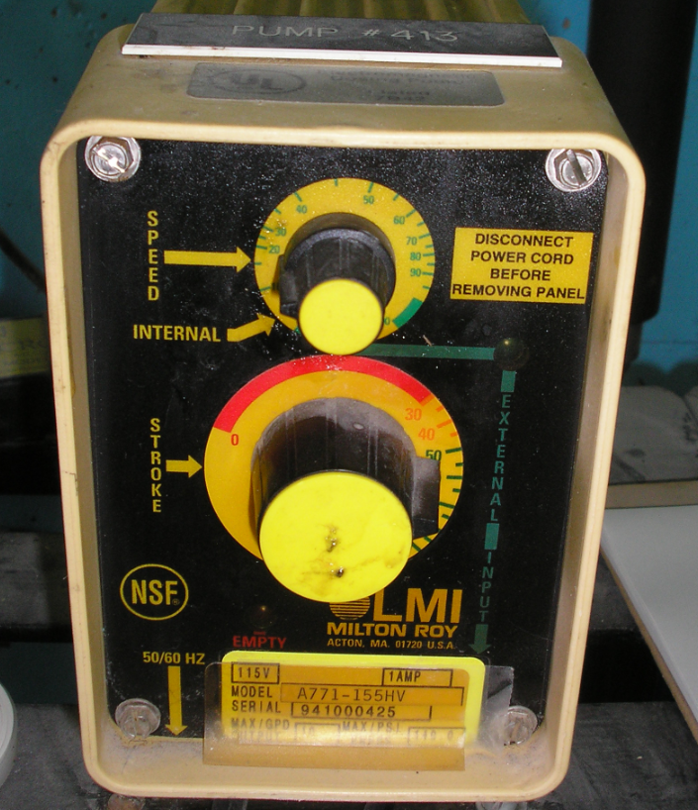
Dose and Chemical Feeder Settings
Notes:
How do you determine a chemical feed pump setting based on a desired dose (mg/L)?
The next slides go through the steps to do this.
These steps should be included in an operational guideline on setting chemical feed rates.

Slide 25
Would you be able to answer the following questions?
What was the coagulant dose when we exceeded 1 NTU?
Did we exceed the maximum recommended dose (NSF-60)?
Which coagulant costs less given the differences in aluminum content?
Will we need new feed pumps if we increase plant capacity?
Notes:
How do you determine a chemical feed pump setting based on a desired dose (mg/L)?
The next slides go through the steps to do this.
These steps should be included in an operational guideline on setting chemical feed rates.

Slide 26
Dose and Chemical Feeder Settings
You will need…
Dosage required for good water quality (jar test, target pH, target chlorine residual, etc.)
Chemical pump feed rate required for desired dose.
Product strength (density x % concentration).

Slide 27
Approach
Establish a desired chemical dose (jar testing results are of little value if they can’t be applied in plant!).
Calculate the coagulant feed pump setting to achieve the desired dose.
Adjust the coagulant feed pump based on a calibration curve or pump flow rate test with graduated cylinder.

Slide 28
Conversion Factors
Good conversion factors to know:
  1 lb = 454 grams (2.2 kg)
  1% = 10,000 mg/l (Assumes specific gravity = 1)
About water:
  Specific gravity of water = 1.0 (varies with temp)
  1 gallon of water weighs 8.34 lbs (8.344 lbs at its densest)
  1 ml of water weighs 1 gram
  1 US gallon = 231 cubic inches = 7.785 liters (3.78541)

Slide 29
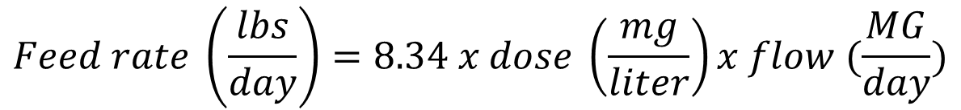
About the “pounds formula”
$$Feed rate \left(\frac{lbs}{day}\right)=8.34 x dose \left(\frac{mg}{liter}\right)x flow (\frac{MG}{day})$$
Can be used for liquid products (can be used as is if product has a specific gravity of 1 and is 100% pure – e.g. water. Chlorine is generally considered to have a SG of 1. Polymers are generally treated as 100% “pure”.)
Can be used for dry products (assumes 100% active ingredient).

Slide 30
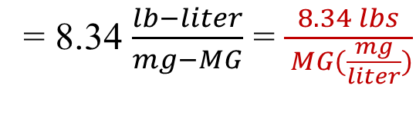
More about the “pounds formula”
$$Feed rate \left(\frac{lbs}{day}\right)=8.34 x dose \left(\frac{mg}{liter}\right)x flow (\frac{MG}{day})$$
Can be used for liquid products (can be used as is if product has a specific gravity of 1 and is 100% pure)
Can be used for dry products (assumes 100% active ingredient).
8.34 is factor resulting from a “simple” conversion of units:
[$\frac{1 lb}{454 grams}$] x [$\frac{1 gram}{1,000 mg}$] x $\left[\frac{3.7854 liters}{gallon}\right] x \left[\frac{1,000,000 gallons}{MGD}\right]$
= 8.34 $\frac{lb−liter}{mg−MG}$ = $\frac{8.34 lbs}{ MG(\frac{mg}{liter})}$

Slide 31
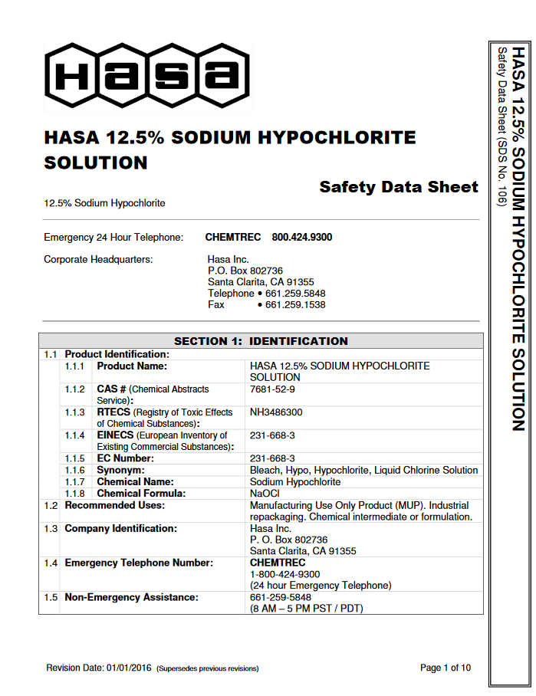

Feed rate in gallons/day (GPD)
$Feed rate \left(\frac{lbs}{day}\right)=\frac{8.34 lbs}{ MG(\frac{mg}{liter})}x dose \left(\frac{mg}{liter}\right)x flow (\frac{MG}{day})$
Convert to gpd – density
If the feed rate needs to be in volume (e.g. gallons/day), you need to factor in the density of the product (weight/volume).
  A volume (e.g. gallon or ml) of product may be literally weighed to determine this.
  Or you could use the specific gravity of the product, which is typically available from the product specification sheet.

Slide 32

Density
$Feed rate \left(\frac{lbs}{day}\right)=\frac{8.34 lbs}{ MG(\frac{mg}{liter})}x dose \left(\frac{mg}{liter}\right)x flow (\frac{MG}{day})$
Density
The density of a substance is the weight for a given unit volume. For example water has a density of 8.34 lbs/gallon (1 g/ml).
Specific gravity (Sp. Gravity or SG) is the density of a liquid substance relative to the density of water. Water has a SG = 1.0.
Example: 12.5% sodium hypochlorite (NaOCL) has a SG of around 1.2, therefore, the density of the chlorine = SG of chlorine x density of water.
H₂O
NaOCL
$$Density of 12.5\% NaOCL=1.2 x 8.34= 10 lbs/gallon$$

Slide 33
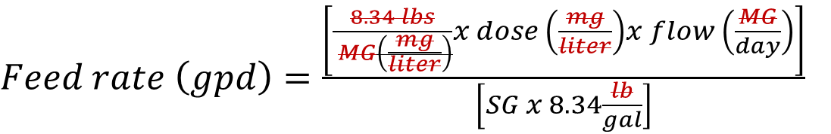
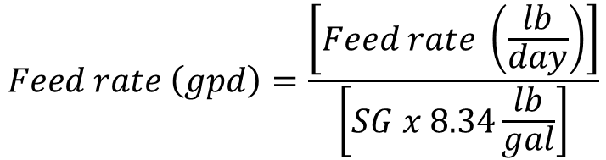
Density and GPD
$Feed rate \left(\frac{lbs}{day}\right)=\frac{8.34 lbs}{ MG(\frac{mg}{liter})}x dose \left(\frac{mg}{liter}\right)x flow (\frac{MG}{day})$
Convert to gpd
Or combined…
$$Feed rate \left(gpd\right)=\frac{\left[Feed rate \left(\frac{lb}{day}\right)\right]}{\left[SG x 8.34\frac{lb}{gal}\right]}$$
$Feed rate \left(gpd\right)=\frac{\left[\frac{8.34 lbs}{ MG\left(\frac{mg}{liter}\right)}x dose \left(\frac{mg}{liter}\right)x flow \left(\frac{MG}{day}\right)\right]}{\left[SG x 8.34\frac{lb}{gal}\right]}$

Slide 34
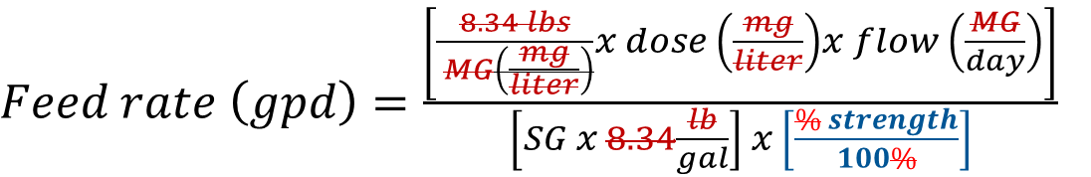
% Concentration
$Feed rate \left(\frac{lbs}{day}\right)=\frac{8.34 lbs}{ MG(\frac{mg}{liter})}x dose \left(\frac{mg}{liter}\right)x flow (\frac{MG}{day})$
How does % concentration factor in?
If the product is diluted in any way, this also needs to be factored in. Generally this is expressed as a % concentration (e.g. 12.5% sodium hypochlorite, 50% caustic, or 48.5% alum).
Divide the feed rate by the product % concentration (converted to a decimal by dividing by 100%) as shown below:
$Feed rate \left(gpd\right)=\frac{\left[\frac{8.34 lbs}{ MG\left(\frac{mg}{liter}\right)}x dose \left(\frac{mg}{liter}\right)x flow \left(\frac{MG}{day}\right)\right]}{\left[SG x 8.34\frac{lb}{gal}\right] x \left[\frac{\% strength}{100\%}\right]}$

Slide 35
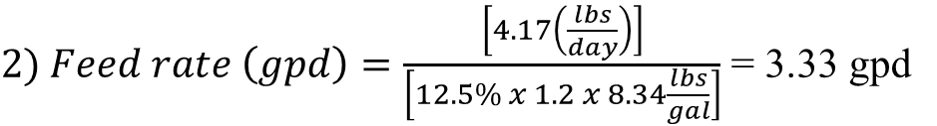
Example – “pounds formula”
Example: What feed rate in (lbs/day, gpd, and ml/min) is needed for 0.5 mg/l dose of 12.5% NaOCL (SG = 1.2) at a flow rate of 1 MGD?
$1) Feed rate \left(\frac{lbs}{day}\right)=\frac{8.34 lbs}{ MG(\frac{mg}{liter})}x 0.5 \left(\frac{mg}{liter}\right)x 1 \left(\frac{MG}{day}\right)=4.17\frac{lbs}{day}$
$2) Feed rate \left(gpd\right)=\frac{\left[4.17\left(\frac{lbs}{day}\right)\right]}{\left[12.5\% x 1.2 x 8.34\frac{lbs}{gal}\right]}$ = 3.33 gpd
$$3) Feed rate \left(\frac{ml}{min}\right)=\left(\frac{1 day}{1,440 min}\right)x 3.33 \left(\frac{gallons}{day}\right)x 3.7854 \left(\frac{liters}{gallon}\right)x 1,000 \left(\frac{ml}{liter}\right)$$
= 8.75 ml/min

Slide 36
Coagulant Feed Rate - Summary
Liquid Products
Convert desired dose to required feed rate:
  Dose (ppm) x 8.34 lb/gal x flow (MGD)
  = feed rate (lb/day)
  Feed rate (lb/day) ÷ product density (lb/gal) ÷ % strength
  = feed rate (gal/day)
    Product density = product weight per unit volume
    (liquid alum ~ 11.1 lb/gal)
    Sometimes the term “product strength” is used to combine the terms of product density times % strength
    (liquid alum ~ 11.1 lb/gal x 48% alum = 5.3 lb/gal)

Slide 37



Example Product Strength Calculation for a Diluted Polymer
Add 1 gallon of polymer weighing 9 lb/gal (density of 100% pure product)
Fill batch tank with water to 200 gallon mark (199 gal of water at 8.34 lb/gal)
Batch Tank Density =
$$9\frac{lb}{gal} \left(\frac{1}{200}\right)+8.34\frac{lb}{gal}\left(\frac{199}{200}\right)=8.3433 lb/gal$$
Batch Tank Concentration (%wt/wt) =
$$100\% x \left(\frac{1 gallon x 9 lb/gal}{199 gallons x 8.34 lb/gal}\right)=0.5423\%$$
Batch Tank
Batch Tank Concentration (lb/gal) =
$$8.3433\frac{lb}{gal}x \frac{0.5423\%}{100\%}=0.045 lbs of polymer/gallon$$

Slide 38


Another way to calculate density in this example:
D1·V1 + D2·V2 = D3·V3 ====> D3 = (D1·V1 + D2·V2 ) / V3
D2 = 8.34 lb/gal
V2 = 199 gallons
D1 = 9 lb/gal
V1 = 1 gallon
Batch Tank Density =
$$\left(\frac{(D1xV1)+(D2xV2)}{V3}\right)=D3$$
$$\left(\frac{(9 x 1)+(8.34 x 199)}{200}\right)=8.3433 lbs/gallon$$
Batch Tank
D3 = ___ lb/gal
V3 = 200 gallons

Slide 39


Can you calculate concentration the same way? Yes!
C1·V1 + C2·V2 = C3·V3 ====> C3 = (C1·V1 + C2·V2 ) / V3
C2 = 0 lb/gal
V2 = 199 gallons
C1 = 9 lb/gal
V1 = 1 gallon
Batch Tank Concentration =
$$\left(\frac{(C1xV1)+(C2xV2)}{V3}\right)=C3$$
$$\left(\frac{(9 x 1)+(0 x 199)}{200}\right)=0. 045 lbs of polymer/gallon$$
Batch Tank
C3 = ___ lb/gal
V3 = 200 gallons

Slide 40

Another example with chlorine:
C1·V1 + C2·V2 = C3·V3 ====> C3 = (C1·V1 + C2·V2 ) / V3
C1 = 12,500 mg/l chlorine (12.5%)
V1 = 1 gallon
C2 = 0 mg/l chlorine
V2 = 9 gallons
Tank Concentration =
$$\left(\frac{(C1xV1)+(C2xV2)}{V3}\right)=C3$$
$$\left(\frac{(12,500 x 1)+(0 x 9)}{10}\right)=1,250 mg/l$$
Tank
C3 = ___ mg/l
V3 = 10 gallons
Notes:
This example could also apply to feeding other water treatment chemicals like potassium permanganate.

Slide 41
One more example – Alum (it just got real!)
Jar testing shows that the most settleable floc is formed at an alum dose of 20 mg/l. The flow rate on the plant effluent meter reads 1,388 gpm and will stay at that rate for the next 24 hours. The coagulant used is 48.5% liquid alum with a weight (density) of 10.9 lbs/gal.
Solve for:
Plant flow in MGD;
Alum specific gravity (SG);
Available alum concentration in mg/l;
Alum feed rate in lbs/day;
Alum feed rate in gallons per day (gpd);
Alum feed rate in ml/min; and
Use calculated feed rate to verify alum dose in mg/l.
48.5% Alum
SG = ???
Target Dose = 20 mg/l
Pump Feed Rate = ???
⬅ Flow = 1,388 gpm

Slide 42
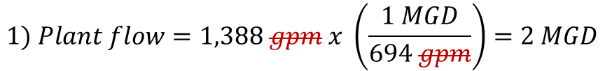
One more example - Alum
Jar testing shows that the most settleable floc is formed at an alum dose of 20 mg/l. The flow rate on the plant effluent meter reads 1,388 gpm and will stay at that rate for the next 24 hours. The coagulant used is 48.5% liquid alum with a weight of 10.9 lb/gal.
Solve for:
Plant flow in MGD;
Alum specific gravity (SG);
$$1) Plant flow=1,388 gpm x \left(\frac{1 MGD}{694 gpm}\right)=2 MGD$$
48.5% Alum
SG = 1.31
$2) Alum SG=10.9 \left(\frac{lb}{gal}\right) x \left(\frac{1 gal water}{8.34 lbs}\right)=1.3$0695 ~ 1.31
⬅ Flow = 1,388 gpm = 2 MGD
$$100\% water weighs\left(\frac{1 gram}{1 ml}\right)⇒ \left(\frac{1 gram}{1 ml}\right)x\left(\frac{ 1 lb}{454 gram}\right)x\left(\frac{3.78541 l }{1 gallon}\right)x\left(\frac{1,000 ml}{l}\right)=8.338 lbs/gallon$$

Slide 43
One more example - Alum
Jar testing shows that the most settleable floc is formed at an alum dose of 20 mg/l. The flow rate on the plant effluent meter reads 1,388 gpm and will stay at that rate for the next 24 hours. The coagulant used is 48.5% liquid alum with a weight of 10.9 lb/gal.
Solve for:
Plant flow = 2 MGD
Alum SG = 1.31
Available alum concentration in mg/l – there are 2 ways to solve for this;
The 1st way uses the relationship of 1% = 10,000 mg/l, which is based on the weight of water (SG=1) where 1 ml weighs 1 gram. This calculation is shown below:
48.5% Alum
SG = 1.31
$$100\% water weighs\left(\frac{1 gram}{1 ml}\right)⇒ \left(\frac{1 gram}{1 ml}\right)x\left(\frac{1,000 mg}{1 gram}\right)x\left(\frac{1,000 ml}{l}\right)=1,000,000 mg/l$$
$$1\% of the weight of water= 1\% x\left(\frac{1,000,000 mg}{100 \%}\right)=10,000 mg/l$$

Slide 44
One more example - Alum
Jar testing shows that the most settleable floc is formed at an alum dose of 20 mg/l. The flow rate on the plant effluent meter reads 1,388 gpm and will stay at that rate for the next 24 hours. The coagulant used is 48.5% liquid alum with a weight of 10.9 lb/gal.
Solve for:
Plant flow = 2 MGD
Alum SG = 1.31
Available alum concentration in mg/l – there are 2 ways to solve for this;
The 1st way uses the relationship of 1% = 10,000 mg/l, which is based on the weight of water (SG=1) where 1 ml weighs 1 gram. This calculation is shown below:
48.5% Alum
SG = 1.31
Available alum concentration in $\frac{mg}{l}=SG x \% concentration x \left(\frac{10,000 mg/l}{1 \%}\right)$
$$Available alum concentration=1.31 x 48.5\% x \left(\frac{10,000 mg/l}{1 \%}\right)=635,350 mg/l$$
Remember, we have to account for liquid alum (which is a dilution containing 48.5% alum in water)

Slide 45
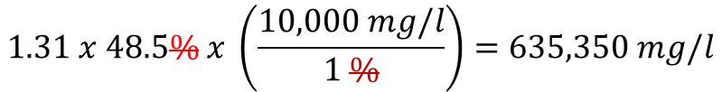
One more example - Alum
Jar testing shows that the most settleable floc is formed at an alum dose of 20 mg/l. The flow rate on the plant effluent meter reads 1,388 gpm and will stay at that rate for the next 24 hours. The coagulant used is 48.5% liquid alum with a weight of 10.9 lb/gal.
Solve for:
Plant flow = 2 MGD
Alum SG = 1.31
Available alum concentration in mg/l – there are 2 ways to solve for this;
The 2nd way uses the % concentration, density of the 48.5% alum, and a series of unit conversions…
48.5% Alum
SG = 1.31
$$\left(\frac{48.5\%}{100\%}\right)x\left(\frac{10.9 lbs}{gallon}\right)x\left(\frac{454 g}{1 lb}\right)x\left(\frac{1,000 mg}{1 g}\right)x\left(\frac{1 gallon}{3.7854 l}\right)= 634,032 mg/l$$
$$1.31 x 48.5\% x \left(\frac{10,000 mg/l}{1 \%}\right)=635,350 mg/l$$

Slide 46
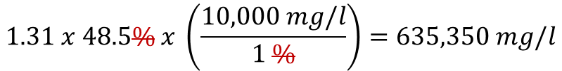
One more example - Alum
Jar testing shows that the most settleable floc is formed at an alum dose of 20 mg/l. The flow rate on the plant effluent meter reads 1,388 gpm and will stay at that rate for the next 24 hours. The coagulant used is 48.5% liquid alum with a weight of 10.9 lb/gal.
Solve for:
Plant flow = 2 MGD
Alum SG = 1.31
Available alum concentration in mg/l – there are 2 ways to solve for this;
The 2nd way uses the % concentration, density of the 48.5% alum, and a series of unit conversions…
48.5% Alum
SG = 1.31
$$\left(\frac{48.5\%}{100\%}\right)x\left(\frac{10.9 lbs}{gallon}\right)x\left(\frac{454 g}{1 lb}\right)x\left(\frac{1,000 mg}{1 g}\right)x\left(\frac{1 gallon}{3.7854 l}\right)= 634,032 mg/l$$
$$1.31 x 48.5\% x \left(\frac{10,000 mg/l}{1 \%}\right)=635,350 mg/l$$
Why the difference? Rounding errors ☹

Slide 47
One more example - Alum
Jar testing shows that the most settleable floc is formed at an alum dose of 20 mg/l. The flow rate on the plant effluent meter reads 1,388 gpm and will stay at that rate for the next 24 hours. The coagulant used is 48.5% liquid alum with a weight of 10.9 lb/gal.
Solve for:
Plant flow = 2 MGD;
Alum SG = 1.31;
Available alum concentration = 634,032 mg/l;
Alum feed rate in lbs/day;
$Feed rate \left(\frac{lbs}{day}\right)=\frac{8.34 lbs}{ MG(\frac{mg}{liter})}x 20 \left(\frac{mg}{liter}\right)x 2 \left(\frac{MG}{day}\right)=333.6\frac{lbs}{day}$
Pump Feed Rate = 333.6 lbs/day

Slide 48
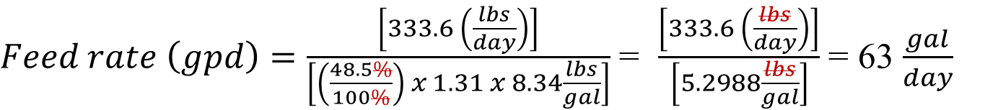
One more example - Alum
Jar testing shows that the most settleable floc is formed at an alum dose of 20 mg/l. The flow rate on the plant effluent meter reads 1,388 gpm and will stay at that rate for the next 24 hours. The coagulant used is 48.5% liquid alum with a weight of 10.9 lb/gal.
Solve for:
Plant flow = 2 MGD;
Alum SG = 1.31;
Available alum concentration = 634,032 mg/l;
Alum feed rate = 333.6 lbs/day;
Alum feed rate = 63 gpd;
$Feed rate \left(gpd\right)=\frac{\left[333.6 \left(\frac{lbs}{day}\right)\right]}{\left[\left(\frac{48.5\%}{100\%}\right) x 1.31 x 8.34\frac{lbs}{gal}\right]}$ = $\frac{\left[333.6 \left(\frac{lbs}{day}\right)\right]}{\left[5.2988\frac{lbs}{gal}\right]}$ = 63 $\frac{gal}{day}$
Pump Feed Rate = 63 gpd

Slide 49

One more example - Alum
Jar testing shows that the most settleable floc is formed at an alum dose of 20 mg/l. The flow rate on the plant effluent meter reads 1,388 gpm and will stay at that rate for the next 24 hours. The coagulant used is 48.5% liquid alum with a weight of 10.9 lb/gal.
Solve for:
Plant flow = 2 MGD;
Alum SG = 1.31;
Available alum concentration = 634,032 mg/l;
Alum feed rate = 333.6 lbs/day;
Alum feed rate = 63 gpd;
Alum feed rate in ml/min;
$$Feed rate \left(\frac{ml}{min}\right)=\left(\frac{1 day}{1,440 min}\right)x 63 \left(\frac{gallons}{day}\right)x 3.7854 \left(\frac{liters}{gallon}\right)x 1,000 \left(\frac{ml}{liter}\right)$$
Pump Feed Rate = 165 ml/min
$$Feed rate=165 ml/min$$

Slide 50
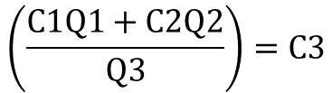


One more example - Alum
Jar testing shows that the most settleable floc is formed at an alum dose of 20 mg/l. The flow rate on the plant effluent meter reads 1,388 gpm and will stay at that rate for the next 24 hours. The coagulant used is 48.5% liquid alum with a weight of 10.9 lb/gal.
Solve for:
Plant flow = 2 MGD;
Alum SG = 1.31;
Available alum concentration = 634,032 mg/l;
Alum feed rate = 333.6 lbs/day;
Alum feed rate = 63 gpd;
Alum feed rate = 165 ml/min;
Use calculated feed rate to verify alum dose in mg/l.
$$C1Q1+C2Q2=C3Q3$$
$$\left(\frac{C1Q1+C2Q2}{Q3}\right)=C3$$
48.5% Alum
SG = 1.31
Target Dose = 20 mg/l
Pump Feed Rate = 63 gpd
Pump Feed Rate = 165
C2 = 0 mg/l
Q2 = 2,000,000 gpd
C3 = ____ mg/l
Q3 = 2,000,063 gpd
⬅ Flow
$$\left(\frac{(634,032 x 63)+(0 x 2,000,000)}{2,000,063}\right)=19.97 mg/l$$
C1 = 634,032 mg/l
Q1 = 63 gpd

Slide 51
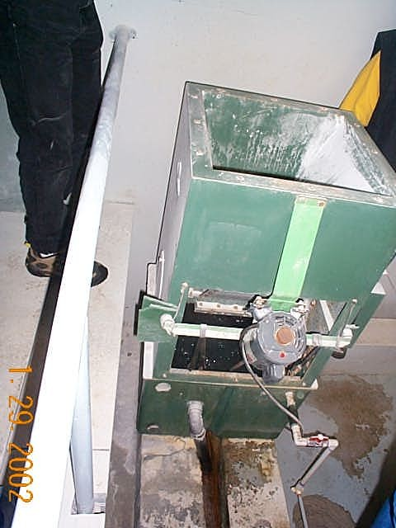
Determination of Coagulant Feed Rate
Dry Products
Convert dose to feed rate:
  Dose (mg/l) x 8.34 lb/gal x flow (MGD)
  = feed rate (lb/day)
Dry feeders:
  Calibrate from grab sample(s) over timed period.
    Weigh sample(s) and express as weight per unit time.
    Develop calibration curve based on multiple grab samples at different feeder settings.
Notes:
Dry feeders are commonly used to feed pH adjustment chemicals like lime and soda ash.

Slide 52
Approach
Establish a desired chemical dose (jar testing results are of little value if they can’t be applied in plant!).
Calculate the coagulant feed pump setting to achieve the desired dose.
Adjust the coagulant feed pump based on a calibration curve or pump flow rate (“drawdown”) test with graduated cylinder.

Slide 53
Pump Flow
Normal coagulant flow path

Slide 54
Pump Flow Rate (“Drawdown”) Test
Coagulant flow during pump drawdown test

Slide 55

Pump Flow Rate (“Drawdown”) Test
Coagulant flow during pump drawdown test
Either:
Fill the calibration column and allow pumping coagulant out of column.
Measure what volume of coagulant is pumped during 1 minute.
or:
Pump into a graduated cylinder.
Measure what volume of coagulant is pumped during 1 minute.

Slide 56
Pump Flow Rate (“Drawdown”) Test
Coagulant flow during pump drawdown test
Tabulate and/or plot results
P1 ID | P1 Stroke (%) | P1 Speed (%) | P1 Pump Output (ml/min)
PASS C-X | 100.0% | 18.0% | 1.79
PASS C-X | 100.0% | 30.0% | 4.50

Slide 57
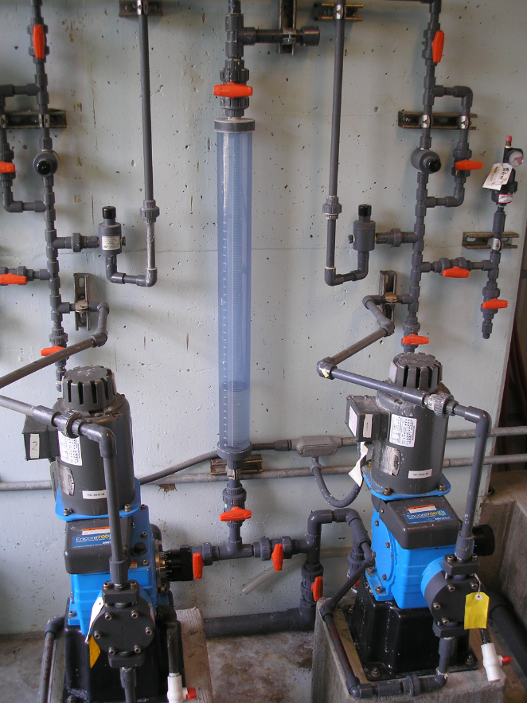
Pump Flow Rate (“Drawdown”) Test
Coagulant flow during pump drawdown test
You can have a calibration column for each pump or use the same calibration column for two pumps (a primary pump and a backup for example), provided they pump the same chemical.
City of Corvallis, 2009

Slide 58
Example – Does current dose match what you think you are dosing?
Equation 3:
Equation 1:
Equation 2:
Equation 4:
Pump 1 Dosage Check
Variable | Result | Units | Comments
Reported plant flow | 57 | gpm
Reported plant flow | 0.082 | MGD | (57 gpm)
Feed Rate | 4.5 | ml/min | Drawdown Test (Equation 1)
Feed Rate | 1.71 | gal/day | (Equation 2)
Product Strength | 100 | %
Product Specific Gravity | 1.24 | SpGr
Product Density | 10.34 | lbs/gal | 100% PASS C-X, SpGr=1.24
Feed Rate | 17.71 | lbs/day | (Equation 3)
Calculated plant dosage | 25.86 | mg/L | (Equation 4)
Reported plant dosage | 26 | mg/L

Slide 59
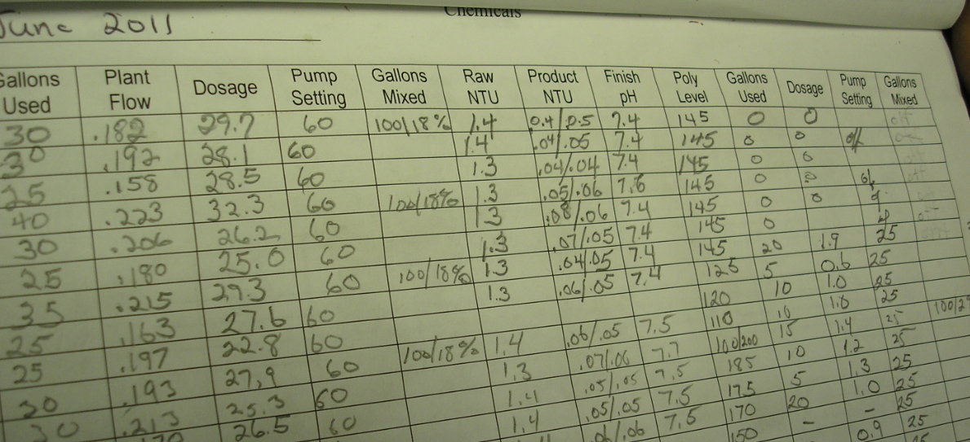
Homework Assignment
Develop operational guidelines for plant-specific approach to setting coagulant feed.
Notes:
Provide a copy of the Chemical Feed Operational Guideline to the participants.

Slide 60
Coagulation Optimization
Potential Special Studies
Coagulant type and dose for given water quality
(i.e., turbidity, alkalinity, temp., TOC, algae).
Rapid mix (ideal: high energy & short time).
Coagulation pH (TOC removal).
Effect of coagulant aids.
Addition of alkalinity (e.g., lime, soda ash).
Effect of pre-oxidants (i.e., chlorine, KMnO₄).
Others?

Slide 61
Flocculation Optimization
Possible Special Studies
Mixing energy (use jar test calibration studies to assess changes in mixing speed).
Basin short-circuiting (baffle addition?).
Floc breakup at transition zones.
Use of flocculant aids.
Others?
Notes:
Jar testing can be used to test many of these topic areas.
Operational changes should be assessed first, followed by minor modifications such as baffling

Slide 62
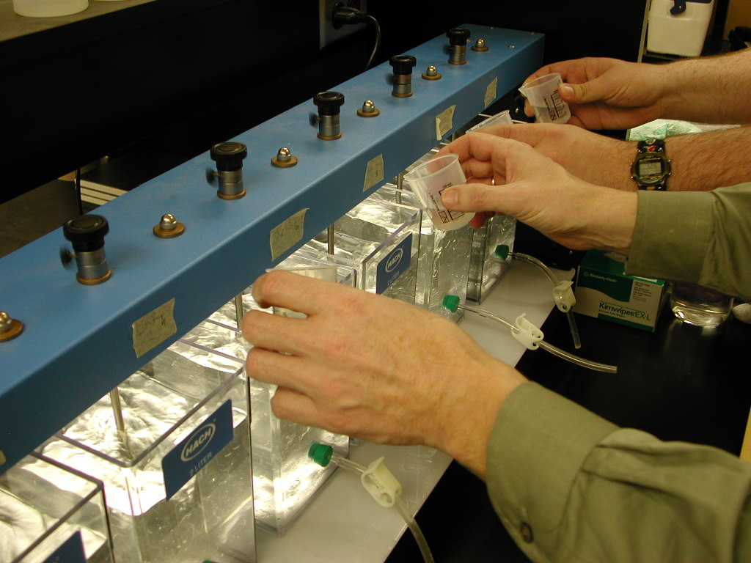
Jar Testing
Advantages:
  Can be used to optimize both coagulation and flocculation
  Available in most plants
  Proven process control tool
  Effective training tool (special studies)
Disadvantages:
  Matching jar test performance to plant
  Jar test procedure intimidating for some plant staff

Slide 63
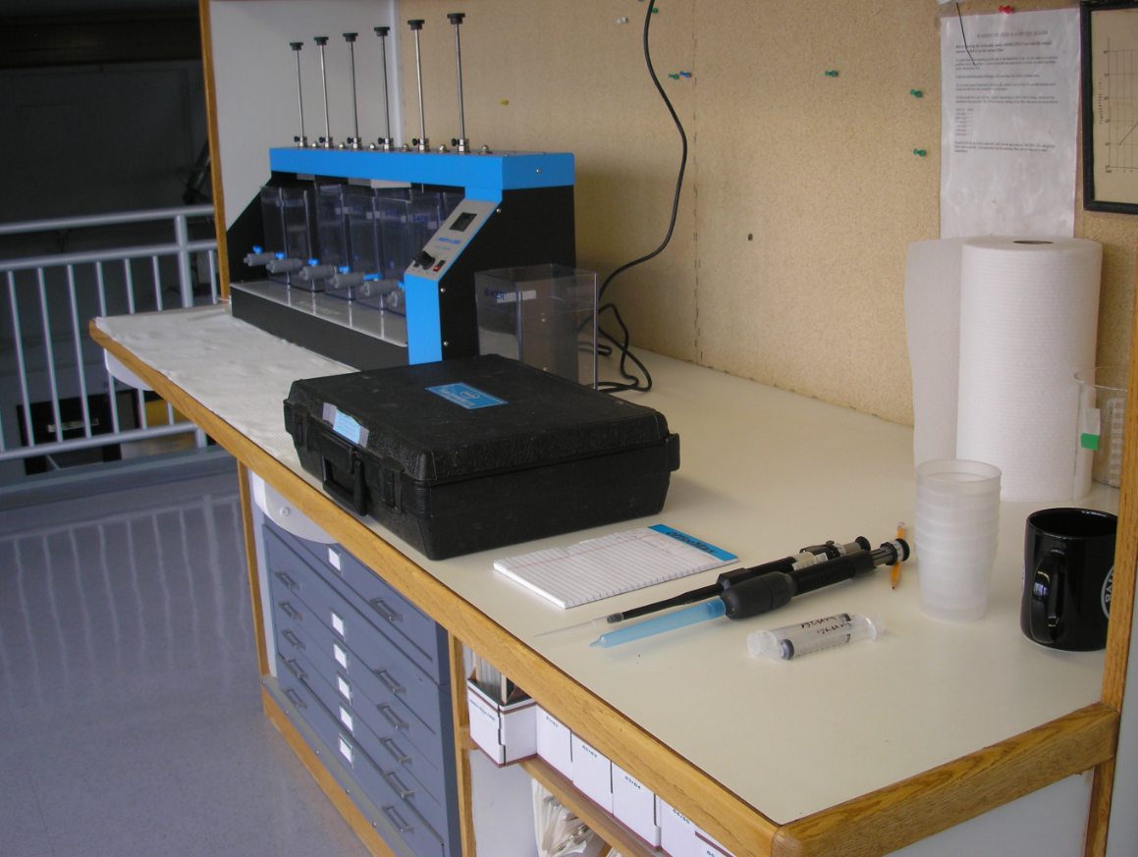
Jar Testing
  Equipment needed
  300-RPM jar tester
  2-L square jars (x6)
  10-ml pipette
  1.0, 3.0, 12.0 ml syringes (x6)
  Plastic cups (x6)
  100-ml Volumetric flask
  Turbidimeter w/6 sample vials
  Coagulant
  City of Corvallis, Oregon – Taylor Water Treatment Plant

Slide 64
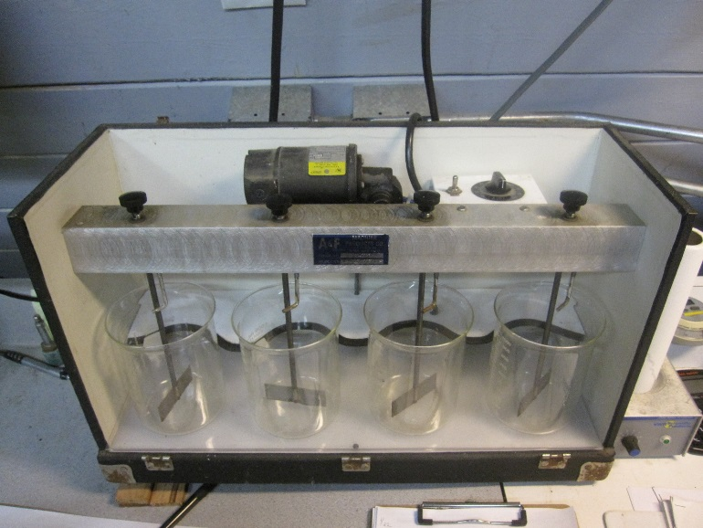
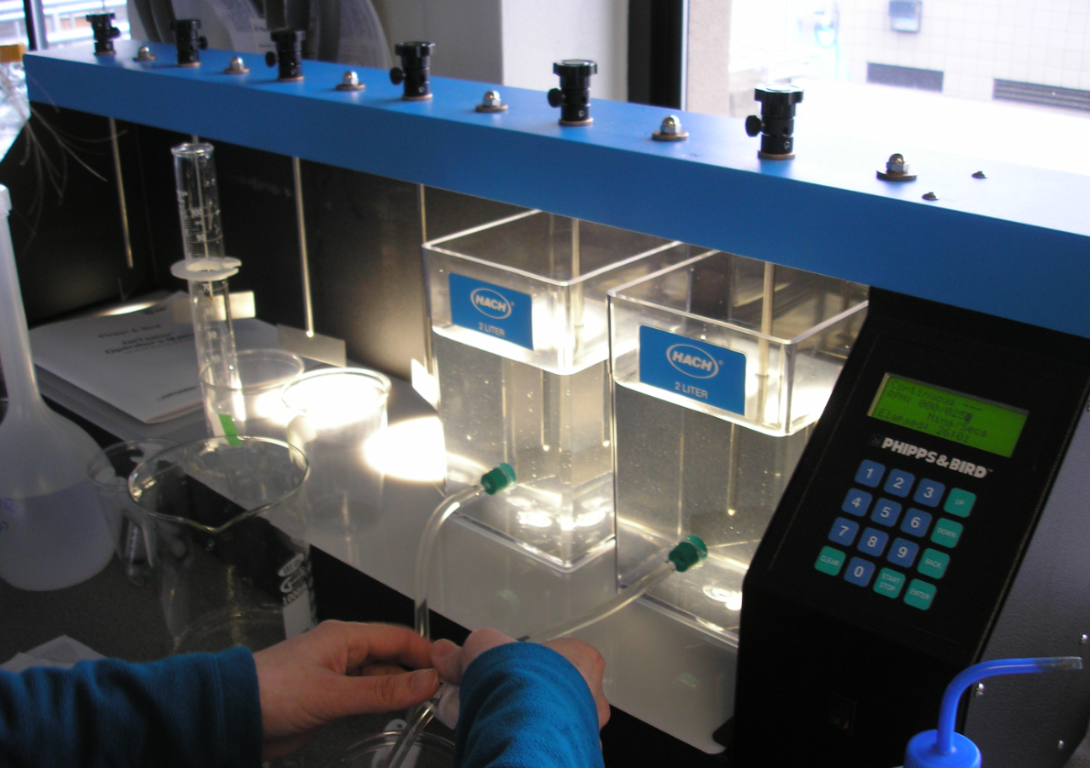
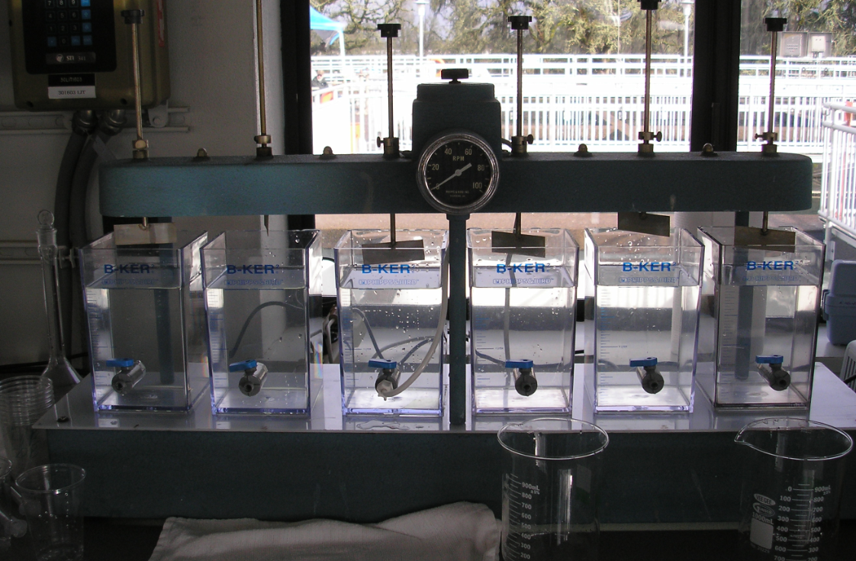
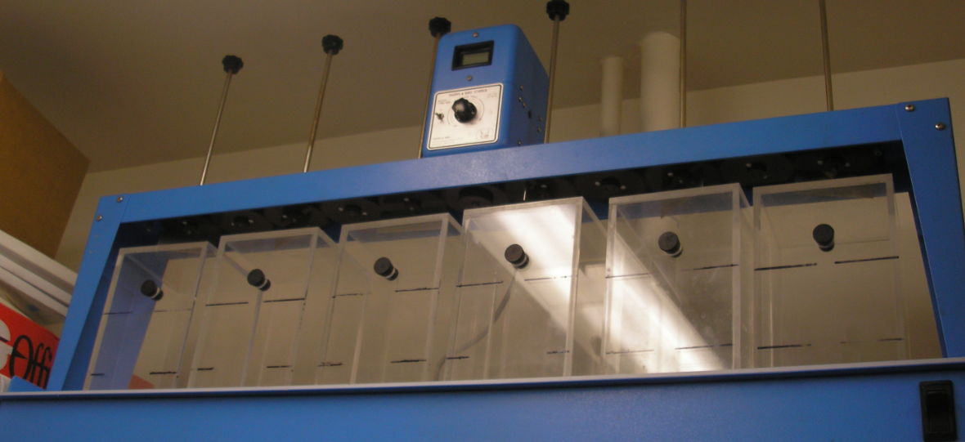
Jar Testing
  Jar testers come in a variety of forms
  <= 4-jar
  (portable)
  Programmable =>
  <= 6-jar =>

Slide 65
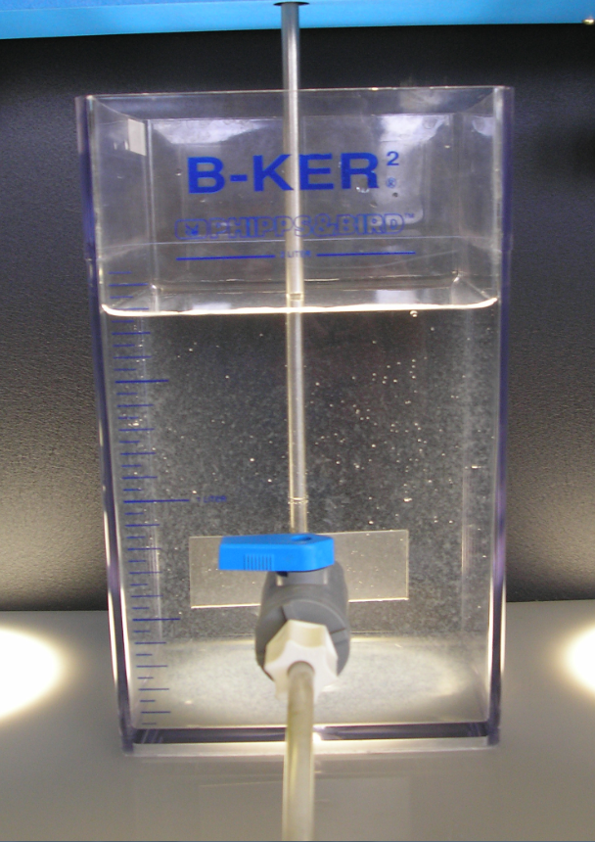
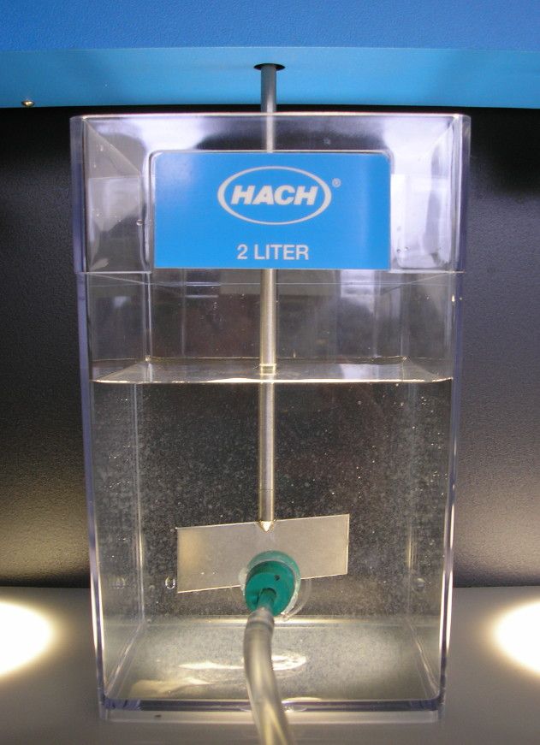
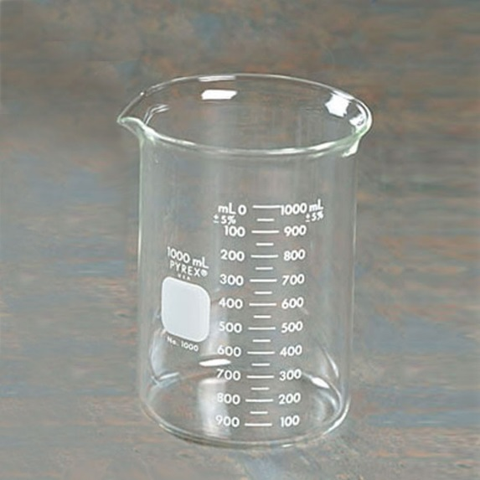
Jar Testing
  Jars can be 2-L square or 1-L round
  no good way
  to sample
  bulkhead fitting cork” stopper
  (works better) (tends to dislodge)

Slide 66
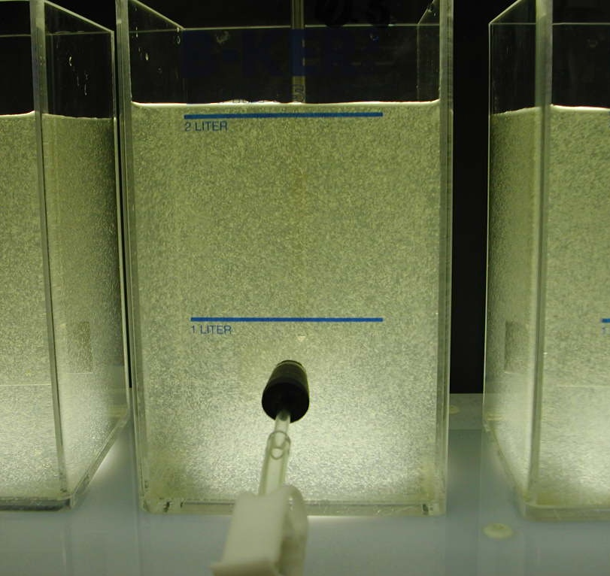
Advantages of the 2-Liter
Square Jars
Better mixing
Mixing curve available
Better insulating properties (reduces water temperature changes)
More water for testing (versus 1 L)
Standard sampling location used to determine settling velocity
10 cm
Notes:
Jar testing equipment can also be moved outside the lab to an unheated area of the plant to more closely match water temperature. Water baths can also be used.

Slide 67
Standard Jar Test Procedure
Prepare chemical stock solutions or microsyringes.
Decide on jar chemical doses and volumes.
Collect water sample and fill jars.
Start mixer and adjust for rapid mix.
Add chemicals in same sequence as plant.
Adjust mixer speed to simulate flocculation.
Stop mixer after floc time and settle.
Sample jars and test.

Slide 68
Jar Test Basics
Preparing Stock Solutions
Determine the dose range to be tested:
  Use historical data, vendor recommendations, raw water quality.
Select the stock solution concentration.
Make stock solution using a volumetric flask and distilled water.
Make dilute stock solutions (< 0.1 %) on a daily basis
(> 0.1% hold for a week).
Remember – stock solutions can be made to test polymers, pre-oxidants, and pH adjustment chemicals.

Slide 69
Stock Solution Selection
Dose (mg/L) for each mL of Stock Solution Added to 2-Liter Jar | Stock Solution Concentration
 | % wt | Mg/L
0.10 | 0.01 | 100
0.25 | 0.05 | 500
0.50 | 0.10 | 1,000
1.0 | 0.20 | 2,000
2.5 | 0.50 | 5,000
5.0 | 1.0 | 10,000
10.0 | 2.0 | 20,000
Notes:
Note: This table is found in the jar test calibration spreadsheet and can be used to determine the appropriate stock solution concentration to make for a jar test.
Start with the column on the left and choose the incremental change in dosage in a 2 liter jar for each mL of stock solution added. Then, select the corresponding stock solution concentration to the right. The spreadsheet can be used to calculate the amount of product that needs to be added to a volumetric flask to make a specific stock solution concentration.

Slide 70
Example Jar Test Setup
Stock Solution *
1 mL
2 mL
3 mL
4 mL
5 mL
6 mL
5 mg/L
10 mg/L
15 mg/L
20 mg/L
25 mg/L
30 mg/L
Dose
* 1% stock solution provides 5 mg/L dose in 2 L jar per 1 mL added

Slide 71
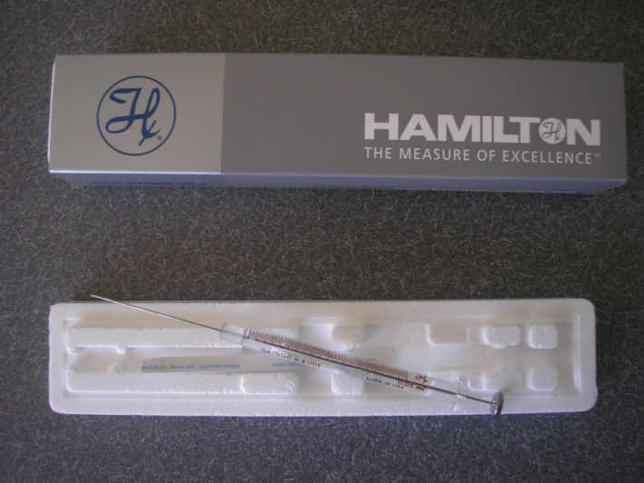
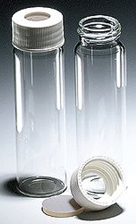

Adding Coagulant Directly to Jars Using Micro-syringe
Some vendors (e.g. DelPac) recommend dosing their coagulant using micro-syringes (versus making a stock solution).
Coagulant is placed on septum or slide cover and dropped into the jars.
Micro-syringe
Septum
Slide Covers
For example:
DelPac product with specific gravity of 1.206 and 20 mg/L dose to 2 L jar.
Required volume:
20 mg/L x (1 µl/1.206 mg) x 2 L = 33.2 µL

Slide 72
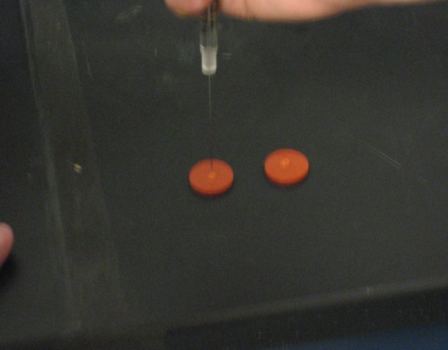
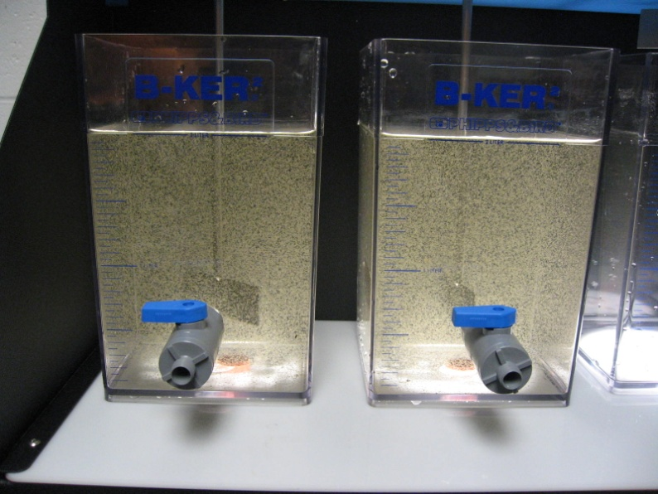
Adding Coagulant Directly to Jars Using Micro-syringe
Deliver coagulant to septa or slide cover using micro-syringe.
Drop the septa into the jar at the time when coagulant is to be added.
Septa stays in jar.
Notes:
A little practice is needed to get good at using a microsyringe. Accuracy is critical since a small error in delivering the coagulant can result in a large change in jar dosage.

Slide 73
Equipment and Techniques Considerations
Thoroughly clean jars and mixers to remove chemical residue.
2-liter square jars preferred with sample tap at 10 cm:
  2-liter beakers acceptable (with baffles)
Transferring dose:
  Multiple syringes (1cc = 1mL)
  Containers with pre-measured volumes (rinse container with distilled water after transfer)
  Use microsyringe and septa if dosing neat.
Sampling:
  Flush sample taps slowly before sampling (displace tube volume).

Slide 74
Initial Jar Test Settings
Based on existing unit process sizes and equipment mixing energy
Based on current plant flows and basin loadings
Use as a starting point for making a jar test work at your plant
Initial settings should be calibrated

Slide 75
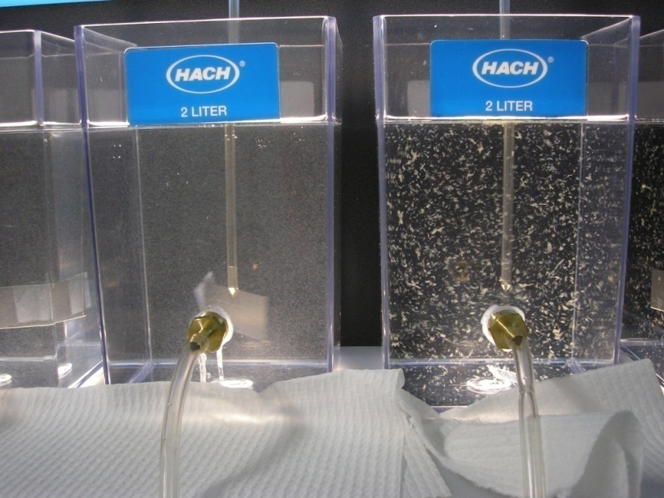
Summary
Gain experience and confidence with jar testing – it can be a powerful tool.
Paying attention to details makes the difference between a good jar test and a bad one.

Slide 76
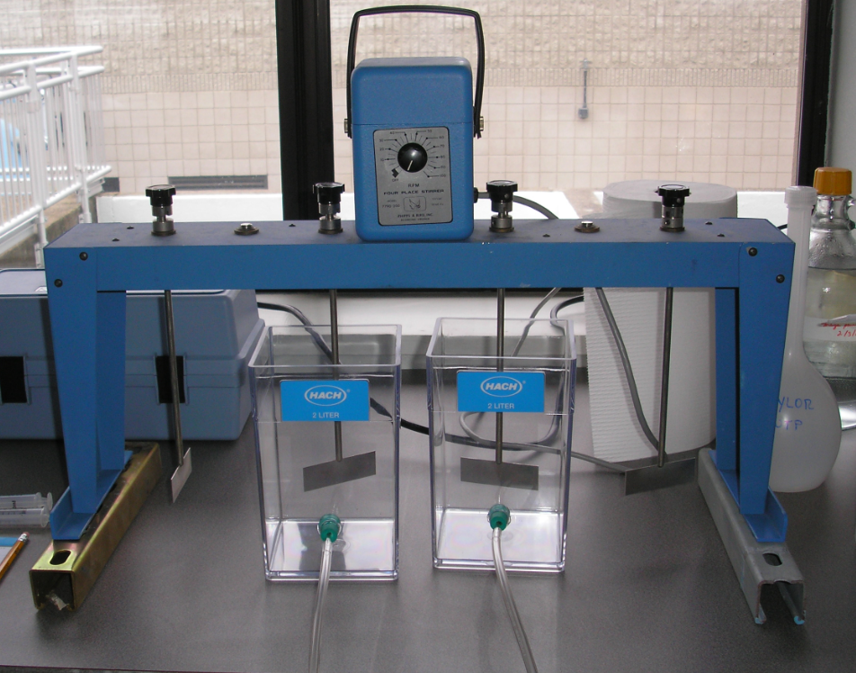
Exercise – Jar Test Demonstration
Use 4-jar mixer
Use one 2-L square jar and three 1-L round jars
Make 1% Alum Stock Solution
Dose Jars

Slide 77
Calibration of Jar Test Settings
Main criticism of jar testing:
    Jar test results do not predict my plant’s performance.
Possible reasons:
  Inaccurate dosing of jars
  Stock solutions are not accurate
  Water temperature effects
  Jar testing equipment is not clean (residual chemicals)
  Out-of-date or damaged jar testing equipment
  Jar conditions do not match plant conditions
  (i.e., mixing energy, detention time, sludge addition)
  Plant conditions are not what they are assumed to be (e.g., inaccurate dosing, plugged chemical feed lines, short-circuiting, mixing energy too low or too high)

Slide 78
What is Jar Test Calibration?
Jar test calibration is the systematic use of special studies to match plant and jar test conditions so that jar testing can be used as a useful tool to support plant optimization!
Requires a commitment at the staff level to “make the jar test work”

Slide 79
Jar Test Calibration is Conducted in Four Studies
Study 1 – Quality Control
Study 2 – Rapid Mix
Study 3 – Flocculation
Study 4 – Sedimentation
Studies will likely need to be repeated to complete the jar test calibration for your plant!!
Notes:
To demonstrate jar test calibration during the afternoon workshop each group will complete study 1 and one additional study.
All participants will be hear about the approach and results of all the studies.

Slide 80

Equipment Needed
Jar Tester (6 jars, 300-rpm)
Six 2-L Square Jars
Portable or benchtop turbidimeter
pH analyzer
Misc. lab ware for making stock solution

Slide 81

Sampling Sites - Lab
Raw water sample line – clearly labeled taps help!

Slide 82


Sampling Sites - Plant
Raw
Coagulated
Flocculated
Settled
Filtered

Slide 83


Sampling Sites - Plant
Raw Coagulated
(pre alum addition) (post rapid mix)

Slide 84
Study 1 - Quality Control
This special study must be successfully accomplished before proceeding with jar test calibration at your facility.
Settling curves are used as a primary indicator during jar test calibration to show that similar floc is being formed in the jar as well as in the plant.
Approach: Treat two jars in an identical manner. Develop settling curves for both jars.

Slide 85

Study 1 – Quality Control (checking sampling technique)
Use 2 jars filled with raw water
Dose both jars equally with the current plant dose
Place in jar tester and complete jar test sequence for your plant
          Data will be tabulated and graphed (1 curve for each jar)
          If curves match – quality control is good
Time min | Jar 1 NTU | Jar 2 NTU
0 | 5.14 | 5.75
1 | 5.55 | 5.99
2 | 5.33 | 5.3
4 | 5.03 | 4.48
6 | 4.44 | 5.06
8 | 4.42 | 4.35
10 | 3.67 | 3.87
Example Jar Speed | Example Mix Time
300 RPM | 5 seconds
77 RPM | 30 seconds
52 RPM | 20 minutes
Turn mixer off and wait 1 minute for jars to stop spinning (the end of this wait period will be considered T = 0 minutes for sampling)
Settle for 10 minutes, sampling turbidity from each jar at T = 0, 1, 2, 4, 6, 8, and 10 minutes.

Slide 86

Study 1 – Compare the Two Settling Curves
If reproducible results are not achieved, technique must be addressed… repeat the study!
Time min | Jar 1 NTU | Jar 2 NTU | Absolute Difference (Diff between Jar 1 and Jar 2) NTU
0 | 5.14 | 5.75 | 0.61
1 | 5.55 | 5.99 | 0.44
2 | 5.33 | 5.3 | 0.03
4 | 5.03 | 4.48 | 0.55
6 | 4.44 | 5.06 | 0.62
8 | 4.42 | 4.35 | 0.07
10 | 3.67 | 3.87 | 0.2
Total ABS difference: |  |  | 2.52 NTU
Average of all readings |  |  | 4.88 NTU
Ratio: Total ABS diff ÷ Avg of all readings: |  |  | 0.52
Ratio interpretation:
Ratio < 1.0 indicates lines considered to be similar
2.0 > Ratio > 1.0 indicates room for improvement
Ratio > 2.0 indicates dissimilar lines
Notes:
The spreadsheet has two approaches for determining if the settled curves are similar. One is the plotting of upper and lower bounds. The other is a ratio calculation based on the difference between two measurements.

Slide 87
How is quality control study useful?
Study 1 – Quality Control Special Study
  Helps refine sampling technique
  Not flushing sampling line leads to erroneous results
T = 0 min: 2 NTU 2 NTU
T = 5 min: 2 NTU 1 NTU
T = 10 min: 2 NTU 0.5 NTU

Slide 88
Study 2 – Rapid Mix Process Calibration
Calibration factors (variables):
  Detention time & mixing energy – Start with theoretical for your plant
  Definition of rapid mix is often expanded to include multiple mixing zones.
  Chemical addition – Match chemical addition in plant. Use sample with most chemicals added (dynamic testing).
Performance indicators:
  Measure pH following rapid mix in jars and compare to pH following plant rapid mix (works best with alum and ferric).
  Matched pH indicates accurate stock solutions and jar test dosing.
Notes:
If available, streaming current or zeta potential could be used as a performance indicator. These instruments could be used to measure the particle charge in the jar as well as in the plant.

Slide 89
Study 2 – Rapid Mix
(For alum, match pH to verify dose & stock solution)
Use 6 jars filled with raw water
Dose jars to bracket current plant dose (jar 1 to have no coagulant, jar 4 to have plant dose)
Place in jar tester and complete the following mixing/sampling sequence:
    Data will be tabulated and graphed (1 curve for each jar).
Jar | Dose Mg/l | Jar pH | Plant Grab Sample pH
1 | 0 (blank) | 7.1
2 | 10 | 6.7
3 | 12 | 6.6
4 | 16 (plant dose) | 6.4 | 6.3
5 | 20 | 6.1
6 | 20 | 6.1
Example Jar Speed | Example Mix Time
300 RPM | 5 seconds
77 RPM | 30 seconds
10 RPM | While sampling
Sample pH from each jar
Sample pH of coagulated water from the plant (grab sample just prior to flocculation)

Slide 90

Study 2 – Rapid Mix Results
Jar | Dose mg/l | Jar pH | Plant pH
1 (Blank) | 0 | 7.1
2 | 10 | 6.7
3 | 12 | 6.6
4 (plant dose) | 16 | 6.4 | 6.3
5 | 20 | 6.1
6 | 20 | 6.1
Interpretation of Results:
Some coagulants like alum will lower the pH. The pH in the jar at the plant dose should match the plant pH. If not, then check dosage calculations and/or stock solution preparation.
Note: the rapid mix setting (time and jar mixing speed) is not confirmed by this study.
Notes:
The spreadsheet has two approaches for determining if the settled curves are similar. One is the plotting of upper and lower bounds. The other is a ratio calculation based on the difference between two measurements.

Slide 91
How is rapid mix study useful?
Study 2 – Rapid Mix/Dosing Control Special Study
  If you are not able to replicate plant dose in the jar, the reverse may also be true – i.e., you may want to replicate results of different coagulant doses you’ve created in the jars.
  Procedures for making stock solutions may need refining.
  Plant dose calculations may need to be revised.
  Coagulant pump output may not be as predicted, as evidenced by a pump calibration.

Slide 92
Study 3 – Flocculation Process Calibration
Calibration factors:
  Detention time – Start with theoretical for each stage.
  Chemical addition – If feeding flocculent aid, match dose and feed location.
  Mixing energy – Start with theoretical mixing energy for each stage
  Performance indicators:
  Floc particle settling characteristics
  Compare jar and plant settling curves following flocculation

Slide 93
Study 3 – Flocculation Process Calibration
Calibration Steps:
  1st – collect water from the beginning of the floc basin, being careful not to break floc apart.
  Take sample and run the jar test procedure beginning with the flocculation stage and develop a settling curve.
  Take another sample of water from the end of the floc basin, by carefully dipping into the basin. Then develop a settling curve for this sample.
  Graph and compare both settling curves.

Slide 94
Study 3 – Compare Settling Curves from Beginning-of-Floc-Basin and End-of-Floc-Basin Sampling.
Notes:
These settling curves do not match well. The Time 0 thru 2 minute turbidities were higher for the Beginning-of-Basin test than for the End-of-Basin test.

Slide 95
Flocculation – Studies 3b and 3c
(Adjust mixing time and speed – observe impact)
3b. Results for ½ Time
Time min | Jar 1 NTU | Jar 2 NTU
0 | 1.79 | 1.87
1 | 2.01 | 1.83
2 | 2.02 | 1.87
4 | 1.8 | 1.95
6 | 1.83 | 1.86
8 | 1.87 | 1.76
10 | 1.85 | 1.86
Study 3b – ½ time
  Use 2 jars
  Repeat study 3a with only ½ the mixing time
  Tabulate and plot the results to see the impact
Study 3c – ½ mixing speed
  Use 2 jars
  Repeat study 3a with only ½ the mixing speed
  Tabulate and plot the results to see the impact
3c. Results for ½ Speed
Time min | Jar 1 NTU | Jar 2 NTU
0 | 1.72 | 2.14
1 | 1.64 | 2.21
2 | 1.65 | 1.96
4 | 1.63 | 2.09
6 | 1.72 | 2
8 | 1.39 | 1.98
10 | 1.16 | 1.96

Slide 96
Study 3 – Example Showing Impact on Settling Curve When Jar Mixing Energy Decreased

Slide 97
How is flocculation study useful?
Study 3 – Flocculation Process Calibration
You may want to replicate different flocculation speeds in your jars (think of the jars as a pilot plant) before trying the change full-scale.

Slide 98
Study 4 – Sedimentation Process Calibration
Calibration approach for sedimentation:
  A theoretical jar sampling time can be calculated by knowing the sedimentation basin loading rate.
    For example: surface loading rate = 0.5 gpm/ft² ~ 2 cm/min
    Sampling jar after 5 minutes is equivalent to this loading rate
    (10 cm settling distance ÷ 2 cm/min)
    Add extra time for the water in the jars to stop moving after mixer is stopped (e.g., ½ to 1 minute; maybe settle for 6 min.)
  Sedimentation calibration is conducted by collecting 2 jars of water from the end of the flocculation basin, simulating a slow mix step in the jar tester, and developing a settling curve over ~ 30 minutes.

Slide 99
Study 4 – Enhancement to Sedimentation Process Calibration
Impacts of continued flocculation in sedimentation basin:
  Continued flocculation typically occurs at the beginning of conventional sedimentation basins.
  The result is larger, faster settling particles, and
  plant performance is often better than jar performance.
To simulate this effect, a short period of time and low energy are applied to the end of floc basin sample to start the test (e.g., 5 minutes @ 7 rpm).
Notes:
Note: this is a recent change to the sedimentation calibration study. An advantage of this approach is that the jars can be taken into the lab and run on the jar tester to simulate sedimentation. In the previous approach the test was conducted at the end of the flocculation basin, and the 2 jars had to be set up to have equal settling conditions (a difficult task to do even with practice).

Slide 100

Study 4 – Sedimentation Process Calibration
Time | Jar 1 | Jar 2
0 | Sample
2 |  | Sample
4 | Sample
6 |  | Sample
8 | Sample
Continue alternating to ~ 30 min.
  Fill 2 jars from end of flocculation process. Two jars are used to minimize drawdown in the jars during sampling.
  Start the test with the slow mix step (e.g.,
  5 min. @ 10 rpm to keep floc suspended).
  Next, sample jars alternately from Time 0 to ~ 30 minutes.
  While conducting the settling test, also collect samples of the sedimentation basin effluent and measure turbidity.
  Compare jar settling curves with actual sedimentation basin performance.
Notes:
Don’t forget to collect several representative grab samples from the end of the sedimentation basin. These results are needed to compare to the settling curve.

Slide 101
Study 4 – Example Settling Curve to Assess Sedimentation Sampling Time
Predicted sample time from jar test
Predicted sample time did not match sed basin; modify slow flocculation step and repeat study
Measured Sed basin turbidity
Notes:
If sed basin has tube or plate settlers installed, it may be difficult for the jar to match the sed basin.
Avoid long jar settling times (i.e., > 20 minutes) since the sensitivity of the jar test is greatly diminished under these conditions.

Slide 102
How is sedimentation study useful?
Study 4 – Sedimentation Process Calibration
This may influence a decision to switch coagulants or dosages.
10 min of available settling time
<= Jar 2 closely matches plant
<= Jar 4 results in lower settled water turbidity, but not fast enough for the available detention time.

Slide 103
Example Calibrated Jar Test Settings
Rapid Mix:
  Set jar mixer to 300 rpm (static mixer).
  Add Alum coagulant and mix @ 300 rpm for 5 seconds.
  Turn down mixer to 77 rpm for 2 minutes (pipeline mixing).
Flocculation:
  Turn down mixer to 40 rpm for 15 minutes (1st stage floc).
  Turn down mixer to 25 rpm for 15 minutes (2nd stage floc).
  Turn down mixer to 7 rpm for 10 minutes (floc/sed transition mixing).
Sedimentation:
  Stop mixer.
  Sample jars for turbidity after 10 minutes.
Notes:
This is one end result of jar test calibration studies – having calibrated jar test settings that can be used to conduct other process optimization studies.
Studies should be repeated under dramatically different operating conditions (e.g., large flow changes, large temperature changes)

Slide 104
During the Jar Test Calibration Process…
You may discover things about your plant that you did not know before.
Initial special studies may point to plant limitations:
  Flow splitting
  Chemical feeding
  Limited range in mixing energy (i.e., rapid mix, flocculation)
  Others
Identifying and correcting plant limitations is part of jar test calibration and future special studies.
Remember “special studies breed more special studies.”

Slide 105

Streaming Current
Streaming current
  A device consisting of a piston within a cylinder that is used to draw the water sample in, induce a current through fluid motion, and measures the streaming current as a constant signal output.
  A stationary liquid boundary layer lies at the surface of both a piston and a cylinder, which contains negatively charged particles. Since the stationary layers contain negative particles, the fluid between the cylinder wall and the piston becomes positively charged. These two oppositely charged layers glide past each other as the piston moves up and down in the cylinder. This movement of two charged layers, induces a current, which is then measured by an electrode in microamperes.
  The current is an alternating current (AC) due to the back and forth motion of the piston. This alternating current is then rectified and time-smoothed to provide a “streaming current” or constant signal output (numerical reading).

Slide 106
Streaming Current
Output (“zero offset out”) is in relative units (does not provide actual current or charge density due to sensitivity in small differences between the cylinder wall).
Measured current is impacted by irregularities in the cylinder wall as well as the motor speed.
Span/gain adjustment:
Used to vary output by a factor of up to 30 or 50. 10% dose change = +10
Zero adjust/”Zero offset in”:
Used to move the reading up or down in value by a selected amount.
Up stroke
Down stroke
Piston Velocity
Measured alternating current (AC)
Rectified (& amplified)
Time-smoothed output (streaming current)
+1 +0.8
0
-1.1 -0.7
+1 +1.1 +0.8 +0.7
0
+0.9
0

Slide 107

Streaming Current - Particle Charge
Relationship to Turbidity & TOC
An example of how particle charge can be related to settled water turbidity and TOC removal.
Set Point B = Better Settled Water Turbidity (blue line)
Set Point A = Better TOC Removal (green line)

Slide 108
Streaming Current Response
Streaming current goes more positive caused by:
  Decrease in: pH, flow, color, turbidity, lime, caustic, and anionic polymers
  Increase in: Alum, Ferric sulfate, ferrous sulfate, PAC, cationic polymers, and chlorine.
Potassium permanganate has no appreciable effect (1-2 ppm dose)
“Set point” determined by optimizing coagulation and turbidity/TOC removal (jar testing) and noting SC reading

Slide 109

Streaming Current - Particle Charge
Relationship to pH
An example of how particle charge can be related to a buffered kaolinite suspension of varying pH.

Slide 110
Streaming Current - Rapid Fluctuations
Rapid fluctuations in SCD readings can be caused by:
  Improperly mixed coagulant in the sample line causing the detector to measure alternating doses of coagulated and under-coagulated water
  Extended off and on periods of the coagulant feed system, that provides periods of under dosing and over dosing, even though the dose may be correct when averaged over time.
  SCD sensor in need of cleaning. Be sure to check sample lines as clogging is a commonly reported problem – clear sample lines help identify problems.

Slide 111
Streaming Current – Good Applications
Streaming current detectors set up to control coagulant dose are good for:
  When charge neutralization is the main objective
  Responding to rapid changes in raw water quality (e.g. storm events)
  Compensating for variations in strengths of similar products or different batches of same product
  Responding to changes in plant influent flow rates
Periodic jar testing to verify the optimal set point is strongly recommended.

Slide 112
Streaming Current – Considerations
Control - Where the coagulant is controlled by the SCD controller, but not the lime addition for pH. The solution is to control both the pH and coagulant feed rates at a constant proportion with the ability to manually fine-tune the proportion.
PAC - The periodic addition of PAC may require that set points be closely monitored. The PAC may add a coagulant demand due to its negative surface charge, but may also lower the coagulant demand, depending upon the level of organics adsorbed by the PAC
Maintenance - Fe, Mn and lime can deposit and foul sensor (Clean per Mfr. Recommendations)
Temperature - Where temperature fluctuations greatly impact coagulation rates. The solution is to determine optimum set points monthly or at least quarterly.

Slide 113

Streaming Current
Device Placement
Placement should be after coagulant addition and rapid mixing.
Depending on the efficiency of the rapid mix, a delay time of 2-5 minutes should be incorporated (e.g. through a longer sample line) to ensure the coagulant has fully equilibrated. If the coagulant is given enough time to adsorb or precipitate onto particles, less of it will remain in solution to deposit onto surfaces of the SCD’s sensor.
On the other hand, an excessive lag time will cause an excessively delayed coagulant feed control response causing the coagulant feed control to “chase” the SCD set point.

Slide 114
Streaming Current – Jar Testing
Jar testing can help identify:
  Sensor malfunction or need for cleaning
  When “sweep floc” coagulation may be needed
  Temperature effects
  Signal delay effects
  Optimum dose for removal of NOM, as indicated by TOC or UV254

Slide 115
Impact of Coagulation Choices
What you do in the treatment plant can affect corrosion in the distribution system…
Parameter | Effect of Enhanced Coagulation | Lead | Copper | Iron | Lead from Brass | Concrete
TOC | ↓ | -- | ▲ | ↓ | ↓ | ▲
Alkalinity | ↓ | ▲ | ↓ | ▲ | ▲ | ▲
Aluminum | ▲ | ▲ | ▲ | ? | ? | ▲
pH | ↓ | ▲ | ▲ | ▲ | ▲ | ▲
Sulfate | ▲ | ↓ | ▲ | ▲ | ↓ | --
Chlorite | ▲ | ▲ | ↓ | ▲ | ▲ | --
▲ Increase (bad) ↓ Decrease (good) -- Same (no change) ? Impact Unknown
Adapted from table on pg 6-13 of the Enhanced Coagulation & Enhanced Precipitative Softening Guidance Manual. USEPA. 1999.

Slide 116
Exercise
Form groups of 4 or 5 and…
  Share your process for coagulation control with your group.
  Share at least 1 experience that helped you better improve your process.
  Identify any opportunities to improve your process.
Identify one person to report to the class:
  What was the most common coagulation control tool or method used?
  Report on at least 1 experience that the class may be able to benefit from.
  Provide an example of at least 1 opportunity for improvement identified among your group.

Slide 117
Class Outline
9 AM Introduction/Overview
  10:15 AM – 15 minute break
10:30 AM Coagulation/Flocculation
  12 noon – Lunch (on your own)
1 PM Clarification/Sedimentation
2 PM Filtration
  2:15 PM – 15 minute break
2:30 PM Filtration (continued)
3:30 PM General Operations
  4:30 PM - End

