Slide 1
Jeopardy
Notes:
Created by Educational Technology Network. www.edtechnetwork.com 2009

Slide 2
Water system hodgepodge | Public Notification | Lead in schools/ child care | Distribution | Mixed Bag
100 | 100 | 100 | 100 | 100
200 | 200 | 200 | 200 | 200
300 | 300 | 300 | 300 | 300
400 | 400 | 400 | 400 | 400
500 | 500 | 500 | 500 | 500

Slide 3
Question: Water System Hodgepodge 100
True or False
Adding UV requires plan review only if required to treat recurring coliform or other pathogens

Slide 4
Answer: Water System Hodgepodge 100
What is TRUE
Bonus question:
Would significant deficiencies still apply if UV was not required?

Slide 5
Question: Water System Hodgepodge 200
In what scenario(s) would a DWS hydrogeologist be available to do a site visit with you?
a) Contamination/spill next to a well
b) New brewery nearby
c) Confirmed E. coli in spring sources
d) A and C
e) All of the above

Slide 6
Answer: Water System Hodgepodge 200
What is d) Both A and C
Spill next to well, and confirmed EC at spring source
(to help look for potential contaminant sources and construction deficiencies)

Slide 7
Question: Water System Hodgepodge 300
True or False
Only plan review engineers should submit inventory updates for a well in plan review.

Slide 8
Answer: Water System Hodgepodge 300
What is False
While plan review engineers don’t usually do inventory updates until the project is final, if you know the well is in use – consider updating the inventory form and submitting to DMCE.

Slide 9
Question: Water System Hodgepodge 400
When the Total Coliform Rule (TCR) was replaced with the revised rules (RTCR), what did a total coliform MCL violation become?

Slide 10
Answer: Water System Hodgepodge 400
What is a required Level 1 investigation?

Slide 11
Question: Water System Hodgepodge 500
Which are significant deficiencies/rule violations?
a) A new well in use during the survey that has received a conditional approval letter
b) A chlorinator in use. No final approval. Verification of NSF certification was only condition in conditional approval letter
c) A new reservoir with conditional approval 5 years ago but construction is not completed

Slide 12
Answer: Water System Hodgepodge 500
What is (a):
A new well in use during the survey that has received a conditional approval letter
Infrastructure is not supposed to be used until final approval has been granted.

Slide 13
Question: Public Notification 100
Public Notice is required when there are these of any regulation by the water system

Slide 14
Answer: Public Notification 100
What are violations

Slide 15
Question: Public Notification 200
A distribution water outage (zero or negative pressure)requires which Tier of public notice?

Slide 16
Question: Public Notification 200
What is Tier 1
*boil notice*

Slide 17
Question: Public Notification 300
This type notice includes: Acute MCL and distribution system sampling violation when E. coli are present

Slide 18
Answer: Public Notification 300
What is Tier 1

Slide 19
Question: Public Notification 400
After a Tier 2 violation, you have __ days to post this notice. After a Tier 1 you have __ days

Slide 20
Answer: Public Notification 400
What is 30 days and 1 day (24 hours)

Slide 21
Question: Public Notification 500
How often does a Tier 1 public notice need to be re-issued for an on-going situation?

Slide 22
Answer: Public Notification 500
What is:
Every 3 months
*or more frequently at the discretion of the Authority for as long as the violation or situation persists*

Slide 23
Question : Lead in Schools - 100
What EPA document is referenced for sampling protocol in schools?

Slide 24
Answer : Lead in Schools- 100
What is the
3T’s for
Reducing Lead

Slide 25
Question : Lead in Schools- 200
Which taps should be sampled?

Slide 26
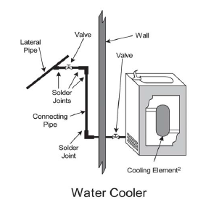
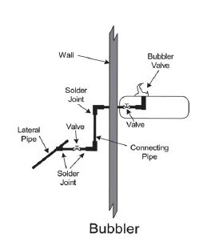
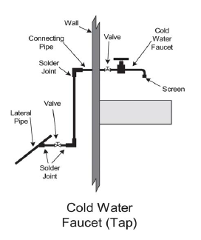
Answer : Lead in Schools - 200
Every outlet used for cooking and drinking should be sampled.

Slide 27
Question : Lead in Schools- 300
What is the level for a safe amount of lead?

Slide 28
Answer : Lead in Schools- 300
What is zero

Slide 29
Question : Lead in Schools- 400
How often do schools and child care facilities need to test for lead?
(OR Dept of Ed)

Slide 30
Answer : Lead in Schools - 400
What is every 6 years

Slide 31
Question : Lead in Schools- 500
List 3 mitigation options (for schools which are not separate PWSs) and the level at which mitigation is required

Slide 32
Answer : Lead in Schools - 500
Mitigation options:
*replacement *flushing program
*POU treatment
*permanent shut off
Mitigation is required at:
15 ppb*

Slide 33
Question : Distribution- 100
What is a reverse flow of undesirable materials & contaminants into the water mains

Slide 34
Answer : Distribution- 100
What is a backflow

Slide 35
Question : Distribution- 200
True or False:
Check valves require an outside power supply or signal to operate

Slide 36
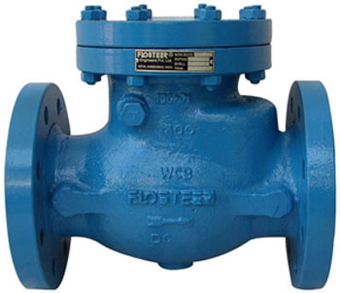
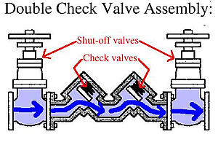
Answer : Distribution- 200
What is false

Slide 37
Question : Distribution- 300
This is a link or structural arrangement where potable water in a distribution system can be exposed to unwanted contaminants

Slide 38
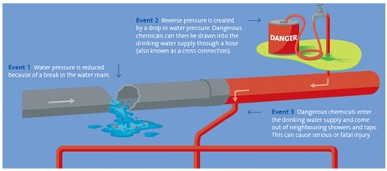
Answer : Distribution- 300
What is a cross connection

Slide 39
Question : Distribution- 400
The minimum psi requirement at a service connection

Slide 40
Answer : Distribution- 400
What is 20 psi

Slide 41
Question : Distribution- 500
What location(s) can NOT be used for distribution samples
(lead/copper, coliform, DBP’s)
a) Bathroom sinks
b) Kitchen sinks
c) Water bottle filling stations
d) Water fountains

Slide 42
Answer : Distribution- 500
What is:
c) Water bottle filling stations
*usually have built in filters *

Slide 43
Question : Mixed Bag- 100
What is the new acute level for arsenic?

Slide 44
Answer : Mixed Bag- 100
What is 35 ppb
*formerly there was no acute level, just an MCL of 10 ppb*

Slide 45
Question : Mixed Bag- 200
What document should a water system refer to in the event of a routine coliform positive sample result?

Slide 46
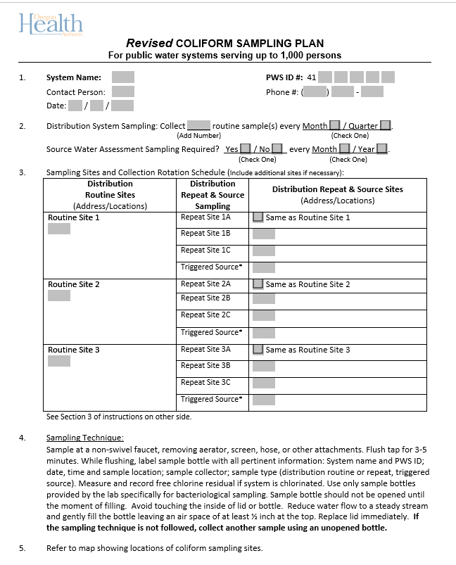
Answer : Mixed Bag- 200
What is a
coliform
sampling plan?

Slide 47
Question : Mixed Bag- 300
How many times a week are you supposed to test and record the chlorine residual in the distribution system if a system uses chlorine for residual maintenance

Slide 48
Answer : Mixed Bag- 300
What is at least twice per week

Slide 49
Question : Mixed Bag- 400
What is the length of time a groundwater system has to correct deficiencies noted during a survey?

Slide 50
Answer : Mixed Bag- 400
What is 18 weeks

Slide 51
Question : Mixed Bag- 500
What are the (4) criteria for outstanding performer determination?

Slide 52
Answer : Mixed Bag- 500

