Slide 1


Using HIA on Climate Change Policy:
A Training Course for Public Health Professionals
Chapter 1:
Introduction and Overview
Notes:
Point of slide: Space holder while introduce and explain what we had in mind.
Welcome and introductions.
The purpose of this training module is for local, state and federal public health agency professionals to understand how to apply Health Impact Assessment practice to Climate Change Policy.
See the Participant’s Guide for a complete list of all learning objectives and a description of the training elements and structure.
In Chapters One learners will:
Review how climate change will potentially impact health,
Review HIA stages,

Slide 2
Trainer Expectations
Participants have training/experience in Health Impact Assessments
Participants have background knowledge in climate change
We will build on this knowledge
Notes:
We expect that
Participants have training/experience in HIAs
Participants have background knowledge in climate change
We will build on this knowledge

Slide 3
Module Description
Chapter 1 – Overview of climate change, health outcomes and HIA
Chapter 2 – Adaptation, mitigation and emergency preparedness policy types and how to differentiate among them
Chapter 3 – Screening strategies for climate change policy HIAs, strategies to consider equity, and an exercise
Chapter 4 – Scoping strategies for climate change policy HIAs with an exercise
Chapter 5 – Identifying data sources and strategies for the Assessment phase with an exercise
Chapter 6 – Climate change and policy communication strategies with an exercise
Chapter 7 – Notes on evaluation for climate change policy HIAs
Time for questions at the end of each chapter

Slide 4
Module Learning Objectives
Define critical climate change policy or policy elements among various sectors. (Ch2)
Differentiate among climate change policy types (e.g. mitigation, adaptation, emergency preparedness).(Ch2)
Evaluate appropriateness of HIA on various climate change policy types.(Ch3)

Slide 5
Module Learning Objectives
Appropriately scope a potential climate change policy based policy type and available resources. (Ch4)
Determine the apparent co-benefits and co-costs for climate change policy.(Ch3 and 4)
Delineate the critical pathways between climate change policy and population health effects, encompassing direct and indirect mechanisms.(Ch3 and 4)

Slide 6
Module Learning Objectives
Understand how HIAs on climate change policy can address equity.(Ch4)
Identify relevant quantitative methods to measure these health effects.(Ch5)
Develop appropriate climate change policy communication techniques.(Ch6)

Slide 7
Toolkit Review
Notes:
Please open your Toolkit and review them. You will use them in exercises throughout this training. You can do the exercises on your own, or with a small group.

Slide 8
HIA Review:
Climate Change-Related Projects or Policies…
But Not in HIA Report
Notes:
In the HIA Review Summary we did not include policies or projects that might have an impact on climate change if the HIA authors did not introduce the topic. For example, locally, the Portland to Lake Oswego Transit Project HIA and the Clark County Bicycle and Pedestrian Master Plan

Slide 9
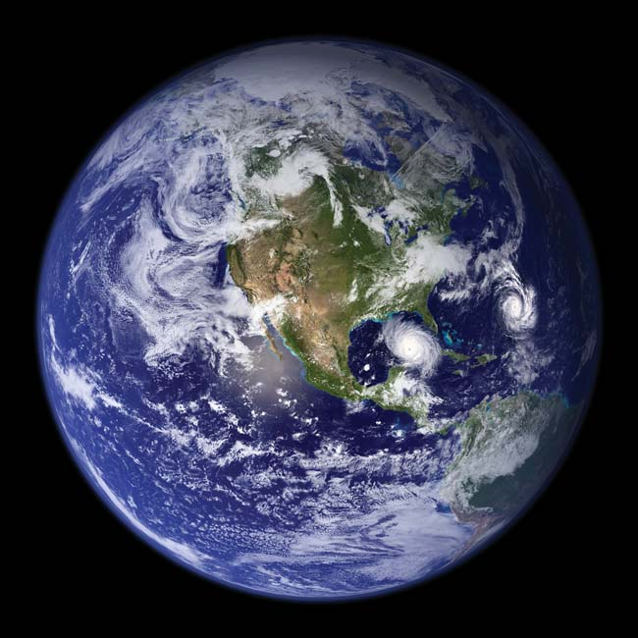
Climate Change & Health Review

Slide 10
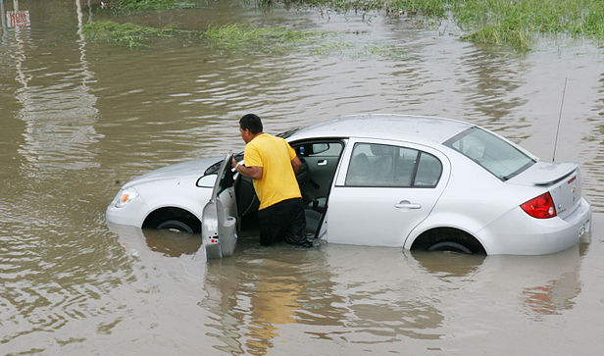
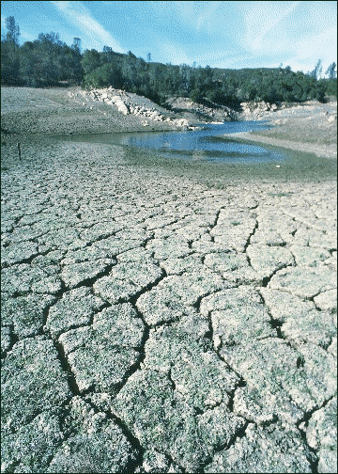
Extreme Weather
FLOODS
DROUGHT
Image sources: FEMA image library; Wpclipart.com
Notes:
Point of slide: Introduce climate change impacts on weather. This sets the context of the discussion – it’s a quick review to get our heads back in the climate change thought process where health is concerned.
Key Points:
Climate change will lead to changes
in precipitation
Including increased flooding
And droughts
Context: Climate change evidence continues to show up. The United Nations Intergovernmental Panel on Climate Change (IPCC) observes in their 2007 Climate Change Synthesis Report¹ “Warming of the climate system is unequivocal, as is now evident from observations of increases in global average air and ocean temperatures, widespread melting of snow and ice and rising global average sea level.”
It is beyond our scope to go in-depth on climate change science and climate change trends. Please see the Climate Change Resources and Bibliography section of the Toolkit for further detail on these elements. You can also see the Training Resources if you need further background in climate change, for example the World Health Organization’s Climate Change for Health training. Further along, we will introduce different quantitative methods for measuring health impacts, please see the Training Resources for relevant methods training.
______________________
1 - IPCC, United Nations Intergovernmental Panel on Climate Change, 2007, Climate Change 2007: Synthesis Report

Slide 11
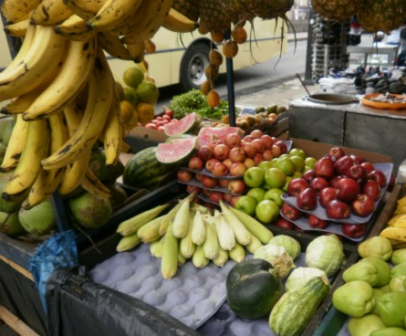


Affects Basic Necessities
FOOD
WATER
SHELTER & ENERGY
Image Sources: Agriculture Research Service, Scott Bauer; MorgueFILE users hotblack and chelle
Notes:
Point of slide: Extreme weather events affect basic needs of life.
Key Points:
Changes in climate will affect basic necessities:
Crop yield changes will affect food availability
Precipitation and heat will affect water availability
Displaced populations will have a difficult time accessing shelter
And the cost of electricity is expected to rise affecting access to energy
Context:
Global environmental changes are affecting climate and result in droughts, floods, wildfires, and extreme weather events which affect the basic needs of life: food, air and water.

Slide 12
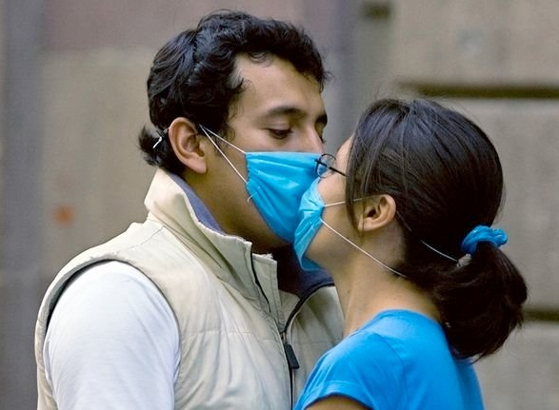

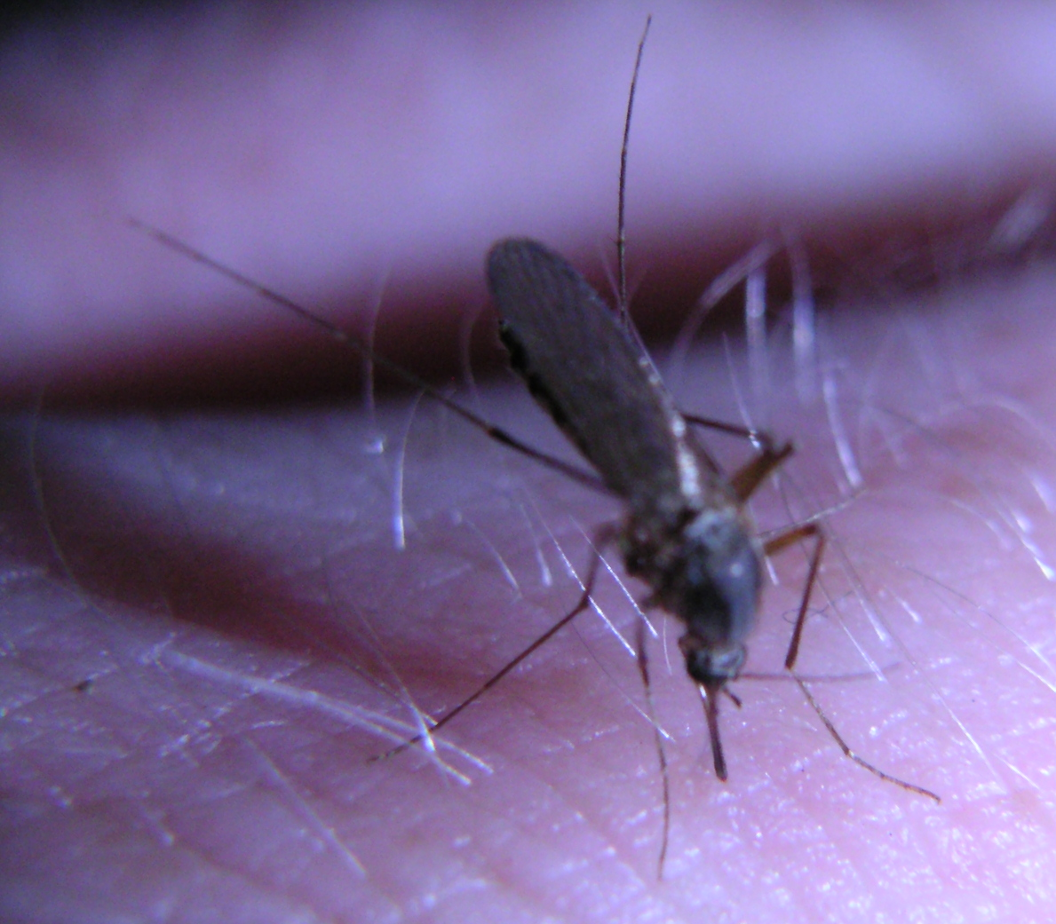
RESPIRATORY DISEASE
EXTREME WEATHER-RELATED ILLNESS, INJURIES & FATALITIES
And Human Health
VECTOR-BORNE ILLNESS
Notes:
Point of slide: These changes will result in health impacts.
Key Points:
These changes will increase the likelihood of health impacts such as
Respiratory illness related to air pollution or pollen changes
Infectious disease including water and vector borne illness
Context: Climate change could create adverse health effects such as heat-stress related illness and death, air pollution-related respiratory illness, infectious disease from water, food and vector-transmitted diseases, malnutrition, and extreme weather related injuries, death and illness.

Slide 13
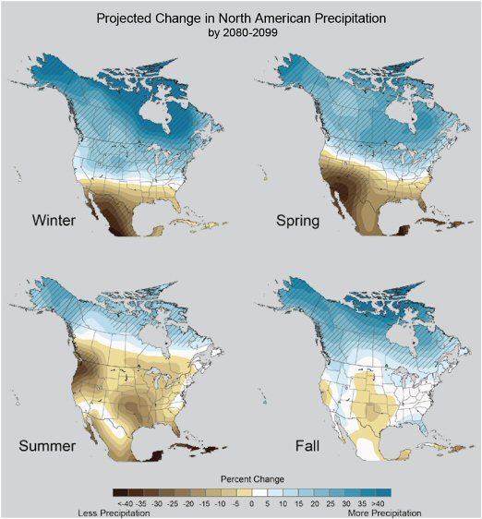
Source: US Global Change Research Program
Notes:
Point of slide:
A changing climate will bring changes in precipitation to your area.
This slide from the US Global Change Research Program shows how precipitation will increase or diminish by region and by season. Point out the drier south in spring, the drier country in summer and the wetter north in winter.
This will impact growing seasons, crop yields, pollen cycles, vector habitats, and water availability.
Precipitation change: Floods
Temperature: Drought, Heat waves
Text below image: The maps show projected future changes in precipitation relative to the recent past as simulated by 15 climate models. The simulations are late this century, under a higher emissions scenario (cited source 91). For example, in the spring, climate models agree that northern areas are likely to get wetter, and southern areas drier. There is less confidence in exactly where the transition between wetter and drier areas will occur. Confidence is the projected changes in highest in the hatched areas.
Image link: http://www.globalchange.gov/resources/gallery?func=viewcategory&catid=3&startpage=1#category
See also: US Department of Transportation, Federal Highway Administration
Regional Climate Change Effects: Useful Information for Transportation agencies
http://www.fhwa.dot.gov/hep/climate/climate_effects/effects03.cfm

Slide 14
Local Rainfall Impacts:
Run-off – Affecting food crops
Flooding – Injuries, drowning
Drought – Lack of water access
All – Water-borne diseases
Notes:
Precipitation related health issue

Slide 15
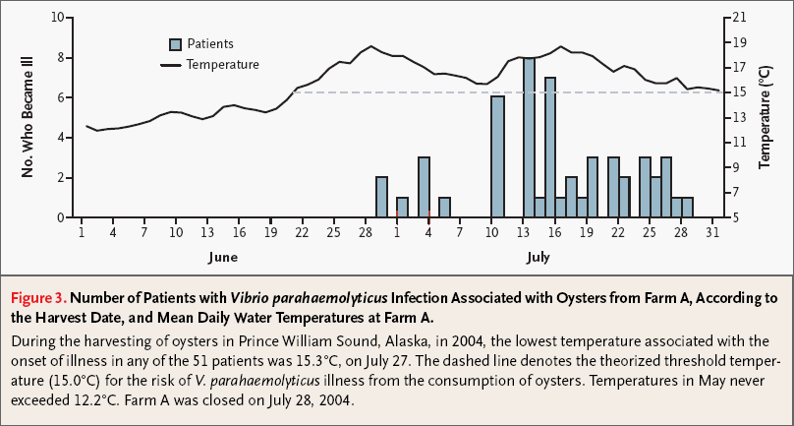
Vibrio parahaemolyticus Outbreak
Alaska – 2004
McLaughlin et al., 2005; World Health Organization Climate Change Training Module 2008
Notes:
This is an example of a bacterial outbreak in relation to changes in water temperature related to precipitation. The top graph shows an outbreak of Vibrio parahaemolyticus in Alaska in 2004. This outbreak, which was due to contaminated oysters harvested in Prince William Sound, extended the known range of V. parahaemolyticus infections by more than 1,000 km.
This outbreak was preceded by unusually warm seawater. In particular, sea surface temperatures exceeded 15°C during the outbreak period. 15°C is a common threshold temperature for the replication of many Vibrio spp. and is rarely reached in these waters.
Sources: World Health Organization Climate Change Training Module 2008 Foodborne disease chapter;
McLaughlin, J.B., A. DePaola, C.A. Bopp, K.A. Martinek, N.P. Napolilli, C.G. Allison, S.L. Murray, E.C. Thompson, M.M. Bird, and J.P. Middaugh. 2005. Outbreak of Vibrio parahaemolyticus gastroenteritis associated with Alaskan oysters. New England Journal of Medicine 353:1463–1470.

Slide 16
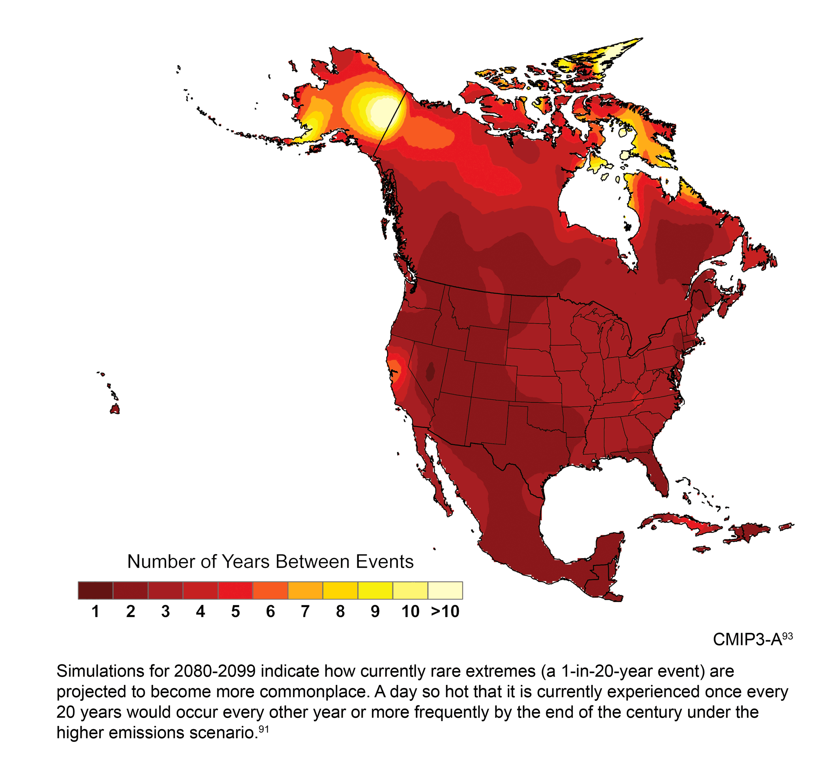
Projected Changes in Extreme,
Rare Weather Events (“1 in 20 years”) 2080-2099
Source: US Global Change Research Program
Notes:
Point of slide:
A changing climate will impact your region differently.
This slide from the US Global Change Research Program shows how extreme weather events (e.g. very hot days) will increase for the entire country. Rather than one event every year, most of the country will have one event annually, and some areas such as Alaska and California may have up to ten a year.
This will impact injuries, deaths and illnesses related to extreme weather events and contribute to changes in vector habitat.
Text from slide: Simulations for 2080-2099 indicate how currently rare extremes (a 1-in-20 year event) are projected to become more commonplace. A day so hot that is currently experienced once every 20 years could occur every other year or more frequently by the end of the century under the higher emissions scenario (91 source cited).
Link: http://www.globalchange.gov/resources/gallery?func=viewcategory&catid=3&startpage=1#category
Extreme weather
Sea level rise
Wildfires

Slide 17
Health Impacts by Event:
U.S. Hurricane Deaths
Deaths per year from hurricanes
U.S. hurricane death totals are driven by single storm impacts
Source: Mills, 2009; World Health Organization Climate Change Training Module 2008
Notes:
An example of how understanding the actual data on health impacts provides greater context when summary or “average” figures are presented.
In this slide, showing deaths from hurricanes with U.S. landfalls from the year 1900 and the period 1940-2007 there are two significant years, 1900 and 2005, when total deaths are in excess of 2,000 (note the logarithmic y-axis scale). In all other years the totals are greatly lower. These two years dominate estimates of averages and reported totals. Even these data partially obscure the impact of single events though because mortality is summed across all events within a year. In some cases totals represent relatively small impacts across a number of events. At the extreme, the value shown for 1900 of 8,000 lives lost is solely for the hurricane that struck Galveston, Texas.
The main conclusion from this example is that within the category of extreme weather events there is not all events are equal in terms of their health risks and impacts and that there is a further subset of events that drive health impact results.
Sources: World Health Organization Climate Change Training Module 2008, Chapter 10 Extreme Weather Events; Mills, D. 2005. Excessive Heat Events: a Review of Evidence on Health Risks, Impacts, and Opportunities for Response, Final Report. Prepared for U.S. Environmental Protection Agency, Office of Air and Radiation, Office of Atmospheric Programs, Climate Change Division. October 27.

Slide 18
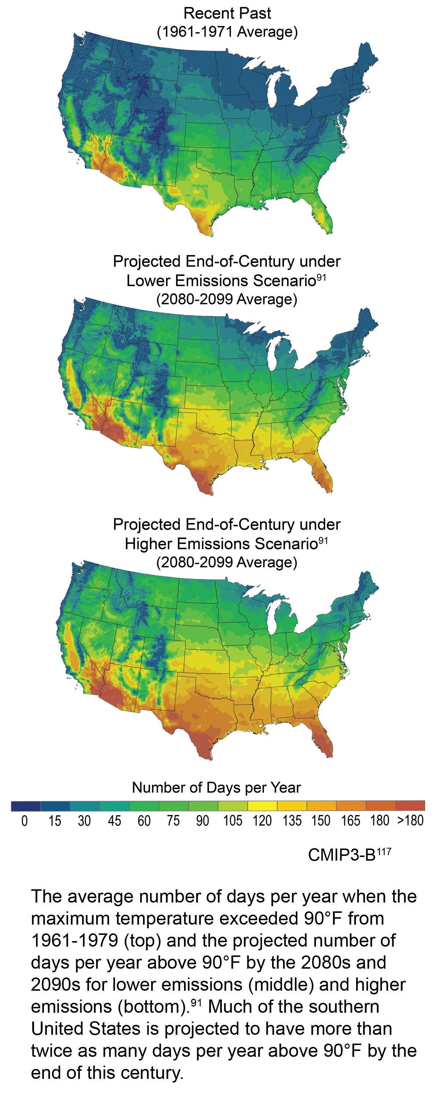
Over 90°F
Source: US Global Change Research Program
Notes:
Point of slide:
A changing climate will impact your region differently.
This slide from the US Global Change Research Program shows how different regions will experience more hot days (over 90 degrees) based on a higher emissions scenario.
Heat alone contributes to illness and death and strongly affects low-income and older adults.
These changing conditions may be what initiates climate change policies where you live. As a result, states and jurisdictions will likely begin climate change planning to adapt, mitigate or respond to trends.
http://www.globalchange.gov/resources/gallery?func=viewcategory&catid=3&startpage=1#category
Text from slide: The average number of days per year when the maximum temperature exceeded 90*F from 1961-1979 (top) and the projected number of days per year above 90*F by the 2080s and 2090s for lower emissions (middle) and higher emissions ( bottom) (91). Much of the southern U.S. is projected to have more than twice as many days per year above 90*F by the end of the century.

Slide 19
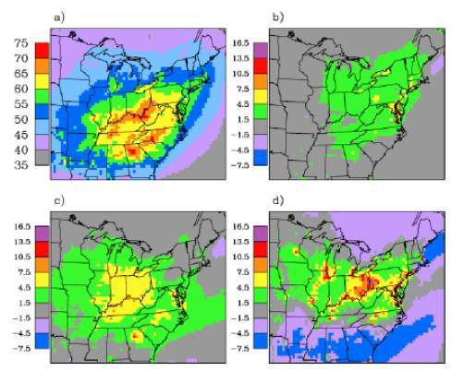
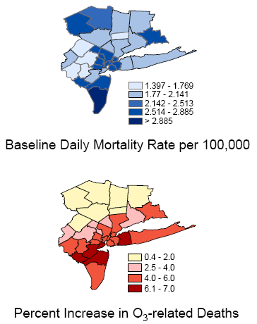
Projected Changes in Ozone and Related Deaths,
New York Metro Area
1990
2020s
2050s
2080s
2050s
World Health Organization Climate Change Training Module 2008; Kinney et al. 2006
Notes:
Ozone is a secondary pollutant formed from precursor molecules interacting with sunlight (primarily from fossil fuel combustion and biogenic emissions) on clear days, with the rate of formation dependent on the ambient temperature.
This study for the New York City metropolitan area suggests that, all else staying the same (i.e., precursor emissions remaining constant), that climate change will increase ozone concentrations and ozone-related mortality. The left figures show changing ozone concentrations and the maps on the right show baseline mortality and the projected percent increase in ozone-related deaths in the 2050s.
Source:
World Health Organization, 2008. Protecting Our Health from Climate Change: WHO Training Course for Public Health Professional, World Health Day 2008, available online: http://www.searo.who.int/en/Section260/Section2468_14932.htm
Kinney, P.L., J.E. Rosenthal, C. Rosenzweig, C. Hogrefe, W. Solecki, Kim Knowlton, C. Small, B. Lynn, K. Civerolo, J.Y. Ku, R. Goldberg, and C. Oliveri. 2006. Assessing the potential public health impacts of changing climate and land use: NY Climate & Health Project. Chapter 6 in: Climate Change and Variability: Impacts and Responses, M. Ruth, K. Donaghy, and P. Kirshen (eds.). New Horizons in Regional Science, Edward Elgar, Cheltenham, UK.
20

Slide 20
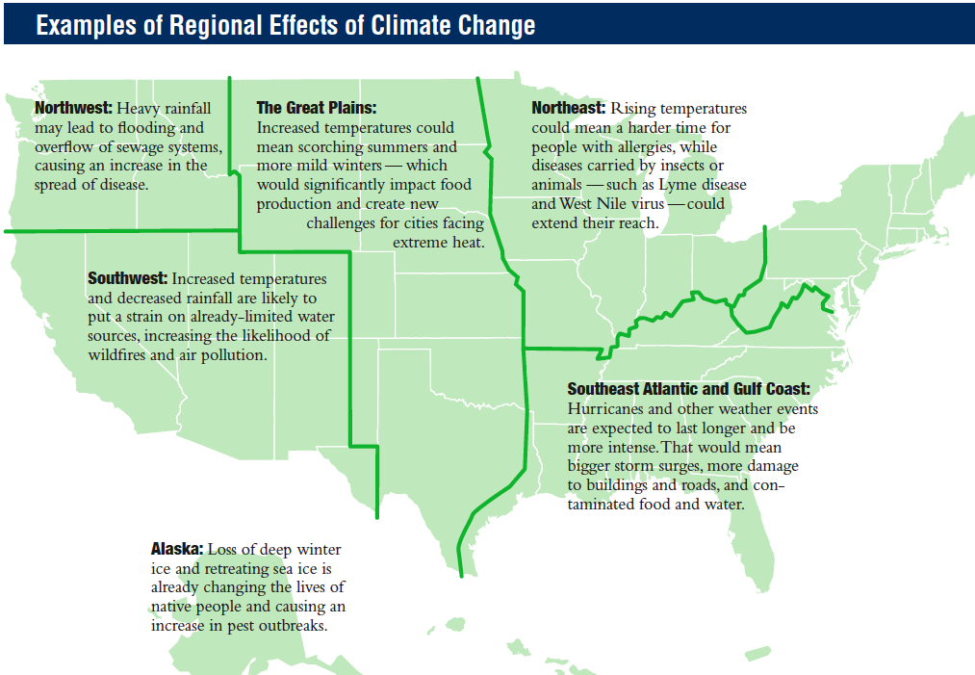
Impacts Will Depend on Local Context
Source: American Public Health Association. Climate change: Our health in the balance [Internet].
Washington, DC: American Public Health Association; 2008. Available from: www.nphw.org/nphw08/NPHW_bro.pdf

Slide 21

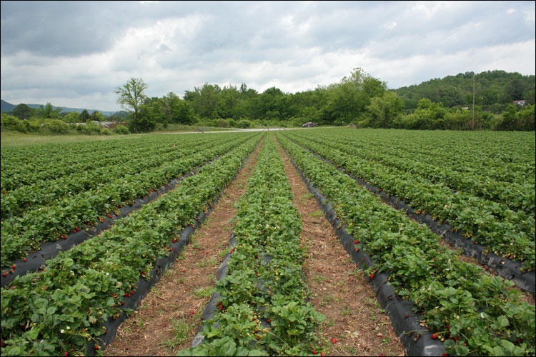

HIA Review
Incorporating Health into Decision Making
Health is a state of
complete physical, mental and social well-being
and not merely the absence of disease or infirmity (WHO, 1948).
The world would look different if we considered health…
Development
Farm Policy
Education

Slide 22
Key Goals of an HIA
Improve population health
Make health a key factor in decision making
Create decisions based on scientific evidence
Demonstrate the value for local residents
Notes:
Context:
The level of communication used to convey the health impacts of climate change will depend on factors such as:
The main goals or purpose of the HIA (What do you want to do?)
Who or what you are trying to influence (Examples include legislative discussion, content of a policy, or policy implementation)
The audience that the HIA is targeted to (Who do you want to question or speak to about what you are doing?)
The dissemination strategy fits the audience (How are you going to tell them?)

Slide 23
Other Forms of Assessment
Health Risk Assessment
Community Health Assessment
Quantitative analytic method
Analysis of human health risks from exposure
Magnitude of health risk from exposures
Focused, more narrow
Can be included in HIA
Quantitative and qualitative
Regular, systematic collection of health statistics
Analysis and distribution of health
Health needs and/or assets
Can be included in HIA

Slide 24
Other Forms of Assessment
Environmental Risk Assessment
Cost-Benefit Analysis
Quantitative analytic method
Analysis of human health risks
Risks to environment
Magnitude of health risk from exposures
Focused, more narrow
Can be included in HIA
Economic decision making
Policy analysis
Compare policy scenarios against expected costs
Weight benefits to costs
Does not include health
Can be included in HIA

Slide 25
Unique HIA Features
Judges magnitude of health impacts
Policy analysis
Forecasting impacts
Makes recommendations to mitigate negative impacts and increase positive impacts
May use other forms of assessment
Can be a part of Environmental Impact Assessment

Slide 26
Health Impact Assessment
A combination of procedures, methods and tools that systematically
judges the potential, and sometimes unintended,
effects of a policy, plan, program or project
on the health of a population
and the distribution of those effects within the population.
HIA identifies appropriate actions to manage those effects.
International Association for Impact Assessment, 2006
Notes:
HIA addresses a specific policy or project
It’s a structured, systematic research process
To judge the potential impacts of a plan or policy
On the health of groups within a population
And how those effects may be distributed among those groups
Then, an HIA helps identify steps decision makers can take to manage those effects, or to improve positive health outcomes

Slide 27
Definitions
Health Outcome
Health Determinant
A change in the health status of an individual, group or population which is attributable to a planned intervention or series of interventions, regardless of whether such an intervention was intended to change health status.
The range of personal, social, economic and environmental factors which determine the health status of individuals or populations.
(Source: World Health Organization, Health Promotion Glossary, 1998).
Notes:
I thought I would begin with some definitions.
When we talk about health outcomes, we mean the health conditions that people experience – can anyone think of some examples of health outcomes looking at this definition?
Obesity, asthma, depression, high blood pressure, heart disease, diabetes, cancer…
Okay, and when we think of health determinants – these are the root causes of those health outcomes. And many determinants interact to yield a given health outcome…

Slide 28
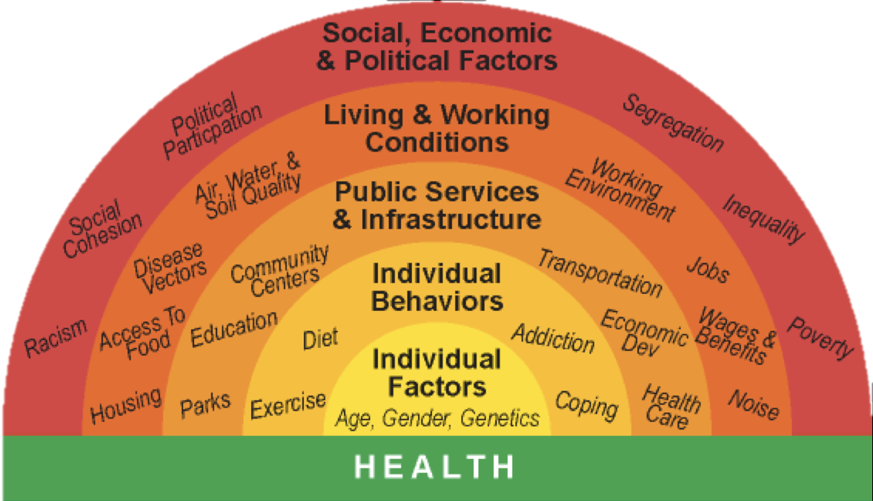
HIA Predicts Impacts on Health
How does the proposed
project, plan, policy
affect health determinants
and lead to
health outcomes?
Source: Human Impact Partners
Notes:
Point of slide: Re-introduce HIA and concepts of health determinants
Key points:
Reminder that a health impact assessment (HIA) is an information collection, analysis and recommendation development process used to inform decision-makers about how a policy, plan or project’s decision elements may affect different population’s health in order to support decisions that reduce harmful effects.
Climate change policies will have an impact on specific health determinants which we will cover later.
We may gather research from literature, economic models, and experts in the field to help us predict what impact a policy will have on people’s health. For a review of HIA practice, see the HIA Resources in the Toolkit.
When we consider climate change policy, we think about what health determinants the policy acts on, which may or may not directly impact climate change health impacts. Social determinants of health are the factors that contribute to population health.
____________________
Figure Source: Human Impact Partners and (the author of the rainbow diagram)

Slide 29
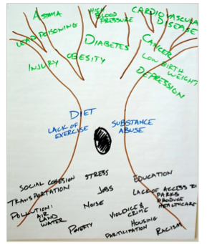
Health Outcomes
Individual Behaviors
(Health Determinants)
Other Health Determinants
Source: Human Impact Partners
Notes:
Purpose of slide: Reminder of how health determinants are related to health outcomes, and can overlap.

Slide 30
Health Determinant Pathway Sample
Health determinants and other impacts/outcomes
Policy/ Project
Direct Impacts
Intermediate Outcomes
Health Outcomes
Δ Climate change-related illness:
Heat-related illness Water-, food-, vector- borne diseases
Greenhouse gases
Climate change
Δ in air pollutants (PM2.5, Nox, Ozone, Benzene, Diesel PM, Acrolein, other mobile air toxics)
Δ Air quality related illness:
Asthma
Respiratory disease
Cardiovascular disease
Cancer
Reproductive health
Maritime port construction
Construction equipment
Source: Los Angles and Long Beach Maritime Port HIA Scope, 2010. Human Impact Partners

Slide 31
Training Module Orientation:
Steps of an HIA
1.Screening | Determines the need and value of an HIA
2.Scoping | Determines health impacts to evaluate, methods for analysis, and a work plan
3.Assessment | Profiles existing health conditions and evaluates the direction and magnitude of potential health impacts
4.Recommendations | Provide strategies to manage identified adverse health impacts
5.Reporting | Communicates the HIA findings and recommendations
6.Monitoring and Evaluation | Tracks: 1) Impacts on decision making and the decision 2) Impacts on health determinants
Notes:
Change this to a different format so can go over each through animation….
Point of slide: We created this module thinking about the basic HIA steps, the module follows these steps. We also created it based on thinking about how a climate change policy could be unique from other policies we might assess in an HIA.
We will review each stage at the beginning of each chapter.
If they don’t: Refer to toolkit.
Orient them: Climate Change Resources bibliography includes training on HIA and climate change. Also has resources for general information (doing homework

Slide 32
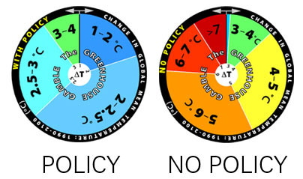
What Makes an HIA on a Climate
Change Policy Unique?
Image Source: The MIT Joint Program on the Science and Policy of Global Change
http://globalchange.mit.edu
Notes:
Point of slide: We created this module thinking about what makes an HIA on a climate change policy unique.
The Greenhouse Gamble™ wheels were developed by the MIT Joint Program on the Science and Policy of Global Change to better convey uncertainty in climate change prediction. The roulette-style spinning wheels depict the estimated probability, or likelihood, of potential temperature change (global average surface temperature) over the next 100 years. The face of each wheel is divided into colored slices, with the size of each slice representing the estimated probability of the temperature change in the year 2100 falling within that range.
The Greenhouse Gamble wheel on the left is the "no policy" or reference case, in which it is assumed no action is taken to try to curb the global emissions of greenhouse gases. The median value of the "no policy" wheel, or the temperature at which there is a 50% chance of falling above or below that level (even odds) is 5.2 °C.
The Greenhouse Gamble wheel on the right is the "with policy" case, which assumes that policies are enacted to limit cumulative emissions of greenhouse gases over the century to 4.2 trillion metric tons, measured in CO2-equivalent. The median warming level (even odds) is 2.3 °C.
The resulting change in probabilities when switching from a "no policy" scenario to a "with policy" scenario is shown by the altered size of the representative temperature slices. If policies to reduce greenhouse gas emissions are enacted, the likelihood of constraining global temperature change in 2100 to below 3 °C warming increases to 90% (9 in 10 odds) from the "no policy" scenario. As global emissions of greenhouse gases continue to increase, the "no policy" roulette wheel continues to spin. By reducing emissions, we can limit the risks from global climate change impacts.
We assume everyone has:
1. Climate change background
2. HIA background.
If they don’t: Refer to toolkit.
Orient them: Climate Change Resources bibliography includes training on HIA and climate change. Also has resources for general information (doing homework).

Slide 33

COMPLEXITY
Notes:
Point of slide: Climate change is a complex topic and difficult to understand from a scientific perspective.

Slide 34
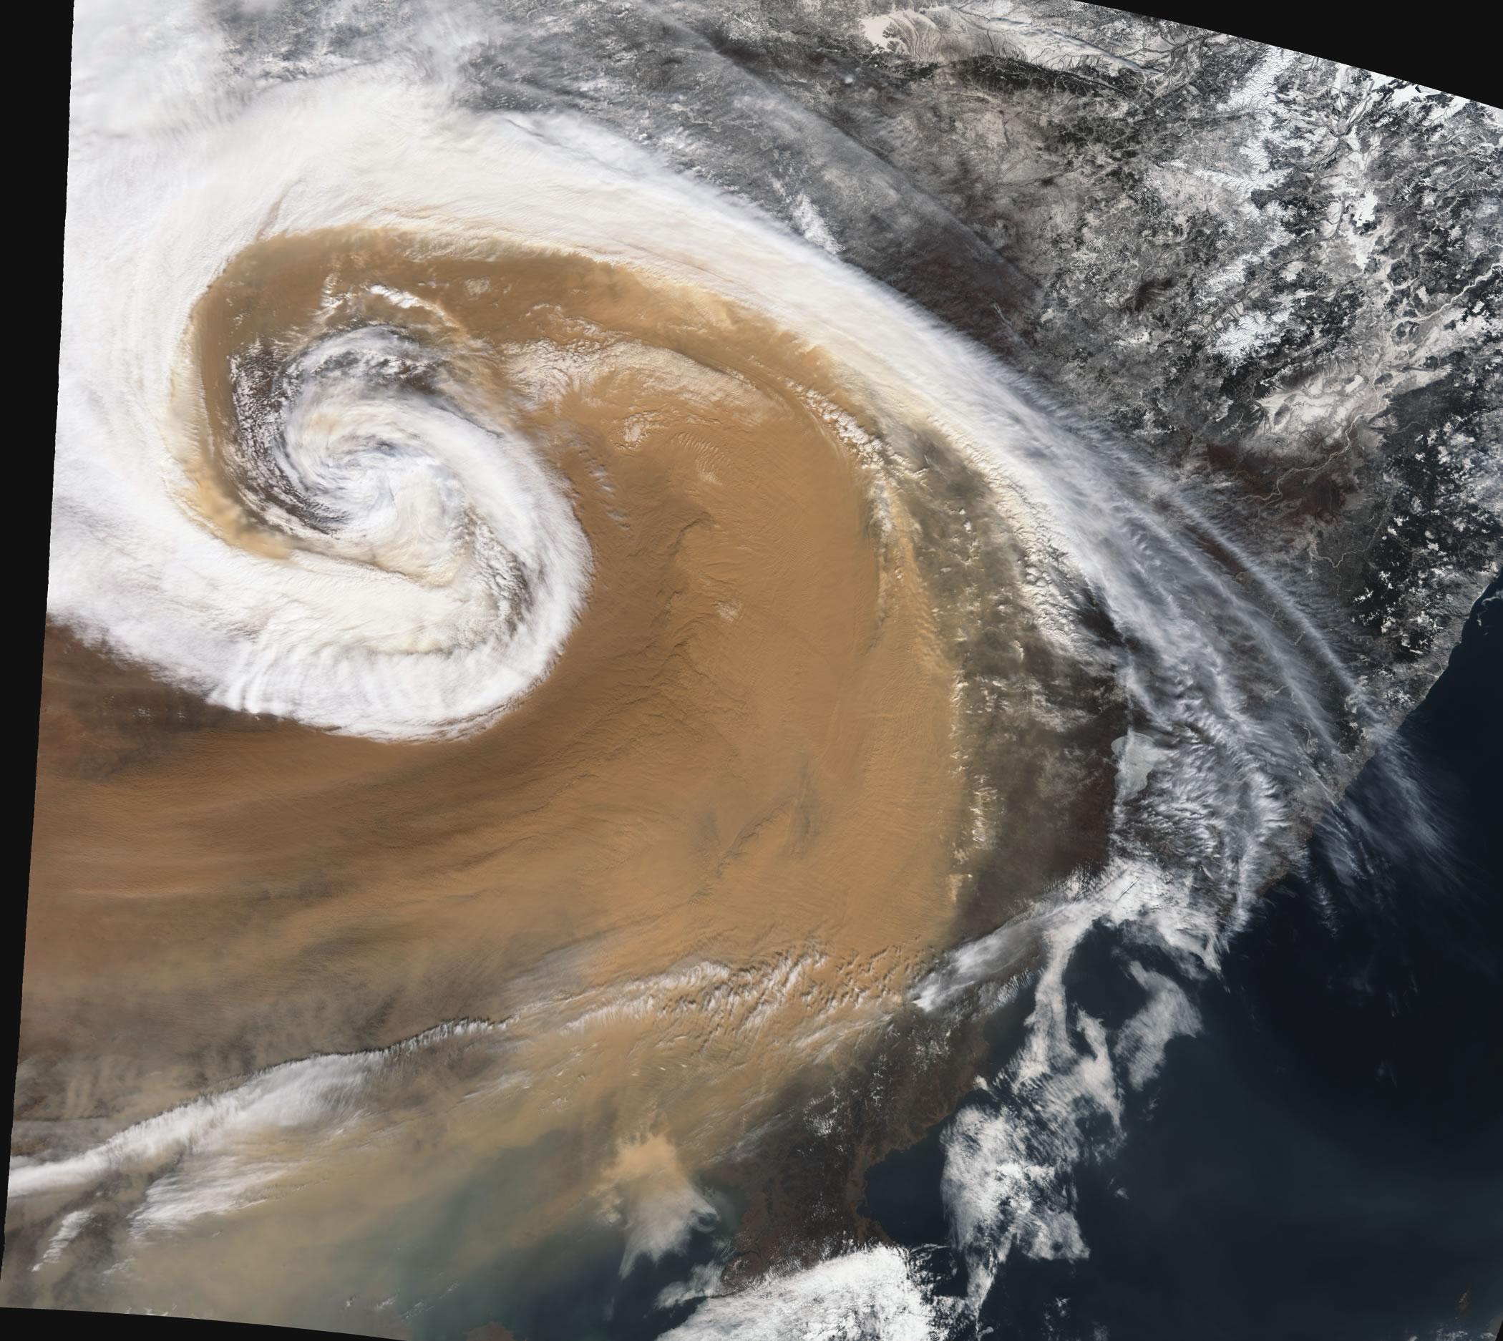
UNCERTAINTY
Notes:
Point of slide: It involves uncertainty, long timelines, and is challenging to assess.
Our Changing Planet 2009 Image 70; US Global Change Research Program

Slide 35
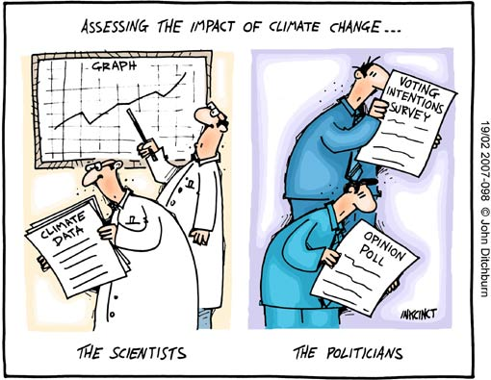
POLITICAL
Notes:
Point of slide: Climate change science is mired in a political debate based on these factors.
We will discuss appropriate ways to address this debate in the reporting stage in Chapter 6.

