Slide 1
2023 Risk Refresher In-Service

Slide 2
Welcome!
This Risk Refresher In-Service is informed by common review findings and aims to support hemoglobin testing procedures with the return to in-person services
This in-service can be completed in about 30 minutes
It would be ideal to complete in a group setting with discussion, but can be completed individually

Slide 3
Outline
Overview of Nutrition Risks and Info Sheets
Overview of nutrition assessment
Review of correct risk assignment
Review risks that require additional documentation
Hemoglobin screening and procedures
Notes:
Objectives:
At the end of this in-service staff will be able to:
Describe the importance of a complete nutrition assessment
Demonstrate how to add and remove a nutrition risk in TWIST
Describe how to confirm when a nutrition risk needs further documentation
Describe the difference between Risk 201 (Low Hemoglobin or Hematocrit) and Risk 341 (Nutrient Deficiency or Disease)

Slide 4
Background
Oregon WIC last had a risk update in October 2021
There are no new risk updates for 2023
This in-service is a risk refresher!

Slide 5
Did you know?
Nutrition Risks are created and updated by the Risk Identification and Selection Collaborative (RISC), which was formed by USDA/FNS in 1996
RISC provides a systematic method of ongoing review of how risks are defined and selected
RISC is charged with revising the currently allowed risks and criteria and adding new risk criteria
Risks and their criteria are evidence-based and linked to the nutrition services provided by WIC
RISC is made up of NWA-appointed state and local agency staff and FNS Headquarters and Regional Office staff
More information: https://www.fns.usda.gov/wic/nutrition-risk-criteria

Slide 6
Risk Information Sheets
RISC provides detailed risk information sheets
State WIC agencies have the option to adapt risk criteria to their region
State WIC agencies set the risk levels for each risk
Oregon WIC has adapted and streamlined Risk Information Sheets to make relevant information easier to find
Oregon Risk Information Sheets include documentation/action requirements for each risk

Slide 7
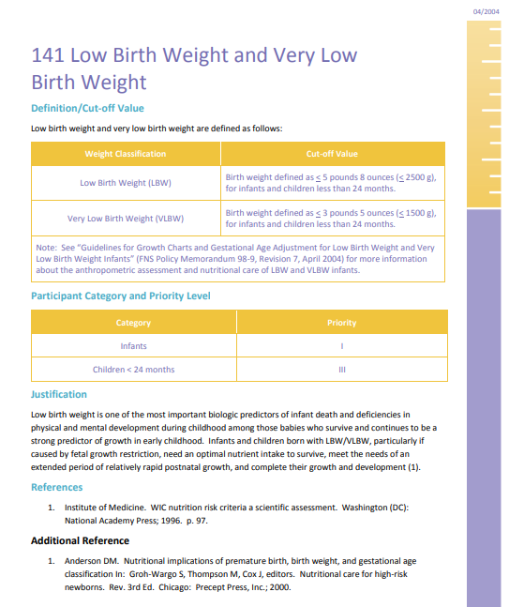
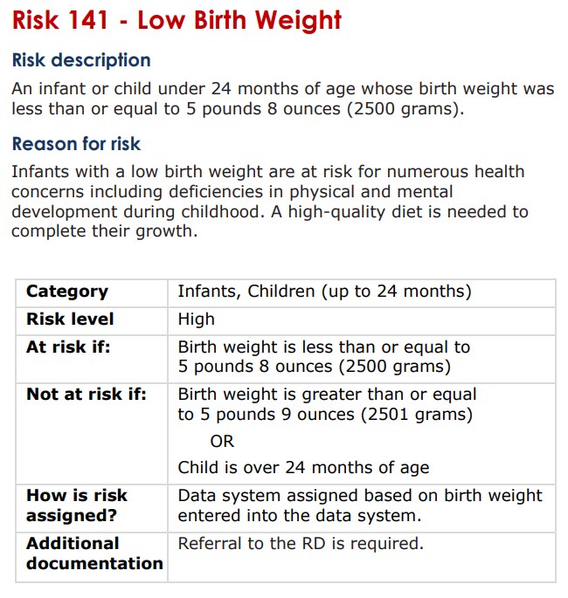
RISC info sheet:
Oregon info sheet:

Slide 8
Nutrition Assessment
Nutrition assessment informs risk assignment
Nutrition assessment is the foundation from which other WIC nutrition services are planned and provided, such as:
Nutrition education and counseling
Referrals
Food packages
Breastfeeding promotion and support
Nutrition services are provided by WIC to help address identified risks

Slide 9
Risk Assignment: Purpose
Risk assignment is required for determining WIC program eligibility
Risks help certifiers know what nutrition education and food packages to offer participants
Risk level helps indicate what type of follow up/referrals are needed
Each certification needs to stand alone, including all relevant risks
Some risks need to be carried over from one certification to the next, often medical conditions (e.g. Down syndrome and Type 2 Diabetes)

Slide 10
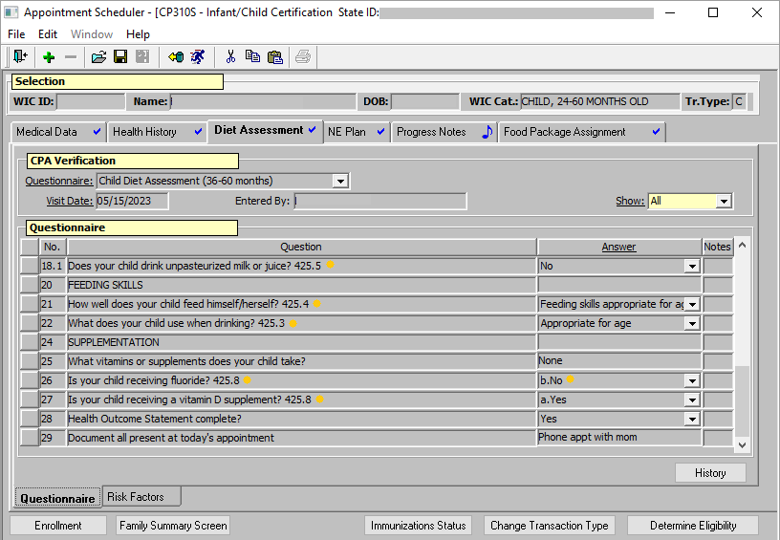
Risk Assignment: Process
Complete assessments are important, as many questions are tied to auto-assignment of risks in TWIST
A number at the end of a question indicates the risk that the question is tied to specific responses (shown in image on right)
Notes:
In the example image, risk 425.8 would be assigned, as the participant is not receiving fluoride.

Slide 11
Risk Assignment: Final Steps
After completing the health history and diet assessment, review the risks that have been assigned for the participant
The Risks/Interventions subtab of the NE tab is a great place to ensure risks are correctly assigned
Do the assigned risks feel accurate? Does it look like anything is missing?
If a risk is assigned but needs to be removed, this is the time to do so
For IE or follow-up appointments, be sure any additional risks reported are added (example: assigning Risk 355 due to a new diagnosis of lactose intolerance)
Notes:
Risk 355 Information Sheet: https://www.oregon.gov/oha/PH/HEALTHYPEOPLEFAMILIES/WIC/Documents/modules/risk/355.pdf

Slide 12
Manual Risk Level Change
Do not manually change risk levels
The only exception: Participants who have a very low hemoglobin should have their risk level manually changed to high, as well as referred to the WIC Nutritionist within 1-2 months
More on hemoglobin and Risk 201 coming up!
TWIST will not auto-adjust risk level as new risks are added if risk level is manually changed during a certification period
This causes incorrect risk status if a high risk is added later (example on next slide)
Referral to the WIC Nutritionist may be missed due to the incorrect risk level

Slide 13
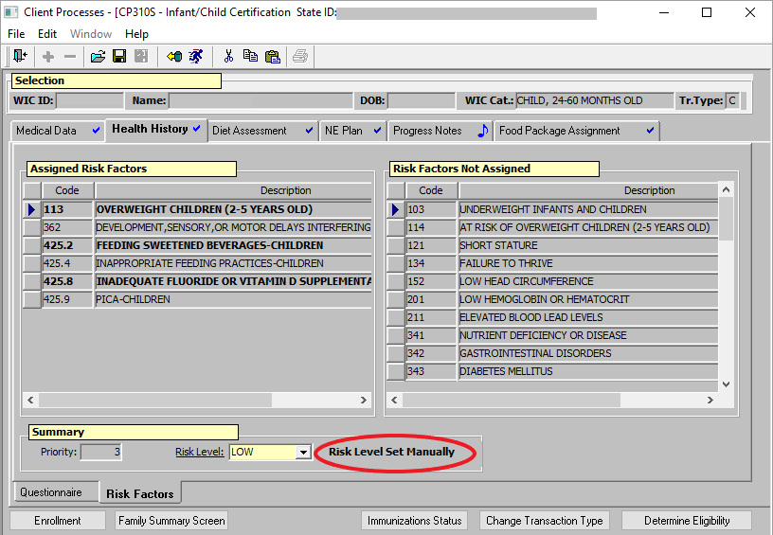
Risk Level Error: Manual Risk Level Change
TWIST now flags risk level when set manually
In this example, the risk level should be high (Risk 362) though the risk level was manually set to low earlier in the certification
Document any risk level errors in progress notes
Contact your assigned nutrition consultant or app support to assist
Notes:
If you come across this in a record, ultimately you need to contact your assigned nutrition consultant or app support to assist. Do not change risk level yourself. Your local agency may prefer that you speak with your Training Supervisor first – please check with your local agency’s leadership for the process at your agency.

Slide 14
Trivia
A parent of a breastfeeding infant reports that the infant is having difficulty latching onto the breast and this difficulty is impacting the infant’s intake and you decide to assign Risk 603.
Where are three places you can go to add Risk 603?
Notes:
Answers:
The “Risk Factors” subtab of the Health History Tab
The “Risk Factors” subtab of the Diet Assessment Tab
The “Risks/Interventions” subtab of the NE Plan Tab
Risk 603 Information Sheet: https://www.oregon.gov/oha/PH/HEALTHYPEOPLEFAMILIES/WIC/Documents/modules/risk/603.pdf

Slide 15
Risk Documentation

Slide 16
Risk Documentation
The reason for assigning each risk must be clear in the participant record.
Sometimes the answer to the TWIST question is enough information
Other times, additional documentation is needed
Risk Information Sheets specify what documentation/action is required
Use the Risk Summary Job Aid as a guide, pictured on next slide
Notes:
Risk Summary Job Aid: https://www.oregon.gov/oha/PH/HEALTHYPEOPLEFAMILIES/WIC/Documents/modules/risk/risk-8-1-ja-risk-summary.pdfI

Slide 17
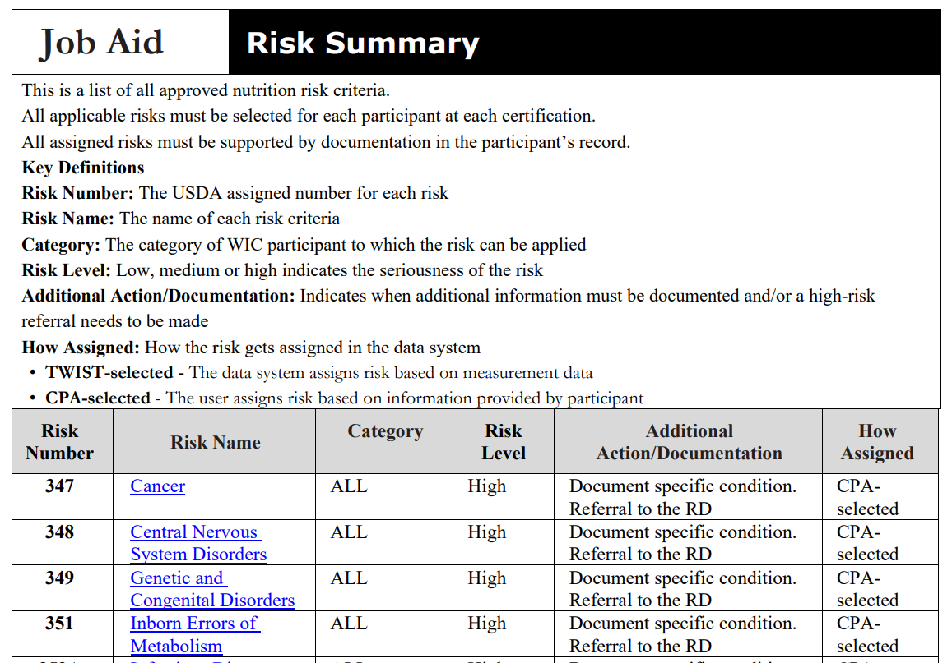
Risk Summary Job Aid
Notes:
Risk Summary Job Aid: https://www.oregon.gov/oha/PH/HEALTHYPEOPLEFAMILIES/WIC/Documents/modules/risk/risk-8-1-ja-risk-summary.pdf
The “Risk Name” is a link that goes to the corresponding Risk Information Sheet and the “Additional Action/Documentation” column makes it clear for each risk what is required.

Slide 18
Trivia
60% of Medical Risks (300s) require additional documentation
What percent of Dietary Risks (400s) require additional documentation?
Notes:
Answer:
74% of dietary risks (400s) require additional documentation

Slide 19
Risk Documentation: Where & What
WHERE: Documentation can be made in:
Notes field of Health History/Diet Assessment questionnaires
Progress Notes
WHAT: Document enough information so that it is clear why each risk was assigned
Documentation can be brief
More details, if provided, are helpful for high risk participants or participants with challenging feeding behaviors that are referred to the WIC Nutritionist

Slide 20
Risk Documentation: Examples
Risk 355 Lactose Intolerance
A diagnosis of Lactose Intolerance is reported and Risk 355 is assigned
Document symptoms caused by eating dairy products
Risk 425.2 Feeding Sweetened Beverages
Caregiver reports that their child drinks chocolate milk daily
Document specific sugar-sweetened beverage(s)
Notes:
Risk 355 Information Sheet: https://www.oregon.gov/oha/PH/HEALTHYPEOPLEFAMILIES/WIC/Documents/modules/risk/355.pdf
Risk 425.2 Information Sheet: https://www.oregon.gov/oha/PH/HEALTHYPEOPLEFAMILIES/WIC/Documents/modules/risk/425.2.pdf

Slide 21
Risk Documentation
Why don’t all risks need additional documentation?
Many risks do not need further documentation For example:
Measurements support risk assignment
Weight for length percentiles lead to assignment of Risk 103 (Underweight Infants and Children)
Answers to TWIST questionnaires may provide required detail*
Example: Risk 425.3 (Inappropriate Use of Bottles, Cups or Pacifiers)
Guardian reports bottle use after 14 months; questionnaire answer shows the reason for assignment
*Other times, additional documentation could be needed for this risk, see risk info sheet for examples
The risk name itself is specific enough
Risk 302 (Gestational Diabetes)
Risk Summary Job Aid
Notes:
Risk 103 Information Sheet: https://www.oregon.gov/oha/PH/HEALTHYPEOPLEFAMILIES/WIC/Documents/modules/risk/103.pdf
Risk 425.3 Information Sheet: https://www.oregon.gov/oha/PH/HEALTHYPEOPLEFAMILIES/WIC/Documents/modules/risk/425.3.pdf
Risk 302 Information Sheet: https://www.oregon.gov/oha/PH/HEALTHYPEOPLEFAMILIES/WIC/Documents/modules/risk/302.pdf
Risk Summary Job Aid: https://www.oregon.gov/oha/PH/HEALTHYPEOPLEFAMILIES/WIC/Documents/modules/risk/risk-8-1-ja-risk-summary.pdf

Slide 22
Trivia
Nutrition assessment helps inform risk assignment and which WIC services?
Notes:
Answers include (but not limited to):
Nutrition education and counseling
Referrals
Food packages
Breastfeeding promotion and support

Slide 23
Hemoglobin and Anemia Risks
Anemias occur from nutrient deficiencies that can impair energy metabolism and immune function
Iron deficiency is the most common cause of anemia in women and children
WIC uses hemoglobin screening to refer WIC participants to their health care providers
Health care providers determine if an individual has anemia and they can prescribe appropriate supplementation
WIC has 2 risks that relate to low hemoglobin and anemia:
Risk 201 Low Hemoglobin or Hematocrit
Risk 341 Nutrient Deficiency or Disease
Notes:
Risk 201 Information Sheet: https://www.oregon.gov/oha/PH/HEALTHYPEOPLEFAMILIES/WIC/Documents/modules/risk/201.pdf
Risk 341 Information Sheet: https://www.oregon.gov/oha/PH/HEALTHYPEOPLEFAMILIES/WIC/Documents/modules/risk/341.pdf

Slide 24
Risk 201: Hemoglobin Screening
WIC provides hemoglobin screening at certification appointments and appropriate intervals for women and children
If a participant’s hemoglobin level is below normal range for their age and/or category, TWIST assigns Risk 201 (Low Hemoglobin or Hematocrit)
If the hemoglobin level is more than 1 point below normal, that is considered “very low” and the participant’s risk level increases to high and further actions need to be taken
Notes:
Risk 201 Information Sheet: https://www.oregon.gov/oha/PH/HEALTHYPEOPLEFAMILIES/WIC/Documents/modules/risk/201.pdf

Slide 25
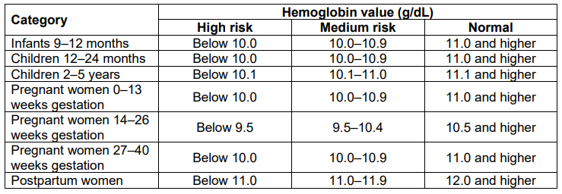
Risk 201: Hemoglobin Values
Source: Policy 626, Page 10, Appendix A Table 1
Notes:
Risk 201 Information Sheet: https://www.oregon.gov/oha/PH/HEALTHYPEOPLEFAMILIES/WIC/Documents/modules/risk/201.pdf
Policy 626: https://www.oregon.gov/oha/PH/HEALTHYPEOPLEFAMILIES/WIC/Documents/ppm/626.pdf

Slide 26
Risk 201: High Risk
When a hemoglobin is more than 1 point below normal range for the participant’s category, further action needs to be taken as outlined in Policy 626
Action 1: Recheck
The participant’s hemoglobin needs to be rechecked at the same appointment, utilizing a new puncture site on a different finger
Document the higher of the two results in TWIST on the Medical Data tab
If the second test is also more than 1 point below normal range, the very low level has been confirmed; document that a recheck has occurred, including the lower value, in the Medical Notes section and move on to action 2 (next slide)
If the second test is in the medium risk or normal range, enter the higher value on the Medical Data tab and no further documentation is needed
Notes:
Risk 201 Information Sheet: https://www.oregon.gov/oha/PH/HEALTHYPEOPLEFAMILIES/WIC/Documents/modules/risk/201.pdf
Policy 626: https://www.oregon.gov/oha/PH/HEALTHYPEOPLEFAMILIES/WIC/Documents/ppm/626.pdf

Slide 27
Risk 201: High Risk
Action 2: Manual Risk Change
If the participant’s risk level is not already high, the certifier must manually change the risk level to high (reminder: this is the only time a certifier would manually change a risk level)
Action 3: Appropriate referrals
Follow your agency’s protocol to refer the participant to the WIC Nutritionist, within 1-2 months, for high risk follow up as well as refer to their healthcare provider
Notes:
Risk 201 Information Sheet: https://www.oregon.gov/oha/PH/HEALTHYPEOPLEFAMILIES/WIC/Documents/modules/risk/201.pdf
Policy 626: https://www.oregon.gov/oha/PH/HEALTHYPEOPLEFAMILIES/WIC/Documents/ppm/626.pdf

Slide 28
Risk 341: Nutrient Deficiency or Disease
Risk 341 is assigned when a participant reports that a health care provider has diagnosed them with a nutrient deficiency or disease
Anemia is caused by nutrient deficiency or disease
A low hemoglobin level at a WIC screening is not a diagnosis of anemia
Risk 341 must still be assigned when a participant reports a diagnosis of anemia and has a hemoglobin value within normal range at a WIC appointment
This is a high risk and requires a referral to the WIC Nutritionist
Notes:
Risk 341 Information Sheet: https://www.oregon.gov/oha/PH/HEALTHYPEOPLEFAMILIES/WIC/Documents/modules/risk/341.pdf

Slide 29
Summary
Nutrition Assessment is an important step of a WIC certification and many risks are added during assessment
Correct risk assignment and documentation are important pieces of a WIC Certification
Job Aids, Risk Information Sheets and policies can be helpful in knowing what is required
As we resume in-person services, proper hemoglobin testing, referral and follow up is important
The 2024 Risk Update will include risk changes that will be implemented October 1, 2024

Slide 30
Thank You!
If you have any questions, contact:
Your Local Agency’s Training Supervisor
Your assigned Nutrition Consultant
or
Erica Johnson, Nutrition Consultant:
erica.a.johnson2@oha.oregon.gov

