Slide 1
Getting ready for the big event! Clinic Readiness, Implementation and Training
Kim McGee – Training Coordinator
Vernita Reyna – Nutrition Consultant
Beth Lanham – Nutrition Consultant

Slide 2
Preparing for the event
Notes:
Preparing for eWIC, was a lot like preparing for a heptathlon. There are several events, each important, and each requiring a different method to get ready. Like any coach, we saw our role as helping the local agencies identify what they needed to do, the steps they needed to take, and the training involved. Then once we were ready for the big event, our job was to cheer them on, offer advice and guidance when needed, and be ready to celebrate their success.

Slide 3
Concerns and worries
Notes:
Anytime someone begins a new activity, there are concerns about their chances for success. They worry about what can go wrong and all the work it takes to succeed. This is especially true when there are others depending on us – teammates, coaches, spectators. With eWIC there was a lot of scrutiny and desire to make the process an easy one for staff and participants.
I want you to put yourself into the shoes of a local agency staff person getting ready to start a big event like implementing eWIC. If you are a local agency staff person, this should be pretty easy.
Now take 3 minutes at your table group to list as many of those concerns or worries as you can think of. Remember, think about it from the local agency perspective. Everyone can write their individual concerns on sticky notes – one per note.
What did your group come up with? Give your sticky notes to Beth or Vernita.
Note: Beth and Vernita begin to sticky notes to wall and sort by topic.

Slide 4
Check out our website
https://public.health.oregon.gov/HealthyPeopleFamilies/wic/Pages/ewic.aspx
Notes:
As we go through information we will refer to items that are on our website. If you have an iPad or phone you want to look up what we are referring to, google Oregon eWIC Planning Resources and follow the Oregon Public Health Division link our page.

Slide 5
Get Ready…
Notes:
Way before the day of the event, the training coordination team began to think about what we needed to do to help each local agency be ready to roll out eWIC. In Oregon, we have 34 local agencies which range in size from barely 100 participants and 1 staff person, to over 14,000 participants and 50 staff. That means each local agency has a little bit different way to do things and needed to approach eWIC events in a way that made sense for their situation. Clinic readiness and training was going to look different depending upon the agency.
Oregon’s training coordination team had the responsibility of coming up with a plan. The training team is made up of representatives from all the primary areas of the program such as vendor, data, and nutrition local services team. It includes all the nutrition consultants that work with local agencies, plus the health educators, and training coordinator (that’s me). That means that we take a pretty broad holistic perspective on training. The first thing we decided was that we were going to do the training, rather than ask our eWIC contractor to do the training. We did this because we wanted to blend clinic operations and readiness with the data system training, and because we put most eWIC functions into our data system. We were the experts on our data system, not our contractors.

Slide 6
What do we need to do?
Start with “concept mapping”
Notes:
The first thing we did was to figure out what all the local agencies were going to need to know and be able to do in order to be successful. We start this process with concept mapping – which means we just start listing every possible concept that staff might need to know. We included everything - agency level concepts, staff level concepts, and concepts specific to a position like dietitian or clerk.
At first the list is just random sticky notes of all different shapes and colors. Which we then put them into a spread sheet.
It looked a lot like all your sticky notes with concerns that we stuck on the wall.

Slide 7
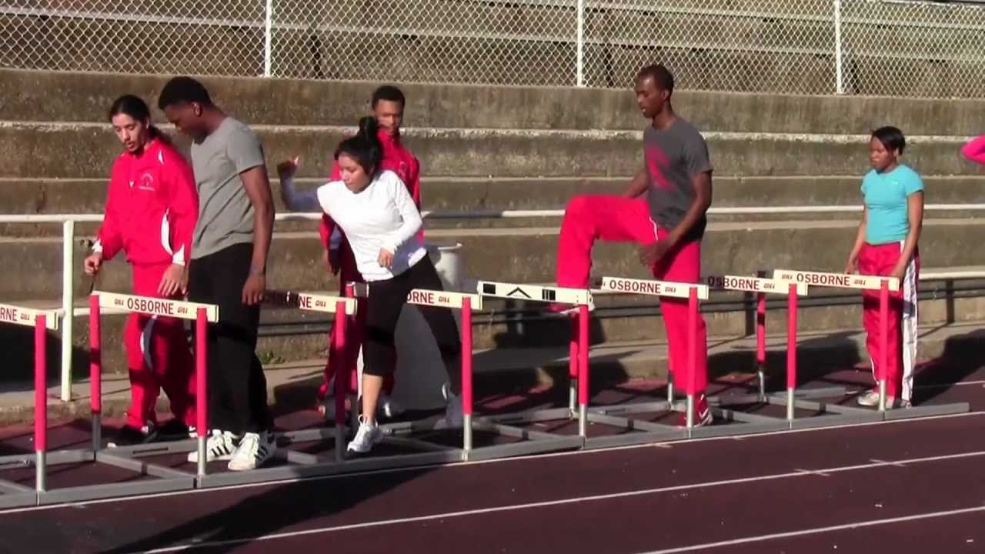
Concepts get sorted by topic, audience, and sequence
Notes:
Once we have a complete set of concepts, we take the list of concepts and start “clumping” them together by topic. They get sorted further by audience. And then we were able to start saying “in order to do this, they need to know this other thing first.” Just like this illustration, at first it was hard to see how it was going to work and it felt like there were more hurdles than we were going to be able to jump. But before long, we had this big spreadsheet that we could sort and use for developing a training plan and strategies.
You see that Beth and Vernita have grouped your sticky notes of concerns into topic areas. Beth or Vernita, could you read off a couple of those areas?

Slide 8
Complex topics take lots of warm up
Notes:
eWIC is complicated business and Staff were very excited to get started. But we knew they couldn’t learn everything at once. Some of what needed to happen was going to require individual agencies to review their clinic operations and decide how they were going to implement eWIC in their clinic. They needed to consider their staff and the unique needs of their participants.
Staff might have a different or specific roles that they needed to plan for.
So we needed a clinic readiness and training plan that would allow each agency to access chunks of information as it was needed by the agency. This would allow them to warm up as they were ready for their events.
Our plan for training started with training on the broad concepts that everyone would need and gradually drilled down to training on specific tasks related to clinic operations and participant food package records and benefit issuance.

Slide 9
Curriculum development
Notes:
The concept map became a curriculum when we identified which concepts went together and the training modality that made the most sense for that set of knowledge or skills. In this sample, you can see the list of concepts we felt everyone needed to know first, the training method we selected, as well as policies impacted and which existing training modules would need to be updated.
So what started as a bunch of clumped sticky notes – became a curriculum guide. We have posted our full concept map to the eWIC resources website if you want to use any of it for your training development.

Slide 10
Flexibility is key
Notes:
We knew that not only were the needs of each agency different, but they were all going to be on different schedules. So we needed a training plan that was flexible – not only in it’s timing but in it’s implementation. We decided to record webinars that agency staff could view together, as they were prepared to tackle that particular effort. We also developed a Clinic eWIC Readiness Toolkit that supported the clinic specific planning efforts for this portion of the curriculum. Beth will talk about this more later.

Slide 11
Readiness Activity Timeline
Notes:
To make sure that every agency could develop their own plan and we could still ensure that the appropriate learning was taking place in a timely fashion, we developed a Readiness Activity Timeline, that gave guidance to local WIC coordinators on when and what should be covered. Beth will cover how that worked.

Slide 12
Final Event: Face-to-face Training
Changes to data system required hands-on training and practice
Notes:
All of the preparation culminated in a final face-to-face training. Our data system was upgraded significantly to support eWIC. Our experience is that people need to be able to actually get their hands on a keyboard to learn changes to any computer system. So our final training event was going to need to be face-to-face. We decided that we could cover all the high priority concepts in a 6 hour training. We weren’t going to have a way to train over 300 local agency staff at one time if we wanted that hands-on experience. So we needed a plan to get everyone trained.

Slide 13
We needed a plan and a schedule
University of Oregon Hayward Field in Eugene, Oregon – Track Town USA
Notes:
As I said before, we have 34 agencies spread out across the state. Over the years we have had success with regional training and have hauled laptop computers from Eastern to Southern Oregon, and everywhere in between. We have a computer lab with 18 computers in Portland. And we have access to a special practice and training data base. Using those resources we developed a schedule for the final face-to-face training for all our local agency staff, including clerks, counselors, dietitians - everyone.

Slide 14
Flip from vouchers to eWIC
The Conversion process
Notes:
Part of what had to be considered when developing the implementation schedule was the conversion of individual participants from vouchers to eWIC. We wanted the process to be a smooth transition for agencies and participants – which meant we didn’t want an agency to plan for all their caseload to show up the first week after agency conversion expecting to be issued eWIC cards and benefits. We had encouraged agencies to plan a gradual transition with participants getting eWIC cards at their normal WIC appointments in the standard 3 month benefit issuance cycle. In other words, the agency could become capable of converting participants to eWIC (agency conversion) without every participant converting at the same time (participant conversion.) Because of aggregated benefits for the family, everyone in the family had to convert together and couldn’t do so if anyone in the family still had vouchers.
Since we could only train so many people at one time, that meant some agencies were going to convert before others. Limitations of our data system (and for basic sanity reasons) the conversion process was a one way street, meaning that once a family converted to eWIC it couldn’t go back to vouchers. This meant that transfers within the state were going to be tricky during the conversion time frame.

Slide 15
Notes:
We had a lot to consider when planning the roll out schedule.
We added up the staff to be trained, divided by the number of computers we had and came up with an 8 week roll-out schedule, not counting pilot. We wanted staff from agencies to train together and we needed to train everyone in a region in the same week. Our plan was to start rollout in the state’s most populated areas and to roll out in concentric circles from there.
We needed 7 trainers to cover all the training dates.
We had to take other things into consideration besides trainers. For example, vendor team staff were going to need to prep vendors prior to the agency conversion. We had to consider travel time and we needed locations to train regionally.
This schedule changed several times as our implementation schedule changed, but once we did the initial plan – it was just a matter of plugging in the new dates and adjusting for holidays. We used a 4 wheel drive jeep to make it to the 12 sites across the state. We ended up training in the dead of winter, but unlike this year – the weather gods blessed us – and no one got stuck or stranded by snow or ice.

Slide 16
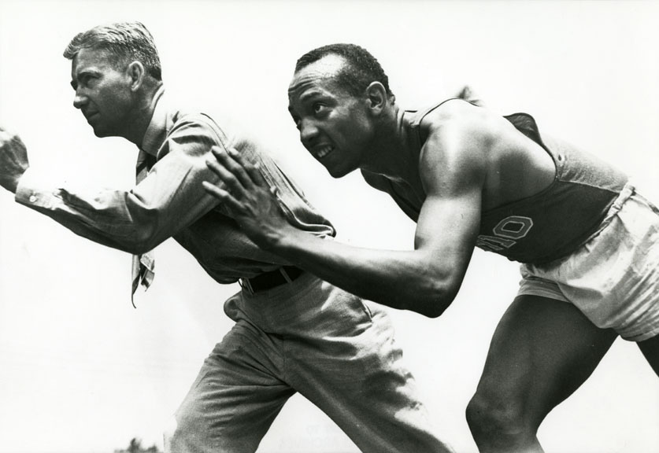
Someone has to go first
Jesse Owens and
Coach Larry Snyder
Notes:
We had this great training plan, but we needed to test it out and make sure it worked. So someone needed to be our guinea pig – I mean, pilot. The plan was to provide the training and tools to them to test early enough to get their feedback and update things as we went. They started everything 4 months before everyone else. When we started looking for pilots sites, we looked for two agencies that weren’t too big or too small. That had experienced coordinators and staff. They needed to be within 2 hours of the state office. They needed to have vendors that represented major chains plus smaller chains and little stores. And we wanted agencies that had a relatively low transfer rate. This is important when you are talking about transfers from a eWIC converted agencies to non-eWIC agencies. We selected Linn and Benton Counties, which is south of here by about 80 miles.

Slide 17
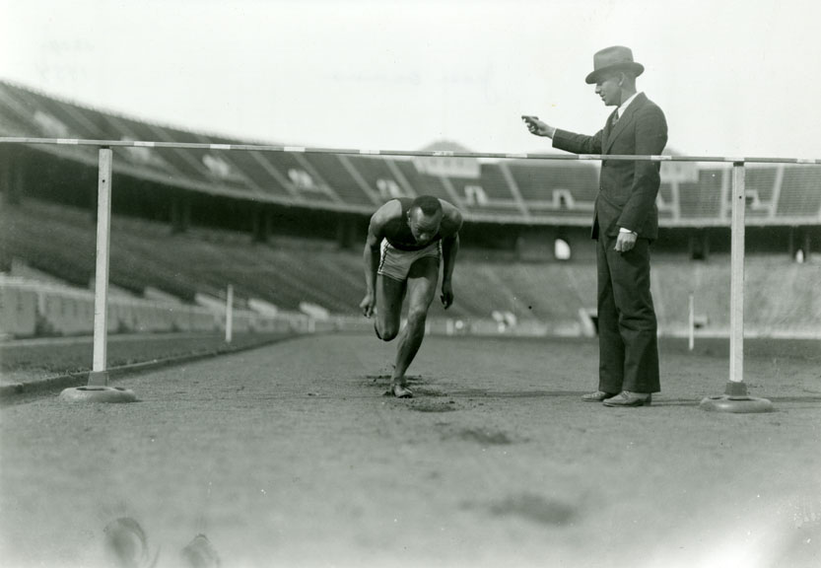
Pilot support
Notes:
Our pilots were close enough for us to provide the hands on support they needed. We knew that during rollout we wouldn’t have the resources to provide on-site coaching and support during the first days or weeks of rollout, but we did spend a week in the pilot clinics. As it turns out, we really didn’t do a lot to help them – they were prepared and ready. What we did do was learn what were the kinds of issues that came up so we could fix things that needed to be fixed.
We limited state staff to one person per clinic site to keep the disruption to a minimum. Every day in those first 2 weeks we had conference calls to review what happened that day and develop plans for any problem solving that needed to happen.
I was lucky enough to spend that first week of pilot in one of the clinics in Linn County. They really didn’t need me at all. I was able to provide moral support, sort of like a teddy bear, but didn’t have to save the day at all. Before long, I was checking emails and helping them with recycling old voucher materials more than doing any eWIC work.

Slide 18
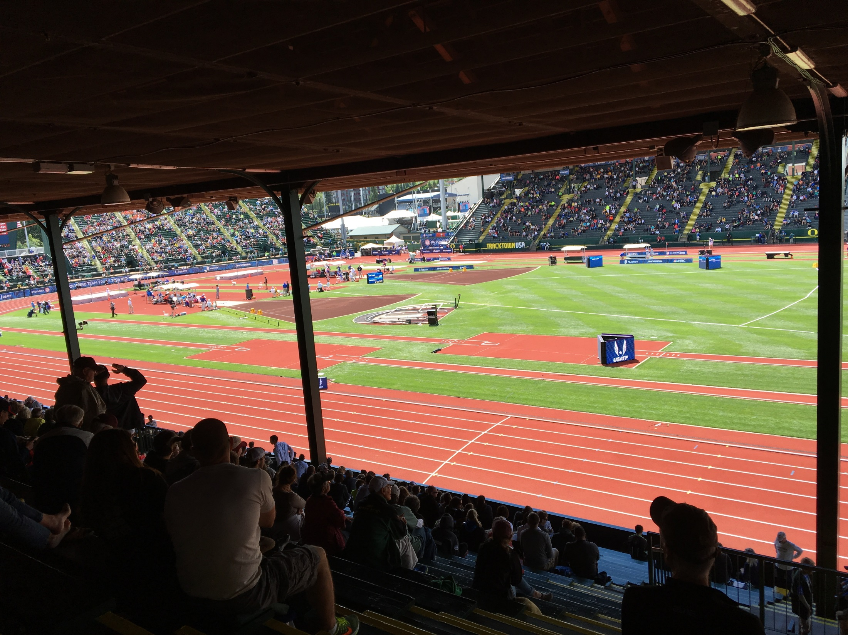
Developing training tools
Notes:
Training tools were develop as they were needed. We didn’t develop everything at once and then voila’ – there they are. We had the plan for what was needed 1st, 2nd, 3rd, etc. by using our concept map. We developed each chunk in sequence as it was needed and felt confident that all the concepts would get covered and nothing would get missed or left out. Each webinar and its’ corresponding planning tools were developed together. During pilot we updated the tools, but the webinars didn’t have to be redone.

Slide 19
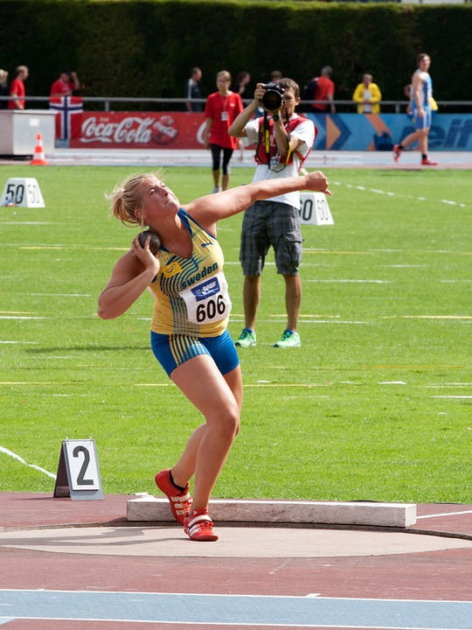
Policy changes
Draft policies for planning
Implement at each agency’s roll out
Notes:
Part of what had to be included in the readiness plan were eWIC appropriate policies. Locals needed to know what those were going to be in order to plan for any necessary changes to clinic operations. So state staff drafted policies that were distributed as part of the readiness tool kit. These new policies were then implemented agency by agency as they rolled out.

Slide 20
Communication Strategies
Notes:
In addition to clinic readiness and training, frequent, clear, and complete communications with local agencies was a major player in our success. When faced with an information gap, staff will fill in any blanks on their own and get more stressed. We developed a communication plan and strategies that helped manage local agency expectations and keep them engaged in the process. We started communicating from the time we announced the eWIC project and never stopped until after the last participant had been converted to eWIC.
We used a variety of communication strategies that considered as many different target audiences as we could think of.
Sometimes what we communicated was “we don’t know”. Sometimes it was “sorry, we got that wrong”. Sometimes it was “here is what you can expect.” but we always communicated something.

Slide 21
eWIC Status reports
Notes:
One strategy was status reports. Status reports were electronic newsletters that we sent out monthly for the entire project. We started with announcements and updates about the upcoming project. Then during the readiness phase, we included suggestions and ideas that we collected from local agencies. During pilot and rollout, we included tips, corrections, lessons learned, troubleshooting ideas and photos from the field.
This was a fairly easy and quick way to communicate anything that we needed locals to know. We used an email distribution list for all WIC Coordinators and training supervisors and asked them to distribute to all WIC staff. In those emails we could also provide specific instructions for what we needed local leadership to do to either correct a problem or avoid pitfalls.

Slide 22
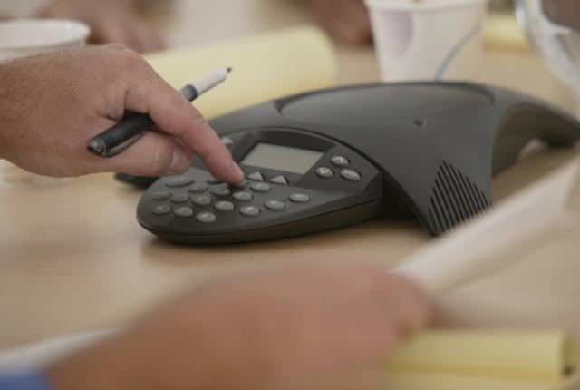
eWIC Technical Assistance Calls
Notes:
Starting about 6 months prior to pilot, during the clinic readiness phase, we held monthly open conference calls to answer questions and share ideas. We called them eWIC Technical Assistance calls because they were designed to answer current questions and provide any technical assistance to local agencies we could.
We also asked those on the call to report on what readiness activity they were involved in, which had the dual purpose of gathering and sharing ideas and making sure progress on implementation was being made locally.

Slide 23
Quarterly meetings
Coordinators
WIC Nutritionists
Training supervisors
Notes:
In Oregon we have meetings quarterly with key leadership positions in each agency. Most of these meetings are conference calls but we also have face-to-face meetings. We used those meetings as a way to both disseminate information, coordinate efforts, and get input on anything we were working on.

Slide 24
Nutrition Consultant Support
Notes:
As far as communications go, all of our local agencies will call their nutrition consultant first with any question. Every agency in Oregon has a state nutrition consultant assigned to provide support, oversight, and technical assistance. They also do the management evaluations of their assigned agencies. Each Nutrition Consultant is assigned from 4 to 7 agencies. They know their agencies and the strengths and weaknesses of each. 5 of the 6 eWIC trainers are also Nutrition Consultants which meant the training team was getting essential input from the field to make sure training was on target.
They played a vital role in assuring that agencies were prepared for eWIC implementation.
This picture shows the 2 nutrition consultants for our pilot agencies – our aviators Vernita Reyna and Cheryl Alto.

Slide 25
Questions?
Notes:
What questions do you have about the planning process for clinic readiness and training.
Beth Lanham is a nutrition consultant who is also a trainer and she is up next to talk in more detail about the local agency preparation and readiness phase.

Slide 26
Get Set…
Preparation in the 6 months prior to rollout for each agency
Notes:
I’m going to focus on the 6 month period before rollout. We said each agency was rolled out on the date they actually began issuing eWIC cards. Face-to-face training was scheduled for 2 weeks prior to roll-out and Vernita will talk about that later. The 6 months of preparation allowed each clinic to spread the decision making and tasks out as much or little as made sense to them. As you can imagine, large agencies needed a lot more time to prepare than smaller agencies.

Slide 27
Clinic eWIC Readiness Toolkit (CeRT)
Sections include:
Introduction
Conversion and participant notification
Appointment scheduling and caseload management
Clinic flow
Equipment – current and new
eWIC cards and inventory
Participant materials
Partner notification
Policy changes
Notes:
I’d like to jump in to our main eWIC planning tool for local agencies. The Clinic eWIC Readiness Toolkit or CeRT.
This was a comprehensive guide for clinics to use to prepare for the coming of eWIC. Each chapter or section was developed as a separate word document complete with tools needed for the tasks it covered. We posted each section to our website for easy access.
Each topic section included an overview of what changes would be happening and questions for consideration and discussion that coordinators could use with their staff to help plan. At the end of each section, we included a required task list specific to that topic.
Let’s talk briefly about each section of the CeRT.

Slide 28
CeRT: Introduction
Planning and Action Steps for Local Agencies
Resources include:
Readiness Activity Timeline
Task Checklist
Webinars
Glossary of Terms and Acronyms
Notes:
The introductory section provided an overview of important resources and tools that would be used along with the CeRT for planning. The Timeline and task checklist were tools that pulled together the activities from the CeRT and the webinars. We will look closer at those tools after we go over the sections of the CeRT.

Slide 29
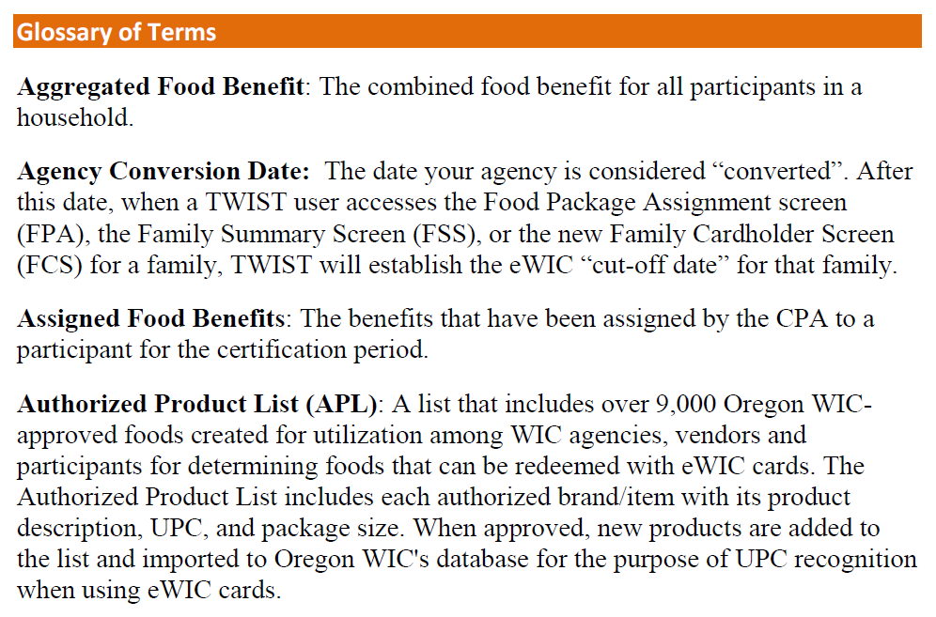
Glossary of Terms and Acronyms
Notes:
The introduction section included a glossary of terms and acronyms. These were crucial because there were so many brand new terms with eWIC; and you all know how we in WIC love to use acronyms!!
So this resource was very helpful in getting staff to talk eWIC- APL (approved product list),

Slide 30
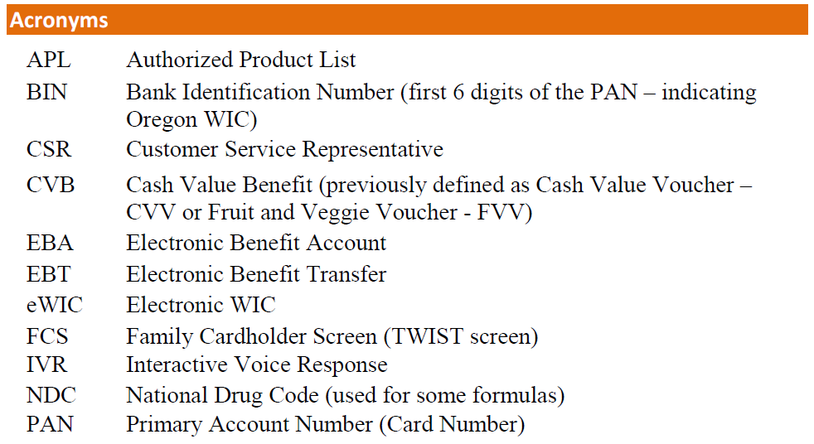
Glossary of Terms and Acronyms
Notes:
CVB, PAN, IVR…..and many more!

Slide 31
CeRT: Conversion and Participant Notification
Know your conversion date and plan activities back from that date
Posters, participant flyers
Notes:
The second section started the discussion about the importance of knowing your agency’s conversion date and how to plan out activities over the 6 months before that date. It was also very important to start talking with participants about the coming of eWIC.

Slide 32
CeRT: Appointment Scheduling and Caseload Management
What adjustments to schedules are needed?
Time for planning activities and during conversion
Importance of caseload
Notes:
The scheduling and caseload mgmt. section talked about the importance of thinking about the extra staff time that would be needed to complete all of the preparation activities and allow time on their schedules. All this plus keeping caseload in mind.

Slide 33
CeRT: Clinic Flow
What responsibilities will be assigned to which positions- adding cardholder information, issuing cards, providing shopper education
Notes:
Clinic flow- this important section outlined the all of the new tasks that would be a part of converting families to eWIC and how that would look in each clinic. For example, who would issue cards and when during an appointment would that happen? Who is going to explain the use of the card and how to shop?

Slide 34
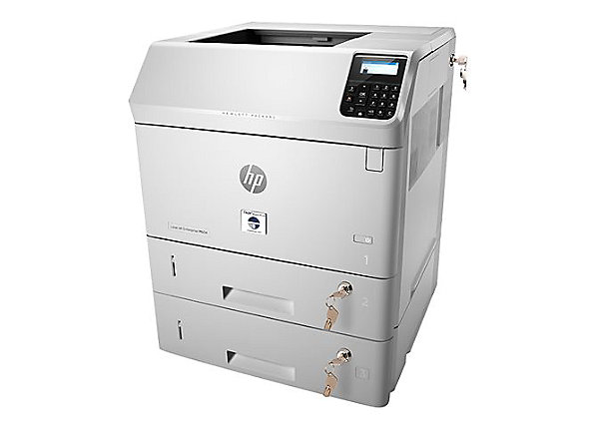
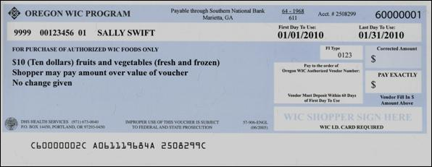
CeRT: Equipment- current and new
How to manage voucher stock during rollout
What to do with your old MICR printers
New eWIC card readers
Notes:
Equipment-Another important thing for each agency to plan for was having enough voucher paper to make it through the entire statewide rollout, considering a non-converted participant (still on vouchers) could easily transfer into an agency that was converted. That agency needed to be able to provide paper vouchers if needed. This section also discussed what to do with old MICR printers once the last vouchers were printed, and how to use the card reader.

Slide 35
CeRT: eWIC Cards and Inventory
eWIC Card Security
Issuance of initial cards
Inventory
Notes:
Cards and inventory-Everyone was so excited about not having to deal with boxes and boxes of voucher stock anymore! This section helped agencies think about how to keep the new cards secure and plan for the inventory of them.

Slide 36
CeRT: Participant Materials
Plan for ordering materials such as:
Shopper ed materials
Cardholder brochure
Rights and Responsibilities and Signature Form
Participant videos
Notes:
As you can imagine, we had many new participant materials that were needed to help educate participants on the new eWIC system. This section provided guidance on ordering these materials and how and when to use them.

Slide 37
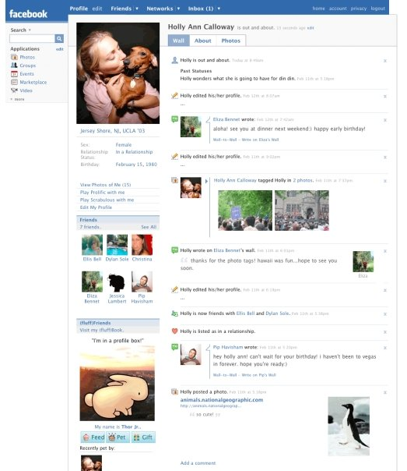
CeRT: Partner Notification
Develop a plan to let partners know about eWIC
Provided a letter template,
FAQs, Status Report, press release, Facebook posts
Notes:
Partner notification- We encouraged our local agencies to provide regular communications to their local partners about the coming of eWIC. To assist them, we provided letter templates, FAQs, and sample press releases and Facebook posts that they could customize for their agency.

Slide 38
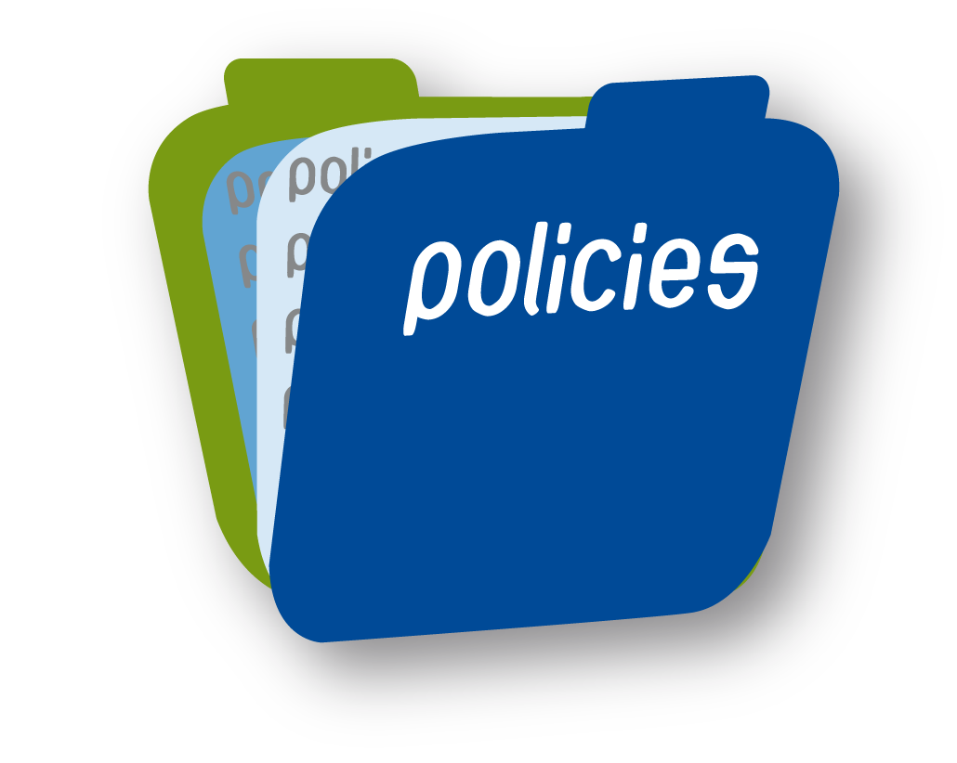
CeRT: Policy Changes
Certain policies were updated for eWIC conversion. These were designated with an “e” after the number
New policies were created, i.e. Cardholder Requirements
Both sets of policies were in place during rollout
Notes:
This section provided a summary of the policy changes that were needed for eWIC, including which ones required a local procedure to be written prior to conversion. I plan to talk about some of the new policies in a little bit more detail later.

Slide 39
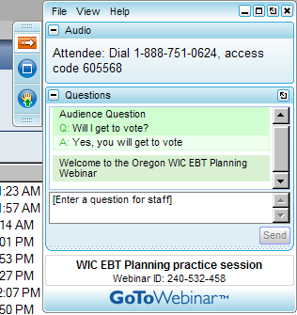
Webinars
Live
Recorded and made available on our website
Compiled questions from live versions into FAQ document
10 Topics
Notes:
Another key component to clinic readiness were the webinars that we provided. We scheduled monthly live 1 hour long webinars during the readiness phase on the various topics from the CeRT. The webinars were recorded and then posted to our website so that local agencies could view them when it fit in to their timeline.
This was a fairly simple and straightforward way to provide training that was adaptable for LA staff. Some agencies watched the webinars as a group in staff meetings so that they could have discussions after watching them. Some agencies found that it was easier for staff to access them and watch on their own time.
We also posted any questions that arose from the webinars on our website as an FAQ document. This started out as just a running list of the questions that came up, then when we got to the last few webinars, we sorted them by topic.

Slide 40
Webinars
eWIC Basics
eWIC in TWIST
Conversion Plan and Participant Notification
Appointment Scheduling and Maintaining Caseload during Conversion
Changes that Impact Clinic Flow
Notes:
You can see that most of these webinar topics corresponds to a section of the CeRT. The idea was that local agency staff would view them in conjunction with the review of the CeRT section.

Slide 41
Webinars
Vendor Perspective and Shopper Education
Outreach Planning for Partners
Formula Warehouse – Managing Formula Orders
Conversion Changes in TWIST for eWIC
Celebration of Pilot and Report from Pilot Agencies on Conversion and Lessons Learned
Notes:
There were a few additional webinars that were not related to the CeRT and planning for conversion. Vendor perspective/shopper ed, Formula warehouse, and Conversion in TWIST were actually required to be viewed in preparation for the face to face training. This way, we didn’t need to cover those topics in detail at the training.
And the very last webinar was a celebration of a successful pilot and lessons learned for the rest of the statewide rollout.

Slide 42
Readiness Activity Timeline
Notes:
Two resources that helped to pull all the readiness pieces together were the Activity Timeline and Task List. Kim mentioned the timeline earlier.
To use the timeline, local agencies would count back a certain number of months from their conversion date to plan their activities that were a part of the CeRT and to watch the corresponding webinar.
This allowed them to spread out the activities over a period of time.

Slide 43
Task Checklist
Notes:
The Task Checklist offered guidance on when to complete certain minimum required tasks with staff based on their conversion date. For example, 2 months before conversion or by eWIC face-to-face training. Each agency could then go in and enter specific due dates based on their conversion date. Examples of these tasks include making adjustments to clinic schedule to allow for planning, viewing webinars, attending training and making sure they have adequate education materials and eWIC cards.
We found that these tasks ended up being completed differently by agency. Most large agencies spread them out over the several months prior to conversion while some smaller agencies completed them closer to the date of conversion.

Slide 44
CeRT Activity
https://www.youtube.com/watch?v=3knBoBO6Gv4&feature=youtu.be
Notes:
Next we are going to view a section of the Clinic flow webinar and we have provided you an example of the corresponding section of the CeRT. (webinar, 12:05-15:48)
Take a look at the Issuing Benefits section on page 2. In your table groups, discuss the questions for consideration and how they would apply to your clinic or agency. Take about 3-4 minutes and then we will ask some of you to share.
So these were a couple of the main tools that local agencies had to help them with planning discussions. How did that go for you?
Could you see something like this working for your agency?

Slide 45
Communication with staff
TA calls
NC support
Notes:
All through the planning process we continued our regular communications like TA calls and NC support.

Slide 46
Monthly Technical Assistance Conference Calls
Notes:
State staff hosted monthly TA calls for Local agency staff to call in and either ask questions or share ideas. Some examples of things that came up on the calls were, new policy and data system clarifications, sharing feedback from participants, and discussions about how they were thinking about handling the increased workload of issuing cards, reviewing rights and responsibilities, and providing shopper education to every family.
The calls were great because they provided us a measurement of where our agencies were in the planning which helped the NCs know who needed a little more support from us.

Slide 47
eWIC Policies
Notes:
Now we are going to switch to policies.
While the local agencies were gearing up their clinics for eWIC, state staff were busy “eWICifying” pertinent polices. We focused initially on those policies with major changes like Ordering and securing eWIC cards and WIC Cardholder Requirements, but waited until after rollout to make the minor revisions like just changing “vouchers” to “benefits”.

Slide 48
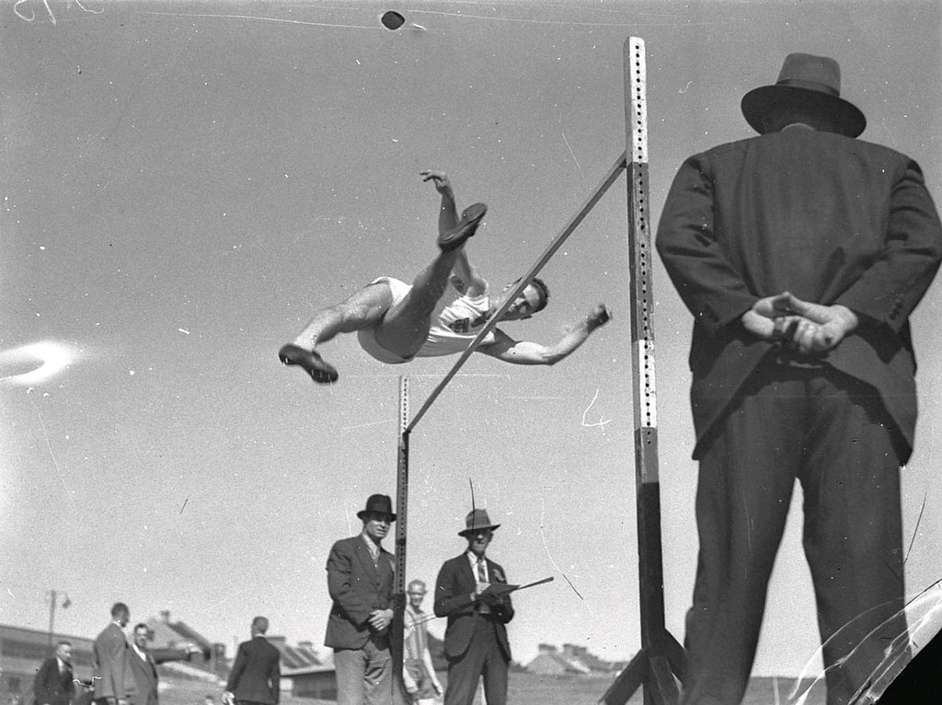
eWIC Policies
Ordering and Securing eWIC Cards
WIC Cardholder Requirements
Eligibility, Rights and Responsibilities
Notes:
Three of the policies that required significant revisions were

Slide 49
Ordering and Securing eWIC cards
Even though no value unless assigned, keep cards in a secure location
Order cards through the State quarterly
Inventory boxes of cards monthly
Notes:
This policy provided the guidance for securing, ordering, and inventorying the new eWIC cards. An important part of the policy included how to handle cards at satellite sites.

Slide 50
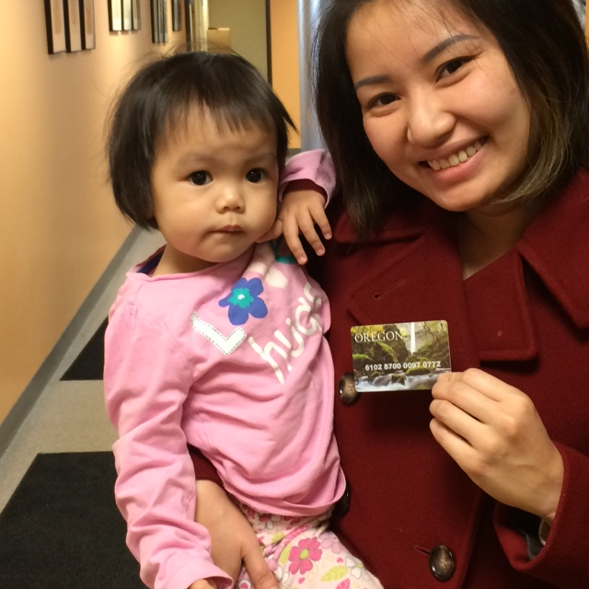
WIC Cardholder Requirements
First cardholder required for each family, second cardholder option
Cardholder sets own PIN for security
eWIC cards are not a form of identity
Notes:
The WIC Cardholder Requirements policy was a brand new policy. It provided guidance such as who could be a cardholder, what data was needed from that cardholder for security purposes, and that eWIC cards are not considered proof of identity.
In Oregon we are unique in the eWIC world in that we allow a family to have two cardholders. Since prior to eWIC, we had two authorized signers who could shop and attend appointments, we felt like we wanted to keep that same level of service and flexibility for our families. This lead to many discussions about the what the first and second cardholder were allowed to do.

Slide 51
First and Second Cardholders
Notes:
So we created a job aid to guide our local agency staff. It outlined who could be a first or second cardholder and what their roles were.

Slide 52
Participant Rights and Responsibilities
Notes:
Another policy with major revisions was the Rights and Responsibilities and the participant forms that accompany it.
In Oregon, we use a written R & R form that is offered to the participant and we have a separate Participant Signature form that they sign and we keep on file.
The R & R had to be revised to include those responsibilities related to eWIC. For example, keep my card safe and PIN confidential, and the right to dispute a transaction.

Slide 53
Participant Signature Form
Notes:
In addition, by signing the Participant Signature form, the participant is acknowledging that they have received their Food Instrument.
Because of this, during rollout every family needed to review the R&R and sign the signature form before receiving their eWIC card.

Slide 54
Ongoing Communication Methods
WIC Staff- Status Reports
Community Partners- press release
Participants- Flyers, word of mouth
Notes:
During the clinic readiness and planning communication with staff, partners and participants continued to be very crucial.

Slide 55
Status Reports
Notes:
Our monthly status reports for staff included information about changes to our data system, new resources that have come available like our shopper app, and reminders of important dates and activities.

Slide 56
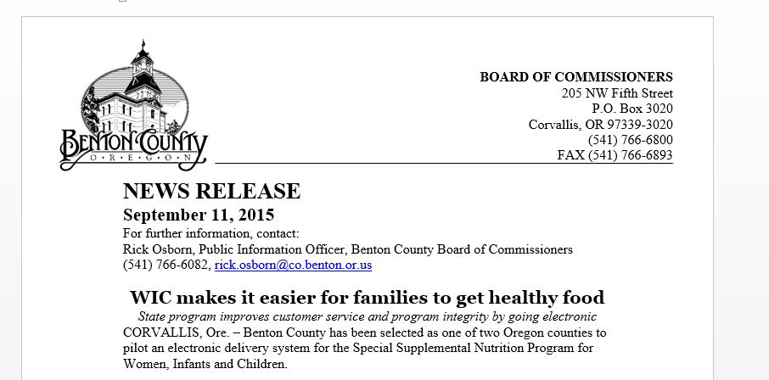
Partner Communications
Info that you can leave with partners “Message to Partners”
Basics of eWIC (FAQ’s)
What’s the change
How will it affect participants
How can partners help
Contact info
Press release templates
Notes:
We wanted to make sure our partners did not feel left in the dark about eWIC.
We also had an FAQ’s or Frequently Asked Questions for partners. The FAQ’s were shared with partners after a presentation or sent to organizations that had questions about the project. It covered basic eWIC information.
Press release templates were also made available for local agencies to use in their community.

Slide 57
Communication to WIC Participants
eWIC is Coming Posters
Coming soon to your WIC clinic flyer
Your Family will be getting an Oregon eWIC card soon!
Notes:
Another important part of clinic readiness was to prepare our participants, too.
Clinics posted eWIC is Coming posters about 6 months prior to their conversion date and started talking about it with participants during appointments.
We also had two flyers announcing the coming of eWIC that were handed out at certain times prior to conversion.
This really helped to build anticipation and excitement for staff and participants, so much so that we had participants wanting to walk in early to get converted, but we had to keep them on their schedule of converting at their next appointment after the clinic’s conversion date.

Slide 58
WIC Webpages
eWIC Resource pages
CeRT
Webinars
Status Reports
Updated Policies
TWIST Training manual
Notes:
As I have mentioned throughout, we kept all of our resources in an eWIC section on our website so they were easily accessed by our local agency staff.

Slide 59
Questions?
Notes:
What questions do you have about local agency planning 6 months prior to conversion?
Now Vernita will talk about pilot and statewide training and rollout.

