Slide 1
The mixed bag of mixed basket:
Preparing shoppers for eWIC
eWIC showcase
March 22, 2017

Slide 2
Notes:
You’ve already learned a lot about eWIC shopping. You’ve had a demo of the stand-beside terminal and had an opportunity to shop at an integrated store. It’s easy, right?
What are some of the biggest lessons you’ve learned as shoppers?
Hopefully by now you’re figuring out what’s going to be important for training your participants and your vendors.

Slide 3
Notes:
Maria and I talked a bit about some of our vendor training earlier. Let’s take a look at our video vignette for shoppers called Shopping with your eWIC card.
When we first heard about eWIC, one of the most exciting things was the idea that shoppers no longer had to keep WIC separate. And this is really cool – as long as the shopper knows for sure they are buying the right items.
It’s when something doesn’t go through as expected that things get more complicated.

Slide 4
eWIC at integrated stores
Cashier scans all items
Shopper swipes eWIC 1st
Shopper verifies items paid by WIC or remaining balance
Shopper asks to void unwanted items before using 2nd tender
Notes:
Let’s back up and summarize how an eWIC transaction generally works at an integrated store.
Since the shopper doesn’t have to separate their items, the cashier just rings everything up.
When the shopper swipes their card first, the POS system goes out and retrieves the cardholder’s benefit balance. It then compares all of the scanned product UPCs and PLUs to their benefit balance and determines what they’re going to buy.
There is an approval process where the shopper reviews the mid-transaction receipt or proposed WIC redemptions receipt, to see what foods will be paid by WIC. If it looks correct, they then approve the purchase.
If there is a remaining balance, the shopper should look at what’s left and ask the cashier to remove any unwanted foods. Then they can pay for the rest.

Slide 5
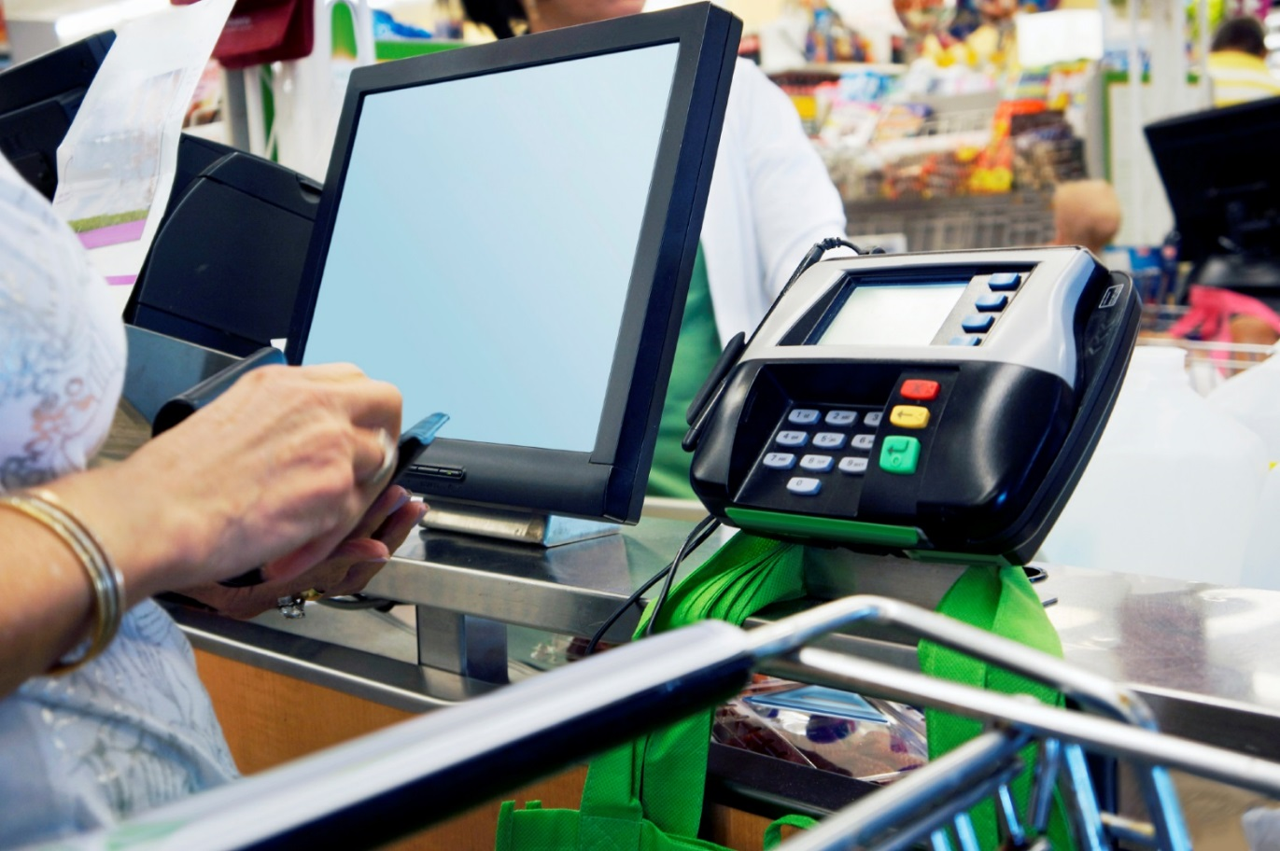
Not all integrated systems are created equal
Customer-facing screen
Mid-transaction receipt
Voiding
Notes:
Wouldn’t it be so nice if all systems worked the same way?
There are technical requirements that all POS systems need to meet. These requirements leave some leeway in terms of how the retailer decides to meet them.
Some of the best systems have a customer-facing screen that shows each item as the cashier scans it, some will even show if the food is WIC approved or Food-stampable.
After the shopper swipes their eWIC card, the list of eligible foods and total amout of the WIC sale shows on the screen for the customer to approve! We love this!
All integrated systems must be able to print a mid-transaction receipt. This happens after the shopper swipes their eWIC card. The receipt shows their beginning balance and then the list of WIC foods that are about to be purchased. Be sure to train shoppers to review it carefully and train cashiers to give it to the customer to review.
If the system doesn’t automatically print a mid-transaction receipt, the cashier can always initiate one.

Slide 6
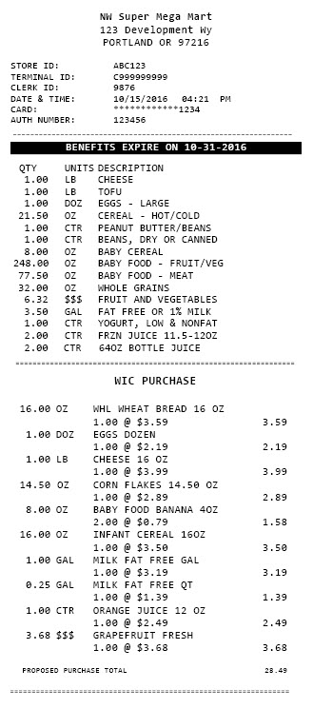
Notes:
Let’s take a closer look at this mid-transaction receipt.
The first part shows the beginning balance or what’s available to buy.
The second section shows the list of foods the shopper bought that WIC will pay for. The shopper really needs to look closely at the items and make sure all the things they thought were WIC foods went through.
If something didn’t go through, look at the beginning balance and make sure they have enough to buy it. Also check the Food List to make sure it’s allowed.

Slide 7
Reading receipts is not for the faint of heart
Notes:
Turns out that reading receipts is not easy! Shoppers and cashiers are used to receipts being foods with dollar amounts.
eWIC receipts have strange units of measure, large numbers that are mostly not dollar amounts (like 128 OZ of baby food), and have 24 character abbreviated food descriptions driven by what’s in the APL.
We made a training tool for cashiers about reading receipts – but you have to read that to understand it!
We also cover some of this concept for shoppers in the How to shop brochure.
This is a tricky thing to train people on, especially people who speak another language or have low literacy (or aren’t math geniuses).

Slide 8
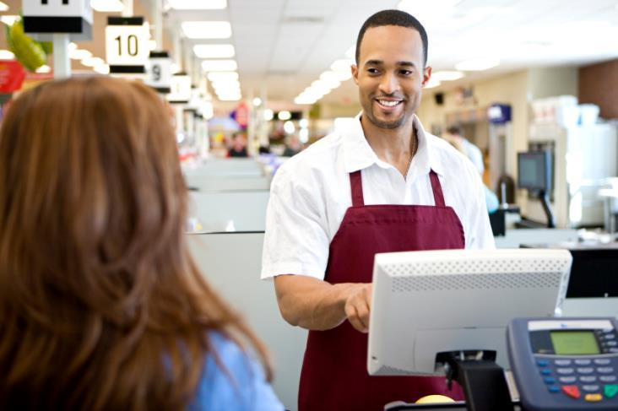
Not enough benefit available
Wrong size
Not in the system
Not a WIC Food
Notes:
One drawback of integrated systems is that if a food isn’t approved for WIC, the system doesn’t tell the cashier or shopper why. There are four basic reasons why something won’t ring up.

Slide 9
Notes:
We’d hoped cashiers would get this concept right away and that it would be easy for them to explain to a WIC shopper why something wasn’t covered by eWIC. Instead we hear they often say something like “you don’t have enough money on your card to cover it” or “WIC hasn’t updated our system yet” or they just throw their hands up and say something like “Honey bunches of nope!”

Slide 10
eWIC shopping tips
OK to keep WIC separate
Review WIC purchase before paying for the rest
Cashier can remove items not covered by WIC
Cancel transaction and check eWIC balance
Notes:
Let’s go over some tips that you can pass on to shoppers. I’m starting with my favorite.
It is OK to keep WIC separate. In fact, I would recommend it for new shoppers or shoppers who primarily speak another language. This makes it much easier to see what went through and what didn’t.
Always review the WIC purchase before paying for the rest.
It is completely OK to ask the cashier to remove foods that didn’t go through. Please let shoppers know they don’t have to pay for any foods they don’t want.
If they decline the eWIC tender, this often makes it easier to make changes to the order. Sometimes stores have to reverse the eWIC tender before voiding foods in the remaining balance. Some other systems require the cashier to void the entire purchase and re-ring it after removing the problematic foods.
If for some reason, nothing went through for eWIC or the system generates a mysterious errors, have the cashier cancel the transaction and have the shopper check their balance. This will determine if there are any benefits for the month, if the card has been pinned, or if the card is active.

Slide 11
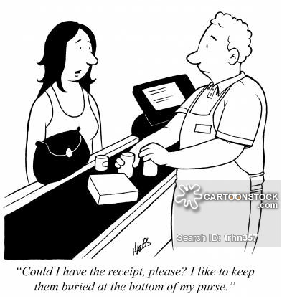
The importance of keeping receipts
Closed transaction is final
Return foods paid for with own money
Cannot return WIC foods
Benefit adjustments
Keep the receipt and bring to WIC
Notes:
Even though most of us don’t save our receipts, I can’t stress enough how valuable that final receipt is for WIC shoppers, especially if they had problems at the store. Here’s why.
Once the transaction is complete, the cashier can’t void it.
If they ended up paying for something with their own money, they can return it. That’s done at customer service and they’ll need their receipt.
Shoppers can’t return WIC foods – nothing has changed here. If they were charged incorrectly, they’ll need to call FIS customer service to initiate a dispute about the benefits deducted. Since benefits expire at the end of the month, this needs to be done right away. FIS can’t make any adjustments for past months.
Most importantly, they should keep the receipt to bring into the WIC clinic if something went wrong.

Slide 12
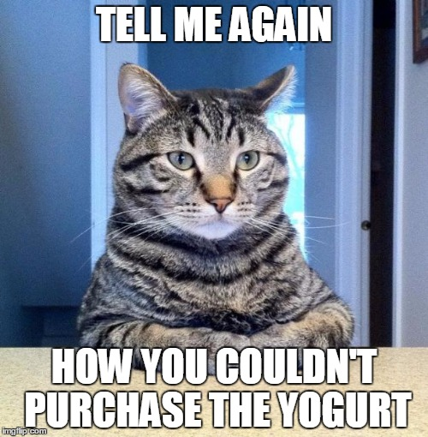
Notes:
Without receipts or pictures of what foods they tried to buy that wouldn’t go through, we often cannot do anything to help.

Slide 13
Notes:
Don’t forget the importance of the Food List. Cashiers can use it to help troubleshoot foods that don’t go through. Shoppers can use it to find the right foods, too.

Slide 14
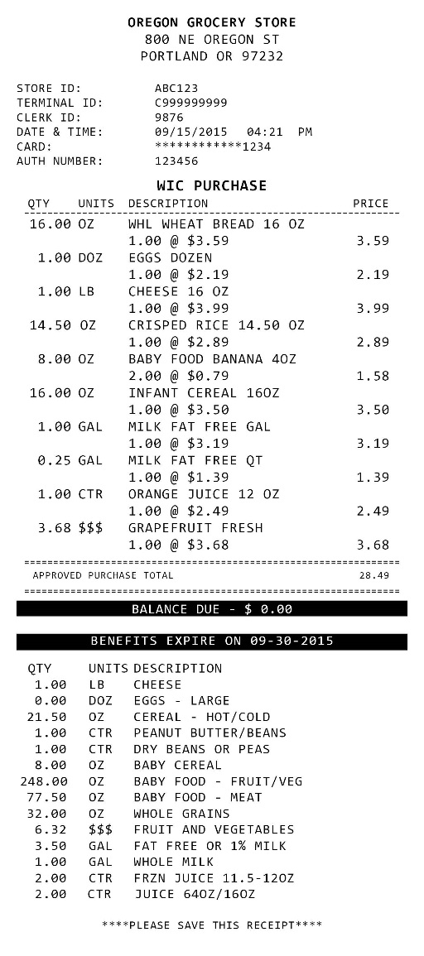
Magic receipt
Notes:
That final receipt is the magic key for figuring what happened during the transaction!
It shows the date and time of the transaction.
It identifies the cashier– either a name or employee ID number.
When we contact a store to follow up on a complaint, they always want to know who the cashier was so they can provide training.
It shows what WIC foods were purchased.
It will also show anything purchased with their own money.
It’s useful to look at those items to figure out why it didn’t go through for WIC.
The receipt always shows the beginning and ending WIC balance. Both can be used to troubleshoot why something didn’t go through. And the ending balance can be used for their next shopping trip.
It will also show how any discounts or coupons were applied.
That receipt greatly improves our ability to figure out what happened at the store. And then what shopper or vendor education is needed.

Slide 15
Questions?
Notes:
The end.

