Slide 1
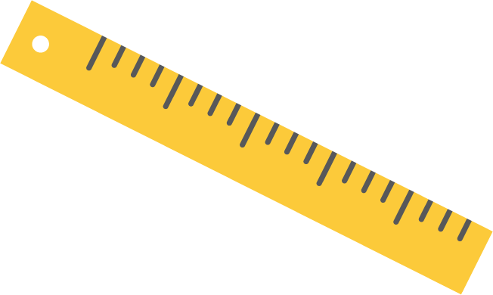
Let’s Talk About Growth
WIC In-service
All certifiers must complete this in-service by 5/30/2020.

Slide 2
Objectives for this in-service
After completing this in-service, certifiers will be able to:
Identify potential measurement errors and correct them.
Interpret growth graphs correctly.
Demonstrate how to offer growth information neutrally.

Slide 3
A child’s growth is something most caregivers want to talk about.

Slide 4
Growth is something caregivers can see. They understand that increases are expected and good. They can share this information with others who love their child.

Slide 5
Caregivers know that each child is different…

Slide 6
…but lots of things influence their hopes and expectations…

Slide 7
…and percentiles may be seen more like a grade than a measurement.

Slide 8
Activity: What kinds of things have you heard caregivers say about their child’s growth?

Slide 9
So, how can we translate measurements into understandable growth information for caregivers? We can: Take accurate measurements Interpret growth graphs correctly Consider culture and environment Communicate information clearly

Slide 10
The Basics

Slide 11
Why do we take length, weight and head circumference measurements?
It gives us clear, accurate, objective growth data that is entered into the data system.
It is used for mathematical calculations that generate percentiles and risks. The math and the risks are defined by USDA.
Measurements are tracked over time and plotted on graphs that give a picture of growth patterns or trends.

Slide 12
What do you do with the information?
Before providing counseling, consider the information provided by measurements, percentiles, assigned risks, and growth charts.
Use this information to support your critical thinking and see the bigger picture.
Consider who needs to know this level of detail. Often the information helps the counselor more than it helps the participant.

Slide 13
Anthropometric related risks
Anthropometrics refers to measurements of the human body.
Anthropometric related risks are risks based on measurements. USDA has assigned 100 level numbers to all anthropometric risks.
Anthropometric risks are automatically assigned to participants by the data system based on data entered on the medical data screen.
Risk levels (low, medium, high) are automatically designated by the data system based on the risks that are assigned.
Critical thinking is used to confirm that accurate measurements have been taken and that correct risks have been assigned.

Slide 14
Most risks and risk levels are assigned based on a single set of measurements entered into TWIST
103 – Underweight Infants and Children (High risk) based on current weight for length
113 – Overweight Children 2-5 years (Medium risk) based on current BMI
114 – At Risk for Overweight Children 2-5 years (Medium risk) based on current BMI
115 – High Weight for Length under Age 2 years (Medium risk) based on current weight for length
121 – Short Stature (Low risk) based on the current height
141 – Low Birth Weight (High risk) based on birth weight
153 – Large for Gestational Age (Low risk) based on birth weight
152 - Low Head Circumference (Low risk) based on the current head circumference

Slide 15
One risk is assigned based on comparing 2 sets of measurements entered in TWIST
135 – Infant Weight Loss Birth to 6 months (High risk) – based on 2 weight measurements entered in TWIST (compares birth weight to second measurement before 1 month, or compares two measurements that are at least 8 weeks apart)

Slide 16
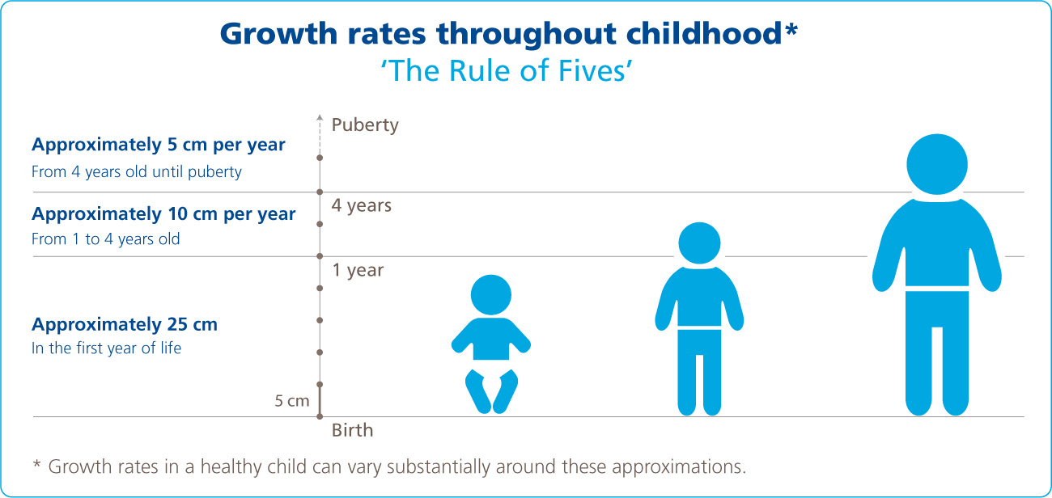
Definition of growth
We know growth is the process of increasing in physical size – which happens very rapidly from babyhood to childhood.
We expect that growth will occur at predictable rates within a predictable range depending on the child’s circumstances.
Those patterns have been studied and translated into growth grids that are used by health care providers to help make sure children are growing as they should.
From Novo Nordisk Research Website

Slide 17
Growth chart, growth graph, growth grid …different names for the same tool
What they are:
What they aren’t:
Growth charts are a visual representation of the growth patterns you can expect from infants and children.
Growth charts are used to compare a child's height, weight and head size with children of the same age and sex.
Growth charts don’t diagnose health conditions.
Growth charts don’t tell the whole story about a child or their growth and development.

Slide 18
TWIST selects the appropriate growth chart
TWIST automatically selects the appropriate growth chart based on the child’s age and sex entered in client demographics.
There are different growth charts for girls and boys.

Slide 19
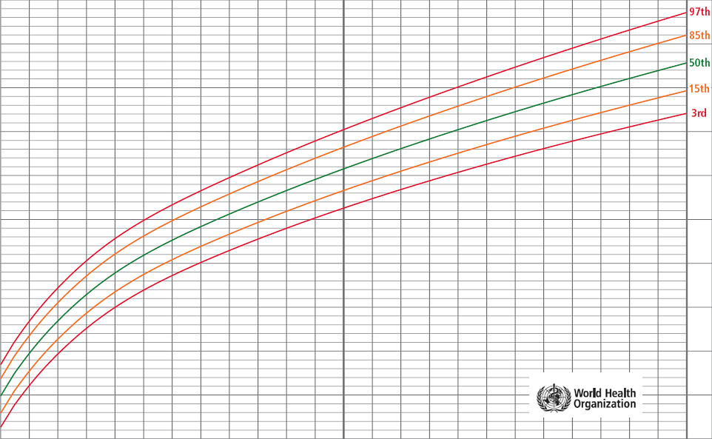
Growth charts used in WIC
Infants, birth to 24 months from the World Health Organization (WHO) graphs
Weight-for-age
Length-for-age
Weight-for-length
Head circumference-for-age
Children, 2 to 5 years from Center for Disease Control (CDC) graphs
Weight-for-age
Height-for-age
Body mass index-for-age
Weight-for-height

Slide 20
WHO versus CDC growth graphs
WHO graphs
CDC graphs
CDC recommends use of these graphs for all children from birth to 24 months.
WHO growth charts reflect growth patterns among children who were mostly breastfed.
They illustrate the growth of healthy children living in well-supported environments throughout the world including the United States.
CDC adopted the use of WHO graphs in 2006.
CDC growth charts are recommended for use from age 2 to 20 years of age.
These charts reflect the growth patterns of children who were mostly formula fed in the United States during the 1970s to 1990s and were updated in 2000.

Slide 21
Body Mass Index (BMI) graphs
BMI is a weight-to-height ratio, calculated by dividing a person’s weight in kilograms by the square of the person’s height in meters.
BMI is used as an indicator of obesity and underweight beginning at 2 years of age when an accurate height can be obtained.
BMI-for-age charts are used in place of weight-for-height charts to help determine whether an individual’s weight is appropriate for their height.
It is difficult to describe BMI calculations so many counselors simply use weight for height terminology when talking with caregivers about their children’s growth.
Consider this:
Note the words used in this information – “indicator,” “help determine.” This means that BMI is not a diagnosis of obesity or underweight. BMI is another tool that we use to assess health risk. If we see a risk assigned, we know to explore further.

Slide 22
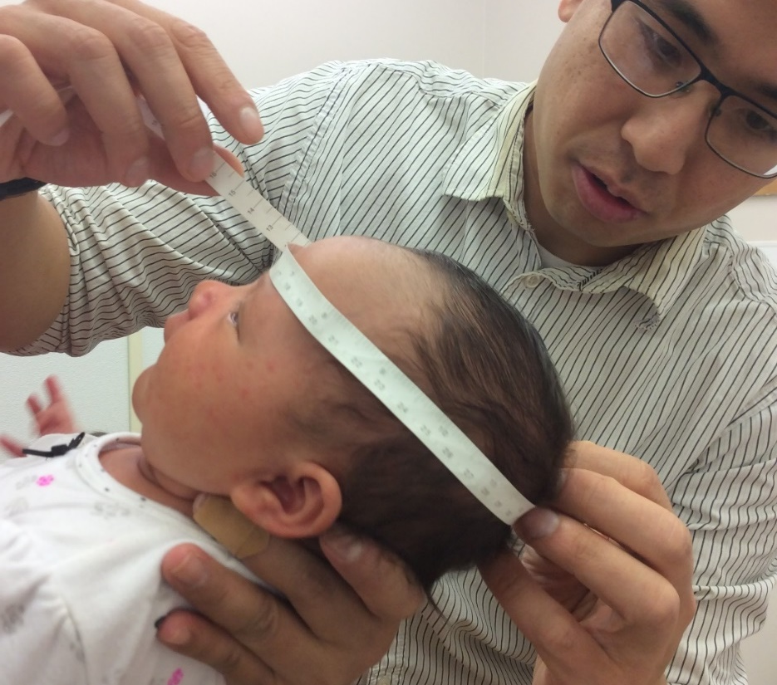
Head circumference graphs
The American Academy of Pediatrics recommends taking children’s head circumference measurements as part of assessment of healthy growth and to help detect potential growth issues such as microcephaly and macrocephaly.
Specific head circumference graphs are available in the data system.
These graphs are sometimes called OFC graphs or Occipital (back of the head) Frontal (front of the head) Circumference graphs.

Slide 23
Growth charts show percentiles
Percentiles are commonly used to assess the size and growth patterns of individual children.
Percentiles show how a child compares to other children of their age and sex.
On the growth charts, percentiles are shown as lines drawn in curved patterns.
The higher the percentile number, the bigger a child is compared to other children of the same age and sex.
You have heard the explanation:
“If a child's weight is at the 50th percentile line, that means that out of 100 girls her age, 50 will be bigger than she is and 50 smaller. If she is in the 75th percentile, that means that she is bigger than 75 girls her age and smaller than 25.”

Slide 24
TWIST shows percentiles on the Medical Data screen
Weight percentile
Height percentile
BMI percentile

Slide 25
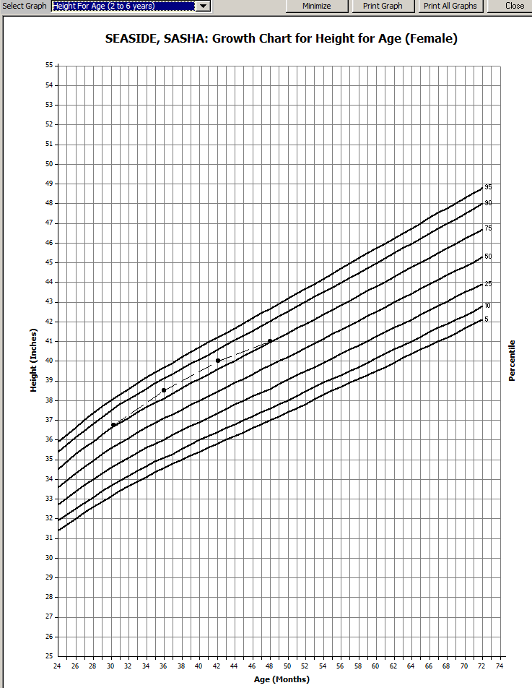
Growth charts plot measurements on the graph and then overlay percentile curve lines.
Growth charts show the trend of a child’s growth over time.
The growth chart plots the information entered on the Medical Data screen.
The growth chart does not generate risk.

Slide 26
Percentage versus percentile (or—math is hard!)
A percentage represents a proportion out of 100.
Example: 3 out of six is the same as 50 out of 100, or 50%. So if you took a test and got half correct, you scored 50%.
A percentile represents how things are distributed. For a given set of data, it is the level below which a certain percentage of data falls.
Example: If you scored in the 75th percentile on an exam, it means you scored higher than 75% of all people that took the exam. It has nothing to do with your actual score. If you scored 50% on the exam, but 75% of the people that took the exam scored less than 50%, you would be in the 75th percentile.

Slide 27
Think about percentiles and percentages and consider how caregivers might interpret that information…
Higher scores are better
Bigger is better
Smaller is not good

Slide 28
Activity: Think carefully before sharing growth grid details with parents…
In what situations do you think sharing the growth grids will help?
In what situations do you think sharing the growth grids will cause confusion?
In what situations do you think sharing the growth grids will support the counseling you want to provide?

Slide 29
How does TWIST interpret measurements?

Slide 30
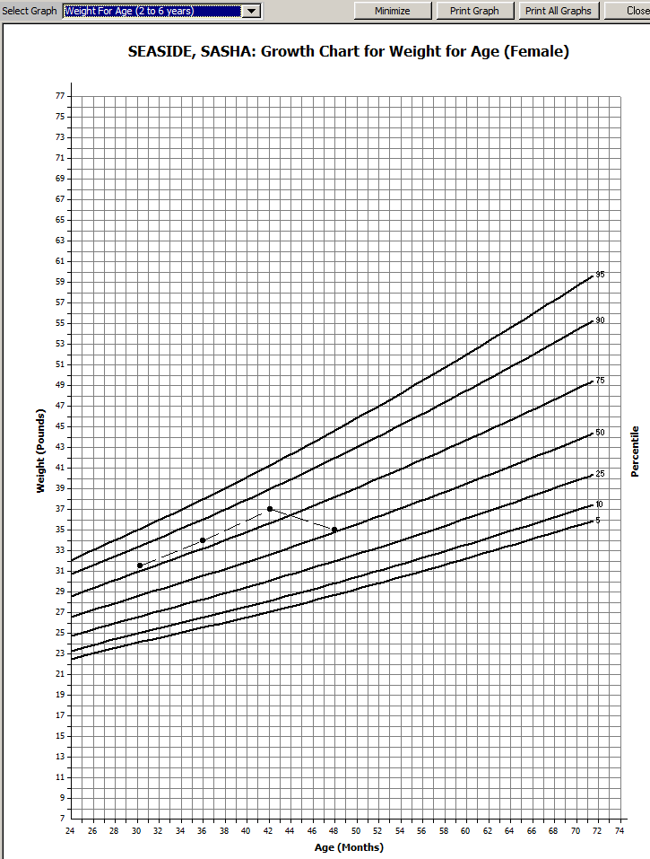
How is measurement data used in TWIST?
Measurements that are entered on the medical data screen in TWIST are used in two ways:
To determine risks.
To prepare or plot growth graphs.
These are two different functions in TWIST.
This is why the percentiles on the medical data screen do not always match the percentiles displayed on the growth graphs.

Slide 31
How do medical data screen calculations differ from growth chart plotting?
Growth graphs:
TWIST uses CDC data to build the structure of the graphs (the percentile lines).
Measurements are plotted on the graphs based on the measurements and age, not percentiles.
Age is rounded up or down to the nearest week.
Plot points can appear above the 99th percentile or below the 0 percentile.
No risk assignment occurs with this functionality.
Medical data screen:
TWIST uses CDC data to calculate percentiles based on the measurements and age entered in TWIST.
Risk determination is made based on these calculations.
Percentiles cannot be displayed on the Medical Data screen when they are above the 99th percentile or below the 0 percentile.
Age is calculated to the day.
Measurements are saved in the participant’s record.
Graphs are recreated every time they are opened in the participant's record.

Slide 32
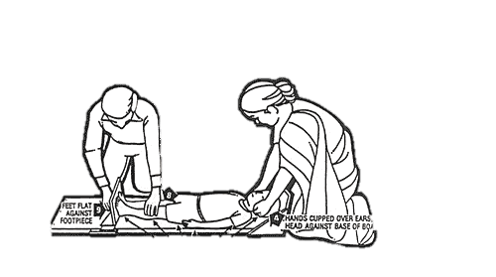
What other factors may affect what is viewed on the medical data screen vs a growth chart?
When a child turns 2 years old, they shift over to a different growth chart.
From birth until 24 months of age, TWIST uses the World Health Organization (WHO) growth charts.
After 24 months of age, TWIST plots on the Center for Disease Control (CDC) growth charts and begins calculating BMI instead of weight for length.
There will be a slight correction in percentiles when moving from one growth chart to the other.
If you measure a child lying down between the age of 2 and 3, select “recumbent” to get the correct growth chart.

Slide 33
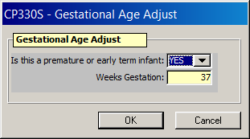
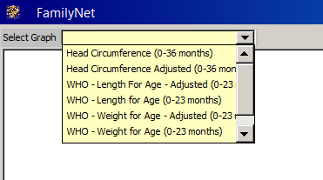
Age adjustment is another factor that can make a difference in what is displayed
Age adjusted graphs will show percentiles that are based on the adjusted age. They will be different than what is listed on the medical data screen as those percentiles are based on chronological age.
Age adjusted graphs become available when a child is marked as preterm in the Gestational Age Adjust field on the Medical Data screen.
Both Age Adjusted and regular growth grids are available to view.

Slide 34
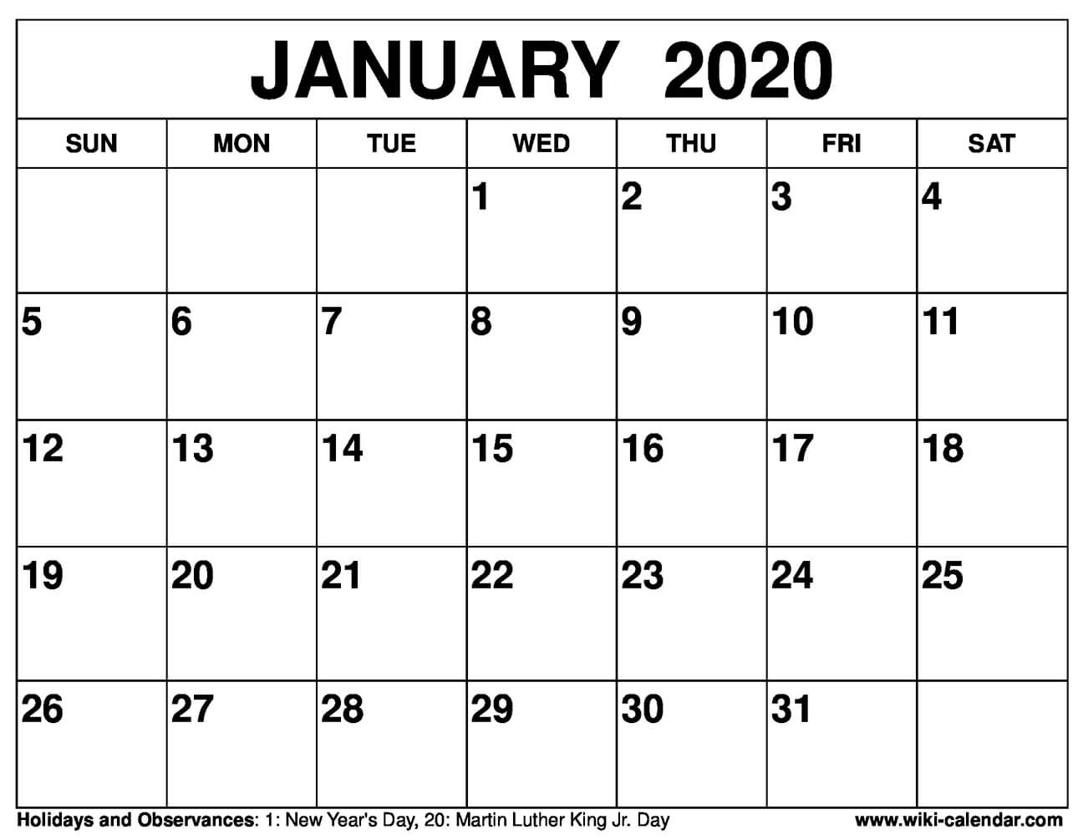
Graphing age adjustment
Age adjustment means you are adjusting the graphs to accommodate the difference between the infant’s actual age and the age they would be if they had been born on their due date.
Chronological age = the age since birth, their actual age in days
Adjusted age = the chronological age minus the number of weeks that they were born preterm.
Example:
Taylor was born on 1/1/2020 (Actual Delivery Date or ADD).
Taylor’s due date was 1/29/2020 (Estimated Delivery Date or EDD).
Taylor was born 4 weeks before his due date.
On 2/26/2020, Taylor’s chronological age is two months.
When you subtract 4 weeks for Taylor’s early delivery, on 2/26/2020 his adjusted age would be one month.
ADD
Age Adjust
EDD

Slide 35
How does age adjustment impact growth graphs?
Age adjustment is calculated by taking the number of weeks of prematurity and subtracting that from the chronological age as shown on the last slide.
Activity: Take a look at the 2 graphs on the next slide.
How did the percentiles change?
Would age adjustment make a difference in how you talk about the child's growth?

Slide 36
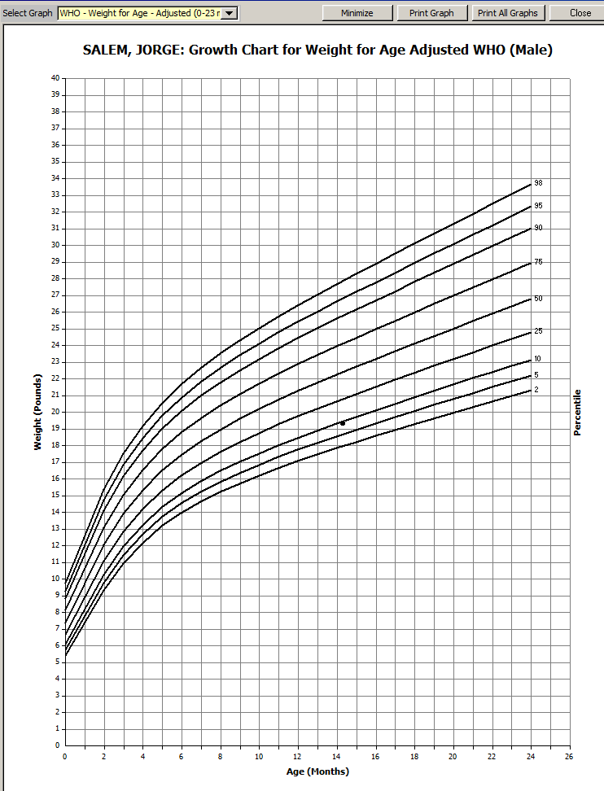
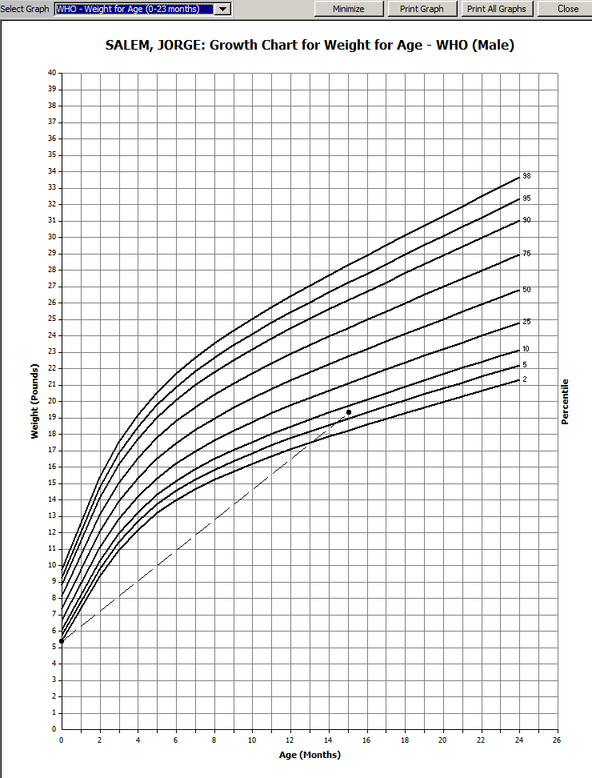

Slide 37
Making sure the data is correct

Slide 38
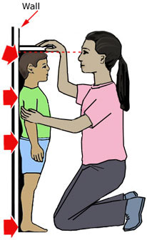
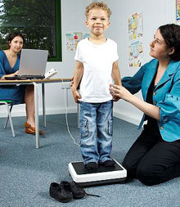
It starts with accurate technique
Since risk factors are assigned based on measurements entered in TWIST, it is important that measurements are taken correctly.
Every 1/8 inch or ounce makes a difference.
Common errors
Leaving on heavy clothing and/or shoes when weighing
Leaving on wet or dirty diapers when weighing
Holding something while being weighed
Forgetting to have a caregiver hold the infants head against the head board when measuring length
Not holding both legs straight when measuring infants
Not removing hats or hair accessories when measuring height
What issues do you have with taking measurements?

Slide 39
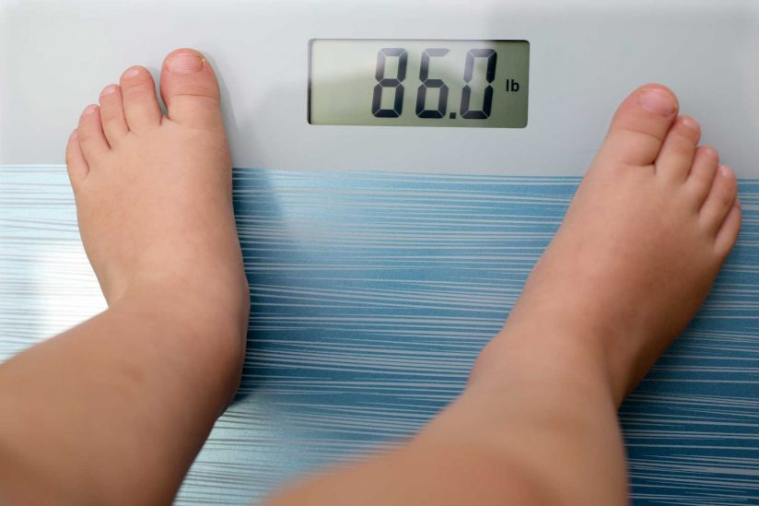
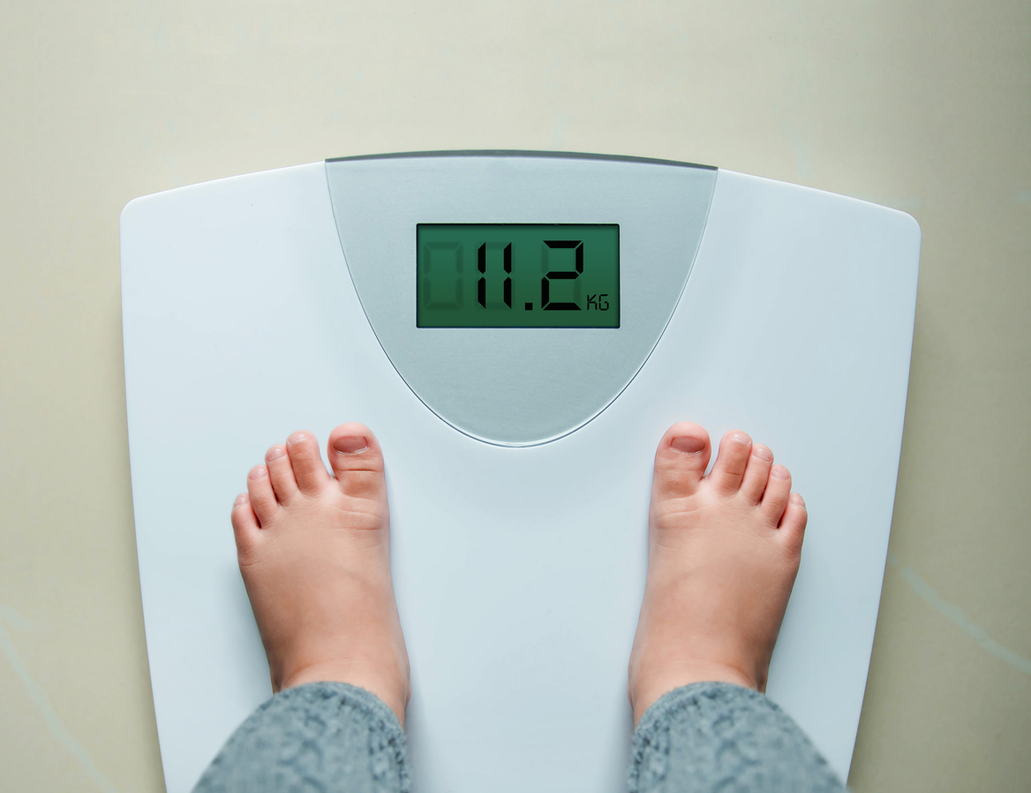
Importance of accurate documentation
TWIST calculates risk based on what you enter, so if you enter it wrong the calculation is wrong.
Common errors
Not double-checking any measurement that seems wrong.
Entering a decimal measurement as ounces (e.g. .2 pounds is 3 ounces, not 2 ounces).
Not writing the measurements down, and entering them from memory.
Not double-checking that what you entered matches the measurements you took.
Rounding measurements up or down.
Mixing up lbs with kg or in with cm.

Slide 40
When to recheck measurements
Sometimes we need to re-do measurements, if growth patterns look off.
Times to recheck:
There is no change since the last measurements
The participant has “shrunk” or lost weight with no explanation
The percentiles (BMI, weight for age, length for age) shown in TWIST have changed significantly since the last measurements
Weight or height loss
Significant Percentile changes

Slide 41
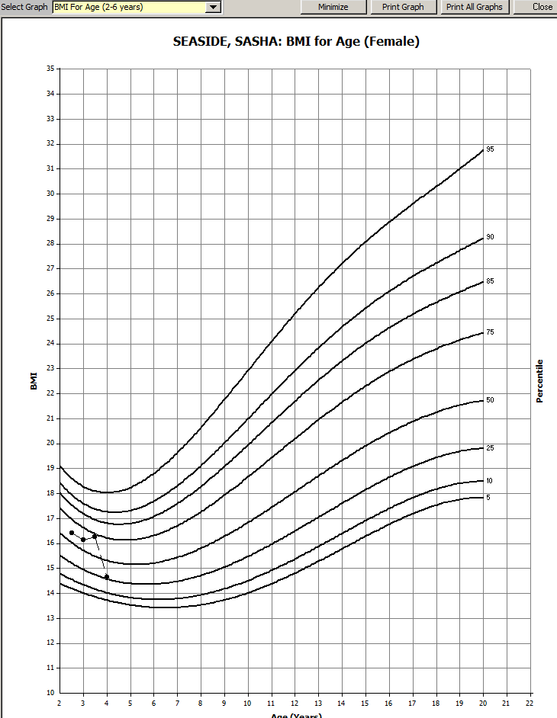
Use the growth grids to explore further if something looks odd.
If you can’t tell from the percentiles, look for changes in patterns on the growth grids.
Which measurement might be an error?

Slide 42
Fixing or removing errors from incorrect measurements or inaccurate data entry
You can correct data entry errors or measurement errors in TWIST on the same day that the entry occurred. After that, the data becomes a permanent part of the participant’s record.
Document the error in Medical Notes on the Medical Data screen if it is discovered later.
Changing the measurement in TWIST does not correct any errors in risk assignment.
If you make any changes to measurements, you must also review the risks that were assigned and make corrections if needed.

Slide 43
Handling measurements from other sources (e.g. doctor’s offices, home visits)
Make sure the date you enter in TWIST is the date the measurements were actually taken, not the date you entered them in TWIST.
The date is used by TWIST to calculate age at the time of the measurement.
Common error: TWIST defaults to today’s date when you add a row in the medical data screen. Staff often forget to change it to the date the health care provider took the measurements, resulting in the wrong age associated with that measurement.
You must document where the measurements came from if they were not taken in WIC.
Document this information in Medical Notes on the medical data screen next to the measurement.

Slide 44
Activity: Discuss this case study
Jess brings in measurements from 18-month old Jo’s doctor appointment a week ago. When you enter the measurements on the Medical Data screen, you check out the percentiles and growth grids. You notice that it appears that Jo has not grown since being measured in WIC at age 12 months.
What could be one reason for the apparent lack of growth?
What possible errors could you check for?
What would you do next?

Slide 45
What do the growth charts tell us?

Slide 46
We use growth charts to look for trends and patterns.

Slide 47
Growth charts do not assign risks, they support critical thinking.
Growth chart info
Critical thinking
Path to good NE

Slide 48
What is “normal” growth?
Normal growth is the progression of changes in height, weight, and head circumference that we can expect based on established standards for a given population.
For example:
Length/height growth rates vary according to age.
From birth to 6 months, an infant can grow from 1/2 to 1 inch a month and total 7 to 10 inches of growth during the first year.
During the second and third year, growth averages 2 to 3 inches.
From age 4 years until puberty, growth is usually about 2 inches per year.
Weight gain for an infant averages 5 to 7 ounces a week.
Most babies double their birth weight by about age 5 months.
After the first year, most children will average weight gain of about 4 to 6 pounds per year.

Slide 49
Critical thinking 1: Compare a child’s growth to normal growth patterns
Normal growth patterns are shown by the lines on growth graphs. The growth graphs show the normal variations of growth you can expect for most children by age.
We interpret growth patterns by using growth graphs to compare a child’s measurements to others of the same age and sex.
If you only have one measurement to plot on the graph, look at the placement of that plot point. Is it high, middle or low on the growth chart?

Slide 50
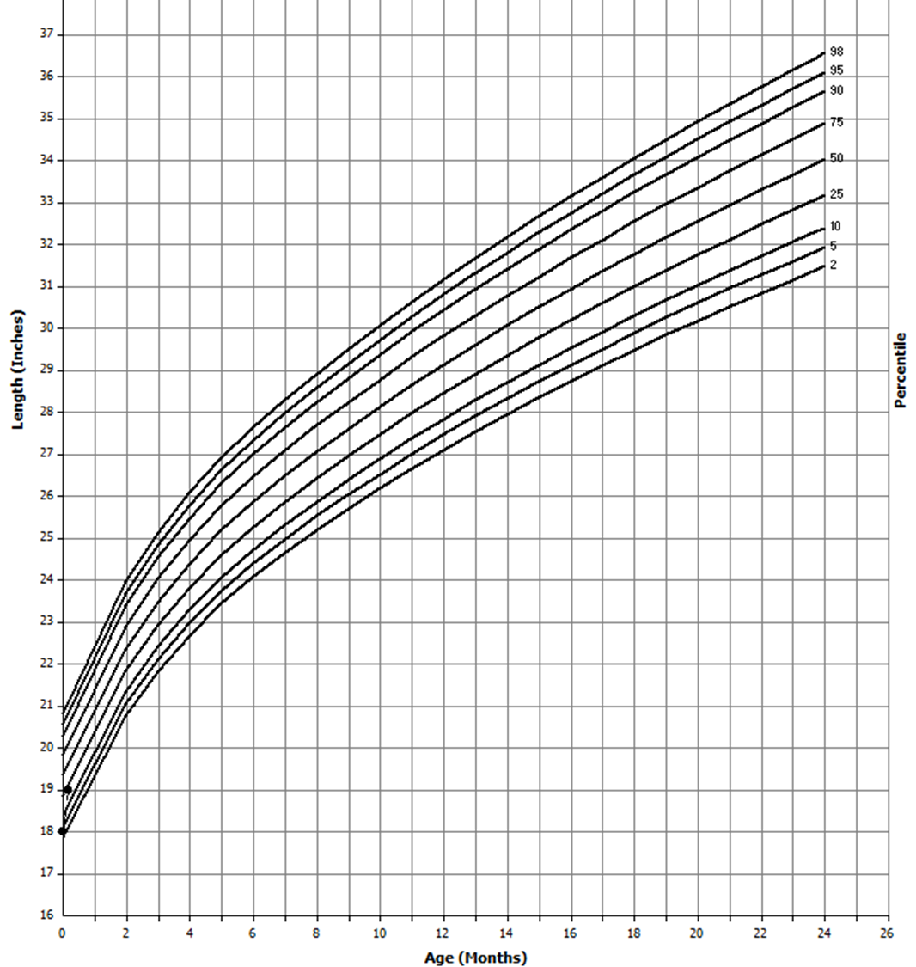
Where is the single measurement on the growth chart?
Between the 25th and 75th percentiles, child is around the average size for a child of that age and sex.
Between the 25th and 5th percentile, child is smaller than most of their peers.
Between the 75th and 95th percentile, child is larger than most of their peers.
Below the 5th percentile, child is underweight or short for their age and sex.
Above the 95th percentile, child is overweight or tall for their age and sex.

Slide 51
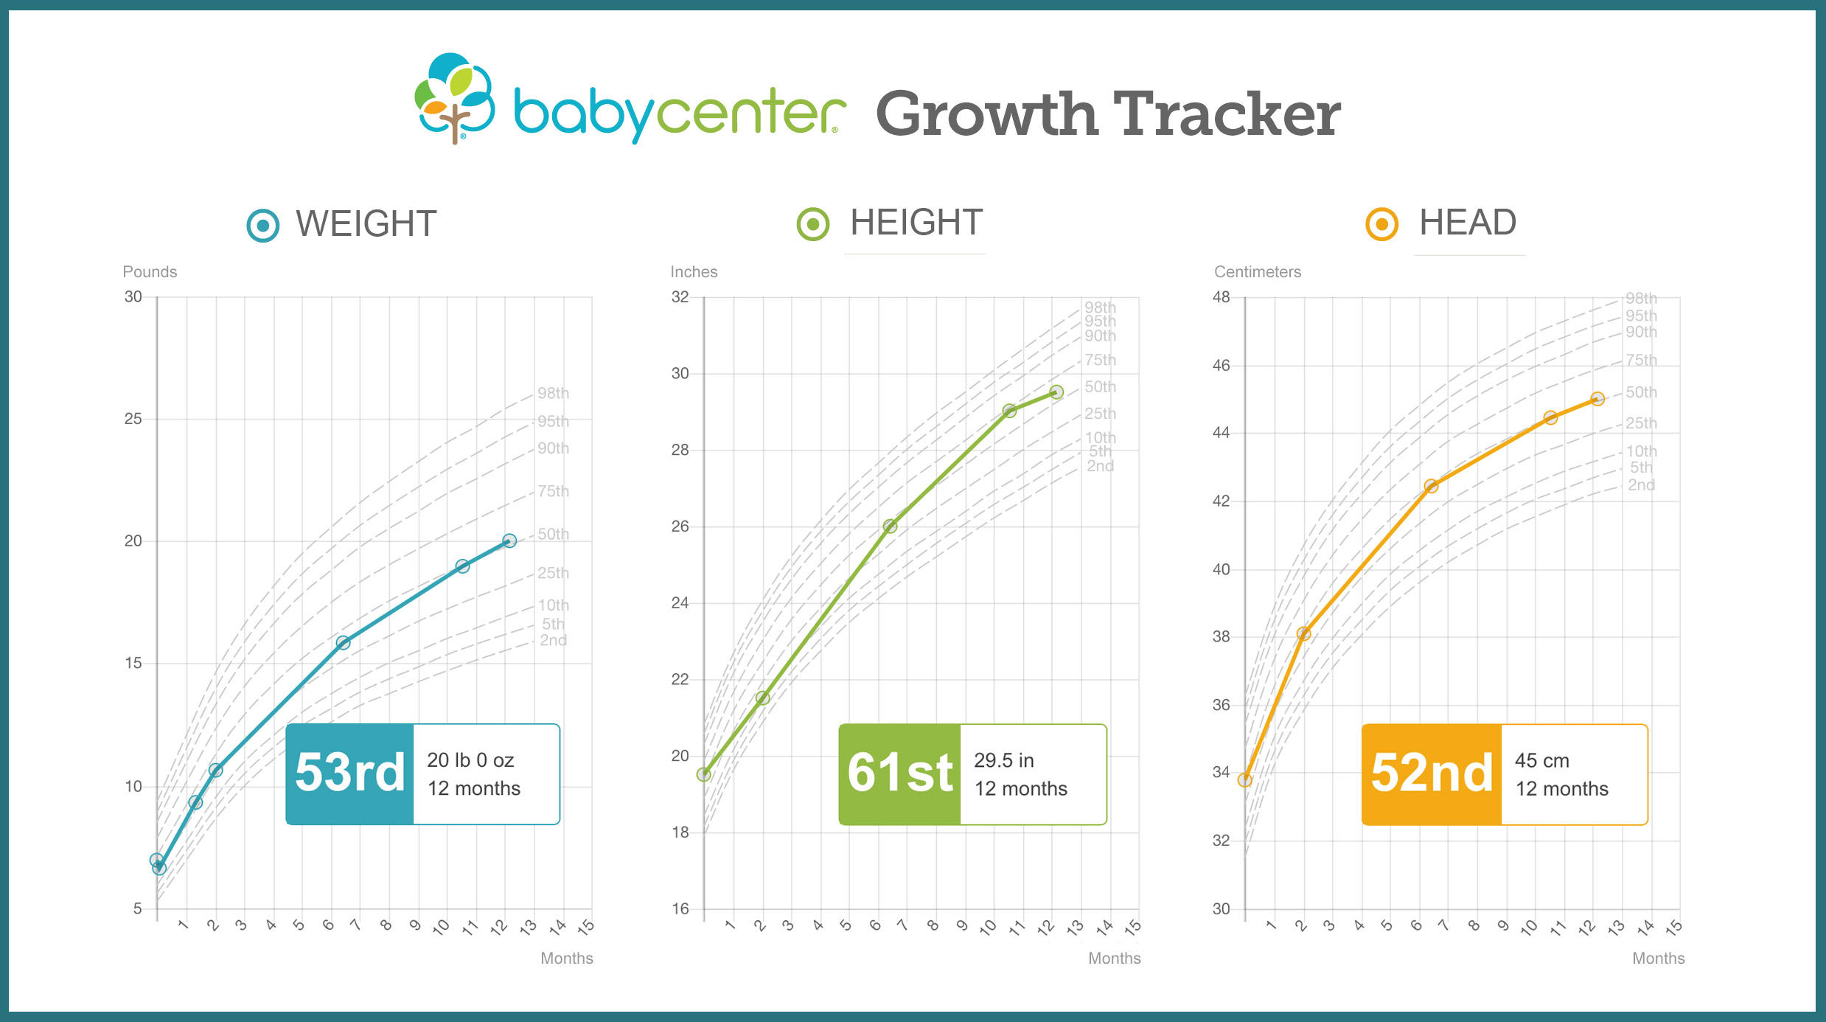
Critical thinking 2: What is a normal growth pattern when you have more than one measurement?
If you have multiple measurements, you begin to see a pattern of growth over time.

Slide 52
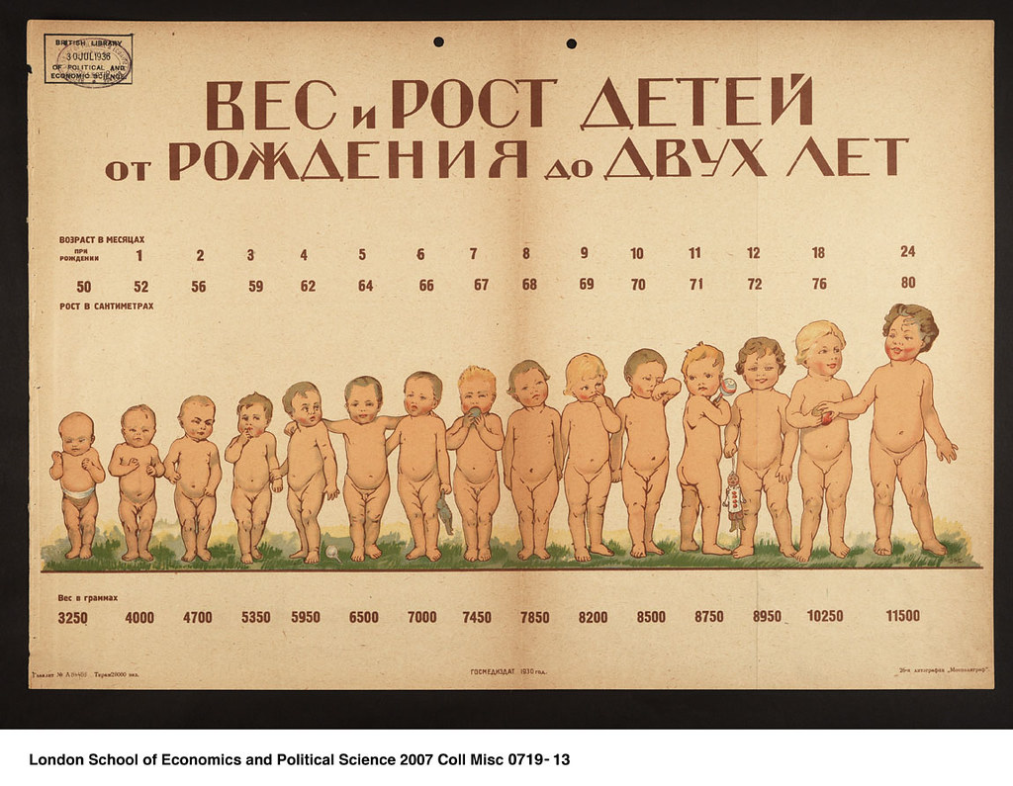
What are normal changes in growth patterns?
Growth rate changes over time. This is illustrated by the curve in growth curves.
Babies do most of their physical growth during their first year. Growth slows after 12 months of age.
Toddlers gain weight at a slower rate during the second year. They are moving more and begin to lose the “baby” look as the stores of fat disappear and the child appears more slender.
After the first year, children experience variations in their rate of growth. They can be hungrier when growing faster and have a smaller appetite when growth slows.

Slide 53
These changes in growth rate is why the infant growth grids bend rather than go in a straight line. You can see how their growth rate slows down.

Slide 54
The BMI graph takes a dip because of these normal changes in growth.

Slide 55
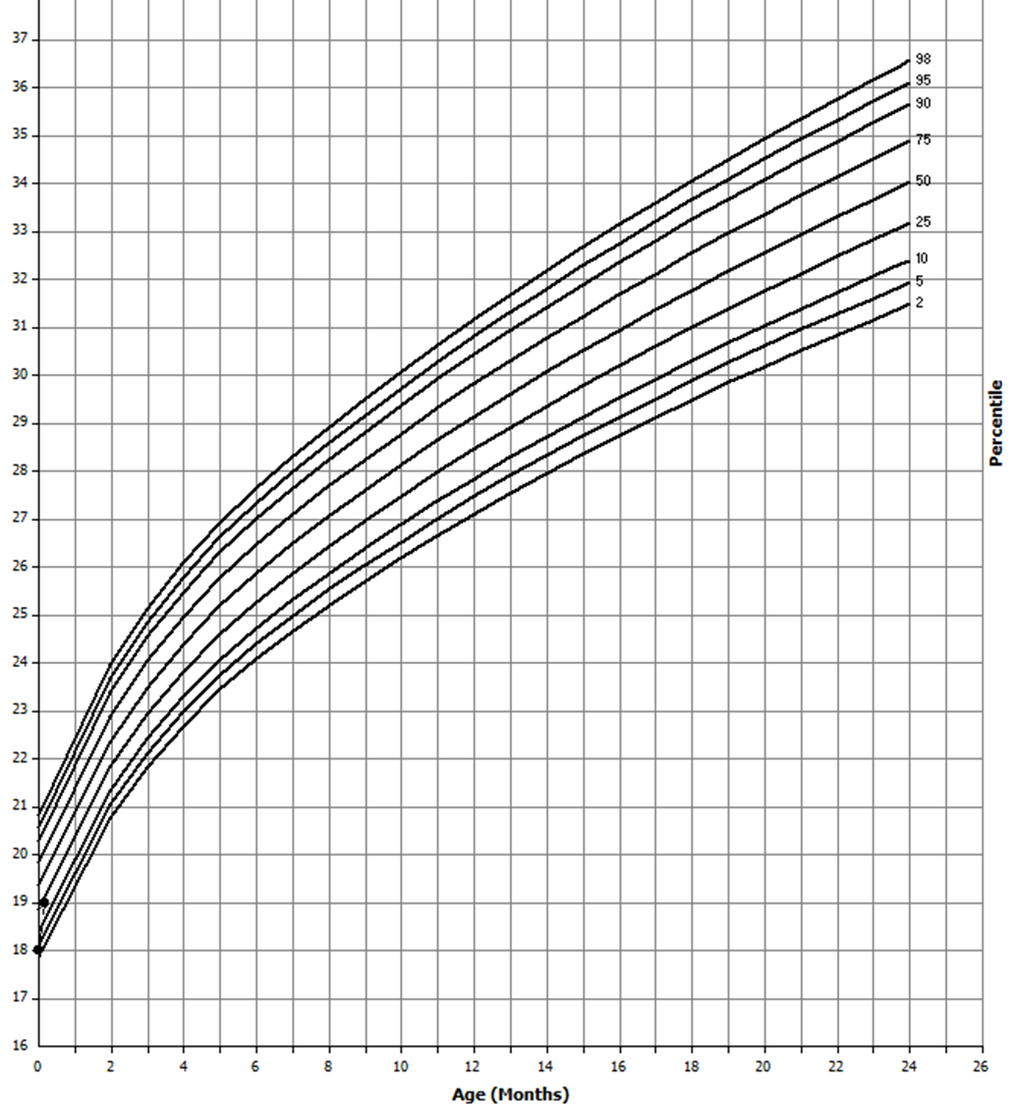
Following a pattern
Remember – it is more important that children stick to an expected pattern, than where the pattern falls on the growth grid.
Consider how the child’s growth fits with family tendencies and family history.

Slide 56
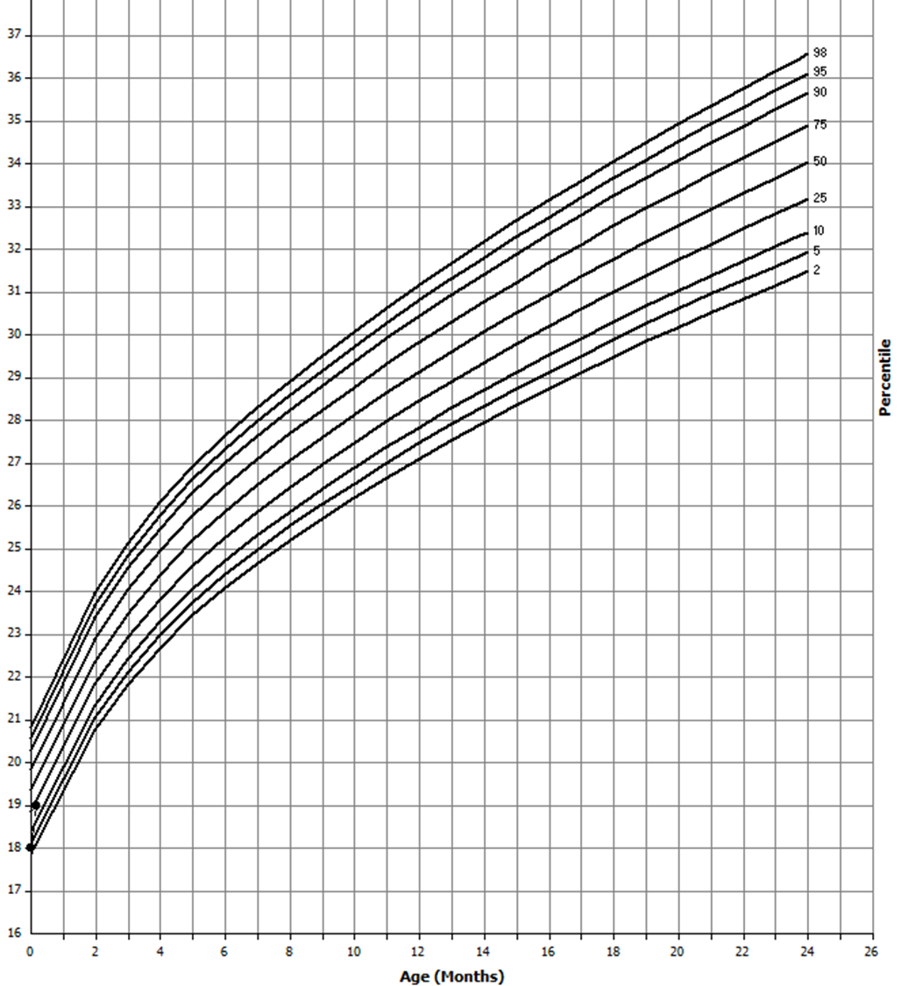
Following a pattern
Higher on the curve may mean the child is part of a family that tends to be taller or heavier.

Slide 57
Following a pattern
Lower on the curve could indicate a family history of being smaller.

Slide 58
Critical thinking 3: Consider weight for length/height
In addition to length for age and weight for age, we also want to look at weight for length or BMI.
Weight for length and BMI graphs show how well a child’s weight matches his or her length. This is less about comparing a child to their peers and more about comparing them to themselves.
No matter how tall or short a child is in comparison with their age group, we want their weight to match their height.
A child can be very tall or very short on their length for age graph but be right at the average for their weight for length when their weight measurements match their height measurements well.
Significant shifts up or down in weight for length or BMI can be a cause of concern.

Slide 59
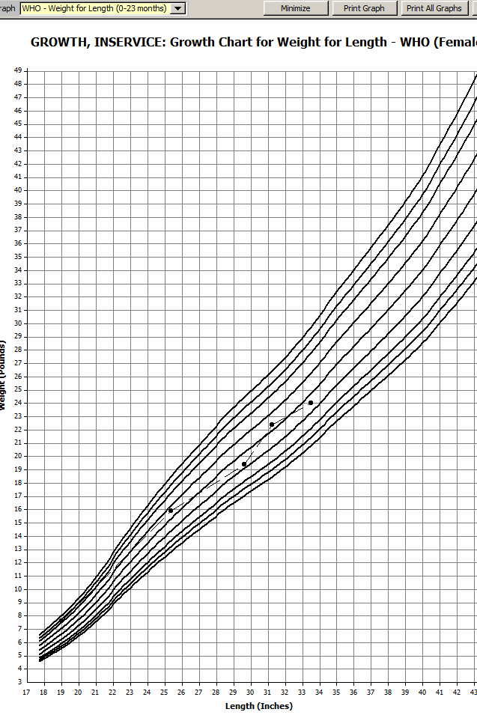
Critical thinking 4: Recognizing growth spurts or trends
What if the growth curve is not smooth, but creates a “zig-zag” pattern?
Children can have growth spurts where they get taller and thinner for a period of time, followed by a period of time when their growth slows and their weight catches up. This pattern may show as “stair steps” or a “zig-zag” pattern on a graph rather than a smooth curve.
If the pattern is still predictable and doesn’t cross more than two percentile lines, it is not an indicator of a concern.

Slide 60
Activity: Interpret growth charts
When there are several measurements to plot on the graph, we can look for a pattern. The patterns can be consistent with predictable growth or inconsistent with the progress you would expect to see.
Over the next few slides, look at the graphs and identify trends or growth spurts.
Assume that all measurements are accurate and entered correctly in TWIST.
Select the statement that best fits what you are seeing. Find the answer on the following slide.
This statement is to assist you with categorizing what you are seeing…not to specifically share with the child’s caregiver.

Slide 61
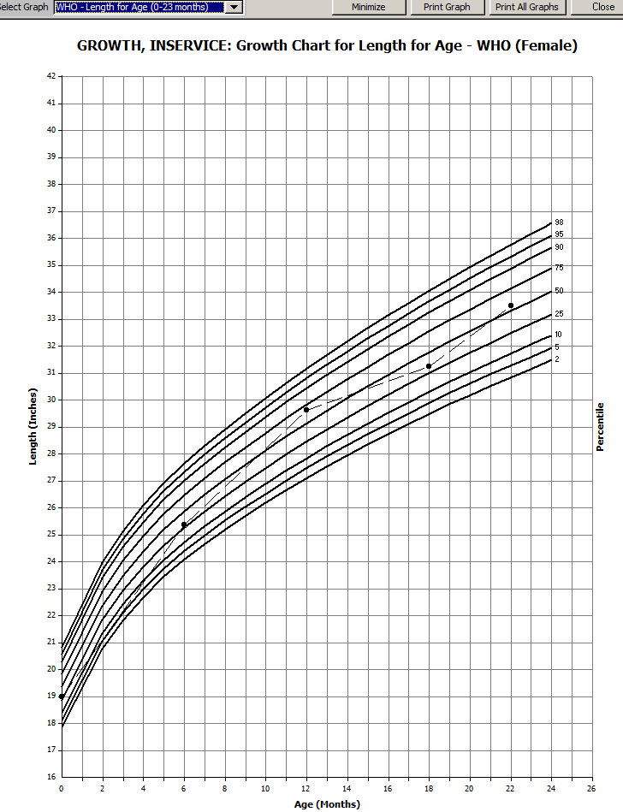
How would you interpret this growth chart?
A. Child is an average size but growth is inconsistent.
B. Child is an average size with predictable growth including occasional growth spurts.

Slide 62
How would you interpret this growth chart?
A. Child is an average size but growth is inconsistent.
B. Child is an average size with predictable growth including occasional growth spurts.
Because measurements are within one channel line on either side of the 50th percentile.

Slide 63
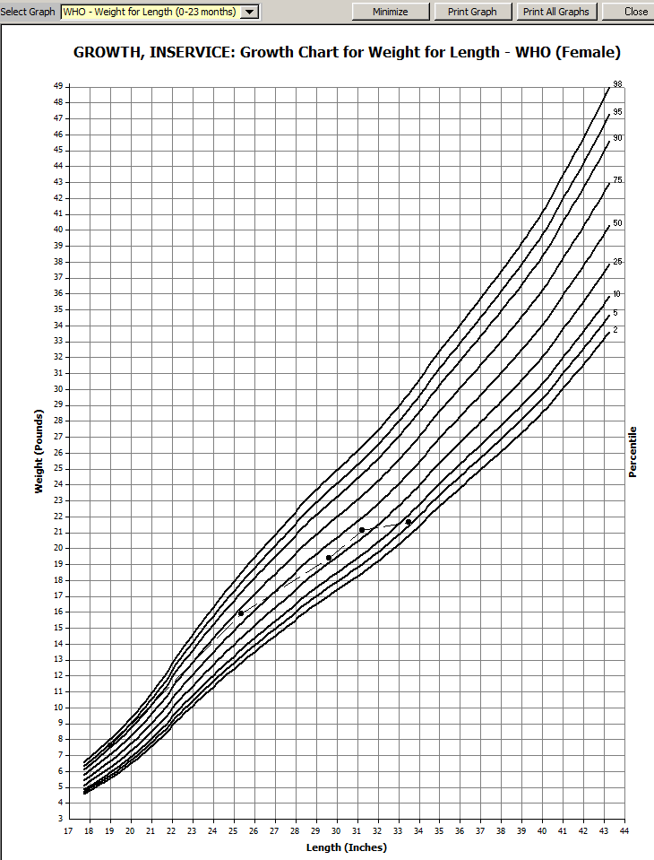
How would you interpret this growth chart?
C. Child’s weight for length is not what would be expected.
D. Child’s weight for length shows expected progress.

Slide 64
How would you interpret this growth chart?
C. Child’s weight for length is not what would be expected.
Because the measurements cross 2 percentile lines between the last 2 appointments.
D. Child’s weight for length shows expected progress.

Slide 65
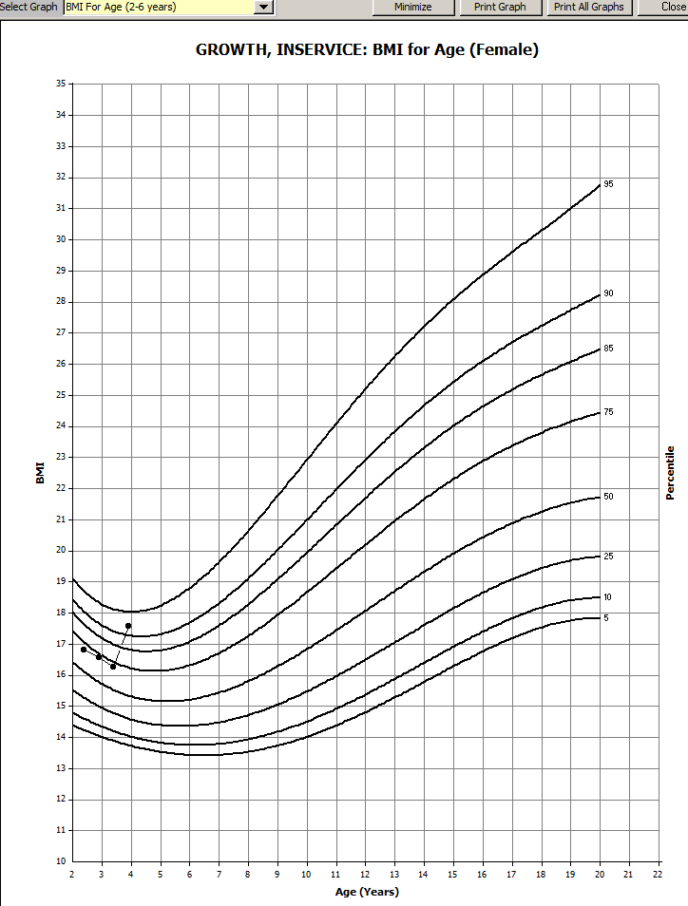
How would you interpret this growth chart?
E. Child’s weight for height is typical for their age.
F. Child’s weight for height shows trending that is not as expected.

Slide 66
How would you interpret this growth chart?
E. Child’s weight for height is typical for their age.
F. Child’s weight for height shows trending that is not as expected.
Because the measurements cross 2 percentile lines between the last 2 appointments.

Slide 67
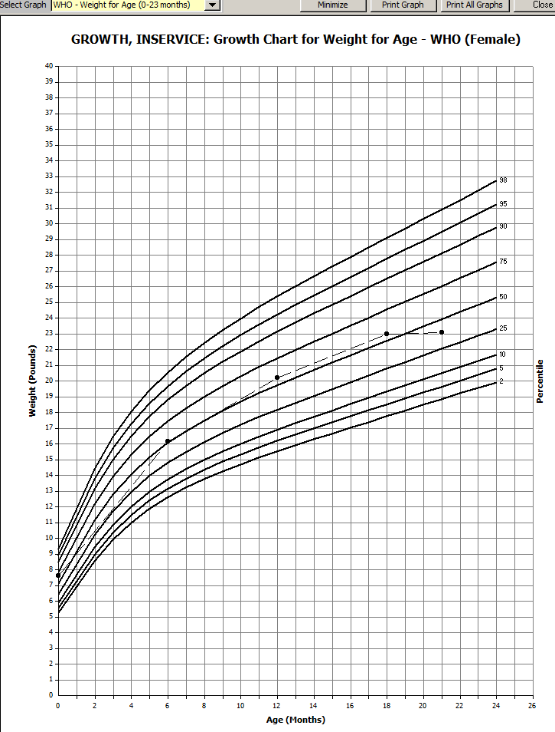
How would you interpret this growth chart?
G Child’s weight for age is average and increasing at an expected rate.
H. Child weight for age is average but they are not gaining at a steady rate.

Slide 68
How would you interpret this growth chart?
G Child’s weight for age is average and increasing at an expected rate
H. Child weight for age is average but they are not gaining at a steady rate.
Because there was no weight gain since the last measurement.

Slide 69
Critical thinking 5: When to refer to the WIC nutritionist?
Talk to your WIC nutritionist if you have any questions about an unusual growth pattern or concerns about a child’s growth.
Identifying unusual growth patterns or trends will help you make appropriate referrals to your WIC nutritionist.

Slide 70
Consider referring to the WIC nutritionist when you see these growth patterns:
Growth patterns show rapid shift up or down at any percentile.
Growth curves are significantly higher or lower than average.
Growth curves are not steady or expected.

Slide 71
Other times you might refer to the RD:
A referral is required if the child is designated as high risk in the data system.
Referrals can be made for medium and low risk participants if you have concerns about their growth.
Referrals can be made when food selection, feeding behaviors, medical or psychosocial issues may be affecting growth.
When the RD needs to make a referral to a health care provider.
Caregivers request an appointment with the RD because they have concerns.
Remember, when referring to the RD, write in progress notes any concerns that are identified during an appointment and any specific follow up needed.

Slide 72
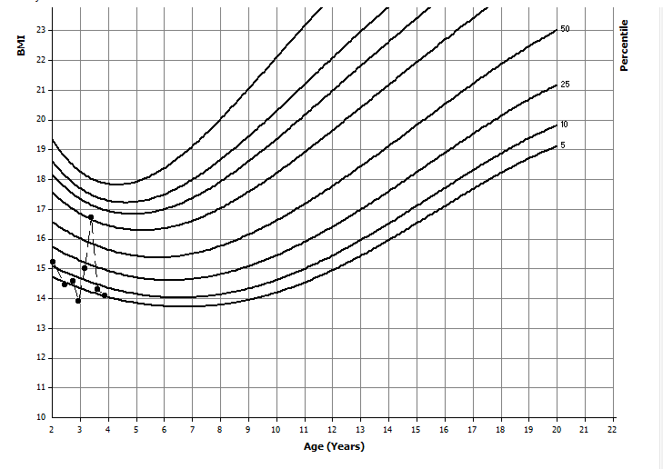
Activity:
What do the changes in pattern on the BMI grid mean?
Which measurement might be an error?
Would you make a referral to your WIC nutritionist?

Slide 73
How do we talk about growth with caregivers?

Slide 74
Sharing growth information with families
The information presented so far in this in-service is for the certifier’s use. It is part of the critical thinking that occurs internally. Although it could help guide growth conversations, it is not intended to be what is said directly to the participant’s family.
When discussing a child’s growth, keep in mind the family history regarding size and their cultural perspective (e.g., some cultures associate heavier children with healthier children).
Remember the difference in what you can determine from a single measurement on the graph (current size in comparison to others of the same age) versus a series of points on a graph (growth pattern or trend).

Slide 75
We start by sharing growth information neutrally.
Neutral means that we offer facts without any words or language that imply “good” or “bad.”
Provide the caregiver with the measurements collected at the current appointment, either in writing or verbally.
Tell them how much growth or weight gain has occurred since the last measurements WIC collected:
She has gained 3 pounds and grown 2 inches since we last weighed her 6 months ago
He has grown 1 inch in the last three months and gained 1 pound

Slide 76
Offering growth information neutrally
Instead of giving percentile numbers that can be difficult to interpret, offer an overview that describes the child’s growth in comparison to his or her peers
He is near the average size for boys his age and his growth looks steady.
She is just above the average for her age which matches where she was when we last saw her.
He is at the top of the typical range for his age group.

Slide 77
Avoid biased language
When talking about growth, use language that does not label or stereotype an individual. Some phrases can promote size bias or seem to be judgmental even when said in a conversational manner with a lighthearted tone.
Consider the possible negative impact the following terms could have:
chunky, hunk, fluffy, big boy, tiny little thing, buddha baby, roly-poly, heavyset, skinny, chubby, plump, bony, husky, scrawny, solid, stocky, lanky, wiry, petite, thin, slim, lean, slight.
If you choose to describe a child, focus on characteristics that all parents want for their children:
strong, smart, healthy, happy, bright, curious, focused, observant, sociable
Activity:
What words do you find yourself using to describe a child when you are assessing growth?
Think about how you can share growth information neutrally.

Slide 78
Should you review growth charts with families?
Reviewing growth charts with participants or their families is not required.
Explaining the growth chart does not count as nutrition education and should not take precedent over talking to the participant about their concerns.
If reviewing the growth charts supports nutrition-focused counseling and education, it can be left to the end of the appointment.
Activity:
Think of a situation where reviewing the growth chart improves or supports nutrition-focused counseling. Why? How did it help?
Think of a situation where reviewing the growth chart did not support nutrition-focused counseling. Why? How did it take away from counseling?

Slide 79
In summary, certifiers review current growth data and compare it to the past
Review present and past growth percentiles at each appointment. Look for consistency and trends.
Growth must be assessed at each appointment. However, looking at graphs at each appointment is not required.
Use critical thinking when deciding what the graphs tell you and what needs to be shared with caregivers.

Slide 80
Questions? Talk to your agency nutritionist or your state nutrition consultant.

Slide 81
Talking about growth versus size
In this in-service we talked about growth, interpreting growth graphs and sharing growth information with families.
In the next in-service, we will talk about discussing weight and size with families and how this can influence education and counseling.

Slide 82
For all you do!

