Slide 1
WIC Inservice
Implementation of WHO growth charts
and related risks
for infants and children

Slide 2
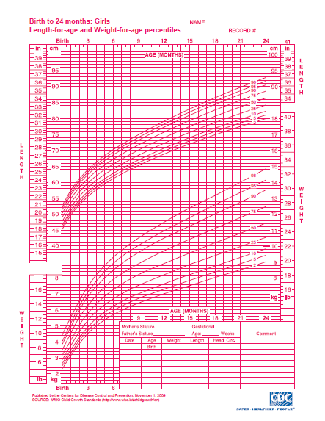
Background
Growth charts are a key tool used to interpret growth measurements

Slide 3
Activity
Discuss together:
How do you use growth charts?
When do you show growth charts to parents?
How do you describe the
graphs to parents?

Slide 4
History
From 1977 to 2000, National Center for Health Statistics (NCHS) charts used worldwide as a growth reference
Since 2000, Center for Disease Control (CDC) growth charts used as a growth reference for children age 0-20 years
April 2006, World Health Organization (WHO) released a new international growth standard for children age 0-5 years

Slide 5
Reference vs. Standard
A reference describes how children have grown in a particular time and place, gives a point of comparison, does not make a value judgment
A standard describes how children should grow, regardless of time or place, defines what is normal or optimal, allows for value judgments

Slide 6
CDC Growth Reference
Describes growth of children in the U.S. during the 1970s and 1980s
Based on data from national surveys and birth certificates
No special characteristics were required to be included in the data

Slide 7
WHO Growth Standard
Frequent data collection from birth to two years of age
Large number of observations completed internationally
Feeding requirements included:
Exclusive/predominant breastfeeding > 4 months
Complementary feeding by 6 months
Continued breastfeeding > 12 months

Slide 8
WHO Growth Standard
Optimal Nutrition
Breastfed with appropriate complementary feeding
+
Optimal Environment
Clean, safe, smoke free
+
Optimal Care
Access to immunizations and medical care
= Optimal growth

Slide 9
WHO Growth Standard
Hypothesis: Children throughout the world will grow similarly if exposed to optimal circumstances
Data collected in:
United States
Brazil
Norway
India
Oman
Ghana

Slide 10
Growth patterns from birth to 24 months from the 6 WHO countries

Slide 11
Recommendations for the U.S.
American Academy of Pediatrics (AAP), National Institutes of Health (NIH) and CDC recommend national use of WHO charts from birth to 2 years and continued use of the CDC charts from 2 to 20 years
USDA accepts recommendation for WIC

Slide 12
Oregon Implementation
WHO charts added to TWIST in December 2011
TWIST will continue to select and plot the appropriate charts for age:
WHO for children from birth to 2 years of age
CDC BMI charts for children from 2 to 5 years
CDC weight for length charts for children from 2 to 3 years if they cannot be measured standing up

Slide 13
Differences between Charts
WHO growth standards measured healthy children under optimal conditions so more extreme cutoffs are appropriate for children measured on WHO graphs
New cutoffs at the 2nd and 98th percentiles on WHO graphs
Continue to use 5th and 95th percentiles on CDC growth charts for older children

Slide 14
Differences between Charts
Fewer infants would be below 5th percentile on WHO weight-for-age charts
Fewer children will be identified as underweight or Failure to Thrive (FTT) especially from 6 to 23 months
More infants would be above 95th percentile on WHO weight-for-length
Formula-fed infants tend to gain weight more rapidly after 3 months and could be identified as overweight.
More infants would be below 5th percentile on WHO length-for- age charts

Slide 15
Comparison of WHO with CDC Weight-for-Age Percentiles for Boys
CDC: Dotted lines
WHO: Solid lines

Slide 16
Case Study
Compare the following growth charts for Sally
What are the differences between the CDC and WHO charts?

Slide 17
Three weight measurements for Sally plotted on the current CDC chart…

Slide 18
The same three weight measurements for Sally plotted on the new WHO charts…

Slide 19
WIC Risk Changes based on the WHO Growth Charts
TWIST will continue to auto assign risks based on information entered on the medical data screen

Slide 20
103 Underweight (Infants and Children)
Underweight
Birth to < 24 months
New! ≤ 2nd percentile weight-for-length
2-5 years
New! ≤ 5th percentile Body Mass Index (BMI)-for-age
At Risk of Underweight
Birth to < 24 months
New! > 2nd percentile and ≤ 5th percentile weight-for-length
2-5 years
New! >5th percentile and ≤ 10th percentile BMI-for-age

Slide 21
High Risk
With WHO charts, fewer children will be assigned the underweight risk.
When it is assigned, this indicates a significant issue with weight.
New! TWIST will assign a high risk level to children with this underweight risk.
These children will need to be referred to the WIC Nutritionist

Slide 22
113 Overweight (Children 2-5 Years of Age)
2-5 years: ≥ 95th percentile BMI or weight-for-stature
Medium risk level
New! Only standing height measurements may be used to assign this risk
New! Risk title changed from “Monitor Weight”

Slide 23
114 At Risk of Overweight (Children 2- 5 years of age)
2 - 5 years:
≥85th and < 95th percentile BMI for age or weight-for-stature
New! Only standing height measurements may be used to assign this risk
Medium risk level

Slide 24
115 High Weight for Length (Infants and Children < 24 Months of Age)
NEW RISK!
Birth to < 24 months: ≥98th percentile weight for length
Medium risk level

Slide 25
121 Short Stature (Infants and Children)
Short stature:
Birth to < 24 months: New! <2nd percentile length/age
2-5 years: ≤ 5th percentile stature/ age
At risk of short stature:
Birth to < 24 months: New! > 2nd to ≤ 5th percentile length/ age
2-5 years: >5th to ≤10th percentile stature/age

Slide 26
344 Thyroid Disorders
NEW RISK
(Not related to growth charts!)
Health care provider’s diagnosis of:
Hyperthyroidism
Hypothyroidism
Congenital hyperthyroidism or hypothyroidism
Postpartum thyroiditis
Medium risk level

Slide 27
Activity
Discuss together:
What terms do you use when talking to parents about their children’s weight?

Slide 28
Talking about weight
Use language that continues to avoid “obese” and “fat” labels
Consider use of supportive phrases such as monitor weight, watch weight gain, weight higher than average or weight above most children at that age etc.

Slide 29
Materials and Resources
Summary of Risk Changes document
Updated risk information sheets for the Nutrition Risk module
Updated Policy 675, Risk Criteria: Codes and Descriptions
World Health Organization website http://www.who.int/childgrowth/en/
Centers for Disease Control and Prevention website http://www.cdc.gov/growthcharts/who_charts.htm
MMWR article September 10, 2010:
Use of WHO and CDC Growth charts for Children aged 0 -59 months
Pediatrics article; originally published online September 26, 2011:
Parental Perceptions of Weight Terminology That Providers Use With Youth

Slide 30
Questions?
Contact your nutrition consultant or Vernita Reyna RD
vernita.d.reyna@state.or.us

