Slide 1
Summaries
Strengthening the craft of
nutrition focused counseling
2021

Slide 2
In-service Goal
Goal: Certifiers will improve counseling skills by using different types of summaries during counseling sessions.
Target audience: All certifiers
Timeline: Complete the in-service by December 31, 2021

Slide 3
Objectives
Identify 3 types of summaries
List the key components of each type of summary.
Demonstrate ways to use summaries in nutrition focused counseling.

Slide 4
Why focus on summaries?
Summaries are important to the fabric of participant-centered education
They are woven throughout each successful counseling session

Slide 5
Summaries are an OARS skill… an essential part of participant centered counseling:
Open ended questions
Affirmations
Reflections
Summaries

Slide 6
Summaries are…
A brief review of what will happen or what has happened
A way to link together and reinforce information that has been discussed
An opportunity to show that you have been listening carefully
A chance for the participant to hear their reasons to change or not to change (change talk)

Slide 7
Types of Summaries
Opening Summary Sets the agenda, letting the participant know what to expect
Transition Summary Gathers together key pieces of the conversation to help move from one activity to the next, checks for understanding
Closing Summary Wraps up the appointment and helps with developing an eligibility statement

Slide 8
Each type of Summary involves
Content – What to include?
Timing – When to offer?
Reason for use – How would a summary help?
Let’s explore how certifiers can determine answers to these questions for each type of summary

Slide 9
Opening Summaries

Slide 10
Using an Opening Summary to set the agenda
Summary content:
Welcome the participant and family
Introduce self and role
Explain appointment activities
Describe length of the appointment
Identify what will be accomplished during the appointment

Slide 11
Opening Summary
Timing: Happens at the beginning of an appointment
Reason for use:
It lays the foundation for the interaction
It lets the participant know what to expect
It is trauma-informed practice

Slide 12
In-person example
Good morning Alice!
My name is Jane, and I am one of the WIC certifiers here.
Is this Liam? It’s nice to see both of you! I understand you are interested in continuing WIC services for Liam. Glad to hear it!
That means we will want to update his information. We’ll take Liam’s weight and height, visit about his health and diet for about 20 minutes, and then get his benefits ready for you.
How does that sound?

Slide 13
Remote example
Good morning, Ann!
My name is Lynn, and I am a WIC certifier. Thank you for talking with me today!
I understand you are interested in receiving WIC services during your pregnancy…I am glad you connected with us!
To get those services started, we’ll talk about your health and diet for about 30 minutes and then I’ll describe our program benefits.
How does that sound?

Slide 14
Consider
How does using an opening summary help to prepare the participant for counseling later in the session?
How does using an opening summary to set the agenda help to address the question, “Are we almost done?”

Slide 15
Activity
Develop an opening summary to set the agenda for the following appointments:
You are calling Rose for her postpartum appointment. Rose was on WIC during her pregnancy. You know she is breastfeeding a baby boy who is three weeks old.
Russell is bringing his two-year-old son, Marc, to the WIC office for their first appointment.

Slide 16
Transition Summaries

Slide 17
Using Summaries during transitions
Content: Clarifies key topics discussed, actions taken, and what will happen next Timing: Use when moving from
Assessment to nutrition focused counseling
One activity to the next
One topic to the next
Reason to use:
Provides direction
Guides the interaction
Checks for understanding

Slide 18
Transition Summaries strengthen nutrition focused counseling
Why is this important?
Nutrition Education is a program benefit that provides participants with information and guidance that lasts well after food benefits are gone.
Nutrition education is a federal requirement and component of every WIC appointment.

Slide 19
Transition Summaries strengthen nutrition-focused counseling
They help the certifier pull together topics that are important to the caregiver into nutrition focused counseling
They move the conversation toward nutrition focused counseling after a full assessment is completed
There are fewer missed opportunities for nutrition education when summaries are used instead of jumping from assessment to asking the participant, “What is your goal?”
Summaries help maintain the flow of the conversation, tie up loose ends and make sure that nothing gets overlooked

Slide 20
Transition Summaries strengthen nutrition-focused counseling
What is the difference between nutrition education and nutrition focused counseling?
Nutrition education is a term used to describe all the different ways that WIC provides nutrition information to participants.
Nutrition focused counseling is a conversation between a participant and a certifier that helps connect nutrition information with the participant’s feelings and experiences, and their typical routines, leading to behavior change.

Slide 21
Transition Summaries strengthen nutrition-focused counseling
Summaries highlight topics that are related to nutrition education. The certifier can present a menu of options for further discussion.
Topics that are not nutrition education:
Sharing growth grids or hemoglobin results.
Assessing a participant’s diet by asking questions about eating habits or activity patterns.
Discussing immunizations.
Changing formulas or adding/removing an item in the food package.

Slide 22
Transition Summaries are used to move from assessment to nutrition focused counseling
The certifier decides what to include and emphasize.
“Using summaries as a transition statement feels the most natural to me. It's a great way of reintroducing potential nutrition education topics in the conversation. As part of the summary, I note some of the things that stood out and ask if I can share some information or if they'd be interested in talking about any of those topics more.”
– Carly Robertson, Lane County

Slide 23
Pin-pointing topics to include in a transition summary

Slide 24
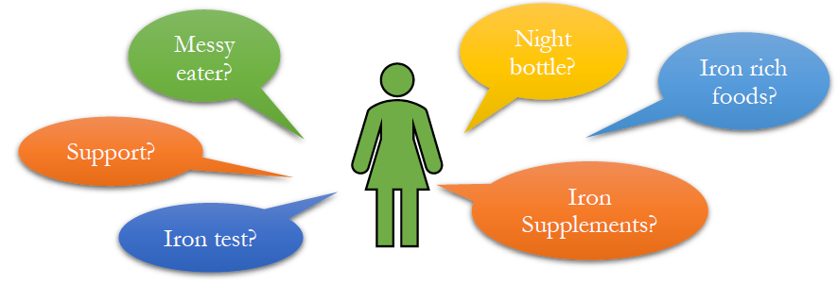
Prioritizing topics
What is most urgent?
What issue has the biggest impact on the health of the individual?
What issue are they most interested in?

Slide 25
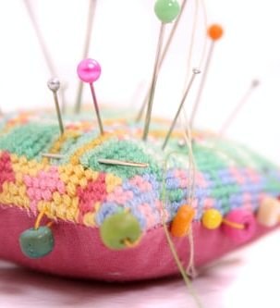
Considerations to help certifiers develop Transition Summaries
What have they tried already? What was their experience with an older child?
How do they feel about what is happening? Is there resistance or ambivalence?

Slide 26
Considerations to help certifiers develop Transition Summaries (continued)
What resources do they have that support making changes?
What reasons do they have to stay the same and not make any changes?
How can anticipatory guidance be used if there are no concerns?

Slide 27
Four steps for developing a Transition Summary for moving from assessment to education
1. Acknowledge what has been discussed up to this point
“We’ve talk about Jimmy’s health and appetite and it has been great to see how much he has grown”
2. Highlight change talk
“You’ve mentioned that you are interested in helping him learn to feed himself”

Slide 28
Four steps for developing a Transition Summary for moving from assessment to education (continued)
3. Prioritize what to include in the summary, refer to ideas, topics, or notes you have gathered
“I also heard that weaning from the bottle may be a possibility”
4. Consider what needs to happen next, ask permission and guide the conversation to nutrition education
“I have some information about feeding children Jimmy’s age that I’d like to offer to you”

Slide 29
Examples of Transition Summaries for moving from assessment to education
“We’ve talked about your concerns regarding Lisbeth’s appetite and learning to feed herself. I am excited to hear that you are planning to offer the cup more and let her do more finger feeding. I have some helpful information on these topics…I’m wondering which of these areas you’d like to focus on today? “
“We have completed the questions regarding Chad’s diet, health and development. It sounds like everything is going very well! Many parents of children his age are interested in hearing about ideas for weaning. I have information on what to expect when making that change that I would like to share with you...”

Slide 30
Examples of Transition Summaries for moving from assessment to education (continued)
“Here is a list of topics that came up so far during our conversation about your pregnancy… did I get it all? Which of these would you like to talk more about during our last few minutes together?”

Slide 31
Transition Summaries also support moving from education to next steps
Transition summaries support the flow of the conversation

Slide 32
Four steps to develop a Transition Summary for moving from education to next steps
Reflect back what you have heard
“You’ve expressed an interest in adding more iron to your diet”
2. Identify a specific, realistic action that could be taken
“We discussed eating more high iron foods such as beef at dinner each day”

Slide 33
Four steps to develop a Transition Summary for moving from education to next steps
3. Check for understanding, ask if you got it all, give an opportunity to confirm or make changes
“Your plan is to…did I get that right?”
4. Follow up in the future, support self-efficacy
“We will check back with you at your next appointment to see how that is going….I’m confident that you will make this happen!”

Slide 34
Questions to help transition to next steps
Given what you’ve told me, what do you think you will do next?
Based on what we have talked about, what changes, if any, are you thinking about making?
How would you like things to turn out? What do you see as the first step in that direction?
Where do you go from here?
I’m wondering where this leaves you in terms of what you want to see happen over the next 3 months?

Slide 35
Examples of Transition Summaries moving from education to next steps
Based on everything we’ve discussed today it sounds like you’ve decided to drink one cup of milk at each meal to boost your calcium intake. Is that accurate?
I look forward to hearing about your success when you return in three months.

Slide 36
Examples of Transition Summaries moving from education to next steps (continued)
We talked a lot about your commitment to breastfeeding and your plan to feed Lily on request for the next three months is excellent.
I am confident that this is something you can absolutely achieve! Please let us know if there is anything more we can do to support you.

Slide 37
Activity
Read the scenario on the next two slides and develop a transition summary to help move from assessment to counseling

Slide 38
Scenario
You are calling Brinn to complete a remote recertification for her 3-year-old daughter Clara. Brinn gives short answers to most of the questions you ask her about Clara’s health and diet. Although Brinn does not seem fully engaged in the conversation, you learn the following:
Clara is healthy and her development appears to be on track.
She has a good appetite for foods she likes – dry cereal, bananas, grapes, hot dogs, macaroni and cheese, apple juice, french fries and green beans. She refuses most other meats and vegetables.

Slide 39
Scenario continued…
Clara can feed herself and uses a cup or glass but will not stay seated at the table during meals. She will eat a bite or two and then run off to play. She mostly just snacks on crackers when she wants something to eat throughout the day.
She does not take any vitamin supplements and she has not been to see a dentist.
When you ask Brinn if there are any nutrition questions or topics she would like to discuss, she replies that everything is fine. She did not voice any concerns about Clara’s activities or eating habits.

Slide 40
Consider
What did you hear during the assessment process that might affect what you choose to include in the summary?
What could be offered during nutrition focused counseling?

Slide 41
Closing Summaries

Slide 42
Closing Summaries
Content: Highlights from the conversation, recap of next steps, program eligibility (health outcome) statement
Timing: End of the interaction
Reason for use:
Provides closure
Meets the USDA requirement to inform participants that they are eligible for WIC services

Slide 43
The WIC Eligibility Statement includes:
Confirmation that a participant is eligible for the program.
The length of their certification.
The reason for eligibility beyond income (the benefit of WIC participation, achieving a positive health outcome):
…support you in having a healthy baby”
…help you meet your breastfeeding goals”
…build a strong feeding relationship with your child”

Slide 44
Closing Summary examples
We had a chance to discuss ideas for weaning Jimmy from the bottle. You came up with a good plan to help him switch to a cup. Jimmy is eligible to be enrolled on WIC for 12 months, so we can help you reach the goals that you have set for his health. We will start by issuing three months of benefits today, then follow up with you to find out how everything is going. How else can I help today?
We talked about Jason’s growth, health and mealtimes today. I’m glad to let you know that Jason continues to be eligible for the program for another 12 months so WIC can help support his good eating habits. Three months of benefits have been issued and you are planning to take another online class within the next three months. What other questions or concerns do you have?

Slide 45
Activity
Identify the components of an eligibility statement in the paragraph below. What, if anything, would you add or delete?
“We visited about your recovery from your C-section. You are planning to gradually increase your level of activity by walking in the park every week. We want to support your recuperation by continuing WIC services. We will check back with you in three months to see how everything is going for you and your baby. That will also be the time when the next set of benefits will be issued. What else can I do for you today?”

Slide 46
Activity
What is missing?
Hint: “…want to support your plan by continuing WIC services until you are 6 months postpartum.”
“We have visited about your recovery from your C-section. You are planning to gradually increase your level of activity by walking in the park every week. You are eligible for the program. We want to support your recuperation by continuing WIC services until you are 6 months postpartum.
We will check back with you in three months to see how everything is going for you and your baby and that will also be the time when the next set of benefits will be issued. What else can I do for you today?”

Slide 47
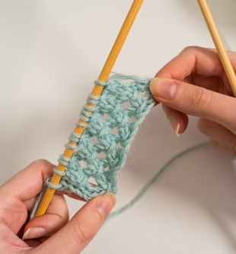
In summary
Skilled certifiers use summaries to seamlessly knit together the elements of each encounter to achieve a meaningful outcome.
Mastering a new skill takes time, practice and attention to your craft.

Slide 48
WIC staff are beautiful threads woven into the tapestry of many lives
We don’t accomplish anything in this world alone….whatever happens is the result of the whole tapestry of one’s life and all the weavings of individual threads from one to another that creates something special.
- Sandra Day O’Connor

Slide 49
QUESTIONS?
Talk with your nutritionist or training supervisor
Contact your state nutrition consultant or state training coordinator

