Slide 1
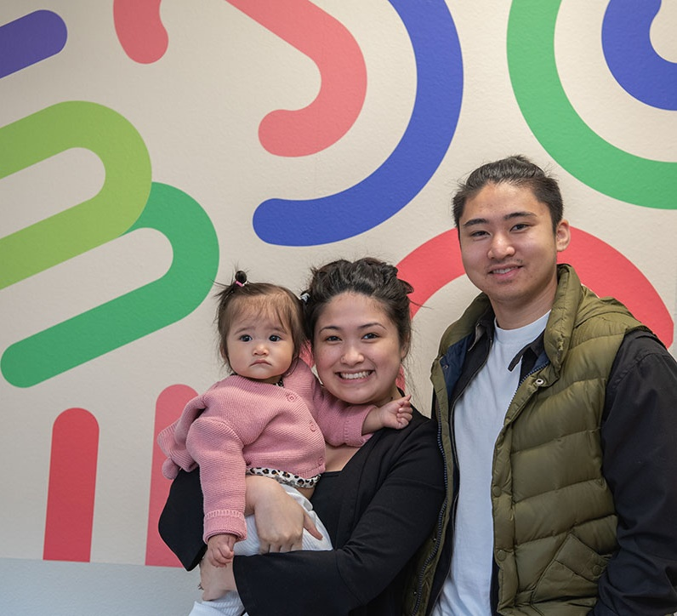
Talking to families about healthy behaviors
Oregon WIC
In-service 2020

Slide 2
Objectives:
This in-service will help shift the conversation from focusing on weight to healthy behaviors.
We hope by the end of this in-service you will be able to:
Create a safe space to discuss weight.
Recognize bias and stigma related to weight.
Acknowledge the complex, conflicting messages related to health and weight.

Slide 3
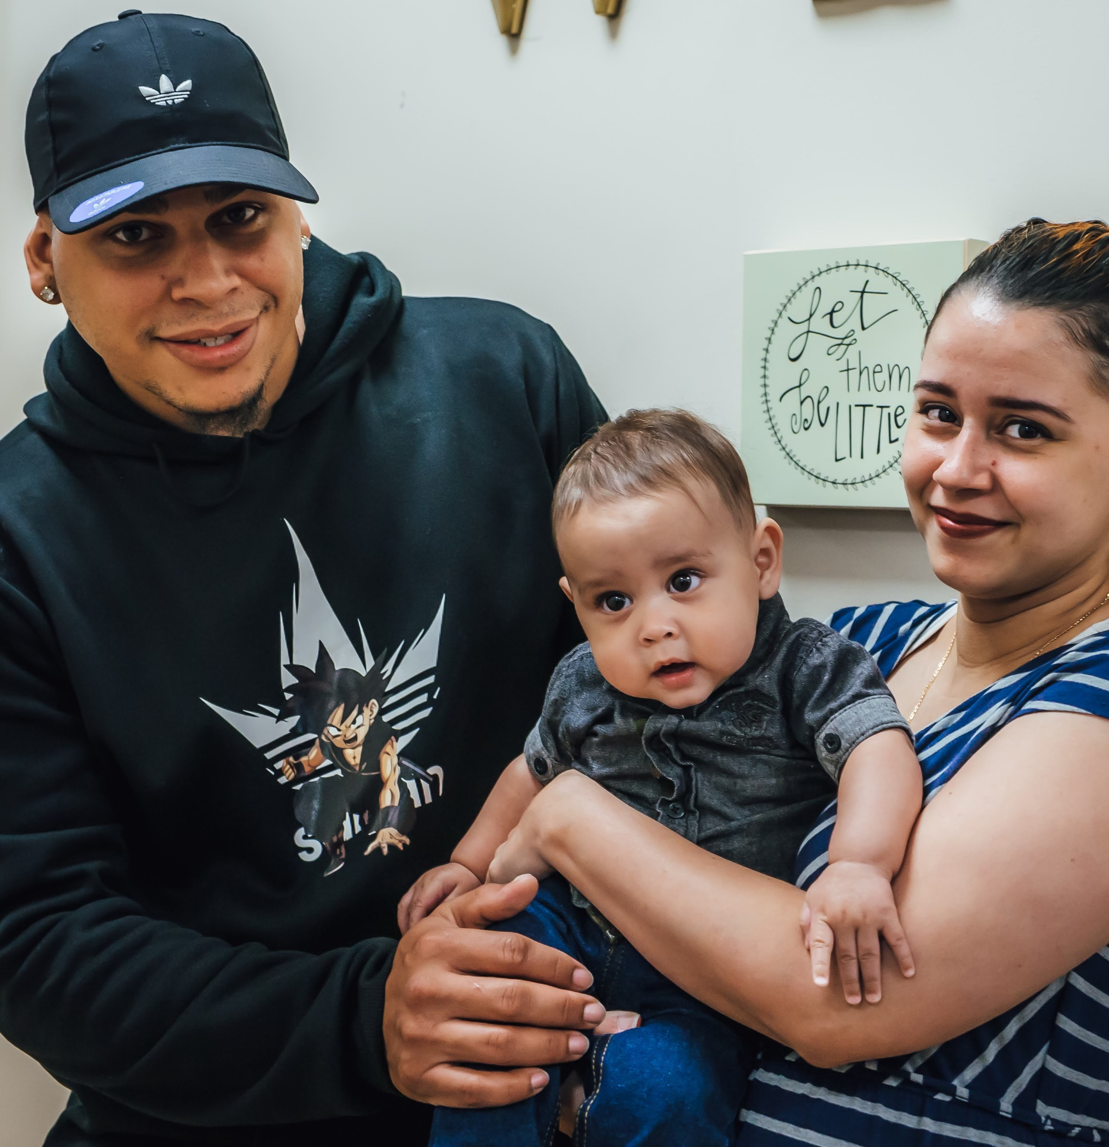
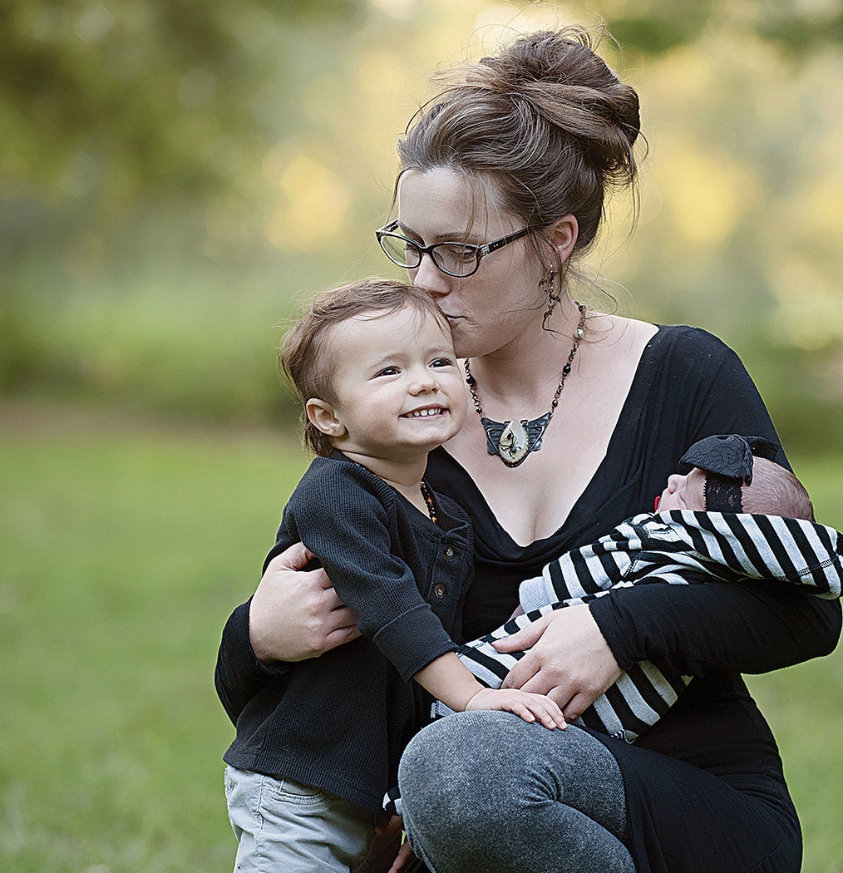
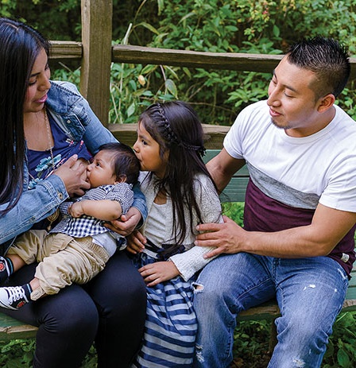
How does this in-service connect to the vision of Oregon WIC?
Our vision at WIC is to ensure optimal nutrition and lifelong health for every Oregon family.
The vision doesn’t change based on size.

Slide 4
We’ve been talking for a long time about how weight may not be the sole indicator of health.
Child Nutrition Module
Basic Nutrition Part 2
LAWN meetings
Statewide meeting sessions
Newsletter articles
RENEW Review Activities

Slide 5
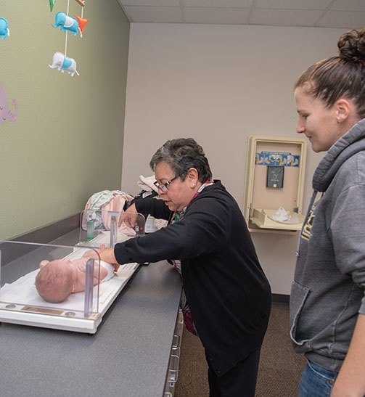
Reminders from the “Let’s Talk about Growth” in-service
Growth does not equal health. Growth charts do not diagnose health conditions. They are a visual representation of growth patterns.
Adults and children can be healthy or unhealthy no matter where they are on the growth grid.
You are not required to show the growth chart. It is a tool, and should not be the main focus of counseling.
Notes:
Meghan:
Health at 50th.Lampl: Growth charts are not an amalgamation of the paths actually taken by individuals. Instead, they summarize data on children’s sizes at targeted ages. By analogy to a connect-the-dots schema, the growth curve lines connect empirically derived descriptive statistics of size for age, joining similar percentiles (e.g., 3rd, 10th, 50th, 75th, or 90th) across ages.
It is entirely normal for individual children to grow at variable rates [40], which results in them being relatively shorter or taller, heavier
or lighter than their peers, irregularly across ages. A relatively short four-year-old may become a relatively tall five-year-old, for example, and this biological growth trajectory may take him from a size at the 35th percentile among four-year-olds to the 60th percentile among five-year-olds a year later

Slide 6
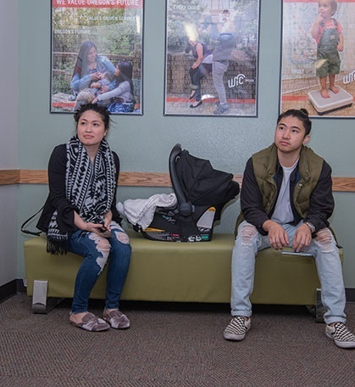
Getting the conversation started
You told us that talking with families about weight and health related behaviors can be a difficult conversation.
As we have shared in past trainings, the best way for us to navigate a difficult conversation is to prepare ourselves ahead of time by examining our own beliefs, biases and increasing our knowledge of those topics.
Learning more about the impact of weight bias and social stigma will help in conversations with families. We will also share information about how we can highlight healthy behaviors without focusing on weight loss as the goal.

Slide 7
Background information helps us shift our approach to become more weight inclusive
This includes:
Information about how culture, bias and stigma impact conversations.
Critical thinking and participant centered education skills to help us support WIC families in a non-judgmental way.
Resources and ideas of how you can support participants in your clinic.
This is an ongoing conversation…There will be a “part 2” deeper counseling in-service next year.

Slide 8
Oregon WIC acknowledges:
Bodies can be healthy or unhealthy at every size.
Everyone benefits from practicing healthy behaviors that are accessible to them and match their abilities and interests.
Parents and caregivers have the power to teach and model healthy behaviors for their children. Children and adults have a division of responsibilities related to feeding and meal practices.

Slide 9
Oregon WIC acknowledges:
WIC staff can be supportive as role-models, in the language we use, and the environment we set up.
Nutrition-focused counseling skills help us tailor our efforts to individual interests and needs to help participants identify and work towards their desired health outcomes.
“Diets” do not work in the long term.

Slide 10
Recognizing bias, stigma and how we view health and weight

Slide 11
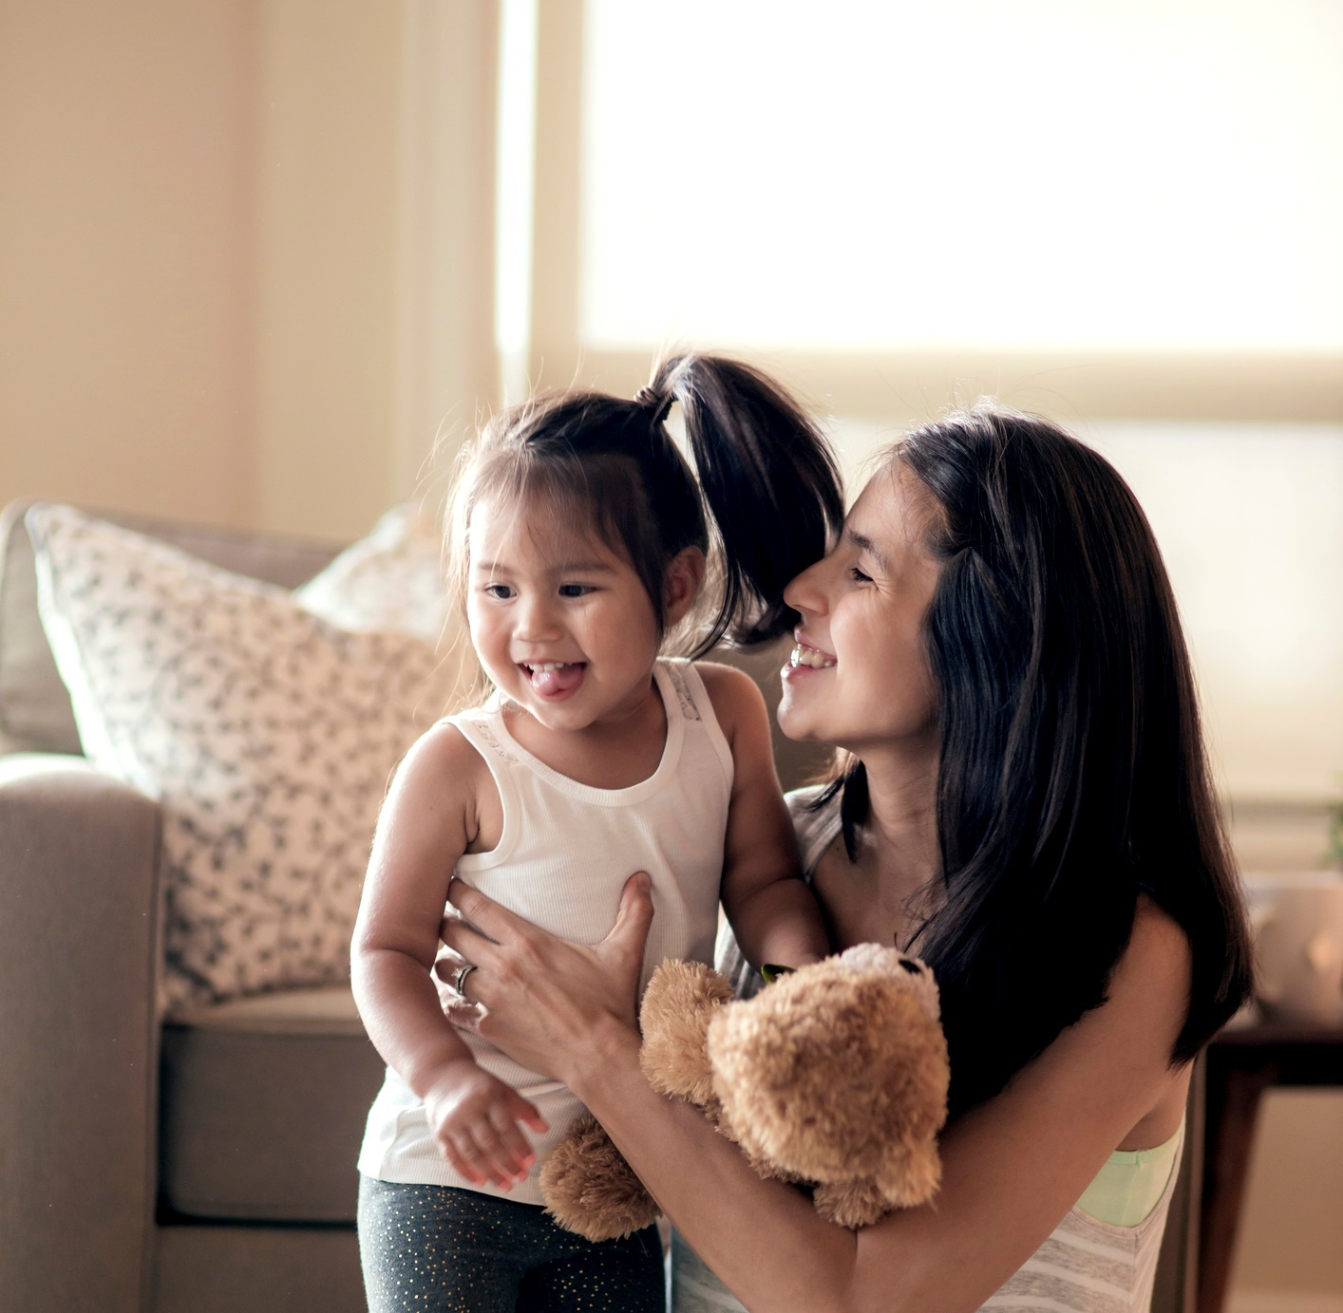
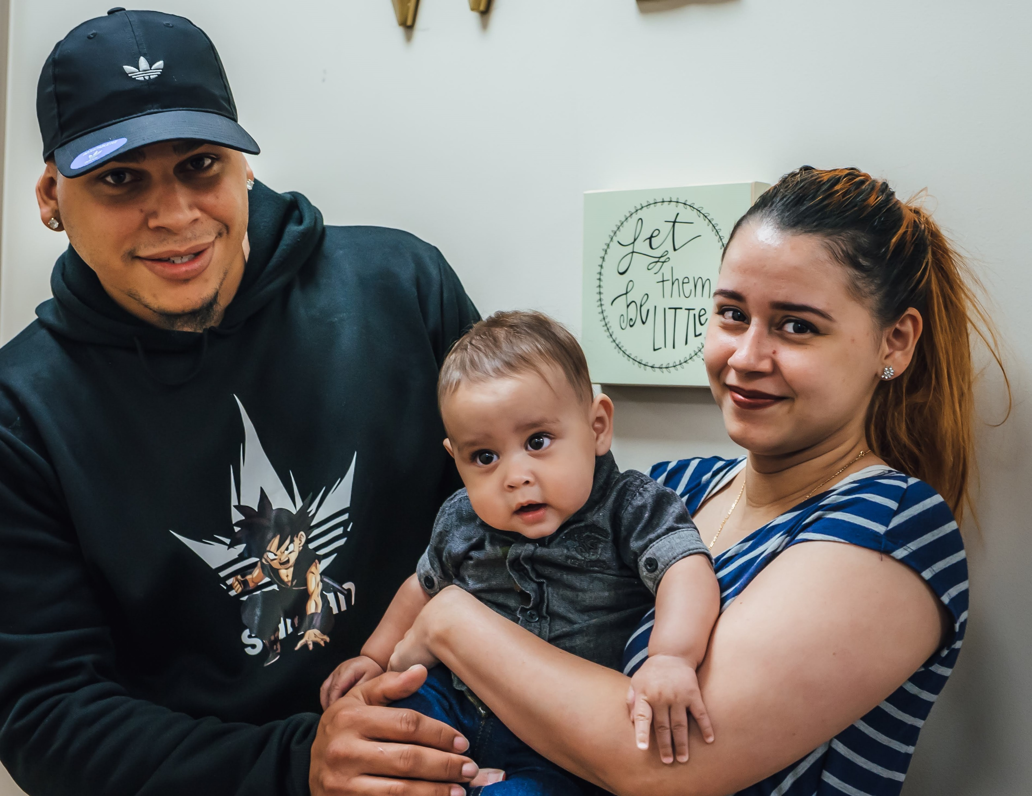
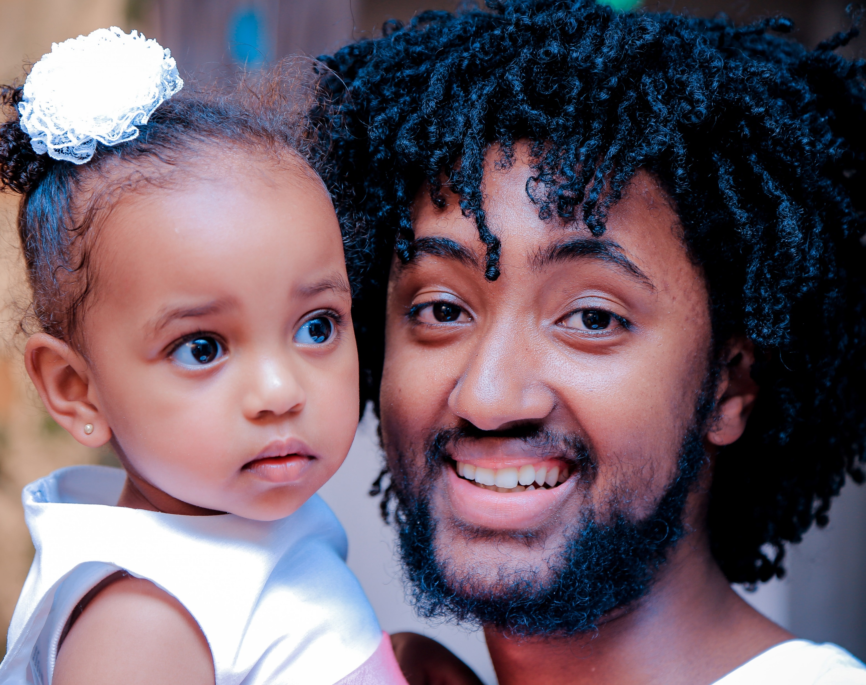
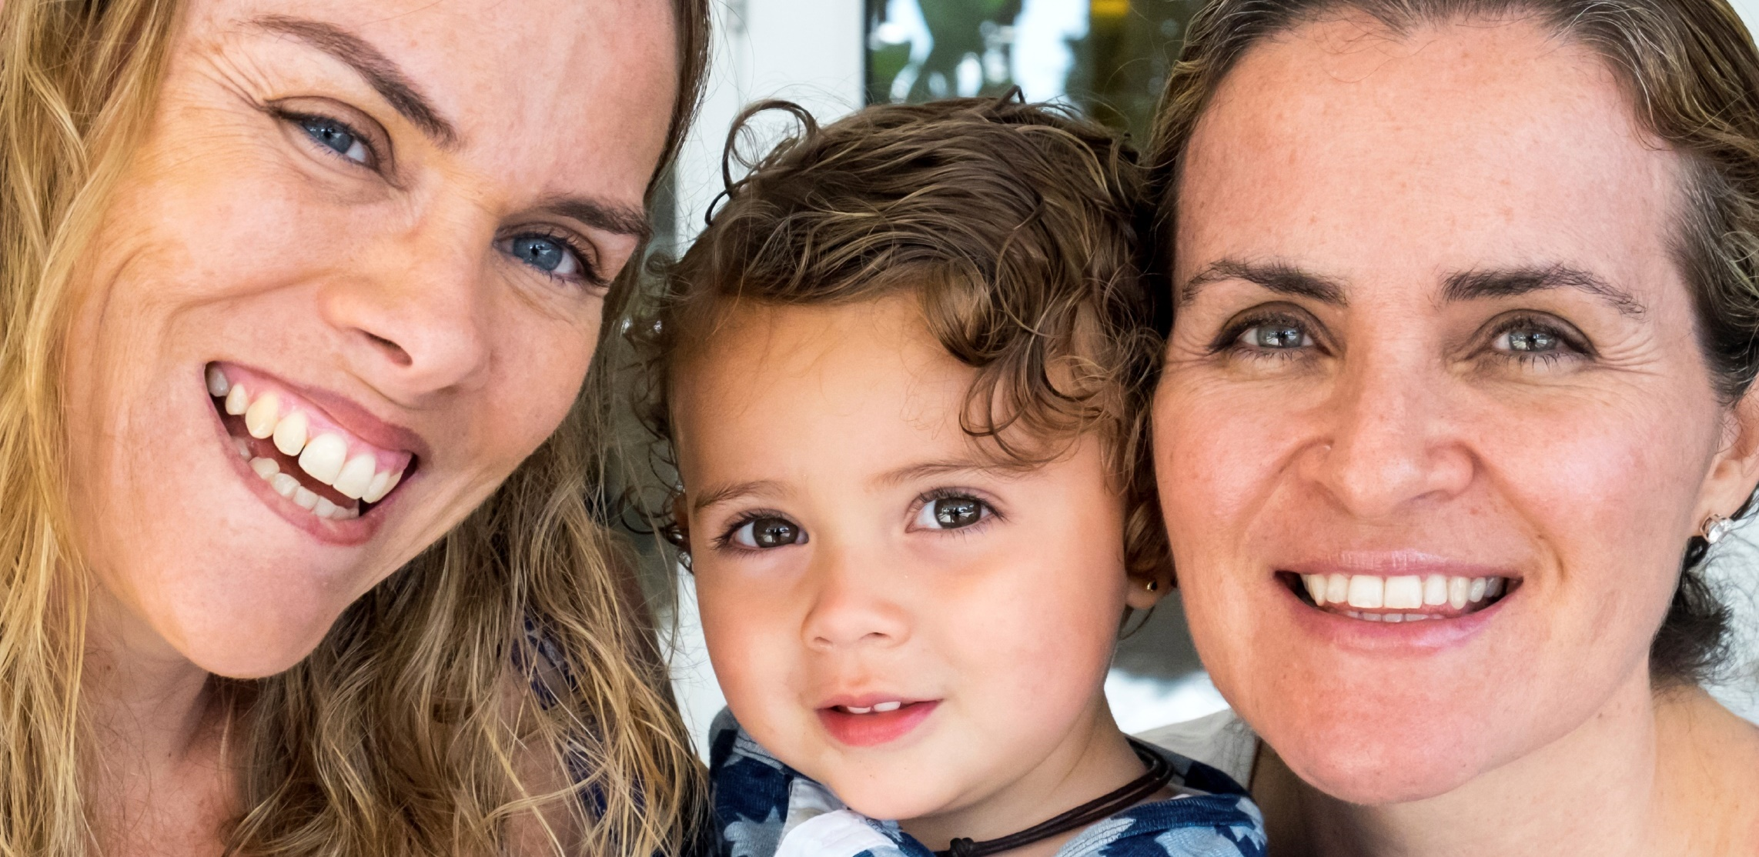
We all come to this subject from different perspectives
This in-service can help us all practice being non-biased and using our participant centered skills to focus on individuals.

Slide 12
When we work with families it’s important to remember that there’s a lot that goes into eating. This could include things like:
Culture
Access to food
Preferences in types of foods
Allergies
Living and working situation

Slide 13
Culture shapes how we view health and weight
Everyone exists within a culture—this includes the language we speak, holidays we celebrate, our food preferences and much more.
Cultural beliefs are not always conscious.
Feeding and eating relationships, exercise patterns and growth can all be influenced by a culture of origin.

Slide 14
Cultural Context
Cultures have different perspectives on what “healthy” looks like and what body traits are desirable.
There are also “rules” and expectations around who cooks, what exercise is acceptable, and how much you eat when offered food.
For some cultures, conversations about weight management and dieting is considered “small talk”.

Slide 15
Cultural Context
Cultures have a variety of ways of communicating around what is “okay” or “not okay” around eating and body size. This could include teasing, media portrayals of bodies, comments, conversations, or exclusion from activities due to body size.
Culture also influences biases and social stigma. Let’s take a deeper look at those concepts.

Slide 16
What is bias?
Bias is prejudice against something or someone.
Bias can be conscious - something you’re aware of. Bias can be unconscious - which you are not aware of having. Implicit bias means you are unconscious of what you are prejudiced against.
All people have biases.
By looking at and what biases we may have, we can try to move past them.
Notes:
https://implicit.harvard.edu/implicit/

Slide 17
Consider where biases may come up about body size, weight and behaviors
Comfort | How comfortable am I working with people of different body sizes?
Assumptions | What assumptions do I make regarding a person’s character, intelligence, abilities, health status or behaviors based only on their weight?
Stereotypes | What common stereotypes come to mind related to weight?
Counseling | How do my participants feel when they leave my office?
Reflective practice | How do I feel after a challenging counseling session? What would I do differently or the same next time?
Trust | Can I fully trust my participant with their own body? Am I worried they are being reckless with their food choices?

Slide 18
Social stigma influences how people are treated and perceived
Social stigma is severe social disapproval from others in society towards a person on because of their characteristics.
Examples of groups that experience stigma:
People living with serious mental illnesses
People experiencing homelessness
People who live in larger bodies—or are considered “obese” or “overweight”
Weight bias and discrimination show up in all areas of life including the workplace, clinic settings, media, playgrounds and within families.

Slide 19
Weight bias and stigma have harmful impacts on health and well-being
Experiencing weight bias increases an individual’s vulnerability for depression, anxiety, low self-esteem, poor body image and suicide.
Weight Stigma is a stressor that increases risk of distorted eating behaviors: binge eating, unhealthy weight control practices, or coping with stigma by eating more food. This stress can increase cortisol reactivity and the cycle continues. Weight stigma can also impact the quality of medical care and treatment people receive.
Notes:
What can happen when people experience bias and social stigma about their weight?

Slide 20
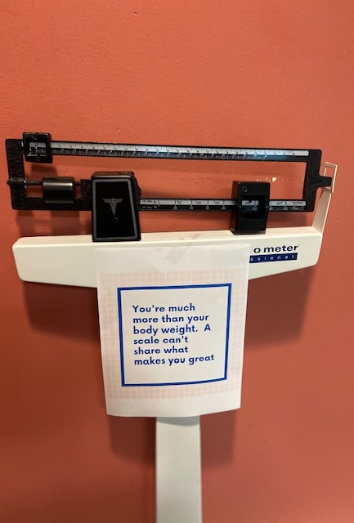
We can help decrease bias and stigma
It starts with how we, as individuals, think and feel about issues related to body size. It is okay to experience discomfort and have questions.
We can question the messages we hear from our culture and many of our professional trainings.
WIC is a public health program. We must complete certain tasks to provide health and nutrition information. We can use PCE to filter and tailor this information to individual needs and interests.

Slide 21
Next up, there are some questions that encourage you to reflect on your experiences and perspective. This may be a challenging topic. We encourage you to practice self kindness and compassion.

Slide 22
Discussion questions:
How were the topics of self-image, weight and health discussed when you were growing up?
How does this influence the way you think and talk about bodies and weight now?
What would you want to be different for your child?
What would you want to be different for participants?

Slide 23
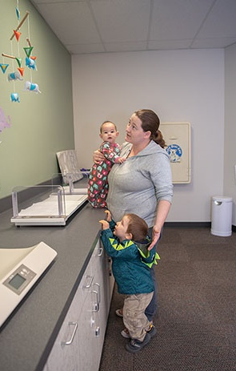
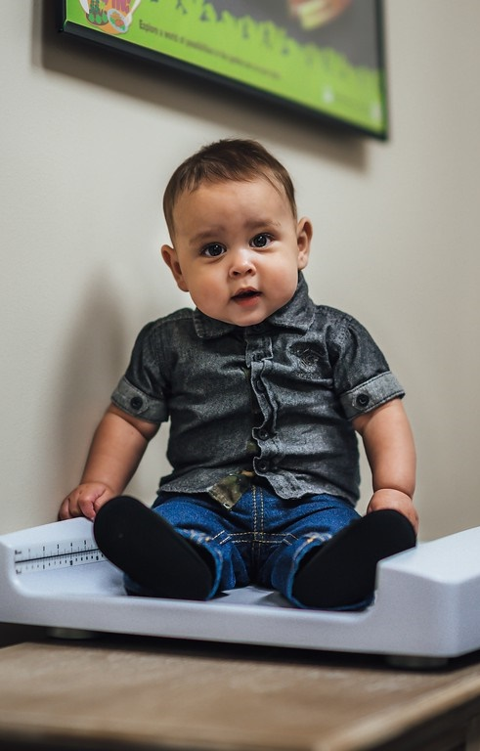
Health is more than weight or size
Health is a state of complete physical, mental and social well-being and not merely the absence of disease or infirmity. – World Health Organization (WHO)

Slide 24
Health is determined by many factors. The WHO defines health factors as:
the social and economic environment,
the physical environment, and
the person’s individual characteristics and behaviors.

Slide 25
WIC staff can help improve health:
By assigning and tailoring WIC food packages and providing breastfeeding services, you are providing nutrition and economic supports.
By providing referrals for housing, mental health services or energy assistance, you are helping to address those factors we call social or environmental determinants of health.
By practicing trauma informed care, you tailor counseling to the needs of individuals.
By providing nutrition focused counseling that helps participants address their interests, you may have a greater impact on health than counseling about how to lose weight.

Slide 26
Taking a weight inclusive approach in WIC

Slide 27
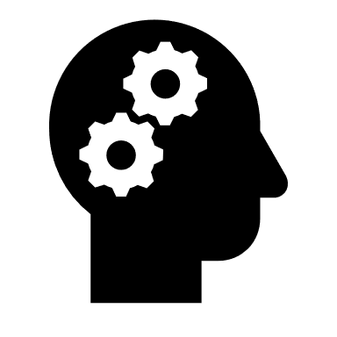
Defining the term “weight inclusive”
The weight inclusive approach supports accepting and respecting the diversity of body shapes and sizes. There is no one “ideal” size that people should be. People should be treated with respect and dignity no matter their body shape or size.
Shift the focus from trying to control weight or lose weight or gain weight. Instead, providers and public health professionals can support steps to improve health regardless of weight.
By making efforts to be weight inclusive, we hope to decrease weight bias and stigma.
Notes:
This is one component of the principals of Health at Every Size. This training will not go into depth about this concept, but we do want to acknowledge that Health At Every size principles state the value in eating for well-being, life enhancing movement, respectful care and access to information and services to improve well-being.

Slide 28
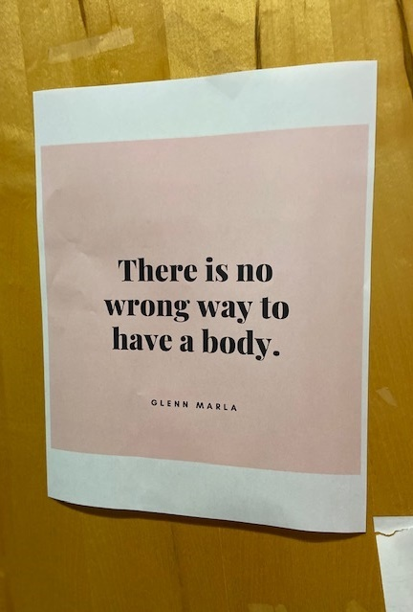
Setting the stage with participants
As we welcome participants and set the stage for the appointment, we have an opportunity to set a positive tone.
Implicit bias often shows up when we greet participants with small talk, make observations, or comment on appearance.
Remember size inclusive language from the growth in-service? Let’s look at some examples.

Slide 29
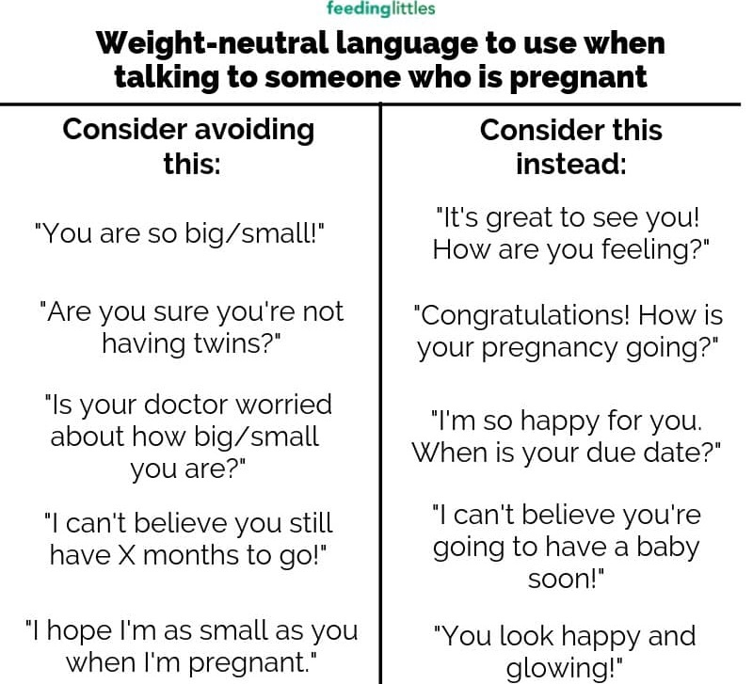
Examples of weight inclusive language for pregnant women
Visual credit to Feeding Littles

Slide 30
Shifting the focus with children: Weight inclusive conversation ideas
Instead of this | Try this!
Wow! I can’t believe how big you are getting! | (Name) I am so glad to see you!
Eat your vegetables so you will be healthy. Listen to your mom and dad. | Trying new things can feel hard. You can do hard things, it’s okay to try.
It’s good he is riding his tricycle. That will help his chubbiness as he grows. | Riding the tricycle is a great way to move!
You really should keep an eye on her growth right now, it will just get harder to make her change. | Trust in your ability to be a good role model and parent. Healthy behaviors matter, your child’s weight will sort itself out.
Enjoy eating this now! When you’re my age you won’t be able to eat like that. | I love seeing how much joy is on your face as you eat that food!

Slide 31
Discussion questions:
What are your thoughts about these examples?
What might you do differently after seeing these comparison statements?
Notes:
We aren’t trying to “police” language, but to give you an opportunity to reflect and tools to use.

Slide 32
Optional Break

Slide 33
Gathering health information, including weight, is part of what we do at WIC
Federal policies determine what counts as a risk factor, including high and low BMI.
Risk assessment, including gathering information on height and weight, is a requirement of participation in the program. This assessment, combined with questions in TWIST, generate risk factors. These risk factors might bring up conversations related to weight and growth.
The emphasis on weight and growth in the data system may feel like a mismatch when we want to support the idea that bodies can be healthy or unhealthy at any size.

Slide 34
WIC balances between being a public health program and tailoring services to individuals
WIC as public health
WIC as a participant centered service
We track population level trends like breastfeeding rates, childhood obesity, pregnant women getting into prenatal care.
Greatest good for the most amount of people. We provide standard food package options selected by nutrition experts.
We take a prevention and upstream approach by connecting participants with other providers and services.
We meet participants where they are at, and tailor nutrition education to interests and their family’s needs.
Measures of success personalized (setting breastfeeding goals, increasing fruit and veg intake, increasing mom’s confidence in the feeding relationship).
Create a safe and supportive environment—benefits continue even if a participant doesn’t achieve health or behavioral goals they’ve shared.

Slide 35
Over the past 50 years public health messaging has focused on the individual and often these messages were oversimplified and stigmatizing. Here are some examples:
We should aim for a certain weight based on our height and sex.
Obesity is a disease and needs a cure.
The cure for obesity is weight loss.
Slogans: Eat less, exercise more. Calories in calories out. You are what you eat. Willpower is all it takes. Work out to “earn” food. Eat “clean” foods.

Slide 36
Repeated cycles of dieting harms health
Discussion question: What are your thoughts about this?

Slide 37
Taking a deeper look at the impact of obesity messaging and public health
Over 90% of weight-loss diets fail, and most people regain lost weight within 1-5 years.
This cycle may evoke shame, anxiety and depression.
Yo-yo’ing weight is a risk factor for overall health.

Slide 38
Health impacts continued
Research is mixed on the health impacts of obesity itself or the impacts from bias and social stigma.
Are people getting sick because of obesity, or because of bias in the health care system?
Or are there other factors outside weight?

Slide 39
Traditional Weight Loss Approach
Obesity is a disease.
Individuals are personally responsible to be a certain weight.
Food perceived as good/bad, should/should not eat.
Amount to eat is determined by external sources (calories, grams, exchanges).
Exercise for the purpose of losing/maintaining weight.

Slide 40
The Weight Loss Approach Measures:
Weight loss
Body mass index (BMI)
Tracking or controlling calories in/calories out

Slide 41
Weight Inclusive Approach
Body will find natural weight when individual eats in response to cues.
Weight set points can change.
All food is OK to eat.
Amount and quality of food determined by response to physical cues (hunger/fullness/taste).
Movement for fun, enjoyment, body self care.

Slide 42
Weight inclusive approaches measure:
Improved metabolic fitness (blood pressure, lipids, blood sugar)
Health behaviors
Self-efficacy, self-acceptance

Slide 43
Discussion questions:
Compare these two approaches.
What stands out about the weight inclusive approach ?

Slide 44
By exploring the weight inclusive approach, we deepen participant centered services
To combat weight bias and stigma many experts now recommend a non-dieting way of thinking and counseling.
You may have heard of some of these sets of ideas, including Health at Every Size, Body Trust, or the Intuitive Eating approach. This training won’t go into detail about each of these, but there are resources at the end of the training to take a deeper dive about these approaches.

Slide 45
Deepening PCE by being weight neutral continued
Ellyn Satter’s division of responsibilities for children and parents is another example we use a lot in WIC. This weight inclusive approach supports children listening to their bodies and identifying their own hunger and fullness cues.
The non-dieting ideas encourage people to reflect on their own needs, motivators and intuition. These ideas typically don’t have lots of “shoulds” for individual practices.

Slide 46
Weight inclusive approaches helps overall well-being
Normalized eating gives someone the unconditional permission to eat.
People who follow this are more likely to practice the acceptance of their weight. This includes understanding that weight may evolve as a result of eating and activity.
Improvements in physical self-esteem.

Slide 47
Discussion questions:
What are your thoughts about the dieting vs. the weight inclusive perspective?
What questions come up for you? Please feel free to write those down and share them with us.

Slide 48
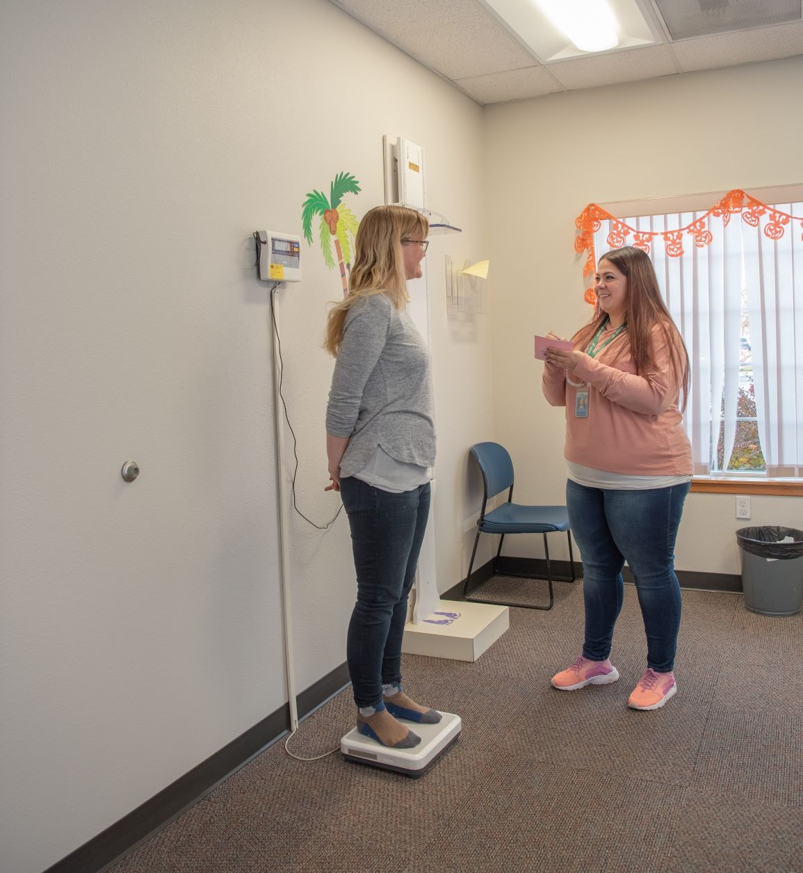
Does a weight inclusive perspective mean we just avoid talking about weight?
Not necessarily. What we are suggesting is a shifting the way we approach these conversations by thinking deeply about weight science, bias, stigma and the cycle of dieting.
If a participant expresses concerns about their weight, or a child’s growth– use the skill of reflecting back what you think you’re hearing. This will help you explore their interests and potential next steps.

Slide 49
Our goal is meeting people where they are through individualized next steps
When we fill in “next steps” mentally before people are done exploring, this is an area where bias or assumptions can creep into a counseling session.
Hearing someone’s concerns is a good opportunity to use “explore, offer, explore” about topics without making weight or weight loss be a primary focus. Weight, weight-loss and dieting may be an area of ambivalence for participants.
We can support participants with where their interests lie, while working to embrace non-diet practices. We focus on what they are doing and how they are planning to make changes.

Slide 50
Examples of shifting from an adult participant’s intentions to their next steps using a weight inclusive approach.
Participant’s intention: | Explore first. Then shift from the participant’s intention to their desired health behavior.
“I want to eat healthier.” | “You would like to eat fewer processed foods. You mentioned that you can do this by taking fruits and nuts with you for a daily afternoon snack.”
“I want to exercise more before my baby is born so I don’t gain too much weight.” | “You want to commit to walking with your sister 2x a week. There’s a yoga class you would like to try next week. ”
“I want to lose weight. I might try Keto.” | “You’re going to try to eat fast food less. In the past you’ve liked to use your crockpot while you’re at work. Your whole family likes things like chili and salad. You’re interested in checking out the food hero site.
Notes:
“I want to eat healthier.” This is the intention not a goal. Through exploring, offering ideas and exploring we can come up with the HOW, “I would like to eat fewer processed foods. I can do this by taking fruits and nuts with me for a daily afternoon snack.”
“I want to exercise more before my baby is born so I don’t gain too much weight.” This is the intention. Through discussion you can get to the HOW. “I want to commit to walking with my sister 2x a week, on Tuesday and Thursday mornings. There’s a yoga class I would like to try next week. ”
What we want to highlight is the behaviors. There is value in consistently practicing healthy behaviors instead of cycling through “good” behaviors and “bad” behaviors.

Slide 51
Weight inclusive next steps for children
Caregiver’s intention: | Explore first. Then shift from the participant’s intention to their desired health behavior.
“ I’m worried about my daughter not exercising enough. Her doctor said to keep an eye on her growth.” | “Your family wants to try to move your bodies together. You mentioned some things you’d like to try including: walking at the park, swimming at the family center or YouTube exercise videos. I also shared some ideas from the Vroom activity app.”
“Can I get some PediaSure? His grandma says he looks too skinny.” | “Grandma wants the best for her grandchild. You’re planning to share what you’ve learned today about hunger cues. You’ll invite her have join me at the next clinic visit so we can be on the same page with healthy behaviors.”
“Anytime I try to feed her vegetables she just throws them from her high chair. I want her to eat vegetables.” | “I’ll try to keep the time she’s in her high chair short. I’ll offer her the cooked vegetables everyone else in the family is eating.”

Slide 52
Case study
You’re talking with a new mom. She’s sharing that she feels uncomfortable in her postpartum body and feels like she should have “her old body” back.
From this case study, how might you explore her feelings about her body?
What would you ask to explore more about her health behaviors?
What goals, or next steps would support her healthy behavior vs. support weight loss?

Slide 53
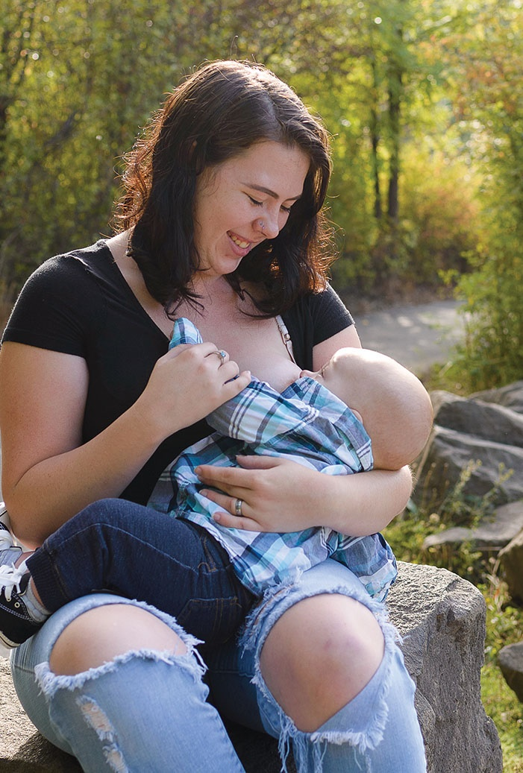
Mom’s healthy behaviors sets the tone for the family
Actions mom takes sets a pattern that children will follow.
Mom eating a wide variety of foods means a child is more likely to eat a variety of foods.
When mom is able to identify her own hunger cues it is more likely that she is able to identify hunger cues in her child.
Mom’s feelings about her body are likely to translate how she talks about her children’s bodies.
What other examples can you think of ?

Slide 54
Discussion opportunity: How we can promote weight inclusive approach on our team at WIC?
How do we talk about ourselves and our bodies?
What messages do our clinics present to our families?
Do we include body positive messages and images?

Slide 55
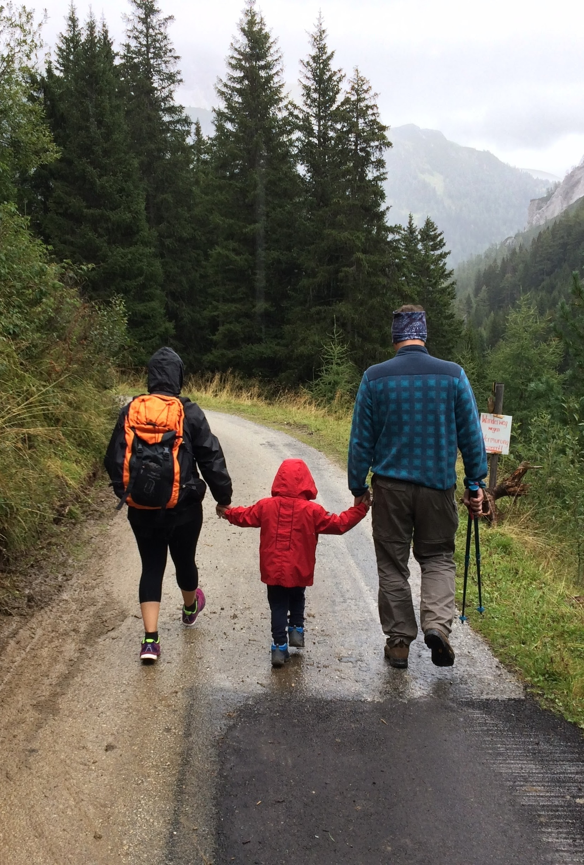
Thank you for your time and attention!
In May we will send out an optional RENEW review activity that will give you the opportunity to think more about this and practice.
In 2021 we will release a deepening counseling skills in-service which will focus on practicing using PCE and active listening skills.
Feel free to share your thoughts and feedback with Jameela Norton jameela.norton@state.or.us

Slide 56
Resources: there’s a lot out there!
Intuitive Eating by Evelyn Tribole & Elyse Resch
Body Respect by Lindo Bacon & Lucy Aphramor
A Hunger So Wide and So Deep: A Multiracial View of Women’s Eating Problems by Becky Thompson
PODCASTS
Dietitians Unplugged
Food Psych
Body Kindness
Poodle Science video – YouTube
https://www.youtube.com/watch?v=H89QQfXtc-k

Slide 57
Resources continued
Implicit biases:
http://www.uconnruddcenter.org/weight-bias-stigma-tools-for-researchers
https://implicit.harvard.edu/implicit/takeatest.html
Tools, Resources:
https://www.nytimes.com/2019/05/08/smarter-living/5-people-learn-to-love-your-body.html
Body Trust is a Birthright Dana Sturtevant and Hilary Kinavey https://www.youtube.com/watch?v=aPUH3Hp1t9k&feature=youtu.be

Slide 58
Other resources
What Historical Ideals of Women’s Shapes Teach Us About Women’s Self-Perception and Body Decisions Today
Rudd Center: what words should we use to talk about obesity?
Distressed or not distressed? A mixed methods examination of reactions to weight stigma and implications for emotional wellbeing and internalized weight bias

Slide 59
Ellyn Satter Institute Resources
https://www.ellynsatterinstitute.org/family-meals-focus/12-helping-without-harming-with-child-overweight/
https://www.ellynsatterinstitute.org/family-meals-focus/56-hierarchy-of-food-need/

Slide 60
Diverse voices supporting the feeding relationship
Raising a Healthy Happy Eater by Nimali Fernando, MD, MPH and Melanie Potock, MA, CCC-SLP
Hungry for Love by Charlie Slaughter, MPH, RD
Adventures in VeggieLand by Melanie Potock, MA, CCC-SLP
Try New Food by Jill Castle, RDN
Helping Your Child with Extreme Picky Eating by Katja Rowell, MD, and Jenny McGlothlin, MS, SLP

