Slide 1
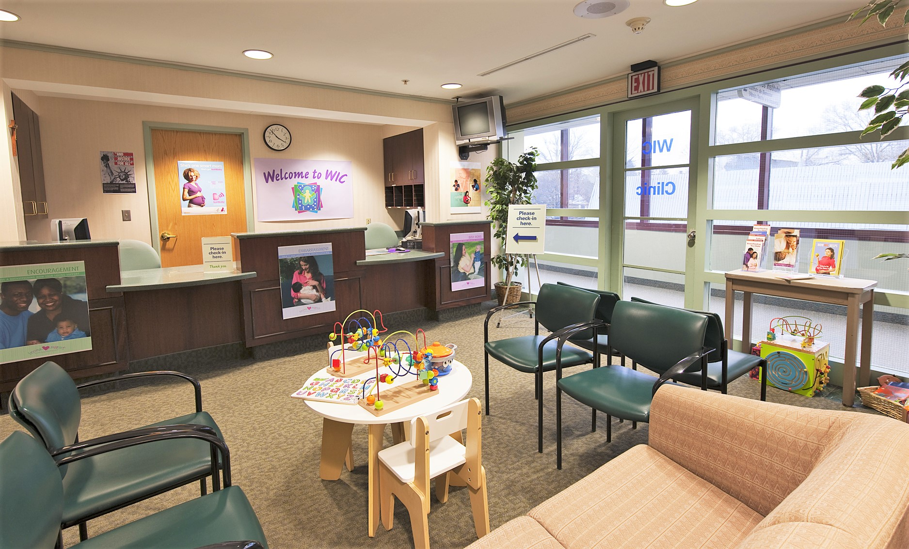
Assessing Clinic Environment and Practices
In looking at Caseload Management, one of the things you will want to consider is whether or not your WIC clinic reflects a warm environment and good customer service. This section will provide tools to assess your clinic environment and practices.

Slide 2
Families come to WIC for the services – healthy foods, nutrition education, breastfeeding support, and more. But there is also a cost.
What are the barriers to coming to WIC?
Nutrition Education
Community Referrals
Breastfeeding Promotion and Support
WIC Foods

Slide 3
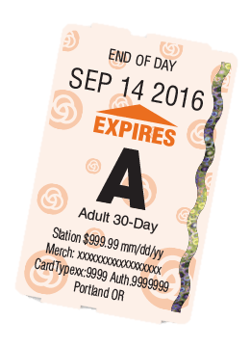
Here are some examples of barriers WIC participants face in receiving services:
“I have to take time off work to come to clinic hours.”
“It takes a lot of time to find my proofs, get here, and wait in the lobby.”
“I hate that appointments take so long.”
“I can’t keep asking my sister to watch my kid or for a ride to these appointments.”
“I don’t have a car and the clinic isn’t near a bus stop.”
“It’s hard to get through on the phones.”

Slide 4
Each participant associates a different value with the benefits and costs. WIC aims to have the benefits out weigh the cost for every WIC participant.
Costs
Benefits

Slide 5
Resources for my child and me
Extra food
Breastfeeding Education and support
Formula
Someone to listen to me
Help with communicating with my child and understanding their needs
Someone who cares about my child and my needs
Someone I can trust with my concerns
Learning to feed my family healthy meals
Referrals to supplemental care/support
Help finding what I need for my family
Support in building my family’s relationships
Embarrassment
Time to make the appointment
Time to find proofs
Time to come to the clinic
Time to wait in the lobby
Time in the appointment
Time away from work
Lost wages for missed work
Money for gas or bus ticket
Using up a favor to babysit other child, for a ride to the clinic, to take me to the store
Costs
Benefits

Slide 6
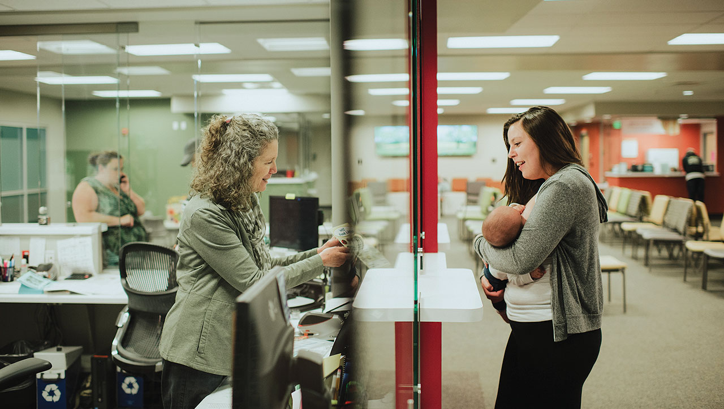
Use these tools to evaluate your clinic environment and caseload management practices. By reducing barriers, your families are more likely to return to your clinic and tell their friends about WIC, which will have a positive impact on your caseload.
Local Agency Caseload Management Assessment Tool
WIC Clinic Environment Observation Tools
Notes:
To access the tools, hold down the “Ctrl” button and click the blue buttons.

Slide 7
Gather participant input
Gathering input from your participants can provide valuable information about what you are doing well and how you can improve. Some of the most common ways to gather participant input are surveys, focus groups and interviews.
Surveys
Focus groups
Interviews

Slide 8
Considerations when gathering participant input
Remember that WIC participants may have different priorities, experiences and viewpoints than staff. Getting honest input is key to maintaining caseload. | While designing surveys or focus group scripts may seem easy, there are many potential pitfalls. Using a survey or script that has already been created and tested will help ensure your tool gathers the information you’re seeking.
Consider the pros and cons of having your own staff conduct the surveys, focus groups, or interviews. Will participants feel safe giving honest feedback? Would it be better to have someone outside your program gather input? | State WIC staff are here to help you with planning, designing, administering, and analyzing participant input. Contact your State nutrition consultant to get started.

Slide 9
Sample Phone Survey
Click the blue button to see a sample of a phone survey.
If you need more help designing your own survey reach out to the Research Analyst at the State WIC office for help.
Sample Phone Survey
Notes:
To access the sample phone survey, hold down the “Ctrl” button and click the blue button

Slide 10
Interview with an expert
Interview with an expert:
Quality Improvement
Deschutes County Quality Improvement
Click to play video
This video shows Laura Spaulding, WIC Coordinator, describe how Deschutes County used a Quality Improvement (QI) project to engage staff to increase show rates and improve their caseload. The video is about 25 minutes long.
Notes:
To watch this video, press the “Ctrl” button and click the green play button.

