Slide 1
Monitoring General Caseload Health
Monitoring General Caseload Health
As a WIC coordinator, it’s an important part of my job to always be asking…is my agency meeting its caseload goal?
Caseload

Slide 2
How to check your numbers
How to run TWIST reports
TWIST reports are a great way to monitor caseload.
If you are not sure how to run a TWIST report, check out this video.
How to run TWIST Reports
To watch this video, press the “Ctrl” button and click the green play button.
Click to play video
Notes:
To watch this video, hold down the “Ctrl” button and click the green play button

Slide 3
Caseload Goal
The goal is to keep your participating caseload within 97 – 103% of your assigned caseload.
Participating caseload only includes the participants who have been issued benefits.
103%
Caseload Goal
100%
97%

Slide 4
Funding and Caseload
The caseload goal is important because it was set based on the potential need for WIC in your community. Caseload also determines funding; if your agency is regularly below its caseload goal, your funding may be reduced for the next fiscal year.
caseload goal
assigned caseload
$
$
$
$
$
$
$
$
$
$
$
$
To learn more about WIC funding, use the job aids section to access Fiscal 101.
$
$
$
$
$
$
$
$
$

Slide 5
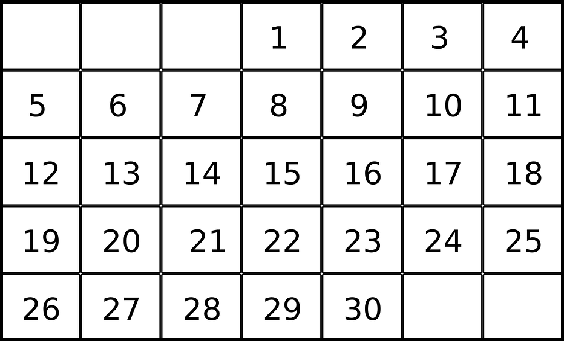
When to check your numbers
When to check your numbers
Check your caseload numbers at the beginning of every month. The caseload totals for the previous month are determined on the 1st, so check your numbers on or after the 2nd.

Slide 6
How to check your numbers
How to check your numbers
You can monitor your caseload health by running 3 reports in TWIST every month:
Percent of Assigned Caseload Report- how your participating caseload compares to your assigned
Participating Caseload Report- number of certified individuals who have been issued benefits
Certified Caseload Report- number of individuals who have been WIC certified
If your numbers are below 97%, look at the sections about maintaining caseload.

Slide 7
Caseload Reports: Percent of Assigned Caseload – 12 Month History Report
Caseload Reports:
Percent of Assigned Caseload – 12 Month History Report
What this report tells you: The percent comparison of participating caseload to assigned caseload for each month for the past 12 months, and the 12 month average. It shows how you are meeting your caseload goal of serving 97-103% of assigned caseload.
Why use this report: Use to monitor assigned caseload with the goal of keeping the participating caseload between 97-103% of the assigned caseload.
How to run this report: Operations Management- Outputs- Caseload. Enter the month and year.
When to run this report: Run on the 2nd of each month.
How to use the Percent of Assigned Caseload Report
Click to play video
Notes:
To watch this video, press the “Ctrl” button and click the green play button.

Slide 8
Caseload Reports: Participating Caseload – 12 Month History Report
Caseload Reports:
Participating Caseload – 12 Month History Report
What this report tells you: The number of participants with benefits every month for the past 12 months.
Why use this report: To see if your participating caseload has increased or decreased, month to month. Large agencies may see a larger fluctuation in month to month numbers.
How to run this report: Operations Management- Output- Caseload. Enter the month and year.
When to run this report: Run on the 2nd of each month.
How to use the Participating Caseload Report
Click to play video
Notes:
To watch this video, press the “Ctrl” button and click the green play button.

Slide 9
Caseload Reports: Certified Caseload – 12 Month History Report
Caseload Reports:
Certified Caseload – 12 Month History Report
What this report tells you: The number of participants with current certifications, whether or not they have been issued benefits. Shows the past 12 months.
Why use this report: Track the change in your total certified caseload from month to month.
How to run this report: Operations Management- Outputs- Caseload. Enter month and year.
When to run this report: Run on the 2nd of each month.
How to use the Certified Caseload Report
Click to play video
Notes:
To watch this video, press the “Ctrl” button and click the green play button.

