Slide 1
5. Using Outreach to Build Caseload
Using Outreach to Build Caseload

Slide 2
3 parts of outreach
What is outreach?
Reaching out and building relationships with organizations serving families in your community, in an effort to extend benefits and services to a wider population. Outreach is having a visible presence in the community and increasing awareness of the needs of underserved populations.
There are 3 basic parts of outreach – the Outreach Plan, Marketing & Promotion, and Collaboration.

Slide 3
What might WIC outreach look like?
Building relationships with key contacts in self sufficiency/ SNAP, community service and health care to increase referrals.
Encouraging participants to tell their family and friends about WIC.
Conducting targeted outreach to underserved groups and families by going to where they live or places they are already receiving services.
Promoting WIC in the traditional media through the use of press releases, free radio ads or TV public service announcements.

Slide 4
How to create relationships
Make a list of key community partners serving similar families. Identify and fill any gaps in your contact list. Email or call one contact a month and meet for coffee. Talk about ways to support referrals to each others’ programs. Host an informational table or offer to present about WIC at a preservice training at your local Head Start program. Create WIC post cards, featuring a picture of your smiling team on one side and what WIC offers women and children on the other side. Take this to the front desk (with food if you choose) of your OBGYN or pediatric clinic. Offer to provide a brief WIC 101 presentation at a staff meeting.

Slide 5
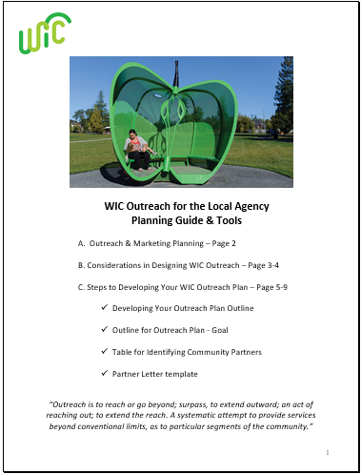
Resources for Outreach Planning
To learn more about developing an outreach plan, marketing & promotion of your program, and collaboration with partners, take a look at the following resources. They can all be found on the pages linked to the corresponding images below.
WIC Outreach Planning Guide
WIC Outreach Morsel Series
Targeting Priority Populations
Community Assessment
Partnership Development
Information Sharing
Improving how WIC does Business
Notes:
To access these resources, hold down the “Ctrl” button and click the image or title.

Slide 6
Targeting Outreach to Providers
The WIC and Healthcare Provider Toolkit can be used to support engagement with healthcare providers. Click the image to access the ‘Resources for medical providers’ page where this toolkit lives.
Notes:
To access this resource, hold down the “Ctrl” button and click the image.

Slide 7
If you need more help with Outreach, contact the Outreach Coordinator at the state WIC Office.

