Slide 1
Oregon WIC Program Growing Healthy Futures
Presenter Name, Credentials
Position Title
Title of Presentation if applicable
Date

Slide 2
Our vision
Every Oregon family achieves optimal nutrition and lifelong health.
Notes:
WIC Values:
every child
strong relationships
services delivered with trust and integrity
Oregon’s future
Note: Most of the photos in this presentation are of Oregon WIC families

Slide 3
The Special Supplemental Nutrition Program for Women, Infants, and Children
Authorized under Child Nutrition Act
Administered by USDA, Food & Nutrition Services
Managed by Public Health Division, Oregon Health Authority
Notes:
National attention to hunger and malnutrition in the late 1960’s lead to the establishment of a pilot federal program in 1972 called the Special Supplemental Nutrition Program for Women, Infants & Children. Established in 1974 by an amendment of the Child Nutrition Act of 1966.
The mission is “to safeguard the health of low-income women, infants and children up to age 5 who are at nutritional risk by providing nutritious foods to supplement diets, information on healthy eating, and referrals to health care.”
WIC is a discretionary federal program for which Congress must appropriate funding each year.
WIC is not an entitlement program, so it must be funded by an appropriation every other year.

Slide 4
WIC is a public health nutrition program serving:
OHP-eligible or enrolled pregnant, breastfeeding or postpartum women, infants & children up to age 5
Grandparents, foster families and dads with kids under age 5 (that are income eligible)
Notes:
Did you also know that:
Just under half of the babies born in rural Oregon were born to mom’s who were on WIC
An average of 71% of WIC families are working
we serve more women in their 30s, than teenage moms

Slide 5
WIC participants are often co-enrolled in other programs
87% in OHP
61% in SNAP
11% in TANF
Notes:
Pregnant, postpartum or nursing women, infants and children that are enrolled or eligible for Medicaid/OHP, SNAP or TANF are automatically income eligible for WIC.
Household income must be less than 185% of the Federal Poverty Level. A family of 4 can make just over $47 thousand/year (or just under 4 thousand/month, gross income) to qualify (2018).
OHP – Please refer all your OHP-enrolled pregnant women, infants and children to WIC. All of these patient’s are eligible for WIC services.
SNAP – SNAP and WIC are often thought of the same programs. We both offer supplemental foods however WIC has:
A prescribed food package that offers specific nutrients for the participant’s needs
Social history with our participants. We have at least 2 contacts with participants every six months (up to 4 a year).
A strong emphasis on nutrition-focused counseling using motivational interviewing
TANF stands for Temporary Assistance for Needy Families. The TANF program, which is time limited, assists families with children when the parents or care givers cannot provide for the family's basic needs.

Slide 6
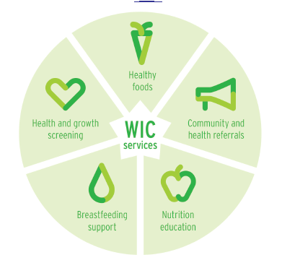
WIC Services & Data
Notes:
Review the WIC services within the wheel.
Share your county data sheet and highlight (visual includes data from state WIC collectively 2018)
Numbers of participants served
Breastfeeding rates
# of stores accepting WIC and the economic benefit
# of participating farmers and the $ paid to them from the FDNP

Slide 7
Notes:
We help families be healthy by offering nutritious food, health screenings and quality nutrition education offered by trained and professional staff.

Slide 8
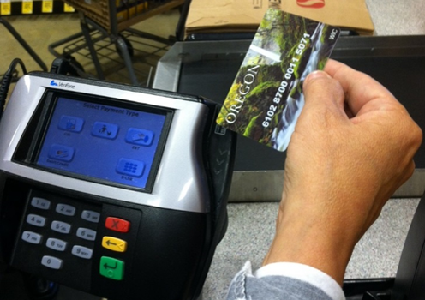
WIC foods
Vegan diets –Tofu and a variety of beans are available for vegetarians or vegans.
Dairy – Dairy alternative options include soy, lactose-free, acidophilus or goat milk alternatives.
Juice – WIC follows the AAP recommendations of 4 oz or less of juice for children
Organics – Organic fruits, veggies and baby food
Vouchers – What vouchers? We have an EBT card!
WIC Shopper App – WIC food benefits can be checked on this app making shopping easy.
Notes:
This picture on the top left represents a typical WIC food package. Average value per participant is around $50. (A pregnant mom with a child would get approximately $150 worth of food per month)
WIC Food package choices include:
Fruits & Veggies; can be organic; fresh or frozen
Whole Grains; adding new options like whole grain pasta and tortillas
Milk; low-fat age 2 and older
Cheese (single-serving string cheese mozzarella was recently added)
Eggs
Peanut Butter and/or beans; adding canned beans in addition to dried
Cereal (In 2019 Oregon removed certain cereals to eliminate any artificial dyes)
Juice (As noted above, the amount per month averages out to be 4 ounces per day, in line with AAP recommendations)
Fish (canned)
Infant Foods (In 2019: Oregon first in the nation to remove infant rice cereal from our food package due to concerns with levels of arsenic in infant rice cereal)
Baby food (offering more organic options)
Tofu and yogurt (added more options in 2019)
Items on our food list are evaluated by:
Nutrient profile analysis
Participant preferences
Price
Availability

Slide 9
WIC visits Health screenings include:
Measuring for height and weight
Assessing iron levels
Completing a health assessment – screening for immunizations and referral
Referring to dietitian or other community resources
Offering breastfeeding support and nutrition-focused counseling
Notes:
Share how you assess iron levels and what you do when you get a low hgb value. Ask if the providers would be interested in WIC sharing this information and how.
Optional - Opportunity to talk about WICs approach to healthy weight
Goal to maintain (instead of reducing BMI)
Health at every size

Slide 10
Nutrition- focused counseling is the cornerstone of WIC
Notes:
WIC values quality nutrition education which is what sets our program aside from other supplemental food programs.
WIC sees our participants every 3 to 6 months for nutrition education. Potentially up to 21 contacts between birth and 5 years of age. This education takes many different forms. We offer:
personalized nutrition-focused consultation that assess health and diet and addresses responsive feeding,
a variety of group classes (share typical classes) and
20 different online nutrition-related course options for our busier families. (Online nutrition education options for WIC families include: Life course nutrition, Breastfeeding, Baby and me classes, Infant feeding cues and baby behaviors, Picky eating behaviors, Shopping for, storing and preparing fresh fruits and veggies, Physical activity)

Slide 11
WIC staff are well trained in motivational interviewing and offer participant centered services
The participant is at the center of the nutrition focused counseling process
A WIC counselor is a facilitator of behavior change and acts as an advisor to help guide the participant
The participant makes decisions based on his/her unique needs and circumstances
Notes:
History –
After 30 plus years of effort and research, we know that the old way of giving nutrition education / counseling doesn’t work.
Oregon WIC implemented a statewide training on motivational interviewing to improve our participant’s health outcomes.
When we are talking about how this applies to the whole clinic, we call it participant centered services (PCS).
Staff training-
Staff have extensive training in nutrition focused counseling
Learning modules take 90 to 100 hours
Counseling staff have an additional 70 hours of observations
Courses that WIC staff take to offer the best nutrition education include:
breastfeeding
Adverse Childhood Experiences (ACEs),
anthropometric and hematology,
basic nutrition and nutrition risk
prenatal and postpartum nutrition
baby behaviors and understanding toddler behaviors

Slide 12
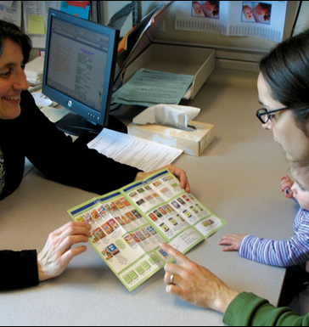
Registered Dietitian Nutritionists
Are in every WIC agency, or on contract
Follow-up with participants at higher medical and social risk. Including participants with food allergies, in foster care, with special health care needs and women with gestational diabetes (some examples)
Monitor children on special medical formulas and help determine WIC approved formulas and foods
WIC dietitians are available to support patients with greater medical complexity
Notes:
Share the # of RDNs working at your county WIC program. There are 50 RDNs working for WIC in Oregon

Slide 13
Notes:
WIC supports the AAP recommendation of exclusive breastfeeding until 6 months and continued breastfeeding to 12 months. We support continued breastfeeding beyond one year.
Note: For HCPs this may be preaching to the choir. Pick and choose what you feel is important to share.
Breastfeeding is important because it is
known to increase cognitive development and
reduces the incidence of infections, asthma and Sudden Infant Death Syndrome
Exclusive breastfeeding is associated with lower rates of childhood obesity, diabetes, heart disease and cancers later in life. Mothers who breastfeed have significantly lower rates of breast and ovarian cancer, diabetes and heart disease.
Breastfeeding is more economical for the family budget, does not require preparation, is convenient and portable, and is ready whenever baby wants to eat.

Slide 14
WIC promotes breastfeeding as the norm for infant feeding
Breastfeeding in WIC has been a primary focus for over 15 years. We believe:
That breastfeeding is normal.
In long-term, exclusive breastfeeding.
That there is value with baby having time at the breast.

Slide 15
How does WIC support breastfeeding?
“My breastfeeding peer counselor has helped me to believe that I could overcome the obstacles in my path and has given me the emotional support I needed. I trust her and am so very thankful for her, and that this program exists.”
"WIC is the only place I hear "good job" for nursing my children for the past two years. Not even my doctor says that!"
Notes:
WIC Participant quotes.

Slide 16
WIC supports breastfeeding women in the following ways
All WIC staff are trained to provide basic breastfeeding education and support.
WIC peer counselors provider mother to mother support helping women overcome common breastfeeding challenges.
WIC protects breastfeeding by not routinely issuing formula to breastfeeding infants in the first 30 days.
Notes:
WIC staff training breastfeeding - All counseling staff are required to have a minimum competency in breastfeeding covering:
Value of long-term, exclusive breastfeeding
Planning for the hospital
Skin to skin
Establishing milk supply
Baby behavior and infant sleep patterns
List of classes that a WIC certifier takes
Helping with a breastfeeding and what to expect in the hospital
The First hour, Skin-to-skin, Value of exclusivity
Early postpartum breastfeeding -Establishing milk production
Maintaining breastfeeding through the first year
Baby behavior, Growth spurts, Adequate milk, Sleep, Stooling, Milk volume, Teething, Returning to work or school
Overcoming Challenges -Focus on physiological issues, from most to least commonly occurring, Low milk production, Engorgement, Sore nipples, Mastitis, plugged ducts, Overactive letdown
The reason WIC does not provide formula in the first 30 days - A major goal of WIC is to improve the health of mothers, infants and children; therefore, WIC families are encouraged to breastfeed infants unless medically contraindicated. The first days and weeks after delivery are a critical time for mothers and infants to establish breastfeeding. Formula supplements interfere with milk production and make learning to breastfeed difficult.

Slide 17
WIC provides professional lactation support: International Board Certified Lactation Consultants (IBCLC)
Expertise in clinical management of complex lactation problems
500-1000 clinical practice hours, 90 hours BF-specific education & passing international exam
20 IBCLCs that work throughout Oregon in WIC
Notes:
The evidence-based approach of IBCLCs makes them uniquely qualified to provide safe and highly individualized services that take into account the needs of each mother and baby.
Share if your agency has an IBCLC.

Slide 18
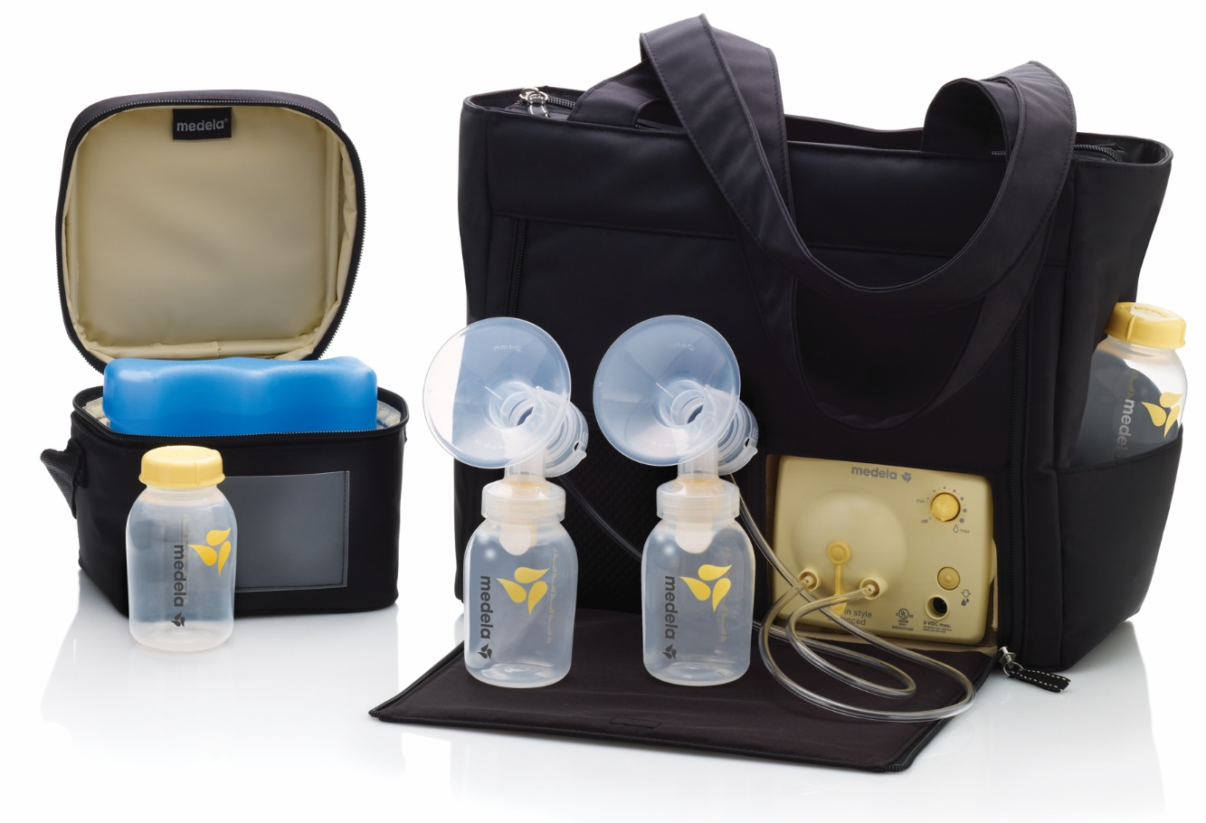
WIC and breast pumps
Multi-user breast pump loans for WIC mothers with medical needs (premature birth, multiple birth, etc.)
Personal pumps for WIC mothers temporarily separated from their babies for work or school (20 hours/week or more)
Manual pumps for WIC mothers with short-term separations (less than 20 hours/week)
Notes:
WIC offers breast pumps for women who cannot obtain a pump through their insurer and under certain circumstances. WIC offers the following pumps (listed above)

Slide 19
WIC and formula
USDA requires that WIC provide infant formula when mothers are unable or choose not to breastfeed
WIC is federally mandated to use a competitive bid process for standard infant formula as a means of cost containment
Current contract is with Abbott Nutrition for milk-based and soy-based formulas:
Similac Advance
Similac Soy Isomil
Notes:
The 19 calorie formulas will be changing by the end of 2019 and will no longer require medical documentation
Different formulas can be provided by WIC for those with a qualifying medical condition

Slide 20
WIC Medical Documentation Form
Use when a participant has a need/diagnosis for a medical formula
Limited to formulas allowed by Oregon WIC; formulary is listed on backside
Located on the Oregon WIC website as a fillable form or available as a tear-off pad
Notes:
Bring some MDFs. Offer some examples of when a MDF should be filled out.
Encourage providers to:
Complete all fields for formula & foods
Fax or return the completed form to your local WIC clinic
Re-authorize at least every 3 months and not to exceed 12 months

Slide 21
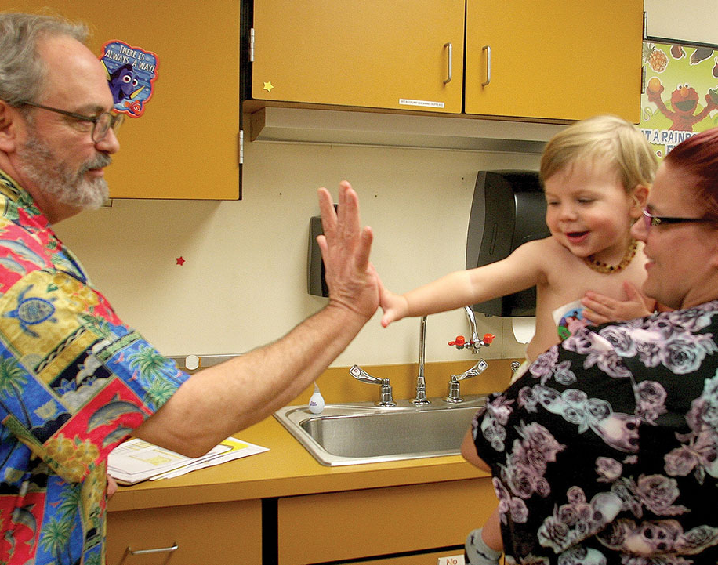
In summary- WIC can offer
Breastfeeding and nutrition expertise – IBCLCs, dietitians and trained counseling staff
Nutrition education resources
A rich social history of patients
Referrals to the doctor

Slide 22
What are ways we can coordinate care?
Connect with IBCLCs or peer counselors for breastfeeding resources
Have critical dialogs with WIC dietitians about infant formula or patients with greater medical complexity
Encourage staff to refer OHP patients that are pregnant, infants or children (up to age five) to WIC.
Help us identify what data you are interested in receiving and how can we share that
Notes:
Offer WIC outreach materials –WIC Rx pad, outreach brochures or posters

Slide 23
Let’s be in touch!
WIC contact information
List clinic sites and hours
What is our process to be in touch?

