Slide 1
IQIP
Immunization Quality Improvement for Providers
Image by David Mark from Pixabay

Slide 2
IQIP Process

Slide 3
Clinic Rates
]
Two-year-olds
30
Up to date rate^{[1]}
77%
Missed Opps
13%

Slide 4
Clinic Rates
]
13 to 17-year-olds
166

Slide 5
Clinic Rates
]
13 year-olds
37

Slide 6
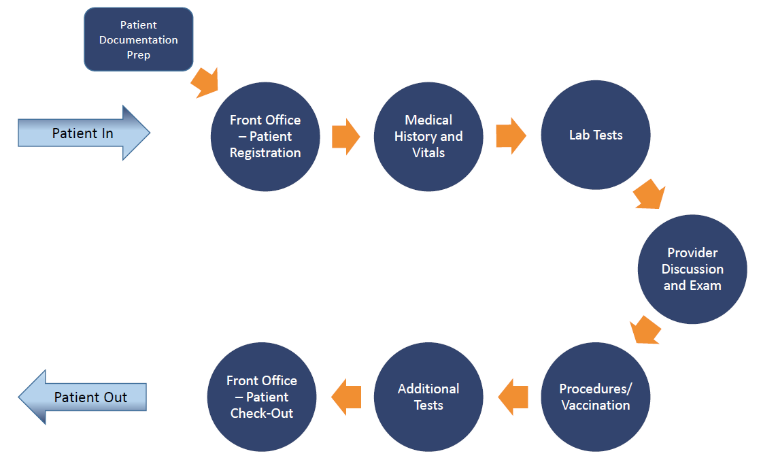
Workflow

Slide 7
Look for the gaps

Slide 8
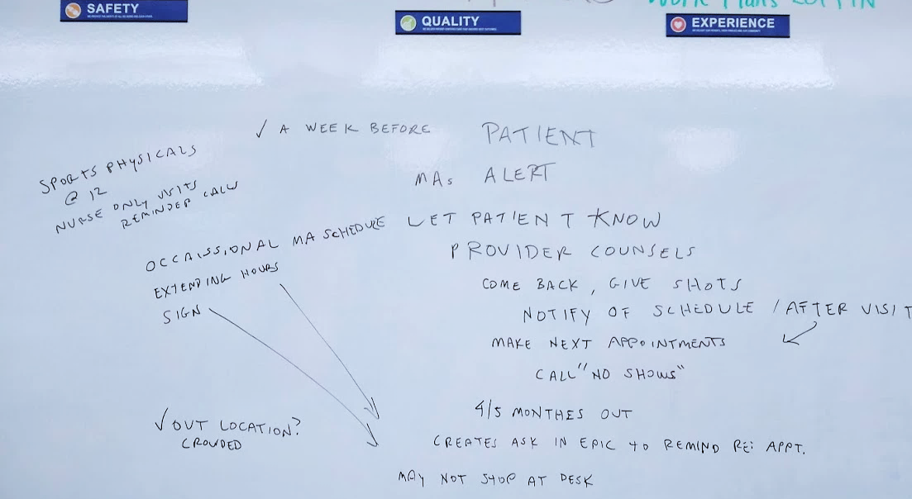

Slide 9
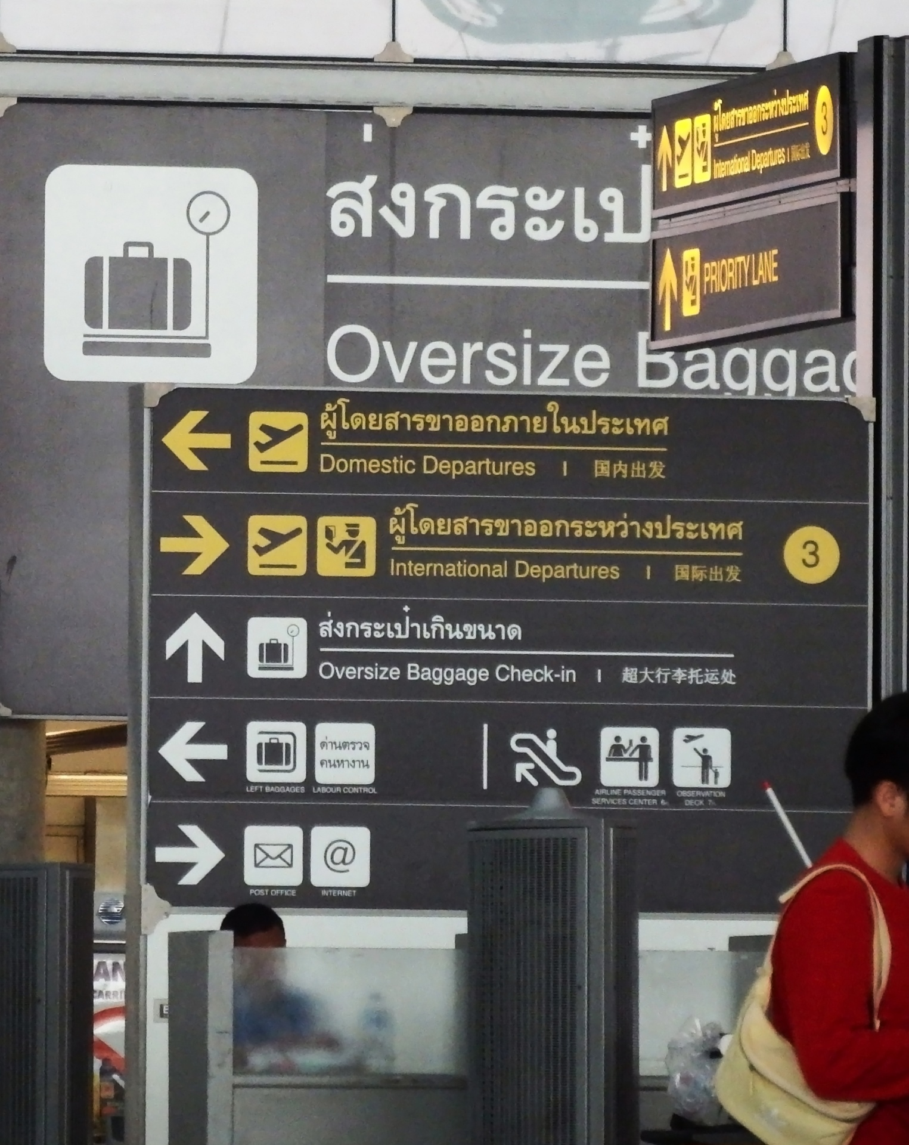
Gap
crowded and chaotic check out
station that’s hard to locate

Slide 10
Strategies

Slide 11
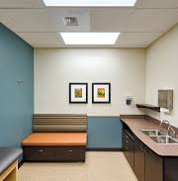
Schedule the next immunization appointment before the patient leaves the office
Put up a sign
Lengthen EHR scheduling window
Schedule while in exam room
Stay open late

Slide 12
Reminder/recall
Forecasting
Inactivate patients
Leverage
immunization information system (IIS) functionality to improve immunization practice

Slide 13
Give a strong
Agree on approach
Train all staff
Offer materials
vaccine recommendation (include HPV)

Slide 14
You’re not in this alone

Slide 15
Thank You
Fabrikam, Inc.
Jens Martensson
Questions?
+1 23 987 6554
jens@email.com
http://www.fabrikam.com/

