Slide 1


Portland Area Immunization Program
CAPT Thomas Weiser
Medical Epidemiologist
Portland Area IHS

Slide 2
IHS Mission
To raise the physical, mental, social, and spiritual health of
American Indians and Alaska Natives to the highest level

Slide 4
Oregon
Portland Area

Slide 5
Oregon
Portland Area

Slide 6
Immunizations Knowledge, Attitudes and Beliefs Project
Funding and Tribal Approval
Funded by Portland Area IHS, May, 2012.
NPAIHB Delegates approved the project at the June, 2012 Quarterly Board Meeting.
Approval from the Tribes hosting focus groups was obtained prior to holding the discussions.
Informed consent obtained from participants
http://www.npaihb.org/wpfb-file/immunizations-knowledge-attitudes-and-beliefs-final-report_6_18_19-docx/

Slide 7
Questions we hoped to answer:
Is low reported immunization coverage simply a data question?
Are NW AI/AN communities hesitant or resistant to immunizations like many non-AI/AN communities in the NW?
Do elders play a supportive role in immunizations through their experience with vaccine-preventable diseases?

Slide 8
Methods
Survey of healthcare workers in ID and OR clinics
Interviews with healthcare workers in ID, OR and WA clinics
  N=33
3 Focus groups with community members from AI/AN communities in OR and WA
  N=36

Slide 9
Concerns or Barriers to Immunization
Major themes included:
  Mistrust/Fear
  Inadequate information
  Parental logistical concerns
  Poor clinic reputation
  Community and personal aversion to immunizations
  Belief in natural immunity/natural lifestyle

Slide 10
Things that help increase vaccine acceptance
Information
  Making information understandable
  Advertising, newsletters, handouts
Personal Experience
  Having had the disease or a child with the disease
Community Support and Trust
Clinic Support
  Providers with time/ability to educate in plain language
  Having pediatricians was perceived as increasing
  confidence and acceptance of immunizations

Slide 11
Conclusions
Adequate patient education about immunizations was identified as an important concern of NW AI/AN community members.
Improving patient and provider education regarding immunizations is needed
Fear of vaccines (ingredients, side effects) and mistrust of government and pharmaceutical companies were important concerns

Slide 12
Limitations
First attempt at using qualitative methods
Some focus groups included HCW from the clinic
None of the focus groups was from a Tribe served directly by IHS

Slide 13
Next Steps
Develop patient education tools endorsed by Tribes and Tribal organizations trusted by community members
Develop healthcare provider education tools to help providers talk to patients more effectively
Share “Best Practice” recommendations for improving immunizations services

Slide 14
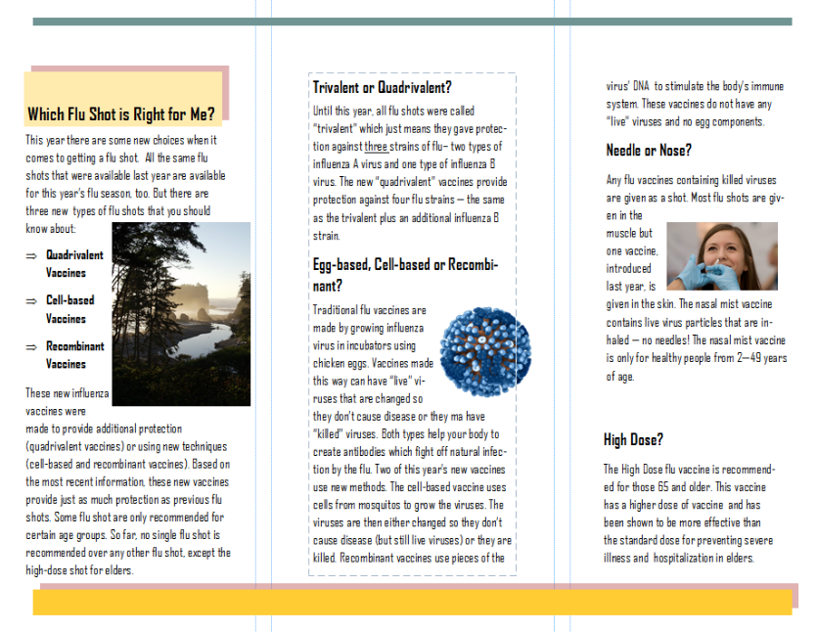

Slide 15
Acknowledgments
Portland Area IHS- funding
Monika Damron- student research assistant
Tam Lutz- qualitative analysis mentor
Clarice Charging- immunizations coordinator

Slide 16
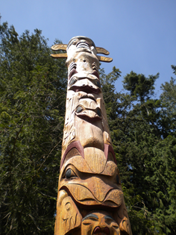
Thank
You!

