Slide 1
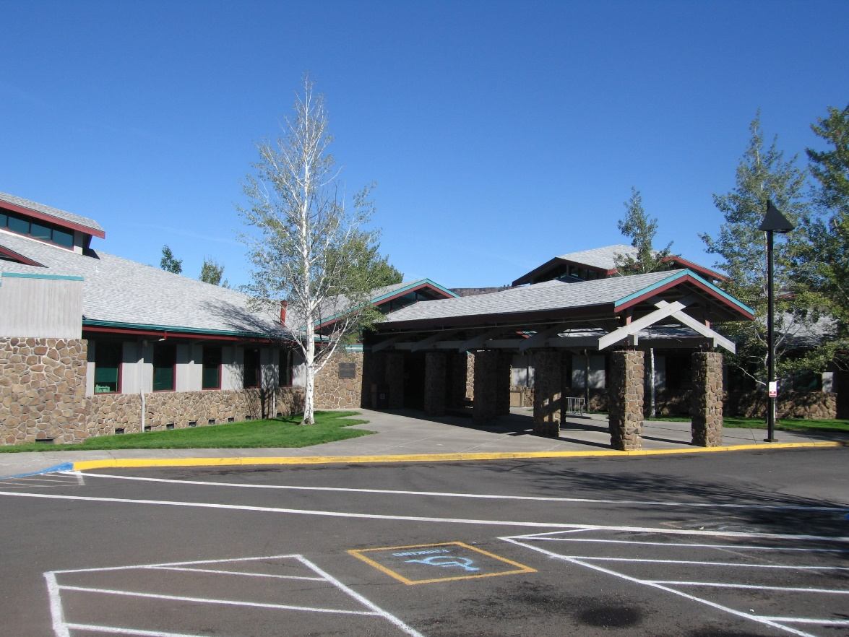
Warm Springs Health & Wellness Center
Strategies and tips for improved immunization rates

Slide 2
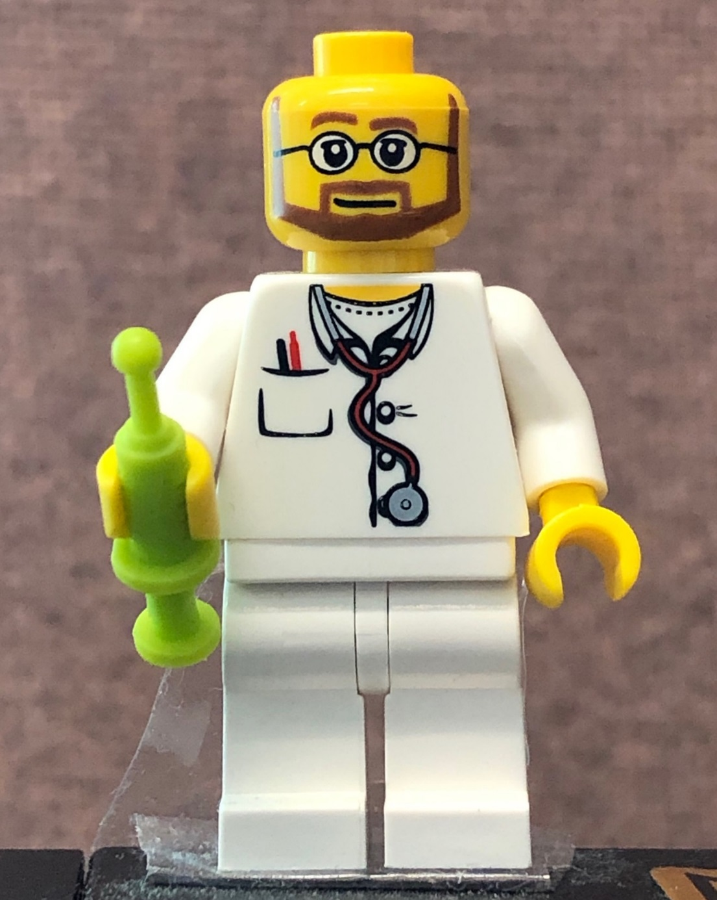
Marc R Mason, RN
Immunization Coordinator
Warm Springs Community Health
Notes:
This Lego Mini-fig was my fiancée’s graduation present to me. Seems a bit accurate.

Slide 3
Factors We Attribute Our Success To!

Slide 4
Manual Audits
Due letter, pull up chart, pull patient up in Alert, compare, chart note, rinse, repeat.
Marc R Mason, RN
Immunization Coordinator
Notes:
-Many, many manual audits while doing due letters.
-I will sit with stack of letters in front of me.
-Pull up each patient’s chart in EHR, & then pull patient up in ALERT
-Check EHR to make sure patient hasn’t been in for shots since printing (sometimes takes weeks to complete due letters between other duties). If so, document this in template & shred due letter.

Slide 5
Manual Entry
Updating outside Imms BEFORE creating visit defaults to Historical immunization entry, which reduces the number of clicks and fields you have to do.
Notes:
If patient has out of clinic imms in Alert not in chart, manually enter them (trick is to not create visit yet, so it defaults to historical imms & reduces the clicks & fields needed to navigate). After historical imms entered, create chart review encounter & chart based on template. If they still have imms due after updating records, reprint due letter from RPMS & send. **Show template example for chart review** Template automatically drop in list of immunizations due, and has half a dozen options based on the possible outcome of the audit.

Slide 6
Immunization Due Letter Chart Review Template
This has sped up due letters significantly.
Kindly created for me by Jim Gemelas.
Notes:
This has sped up due letters significantly. Kindly created for me by Jim Gemelas from the Copy & Paste word document I was using.

Slide 7
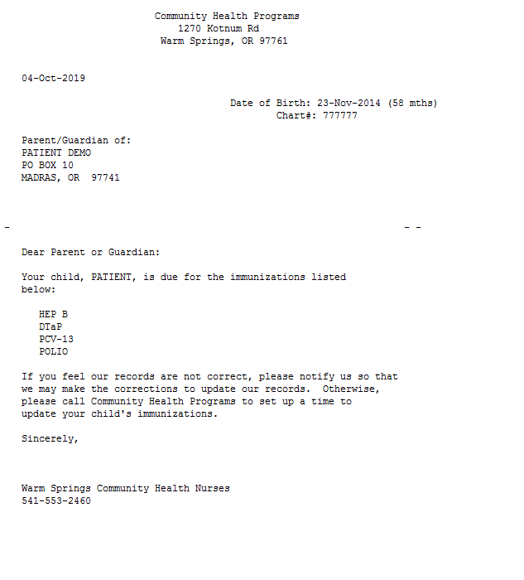
Due letters!
So, SO many due letters.
Notes:
Loooooong process, but it gets faster & faster each round of letters, as you catch the ones that need to be updated.
I don’t click “sign” after each chart note, I will instead just select the next patient- HER will automatically prompt you to sign your note. May not seem like much, but if clicking to sign, THEN clicking to select the patient adds 3 seconds per chart, and you have 300 letters to go through= 900 seconds/60= 15 MINUTES OF MOUSE MOVING AND CLICKING every other month.

Slide 8
WIC Staff
Our WIC staff are invaluable in capturing due patients.
Notes:
WIC Staff- Our Community Health department shares office space with our WIC staff, who are vital to our immunization process. I have shown them how to check the wellness tab for due immunizations, and if there is anything listed there, they let me know they have a patient due for shots.
-While they do the WIC visit, I prep due letter, VIS forms, screening checklist, etc and get ready to see the patient.
-When they finish, they put the patient in the room across the hall to wait for me, and come let me know.

Slide 9
WIC’s Schedule
When able, I scrub the patient charts on the WIC schedule and notate patients that are due for shots.
They have also been great at offering parents for us to get the flu shot!
Notes:
I have recently gotten access to the WIC schedule, and depending on how busy my morning is, I will scrub all of the patients on their schedule and put a note in the appointment notes such as “***Imms due*** -MRM”

Slide 10
Walk-ins!
The majority of our immunization visits are from either the aforementioned WIC schedule, or are walk-ins.
I do my utmost to be available for shots when not needed elsewhere.

Slide 11
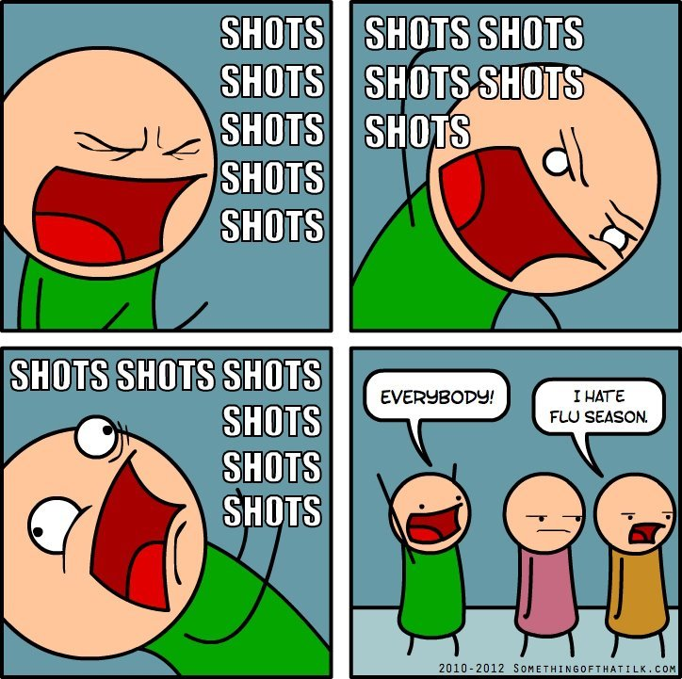
Actually me, on October 1st, every year. ….Who am I kidding…This is me EVERY day.
Marc, RN
Marc, RN
Marc, RN

Slide 12
Vaccine Waste Reduction Efforts

Slide 13
Pyxis System
The number of unaccounted for doses plummeted after installation of the Pyxis In Medical.
Notes:
Pyxis System- In December 2017, Medical installed a Pyxis in their shot room attached to the vaccine fridge. The number of unaccounted for doses dropped, since immunizations were now stocked in the Pyxis by myself and pharmacy. Previously, medical would come pick up boxes of whatever they were low on themselves, and take it down to their fridge. These were not tracked.

Slide 14
Vaccine Waste Log
Form I created in order to track immunization wastes and look for trends in this data.
Notes:
Vaccine Waste Log- I created the vaccine waste log in order to get a better idea of why immunizations were being wasted. There was a stretch where I kept finding prepped shots in the fridge without any information attached as to when they were prepped, who they were for, and who prepped them, up to a week after they had been initially prepared.
-I wanted to create more of a sense of accountability for the providers preparing the shots, so they would consider the cost of the wasted doses. Hence, the two separate columns for staff initials and signature.
-One specific example of how this guided change was that the Pyxis was set up with 2-, 4-, and 6-month “kits” for pediatric immunizations when set up 12/2017. In 2/2018 we changed to Pedvaxhib from ActHib, which removes a dose at 6 months. After noting several wastes with the reason “HIB not given at 6 months,” I checked the kit lists, and sure enough, Pedvaxhib was on the 6 month kit. I had poharmacy remove it from that kit. (Personally, I would like to move away from “kits”…)

Slide 15
Resource Sheet
Created in order to keep providers up to date on formulation changes, and get new providers up to speed rapidly.
Notes:
Resource List- Created as a quick reference in order to keep providers up to date on formulation changes, and get new providers up to speed rapidly.
-We have had a shortage of nurses, so we have a lot of locum nurses coming to our facility.
-It also helps illuminate the differences between the Adult and VFC stock, to ensure correct selection of vaccines.

Slide 16
Missed Opportunities!
In the process of going through due letters, I started auditing missed opportunities.
Notes:
Lots of repeat visits but no imms given,
-If a MD, NP, PA, RN, MA that could give shots or determine fitness to receive them had a note, but didn’t give them without anything noted about contraindications, I considered it a MO.
-Feeling crummy but no contraind., Give the shots! Don’t make fear coming in.
-Mostly, I would like to start with seeing documentation in notes saying not given for X reason, but eventually would like to see more pts updated at walk-in triage visits if able.
Vast majority walk-in triage. Also WCC, ER F/U, Hospital F/U, Sports Physicals, DOTs, BC, GYN, and….IMMUNIZATION VISITS!
And I am not immune- I did catch myself in a few of these visits missing opportunities to update patients’ imms.
177 Patients with a combined 437 missed opportunities, with a total of 352 vaccines NOT given.

Slide 17
Totals!
Over 562 Chart reviews, I found…
177 Patients
With a combined 437 MISSED OPPORTUNITIES
Totaling of 352 vaccines NOT given across these patients.

