Slide 1
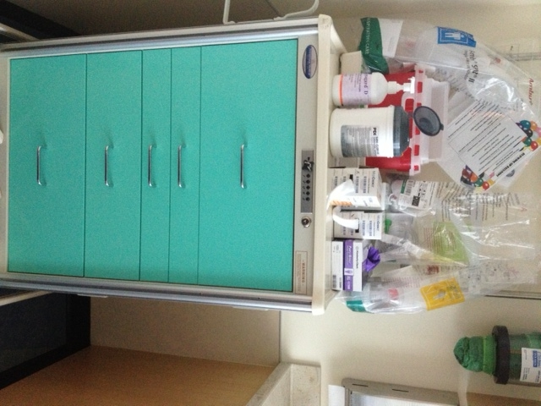
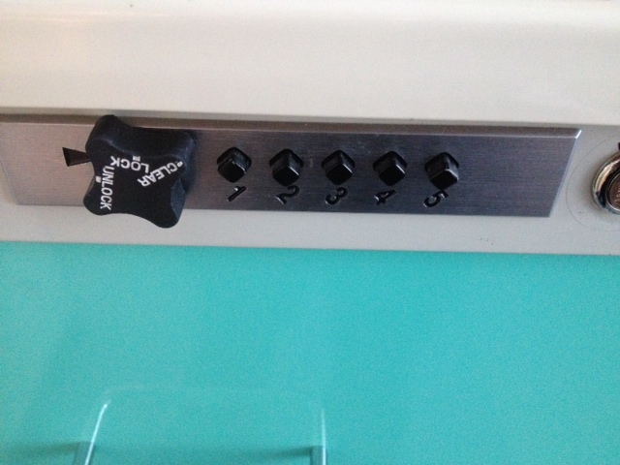
Peds Room Cart Configuration
Peds Rooms 1-10 all have a similar cart for respiratory equipment, IV supplies, blood draws, and fluids. On the back of each cart hangs an Ambu bag of each size. On top of each cart is a sharps container, Sani Wipes, and tube gauze.
CODE: 1-3-5
Cart must remain locked at all times when not in use
*When a bin in the cart is empty toss it on the top of the cart for refilling.

Slide 2
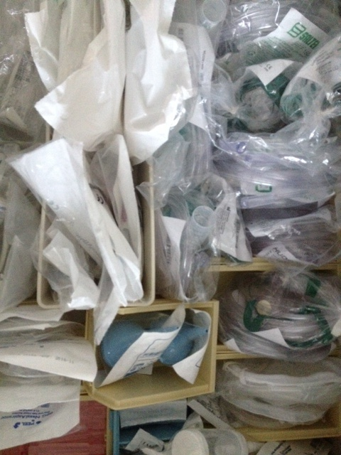
Drawer 1
Adult, Peds, Infant nasal cannulas
Adult and peds non-re-breather masks
Nebulizers
Suction sputum collection container
Bulb suction
Atomizer
Nasal aspirator
Saline Fish
Blood pressure cuffs

Slide 3
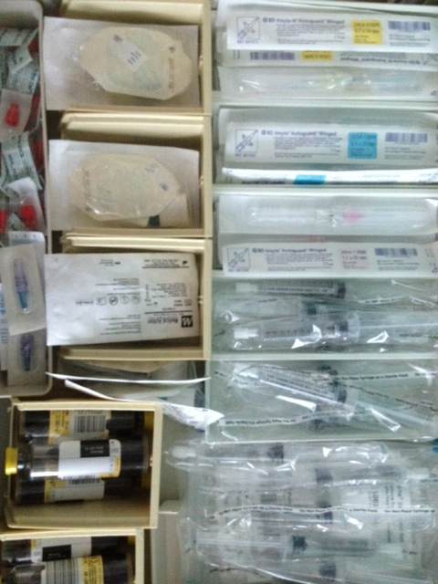
Drawer 2
Remember to only get blood cultures on febrile kids—don’t culture everyone!
Only 1 blood culture in kids <16 years old
Unless they have a central line then, culture every lumen
24G, 22G, 20G caths
IV start Kits
Red caps
Posi-flow valves
Saline flushes
T-connectors
Pediatric Blood culture bottles (for use with <16 years of age)

Slide 4
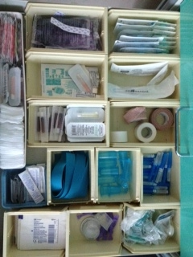
Drawer 3
Remember NO coban or circumferential tape on pediatric peripheral IV sites
Heel stick lancets
VBG syringes for Istat/Blood gases
Tape
Vacutainer
Pacifiers & Sweetese
Heat packs
Tegaderm
LMX
Mastasol
Iodine
Adhesive Remover
Chloraprep
Alcohol pads
2x2 sterile and non-sterile
Band-Aids

Slide 5
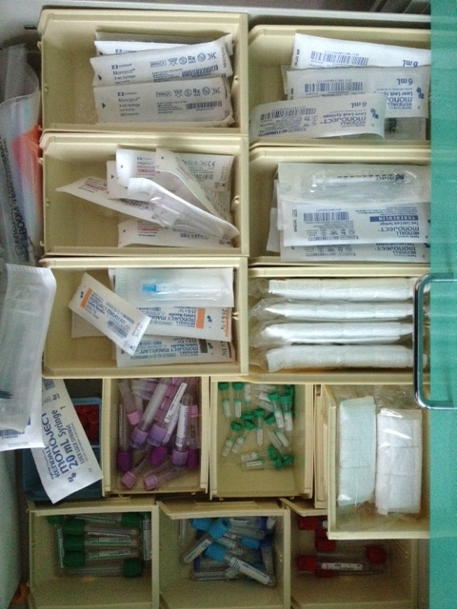
Drawer 4
3 mL Syringes
Tuberculin syringes
6 mL syringes
18 G needles
Various needles
Pediatric and Infant arm boards
12 and 20 mL syringes
Lab Specimen bags
Pediatric and adult blood tubes

Slide 6
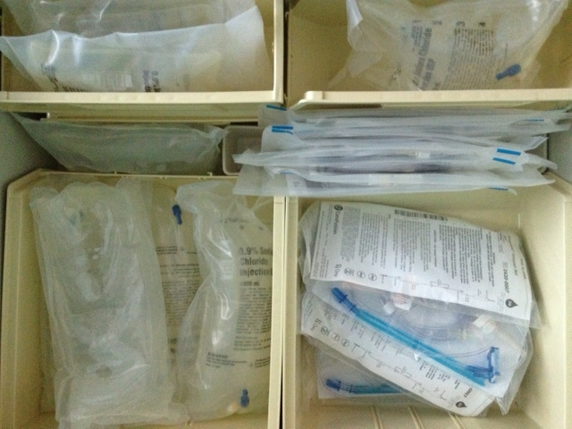
Drawer 5
Remember all pediatric fluids and medications must infuse on a pump per DCH policy.
Alaris Pump tubing
Syringe pump tubing
NS 250 mL, 500 mL, and 1 Liter bags

