Slide 1
Billable Vaccines Workgroup: Administration Fees January 15, 2012

Slide 2
Vaccine Administration Fees
Maximum allowable fee for VFC kids = $21.96
Fee must be waived if parent/guardian is unable to pay
For BILLABLE patients:
State does not cap – each agency determines amount
Admin fees may be billed to private insurance or the patient/parent
Public clinics across Oregon charge a wide range of administration fees:
$7.50-$50 for the first injection
$7.50-$27 for successive injections

Slide 3
Administration Fees at Your Agency…
Same fee for all payers?
VFC & private insurance
If so….why? Does the amount reflect a true cost of the service?
How was it determined?
Using DMAP allowable rate as guide
Using cost calculators
What feels right based on knowledge of community
Other?
How should it be determined, and why is it important to review…?

Slide 4
Admin Fee – Why so Important?
Set too low
Undervalues care provided
Sends false message re: the true cost of LHD services
Set too high
Turns away clients and insurers
Compromises “safety net”

Slide 5
Calculating Costs of Your Admin Fees*
Scheduling
Clinical staff time
Billing services
Registry use
Supplies
Medical waste disposal
Non-routine activities
Vaccine inventory, management, & ordering, telephone inquiries, providing vaccination records to requesters, etc.
*not meant to be an exhaustive list

Slide 6
Written Policy – Fee Assessment and Collection
Prices for state-supplied vaccine are set by the State of Oregon
Administration fees are determined by the costs involved in providing immunization services
For Medicaid clients, fee is reduced to maximum allowable amount ($21.96/injection)
For self-pay clients, fee is reduced to $xx. If a patient/parent states they are unable to pay the fee, the fee must be waived.
Private insurance companies and Medicaid/Medicare for adults are billed at the full fee
Notes:
Note the importance of having a written fee policy regarding immunization services.

Slide 7
AAP Cost Calculators*
Two free resources:
Vaccine Inventory Value Calculator: used to calculate the actual dollar value of your inventory of vaccines at any given time
Vaccine Administration Cost Calculator
*Developed for private clinics by the AzAAP. but may be used to guide calculations for LHDs and other public sites

Slide 8
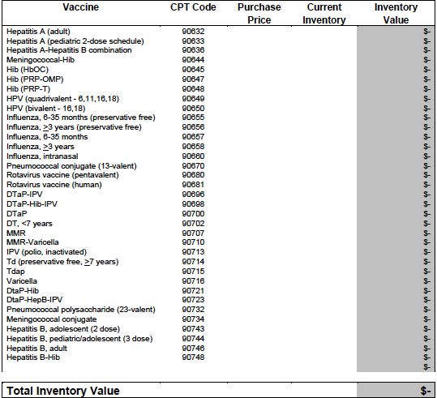
Vaccine Inventory Value Calculator
Notes:
Can be used for Billable doses—OR–-also to calculate the value of all vaccines given by your agency over a given period of time (useful w/ clinic administration, county commissioners, or in community health reports). Just put # of doses given during that period into the column marked “current inventory”

Slide 9
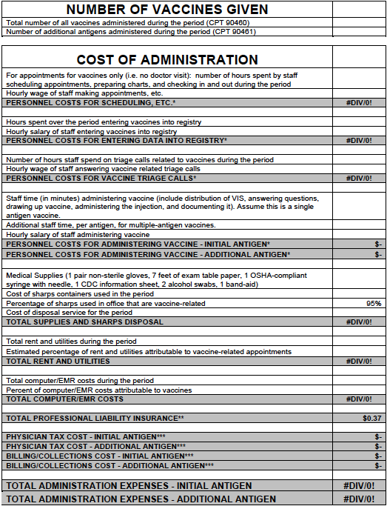
Vaccine Administration Cost Calculator
Vaccine(s)Given
Personnel Costs
Supply Costs
Rent & Utilities
Computer Costs
Total Admin Expenses
(1st inj. & Add’l inj.)
Notes:
Some lines removed.

Slide 10
Others…
Customized Fee Analyzer: Fee Information for Your Area and Specialty, by Ingenix
Oregon Family Planning program cost analysis resource, developed in 2011
Notes:
From Kern County, CA, billing guide.
From Family Planning program

Slide 11
We’re all in this together…
Notes:
Use the listserv!!! Post questions, ask for help, share resources.

