Slide 1
Where do we start? Assessing Health Equity in Your Program or Section
Katherine McGuiness & Liz Stuart

Slide 2
Introductions

Slide 3
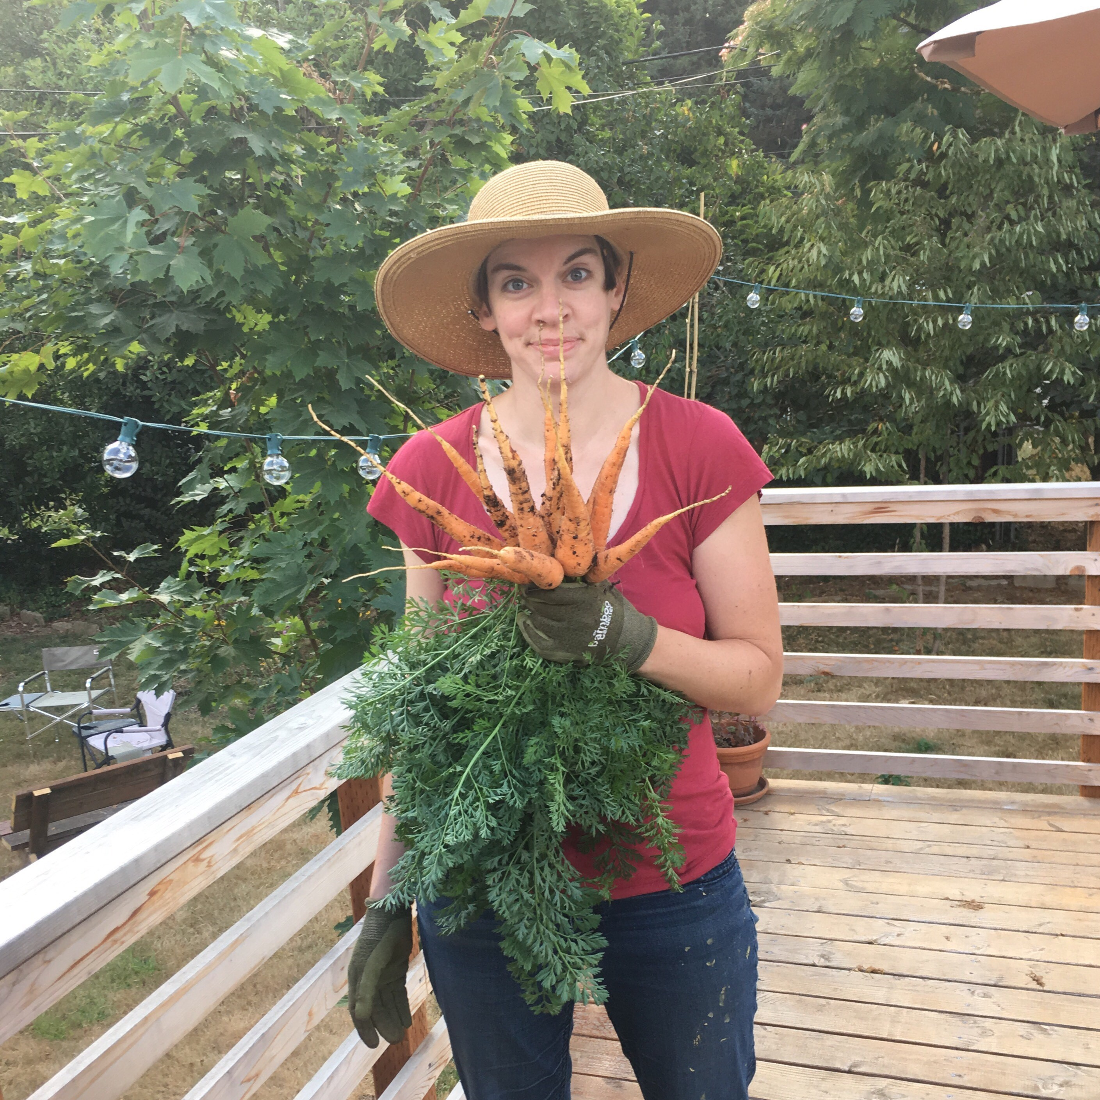
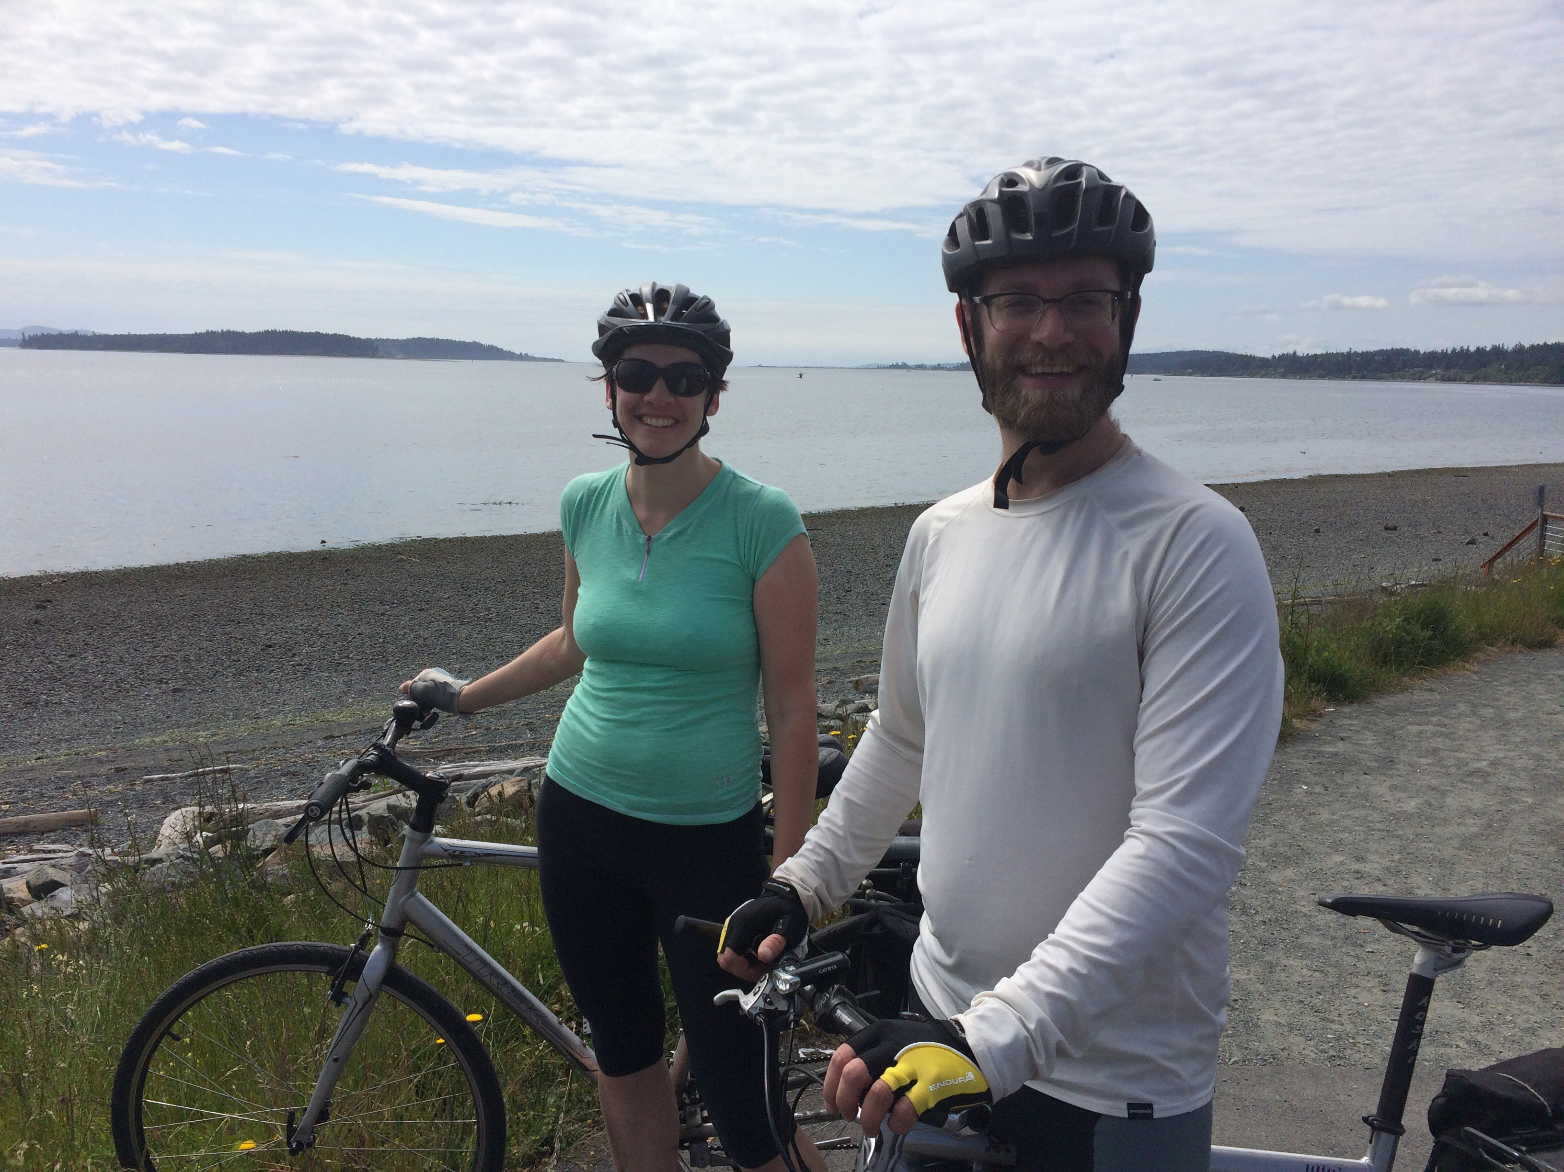
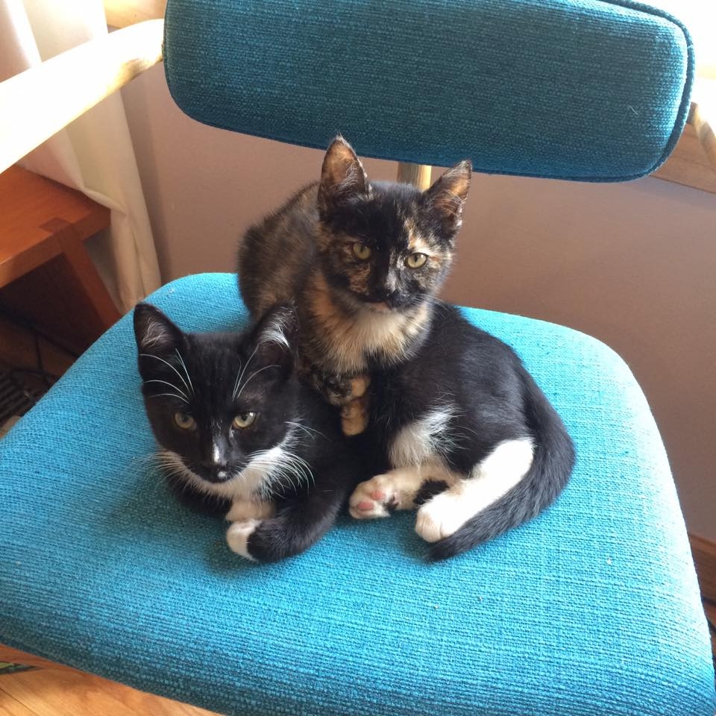
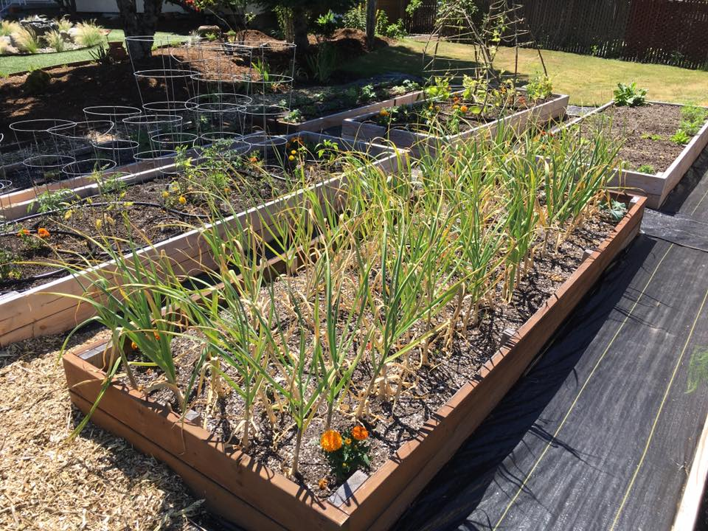
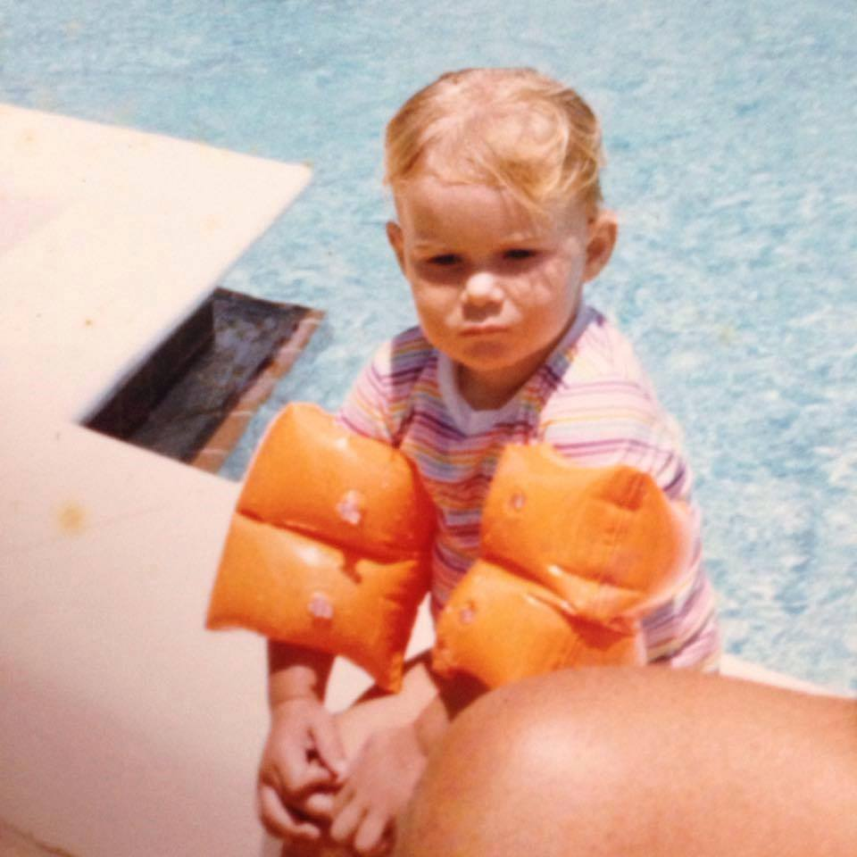
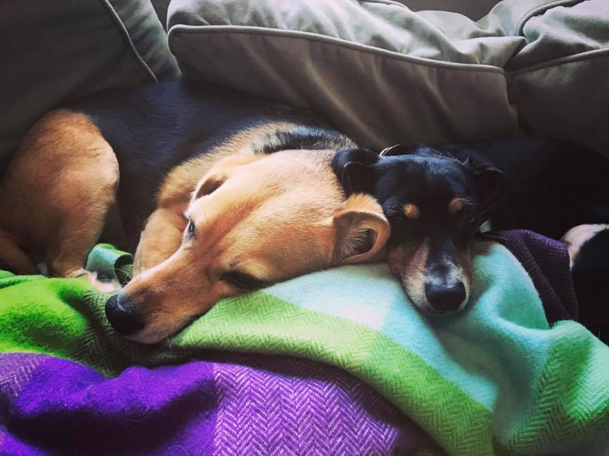
About Us: Liz & Katherine

Slide 4
Why an assessment?
Gives you a place to start
Makes health equity work feel less nebulous for concrete thinkers
Creates a snapshot of current equity work
Provides common language and a path forward
Creates an opportunity for participation from your section or program

Slide 5
How did we get started?
MCH
Health Equity Work Group already existed, exploring where to go with future work
AGRH
Health Equity Committee already existed, and was looking for a way to focus our work and create a path forward

Slide 6
What assessment Tools were reviewed?
Bay Area Regional Health Inequities Initiative: Local Health Department Organizational Self-Assessment for Addressing Health Inequities
CLAS Self Assessment Tool
King County Equity Impact Review Tool
Multnomah County Equity and Empowerment Lens
Western States Center: Racial Justice Assessment Tool
CDC Health Equity Checklist
Coalition of Communities of Color: Protocol for Culturally Responsive Organizations
Coalition of Communities of Color: Tool for Organizational Self Assessment Related to Racial Equity

Slide 7
Selecting and modifying the assessment Tool
Coalition of Communities of Color: Tool for Organizational Self Assessment Related to Racial Equity
CCC is a local organization
Tool was co-created with PSU researchers
Technical assistance available from CCC
Key partners had used the same tool
Leads with race
Comes with the Protocol for further nuance
Is the tool meaningful for your organization?
Think about modifications

Slide 8
Conducting the assessment
Introduced assessment at section meeting
Small assessment workgroup was gathered that represented the section (10-12 people)
Assessment was completed in 3 offsite work sessions
Section staff as facilitators
Started with training
Why leading with race, building shared understanding of terminology
Established community agreements
Provided food/treats and coloring sheets, fidget toys
Flexibility to allow for processing time, to be fully present in the work

Slide 9
Lessons Learned
Important to establish at the beginning why you are leading with race
Build shared language, understanding of terminology (e.g. equality vs. equity, white privilege, systemic oppression)
Keep focused on what is happening in your section or unit right now (snapshot, not history)
Keep focus on assessment, not problem solving/work planning
Management involvement is crucial, but champions can be found at all levels of work

Slide 10
What happens after the assessment?
Write up assessment results/findings
Bring that report back to the assessment group to make sure everything was captured
Bring results to your larger section or program
Have section review results
Gather section feedback on priorities for work planning
Attend Part 2 session tomorrow!
Now What? Developing and Implementing a Plan for Equity
9-10 AM in Room 1E

Slide 11
Questions or Clarifications?

Slide 12
Small Groups/Conversation
Discuss and think about:
Is your section doing any intentional health equity work? If so- how is it organized?
Do you have health equity champions in your program/section? If so- who are they?
Do you think your section is ready for an assessment? Do you need to do an assessment? Do you WANT to do an assessment?
What are some concrete next steps you can take to move this work forward?

