Slide 1
Monkeypox (hMPXV) Update
August 18, 2022
Notes:
Pat and Rachael

Slide 2
Today’s Agenda
What is monkeypox (hMPXV)?
Who can get hMPXV
Who is most affected in the current outbreak?
How does hMPXV spread?
How to prevent hMPXV
hMPXV symptoms
Treatment for hMPXV

Slide 3
What is monkeypox (hMPXV)?

Slide 4
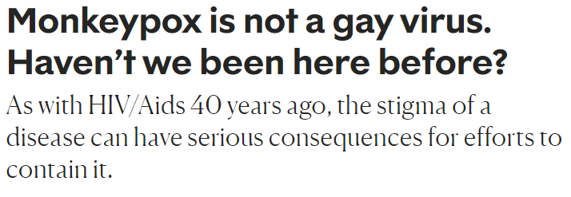
Headlines

Slide 5
What is hMPXV?
Member of the Orthopoxvirus genus of Poxviridae family
Same genus as smallpox
Two distinct genetic clades, or variants:
hMPXV-1 (more severe, more transmissible)
hMPXV-2 (less severe, less transmissible) – current outbreak
Has emerged in the context of smallpox eradication and subsequent cessation of smallpox vaccination campaigns in the late 1970s
Has been active in 11 West and Central African countries since the 1970s
U.S. outbreak in the Midwest related to prairie dogs housed with near small mammals imported from Ghana
Travel-related cases from Nigeria to U.S., U.K., and Singapore (2018-2022)
Notes:
Tim

Slide 6
Why hMPXV?
As a name, “monkeypox” is othering, discriminatory, stigmatizing
The currently circulating variant has been typically called the “West African” clade to differentiate it from the “Congo Basin” clade
The name is also scientifically inaccurate
The natural hosts for the virus are rodents and not non-human primates
Compounded by media use of images of Black/African people to illustrate how the virus presents
African scientists have called for a renaming of the virus, especially in the context of a global outbreak that has no clear link to Africa
https://virological.org/t/urgent-need-for-a-non-discriminatory-and-non-stigmatizing-nomenclature-for-monkeypox-virus/853

Slide 7
hMPXV defined
Therefore, we’ve adopted the naming system advocated by African scientists
To be very technical, the virus circulating in the current global outbreak is hMPXV-2
h = human
MPXV = monkeypox virus
2 = type 2 (less transmissible, less severe illness compared to type 1)

Slide 8
What hMPXV is Not
hMPXV is not a gay disease
hMPXV is not an African disease
hMPXV is not a sexually transmitted infection/disease
Notes:
Tim

Slide 9
Who can get hMPXV

Slide 10
Who is most affected in the current outbreak?

Slide 11
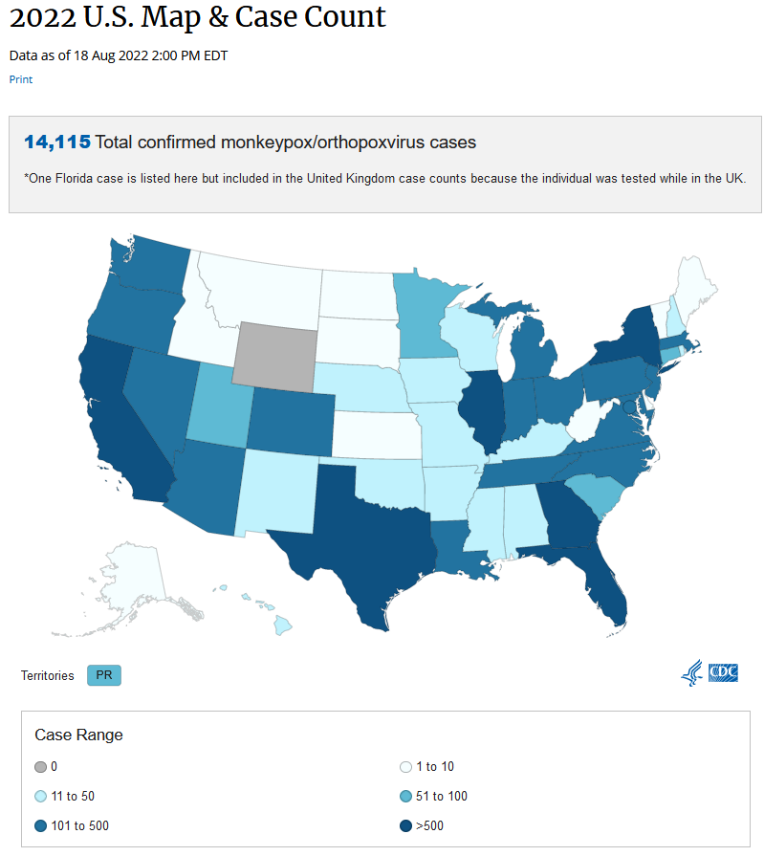
Notes:
Tim

Slide 12
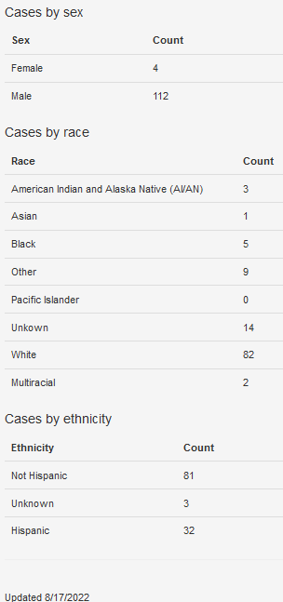
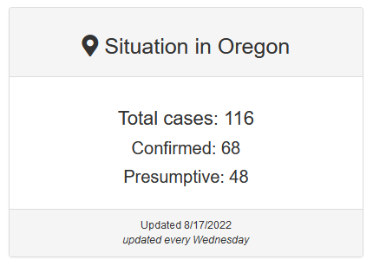
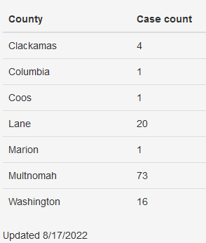
Oregon Cases
Notes:
Tim
36% under Latinx umbrella
Percentages do not add
Differences with US: 13 cases assigned female at birth, 2 pediatric cases, 1 pregnant case

Slide 13
People living with HIV are disproportionately impacted by hMPXV
41/116 (35%) of hMPXV cases are people living with HIV
Notes:
Tim
36% under Latinx umbrella
Percentages do not add
Differences with US: 13 cases assigned female at birth, 2 pediatric cases, 1 pregnant case

Slide 14
Projected Course of the Outbreak
Too soon to make definitive conclusions
Provider awareness and education
Testing and health care access for those with hMPXV
Vaccine availability
Isolation support
Suspect that current case numbers represent an underestimate of the true number of cases
In the short term (next 1-2 months), we expect a continued rise in cases
Based on UK, EU, and early US experience, hMPXV may affect women and children in Oregon
Notes:
Tim

Slide 15
How does hMPXV spread?

Slide 16
hMPXV Transmission
Direct, prolonged skin-to-skin contact with the sores, scabs, or fluids of the rash of a person with hMPXV
Much less likely
Touching/sharing clothing, linens, towels, or other objects used by a person with hMPXV
Contact with the respiratory droplets/secretions of a person with hMPXV
hMPXV is transmissible from the start of symptoms to when the rash has healed over with new skin (2-4 weeks, also the duration of isolation)
Notes:
Tim

Slide 17
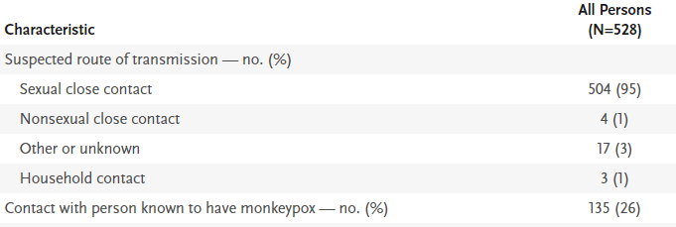
hMPXV Transmission
Direct, prolonged skin-to-skin contact with the sores, scabs, or fluids of the rash of a person with hMPXV
Touching/sharing clothing, linens, towels, or other objects used by a person with hMPXV
Contact with the respiratory droplets/secretions of a person with hMPXV
Transplacental
Thornhill et al. NEJM, 2022
Notes:
Tim

Slide 18
Characteristics of People with hMPXV: International Case Series and CDC Data
Thornhill et al. NEJM, 2022; Philpott et al. MMWR, 2022
Notes:
OR is super different!

Slide 19
How to prevent hMPXV

Slide 20
Potential Vaccine Supply Need
Oregon pop = 4,246,155
Oregon male pop (49.9%) = 2,118,831
Oregon pop of men who have sex with men (4.2%) = 88,991
Number of vaccine doses needed to vaccinate all Oregon men who have sex with men = 177,982
First dose at day 0, second at day 28
Notes:
Tim

Slide 21
While Vaccine Supply is Limited, OHA is Prioritizing:
Close contacts of people with hMPXV (PEP)
People with factors that may indicate recent exposure to someone with hMPXV (PEP+)
First doses of Jynneos
To vaccinate as many people as possible
To rapidly develop community immunity
Will plan to provide boosters in 2-3 months rather than at 28 days except for people with moderate or severe immune compromise
Supported by the available data
Adopted by UK, Canada, NYC, California, Colorado, Washington, Hawaii
Notes:
Tim

Slide 22
An Intersectional Approach to Vaccine Distribution
Delivering PEP+ with an intersectional approach through partnerships that prioritize:
Black, Latinx, Indigenous, Native Hawaiian/Pacific Islander, and Asian people
People living with HIV
Sex workers
People experiencing houselessness
People experiencing incarceration
People who use methamphetamine
People with conditions that may lead to more severe illness
Notes:
Tim

Slide 23
Vaccine Distribution Partners So Far
LPHA partners
Health systems
OHSU
HIV clinic
Richmond Clinic
Kaiser Permanente HIV/PrEP
Samaritan Health
CBO partners
Portland Street Medicine
HIV Alliance
Department of Corrections
Klamath Tribal Health
OHA clinical team
FQHC/Clinical partners
Virginia Garcia Memorial Health Center
Neighborhood Health Center
PRISM/Cascade AIDS Project
Outside In
Carreon Health
Aviva Health
Happy Doc Family Medicine
Notes:
Tim

Slide 24
Vaccine eligibility: interim guidance

Slide 25
hMPXV symptoms

Slide 27
Testing
Nationally, the US Laboratory Response Network (LRN) has the capacity to perform 10,000 tests/week
Oregon State Public Health Laboratory is part of the LRN and is offering testing
Capacity to test 70 specimens/week
143 specimens tested since 5/25/2022
51 positive specimens (from 32 patients) sent to CDC for confirmation
Seven commercial laboratories are also offering testing with the capacity of 70,000 tests/week nationally
Notes:
Tim

Slide 28
hMPXV outcomes
4 received TPOXX
3 hospitalizations (pain, secondary bacterial infections)
0 deaths
Thornhill et al. NEJM, 2022

Slide 29
“Classic” hMPXV course
Incubation period 6-13 days (range 5-21): likely not infectious
Invasion phase (days 0-5): possibly infectious
Fever, headache, malaise, LAD (generalized, axillary, cervical), myalgia, back pain, asthenia
Skin eruption (within 1-3 days of fever): infectious
Typically sores develop and evolve together, centrifugal
Macular, papular, vesicular, pustular, scab
Well-circumscribed, deep-seated, painful
Face (95%)
Palms and soles (75%)
Oral mucosa (70%)
Genitals (30%)
Conjunctivae (20%)
Self-limited illness lasting 2-4 weeks

Slide 30
“Classic” lesions

Slide 31
Clinical symptoms in current cases
Rash or enanthem in all patients
Scattered or localized to a body site
Lesions in different phases of development
Rash often starts in mucosal areas
Proctitis: anorectal pain, tenesmus, rectal discharge, bleeding with visible peri-anal lesions
Oropharyngitis: tonsillar swelling, abscess, dysphagia
Prodromal symptoms absent or follow rash appearance
Co-infections with STI, including acute HIV infection

Slide 32
Rash features in current cases
Thornhill et al. NEJM, 2022

Slide 33
Treatment for hMPXV

Slide 34
Isolation Guidance

Slide 35
Supportive Treatment
Skin/pruritis: calamine lotion, petrolatum, anti-histamines, dressings
Povidine-iodine may prevent secondary bacterial infection and kill hMPXV virus
Mouth: baking soda rinses, “magic” mouth wash, topical benzocaine
Urethral pain: phenazopyridine
Proctitis: sitz baths, topical lidocaine, stool softeners
APAP, NSAIDs, consider short-course of opiate pain medication

Slide 36
Antiviral treatment
Tecoviromat (TPOXX)
Inhibits viral spread to uninfected cells by targeting the orthopoxvirus protein F13 (VP37) which is involved in producing extracellular enveloped virions
Approved based on the “Animal Rule”
For people with or at risk for severe hMPXV
PO/IV forms
Request from OHA
Other antivirals: cidofovir, brincidofovir
Vaccinia IG
Ocular disease: trifluridine
Notes:
Tim

Slide 37
Response to hMPXV

Slide 38
OHA Response to hMPXV
Responses
Communications
Community engagement
Testing
Vaccination
Treatment
Goals
Empower people with the tools they need to stay healthy
Support LPHAs, clinicians, health systems in the hMPXV response
Prevent the further spread of hMPXV
Prevent suffering related to hMPXV
Reduce fear and anxiety related to hMPXV
Notes:
Tim

Slide 39
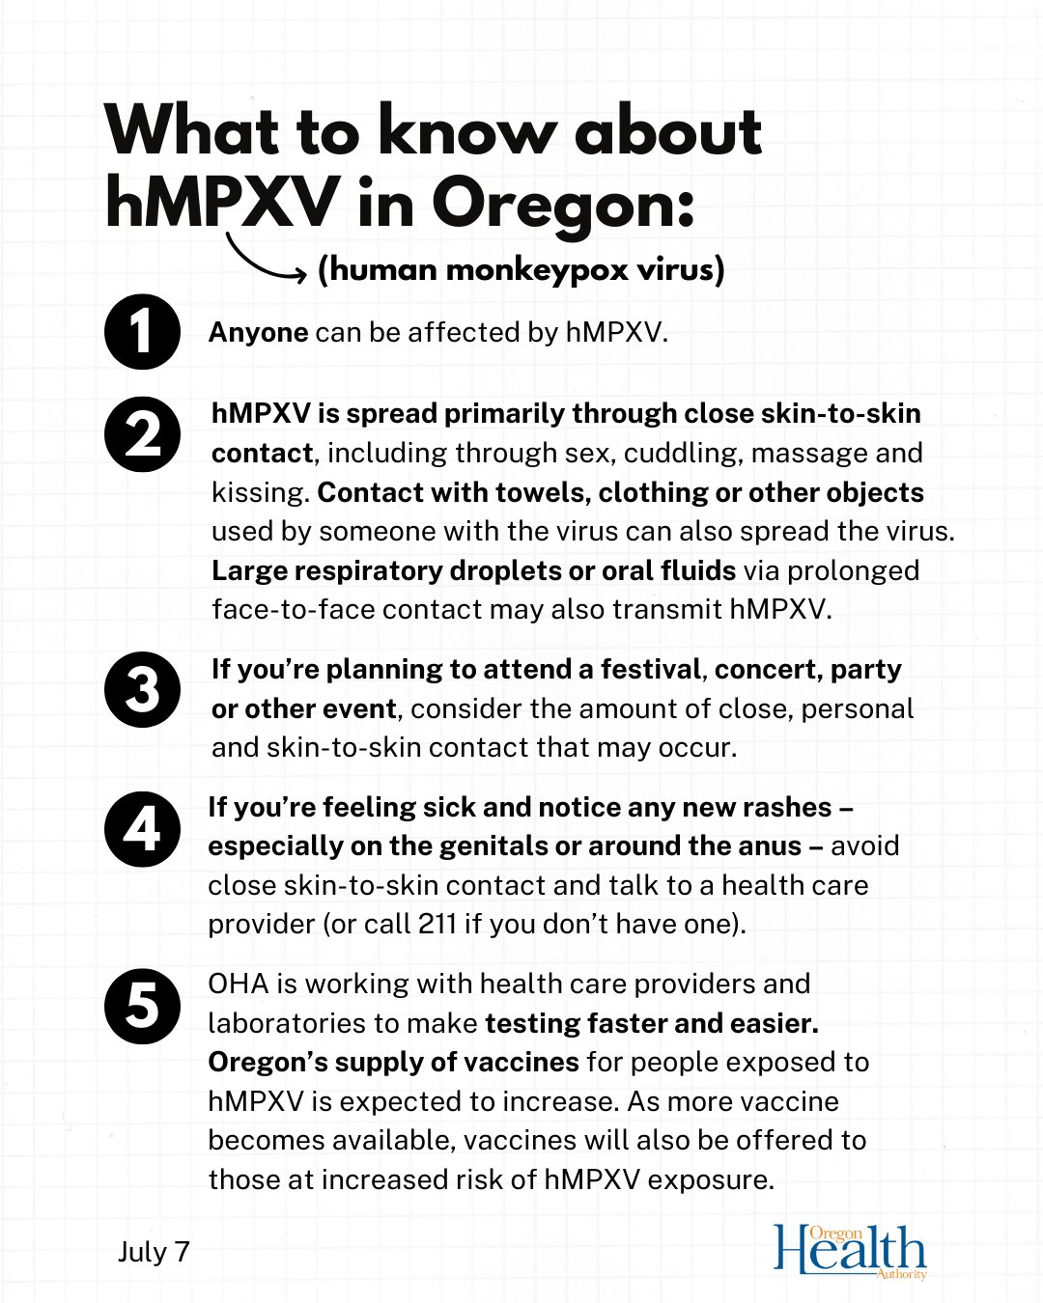
Communications
Press conference
OHA Website for hMPXV
Communications to Clinicians
Recognition of hMPXV
Testing
Treatment
Frequently Asked Questions
Translations
Joint Information Center (JIC)
Notes:
Tim

Slide 40
Community Engagement
Community listening session
Worked with LPHA partners and community in developing community letters and other outreach, including social media
Vaccine and prevention messaging
Developing guidance on activities and their risk of hMPXV transmission
Tri-county vaccine equity listening session
Queer/LGBTQIA+ provider advisory group
Notes:
Tim

Slide 41
Current and Planned Actions
Declaration of Condition of Public Health Importance
Increase community engagement
Listening session with the Latinx LGBTQIA+/queer community
Co-creation of education and prevention materials with community
Increase provider and health system engagement
Distribute vaccine with an intersectional approach
Support partners in timely reporting to ALERT
Monitor ALERT to address disproportionate impact on Latinx community
Adapt vaccine strategy to include more people who can benefit from vaccine prior to potential exposure to hMPXV
Notes:
Tim

Slide 42
Thank you
Notes:
Pat and Rachael

