Slide 1
COVID-19 Vaccine: People experiencing houselessness
Presented by:
Rebecca Knight-Alvarez, OHA
Rob Smith, OHA Vaccine Planning Unit (VPU)
Notes:
Public health director

Slide 2
Agenda
General
Vaccination update
About the COVID-19 vaccine
How and where to get the vaccine
People experiencing houselessness
Strategies: Bringing the vaccination to the unhoused
Outreach and vaccine confidence
Resources
Vaccine Readiness Tool – Considerations for populations experiencing houselessness
Vaccine Partnership Interest Form
Additional community resources
Q&A

Slide 3
Media
This webinar is not intended for members of the media. To connect with OHA as a member of the media, please contact:
orCOVID19.media@dhsoha.state.or.us
Notes:
Liliana

Slide 4
General Vaccine Information
Notes:
Public health director

Slide 5
Everyone in Oregon can get the vaccine now!
Timeline for Unhoused populations:
Adults and youth 16 and over eligible March 29
All people age 16 and over in Oregon eligible as of April 19

Slide 6
Context: where we are now
Over 2.6 million doses of vaccine administered so far to nearly 1.6 million people
Roughly 1,091,777 people in Oregon have been fully vaccinated*
Vaccine supply has been very limited for the last few months, but is increasing significantly
Increases arriving next week and should be maintained at high levels for the next few months
Oregon will have enough doses to vaccinate everyone (16 and older) who wants a vaccine by early June
*As of 12:01 a.m. 4/22/2021

Slide 7
About the COVID-19 vaccine

Slide 8
Vaccine authorized through an EUA
COVID-19 vaccines in the U.S. were authorized by the FDA through an Emergency Use Authorization due to:
Global pandemic
Number of lives already lost

Slide 9
Pfizer and Moderna vaccines
Vaccine | Current minimum age | Number of doses for full protection | Time needed before second dose | Vaccine Effectiveness | Timeframe for effectiveness
Pfizer | 16* | 2 doses | 21 days | 95%​ | 2 weeks after second dose
Moderna | 18* | 2 doses | 28 days | 94.10% | 2 weeks after second dose
*Trials are underway for people under age 16
Notes:
Both vaccines were tested against symptomatic COVID-19. We don’t have data on asymptomatic infection.
They were both only tested against Wuhan strain, because they were done earlier in time. We don’t have definitive data against other variants for these vaccines.
They are both highly effective at 94-95% 2 weeks after second dose of vaccine. We don’t know much about the duration of immunity after vaccination.

Slide 10
Effectiveness of Johnson & Johnson vaccine
Use currently on pause
One dose vaccine that was tested against three different strains of virus, later in time with much higher baseline COVID-19 incidence.
Highly effective at preventing severe disease 85% against all strains of virus. Moderate disease at 72% in United States.
93% protection against hospitalizations.
Effectiveness starts 14 days after the dose and has been studied up to 28 days after. There is evidence that antibody production continues to increase at least until day 56.
Notes:
(and lower for South Africa strain – 66%).
South Africa; 57% (95% of cases were South Africa variant)
United States: 72%
Central & South America: 66%

Slide 11
Vaccine safety
COVID-19 vaccines are safe, and they work.
The COVID-19 vaccine was developed and tested in real-life scientific studies with tens of thousands of people around the world from many ethnic and cultural backgrounds, including Oregonians.
Studies show that COVID-19 vaccines work very well at keeping you from getting COVID-19 and help keep you from getting seriously ill even if you do get COVID-19.
You cannot get COVID-19 from the vaccine.

Slide 12
Concerns About Johnson & Johnson Vaccine
As of 4/12/2021, more than 6.8 million people have received the Johnson & Johnson vaccine
The CDC and FDA are reviewing 6 reported cases of a rare and severe type of blood-clot post Johnson & Johnson vaccine
All 6 cases were people assigned female at birth between the ages of 18 and 48
Symptoms started 6 to 13 days post vaccination

Slide 13
What steps to take consideration during the pause:
People who have received the Johnson & Johnson vaccine who developed severe headaches, abdominal pain, leg pain, or shortness of breath within three weeks after vaccination, should contact a health care provider
This extreme caution is good. The significant adverse reaction rate is currently less than 1:1,000,000.
Moderna and Pfizer are still great and available COVID-19 vaccination options

Slide 14
COVID-19 vaccine side effects
Side effects will vary from one person to another
Last 1-2 days at most
Normal signs that your body is building protection
Side effects may include one or more:
Local side effects:
Pain at the injection site
Redness
Swelling
Systemic side effects:
Joint pain
Headache
Fever (less common)
Muscle aches
Tiredness
Chills
Notes:
While side effects may seem inconvenient, t

Slide 15
After vaccination
Continue prevention measures:
Why?
The vaccine will keep you from getting sick, but it still may be possible to spread COVID to others. Vaccination gives us hope that the pandemic will end, but in the meantime, we need to continue safety measures to keep the virus from spreading: Wear a mask, physically distance from others, wash your hands, avoid gatherings and stay home when you’re sick.

Slide 16
When can individuals experiencing homelessness get a vaccine?

Slide 17
Background and Considerations
People experiencing houslessness are some of the most vulnerable Oregonians.
The unhoused community:
has a life expectancy that is 17.5 years shorter than those that are housed
is dispersed throughout the state and is highly mobile
is unable to self isolate to employ preventative measures to stay healthy
often has tri-morbidity or conditions that put them at higher risks for death from illnesses like COVID-19
has history that makes it untrusting of traditional medicine or the government

Slide 18
Qualifying underlying people who are experiencing houselessness
Unsheltered Individuals 16 and over who are living in encampments or that are on the street
Sheltered Ages 16 and over examples include:
Emergency: Provides temporary housing based on community needs. Categories include domestic violence shelters, sexual abuse shelters, shelter from natural disasters, shelter from the street, or other temporary emergency situations
Transitional: Provides housing for people transitioning from one stage in life (incarceration, substance use disorder, etc.) to permanent housing
Other:
Underhoused (staying with friends);
Receiving rental assistance; or
Living in car or RV on the street

Slide 19
Vaccine confidence
Overall, 37% of people in Oregon have gotten vaccinated. Over 60% of people say they will get vaccinated.
To build vaccine confidence, it is important to share information about:
Vaccine safety
Vaccine effectiveness
Side effects
For people who are hesitant, seeing someone they know get a vaccine makes them more likely to get vaccinated

Slide 20
Where and how
to Get the COVID-19 Vaccine

Slide 21
Typical vaccination connections
Mass vaccination clinics
Local public health authorities
Pharmacies
Federally Qualified Health Centers
Mobile clinics
Tribal health authorities
Veteran’s Administration health providers
Work sites / worker housing sites
Primary care providers (in some areas now with more coming soon)
Notes:
Mass vaccination clinics, such as the Oregon Convention Center and similar sites in Deschutes, Jackson, Lane, Benton and Marion counties.
Local public health authorities, who work with local providers, including some hospitals and health clinics, to get shots in arms.
Pharmacies. Right now, some Bi-Mart, Costco, Health Mart brand pharmacies, Rite-Aid, Safeway/Albertson’s, Walgreens, and Walmart locations are offering COVID-19 vaccines. More pharmacies will join as more vaccines become available.
Federally Qualified Health Centers (also called Community Health Centers). Some sites offer the vaccine.
Mobile clinics for specific at-risk populations (for example, older adults unable to leave their home for a vaccine, or people with developmental disabilities).
Tribal health authorities for tribal members and their families.
Veteran’s Administration health providers for service members receiving care through the VA.
Work sites or worker housing sites of some large employers.

Slide 22
Vaccine Distribution Strategies for the Unhoused
Bring the people to the vaccine
Healthcare facilities
Pharmacies
Bring the vaccines to people
Homeless service sites
Frequently visited areas
Mobile units
Notes:
Mass vaccination clinics, such as the Oregon Convention Center and similar sites in Deschutes, Jackson, Lane, Benton and Marion counties.
Local public health authorities, who work with local providers, including some hospitals and health clinics, to get shots in arms.
Pharmacies. Right now, some Bi-Mart, Costco, Health Mart brand pharmacies, Rite-Aid, Safeway/Albertson’s, Walgreens, and Walmart locations are offering COVID-19 vaccines. More pharmacies will join as more vaccines become available.
Federally Qualified Health Centers (also called Community Health Centers). Some sites offer the vaccine.
Mobile clinics for specific at-risk populations (for example, older adults unable to leave their home for a vaccine, or people with developmental disabilities).
Tribal health authorities for tribal members and their families.
Veteran’s Administration health providers for service members receiving care through the VA.
Work sites or worker housing sites of some large employers.

Slide 23
Waiting for Single-Dose Vaccine to serve unhoused people
Waiting for a particular vaccine (i.e. Johnson & Johnson) to serve the unhoused is problematic:
Stigma - Validates stigma that unhoused people are less important than others
Access and Trust - It erodes trust and takes away vaccine access
Effectiveness - Studies have shown that one dose of either the Moderna or Pfizer vaccine to be between 89 and 92% effective
Tracking second doses
HUD created recommendations for tracking vaccine status.
Frontline providers are generally able to keep track of second doses for their patients.
Based on currently available data we believe that advocating for a “one-shot” approach must not delay access to the vaccine for people who are homeless.
Notes:
The two-dose Moderna and Pfizer vaccines have been shown to be 94% to 95% effective, respectively

Slide 24
Second dose follow-up
Actions homeless service providers can take to improve second dose follow-up:
Request updated contact information and alternate ways to reach people
Everyone will receive vaccination cards with the date, type, and location of vaccination. Keeping a secure copy of the card and providing a space for safe storage of vaccination cards can serve as a second dose reminder
Integrate second dose appointment reminders into routine interactions
Conduct targeted outreach to connect with individuals who could be lost to follow-up

Slide 25
Communication Planning
Creating a communication plan to reach people experiencing homelessness will be critical to successfully distributing the vaccine in this population. Use multiple communication strategies such as:
Flyers at encampments, in shelters, social services providers, and on public transportation;
announcements at healthcare and other service programs;
messages via email, text messaging, social media, television, and radio;

Slide 26
Communication Planning
Create videos that can be shared with a tablet or phone
Advertise in advance of vaccination events for people experiencing homelessness;
Engage and connect with trusted communicators, such as people with lived experience of homelessness, who can provide vaccination education and information to people experiencing homelessness, in planning and hosting events

Slide 27
Vaccination Strategies
Successful events for the unhoused will rely on 5 primary strategies:
Establish trust. Unhoused service providers and local health organizations must work together to meet the needs of individuals in this population
Meet people where they are. It’s hard to worry about vaccination when you don’t have water to drink, or you are avoiding a violent situation
Multi-purpose events. Multi-purpose events like a health connect, allow for individuals to receive better services along with vaccination
Provide vaccine outreach early and often. Better communication means better results
Make the event repeatable. This ties to building trust and the nomadic nature of individuals in this population
There is no wrong door:
It takes great community partnerships to ensure our unhoused community members have good access to vaccination services

Slide 28
Building Vaccine Confidence
Factors such as misinformation and distrust of healthcare system may contribute to COVID-19 vaccine apprehension or hesitancy.
Actions homeless service providers can take to improve vaccine confidence:
– Choose to get vaccinated yourself.
– Start conversations early.
– Engage in effective modes of communication (1:1, video’s)
– Be prepared to answer common questions
– Address misinformation by sharing key facts
Identify vaccine ambassadors: trusted people who can answer questions about COVID-19 vaccination and encourage their peers and network to get vaccinated

Slide 29
Research-based messaging guidance
Lead with empathy and speak to shared values
Emphasize that vaccines are safe and effective
Acknowledge concerns, and provide scientific, unbiased answers
Acknowledge it will take time to vaccinate everyone. Not everyone will be able to get a vaccine as soon as they’re eligible
Don’t ignore that there are side effects, diminish, or exaggerate them
Remind your audience:
Vaccination protects you and your community
When enough people get a vaccine, we will be able to see our loved ones, celebrate holidays and return to more of our normal life

Slide 30
Resources

Slide 31
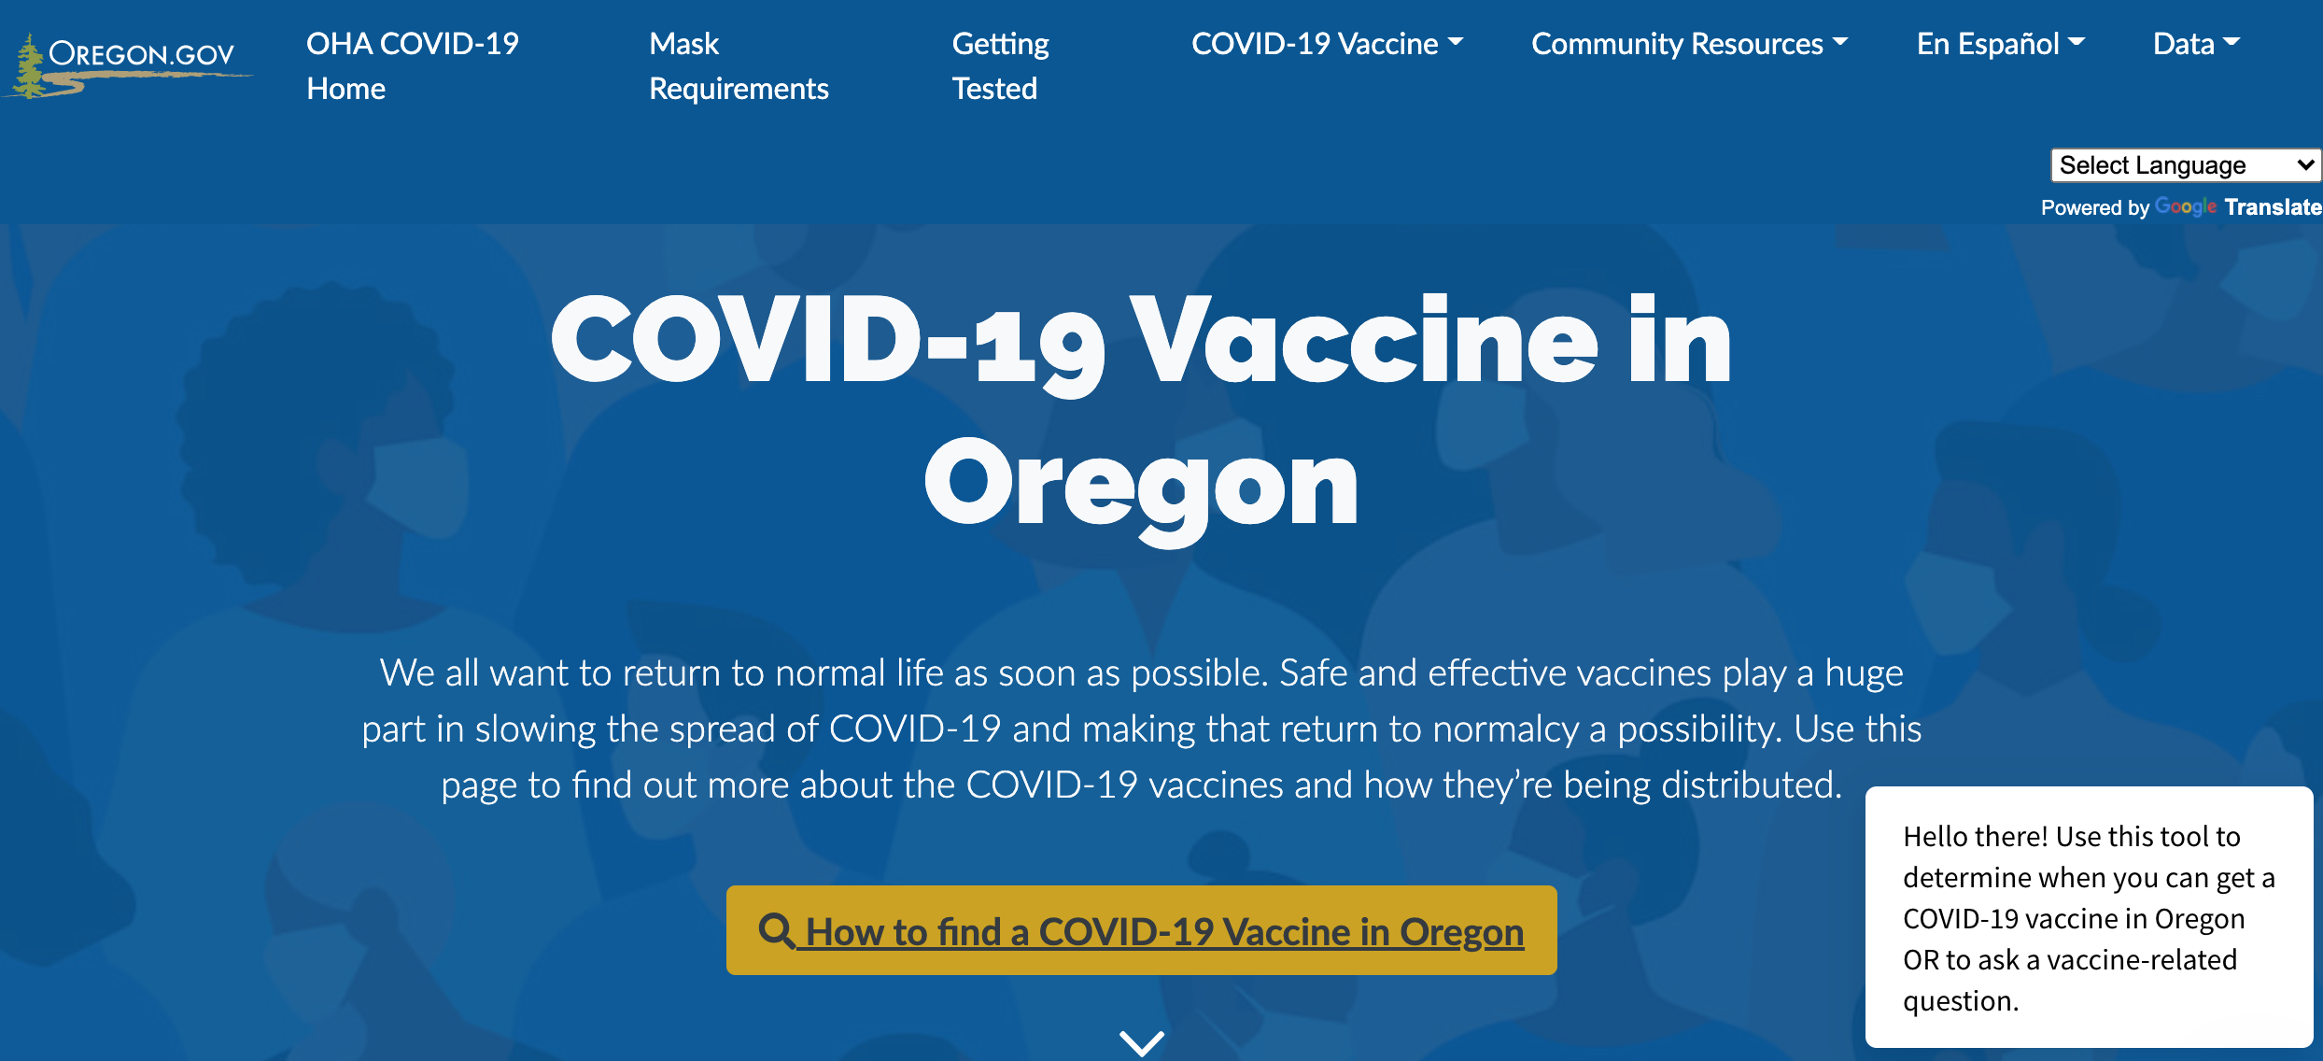
How to get the COVID-19 vaccine
Notes:
We are showing you this so that you can help individuals in your population register for a vaccination using regular channels.

Slide 32
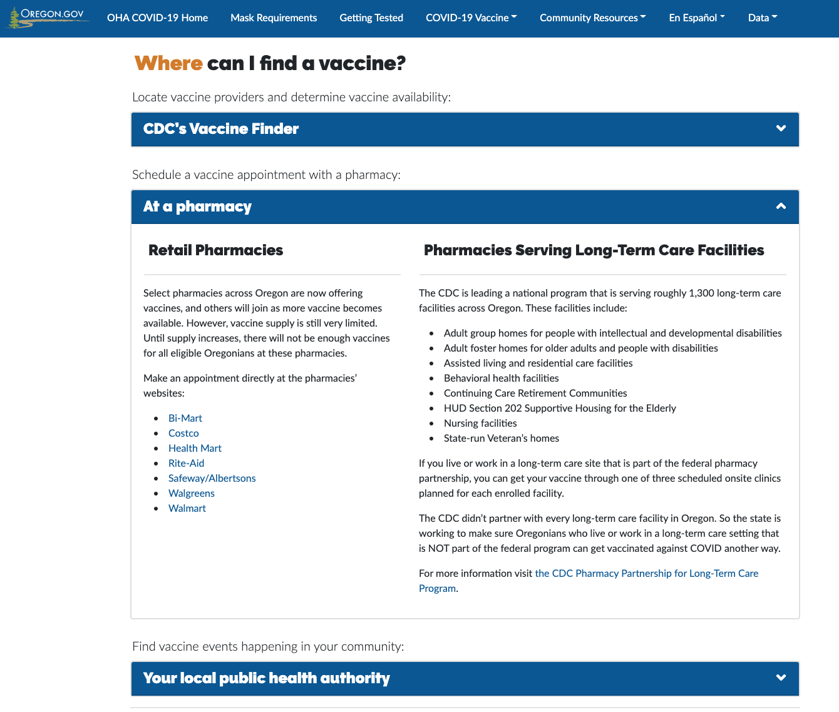
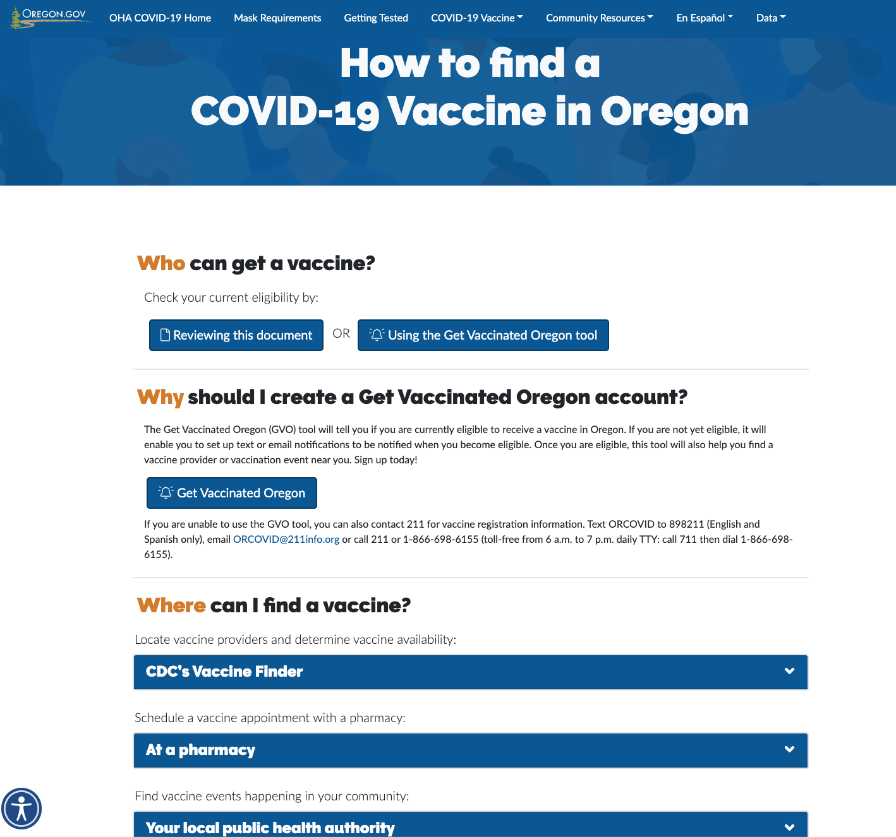
How to get the COVID-19 vaccine

Slide 33
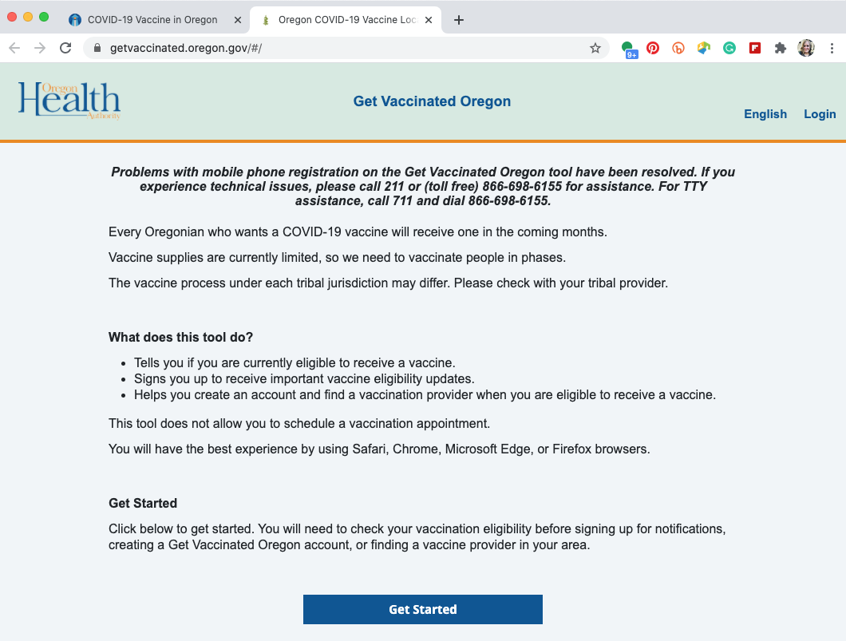
Get Vaccinated Oregon tool

Slide 34
Know before you go

Slide 35
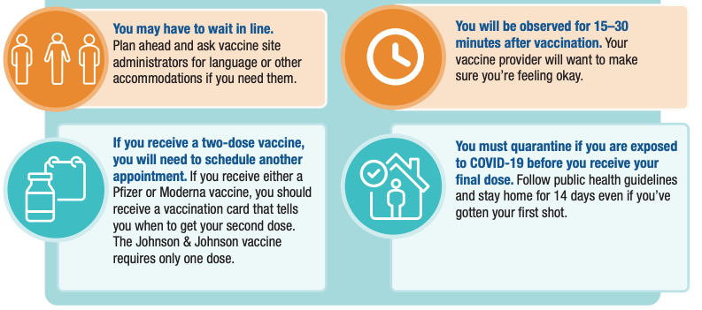
Know before you go
Notes:
COVID-19 vaccines are free.
You may need to get two doses. You get the second shot 3 or 4 weeks after you get the first one. If you get a two-shot vaccine, it is important for you to get both shots for the vaccine to work.
After COVID-19 vaccination, you may have some side effects.
You will still need to wear a mask and physically distance after getting the vaccine for now.
You do not need to show proof that you have an underlying health condition.
You are not required to show proof health insurance, ID or a social security number, though some vaccine providers may ask for it.

Slide 36
Community resources page

Slide 37
Vaccination Fast Facts

Slide 38
Vaccine Readiness Tool – Considerations for populations experiencing houselessness

Slide 39
Questions & Answers

Slide 40
Questions?

Slide 41
Thank you! And a reminder…

