Slide 1
Hazard Mitigation Assistance (HMA)
Oregon State Hazard Mitigation Officer (SHMO)
Amie Bashant (on leave until April)
503-378-4660
shmo@mil.state.or.us
Deputy State Hazard Mitigation Officer (DSHMO)
Anna Feigum
503-798-7240
shmo@mil.state.or.us
Notes:
Anna is the new Deputy SHMO. She joined us on Monday and will be covering down for me while I’m out 19JAN-1APR. Please continue to send inquires to shmo@mil.state.or.us as we are both receiving emails from that address.

Slide 3
HMA Grant Programs
Pre-Disaster:
building resilient infrastructure and communities (BRIC)
*Formerly, pre-disaster mitigation (PDM)
flood mitigation assistance (FMA); and
Post-Disaster:
hazard mitigation grant program (HMGP);
hazard mitigation grant program post fire (HMGP-PF)
Notes:
*PDM was replaced by BRIC in FY20
Focus of the webinar is post-disaster, however we’ll be going over pre-disaster grants briefly due to the amount of inquiries I’ve received.

Slide 4
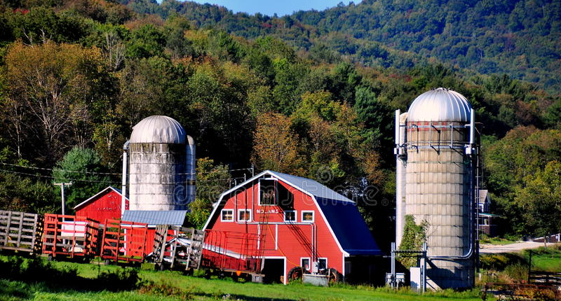
Current Open Post-Disaster Rounds
HMGP-PF-FM-5327-OR
Tied to the 16 FMAGs
HMGP-DR-4562-OR
Tied to the 15 September 2020 Disaster Declaration
Notes:
5327: 16 current FMAGs x $629,281 = $10,074,896 available in federal funds + management costs
The HMGP Ceiling for each FMAG is $629,681 (will decrease as the state lost enhanced status on it’s state mitigation plan on 23 September 2020)

Slide 5
 | HMGP-PF-FM-5327-OR | HMGP-DR-4562-OR
Directly Affected Areas | Clackamas, Coos, Douglas, Jackson, Jefferson, Josephine, Klamath, Lake, Lane, Lincoln, Linn, Marion, Tillamook, Wasco, Washington, and Yamhill Counties in addition to Warm Springs Indian Reservation | Benton, Clackamas, Columbia, Coos, Deschutes, Douglas, Jackson, Jefferson, Josephine, Klamath, Lake, Lane, Lincoln, Linn, Marion, Multnomah, Tillamook, Wasco, Washington, and Yamhill Counties in addition to any Tribal lands that were directly affected
Incident Type | - | Oregon Wildfires And Straight-line Winds
Declaration Date | August 13, 2020 (first FMAG declaration) | September 15, 2020
SHMO sent out initial statewide guidance | September 25, 2020 | October 24, 2020
Pre-application due to SHMO | January 15, 2021 April 15, 2021 | April 1, 2021 July 1, 2021
Subapplication due to SHMO | February 19, 2021 May 28, 2021 | August 25, 2021 November 29, 2021
Subapplication due to FEMA from SHMO | March 30, 2021 June 28, 2021 | September 15, 2021 December 14, 2021
Period of Performance | March 30, 2024 June 28, 2024 | September 15, 2024 December 14, 2024
Federal Funds | $10,074,896.00 | $60,045,205.00 (per 30-day estimate)
Federal Funds Still Available as of 1/6/2021 | $6,390,453.50 | $42,917,288.40
Notes:
Those areas directly affected will take priority, however other entities are encouraged to submit pre-applications and will be taken into consideration as well.
Please note that a modification to the Application Period will result in a change to the Period of Performance end date. For HMGP, the Period of Performance ends no later than 36 months from the close of the application period.
If completed sooner/prior to the pre-application or subapplication deadlines, you may submit them sooner.

Slide 6
Who is eligible to apply for HMA funding?
Priority of Funds
Those entities within the HMGP grant declared disaster area will take priority during the application process, however all entities interested in funding are encouraged to apply.
Natural Hazard Mitigation Plan Requirement (PNPs exempt)
To be an eligible subapplicant, entities must have a FEMA-approved National Hazard Mitigation Plan (NHMP) – or be annexed into one – at the time of HMGP award. However, an Extraordinary Circumstances Exception (ECE) can be submitted at the time of award for a one-year extension.
If your entity is interested in applying for HMGP funding but does not have a current FEMA-approved NHMP, please contact the SHMO to discuss possible options.
Notes:
E.5.3 Extraordinary Circumstances For HMGP project subawards, the Regional Administrator may grant an exception to the local or Tribal Mitigation Plan requirement in extraordinary circumstances when justification is provided. If this exception is granted, a local or Tribal Mitigation Plan must be approved by FEMA within 12 months of the award of the project subaward to that community. For PDM and FMA project subawards, the Region may grant an exception to the local or Tribal Mitigation Plan requirement in extraordinary circumstances. For PDM and FMA project subawards, the Region may apply extraordinary circumstances when justification is provided and with concurrence from FEMA Headquarters (Risk Reduction and Risk Analysis Divisions) prior to granting an exception. If this exception is granted, a local or Tribal Mitigation Plan must be approved by FEMA within 12 months of the award of the project subaward to that community. For HMGP, PDM, and FMA, extraordinary circumstances exist when a determination is made by the Applicant and FEMA that the proposed project is consistent with the priorities and strategies identified in the State or Tribal (Standard or Enhanced) Mitigation Plan and that the jurisdiction meets at least one of the criteria below. If the jurisdiction does not meet at least one of the following criteria, the Region must coordinate with FEMA Headquarters (Risk Reduction
Part III. Eligibility Information 45
and Risk Analysis Divisions) for HMGP; however, for PDM and FMA the Region must coordinate and seek concurrence prior to granting an exception: ♦ The jurisdiction meets the small impoverished community criteria (see Part VIII, B.2). ♦ The jurisdiction has been determined to have had insufficient capacity due to lack of available funding, staffing, or other necessary expertise to satisfy the mitigation planning requirement prior to the current disaster or application deadline. ♦ The jurisdiction has been determined to have been at low risk from hazards because of low frequency of occurrence or minimal damage from previous occurrences as a result of sparse development. ♦ The jurisdiction experienced significant disruption from a declared disaster or another event that impacts its ability to complete the mitigation planning process prior to award or final approval of a project award. ♦ The jurisdiction does not have a mitigation plan for reasons beyond the control of the State, federally-recognized tribe, or local community, such as Disaster Relief Fund restrictions that delay FEMA from granting a subaward prior to the expiration of the local or Tribal Mitigation Plan. For HMGP, PDM, and FMA, the Applicant must provide written justification that identifies the specific criteria from above or circumstance, explains why there is no longer an impediment to satisfying the mitigation planning requirement, and identifies the specific actions or circumstances that eliminated the deficiency. When an HMGP project funding is awarded under extraordinary circumstances, the Recipient shall acknowledge in writing to the Regional Administrator that a plan will be completed within 12 months of the subaward. The Recipient must provide a work plan for completing the local or Tribal Mitigation Plan, including milestones and a timetable, to ensure that the jurisdiction will complete the plan in the required time. This requirement shall be incorporated into the award (both the planning and project subaward agreements, if a planning subaward is also awarded).

Slide 7
Life of an HMA subapplication: Applying for Funds
Subapplication Period Opens
Pre-application/Letter of Intent
Subapplication
Review Panel*
Revise Subapplication
State Approval and Submittal to FEMA
Notes:
Application Period: HMGP and HMGP-PF
HMGP – 1 year after Disaster Declaration
HMGP-PF – 6 months after September 30th (end of Federal Fiscal Year)
Application Period: FMA, PDM, BRIC
4 Months - NOFO is issued 4-6 weeks prior
State sends out a Notice of Funding Opportunity along with a blank Letter of Intent
LOI – A brief project summary and cost
State reviews eligibility and provides application and guidance
Subapplication development –
State’s application for HMGP/HMGP-PF and
for BRIC,FMA, PDMC the application is in FEMA GO beginning in 2020 (PDM19 and prior is in eGrants)
Complete Applications submitted to State
Projects reviewed and prioritized by panel
State will review and send some RFIs or suggestions for improvement
State submittal to FEMA –
HMGP and HMGP-PF: State enters applications in NEMIS
BRIC, FMA, PDM: State submits through FEMA GO

Slide 8
Post-disaster Overview
State (the SHMO) is considered the “applicant” and local entities, state agencies, special districts, etc. are considered “subapplicants”
Private nonprofits (PNPs) are eligible to apply
Tribes may be the “applicant” or “subapplicant” (varies for each disaster)
State (the SHMO) creates and sends out the NOFO once the 30-day estimate is received for HMGP
State (the SHMO) creates and sends out the NOFO within 2-3 weeks of the first FMAG declaration for HMGP-PF (timeline may vary depending on number of FMAGs, etc.)
Once subapplications are submitted to FEMA, the pre-award process takes 10-18 months for award
The Period of Performance (POP) for HMGP begins with the opening of the application period and ends no later than 36 months from the close of the application period (subject to change)
Uses a different platform than pre-disaster applications (HMGP subapplications are a Word document and SHMO data enters information into NEMIS)
Benefit-cost-analysis (BCA) is typically the biggest challenge for subapplicants
75/25 cost share (75% comes from federal and 25% comes from local)

Slide 9
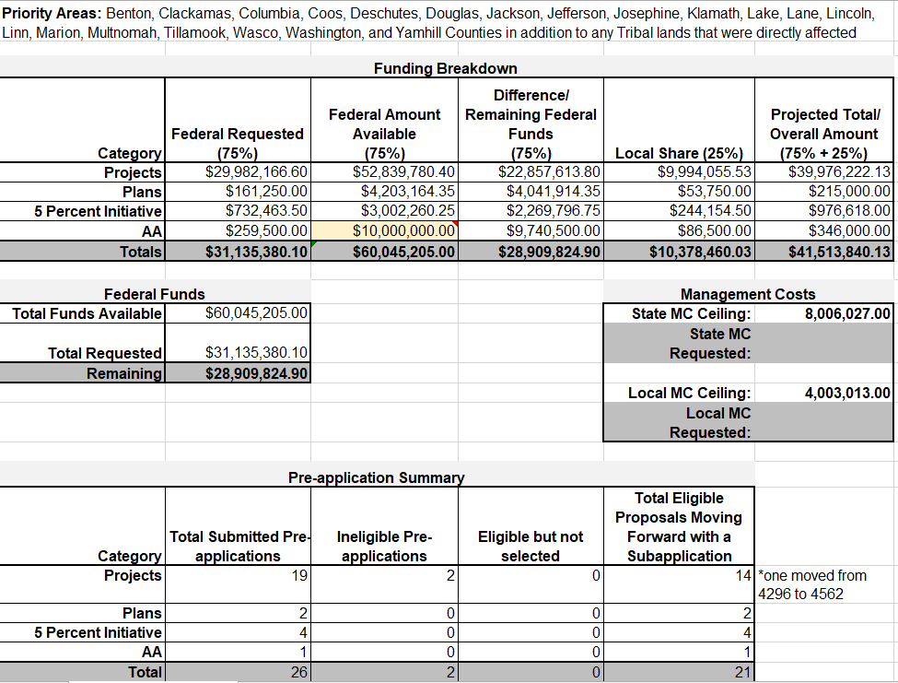
4562 Federal Funds
As of 3.4.2021, approximately $28.9 million remains in federal funds for 4562
Projects do not need to be tied to the disaster for 4562, nor to impacted areas. You can undertake mitigation projects for any type of hazard, in any at-risk area.

Slide 10
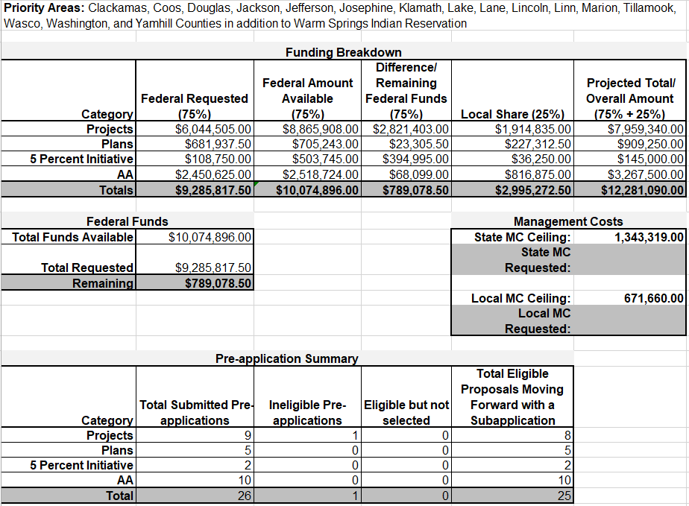
5327 Federal Funds
As of 3.4.2021, approximately $789,000 remains in federal funds for 5327.
Projects do not need to be tied to the disaster for 5327, nor to impacted areas. You can undertake mitigation projects for any type hazard, in any at-risk area.

Slide 11
HGMP Categories
HMGP grants have 4 different categories that can be applied for (only one of the four per pre-application and subapplication):
Projects: There are a variety of eligible projects.
Plans: Natural Hazard Mitigation Plans (NHMP) and Community Wildfire Protection Plans (CWPP) are the two most common uses for planning funds. Emergency Operations Plans are ineligible.
5% Initiative: For mitigation activities that are difficult to evaluate using FEMA-approved cost-effectiveness methodologies.
Advance Assistance: Used to develop mitigation strategies and obtain data to prioritize, select, and develop complete HMGP applications in a timely manner (up to 25% of the HMGP ceiling or up to $10,000,000).

Slide 12
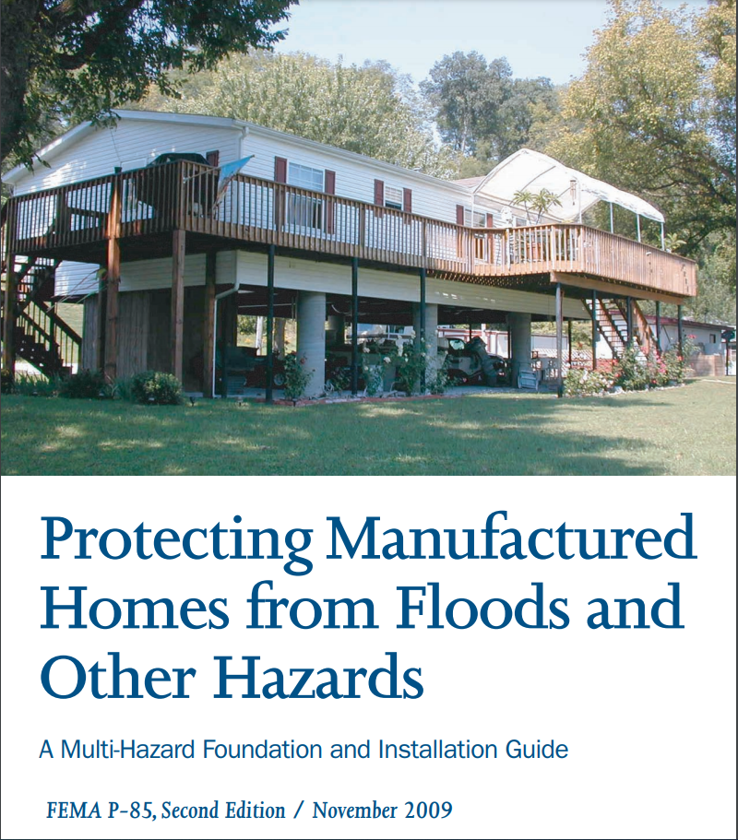
Protecting Manufactured Homes from Floods and Other Hazards
https://www.fema.gov/sites/default/files/2020-08/fema_p85.pdf
FEMA Hazard Mitigation Ideas: https://www.fema.gov/sites/default/files/2020-06/fema-mitigation-ideas_02-13-2013.pdf

Slide 13
Types of Eligible Fire-related Projects
Defensible space measures – The creation of perimeters around residential and nonresidential buildings and structures through the removal or reduction of flammable vegetation
Ignition-resistant construction – The application of non-combustible building envelope assemblies, the use of ignition-resistant materials, and the use of proper retrofit techniques in new and existing structures (must also include defensible space in order to be eligible for this type of project)
Hazardous fuels reduction – Vegetation management to reduce hazardous fuels, vegetation thinning, and the reduction of flammable materials to protect life and property beyond defensible space perimeters but proximate to at-risk structures
Infrastructure Retrofit – Measures to reduce risk to existing utility systems, roads, and bridges.

Slide 14
Ineligible Fire-related Projects
Projects that do not protect homes, neighborhoods, structures, or infrastructure
Projects on federally owned land and land adjacent to Federal lands when the proposed project falls under the primary or specific authority of another Federal agency
Projects for hazardous fuels reduction in excess of 2 miles from structures
Projects to address ecological or agricultural issues related to land and forest management (e.g., insects, diseases, infestations, damage from extreme weather events affecting the forest-wide health)
Irrigation of vegetation to avoid disease or drought-related infestation
Projects to protect the environment or watersheds
Projects for prescribed burning or clear-cutting activities
Projects for maintenance activities, deferred or future, without an increase in the level of protection
Projects for the purchase of fire-related equipment (e.g., vehicles, fire trucks) or communications equipment
Projects for the creation and maintenance of fire breaks, access roads, and staging areas
Purchase of equipment to accomplish eligible work (e.g., chainsaws, chippers)
Projects for vegetation irrigation systems installed on the ground and designed to moisten the surface
Development or enhancement of fire-suppression capability through the purchase of equipment or resources (e.g., water supply or sources, dry hydrants, cisterns not related to water hydration systems, dip ponds)
Activities intended solely to remedy a code violation without an increase in the level of protection
Activities on Federal land
Notes:
Fire suppression items are typically not allowed
Exceptions include hardening buildings, installing external sprinklers, and adding vents on buildings that mitigate coals from entering a building.

Slide 15
Flooding-related Project Examples
Property Acquisition and Structure Demolition
Property Acquisition and Relocation for Open Space
Structure Elevation
For burn scar remediation and reseeding…it is only effective if we can get it awarded and completed very quickly. Flash floods are a huge problem in burn scar areas and we have a hard time being effective with these grants. Basically, the subapplicant should use aerial seeding methods for low ground disturbance and if they are going to use chemicals for invasive plant species, make sure that information, including type of herbicide, is in the subapplication.
There are several other eligible projects as well; see HMA Guidance and the HMA Addendum for further information and options.
Notes:
Acquisitions can also be fire related not just flood-related
HMA does not support pure property acquisitions; there must be a structure

Slide 16
Soil Stabilization (flood after fire)
Soil stabilization projects are eligible under HMGP, HMGP Post Fire, and PDM. Wildfires can destroy vegetation, root systems, and degrade soil quality, which can increase soil and slope erosion and increase the risk for flooding and landslides. Stabilization and erosion-control practices can help enable soil infiltration, stabilize slopes, and reduce potential risks to structures and infrastructure from erosion, sedimentation, floods, and landslides.
Several of the activities listed in DRRA Section 1205 include use of nature-based design methods which may be used alone or in combination with more traditional engineered mitigation approaches to design and implement effective soil stabilization for post-fire risk reduction. Nature-based design techniques can provide ecosystem services and restoration benefits. Ecosystem services are benefits provided to people by nature such as aesthetic value, air quality, recreation space, and water filtration. The FEMA Bioengineered Wildfire Mitigation Job Aid (see Resources) provides guidance on these techniques. In some cases, two or more of these activities may need to be implemented in concert with other mitigation measures to demonstrate an effective mitigation project.
FEMA has developed pre-calculated benefits for post-wildfire soil stabilization and flood risk reduction projects. Soil stabilization and reforestation projects under the cost of $5,250 per acre are determined cost effective and no further benefit-cost ratio (BCR) is required. The BCA Toolkit can be used to perform the benefit cost analysis for projects where the pre-calculated benefits are not enough to cover the mitigation activity.

Slide 17
Soil Stabilization Continued…
Reseeding ground cover with quick-growing or native species
Reseeding ground cover using quick-growing or native species works to prevent soil erosion and encourage soil stabilization after a wildfire.
Planting grass to prevent the spread of noxious weeds
Planting grass helps to control the regrowth of invasive species that serve as fuels. Hydroseeding (a slurry of seed and mulch mixed with water and fertilizer) can promote the growth of native grasses that have extensive root systems to hold soil in place.
Mulching with straw or chipped wood
Mulching covers the area with a protective layer of straw or chipped wood. This layer helps to prevent soil erosion, protects the mineral soils that have been exposed, absorbs humidity, and breaks down swiftly in many landscapes, adding nutrients back into the soil to promote new plant growth (or potentially grass after reseeding).
Placing logs and other erosion barriers to catch sediment on hill slopes
Placing logs and other erosion barriers work to trap sediment on hill slopes, reducing the erosion of soil. These erosion barriers can include erosion control mats or blankets (made of fibers, straw, or other plant material), fiber rolls, and silt fences.
Installing debris traps to modify road and trail drainage mechanisms
Installing debris traps to modify road and trail drainage mechanisms reduces the risks of soil erosion, landslides, and flash floods. In addition to helping stabilize soils, debris traps can also be used to provide flood risk reduction benefits and can be used in local flood risk reduction projects.

Slide 18
Localized Flood Risk Reduction Projects (flood diversion/storage)
Localized flood risk reduction projects are eligible under all HMA programs including FMA. In addition to increasing soil erosion, wildfires can reduce the permeability of soils, which can result in increased potential for flooding. Various mitigation strategies can help to reduce the frequency or severity of flooding by diverting floodwaters away from streams, rivers, or other bodies of water, or storing excess water. These strategies can protect homes and infrastructure and may also work to re-establish the structure and function of ecosystems and floodplains.
Modifying or removing culverts to allow drainage to flow freely.
Increased runoff after a wildfire due to reduced soil permeability and lack of vegetation can overwhelm culverts, and debris carried in the runoff can block the passage of water through culverts. After a wildfire it is not uncommon to modify or temporarily remove a culvert to allow runoff to flow more freely, either through an enlarged culvert or natural channel, to protect buildings, roads, or other infrastructure.
Adding drainage dips and constructing emergency spillways to keep roads and bridges from washing out during floods.
Drainage dips are created by re-grading a road or trail to direct water to drain off the road or trail surface at a desired location. In some cases when hydrologic analysis indicates an existing culvert is too small to handle the short-term runoff after a wildfire, armored rolling dips may be installed to direct the increased flows back to the existing channel, preventing the washout of a culvert, road or bridge. Drainage dips can contribute to flood diversion and storage projects by directing water toward a retention pond.
Constructing straw, rock, or log dams in small tributaries to prevent flooding.
Constructing straw, rock, or log dams in small tributaries can help to trap sediment and debris, reducing the risk of flooding following a wildfire.

Slide 19
Other Examples
Landslide Property Acquisition
Hurricane wind retrofit – must be for residential, excluding manufactured homes

Slide 20
HMA Links
FEMA Advance Assistance: https://www.fema.gov/media-library/assets/documents/32755
FEMA Grant Forms: https://www.grants.gov/web/grants/forms/sf-424-family.html#sortby=1
FEMA Hazard Mitigation Grant Program Post Fire: https://www.fema.gov/hazard-mitigation-grant-program-post-fire
FEMA Hazard Mitigation Assistance Guidance: https://www.fema.gov/media-library/assets/documents/103279
FEMA Hazard Mitigation Assistance Publications: https://www.fema.gov/hazard-mitigation-assistance-publications
FEMA Hazard Mitigation Grant Program: https://www.fema.gov/hazard-mitigation-grant-program
FEMA Hazard Mitigation Ideas: https://www.fema.gov/sites/default/files/2020-06/fema-mitigation-ideas_02-13-2013.pdf
FEMA HMA Application Development Guidance: https://www.fema.gov/application-development-1
FEMA HMA Cost Share Guidance: https://www.fema.gov/sites/default/files/2020-08/fema_hma_cost-share-guide.pdf
FEMA Management Costs: https://www.fema.gov/drra-1215-faq
FEMA Nature Based Solutions: https://www.fema.gov/sites/default/files/2020-08/fema_riskmap_nature-based-solutions-guide_2020.pdf
FEMA HMA 2019 Year in Review: https://www.fema.gov/sites/default/files/2020-09/fema_hma-year-in-review-support-document_June2020.pdf

Slide 21
Questions?

