Slide 1
New Rules,
Same Game
Media access and what it means to you and your crews

Slide 2
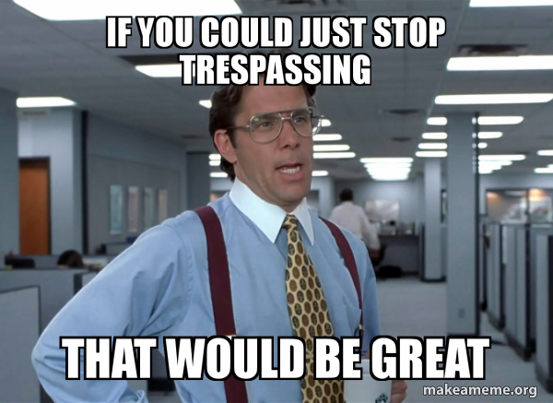
What We Will Cover
What we know with media access
What we don’t know
How it affects you
Keys to success

Slide 3
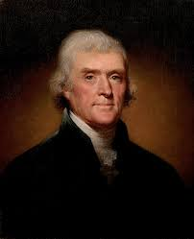
Role of the Press
“Were it left to me to decide whether we should have a government without newspapers or newspapers without a government, I should not hesitate a moment to prefer the latter.”
Notes:
Quote from TJ: In a letter written from Paris while he was Minister to France to Edward Carrington, whom he had appointed to represent the state of Virginia at the Continental Congress
The goals of the media: Inform the public, tell stories, meet deadline, find new insights, provide visuals to the public.

Slide 4
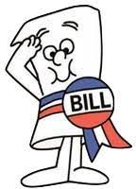
What We Know About Media Access
The origins of HB 4087
What’s included in the bill
Credentialing and assumed risk
Should they stay or do they go?
Media training and PPE
IC discretion

Slide 5
What We Don’t Know
Training curriculum & timeline
Credentialing plan
Mapping & incident information sharing

Slide 6
How This Affects You
1
Presence
2
First Contact
3
Access
You may see media in areas you haven’t seen them before
You may be the first person a reporter meets at the fire
You are not in charge of managing access
Access to the incident does not mean access to fire fighters

Slide 7
Key To Success
1
Advise
2
Behavior
3
Connect
Inform media when conditions are unsafe or could change
Let them know if they are on private lands
Customer service
Check to make sure proper PPE is on
Expect to be on camera
B-roll vs interview
Know how to connect them with a PIO
Make line safeties aware of media presence

Slide 8
Media Pocket Guide for Transition
How we treat the media and community has not changed
Respect and customer service still creates the best results
Media has a job to inform the public, what will that story be?

