Slide 1

2023 ST/TFLD Symposium
Darren Root
SOF2
OSFM Blue Team

Slide 2
Task Force Leaders (TFLD) Expectations
These expectations are intended to assist you in the accomplishment of your duties and to serve as a checklist.
Briefings – You must attend all briefings that require your participation. You will be informed as to which briefings to attend.
Be on time
Be prepared to provide necessary information such as:
Hazards and risks associated with your area of responsibility.
Injuries or accidents associated with your area.
Recommendations for next operational period.
Suggestions to the team to improve overall safety of the incident.
Debrief at the end of the operational period with the Team Safety Officer. Verify any discrepancies in the plan, hazard and risk mitigations that are working/not working and any recommendations.
Notes:
Expectations – It is expected that you will perform all duties of a Task Force Leader.
Interact with Division/Group Supervisors and resources assigned to the area of responsibility.
Provide suggestions to increase safety and health on the incident by identifying hazards and risks throughout the incident and area of responsibility.
Line hazards will be identified by walking your area of responsibility.
Ensure that the Medical Plan (206) is adequate for the DIVS. Be Prepared to act as or assist the Line Medic.
Respond to the scene of any accident and assist the IWI incident commander.
Exercise emergency authority to stop unsafe acts. Document your actions.
Set the standard for safety. Ensure 10 standard fire orders are adhered to, LCES is in place and any of the 18 situations that are present are mitigated or known to those associated with the operation. Documentation of adherence to the 10 Standard Fire Orders and mitigation of the 18 watch out situations shall be performed daily and noted in the Unit Log (214).
Ensure personnel accountability within the DIVS and of Safety/Medical personnel through constant communication of location to the SOF.
Maintain Unit Log (ICS 214) and turn in daily to Team Safety Officer.
Verify escape routes and ensure safety zones are adequate.
Analyze the tactic of the day and associated risks with the DIVS

Slide 3
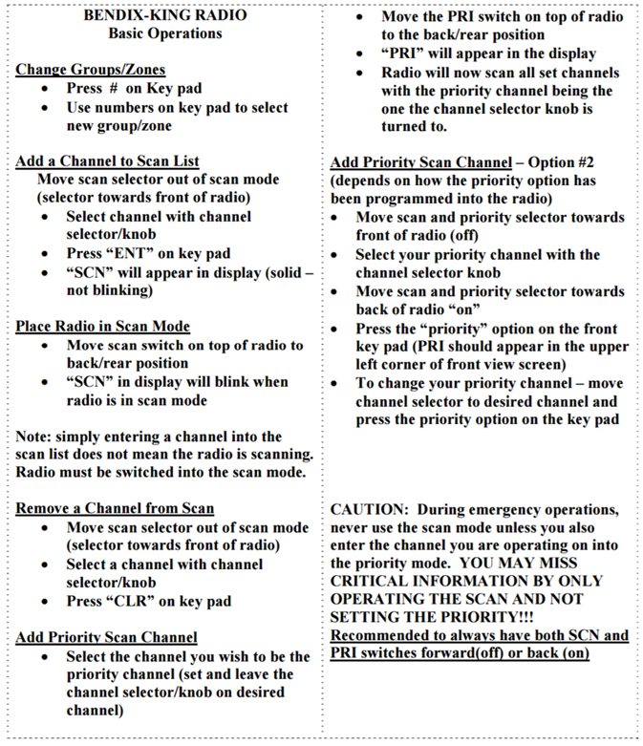
Notes:
To add a Priority Scan Channel:
Turn off scan.
Change channel to desired channel.
Press – ENT for enter on keypad.
“SCN” will appear in the display.
Then turn on scan!

Slide 4
Last Season
9/14/2022 R6 Double Creek, Wallow-Whitman NF: This SafeNet describes a communications issue highlighted during a red medical incident involving a private civilian. Incident resources extracted the individual and provided initial treatment; an incident helicopter transported the individual to a nearby airport. The air ambulance aborted the mission due to smoke/visibility. However, communications with Life Flight were unsuccessful due to not having/using the standard air medical frequency for the state (VMED 29). The Life Flight apparently cannot adjust their radio programming and use a different standard frequency (VMED 28). The Safenet recommends pre-loading standard air frequencies into the communications plan for incidents and all incident radios.
9/5/2022 R6 Cedar Fire, Willamette NF: This Safenet describes an incident where a crewmember's radio fell out of their line gear while engaged in burning operations. Due to fire activity, it was unsafe for them to try to find the radio, and they reported it immediately. After completing the required documentation via comps/claims, fireline supervision, communications, and finance, they were told that the claim was denied, and they'd need to work with their local communications technician to get a replacement. This has proven to be difficult, and the concern is that the effect on communications by not having a radio replaced will compromise safety. A corrective action has been posted.
9/15/2022 R6 Cedar Creek Fire, Willamette NF: A contract firefighter was struck on the head and shoulders/neck from a snag limb (approximately 3" x4'). The firefighter was treated and released. An RLS is ongoing.
8/22/2022 Rum Creek Fire BLM: This Safenet describes the incident's lack of sufficient meal nutrition or quantity. A corrective action has been posted.
08/14/2022 R6 Cedar Creek Fire Willamette NF: A contract firefighter was struck by a tree limb that entered the cab of their apparatus while the individual was driving down a forest road after shift. The tree limb impaled the arm, requiring surgery to remove. The firefighter was transported to a hospital, the surgery was successful, and the individual was released from the hospital and is resting at home. An RLS is being worked on to provide more information.
8/29/2022 R6 Windigo/Potter/Camel Hump/Big Swamp Fires: This Safenet describes an issue with the solar panel battery kits provided for repeaters via the NIFC cache. FS Operations and NIFC are aware of the problem and are working hard to identify a solution.
8/9/2022 R6 Windigo/Potter Fire Umpqua NF: A contract employee received medical treatment for a spider bite on 8/9. On 8/11, the employee reported pain around the bite and not feeling well. The patient was evaluated by incident medics and transported via local ambulance to a medical facility. The patient received a tetanus shot and was released from the hospital and the incident.
8/9/2022 R6 Windigo/Potter Fire Umpqua NF: A contract employee reported difficulty breathing and was transported via ground ambulance initially, then transferred to air transport due to long transport times. The patient was diagnosed with rhabdo and COVID, treated then released.
8/4/2022 R6 Windigo Fire Umpqua NF: A contract firefighter sustained a chainsaw cut to the shin/calf while swamping. The patient received initial treatment by IHC medical personnel, transported via agency vehicle to an ALS ambulance, then to the hospital. The patient received treatment and was released the following morning (8/5).
7/27/2022 R6 Malheur NF, Oregon: This https://safenet.nifc.gov/view_safenet.cfm?id=47630 describes radio network communication issues affecting operations and tracking of resources, including a helicopter doing a training flight. A corrective action has been posted detailing the local LMR technician's ability to restore power to the network.
7/17/2022 Middle Fork Fire, Vale District BLM Oregon: This Safenet describes communication issues during the initial attack. The responding aircraft and dispatch could not communicate on the local flight following channels: this affected Air Attack, a type 3 helicopter, and two SEATs. The Safenet also highlights that the issue with the national flight following only works in certain locations/dispatches in the area. A corrective action has been posted.
5/10/2022 R6 Umpqua NF: This Safenet describes communication issues in a dispatch center where the Forest Service radio network did not hear transmissions. However, communications were possible via the BLM network over the same consoles/software. Issues were also described with the desk phones not allowing outside calling and providing busy signals to anyone calling in. Communications were relayed from the Fire Staff Officer via Microsoft Teams as a workaround. A CHD ticket was filed, and corrective action has been posted.
Notes:
9/14/2022 R6 Double Creek, Wallow-Whitman NF: This SafeNet describes a communications issue highlighted during a red medical incident involving a private civilian. Incident resources extracted the individual and provided initial treatment; an incident helicopter transported the individual to a nearby airport. The air ambulance aborted the mission due to smoke/visibility. However, communications with Life Flight were unsuccessful due to not having/using the standard air medical frequency for the state (VMED 29). The Life Flight apparently cannot adjust their radio programming and use a different standard frequency (VMED 28). The Safenet recommends pre-loading standard air frequencies into the communications plan for incidents and all incident radios.

Slide 5
2022 Mobilizations
Miller Road | Rum Creek
Bret Boysen | Bret Boysen
Larry Wooldridge | Keith Storms
Chris LaBelle | Chris LaBelle
Keith Storms | Bryan Daniels
 | Larry Wooldridge
 | Darren Root
 | Troy Jurgens
 | Jason Bolen
Double Creek/Sturgill | Cedar Creek
Darren Bucich | Mike Gorsuch
Anthony Bucher | Jack Carriger
Greg Deedon | Larry Wooldridge
Jason Bolen
Troy Jurgens

Slide 6
Incident Within the Incident
2023
Notes:
We Must Be the Experts on This!
This plan was developed and adopted by the NIMO Teams in 2021
The plan is a little different by similar language and formatted like the NIMO and PNW teams.
The Crux of the plan is that it assumes that the emergency is an EMERGENCY! Not day-to-day illness/injury
Communications takes on more
Safety and Ops take on the point of contact for us.
The ICs must sign, adopt, and ensure the plan is in place on DELEGATION. (2021) standard.
This plan has Pre-IWI, and During IWI. The intention is for TEAMS to pre-plan the emergency.

Slide 7
During an IWI DIVS or TFLD’s
Name
Green/Yellow or Red
Location
PT Servility
Recommendations
Command Channel

Slide 8
2023 Incident Emergency Action Plan
SAFETY OFFICER (SOF)
Pre-IWI/DIVS and TFLD’s
Complete an IWI Roster at the start of the Team’s incident assignment to include the Command & General Staff who will respond in the event of an IWI.
Safety will ensure that copies of IWI are placed in the ICP Communications and distributed within C&G.
Helibase Emergency Plan is posted at the Helibase.
Safety will initiate an IMT review for an IWI within 24-48hrs of transfer of command.
Conduct IMT AARs for continued validations of the IWI.
Conduct an IWI drill with IMT.
During IWI
Safety Officer to assemble at the designated IWI emergency meeting area.
Line Safety Officer and/or Field Safety Officer to respond to incident site.
Evaluate safety issues at the accident site and work with Division/Group Supervisor in charge to mitigate them.
Determine required reviews and investigations in accordance with the Red Book Chapter 18.
Initiate the investigation of the IWI and the appropriate investigation resources/teams with Agency Administrator/Incident Commander approval.
Coordinate the protection and security origin of the IWI.
Maintain witness names, initial statements and all evidence relating to the accident.
Coordinate investigation with the Security Manager, Comps/Claims Unit and Unit LEO.
Obtain sketches and photos of emergency scene.
Coordinate with and support the Division/Group Supervisor in charge at the scene.
Verify that agency reporting requirements have been followed.
Confirm notification of Fed OSHA/State OSHA if appropriate.
Notify the Unit Safety Officer and other forest officers as required.

Slide 9
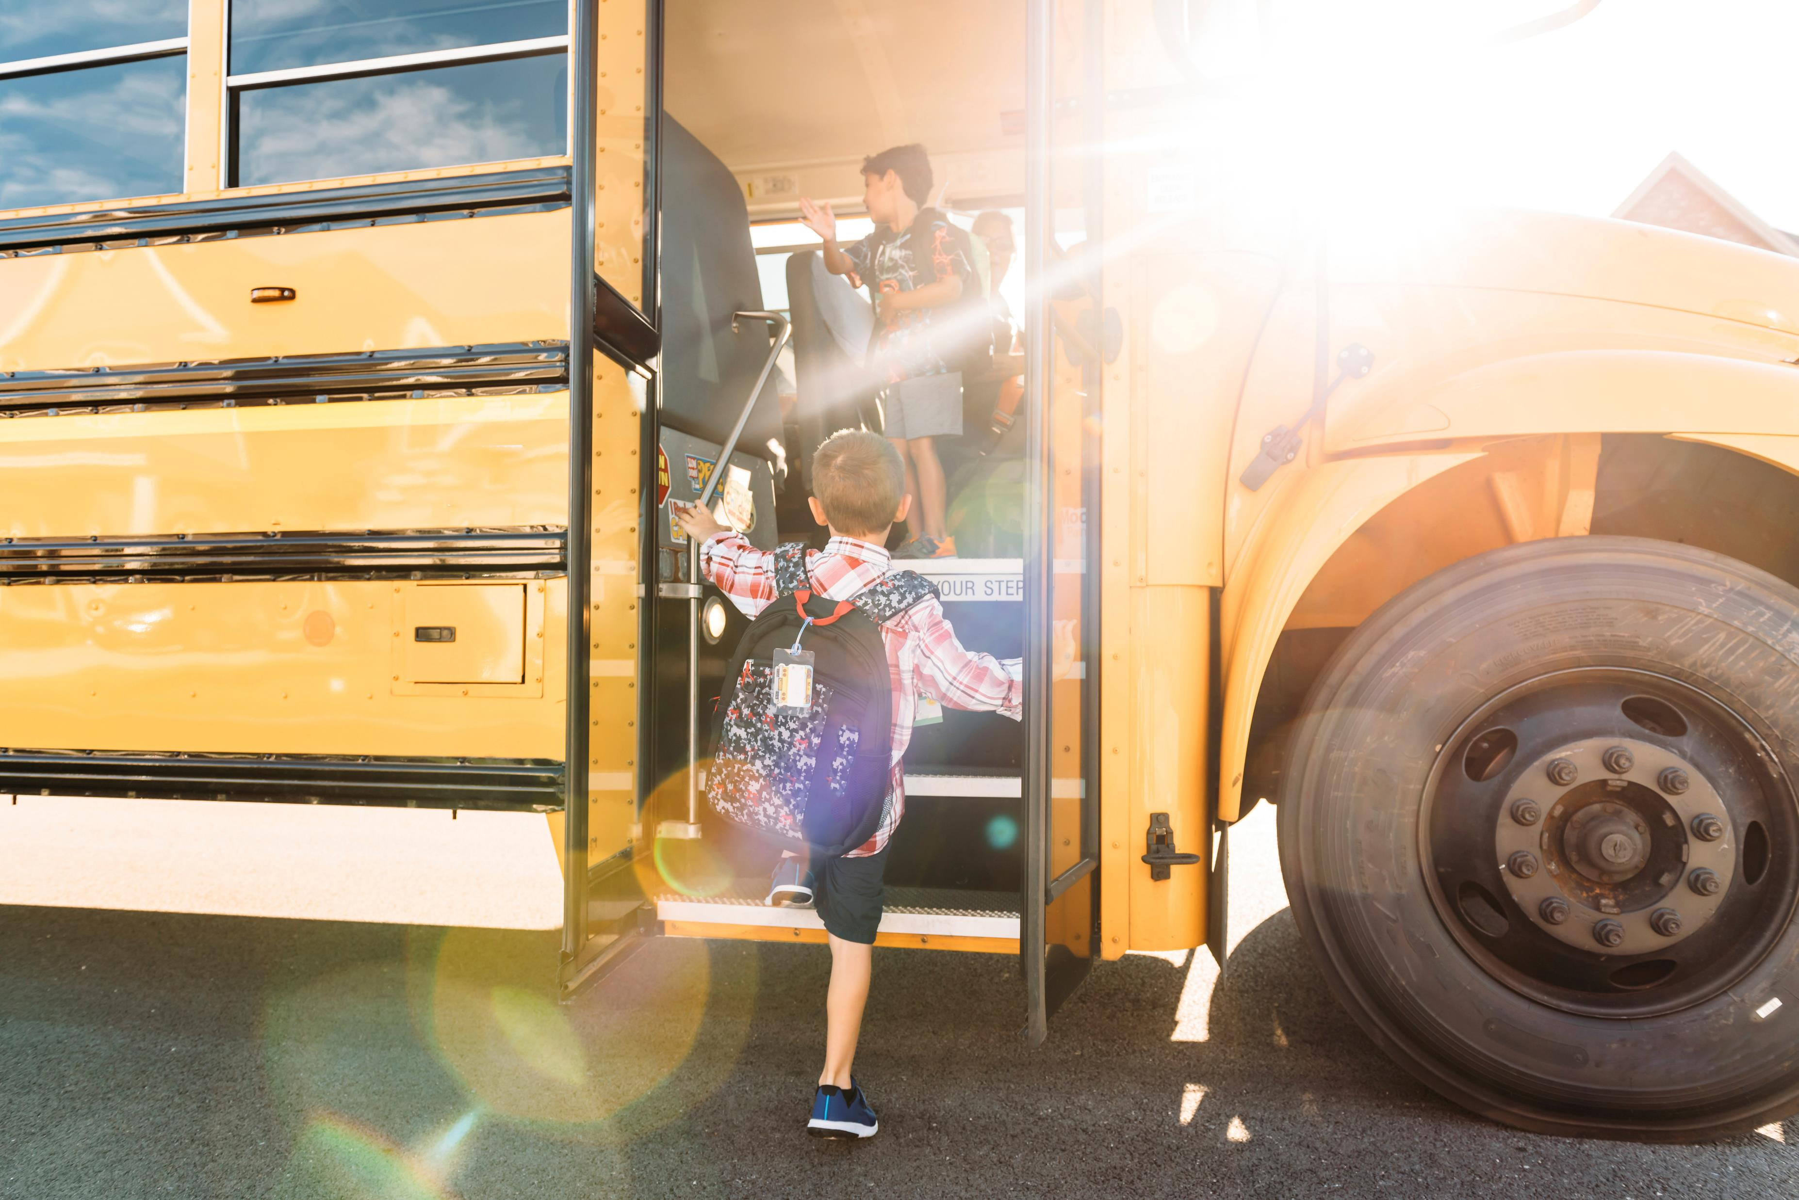
Fast-Acting 7th Grader Saves School Bus After Driver Passes Out
Notes:
Michigan student fast action saved over 40 students when his bus driver has a medical emergency.

