Slide 1
Survey 123
The “paperless” data collection tool for Structure Triage and Damage Assessment

Slide 2
What is Survey123 ??
OSFM Incident Management Team’s Mobile Data Collection Tool
Free ESRI GIS data collection App
Allows GIS Specialists to compile Data from the field for IMT personnel to use for planning and reporting
Free download for IOS and Android devices

Slide 3
“Survey123 for ArcGIS”
Search for “Survey123 for ArcGIS” in Apple or Android App Stores
Install

Slide 4
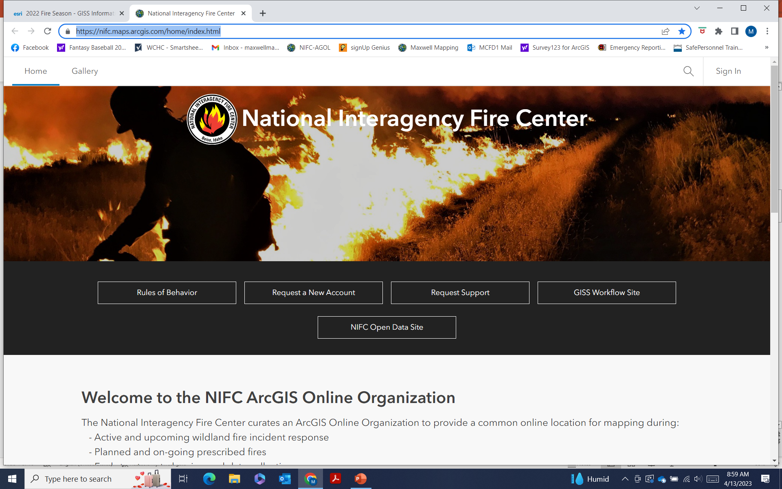
Sign Up for a NIFC Account
https://nifc.maps.arcgis.com
Use a department email, IF POSSIBLE

Slide 5
Request Form Complete form Submit Wait for an email

Slide 6
Next Step
Once you receive your username and set your own password….
Contact Don Maxwell at:
don_maxwell@firenet.gov
For access to OSFM Groups

Slide 7
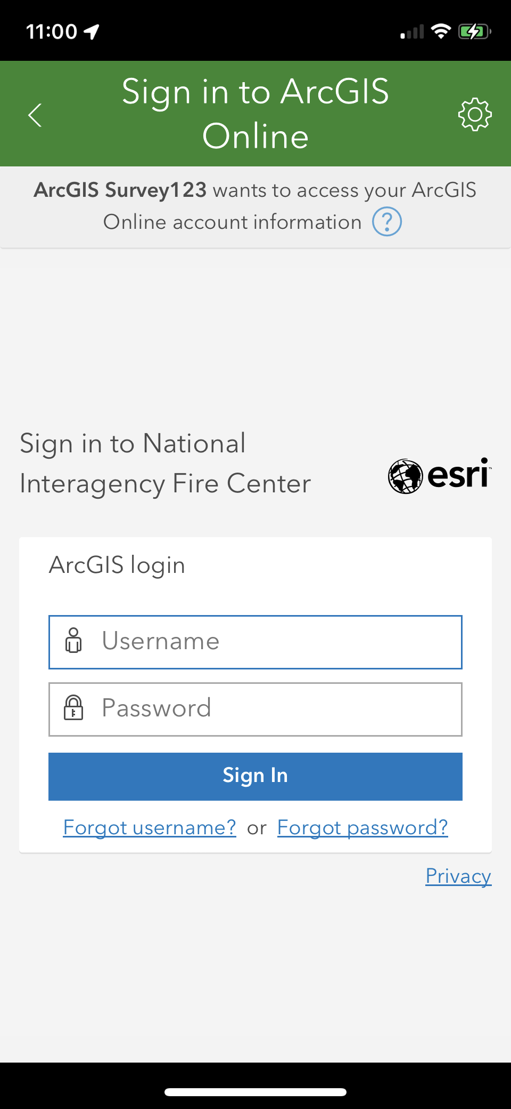
Survey123
When you open the app,
you will be asked for a
username and password.

Slide 8
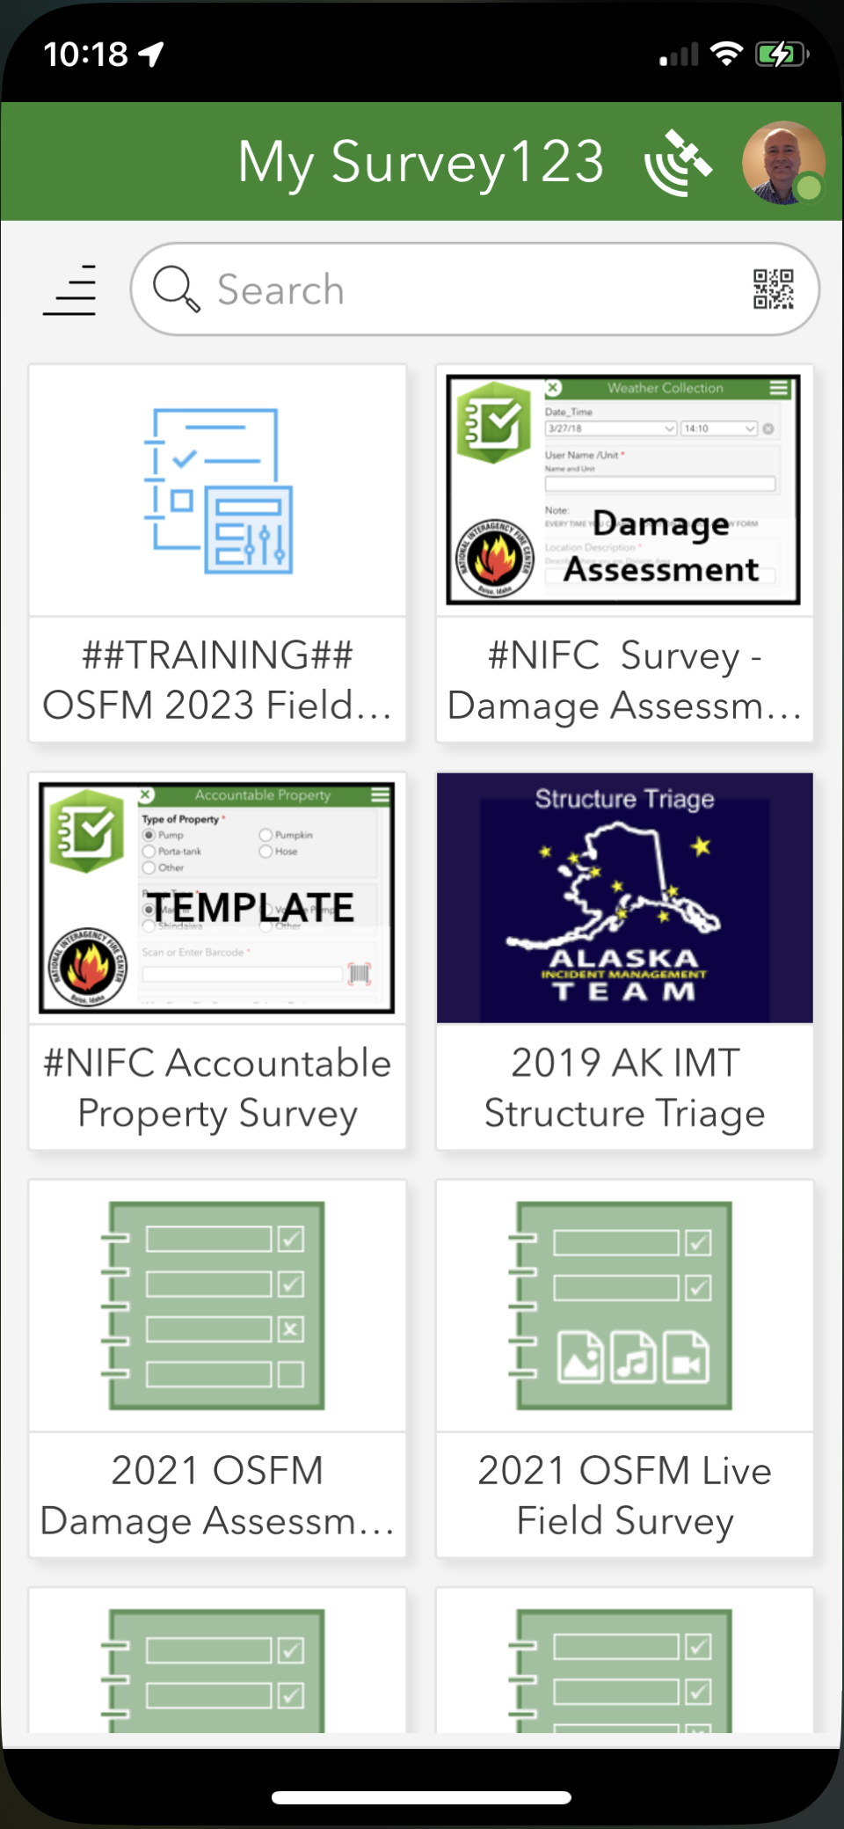
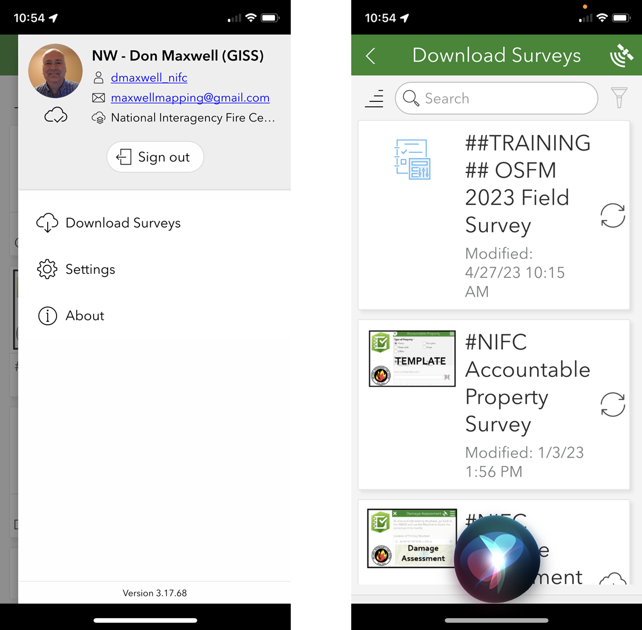
Once that is entered, click the upper right corner to Download the Surveys.

Slide 9
Download 2 surveys
“OSFM 2023 Field Survey”
“OSFM 2022 Damage Assessment v1.1”

Slide 10
Begin collecting Data.
Collect the GPS point AT THE PRIMARY STRUCTURE, not at the road.
The app will keep the data stored and prompt you to upload it whenever the wifi connection allows.
Items with a RED asterisk are required questions.

Slide 11
Select Incident Name
from the list
Set location
Auto-Fill Address

Slide 12
Score from triage questions
Use the score from above as a guide,
But use your best judgement
Select the Risk Assessment here
Document
Sprinkler sets,
Mark 3 Pumps and
Prep status
here
Submit

Slide 13
Additional Surveys and Maps
“Practice Fire” Map and Surveys.
This is a practice environment that will allow you to create inputs and view your work.
Once you login to Survey123 with you NIFC account you can download two surveys…
Practice Fire Field Survey and
Practice Fire Damage Assessment.
“OSFM Unassigned Incident” Map and Surveys.
These are for use for IA purposes before an OSFM team is established. Please only use these for working incidents. If you are local and want to have access to this data later, just let me know.

Slide 14
Interra “sofsa”
http://www.oregon.gov/osp/programs/sfm/Pages/SOFSA_ContactPage.aspx

Slide 17
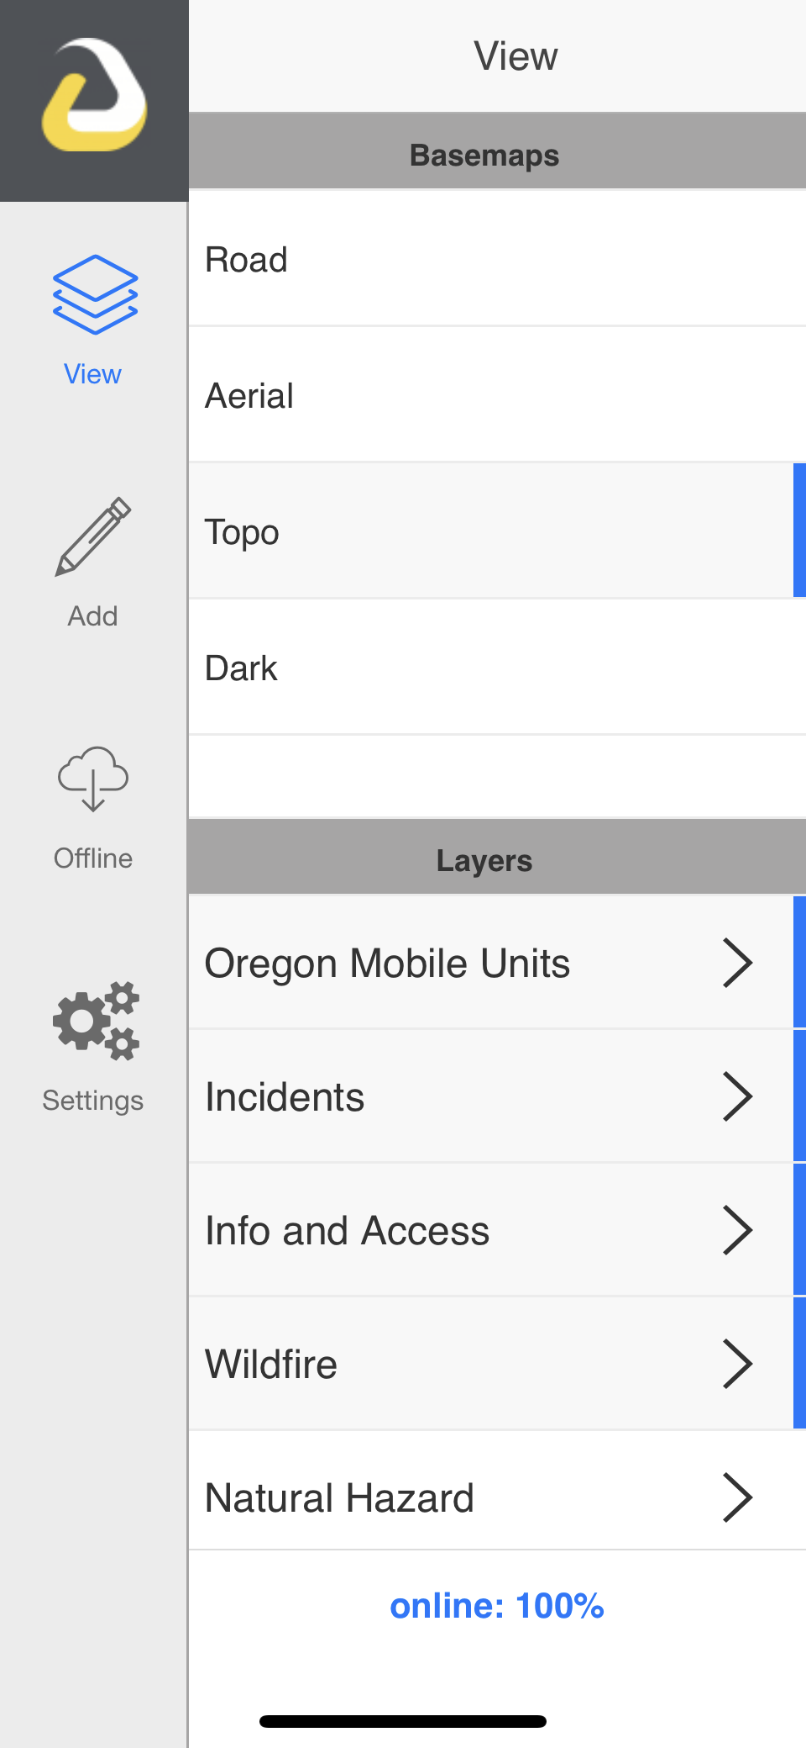
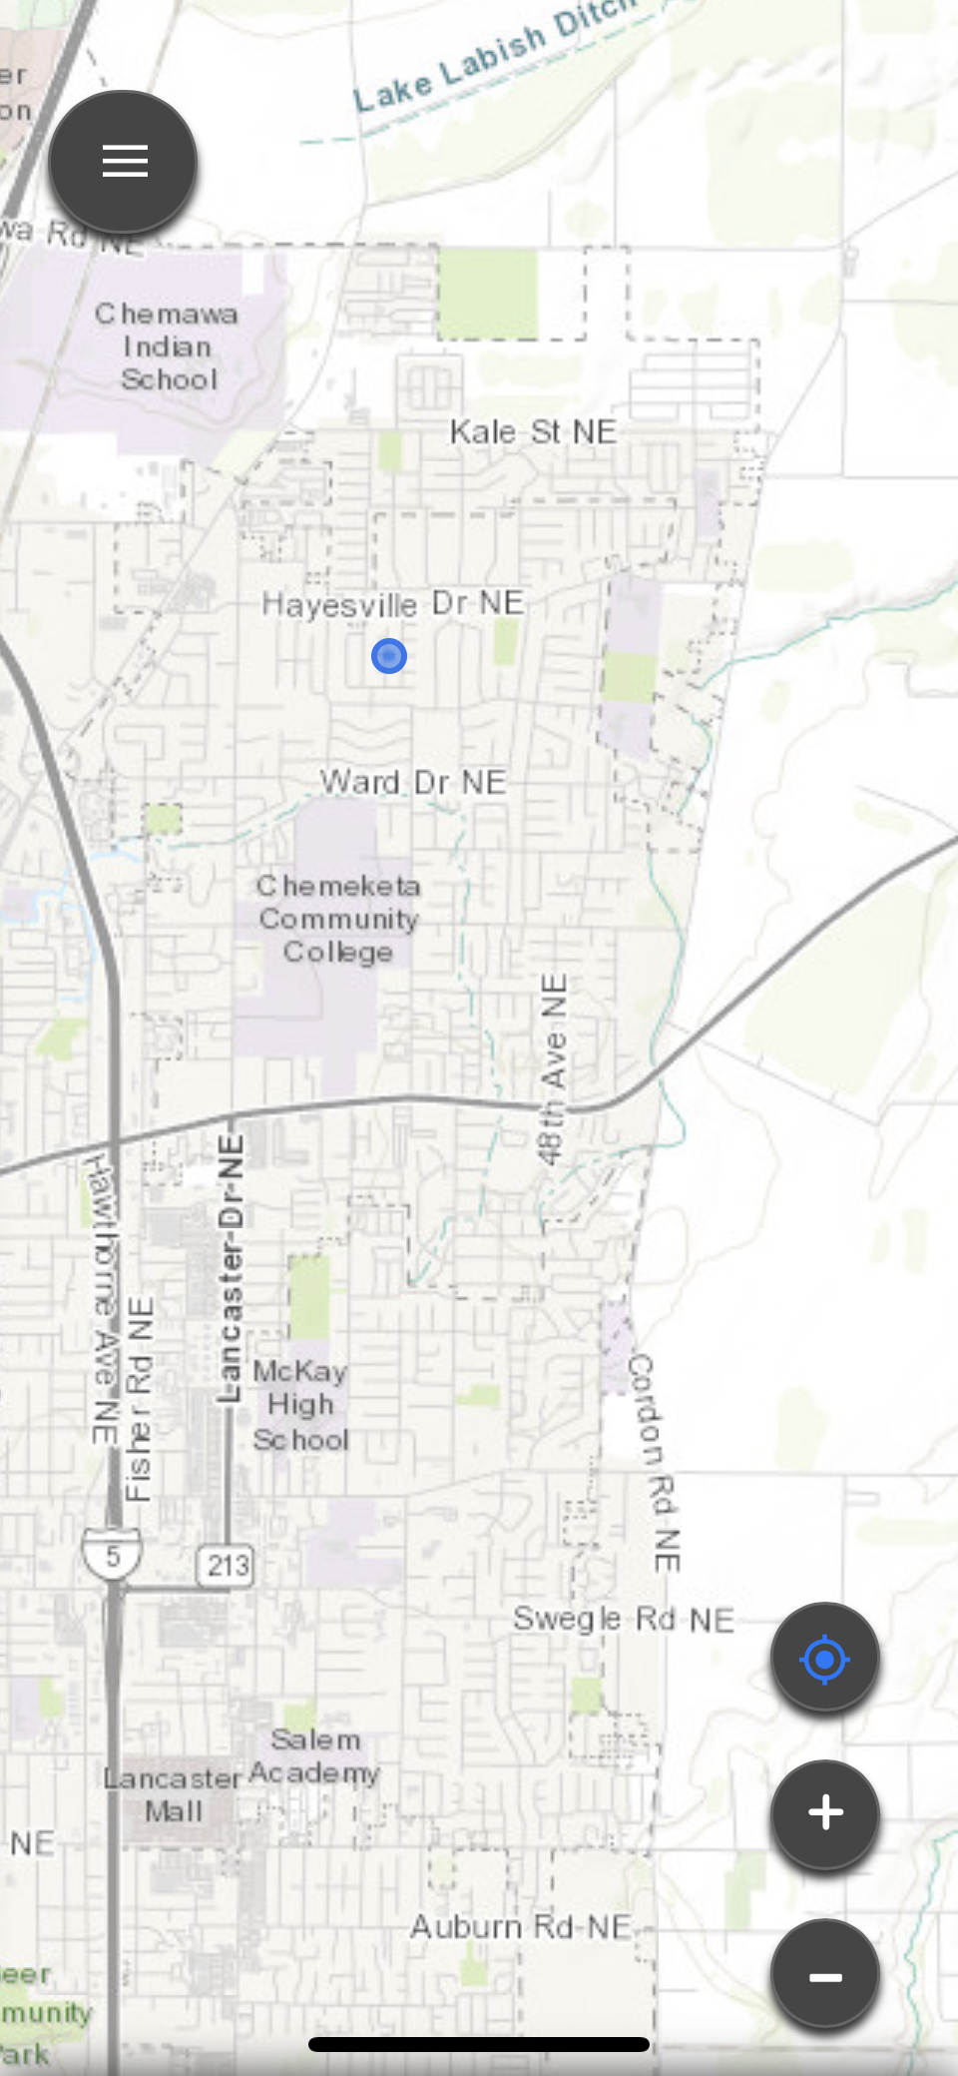
Interra SOFSA
Field App
Situational Awareness Only
No Field Data Collection

Slide 18
Questions???

