Slide 1
Civil Rights Training 2023 Annual Refresher
This continuous learning course is intended for WIC staff who have completed the Civil Rights Orientation Training as a new employee.
Notes:
Notes for training supervisor:
1) Copy and hand out the PDF 2-page job aid that goes with this presentation. One side is for notes and has a picture we’ll use later on, the other side has a “cheat sheet” that you can keep handy near your workstation after this training.
2) There is a more comprehensive Civil Rights course with the nitty gritty for new employees to take. This course is the annual refresher civil rights course for existing staff. We hope that by having a “refresher” style course that gets updated, we can use scenarios that have actually happened to give you some skills that can be used on the job!

Slide 2
What you’ll learn:
Information about protected classes
Collecting protected class information from participants
WIC services for participants with Limited English Proficiency
How to display the “And Justice for All” poster
How to submit complaints to the State WIC Office
Information about civil rights violations and customer service complaints

Slide 3
What are Protected Classes?
Protected class refers to a group of people sharing a common trait who are legally protected from being discriminated against based on that trait.
We refer to the “protected classes” by their traits: age, race, national origin, sex, color, and disability.
Protected Classes in WIC
Notes:
“Protected class” refers to a group of people sharing a common trait who are legally protected from being discriminated against based on that trait. We refer to the “protected classes” by their traits: age, race, national origin, sex, color, and disability.

Slide 4
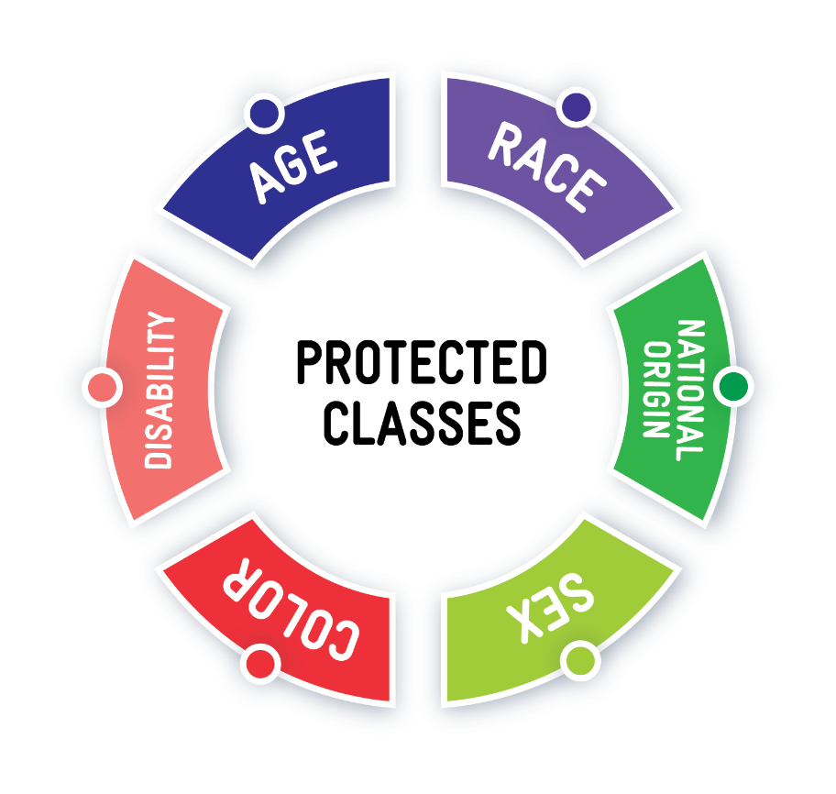
6 Protected Classes in WIC
Age
Race
National Origin
Sex
Color
Disability
Protected Classes in WIC
Notes:
These are the 6 Federal Protected Classes. A detailed definition of what each one represents is on the “job aid”
The state of Oregon has made some of their definitions of the protected classes more inclusive. We will only be discussing the federal definitions since they are what is considered in a civil rights violation investigation.

Slide 5
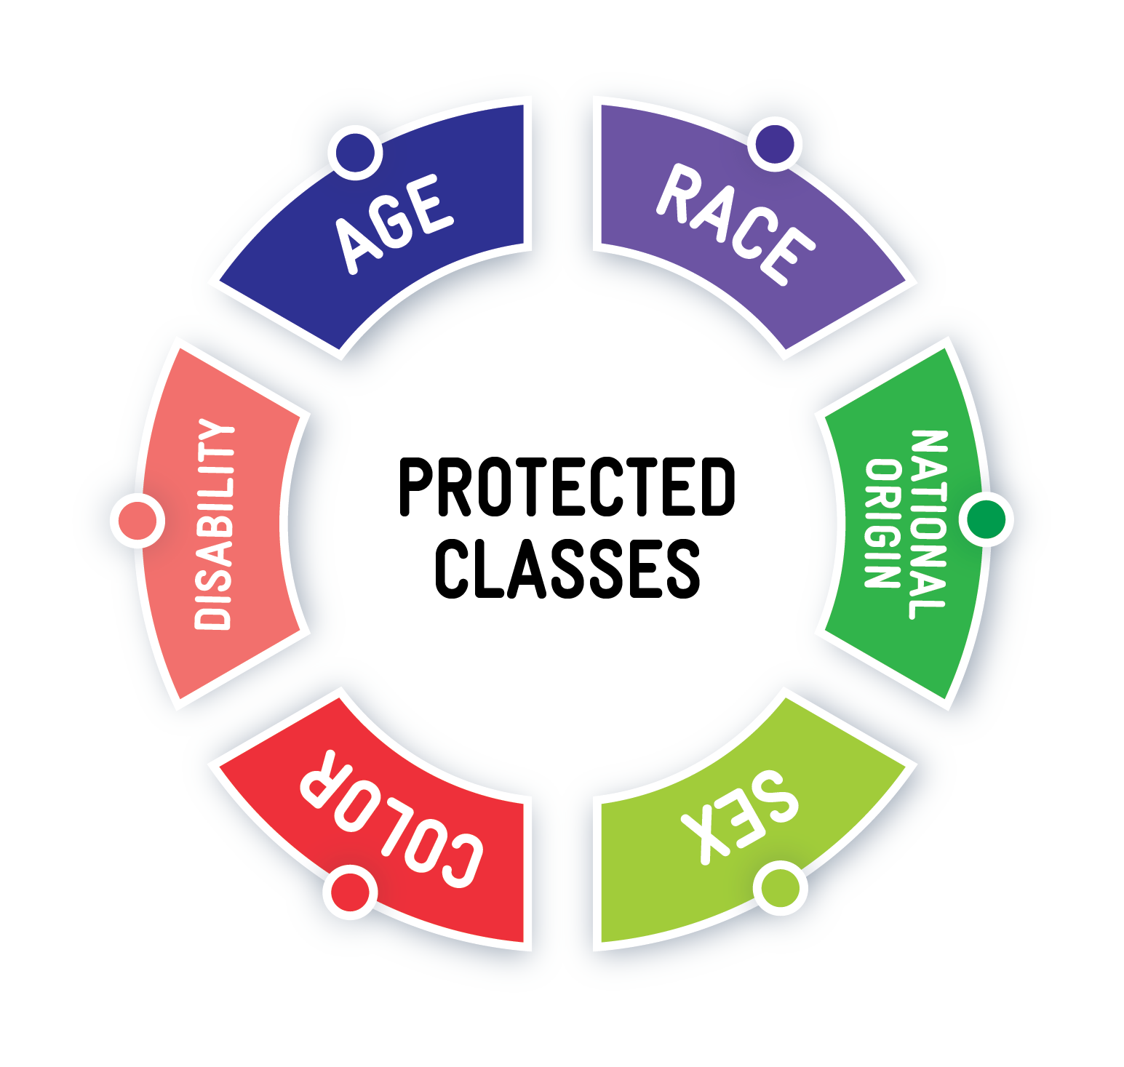
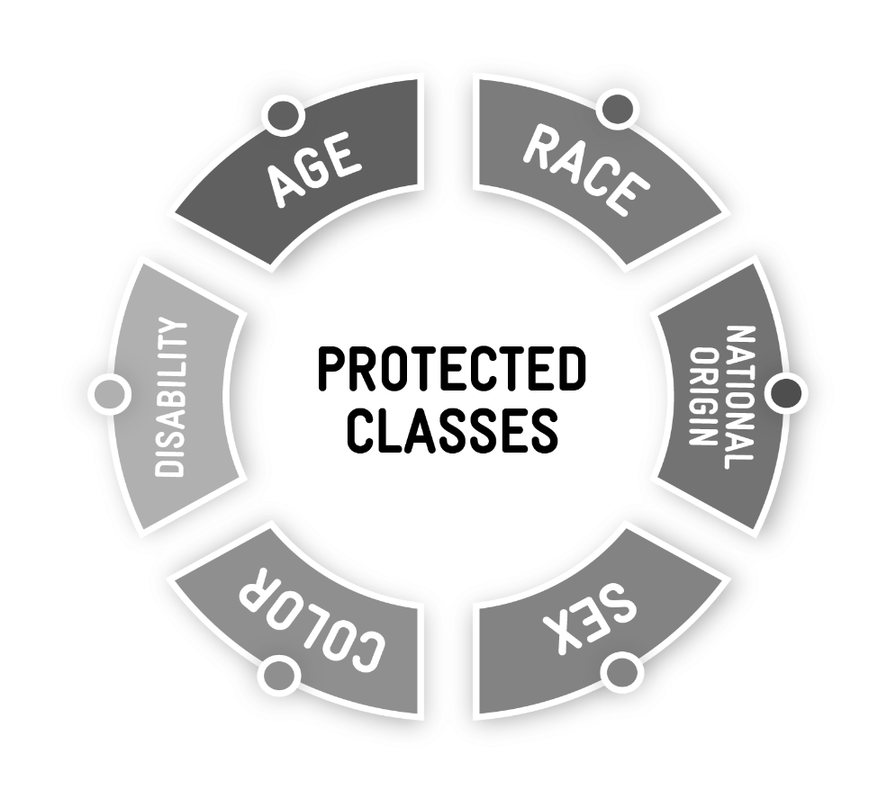
New:
Sexual orientation and gender identity are now included with the protected class for sex
Protected Classes in WIC
Notes:
As of 2022, sexual orientation and gender identity are now included in the protected class “sex.”

Slide 6
Discrimination
How would you define discrimination?
Protected Classes in WIC
Notes:
How would you define discrimination? (take some answers from staff)
Discrimination means the poor treatment of someone based on their association with a certain category of people, such as a being a member of a protected class.

Slide 7
Discrimination
How would you define discrimination?
Discrimination means the poor treatment of someone based on their association with a certain category of people
An example is being a member of a protected class
Protected Classes in WIC
Notes:
How would you define discrimination? (take some answers from staff)
Discrimination means the poor treatment of someone based on their association with a certain category of people, such as a being a member of a protected class.

Slide 8
Civil Rights Violations
MUST include discrimination involving
one or more of these 6 protected classes
Protected Classes in WIC
Notes:
In order for something to be a Civil Rights Violation, it must include discrimination involving one or more of these protected classes.
If the discrimination does not involve one of these 6 protected classes, it is not a civil rights violation.
Only these 6 protected classes are covered by the Federal Civil Rights Act.

Slide 9
A Quick Quiz: What’s Missing?
Looking at this wheel, which two protected classes are missing?
Protected Classes in WIC
Notes:
Looking at this wheel, which two protected classes are missing?
Race
Color

Slide 10
A Quick Quiz: What’s Missing?
Looking at this wheel, which two protected classes are missing?
RACE
COLOR
Protected Classes in WIC
Notes:
Looking at this wheel, which two protected classes are missing?
Race
Color

Slide 11
Discussion
What are examples of discrimination based on one of the protected classes?
Protected Classes in WIC
Notes:
Ask staff to share examples they can think about of discrimination based on a protected class.

Slide 12
Case Study
Lisa is a WIC participant who is Asian. Lisa wants to purchase white rice instead of brown rice with her WIC benefits.
The cashier tells her that white rice is not eligible and shows Lisa the food list with the eligible brown rice.
Lisa feels like the cashier is denying her white rice because she is Asian.
Case Study: Protected Classes

Slide 13
Let’s Discuss
Do you think the cashier is discriminating against Lisa because of her race by not allowing her to purchase white rice with her WIC benefits?
Case Study: Protected Classes

Slide 14
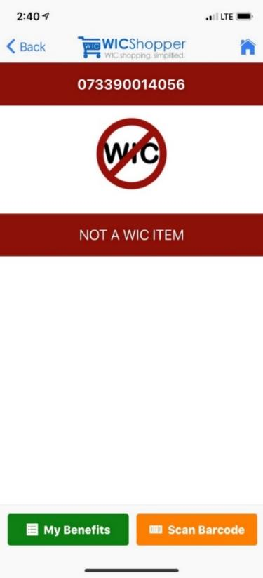
Answer:
Not discrimination.
White rice is not an eligible WIC food.
The cashier is NOT discriminating against Lisa by not letting her substitute white rice for brown rice using her WIC benefits.
Participants who belong to protected classes still have to follow program rules for WIC.
Case Study: Protected Classes

Slide 15
Data collection requirements

Slide 16
Collecting race and ethnicity data
Race
Must choose AT LEAST one:
American Indian/Alaskan Native
Asian
Black/African American
Native Hawaiian/other Pacific Islander
White
Ethnicity
Must choose ONLY one:
Hispanic or Latino
Not Hispanic or Latino
Collecting Protected Class Information from Participants

Slide 17
What if the participant declines?
Use participant-centered language to:
Reassure the person that the information does not affect eligibility
Explain that federal rules require that we collect the information
This information helps us – the WIC program – understand the needs of our participants
Notes:
Explain that the federal rules require that we collect the data, but reassure them that the information doesn’t affect their eligibility - it just helps us understand the needs of our participants.
If they still refuse, let them know that you will need to enter this for them based on their perceived race and ethnicity.

Slide 18
Which protected class information does Oregon WIC collect for every participant to document in TWIST?
RACE
DISABILITY
SEX
AGE
Collecting Protected Class Information from Participants
Notes:
Ask: which of these protected classes do we collect in TWIST?

Slide 19
Which protected class information does Oregon WIC collect for every participant to document in TWIST?
RACE
DISABILITY
SEX
AGE
Collecting Protected Class Information from Participants
Notes:
That’s right, we are able to collect information on race, sex, and age in TWIST. Currently, we cannot collect information about disability

Slide 20
REAL-D Race Ethnicity Language and Disability
Collecting Protected Class Information from Participants
Notes:
You may have heard about REAL-D. REAL-D stands for Race, Ethnicity, Language and Disability. Collecting this information is a state requirement, so other programs may have started collecting this information.
This information will be documented in the new Management Information System, OTIS.
More information and training will be sent out in the future.

Slide 21
Providing reasonable accommodations for disability
WIC programs are required to provide accommodation to participants with disabilities to ensure everyone has an equal opportunity to receive WIC services
Disability and Reasonable Accommodation Requests
Notes:
WIC programs are required to provide accommodation to participants with disabilities to ensure everyone has an equal opportunity to receive WIC services.
Examples include:
Provide materials in alternate formats as needed; Braille, large-print, etc.
Ensure clinic sites are wheelchair accessible.
Provide a sign language interpreter for participants with hearing impairments.
See Policy 452 for guidance.

Slide 22
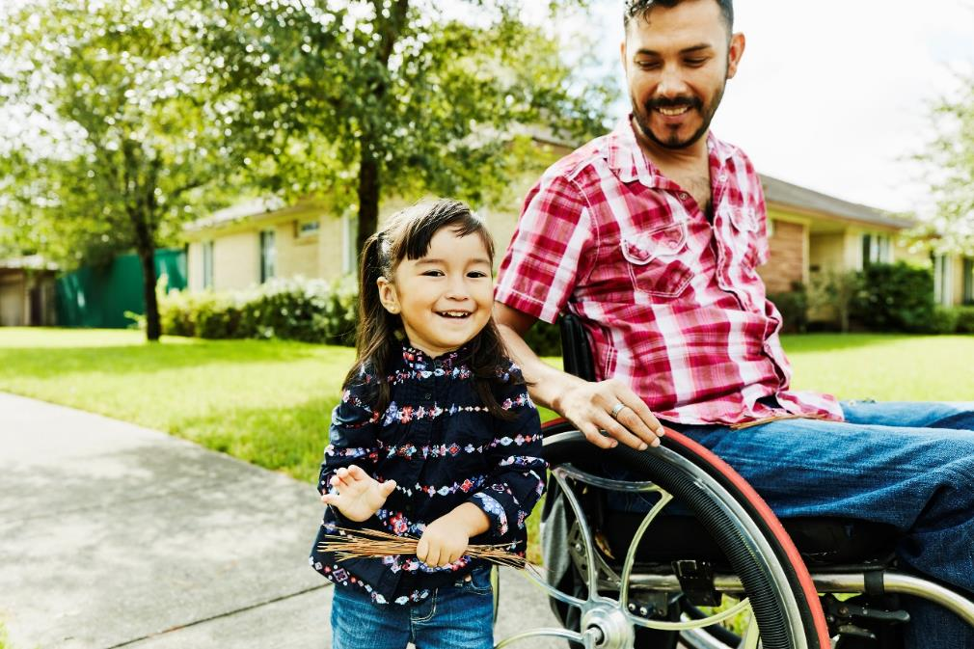
Example
A WIC clinic is located in a rented space that does not have a ramp leading to the front door.
What can you do?
Disability and Reasonable Accommodation Requests
Notes:
It is important that all facilities used by WIC are fully accessible. This should be a provision in any lease signed by any government agency that receives Federal funding. The landlord should be asked to make the building accessible, and the lease should be terminated as soon as possible if this cannot be done.
If there is access through another part of the building, directions on how to gain access should be clearly posted and the agency should check to see if it is accessible from the parking lot without problems.

Slide 23
WIC Services for Participants with Limited English Proficiency (LEP)

Slide 24
.
Limited English Proficiency (LEP) means English is not the participant’s primary language and they do not read, speak, write or understand English
Limited English Proficiency and WIC
WIC Services for Participants with Limited English Proficiency
Notes:
Limited English Proficiency (LEP) means English is not the participant’s primary language and they do not read, speak, write or understand English. We must provide services in a language that the participant understands well enough to know what they need to do.

Slide 25
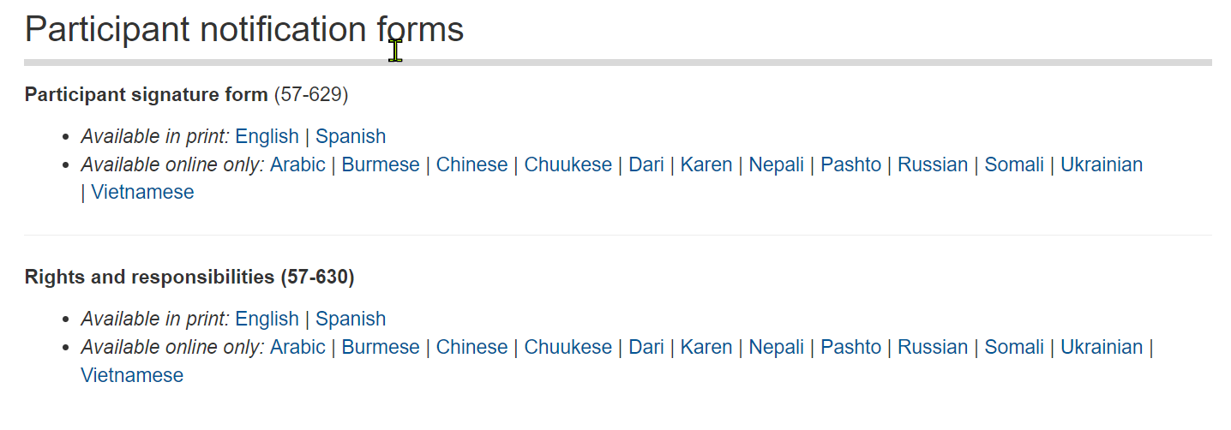
Translated Materials
The State WIC office must ensure all rights and responsibilities are read to applicants in the appropriate language.
https://www.oregon.gov/oha/PH/HEALTHYPEOPLEFAMILIES/WIC/Pages/clinicforms.aspx
WIC Services for Participants with Limited English Proficiency
Notes:
The State WIC office must ensure all rights and responsibilities are read to applicants in the appropriate language.
The State WIC office helps by providing translated documents for local agencies to use.
The State WIC office must consider:
The number of WIC participants who speak languages other than English. All written materials are translated into any language written by more than 10% of participants statewide
For those who need help with spoken language, work to secure an approved translator.
Critical materials (Food List, outreach materials, etc.) are translated into additional languages and provided either in print or on our website. Our Food List is available in at least 14 languages on our website!
Translation requirement does not apply to materials targeting vendors.

Slide 26
Are interpreters required to be physically present when the participant has limited English Proficiency?
YES
NO
WIC Services for Participants with Limited English Proficiency

Slide 27
Are interpreters required to be physically present when the participant has limited English Proficiency?
YES
NO
We must offer interpreter services.
We must know how to access those services at the appointment.
Participants may choose to decline the offer.
If a participant must offer declines interpreter services, document it in TWIST.
WIC Services for Participants with Limited English Proficiency
Notes:
Correct answer:
No, we must offer interpreter services, but participants can choose to decline.
If a participant declines documenting it in TWIST is best practice.

Slide 28
A participant declines an interpreter because they want their older child to interpret for them
What do you do?
WIC Services for Participants with Limited English Proficiency

Slide 29
A participant declines an interpreter because they want their older child to interpret for them
What do you do?
WIC policy states that children cannot be used as interpreters
Offer an interpreter from WIC.
If a participant declines an in-person interpreter, offer to use the language line on speaker phone to help.
Plan for the future.
WIC Services for Participants with Limited English Proficiency
Notes:
What if the participant declines an interpreter because they have an older child along, and want their older child to interpret? WIC policy states that children cannot be used as interpreters.
First, Offer an interpreter from WIC. You could say something like: “I’m so glad your older child is here! You must be proud of their skills. We would like to offer an interpreter. They have special training and can make sure you get all your questions answered.”
If a participant declines an in-person interpreter, offer to use the language line on speaker phone to help.
Plan for the future. Offer to have a translator available and ready to use at their next appointment.

Slide 30
Are other services needed?
Other services may be needed at local clinics:
Oral language services (telephone language lines, interpreters, bilingual staff).
Written language services (translation of office specific forms and materials).
See Policy 452: Civil Rights for guidance.
WIC Services for Participants with Limited English Proficiency
Notes:
Remember, providing a written translation may not be the best way to meet the participant’s needs!

Slide 31
Example
A clinic is located in an area near a large, single-language minority population that might have members who are eligible for WIC.
What services can you offer?
WIC Services for Participants with Limited English Proficiency
Notes:
A clinic is located in an area near a large single-language minority population that might be eligible for WIC. What services can you offer?
If there is no one on staff who is qualified to interpret in the language spoken by the participants, a language line or some other means should be used to ensure that there is accurate interpretation. If the clinic is located in an area with a large single language minority population that has regular contact with the clinic, then consideration should be given to hiring bilingual staff.

Slide 32
How are we doing?
How are interpreters used in your clinic?
What questions do you have about using the language line or scheduling interpreters?
WIC Services for Participants with Limited English Proficiency

Slide 33
Public Notification Requirements
Notes:
The USDA non-discrimination statement must be included on all WIC program materials that are produced for public notification.

Slide 34
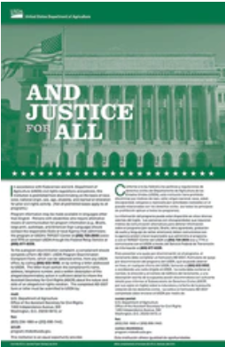
Public notification and outreach requirements
What are WIC’s requirements for public notification and outreach?
Public Notification Requirements
Notes:
What activities require the non-discrimination statement?
Using non-discrimination statement
Providing information in other languages and formats
Showing diversity in messaging and images
Conducting outreach (required at least 1x/year) is required

Slide 35
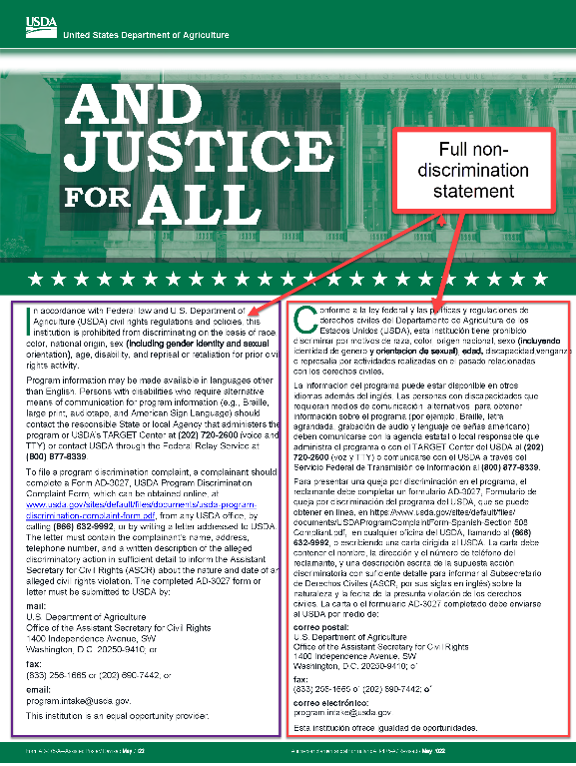
Non-discrimination statement
Required on anything (print or electronic) that has an outreach message or information on WIC benefits and services
Wording is provided in Policy 452: Civil Rights
Some local agencies will use language provided by their organization
Public Notification Requirements
Notes:
The non discrimination statement is required on anything (print or electronic) that has an outreach message or information on WIC benefits and services
It is not required on nutrition education materials.
There is a short version that can be used on small items such as postcards and letters.
The short and long versions can be found in Policy 452

Slide 36
Example
A newspaper wants to run a story about the local WIC clinic’s conversion to eWIC
Does the newspaper need to print the non-discrimination statement in their story?
Public Notification Requirements
Notes:
A newspaper wants to run a story about the local clinic’s conversion to eWIC. Does the newspaper need to print the non-discrimination statement in their story?
Newspapers do not need to include the nondiscrimination statement in stories that they write about the WIC program because they are not recipients of Federal financial assistance.
If an agency sends in a press release or a public service announcement or pays for an ad, the nondiscrimination statement should be included, but the news media does not have to include it unless it is part of paid advertising.

Slide 37
All WIC clinics are required to display “And Justice for All” posters in an easy-to-see location
Displaying “And Justice for All” Posters

Slide 38
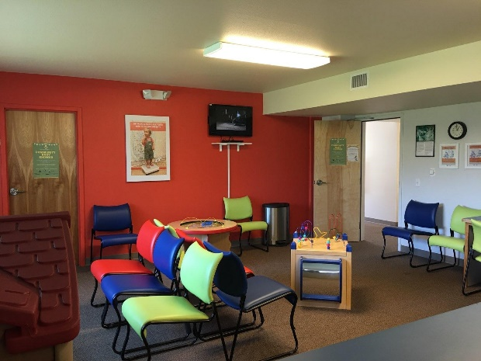
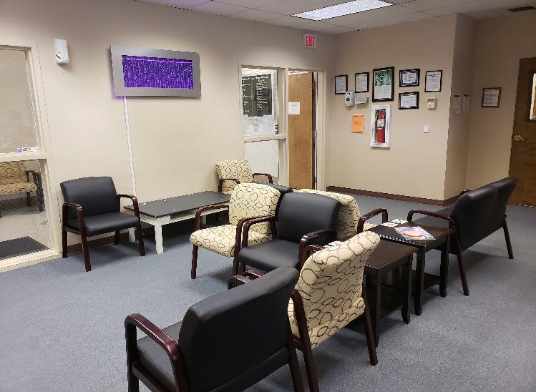
“Easy to see” location
Displaying “And Justice for All” Posters
Notes:
What do you think an “easy-to-see” location is? Where would that be in your clinic?
Please share your thoughts with the group.
An easy to see location is somewhere participants and the public can easily access the poster. This might be in an entry way, waiting area, etc. This does not mean having to go behind a counter or into another room or back hallway.
It is also somewhere participants can easily see the poster, without chairs, tables, desks, or counters blocking their ability to read it.

Slide 39
Discussion topic
Why is it important that this poster is in an easy-to-see location?
Displaying “And Justice for All” Posters
Notes:
Why is it important that this poster is in an easy to see location?
It is a federal requirement, and must be posted in all locations that WIC services are provided. The audience for the poster is participants, applicants and the general public. It helps people find out how to file a complaint about a civil rights violation. They can do so easily and anonymously.
The poster has instructions in English and Spanish.
Training supervisor note:
This poster is meant for participants, applicants, and the public. It is not meant to be put with the mandatory employment postings like wages and OSHA.
You can post as many of these as you want, you can order them through Shopify!

Slide 40
Discussion topic
Where is the “And Justice for All” poster in your clinic?
Displaying “And Justice for All” Posters
Notes:
Where is the “And Justice for All” poster in your clinic? Is it easy for everyone to see and read? Remember, this poster must be put up at all satellite clinic locations and anywhere else you might be doing outreach.

Slide 41
Submitting Complaints

Slide 42
Complaints can be received in many ways
In person, email, phone, things we see on social media
Complaints can be submitted by witnesses or the person who experienced the event
Enter all complaints
Complaints can be about poor customer service, civil rights violations or a combination of both
Submitting Complaints

Slide 43
Anytime a participant claims discrimination, you must report the complaint to the State WIC office for review
Submitting Complaints
Notes:
If a participant is alleging discrimination, you must report the complaint so the state agency can review it.
Best case scenario is that it was not a civil rights violation, worst case it was and reporting it helps resolve it.

Slide 44
Reporting Complaints in TWIST
Complaints are entered in the Compliance section of Operations Management in TWIST
Submitting Complaints
Notes:
When entering complaints, if you think it might be a Civil Rights violation click the “Civil Rights” box in TWIST. Even if you are not sure whether or not it was a civil rights violation, be sure to check the “Civil Rights?” box – it’s located where the red arrow is pointing. (click to animate arrow) Checking this box flags the complaint for the state agency Civil Rights Coordinator to review the complaint and make a determination.
The State WIC Office Civil Rights Coordinator reviews all items selected as “Civil Rights” complaints in TWIST.
Checking the box flags the complaint so we are sure it gets reviewed correctly.
Local Agency staff do not have to worry about making the determination about whether a complaint was definitely a civil rights violation or not. The state agency Civil Rights Coordinator will review and refer to USDA for investigation. When it doubt, check the box!

Slide 45
What do I include in a Civil Rights complaint?
Here’s what we need to know:
Who was involved?
What happened during the incident?
Where did it happen?
When did the participant realize it happened?
Why is this a potential violation? Which protected classes may have been involved?
Include all available documents related to the incident
Include any information about witnesses or people who may have been around during the incident
Submitting Complaints
Submitting Complaints
Notes:
**** These information descriptions are located on your “cheat sheet”

Slide 46
What if you run out of space on the TWIST complaint screen?
Submitting Complaints
Notes:
What if you run out of space on the TWIST complaint screen?
For participant complaints:
Put a note in WIC Notes with the rest of the information and add “see WIC Notes” on the TWIST complaint screen.
Non-participant complaints:
Use TWIST then email the State WIC Office Civil Rights Coordinator with the full complaint.
If there is additional documentation:
Email pictures or witness information to the State WIC Office Civil Rights Coordinator.

Slide 47
Submit complaints as soon as possible
Submitting Complaints
Notes:
Please submit complaints as soon as possible, because we must respond and support participants as quickly as possible. We have federal timeframe requirements for investigations.

Slide 48
What do I do if the complaint is about WIC Staff?
Complaints about WIC staff should not go into TWIST Read Policy 588 Program Integrity: Complaints to learn more
Send Civil rights complaints about WIC staff to the Oregon WIC Civil Rights Coordinator by phone or email marked urgent
Submitting Complaints
Notes:
Complaints about WIC staff should not go into TWIST. To learn more read Policy 588.
Civil rights complaints about WIC staff should be sent to the Oregon Civil Rights Coordinator by phone or email marked urgent.

Slide 49
State WIC Office Civil Rights Coordinator
Questions?
Want more information?
Need help with the complaint?
Contact:
Compliance and Civil Rights Coordinator
wic.compliance@odhsoha.oregon.gov
971-673-0040
Submitting Complaints

Slide 50
Complaint Case Studies
Notes:
Sometimes it’s hard to tell the difference between bad customer service and civil rights complaints.
All complaints should be reported even if they don’t seem serious, or they don’t seem like they can be “proved.”
Complaints are tracked and recorded to look at how we can support participants and our vendors.
Let’s look at some case studies to see the difference.

Slide 51
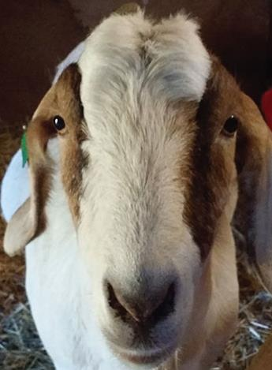
Case Study
A participant has goat milk as a benefit in their food package.
The family can’t find it on the shelf at the local store. The participant asks the store to start carrying it for them.
The store tells them that it’s not a minimum stock requirement for the WIC program. The store tells the WIC participant they cannot carry it because it’s too expensive and they are not required to carry it.
Case Study: Complaints
Notes:
Questions:
Does having goat milk as a benefit make someone part of a protected class?
Is the store discriminating against the participant by declining to carry goat milk?
Is this bad customer service?
If you hear this complaint should you enter it into TWIST?

Slide 52
Case Study Answers
Having goat milk is not a part of a protected class
The store is not discriminating against the participant
This is not bad customer service.
The complaint must be entered in TWIST
Case Study: Complaints
Notes:
Having goat milk as a benefit does not make someone part of a protected class.
The store is not discriminating against the participant, because it is not a minimum stocking requirement to have goat milk.
This is not bad customer service, they gave the WIC family a clear explanation about why they cannot carry this item.
Yes, do enter this complaint in TWIST. This helps us track and answer any questions or clarify important information with participants or the grocery store.

Slide 53
Case Study
A participant goes to the register to check out. Here is what is in their cart:
milk,
bread,
eggs,
cheese,
cereal
The cashier says “Oh, you must be on WIC, I can tell by what you’re buying.”
Case Study: Complaints
Notes:
Questions to consider:
Is being a WIC participant a protected class?
Are stores required to treat WIC participants like they treat all other customers?
Was this bad customer service?
If you hear about this in the participant’s next appointment should you enter a complaint into TWIST?

Slide 54
Case Study Answers
Being a WIC participant is not a protected class
Stores are required to treat WIC participants like they treat all other customers
This is bad customer service
Enter this complaint in TWIST
Case Study: Complaints
Notes:
Is being a WIC participant a protected class?
Answer - No.
Are stores required to treat WIC participants like they treat all other customers?
Answer - Yes.
Was this bad customer service?
Answer - Yes. This is not treating the participant like other shoppers.
If you hear about this in the participant’s next appointment should you enter a complaint into TWIST?
Answer - Yes. The State can provide feedback and training to vendors, and track this information.

Slide 55
Compliance Review

Slide 56
Civil Rights compliance review
USDA Western Region staff review state and local WIC programs for civil rights compliance.
Local agencies are reviewed for civil rights compliance during the biennial WIC review and the triennial review.
Corrective actions may be needed to bring the agency into compliance.
Failure or refusal to cooperate can result in loss of federal funding.
Compliance Review

Slide 57
Resolution of non-compliance
Any findings related to civil rights will be provided in writing to the local program.
Nutrition Consultants and the Civil Rights Coordinator work with local programs to resolve any findings of non-compliance.
Compliance Review

Slide 58
Conflict resolution

Slide 59
When participants are angry
What are some reasons a participant might feel angry?
Conflict Resolution
Notes:
What are some reasons a participant might feel angry?
When they are denied benefits or determined to be ineligible
When they’re received what they see as unsatisfactory service
When they see others receiving what they view as “better” service than what they’ve received
Resolving conflicts effectively can prevent a complaint

Slide 60
Defuse angry situations with l.o.v.e.
Listen
Ask open-ended questions
Validate their concerns
Empower, educate and empathize
Adapted from Kansas WIC
Conflict Resolution
Notes:
Listen:
Be sincere and try to understand.
Receive comments without interruption.
Do not become defensive.
Let them vent their frustration if necessary.
Ask Open Ended Questions
Be careful to use tact when asking questions.
Try identify the real issue.
Avoid making excuses.
Express your regret that the situation occurred.
Validate their concerns
Show your desire to help work out the issue.
Remember, someone in crisis may not be able to begin by talking about solutions.
When ready, follow up with a discussion of the problem.
Empower, educate and empathize
Empower by working together to find a solution.
Empathize and respect each other’s point of view.
Educate by offering realistic solutions.

Slide 61
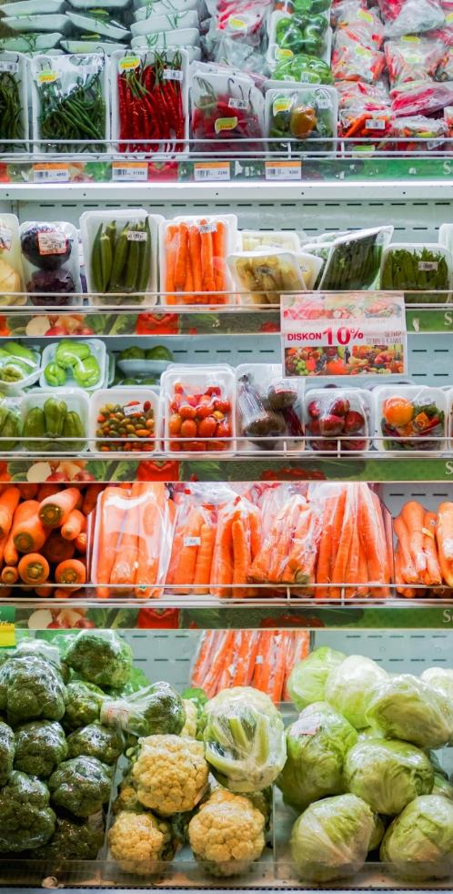
Case Study: Complaints
A WIC participant for whom English is not their first language goes to the register to check out with WIC eligible foods. She speaks with a heavy accent.
She does not have enough CVB benefits to cover all of her fruits and veggies, so she asks to have some of the vegetables removed.
The cashier yells “I can’t understand you, if you can’t speak English I can’t help you so you’ll have to go somewhere else.”
The participant was embarrassed. They left without any of the WIC foods because the cashier refused to help her.
Case Study: Complaints
Photo by Fikri Rasyid on Unsplash
Notes:
Questions:
Is this a Civil Rights Violation? If yes, why?
If the participant tells you about this incident, what should you do?

Slide 62
Case Study: Answers
Yes, this is a civil rights violation.
Enter a complaint in TWIST and check as a possible Civil Rights violation
Photo by Fikri Rasyid on Unsplash
Case Study: Complaints
Notes:
Yes, this is a civil rights violation. The mom was discriminated against based on a protected class.
Enter a complaint in TWIST and check as a possible Civil Rights violation.
Because the cashier refused to help the WIC Mom, she was forced to leave without any of her foods. This is different treatment than other customers receive.
The cashier at the store discriminated against the participant based on the way she spoke as a Latina WIC Mom when asking to take some items off her balance. This discrimination was clearly stated based on how the participant spoke.
Remember, it’s okay if you’re not sure if it is a clear Civil Rights Violation. Even if you’re not 100% sure, submit a complaint through TWIST and check the Civil Rights box.

Slide 63
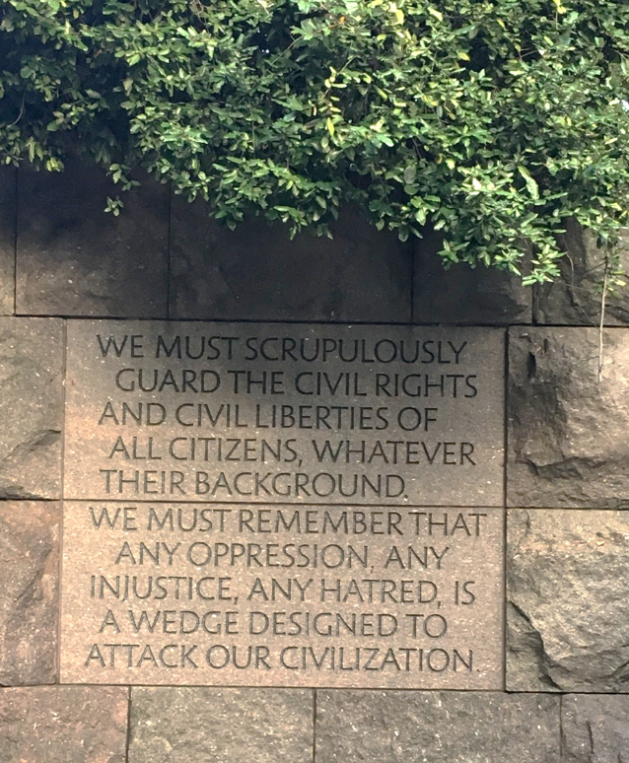
A note about equity and Civil Rights
We know it can be difficult
A note from the Civil Rights Coordinator
Notes:
We know it can be difficult. We want to acknowledge that civil rights violations and complaints can come with a lot of intense emotions. From the participant who experienced the event, to you listening to them share their story.
If you are feeling upset, frustrated, angry, or any other emotion, be sure to do something to help you feel better. Whether that is taking a few deep breaths, taking a short walk on your break, meditating in your office, whatever helps you not focus solely on those intense emotions.

Slide 64
We also need to acknowledge…
The law does not always address equity, diversity, and inclusion and can leave gaps
Civil Rights laws, while good in intent, are open to interpretation based on personal feelings, values, and bias when it comes to application
A note from the Civil Rights Coordinator

Slide 65
Here are things we can do beyond the law
We can help address the gaps by using an equity lens in our work when we complete trainings, develop materials, and interact with others
Using an equity lens in all interactions gives us the chance to reinforce WIC values that foster equitable and trauma sensitive interactions
This will help us create an environment that feels safe for our participants to return to after they’ve had interactions like the ones in our case studies
A note from the Civil Rights Coordinator
Notes:
“Using an equity lens” refers to an intentionally inclusive approach to decision-making. It introduces a set of questions into the decision that help the decision makers focus on equity in both their process and outcomes. It is explicit in drawing attention to the inclusion of marginalized populations, typically communities of color, and can be adapted to focus on other communities.

Slide 66
CONGRATULATIONS!
You have completed the 2023 Civil Rights Training!

