Slide 1
GRADE 5 Basket Math

Slide 2
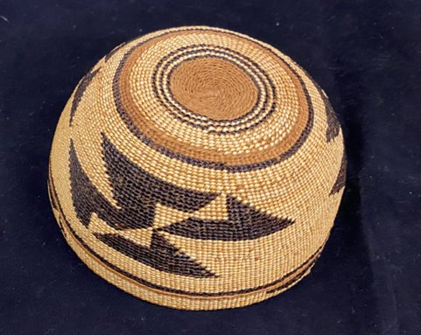
All images courtesy of the Confederated Tribes of Siletz Indians.
Notes:
Say: We’ve been discussing basketry and basket caps in particular. These basket caps are prized because of their beautiful designs, their durability, and the skill needed to create them. Some people who are not familiar with basket caps think they are storage baskets and display them upside down! As you look at the photos, notice the woven patterns and consider the math and art skills needed to make those patterns, which aren’t flat, but rather on a curve. To get the right shape weavers must constantly add in sticks to the basket. But, adding sticks means that as the weaver moves up the basket cap, the number of sticks in the pattern changes. Weavers have to plan this change out ahead in order to keep the mark looking symmetrical even as the number of sticks in the design may be changing. This can take a lot of planning—and math—to figure out just the right number of sticks to add in so that the pattern will stay even.

Slide 3
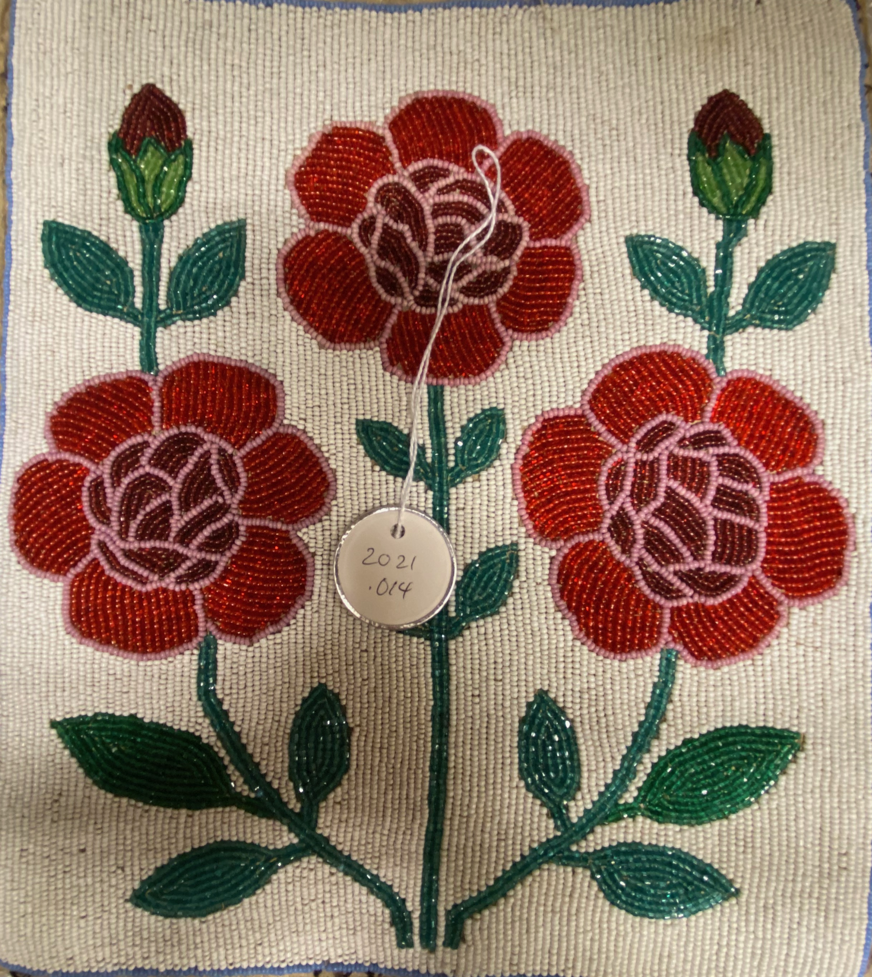
All images courtesy of the Confederated Tribes of Siletz Indians.
Notes:
Say: Part of planning a basket design is being able to make a design (or “mark” as many weavers call it) from lots of little individual pieces. Each mark is made up of many individual overlays of design material that create the color in just the right place. This is a common skill in Native American art in general—and Indigenous art from around the world. Compare the basket marks we looked at earlier with this example of a beaded bag that was also made at Siletz.

Slide 4
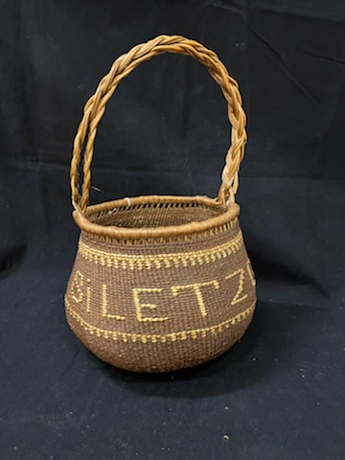
All images courtesy of the Confederated Tribes of Siletz Indians.
Notes:
Ask students what is different about this baskets compared to the ones that they have seen so far.

