Slide 1
Oregon Board of Accountancy
EXAM AND LICENSING: AN OVERVIEW

Slide 2
Board Staff - contact information
Kimberly Fast – Executive Director kimberly.fast@oregon.gov
(503)378-2280
Licensing Department:
Julie Nadeau – Licensing Manager julie.nadeau@oregon.gov
(503)378-2270
Stacey Janes – Licensing Specialist stacey.janes@oregon.gov
Applications A-L (503)378-2264
Ashlie Rios – Licensing Specialist ashlie.m.rios@oregon.gov
Applications M-Z (503)378-2268
Leah Von Deylen - Front Desk leah.m.vondeylen@oregon.gov
(503)378-4181
Compliance Department:
Joel Parks – Compliance Specialist joel.parks@oregon.gov
(503)378-2262
Anthony Truong – Lead Investigator anthony.t.truong@oregon.gov
(503)378-2273
Jeremiah Leppert – Investigator jeremiah.leppert@oregon.gov
(503)378-5041

Slide 3
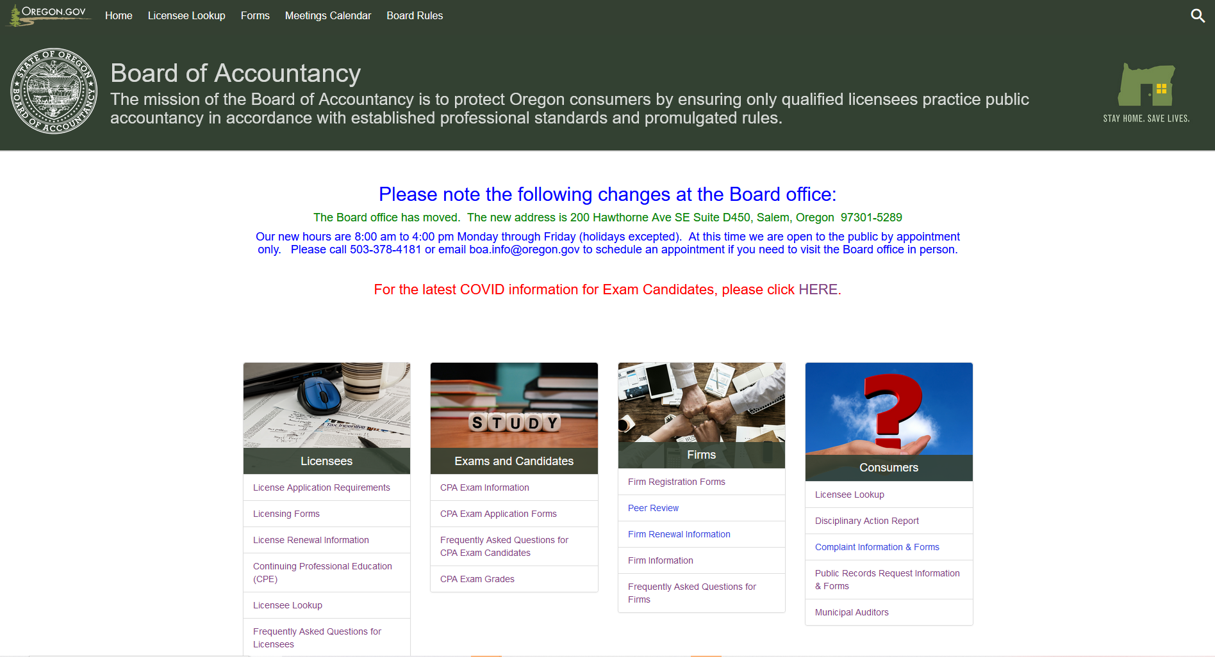
Topics of Discussion
What is the role of the Board?
CPA Exam Prerequisites
-Education requirements www.Oregon.gov/BOA
-Application Process
Passing the CPA Exam
Applying for Initial Licensure
Renewal and CPE
(Continuing Professional Education)
FAQ

Slide 4
What is the role of the Board of Accountancy?
Public Protection
The mission of the Board of Accountancy is to protect Oregon consumers by ensuring only qualified licensees practice public accountancy in accordance with established professional standards and promulgated rules.
Licensing within a profession protects the public by:
Requiring minimum educational standards
Providing standards for minimum competency to practice safely
Compelling accountability through an established code of ethics enforced by the Board

Slide 5
CPA Exam Prerequisites
To qualify to sit for the Uniform CPA Exam, first time candidates must meet the following requirements at the time of application:
Earn 150 Semester (225 quarter) hours, including a bachelor’s degree from a college accredited by a body recognized by the Board that includes:
• 24 semester (36 quarter) hours in upper-division core accounting coursework and
• 24 semester (36 quarter) hours in accounting or related courses (business, economics, finance, and related written or oral communication)
Candidates who wish to sit for the exam to become a PA must have graduated from high school (or equivalent) and have 2 years of public accounting experience under a licensed CPA or PA. PA candidates sit for three sections of the exam (BEC, FAR, REG).
Candidates who have earned foreign educational credentials must have their education evaluated by NASBA International Evaluation Services (NIES).
Transfer candidates who have previously applied for or sat for the exam in another jurisdiction must meet the educational requirements in Oregon at the time of application.
Please note:
*Board staff cannot evaluate transcripts before an application is submitted. If you have a question about a specific course, please email a link to the course description to the appropriate licensing specialist.
*Internship credits are limited to a maximum of 4 semester (6 quarter) hours. Internship credits can be considered for upper division accounting credit if the internship is gained in the practice of public accounting under a qualified supervisor licensee through a public accounting firm or in a qualified industry setting. The internship certification form must be completed and submitted with the application materials.
*Candidates applying to sit for the CPA exam under the experience requirement may only apply to be a Public Accountant.
*Courses from community colleges are accepted if they are transferable to an accredited four-year college or university. Generally, courses 100-level and above are considered transferable. If there is a question about a particular course, a link to the course description on the school website should be emailed to the licensing specialist for review.

Slide 6
Application Process
Candidates must submit the following items in order to complete the application process:
-CPA Exam Application
-Official transcripts sent directly from the school Registrar
-Candidate Information Release form (required only for first time candidates)
-Exchange of Information (only if transferring scores from another state)
After eligibility is verified, the Board will send an Authorization to Test (ATT) to the candidate and to NASBA. The ATT is valid for 90 days and will expire if the section fees are not paid to NASBA within the 90-day period.
After receipt of the ATT and payment of exam section fees, the Notice to Schedule (NTS) will be issued and the candidate can schedule exam section(s) at a Prometric testing center.
A candidate should only apply for sections that will be taken within the 6-month NTS period.

Slide 7
Passing the CPA Exam
All sections of the exam must be passed within an 18 month period. If the last of the four exam sections is not passed within 18 months of the date that the first section was passed, the earliest section is expired from the candidate’s record, and that section must be taken again within the new 18 month period.
After each attempt at an exam section, NASBA will issue an exam score sheet with details of the results. A copy of the exam score sheet will be retained in the Board office and the original will be mailed to the address on file with the Board. When all four sections are successfully completed within an 18 month period, a congratulatory letter will be mailed to the candidate with the final score sheet.
The Board does not issue certificates based on exam passage.

Slide 8
Applying for Initial Licensure
Have a minimum of 12 months full-time employment or a total of 2,000 hours of equivalent part-time experience (over the course of 12+ months).
Develop and demonstrate achievement of the Core Competencies through a written narrative.
Pass the AICPA ethics exam for initial licensure with a 90% or higher.
Obtain experience that consists of activities generally performed by Oregon licensed CPAs and PAs engaged in public practice to meet core competencies.
-Typical public practice includes: attestation engagements, tax return preparation, financial advisory services and/or compliance, and internal control evaluation.
- Experience must be gained under a qualified supervisor licensee.
- Experience can be gained in a public accounting firm or in an industry setting.

Slide 9
Supervised Experience
Applicants must obtain experience directly supervised by a qualified supervisor
A supervisor licensee is a person who holds an active CPA license issued by any state, during the period of supervision, and for at least five of the seven years immediately prior to such supervision.
NOTE: A Public Accountant (PA) may not act as a supervising licensee or verify an applicant’s experience relating to attest services.
The supervisor licensee must have regular and meaningful interaction with the applicant in terms of planning, coordinating, guiding, inspecting, controlling and evaluating activities, and have authority over the employee being supervised.
A licensee acting as a consultant or independent contractor to the applicant’s employer will not meet the requirement of direct supervision.
Successful completion of the CPA exam, passing the AICPA ethics exam, and gaining qualifying experience must all be completed within the 8 years immediately preceding the date of the application for licensure.

Slide 10
Written Narrative
Applicants are required to provide a written narrative along with examples of how competencies within the profession have been achieved.
The narrative is to be written by the applicant, based on his/her unique work experience.
The supervisor licensee must complete and sign the evaluation worksheet and sign the written narrative attesting to the experience. The Board is changing this practice slightly to have the supervisor licensee submit the evaluation sheet directly to the Board. The applicant will submit the remaining documentation with the application for licensure.
Experience may be obtained through the following paths:
- Attest
- Tax
- Industry/Government

Slide 11
Each of the following core competencies must be included in the written narrative, along with examples on how each competency has been met:
A. Understanding the Code of Professional Conduct. B. Ability to assess the achievement of a client's objectives
C. Experience in preparing working papers that include sufficient relevant data
D. Understanding transactions streams and information systems
E. Skills in Risk Assessment
F. Decision Making, Problem Solving, Critical Analytical Thinking
G. Ability to Express Scope of Work, Findings and Conclusions
The Board has developed new narrative forms for Attest and Tax applicants that are similar to the form used by Industry applicants. The new narrative form is available on the Board website with the other license application documents.
*All seven competencies must be met to be considered for licensure. The applicant may obtain a combined total of experience/competencies through more than one qualified employer.

Slide 12
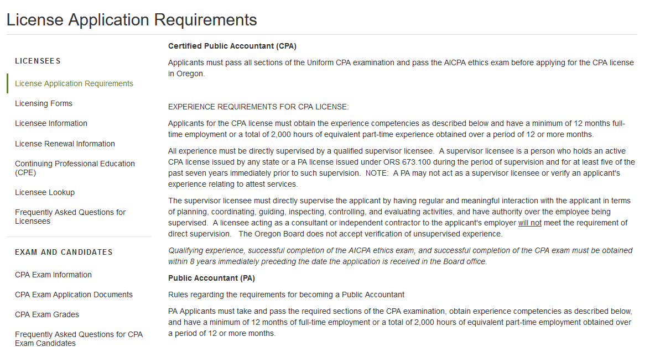
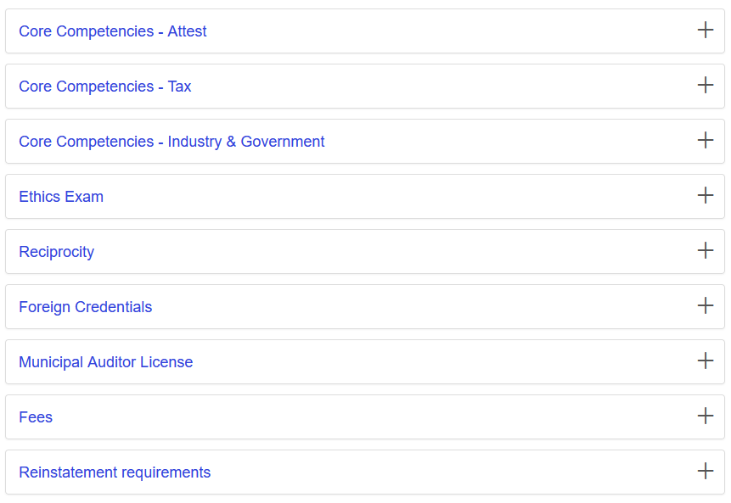
Applicants should include a thorough discussion of knowledge and understanding related to each concept listed in the competency heading, along with examples of specific experiences that support each competency.
The written narrative should only discuss work experience directly supervised by the signing CPA. Be careful not to include experience gained through other employment.
Applicants who do not provide sufficient detail in the initial narrative will be asked to make revisions. Revised narratives must be signed by the supervisor licensee before they will be accepted by the Board.
Tips:
When writing the narrative, use plain English and provide a sufficient level of detail to convey knowledge and understanding to an audience of non-accountants.
The narrative should highlight the applicant’s role and level of responsibility on engagements/projects, rather than discussing firm practice or the activities of the work team.
The narrative should include all relevant details, while being concise and direct. Remember, two of the competencies relate to a CPA’s ability to prepare work papers and express scope of work.
Avoid bulleted lists, instead opting for a written discussion of experiences.
Please refer to the Licensing Requirements section of the Board website at www.Oregon.gov/BOA to learn more about the core competencies.

Slide 13
Industry Experience
The Qualifications Committee (QC) is responsible for verifying the competency of applicants who gain their experience in private industry or government.
The QC meets quarterly and makes recommendations to the Board for approval or denial of industry/government applications. Applicants recommended for approval by the QC will be granted a license that will be ratified by the Board at their next meeting.
* Submission timelines for QC applicants are available on the Board website

Slide 14
License Renewal and CPE (Continuing Professional Education)
Licenses are to be renewed every two years on June 30, based on the number of your CPA license. Even-numbered licenses renew even-numbered years and odd-numbered licenses renew odd-numbered years.
Each biennial renewal period, active CPAs/PAs are required to complete and report 80* hours of CPE, of which no more than 16 hours can be non-technical subject matter. Non-technical CPE in excess of 16 hours will be deleted from the total hours reported.
A minimum of 24* of the required 80 CPE hours must be completed in each year of the renewal period (July-June).
Four hours of Oregon-specific ethics are required each renewal period for all active licensees. To meet the ethics requirement, licensees must take a Board-approved ethics course.
Each biennial renewal period, inactive CPAs/PAs are required to complete and report 32* hours of CPE. Inactive licensees do not have a minimum annual requirement and may report a maximum of 8 hours of non-technical CPE. Inactive licensees must report four hours of Oregon-specific ethics each renewal period.
Acceptable CPE subject matter and other requirements are available under the Administrative rules, 801-040-0040.
For a list of NASBA approved self-study courses, please visit https://www.nasbaregistry.org/sponsor-list
Retired licenses are renewed every two years, but do not include a CPE requirement.
*CPE is prorated for new licensees for both total hours required as well as the annual requirement.
**A list of approved sponsors and Oregon-specific ethics courses can be found on the Board website under the Continuing Professional Education (CPE) link.

Slide 15
Frequently Asked Questions
Will the Board evaluate my transcript, before I apply, to ensure I meet the educational requirement?
While the Board does not evaluate transcripts before an application has been submitted, candidates are welcome to contact the Board if they are unsure about a specific course or have general questions in regards to the education requirements. If you have questions about the eligibility of a specific course, please email a link to the course description to a licensing specialist to request assistance.
Does the Board accept CLEP testing as credit toward the education requirement?
If the college awarded credit for CLEP testing on an official transcript, it will be accepted by the Oregon Board.
If I take (and pass) my final exam section before my first exam section expires, will my scores still be valid?
As long as you sit for your final exam section (and pass) on or before the date your first exam section expires, the credit will be valid regardless of the date that scores are released.
Which upper-division accounting courses count towards the educational requirement?
To satisfy the upper-division accounting requirement, you must take 24 semester (36 quarter) hours of solid accounting coursework, generally listed with a course ID 300-level or above. Accounting courses primarily include auditing, accounting, accounting analytics, and taxation courses. If you are unsure if a course will be counted toward the upper-division credit requirement, please email a link to the course catalog description to one of the Board’s licensing specialists for assistance.
What college courses count as accounting-related courses?
Courses such as lower-division accounting, business, finance, economics, and related written or oral communication are counted toward the accounting-related requirement.

Slide 16
How soon will I receive my ATT after I have submitted my CPA exam application?
Applications are processed in the order they are received. Please allow 2-3 weeks to process a new exam application.
What common issues delay the application process?
- The Board must receive official transcripts directly from the school
- The applicant did not have a notary public complete the notary section on the application
- The photo does not fax clearly
- First-time candidates must submit the required candidate information release form
Can I change the section(s) of the exam I wish to take, even after being issued the ATT?
If you have not paid your exam fees through NASBA, you may change the section(s) of the exam you wish to take by submitting an Exam Section Change Request form found on the Board website, under Forms.
What if I experience issues with my NTS (Notice to Schedule)?
You should contact NASBA first to resolve any issues with the payment coupon or NTS, as the Board does not handle the payment of exam sections or scheduling with Prometric. However, if NASBA is unable to provide assistance, please contact the Board’s licensing specialist so that we may assist with resolving any matters.

Slide 17
Does my supervisor CPA have to hold a current, active CPA license?
Yes, to qualify as a supervisor licensee the person providing supervision must hold an active CPA license issued by any state during the period of supervision and for at least five of the seven years immediately prior to such supervision.
Can my experience be obtained while I am still completing the Uniform CPA Exam?
Yes, applications for licensure may include any relevant experience obtained within an 8-year window of passing the exam and the AICPA ethics exam. The experience can be gained at any time in the 8-year window, whether it is before, during or after passing the Uniform CPA exam.
If I passed the Uniform CPA exam in another jurisdiction, may I apply for licensure within Oregon?
Yes, during the application process, applicants who passed the exam in another jurisdiction should complete the Interstate Exchange Form and send it to the state board through which the exam was taken. The other Board will complete their portion of the form and return it to the Oregon Board. Oregon education, ethics, and experience requirements must be met to qualify for licensure.
How often will I renew my license?
All licensees need to submit an application for renewal every two years. If you are issued an even-numbered CPA license, you will renew by June 30 of even-numbered years. Odd-numbered licenses must be renewed by June 30 of odd-numbered years.

Slide 18
Can I apply for licensure with combined work experience from more than one employer?
Yes, you may submit work experience from more than one employer. The combined experience must allow the applicant to meet full qualifications for licensure. The applicant must submit separate narratives outlining the competencies met with each employer. It is important to note that you may only include information and examples of work experience in the narrative that were directly supervised by the signing licensee. Each supervisor licensee must complete and submit a supervisor evaluation worksheet.
How do I know through which experience path I should apply for licensure?
If you are using work in public accounting to qualify for licensure, you will apply using Attest or Tax experience, or both, depending on the work you performed during the period of supervision. If you work in an accounting role with a private industry or government employer, you will apply through Industry. Industry applications are reviewed by the Qualifications Committee.
What classifies direct supervision for verification of experience?
The supervisory relationship must include direct supervision with regular, meaningful interaction. The supervisor licensee must be able to attest to all work discussed in the written narrative, verifying all of the competency requirements have been achieved. Consultants and independent contractors may not provide qualified direct supervision.
What happens if I let my license lapse?
Lapsed licensees are not permitted to practice public accountancy or to work in public accounting firms. A lapsed license can be reinstated within 6 years of the date of lapse by contacting a licensing specialist to request a reinstatement application. A license that is lapsed for 6 years (3 consecutive renewal periods) will expire and cannot be reinstated.

Slide 19
Will the Board provide an outline or example of the required written narrative for licensure?
While the Board does not provide examples of written narratives, the Board has developed a form that provides an outline to be used for each narrative. It is the responsibility of the applicant to draft a narrative response based on their own unique work experiences. The narrative should include enough detail to convey knowledge and understanding of each concept in a competency, and should outline at least one or two specific, detailed examples for each competency. Licensing staff are available to discuss the general expectations with the applicant. For further guidance, the applicant should consult with their supervisor licensee to review the concepts outlined in each area of competency to identify engagements or projects that will allow the applicant to gain the requisite experience.
Once I have been licensed, how will I know the pro-rated CPE requirement for renewal?
The Board sends a congratulatory letter along with the initial wallet card via US mail after the license is granted. The letter outlines the specific total CPE requirement, as well as the pro-rated annual CPE requirement for the first renewal. You may also reference the Oregon Administrative Rules, Chapter 801, Division 40, located on the Board website, to determine the pro-rated total or contact the Board office.
Once my license is granted, can I provide all CPA services?
The Code of Professional Conduct requires that a licensee only provide those services they are competent to perform. In addition, some services require the licensee to work for a firm registered with the Board and enrolled in peer review. Please contact the licensing department if you have questions about providing attest, review, or compilation services.

Slide 20
References
Where to find Oregon Board of Accountancy Information:
http://www.Oregon.gov/boa/Pages/ExamReq.aspx
http://www.Oregon.gov/boa/Pages/Licensing.aspx
http://www.Oregon.gov/boa/Pages/adminrules.aspx
NASBA Information:
https://nasba.org/products/nasbainternationalevaluationservices/
https://nasba.org/exams/cpaexam/
https://www.nasbaregistry.org/sponsor-list
AICPA Information:
http://www.aicpa.org/BECOMEACPA/CPAEXAM/Pages/CPAExam.aspx

Slide 21
QUESTIONS?

