Slide 1
2019 Grant Management Training Day Two
Rail and Public Transit Division

Slide 2
Welcome and Introductions
Housekeeping
Your Name / Your Agency / Your OPTIS Role

Slide 3
Agenda
OPTIS Workshop
General Tips and Documents Overview
Agency Periodic Reports
Assets
Reimbursement Requests
Managing User Information
Reimbursement Requests Checklist
Procurement – Vehicle Purchase
Q & A

Slide 4
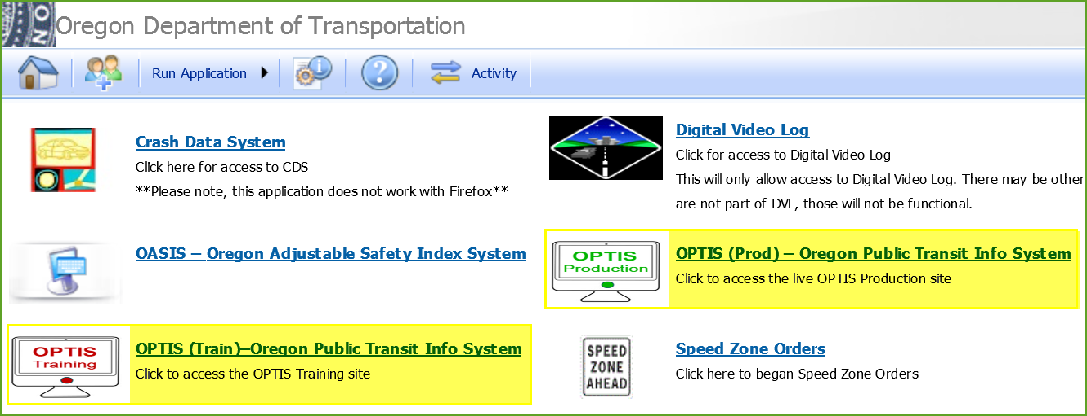
OPTIS – General Tips
Start on our website: https://www.oregon.gov/ODOT/RPTD/pages/index.aspx
OPTIS (Prod) and OPTIS (Train)
Notes:
Website has OPTIS Resources and Training Guides
Be sure to access the correct system: Production (Prod) or Training (Train). This shows in most OPTIS screens at the top left.

Slide 5
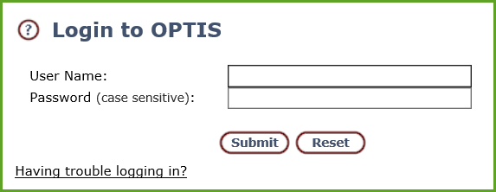
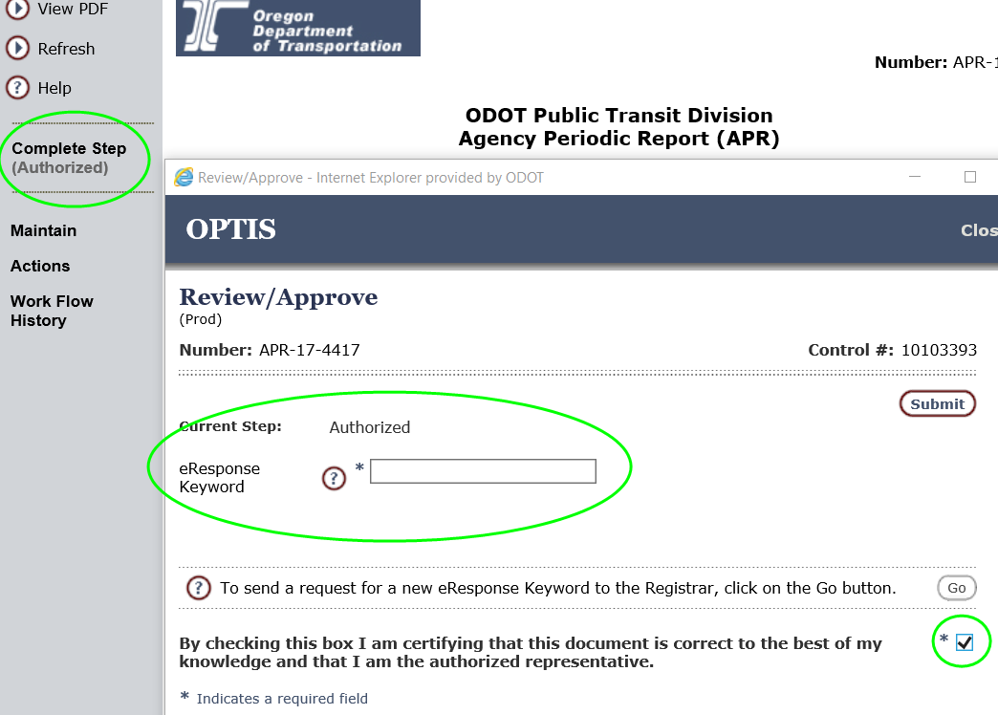
OPTIS – General Tips
Password (All Users)
eResponse Keyword (Authorized Submitters)
Handout 3
Notes:
NOTES
To reset your password, click “Having Trouble Logging In?” and enter your email for an auto-generated password. Also works if you forget your user name.
eResponse keyword is only issued to users who have permission to submit documents for their agency.

Slide 6
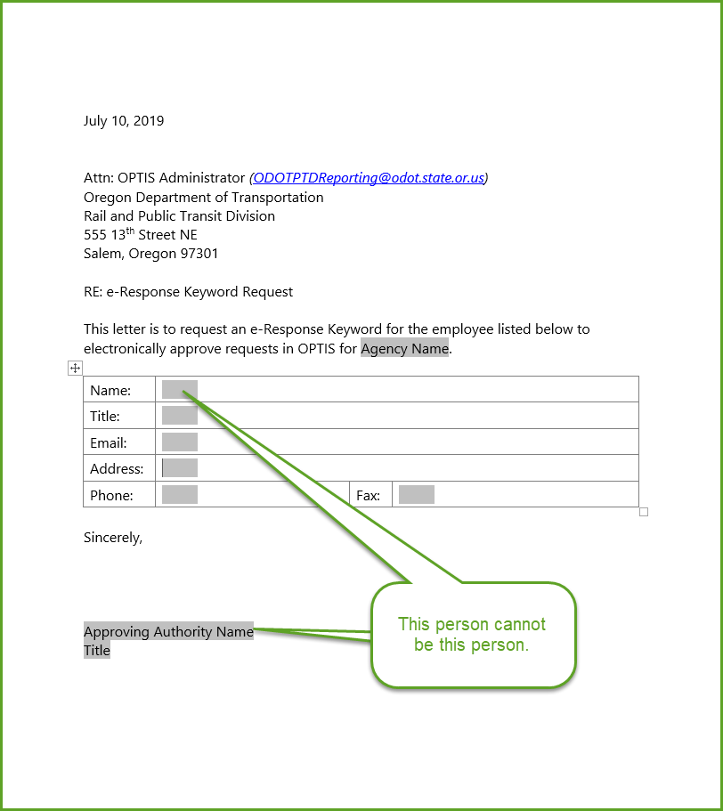
OPTIS – General Tips
eResponse Keyword Authorization Form
Notes:
NOTES
RPTD requires permission from a supervisor or board member to issue eR Keywords. Form is on our website. Be sure that the person needing the permission is not signing the letter.

Slide 7
OPTIS – General Tips
Icons
Complete Document
Incomplete Document
Document Pending Signature
Closed Document
Handout 4
Notes:
NOTES
Four main icons
Complete = document creation is complete
Incomplete Document = document creation is not complete
Document Pending Signature = agreement waiting to be signed by one or more parties
Closed Document = agreement with all activities completed that has been closed out by ODOT

Slide 8
OPTIS – Documents Overview
Document Types
Sub-Grant Agreements
Online and PDF Views
Detailed Information
Signature Pages Attached
Agency Periodic Reports (APRs)
Reimbursement Requests
Payment Requests
Asset Records
Handout 6
Notes:
NOTES
Various Documents in OPTIS – Agreements – APRS - RRs – PRs – Asset Records
Agreements:
Have online (OPTIS screens) and pdf features
Display effective, execution, and expiration dates; grant funding and balances; SOW language; versions (1.0 .01); contacts; workflows
Have signature pages attached after execution
APRS- Quarterly. Document number always starts with APR-1719 or APR-1921 (indicates biennium). Must be completed to request reimbursement (except for Vehicles)
RRs – You Create
PRs – We Process (Same document number)
Assets Register contains a record of all asset types

Slide 9
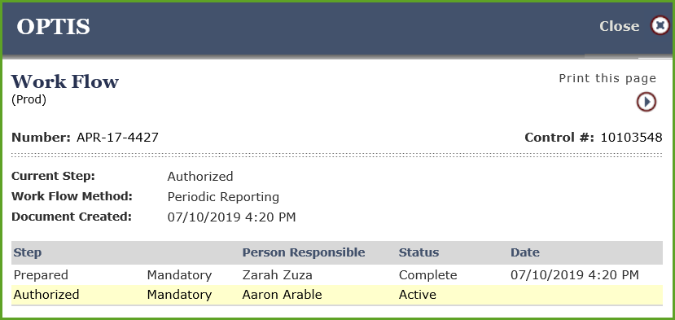
OPTIS – General Tips
Attachments
Overview Screen
Workflow – Click “View Data” / “Workflow History”
Steps – Issue / Prepared / Authorized
Statuses – Forwarded / Complete
Queue
Handouts 7 and 8
Notes:
NOTES
Attachments
Unlimited storage
Backup documentation for RRs
Signed signature pages
Overview – Helpful place to see all agreements and payments in one place.
Workflow
You can see who did what and who has seen a document.
Steps: Issue, Prepared, Authorized (Depends on document type.)
Statuses: Forwarded or Complete
Your Queue and Forwarding. In the Workflow, the step will be highlighted if it is in your queue. On the main document screen the step is bold if it is in your queue and grayed out if not.

Slide 10
OPTIS – Agency Periodic Reports (APRs)
Quarterly reporting is required.
Use OPTIS User Guide Chapter 8.
APR must be in before payment can be made; OPTIS verifies this.
Common Errors:
Vehicle mileage issues
Not updating assets before starting APR
Handouts 11 and 12
Notes:
NOTES
Quarterly reporting using the APR is required of all grant recipients, even those with no current agreement if the vehicle is still in use.
OPTIS validates RRs against APR for the quarter. For vehicle purchases, you will only see a warning – not an error. You can submit.
Vehicle Mileage – If you see a message like “mileage cannot be less than previously reported” we may need to reopen previous APR(s) so you can correct previously reported miles.
Update your assets before you start your APR! Asset record must be in complete status to pull to APR. Disposed assets do not pull to APR.

Slide 11
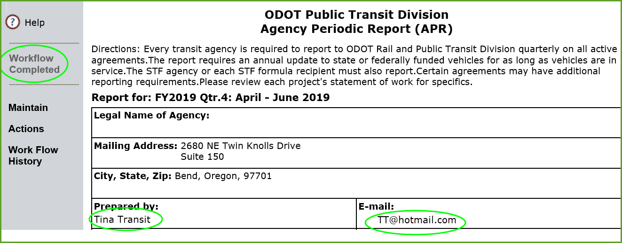
OPTIS – Agency Periodic Reports (APRs)
Common Errors, continued:
Not finalizing the APR document. It requires two steps: Prepared and Authorized
Notes:
NOTES
To complete the APR, click “Complete Step” until you see the eR Keyword request.
Verify it is complete by looking for the open book icon and the words “Complete” in the list view OR “Workflow Completed” and your name and date in the document view.

Slide 12
OPTIS – Agency Periodic Reports (APRs)
Common Errors, continued:
If an error is discovered after an APR is completed, we will reopen it and revert it back to you for correction.
Notes:
NOTES
We may need to open more than one APR, depending on how far back the error occurred.

Slide 13
OPTIS – Reimbursement Requests
How grant payments come to you
Handout 13
Notes:
NOTES
How grant payments come to you
We have a goal of getting payments to you no later than ten business days following receipt of all required documentation.
ODOT Financial Services sometimes combines multiple payments (from all of ODOT) into one check. Remit advice may or may not be helpful. We can help you.
You may receive your grant payment via a check or with electronic deposit. Form is available if you’re interested in signing up for electronic deposit.

Slide 14
OPTIS – Reimbursement Requests
How you can see payment progress
Notes:
NOTES
How to see payment progress
Find your Agreement and Click “View Data” / “Overview (Central File)” – If you see an X by the Payment Request we are still working on it
You can also click “View Data” / “Payment History” from your Agreement
– Expand the plus signs
– If you see a Check # and Check Date, the payment is on its way
– If you see a Batch # but no Check # or Check Date, the payment hasn’t been approved by ODOT Financial Services yet.
- If you see nothing in these columns, we haven’t entered the payment with FS yet.

Slide 15
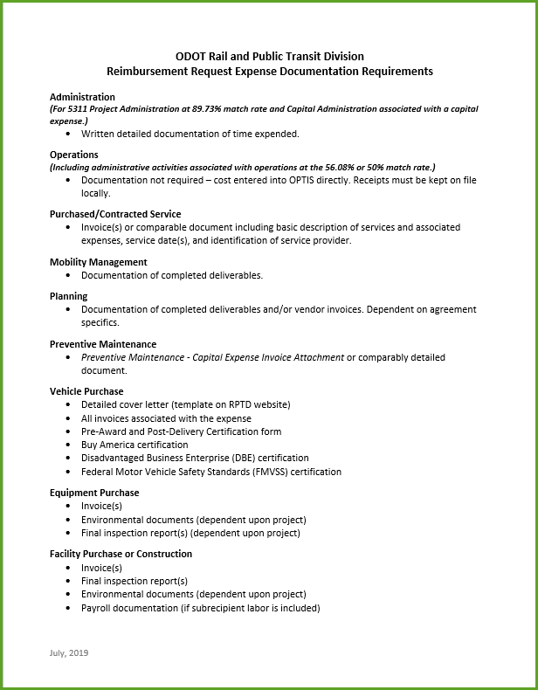
OPTIS – Reimbursement Requests
Required documentation (non-asset-related)
Required documentation (capital documents)
Notes:
NOTES
New Required Documentation Quick Reference Sheet
Capital procurement documents are more complicated / numerous
Cover letter has been updated
Importance of providing us with all necessary details for asset register entry
Bulk vehicle purchases with not all RPTD funded vehicles (please highlight the invoice with grant-funded vehicles)

Slide 16
OPTIS – Reimbursement Requests
Use OPTIS User Guide Chapter 9
Making Corrections – Contact us if already completed.
Common Issues, Integrity Check Warnings and Error Messages
Comments
Notes:
NOTES
Not being able to submit a reimbursement request because the APR for the period is not complete is common
Not attaching required backup documentation to a reimbursement request does not produce an error, but we will check and if it is not there we will revert it back to you for correction to preserve the workflow and authorization
Sometimes you don’t realize you’ve already created a RR. Use the Overview screen to check for Xs (Incomplete)
If a RR isn’t in your queue, you can’t work on it. It will need to be forwarded.
If you’ve chosen one quarter but enter an expense date in a different quarter you will get an error
If you don’t have an eR keyword you won’t be able to submit
Unfortunately, comments on RR don’t come forward to PR (we are working to improve this). Let us know if you have something to say

Slide 17
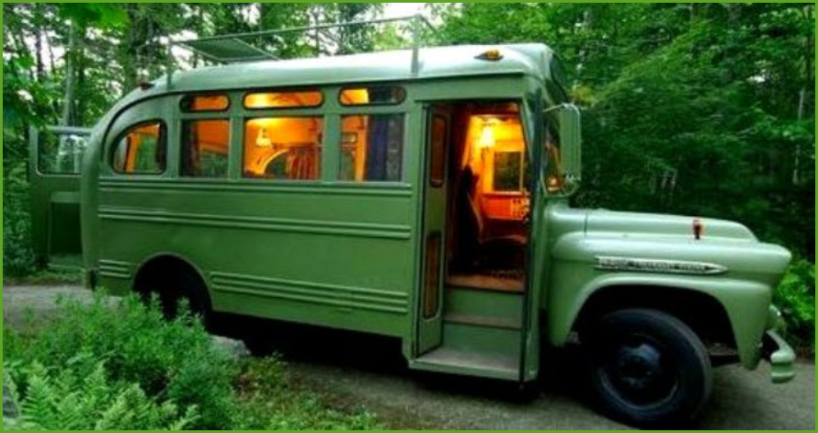
OPTIS – Assets
We enter RPTD-funded assets and you enter locally-funded assets
Asset register vs APR
Which assets pull to APR
Handout 14
Notes:
NOTES
We enter assets funded with all agreements through us except for assets funded with STF Formula (these are considered locally funded)
You enter assets funded through an STF Formula agreement and all locally-funded assets
The asset register has all assets in any step of document completion and in any document status and in any vehicle status. The APR pulls only completed assets (Workflow Complete) that must be reported on. (Active, Pending Disposal, Out Of Service, Back-Up/Spare). So, for instance, a vehicle which has been marked as disposed won’t pull to your APR.

Slide 18
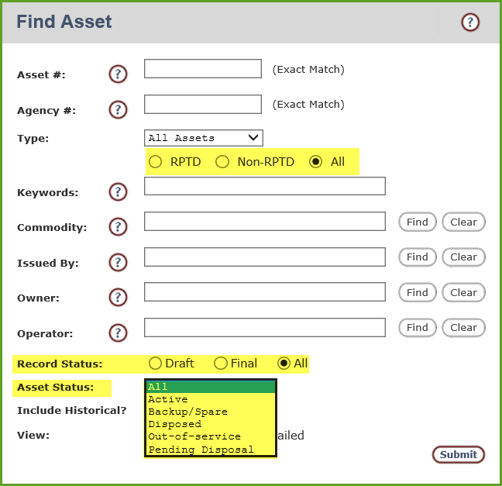
OPTIS – Assets
Handout 15
Notes:
NOTES
Terms:
Asset # - Auto populated by OPTIS
Agency # - (Optional. Can help associate OPTIS asset #s with your own #s)
Asset Type – RPTD-funded or Non-RPTD- funded (aka locally-funded) and Vehicle/Equipment/Signs-Shelters/Facilities
Commodity – Asset coding such as 10.01: Bus STD 35 FT or greater (Cat A)
Issued By – The organization responsible for funding the asset – aka the Security Interest Holder
Owner/Operator – May or may not be the same entity
OPTIS Asset RECORD STATUS – options for searching
Draft Status – the asset record is being created or updated and will not pull to the APR until reviewed and approved using an eResponse Keyword
Final Status – the asset record is complete
All – Displays all assets associated with the agency
Vehicle Asset STATUS
Active
Backup/Spare
Out-Of-Service
Pending Disposal
Disposed
OPTIS Asset STEPS (seen in workflow)
Change Posted
Review Change

Slide 19
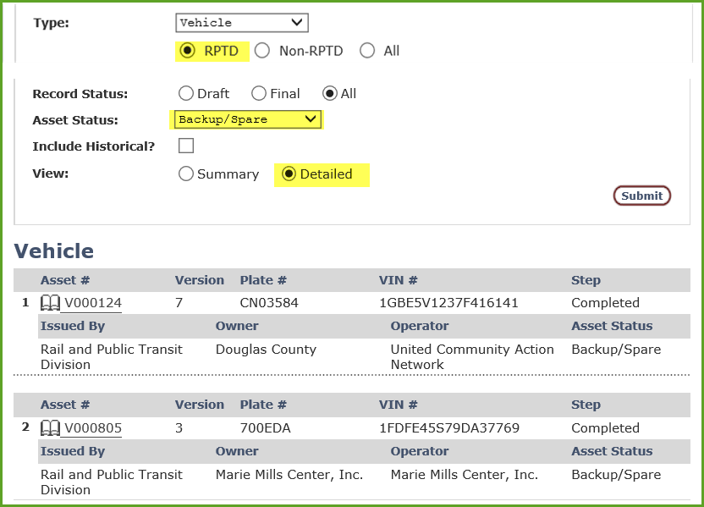
OPTIS – Assets

Slide 20
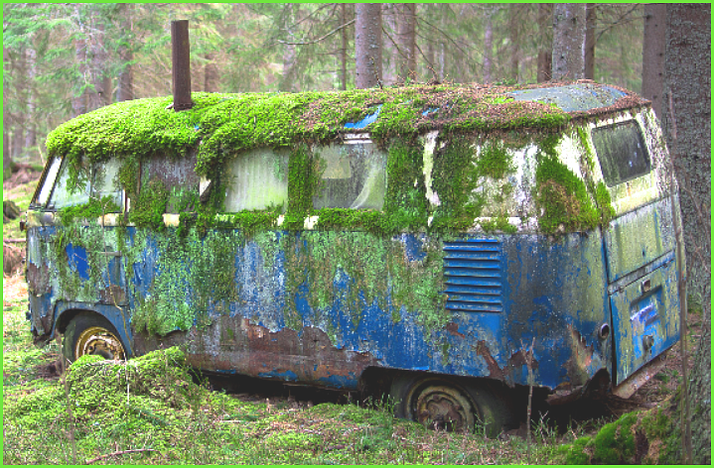
OPTIS – Assets
Vehicle Disposition Process
Send request to Capital Program Coordinator (Kathy Holmes) & Reporting Inbox
Receive title
Dispose of the vehicle
Mark the vehicle as disposed on your next APR
Submit disposal information using new form
RPTD ensures asset register is updated
Vehicle will no longer appear on your APR for reporting

Slide 21
OPTIS – Assets
Remember:
Out-of-service/backup ≠ Disposed
End of useful life ≠ Disposed

Slide 22
OPTIS – User Maintenance
Handout 16
Notes:
NOTES
General info about how you can manage agency and user information. OPTIS User Guide has more info.

Slide 23
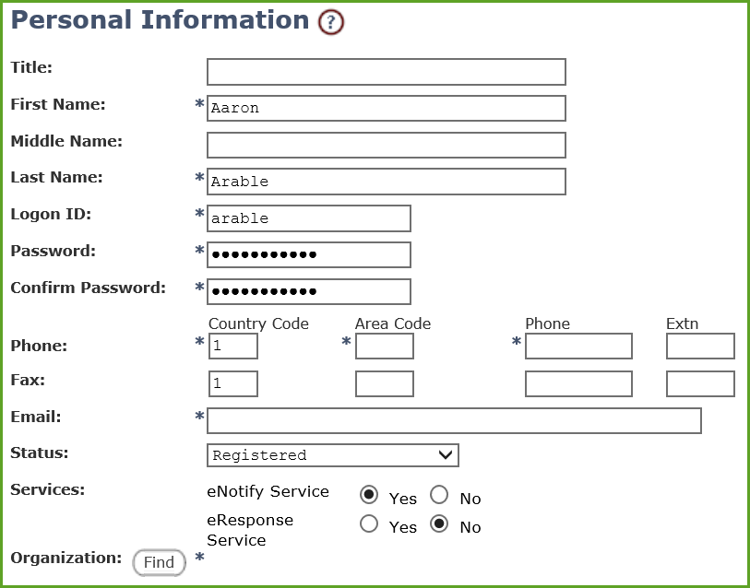
OPTIS – User Maintenance
Add a user
Notes:
NOTES
If you are the primary user for your agency, you have the highest level of privileges. You can add new users, remove users, edit user information, change your agency’s information, and even add a new sub-organization.
Users can edit their own information such as address, phone number, email, etc. and change their password. For name changes, contact RPTD.
To add a new user:
Click on Users / Users
Click “Add a New User”
Enter Required Information
Choose Registered (Read Only Access) or Validated for eResponse. Choose Yes for eNotify if the person should receive emails from OPTIS
Choose Yes for eResponse Service if the person should be able to submit documents from within OPTIS
Click “Find” to locate and select your org or an affiliated org
Click “Submit/Return”
We can help you set up multiple profiles.

Slide 24
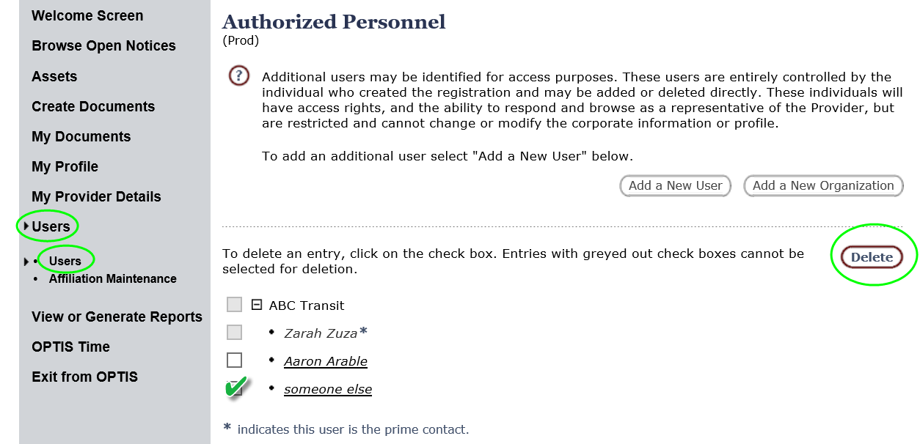
OPTIS – User Maintenance
Delete a user
Notes:
NOTES
To delete a user:
Click on Users / Users
Click the box next to the user you wish to delete
Click “Delete”

Slide 25
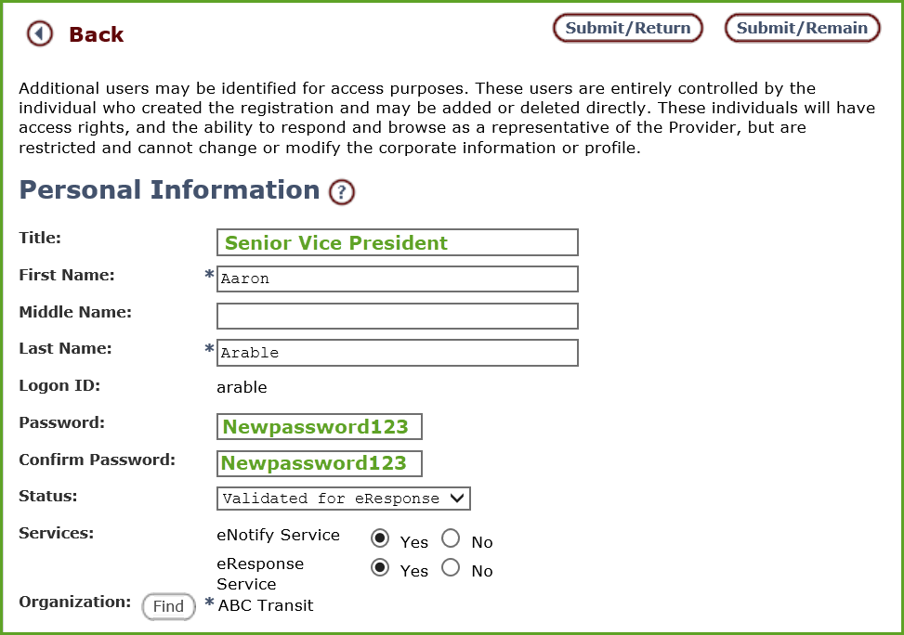
OPTIS – User Maintenance
Edit user information
Notes:
NOTES
To edit user information or reset someone's password:
Click on Users / Users
Change information
Click “Submit/Return” (Use Submit/Remain to save your work and enter another user.)

Slide 26
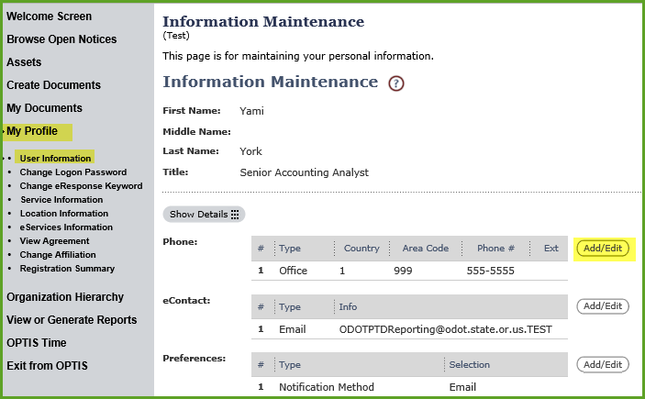
OPTIS – User Maintenance
Edit your own information
Change your password
Notes:
NOTES
To edit your own information:
Choose “My Profile” and “User Information”
Choose “Add/Edit” next to what you need to change
Make the change and click “Submit/Return”
To change your password:
Choose “My Profile” and “Change Logon Password”
Enter current password once and new password twice
Click “Submit”
You can also change your eR keyword this way.
You can also change preferences such as the order in which documents display and the default search parameter.

Slide 28
Please sign up for individualized training.
Let us know how we can help.
If you have suggestions to make OPTIS better we’d love to hear them!
ODOTPTDReporting@odot.state.or.us
OPTIS@odot.state.or.us

Slide 29
New Reimbursement Request Checklist

Slide 30
Reimbursement Request Checklist
Overview of checklist
Where to find the document after training
Questions regarding reimbursement request and documentation
Notes:
The document will be found on the RPTD website in the library, and under reimbursements

Slide 31
Vehicle Procurement

Slide 32
Vehicle Procurement
When purchasing a vehicle with federal or state grant funds passed through the Rail and Public Transit Division (RPTD), grantees must follow specific rules and processes, based on FTA guidance.
https://www.oregon.gov/ODOT/RPTD/Pages/Buy-a-Vehicle.aspx
Notes:
Use the link to show attendees the location where documents can be found.
Open the tabs to show the information contained in each.

Slide 33
Steps for Procuring Transit Vehicles
Use the forms and instructions created by the Oregon Department of Transportation when procuring vehicles; these include:
Request for Quotes template (fillable Word format)
RFQ Vehicle Purchase Price Comparison forms (Excel worksheet)
Vehicle Purchase Order (Adobe template)
Notes:
Let everyone know that there will be new links to documents that will help to provide procurement folks with more detail and ensure that all needed documents are attached. These will be coming out shortly and links are provided on day one of training documents.

Slide 34
Steps for Procuring Transit Vehicles
After completing the Request for Quotes (RFQ) template, listing all vehicle specifications, procurement methodology (i.e. lowest cost selection or best value determination), send the complete RFQ to the RPTD capital program coordinator for review and approval.
The capital program coordinator will contact you with questions or seek clarification as needed.
Notes:
Ensure that people understand the processes that are needed and that they do need to get approval from Kathy on RFQ prior to sending them to vendors

Slide 35
Steps for Procuring Transit Vehicles
When the RFQ is approved by the capital program coordinator, agencies must send the RFQ to at least three vendors listed on the state price agreement.
Using the RFQ Vehicle Purchase Price Comparison form agencies must document all bids solicited and received, even when receiving a “no-bid” response from a vendor.
Notes:
Three bids are required, but on the current price agreement there are only two vendors. A note on the bid comparison sheet with stating this is required to ensure that proper processes were followed

Slide 36
Steps for Procuring Transit Vehicles
Submit your completed RFQ Vehicle Purchase Price Comparison form, including the analysis basis for vehicle selection made in the procurement process, and the RFQs received to the capital program coordinator for review.
Once the vehicle purchase is approved send the signed and complete Vehicle Purchase Order form to the capital program coordinator.
Notes:
Purchases must be approved by Capital program coordinator and then Kathy will send your completed forms to vendor.

Slide 37
Steps for Procuring Transit Vehicles
The capital program coordinator will process the Vehicle Purchase Order and submit it to the vendor. Agencies will be copied on the email ordering the vehicle(s).

Slide 38
Q and A

