Slide 1
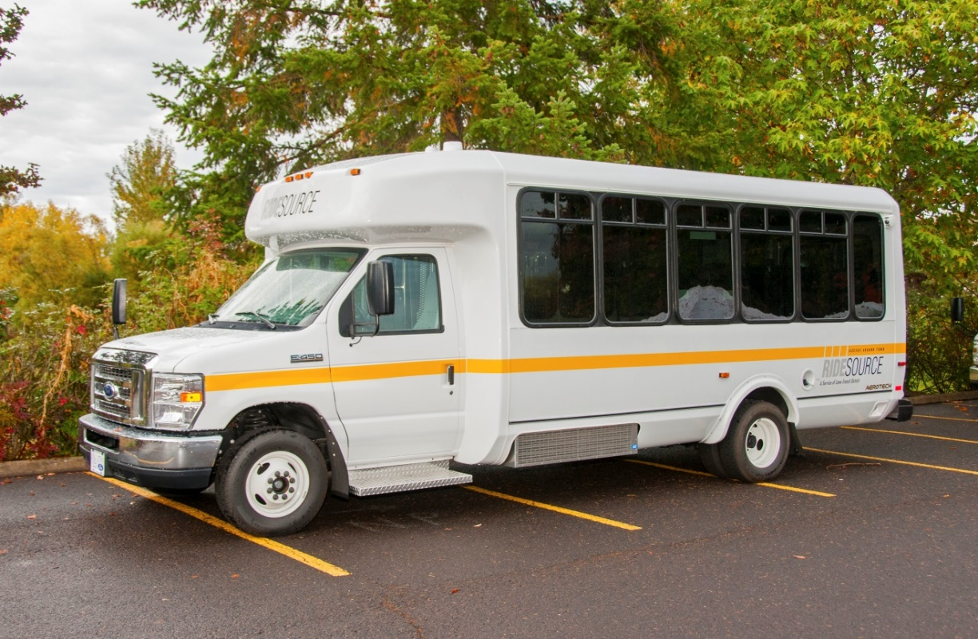

2018 Procurement Training

Slide 2

Vehicle Purchases
Federal Requirements
Rail & Public Transit Division
Use of federal funds require meeting standards such as:
  Altoona testing bus report received
  Verifying Disadvantaged Business Enterprise (DBE) compliance
  Federal Motor Vehicle Safety Standards (FMVSS) certification
  Purchasing from Eligible Transit Vehicle Manufacturers
  Verify Debarment and Suspension certification
  Pre-Award & Post-Delivery inspection
Notes:
For this webinar we are going to focus on using federal funds to purchase vehicles
When using Federal Funds there are several requirements that have to be met
Altoona Testing is required of all transit buses being procured.
The Altoona test provides an unbiased and accurate comparison of bus models
Testing is not pass/fail and does not signify a quality vehicle, but the test lets you know what occurred at certain mileage intervals
For every vehicle order you should receive the Altoona executive summary
You will also Receive the Federal Motor Vehicle Safety Standards (FMVSS) certification this is required for all vehicles
All of the vehicles on the SPA are Eligible Transit Vehicle Manufacturers (TVMs)
Only eligible TVMs may bid on FTA-assisted transit vehicle procurements. Transit vehicle manufacturers that have submitted a goal methodology to FTA that has been approved, or has not been disapproved, at the time of solicitation are eligible to bid (49 CFR 26.49(a)(1)).
We have already verified Disadvantaged Business Enterprise (DBE) compliance but you can again on the FTA’s website, only eligible TVMs may bid on FTA-assisted transit vehicle procurements
We have also verified that none of the vendors are Debarred or Suspended (Debarment and Suspension of each vendor on the SPA)
Pre-Award & Post-Delivery inspection documents are required, we will discuss those in a few more slides

Slide 3
Vehicle Purchases
Federal Requirements
Rail & Public Transit Division
Buy America (49 U.S.C. § 5323(j); 49 C.F.R. Part)
Requires all rolling stock (buses) final assembly must occur in the U.S. and
Requires components and subcomponents produced in the U.S. must be more than:
  65% for FY2018 and FY 2019
  70% for FY2020 and beyond
  (This applies to vehicles Delivered October 1, 2019)
Notes:
Buy America compliance is required CURRENTLY all rolling stock must have 65% domestic content & final assembly must occur in the US
As you can see from the slide the Buy America requirements are increasing for transit vehicles; If you order a bus today that will take 18 months to build and deliver then you will need to meet the 2018 65% Buy America requirement
Rolling stock procurements over $150,000
(a) The Buy America provisions do not apply to the procurement of buses and other rolling stock (including train control, communication, and traction power equipment), if the cost of components produced in the United States is more than 65 percent of the cost of all components and final assembly takes place in the United States.
& Labor costs involved in final assembly are not included in calculating the cost of components
FTA 49 CFR 661.21 State Buy America provisions.(a) Except as provided in paragraph (b) of this section, any State may impose more stringent Buy America or buy national requirements than contained in section 165 of the Act and the regulations in this part.
(b) FTA will not participate in contracts governed by the following:
(1) State Buy America or Buy National preference provisions which are not as strict as the Federal requirements.
(2) State and local Buy National or Buy America preference provisions which are not explicitly set out under State law. For example, administrative interpretations of non-specific State legislation will not control.
(3) State and local Buy Local preference provisions.

Slide 4
Vehicle Purchases
RFQ
Rail & Public Transit Division
Your grant has been awarded, Now What??
  You worked with your Regional Transit
  Coordinator (RTC) to select the right size of vehicle
    This information in your grant agreement
  How do you purchase a bus?
    Agencies must use State price agreements to acquire vehicles unless pre-approved by RPTD
    Oregon Cooperative Procurement Program (ORCPP) membership is required to use State Price Agreements
  Have you been to the Rail and Public Transit Website, Buying and Managing Vehicles and Assets section?
    Located under Buy a Vehicle are all of the required documents and the guidance.
    https://www.oregon.gov/ODOT/RPTD/Pages/Procurement.aspx
Notes:
The majority of purchases on this price agreement will come from ODOT & Federal Transit Administration grant recipients, for those purchases all of the forms & templates are located on the Rail & Public Transit Website, in the Buying and Managing Vehicles and Assets section (I have placed the link on this slide)
Remember your best resources are the RPTD website, myself, other transit agencies or your reginal transit coordinator.

Slide 5
Vehicle Purchases
RFQ
Rail & Public Transit Division
  When creating Vehicle Specifications, ask the experts
    Other Transit Managers
    Maintenance Staff
    Survey Passengers
    The Capital Program Coordinator
      previous bus procurements, look at what was ordered last time, it may be similar
    The Vendors – be careful!
      When doing, “Market Research” you may call or email all of the vendors and ask generalized questions
Notes:
When writing your specs ask the experts Other Transit Managers, your maintenance staff, your drivers, you can even DO MARKET RESEARCH: & ask the vendors, BUT
When performing Market Research on vehicles you will want to contact ALL the vendors, not just one.
I also have your previous RFQs and other transit agencies RFQs
Other transit agencies a re a great resource – Basin Transits manager is one of the best!
An example of a market research question could be: What size air conditioner units are available for this size vehicle? BUT if a vendor gives you the specific specifications for the vehicles they have, basically if they write your specifications THEY CANNOT BID ON YOUR RFQ
An example of writing your specs would be the vendor saying –Yes we have that, just write XXQR on your specification sheet. If Vendors do volunteer to write your SPECS then they are excluded from bidding on that vehicle.

Slide 6
Vehicle Purchases
RFQ
Rail & Public Transit Division
More Specifications for your RFQ
  Do you need an heavy-duty transmission? List it on your RFQ
  How many seats, ADA stations (2 ADA stations are required on buses over 22ft), high-floor or low-floor
  Will you need chains or snow tires
  Not sure what size air conditioner you’ll need & forgot to ask during Market Research?
    The New RFQ form has a vendor suggestion column, just for that purpose
  If you’re worried about the performance of a vendor, ask for references
  Include all preferred options that you may choose to included on your vehicle
Notes:
While writing your specifications Don’t forget Vehicle purchases include: Everything necessary to put your vehicle into operation
Two-way Radios, fire extinguisher, first aid kits –Bus
Extended warranties are acceptable, as long as they don’t exceed the federal useful life of the vehicle DMV license and title fees can never be included in purchase
Reference questions must be listed at the end of the RFQ

Slide 7
Vehicle Purchases
RFQ
Rail & Public Transit Division
The RFQ has two specific fields:
Required specifications: this is a pass/fail,
agencies should not consider any further items listed if any required spec cannot be provided
Preferred specifications: the agency can consider these for tie-breakers, etc., but if these specs are not met, agencies can still select that vehicle.
Need
Want
Notes:
The RFQ has two specific fields, For your Vehicle Specifications, Your need & your want
the most important is what do you need Need – mid back seats with grab handles located on the aisle side, a lift or ramp located in the front or rear of your vehicle, a bus wrap, radio, first aid kit
the second aspect is what you want in your new vehicle? Want – 6 disc cd changer, auto tire chains

Slide 8
Vehicle Purchases
RFQ
Rail & Public Transit Division
Notes:
on the RPTD website you will find the RFQ form
As you can see there is now a “grant funded” check box. I’ve been told, by the vendors, that people love this form and use it even when it’s not a grant funded purchase. So to alleviate calls for the agency's and vendors I have added a check-box to benefit everyone.
In the vendor section I have added a “Meets Buy America Standards” check box, that I hope is self explanatory. All vendors need to certify that the vehicle they are selling meets or exceeds Buy America standards

Slide 9
Vehicle Purchases
RFQ
Rail & Public Transit Division
The RFQ is finally done, Now What?
  The RFQ must be approved prior to release
  Email the RFQ to the Capital Program Coordinator for approval to release it to the vendors
    The Capital Program Coordinator will email you suggested or required changes
  Once the RFQ is approved, send it to all of the vendors on the contract
    If a vendor does not have the vehicle they will let you know and you need to document a “no bid” from the vendor
Notes:
When your RFQ is complete and has been reviewed by the Capital Program Coordinator you must send it to at least 3 vendors,
with only 4 vendors on the contract it’s just as easy to send it to all 4
There are other ways to procure a vehicle, we’ll start with Mini-vans

Slide 10

Vehicle Purchases
Altoona Summary
Rail & Public Transit Division
ALTOONA EXECUTIVE SUMMARY
Eldorado National submitted a model 240 Aerotech, diesel powered 17 seat bus, for a Partial STURAA Test in the 7yr/200,000 mile category. The Federal Transit Administration determined that the following tests would be performed:
  1.2 Servicing, Preventive Maintenance, Repair & Maintenance; 2. Reliability and 5.7 Structural Durability Test.
The odometer reading at the time of delivery was 1,196 miles. Testing started on August 1, 2000 and was completed on October 6, 2000. The Check-In section of the report provides a description of the bus and specifies its major components.
The primary part of this partial test was the Structural Durability Test, which also provides the information for the Maintainability and Reliability results. The Structural Durability Test was started on August 7, 2000 and was completed on September26, 2000.
The first segment of the Structural Durability Test was performed with the bus loaded to a GVW of 14,000lbs. The number of standing passengers was reduced from 17 standees and one wheelchair position, to 5 standees and one wheelchair position (600 lb per. wheelchair position). The reduction in passenger weight was necessary to avoid exceeding the GAWR (9,450 lbs.) of the rear axle. The middle segment was performed at a SLW of 13,275 lbs. The final segment was performed at a curb weight of 10,150 lbs. Durability driving resulted in no unscheduled maintenance failures.
The Reliability Section compiles failures that occurred during Structural Durability Testing. Breakdowns are classified according to subsystems. The data in this section are arranged so that those subsystems with more frequent problems are apparent. Problems also are listed by class as defined in Section 2. The test bus encountered no failures during the Structural Durability Test.
Notes:
This excerpt from the Altoona Test Executive Summary for the Eldorado National model 240 Aerotech, the bottom bold line shows that The test bus encountered no failures during the Structural Durability Test.
Just because a vehicle has had Altoona testing doesn’t mean it’s a good vehicle, read the summary it will tell you if there are issues with a vehicle
One of the handout is an Excerpt from the executive summary – this is a bus that is frequently purchased – There were only 5 reported failures during this test

Slide 11
Vehicle Purchases The bids are in!
Rail & Public Transit Division
Fill out the Request for Quotes Vehicle Purchase Price Comparison form; documenting the vendor selection from price quotes:
  List all evaluation criteria: vehicle models/vendors; special options; prices quoted; other criteria http://www.oregon.gov/ODOT/RPTD/Pages/Buy-a-Vehicle.aspx
Select your winning vendor
  Justify if lowest priced vehicle is not selected (e.g., heavy-duty transmission not available on lowest price vehicle)
  Altoona test and references come in handy here
Notes:
Now that all of your bids are in – you will fill out the vehicle price comparison analysis located on the RPTD website
You are comparing the price of all of the Required specs, not the preferred items – this is because you may not end up ordering the preferred items.
Once you have selected your winning bid, you will send your documents to me, the Capital Program Coordinator
After all of the documents are reviewed and the procurement is approved the purchase order will be sent to the selected vendor with you cc’d on the email

Slide 12
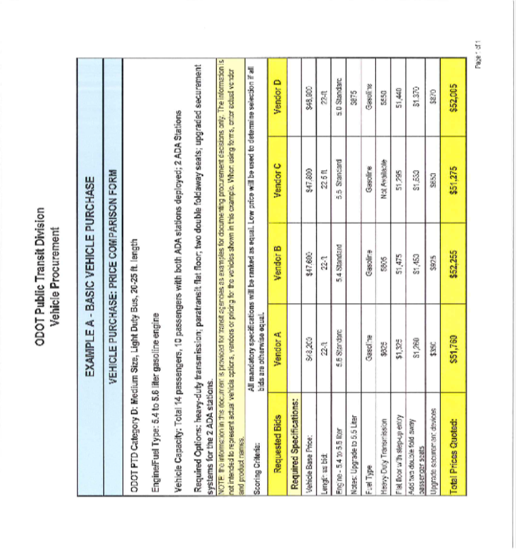
Vehicle Purchases The bids are in!
Rail & Public Transit Division
Fill out the vehicle price comparison analysis:
Notes:
This is an example of the vehicle price comparison located on our website, the actual blank form is located there also

Slide 13
Vehicle Purchases The bids are in!
Rail & Public Transit Division
Email your winning RFQ and Request for Quotes Vehicle Purchase Price Comparison form to the Capital Program Coordinator.
Once the purchase is approved, fill out, sign and send the complete purchase order to the Capital Program Coordinator.
  Fill out your agencies purchase order
  Or you may choose to use ODOT’s purchase order https://www.oregon.gov/ODOT/RPTD/RPTD%20Document%20Library/vehicle-purchase-order-form.pdf
  Directions are on the RPTD Website
Notes:
After all of the documents are reviewed and the procurement is approved you will want to complete and sign a purchase order
That will be sent to the Capital Program Coordinator and I will order your vehicle, cc’ing you on the order

Slide 14
Vehicle Purchases
Other Processes

Slide 15
Vehicle Purchases
Other Processes
Rail & Public Transit Division
If approved to do your own procurement, the agency must conduct an open competitive bid process, usually via a Request for Proposal (RFP)
  Agencies must verify DBE compliance; only eligible Transit Vehicle Manufacturers may bid on FTA funded procurements https://www.transit.dot.gov/regulations-and-guidance/civil-rights-ada/eligible-tvms-list
Agencies follow locally adopted purchasing policies and must meet state procurement laws when not in conflict with federal (e.g., cannot include geographic preference, must receive three bids)
If a agency is approved to conduct its own RFP, this must be approved by RPTD prior to release. The final purchase order must be approved by RPTD prior to submittal (RPTD signs the agency’s Purchase Order & releases it)
Notes:
When a transit agency chooses to conduct a procurement on their own, it must be approved by RPTD prior to solicitation
I can meet with you and go over the federal requirements of Third Party Contracting Circular 4220.1F,
This is FTA Guidance that you will be required to follow – you will also need to meet all of the FTA requirements discussed on the first two slides
I also have a list of the FTA certs and assurance
only eligible TVMs may bid on FTA-assisted transit vehicle procurements.

Slide 16
Vehicle Purchases
Other Processes
Rail & Public Transit Division
With prior approval, agencies may piggyback on another contract
  Must be approved by RPTD prior to accessing
  Contract must contain assignability clause
  Once the piggyback is approved, agencies must follow that state or agency contracting rules
  Washington Accessible Vehicle Contract
  With prior approval transit agencies may purchase from the WashDOT price agreement
  Transit agencies are required to follow the Washington State price agreement rules
Notes:
With prior Approval you may also Piggyback, The FTA does not encourage any type of Piggybacking.
But it is allowed, and will always be scrutinized by the FTA.
A form of piggybacking is using the WashDOT price agreement (AKA Washington State), Oregon is listed in the original procurement as an authorized purchaser - but must follow Washington's contract rules
the transit agency gets approval to piggyback from both RPTD and the Other State/Agency, RPTD approves and documents the approval in the RPTD files - either with an e-mail, or documentation from transit agency regarding the vehicle being accessed and the price quote materials.
ORCPP members can use Washington's price agreement,

Slide 17
Vehicle Purchases
Other Processes
Rail & Public Transit Division
Buying a non accessible vehicle is a little different
Federal Funds may not be used to purchase non-accessible vehicles, only STF or local funds.
Agencies may call, fax, or email local dealerships and receive at least 3 informal quotes, you must document the quotes: who, for what, when, and your signature.
Agencies will use the same review and approval process, with one difference:
  A Certification of Equivalent Service must be filled out. This is a required form for Non-ADA accessible vehicle purchases https://www.oregon.gov/ODOT/RPTD/RPTD%20Document%20Library/certification-of-equivalent-service.pdf
Notes:
If you’re purchasing a non-ada minivan you must work with your RTC and the Capital Program Coordinator prior to purchasing the van –
Certification of Equivalent Service must be filled out & submitted prior to your purchase
the certificate is valid for one year
You musty also receive three quotes, this must be documented – a fax, or email is acceptable

Slide 18
Vehicle Purchases
Certification of Equivalent Service
Rail & Public Transit Division
Certification of Equivalent Service
______________________________ (name of agency) certifies that its demand responsive service offered to individuals with disabilities (as defined in 49 CFR 37.3), including individuals who use wheelchairs, is equivalent to the level and quality of service offered to individuals without disabilities. Such service, when viewed in its entirety, is provided in the most integrated setting feasible and is equivalent with respect to:
  1) Response time;
  2) Fares;
  3) Geographic service area;
  4) Hours and days of service;
  5) Restrictions or priorities based on trip purpose;
  6) Availability of information and reservation capability; and,
  7) Constraints on capacity or service availability.
Public Demand Responsive Agencies: In accordance with 49 CFR 37.77, public funded entities operating demand responsive systems for the general public which receive financial assistance under section 18 of the Federal Transit Act must file this certification with the appropriate state program office before procuring any inaccessible vehicle. Public entities receiving FTA funds under any other section of the FTA Act must file the certification with the appropriate FTA regional office. This certification is valid for no longer than one year from its date of filing.
All Other Grant Recipients: ODOT Public Transit Division requires all participants to certify equivalent service when requesting to purchase non-ADA accessible vehicles. By signing this certification, the above-named agency is certifying that it has a mechanism in place to provide rides to individuals with disabilities. The ride must be provided in a manner equivalent to the service provided by the above-named agency to individuals without disabilities.
All Agencies: Attach a description of how you provide rides to individuals with disabilities.
Notes:
Here is screen shot of the Certification of Equivalent Service
This is available on the RPTD website
Another way to procure a vehicle is on your own…

Slide 19
Vehicle Purchases The vehicle is here
Rail & Public Transit Division
Several months later when your vehicle is delivered you will want to verify it is what you ordered
Vehicle is delivered to your specified location
At the time of delivery verify the vehicle specifications are correct
  Correct floor plan, 2nd heater is in the correct location, lift or ramp installed and works, correct drivers seat, no holes in flooring
The Pre-Award & Post-Delivery Certification form is required
  Fill out the pre-award prior to ordering your vehicle (save it!)
  https://www.oregon.gov/ODOT/RPTD/RPTD%20Document%20Library/vehicle-purchase-reimbursement-instructions.pdf
  Finish the form by completing the post-delivery portion
Please remember you have 30 days to pay the vendor once you accept the vehicle.
Notes:
Pull out he vehicle purchase file and grab those specs!
You should have the pre-award portion of the certification filled out and the document saved in your vehicle purchase file.
Now you’ll complete the post award certification

Slide 20
Vehicle Purchases Pre-Award
Rail & Public Transit Division
  ODOT – RPTD Pre-Award & Post Delivery Vehicle Purchase Certification Form
  By the signature of its authorized representative, the organization identified below certifies the following:
  A. PRE-AWARD PURCHASER’S REQUIREMENTS CERTIFICATION (all purchases over $5,000)
  As required by Title 49 CFR, Part 663 Subpart B, the vehicle(s) listed below is/are the same product(s) described in the recipient’s solicitation specifications, and that the proposed manufacturer is a responsible manufacturer with the capability to produce a vehicle that meets the specifications.
  Purchaser’s required documentation is complete and is part of the procurement file.
   B. PRE-AWARD BUS TESTING (all vehicle purchases except sedans, vans and mini-vans)
  The vehicle obtained in this procurement complies with 49USC A 5323(c) and 49 CFR Part 665.
  I understand that misrepresenting the testing status of a vehicle acquired with federal financial assistance may subject my organization to civil
  penalties (49 CFR Part 31) and that FTA may also suspend or debar a manufacturer under the procedures in 49 CFR Part 29.
  Altoona/STURAA bus test report was received for each vehicle and is in this agency’s procurement file.
   C. PRE-AWARD BUY AMERICA COMPLIANCE CERTIFICATION (all purchases over $100,000)
  As required by Title 49 CFR Part 663 Subpart B, the vehicle and equipment to be purchased by this agency meets the requirements of Section 165(b)(3) of the Surface Transportation Assistance Act of 1982 as amended. The recipient signing below has reviewed the documentation provided by the manufacturer which lists the following: (1) the proposed component and sub-component parts of the vehicle and equipment identified by the manufacturer, country of origin and cost; and (2) the proposed location of the final assembly point for the vehicle and equipment, including a description of the activities that took place at the final assembly point and the cost of final assembly.
  Transit Vehicle Manufacturer’s Buy America certification was received and is attached.
   D. DISADVANTAGED BUSINESS ENTERPRISE COMPLIANCE (DBE) (purchases with FTA funds)
  As required by Title 49 CFR I have obtained a copy of the vehicle manufacturer’s DBE certification (verified at this FTA website: http://www.fta.dot.gov/12326_5626.html ) that this transit vehicle manufacturer has obtained 49 C.F.R § 26.49 DBE certification; has listed its current home office address; and has established a DBE goal reflecting the guidance in 49 CFR Part 26.45, and is therefore an eligible manufacturer.
  Transit Vehicle Manufacturer’s DBE certification was received and is attached
   E. FEDERAL MOTOR VEHICLE SAFETY STANDARDS (FMVSS) CERTIFICATION (all vehicles)
  The vehicle described below meets all Federal Motor Vehicle Safety Standards which are applicable to this type of vehicle. Any modifications to the vehicle have not violated the integrity of the structure, design, or systems that have been tested to conform to the FMVSS for this vehicle.
  Transit Vehicle Manufacturer’s FMVSS certification is attached.
   F. POST-DELIVERY PURCHASER’S REQUIREMENTS CERTIFICATION (all purchases over $5,000) As required by Title 49 CFR, Part 663 Subpart B, after visually inspecting and road-testing the transit vehicle(s) listed below, I certify that the vehicle(s) meet(s) the purchase contract specifications.
  Purchaser’s required documentation is complete and is part of the procurement file.
Notes:
This is an example of the Pre-Award /Post Delivery certification
The Pre-Award & Post-Delivery form has been merged into one document, these forms were almost identical. These certification is required by the FTA for all Vehicle purchases
By signing these documents you are stating that you have received or verified the vehicle and/or vendor meets the federal requirements.

Slide 21
Vehicle Purchases The vehicle is here
Rail & Public Transit Division
Request your reimbursement in OPTIS
These documents (and more) will be required for reimbursement and must be kept in your vehicle procurement file
  Agency reimbursement request letter
  Certification form Pre-Award and Post-Delivery
  All invoices that were required to get your vehicle in to operation
    Vehicle, Bus Wrap, radios, cameras
  Rebate declaration
  Several more documents are required for reimbursements.
Please review the Vehicle Purchase Reimbursement Instructions located on the RPTD Website. https://www.oregon.gov/ODOT/RPTD/RPTD%20Document%20Library/vehicle-purchase-reimbursement-instructions.pdf
Please remember after you submit your reimbursement request notify your RTC to push it through the OPTIS
Notes:
You must submit a request for reimbursement letter,
the pre & post award certification
And all of the invoices that were required to get your vehicle in to operation
Rebates are rare, but call us if you receive one and we’ll help!
Important Information on Rebates and Discounts: Grant agreement recipients must deduct any rebates, discounts, or pricing reductions from the total costs submitted for reimbursement.
Reimbursement request can be done anytime, does not have to be during the quarterly report

Slide 22
Vehicle Purchases Common Problems
Rail & Public Transit Division
  Not ordering the correct vehicle, if your grant is for a Cat B order a Cat B or request a grant amendment
  Not receiving RPTD approval prior to releasing a “best value determination” RFQ (this is required)
  “best value determination” is not a reference check
  “lowest cost” is the life of the vehicle, not today’s purchase price.
  Using brand names – you must use generic descriptions, or add the words “or equivalent”
  Agencies don’t list evaluation/selection criteria for “best value determinations”
  Request for quotes must be sent to at least 3 vendors with contracts for that size/category of vehicle, but sending to all vendors is preferred
Notes:
Common Issues that have occurred
Not receiving RPTD approval prior to releasing a “best value determination” RFQ (this is required)
“best value determination” is not a reference check
“lowest cost” is the life of the vehicle, not today’s purchase price.
Using brand names – you must use generic descriptions, or add the words “or equivalent”
agencies don’t list evaluation/selection criteria in the price quote document
Request for quotes must be sent to at least 3 vendors with contracts for that size/category of vehicle, but sending to all vendors is preferred
Use Best value notes here(if lowest price, then it’s simple - if other factors are being considered, they must be listed up front and be justifiable from a procurement standpoint) Lowest costs is all of the required specifications & the life of the vehicle 4 years, 5 years, 7 years, 10 years, 12 years --Factor in Preventive Maintenance and average maintenance: how many miles away is the warranty shop; determine the price of service loss, fuel costs, etc. Lowest cost does include vehicle downtime for maintenance, oil changes, etc

Slide 23
Vehicle Warranty
Rail & Public Transit Division
  Utilize the vehicle warranty prior to using preventive maintenance funds
  When having vehicle issues, always call the vendor first
    Remember to document any communication on the warranty claim tracking spreadsheet https://www.oregon.gov/ODOT/RPTD/Pages/Maintain-an-Asset.aspx (under the Maintain an Asset link)
  Vehicles covered under warranty may not be taken to a third party shop
  If you are having issues resolving warranty claims, call the Capital Program Coordinator or DAS Fleet and Transportation section
    We are here to help resolve contract issues
Notes:
Some warranty issues have occurred over the past year:
When you have vehicles issues call the warranty shop first, if it’s not covered under warranty then ask if you still need to take it to that shop,
Please use the warranty tracking spreadsheet to document who you talked to and when, this will help if later the item is found to have been covered by the warranty or a manufacturer issue
If you’re having issues with the vendor, call me or Fleet Services at DAS. We’re here to help resolve those issues

Slide 24
Vehicle Purchases Resources
Rail & Public Transit Division
RPTD Website: State Management Plan;
Buying and Managing Vehicles and Assets
FTA Website: Best Practices Procurement Manual; Grant Management Guidelines;
OMB Circulars such as 4220.1F - Third-Party Contracting
ADA Accessibilities Guidelines (ADAAG);
CFR 49 Parts 27, 37, and 38; “Common Rule”: Circular 5010.1D; CFR 49 Parts 18 and 19;
and others
Eligible Transit Vehicle Manufacturers (TVMs); Only eligible TVMs may bid on FTA-assisted transit vehicle procurements, DBE requirement
Notes:
Ask questions and have them clarified prior to releasing your RFQ

Slide 25
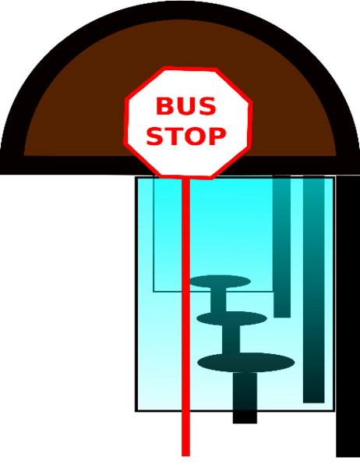
Other Procurements
Rail & Public Transit Division
Notes:
Ask questions and have them clarified prior to releasing your RFQ

Slide 26
Other Procurements
Rail & Public Transit Division
GSA Federal Supply Schedule
Currently, agencies are limited in their use of the Federal Supply Schedules, agencies may only use the GSA schedule to acquire information technology (IT).
When using GSA schedules to acquire property or services in this manner, recipients must ensure all Federal requirements, required clauses, and certifications (including FTA’s Buy America requirements) are properly followed. One way of achieving compliance with FTA requirements is for all parties to agree to append the required Federal clauses in the purchase order. Recipients must obtain an FTA Buy America certification before issuing a purchase order.
  If the property is not Buy America compliant under FTA regulations, the recipient will need to obtain a waiver from FTA before proceeding. (Note: GSA schedules are not subject to FTA’s Buy America regulations and therefore, may include manufactured products that are not eligible for FTA funds.)
Notes:
Ask questions and have them clarified prior to releasing your RFQ

Slide 27
Other Procurements
Rail & Public Transit Division
Three sizes of procurement
$3,500 or less is considered a “micro-purchase,” which involves the fewest federal requirements.
Over $3,500 up to $150,000 is considered a “small purchase” and triggers additional requirements, including comparing costs from multiple vendors.
Over $150,000 is considered a large purchase, and triggers the need for a formal competitive solicitation and other additional requirements.
Notes:
Ask questions and have them clarified prior to releasing your RFQ

Slide 28
Other Procurements
Rail & Public Transit Division
Micro-purchases Do Not Exceed $3,500
No competitive quotes required, if the agency determines the price to be paid is fair and reasonable.
Purchases should be distributed equitably among qualified suppliers in the local area and
Purchases should not be split to avoid procurement requirements for competition
Davis-Bacon prevailing wage requirements will apply to construction contracts exceeding $2,000, even if the recipient uses micro-purchase procurement procedures.
Notes:
When determining fair and reasonable price, use screen prints as verification
There is a micro-purchase handout on the back table

Slide 29
Other Procurements
Rail & Public Transit Division
Small Purchases $3,500 - $150,000
Small purchase procedures may be used to acquire services, supplies, or other property.
Small purchases, agencies must obtain price quotes from at least 3 qualified sources.
Recipients are not allowed to divide or split the procurement to avoid additional procurement requirements that apply to the larger acquisitions.
Notes:
Ask questions and have them clarified prior to releasing your RFQ

Slide 30
Other Procurements
Rail & Public Transit Division
Large Purchases $150,000 +
Competitive Proposals (Request for Proposal) – Competitive proposals, commonly known as a request for proposals, or RFP, are a generally accepted procurement method when the nature of the procurement does not lend itself to sealed bidding and the recipient expects that more than one source will be willing and able to submit an offer or proposal. FTA does not require use of competitive negotiations for any particular procurement.
Notes:
Ask questions and have them clarified prior to releasing your RFQ

Slide 31
Other Procurements
Rail & Public Transit Division
Large Purchases $150,000 +
Competitive Proposals Use
The Nature of the Procurement Does Not Lend Itself to Sealed Bidding
Grantee Expects That More Than One Source is Willing and Able to Submit an Offer or Proposal
The Need for Discussions With Prospective Offerors Is Anticipated
The Basis for Contract Award Is on Factors Other Than Price
Uncertain Number of Sources
Notes:
Ask questions and have them clarified prior to releasing your RFQ

Slide 32
Other Procurements
Rail & Public Transit Division
Large Purchases $150,000 +
Competitive Proposals Use
The Request for Proposals is Publicly Advertised
ODOT Recommends Wide Circulation, Including Urbanized Area Newspapers, Passenger Transport
All Evaluation Factors and Their Importance Are Specified in the Solicitation
Proposals Are Solicited From an Adequate Number of Qualified Sources
Numerical or Percentage Ratings or Weights Need Not Be Disclosed
Notes:
Ask questions and have them clarified prior to releasing your RFQ

Slide 33
Other Procurements
Rail & Public Transit Division
Large Purchases $150,000 +
Competitive Proposals Use
Award to the Offeror Whose Proposal Provides the Greatest Value
The Solicitation Must Inform Potential Offerors That The Award Will Be Made On A “Best Value” Basis And Identify What Factors Will Form The Basis For Award
Evaluation Factors for a Procurement Should Reflect the Most Important Subject Matter or Elements
  Examples:
    Technical Design
    Technical Approach
    Length of Delivery Schedules
    Past Performance
    Management Plan
Notes:
Ask questions and have them clarified prior to releasing your RFQ

Slide 34
Other Procurements
Rail & Public Transit Division
Large Purchases $150,000 +
Sealed Bids – Bids Are Publicly Solicited, and a Firm Fixed Price Contract (Lump Sum Or Unit Price) is Awarded to the Responsible Bidder Whose Bid, Conforming to All the Material Terms and Conditions, is Lowest In Price
Sealed bidding does not allow the recipients to evaluate the merits of technical proposals and to pay more for a higher quality product. Rather, it requires the award be made to the bidder who meets the technical requirements in the solicitation, even if the product is only minimally acceptable. Therefore, the contract specifications should precisely describe the recipient’s minimum requirements that the contractor will be contractually bound to meet.
Notes:
Ask questions and have them clarified prior to releasing your RFQ

Slide 35
Other Procurements
Rail & Public Transit Division
Large Purchases $150,000 +
Sealed Bids – Appropriate Uses of Method
  Complete, Adequate, and Realistic Specification are Available
  Two or More Responsible Bidders are Willing and Able to Compete
  Results in a Firm, Fixed Price Contract and the Selection Can be Made on the Basis of Price
  No Discussion with Bidders is Needed (Does Not Preclude Pre-Bid Meeting)
Notes:
Ask questions and have them clarified prior to releasing your RFQ

Slide 36
Other Procurements
Rail & Public Transit Division
Large Purchases $150,000 +
Sealed Bids – Appropriate Uses of Method
  The ITB Must be Publicly Advertised and Bids
  Must be Solicited from an Adequate Number of Known Suppliers
  Adequate Specification (Detailed)
  The ITB Must Define the Items or Services Sought in Order for the Bidder to Properly Respond
  Sufficient Time Allowed to Prepare Bids
  Public Opening
Notes:
Ask questions and have them clarified prior to releasing your RFQ

Slide 37
Other Procurements
Rail & Public Transit Division
The FTA does allow other procurement types, that will not be discussed today:
Two Step Procurements
A & E Services
Design-Build
Design-Bid-Build
Joint Procurements
Sole Source
Notes:
Ask questions and have them clarified prior to releasing your RFQ

Slide 38
Procurement
Requirements
Rail & Public Transit Division
Before Releasing your Procurement
FTA requires a Cost or Price Analysis with Every Procurement Action, Including Contract Modifications
ODOT Must Review All Bid Documents, Including Plans and Specifications, Prior to the Issuance of an Invitation to Bid
Allow Two Weeks for ODOT Review
  Send documents to the Capital Program Coordinator and to your RTC
Notes:
Ask questions and have them clarified prior to releasing your RFQ

Slide 39
Procurement
Resources
Rail & Public Transit Division
FTA Third Party Contracting https://www.transit.dot.gov/sites/fta.dot.gov/files/docs/Third%20Party%20Contracting%20Guidance%20%28Circular%204220.1F%29.pdf
Best Practices Procurement Manual https://www.transit.dot.gov/sites/fta.dot.gov/files/docs/funding/procurement/8286/fta-best-practices-procurement-and-lessons-learned-manual-2016.pdf
Notes:
Ask questions and have them clarified prior to releasing your RFQ

