Slide 1
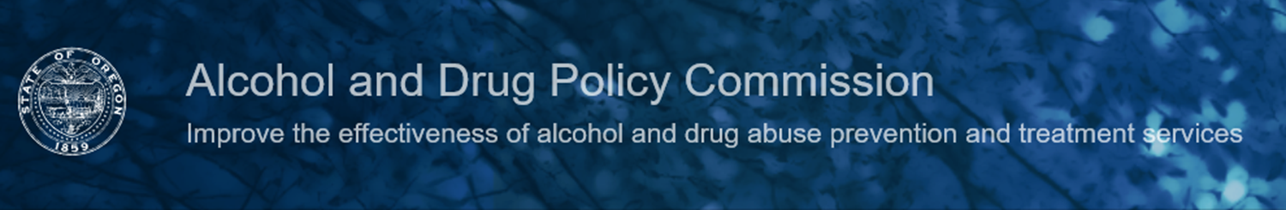
Statewide Strategic Planning
to Prevent Substance Misuse and Substance Use Disorders and Promote Recovery
Town Hall and Regional Stakeholder Engagement Meetings
Dr. Reginald Richardson, Executive Director
Laurie Barger Sutter, JBS International

Slide 2




Welcome!
Introduction
The purpose of this meeting
“Housekeeping”

Slide 3
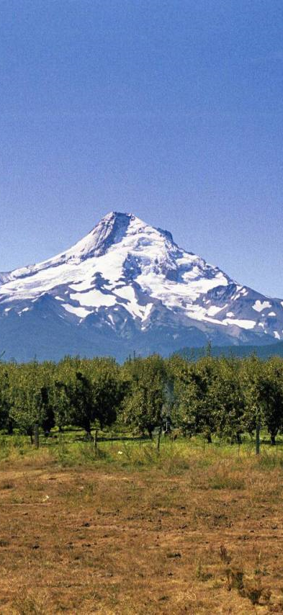
Overview of the Planning Process
Strategic Planning Charge
Notes:
We are doing this in partnership with state and community stakeholders, and building on—and connecting to—all of the work that has been done before.

Slide 4
Strategic Planning Outcomes
Reduce Oregon’s substance use disorder (SUD) rate from 9.55% to 6.82% in five years.*
  Prevent and reduce substance misuse and new cases of SUD
  Improve treatment outcomes
  Increase the recovery rate by 25% in 5 years
* 2015-2016 National Survey on Drug Use and Health (NSDUH)
Notes:
Goals and outcomes identified for the planning process include reducing SUDs, improving recovery, and reducing substance use-related problems. These are works in progress.

Slide 5
Strategic Planning Outcomes
Reduce substance-related health issues such as:
  Overdoses
  Motor vehicle crashes
  Hospitalizations
Reduce substance-related social problems such as:
  Children in foster care due to parental substance misuse
  Drug-related crime and recidivism
Notes:
Some of these will become primary outcomes, others will likely move to a secondary dashboard of indicators that would be expected to improve if rates of SUDs and substance misuse decrease.

Slide 6
Strategic Planning Process
~
Step 1
Develop a State Vision and Mission
Draft: “Our vision is a comprehensive, statewide substance misuse system where policies, investments, and efforts support an Oregon where people are healthy and communities thrive.”
~ April 23, 2019 ~
Oregon Alcohol and Drug Policy Commission, Oregon Health Authority, Oregon Department of Human Services, Oregon Youth Authority, Department of Housing and Community Services, Department of Consumer and Business Services, Youth Development Council, Oregon Department of Education, Department of Corrections, Lottery, Oregon State Police, Oregon Criminal Justice Commission

Slide 7
Strategic Planning Process
~
Step 2
Assess alcohol and other drug (AOD) problems
Prevalence of misuse and disorders
Rate of increase of misuse and disorders
Populations and areas most impacted
Factors driving the problems
Financial and other costs

Slide 8
Substance Use Disorders
Nearly 1 in 10 Oregonians aged 12 and older were estimated to have a substance use disorder in 2015-2016
9.6%
7.1%
3.8%
0.8%
Any
Alcohol
Illicit drugs
Rx Pain Meds
Source: National Survey on Drug Use and Health, 2015-16.
Notes:
Nearly 1 in 10 Oregonians age 12 and older were estimated to have a substance use disorder (SUD) in 2015-2016. This was the fourth highest rate in the nation.
The most common SUD is Alcohol Use Disorder.
Source: National Survey on Drug Use and Health
Illicit drugs includes marijuana, cocaine (including crack), heroin, hallucinogens, inhalants, methamphetamine, and misuse of prescription pain relievers, tranquilizers, sedatives and stimulants.

Slide 9
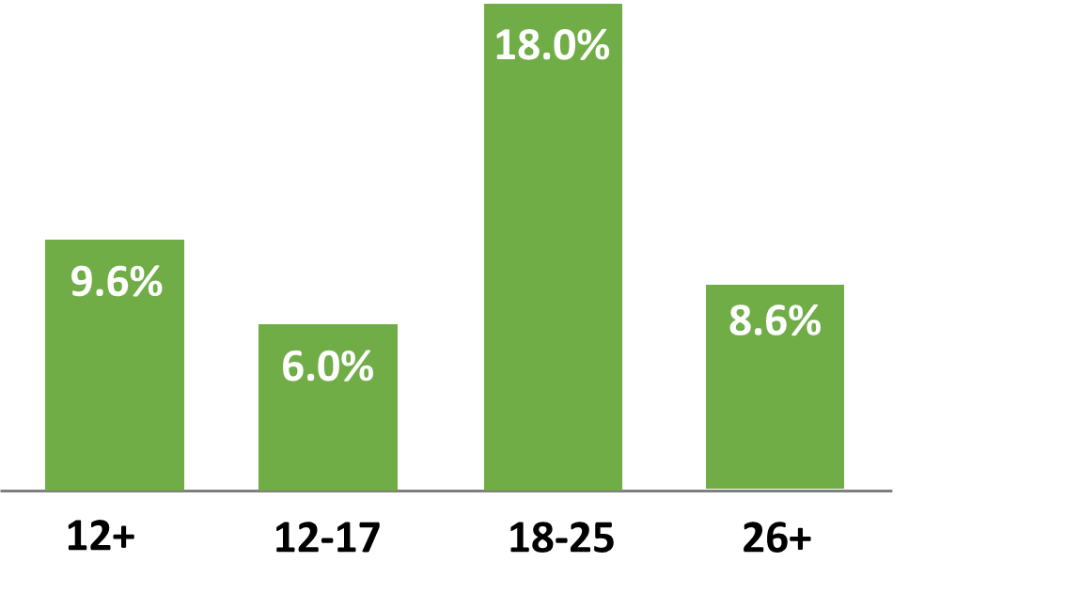
Substance Use Disorders
Nearly 1 in 5 Oregonians aged 18 to 25 were estimated have a substance use disorder in 2015-2016
Source: National Survey on Drug Use and Health, 2015-16. .
Notes:
Nearly 1 in 5 (18%) of 18-25 year olds were estimated to have an SUD, which was twice the percentage of those 26+ and 3 times the percentage of those ages 12-17
Substance Use Disorder is defined as meeting criteria for illicit drug or alcohol dependence or abuse.

Slide 10
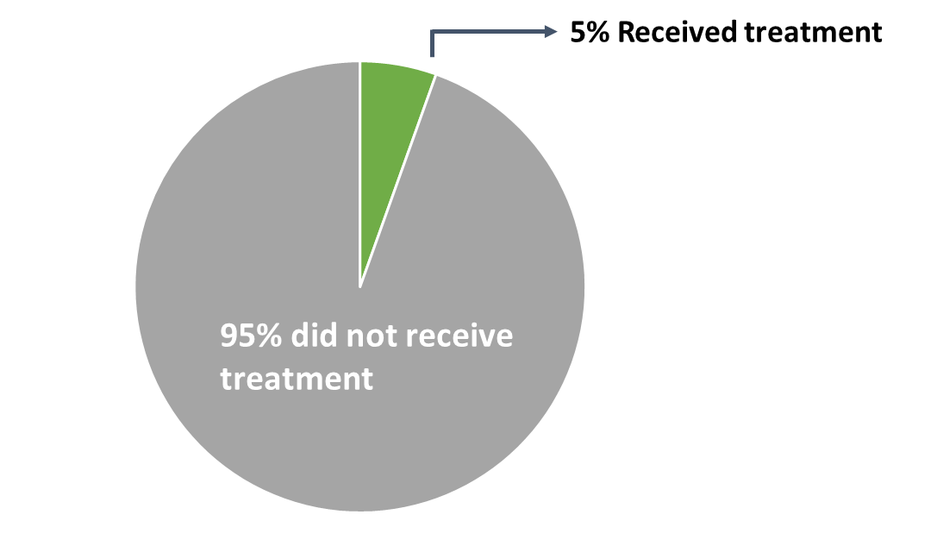
Treatment for Substance Use Disorders
Most Oregonians with a substance use disorder are estimated to not receive treatment
Source: National Survey on Drug Use and Health, 2016-17
Notes:
Most (95%) of Oregonians with an SUD do not receive treatment.
In terms of the number of people this equates to:
Out of the 329,000 Oregonians with any SUD, only about 18,000 of those estimated to need treatment received it in 2016-2017
About 250,000 Oregonians were estimated to need but not receive treatment for Alcohol Use Disorder in 2016-17.

Slide 11
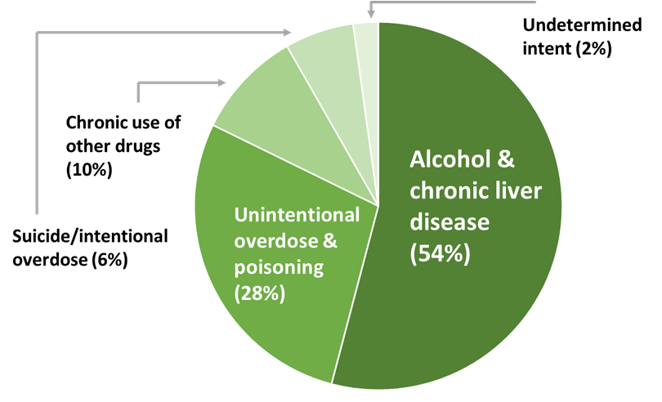
Alcohol and Drug-Related Deaths
1,549 deaths in Oregon in 2017 were due to alcohol or other drugs
Source: Oregon Vital Records (Death certificates)
Notes:
More than 4 Oregonians a day and nearly 130 a month died due to alcohol or other drugs in 2017.
More than half (54%) of these deaths were related to alcohol. Nearly two-thirds (62%) of these deaths were caused by chronic alcoholic liver disease and the rest were other alcohol-induced deaths.
About 10% were due to chronic use of opioids and other drugs not including alcohol
Among opioid-related deaths, 81% were unintentional overdoses, 12% were intentional poisonings/suicide, and 7% were due to chronic opioid use. [data not shown]

Slide 12




Alcohol and Drug Related Deaths
Gender
Two-thirds (67%) of alcohol and drug-related deaths occurred among males
More than half (56%) of intentional overdoses/suicides were among females
Source: Oregon Vital Records (Death certificates)
Notes:
Gender:
Males comprised approximately 2/3 of all AOD deaths in 2017
Females comprised more than half of the deaths due to AOD-related suicides in 2017
Age: The 55-64 age group also had the highest death rate at 83.6 per 100,000

Slide 13
Alcohol and Drug Related Deaths
Age
The 55-64 age group has the highest rate of alcohol and drug-related deaths
Race
  Whites comprised the majority of AOD deaths but Native Americans died at more than twice their rate
  African Americans had the highest rate of death from AOD-related unintentional injuries, followed by Native Americans and Whites
Source: Oregon Vital Records (Death certificates)
Notes:
Gender:
Males comprised approximately 2/3 of all AOD deaths in 2017
Females comprised more than half of the deaths due to AOD-related suicides in 2017
Age: The 55-64 age group also had the highest death rate at 83.6 per 100,000

Slide 14
AOD-Related Social Issues in Oregon*
Child Abuse and Neglect:
  Parent/caregiver AOD use was the most common family stress factor (42.5%) in the 84,233 reports of child abuse received by the Department of Human Services in the last Federal Fiscal Year
Foster Care:
  According to recent case reviews, nearly 75% of Oregon foster care placements involved parental substance use disorder
  *2018 Child Welfare Book, Department of Human Services, October 2017-September 2018;
Notes:
Without access to effective community-based health care for substance addictions and mental illnesses,* too many Oregonians wind up in crisis and then in emergency rooms or jail, leading to high costs and poor health and public safety outcomes.

Slide 15
AOD-Related Social Issues in Oregon*
Crime and Corrections:
  State officials estimate that more than half the people incarcerated in Oregon have significant drug abuse issues.
  *Report on existing barriers to effective treatment for and recovery from substance use disorders, including addictions to opioids and opiates produced for HB 4143

Slide 16

Questions and/or comments about the assessment data

Slide 17
State and Local Systems Assessment
Leadership
Capacity
Use of Effective Processes

Slide 18
Strategic Planning Process
~
Step 3
Prioritize problems
  What’s creating the most harm, and who is most impacted?
Determine goals and objectives
  What change do we want to see in the problem?
  What changes do we need to make to the factors that cause the problem?
Finalize desired outcomes
  What degree of change in the problem needs to be achieved, and by when?

Slide 19
Strategic Planning Process
~
Step 4
Select the most effective courses of action
  What strategies need to be implemented?
Develop an implementation plan
  What activities need to be implemented?
  When do they need to be implemented?
  Who will be responsible for implementing them?
Develop an evaluation plan
  How will implementation of the strategic plan be monitored?
  How will progress toward outcomes be monitored?
  How will evaluation data be used to improve progress toward outcomes?

Slide 20

Questions and/or comments about the assessment data or the strategic planning process

Slide 21

Systems Assessment
What’s working well at the local levels?
What needs to improve?

Slide 22
The ability to develop, communicate, and carry out a vision for the common good based on mutual trust and respect, and collaborative, inclusive and effective methods.
Leadership
Vision and Mission
Conceptual Clarity
Political Will
Inclusion
Influence
Strategic Planning
Sustainability
Accountability

Slide 23
The combination of knowledge, experience and abilities needed to solve problems and implement change
Capacity
Organizational Structure
Knowledge, Skills, and Abilities
Funding, Infrastructure, and Other Resources
Cultural Competence
Accountability
Sustainability

Slide 24
Practices or actions that have been documented to produce desired results, which are performed to achieve a given purpose.
Effective Processes
Collaboration & communication
Operating procedures/protocols
Evidence-based practices
Training & technical assistance
Monitoring & evaluation
Accountability
Sustainability

Slide 25
Wrap Up and Next Steps
We hope you stay connected! Some ways you can continue to participate include:
Sharing your main areas of interest via a brief survey at: https://www.surveymonkey.com/r/X9F6HXC
Emailing your ideas and questions to ADPCStakeholderEvents@jbsinternational.com
Following up with the people you met today to keep the conversation going and be an ambassador for change!

